Slide 1
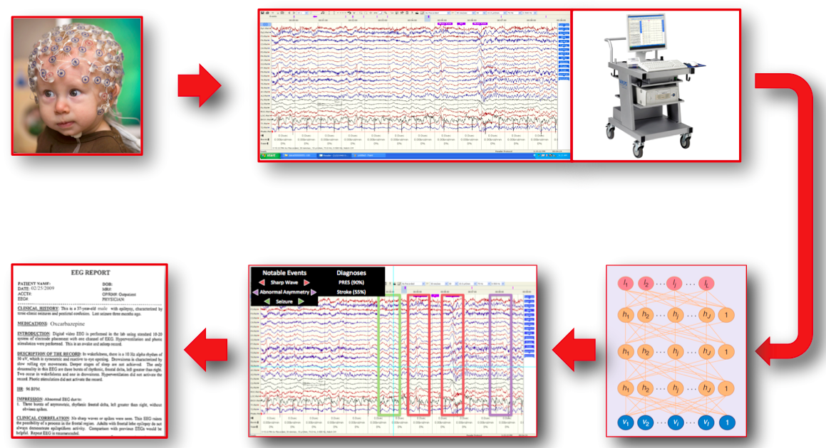
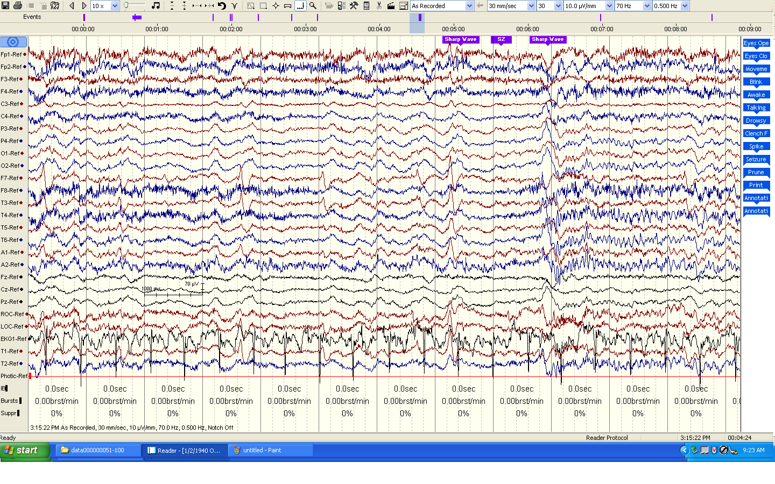
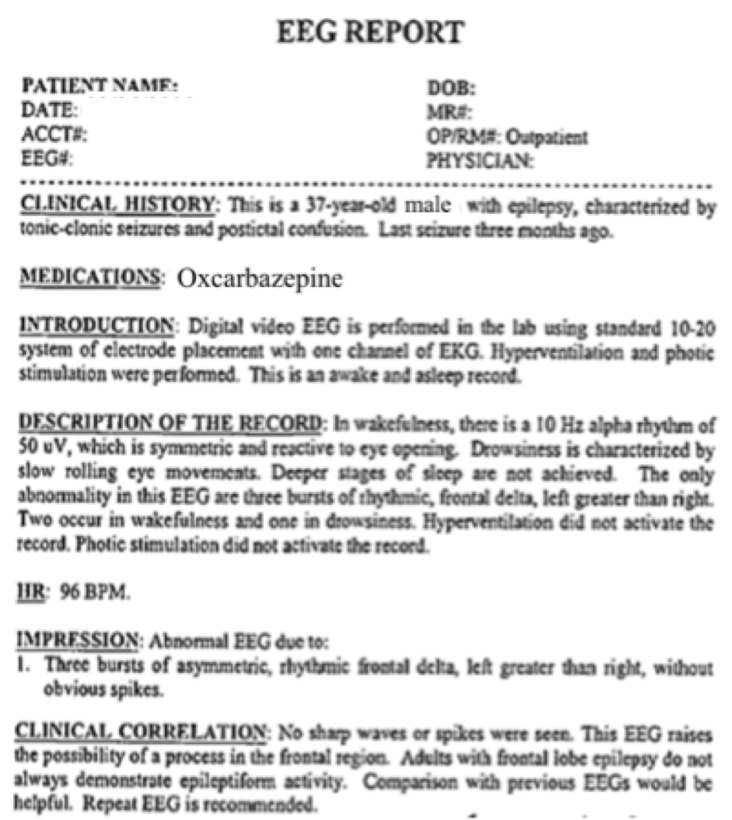
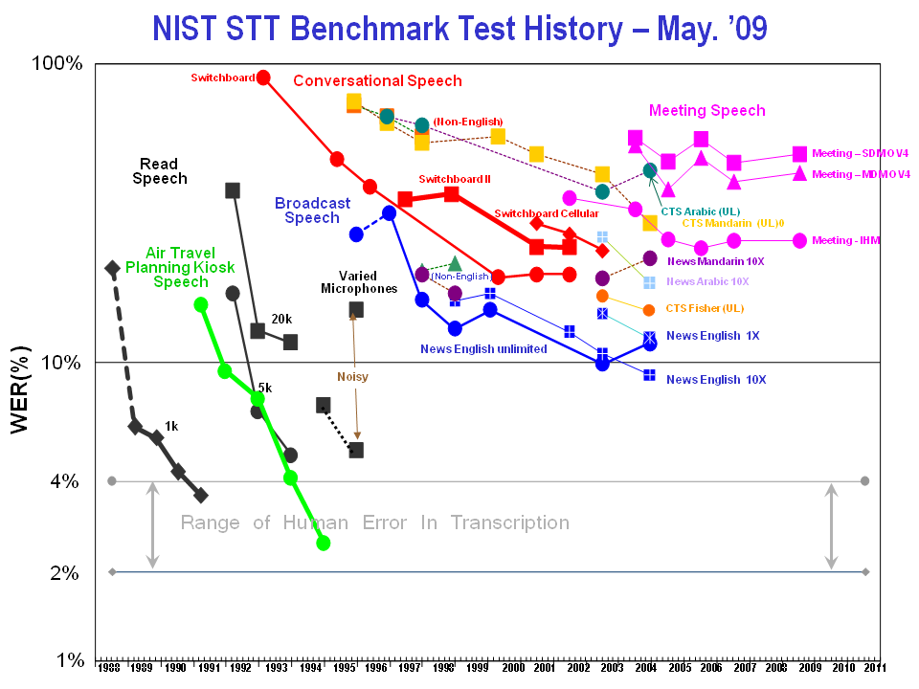
The Leveraging Big Data Resources for Automatic Interpretation of EEGs
C. Ward, I. Obeid and J. Picone M. P. Jacobson, M.D.
The Neural Engineering Data Consortium, Temple University Department of Neurology, Temple University Hospital
www.nedcdata.org
Introduction
The Neural Engineering Data Consortium (NEDC) is being launched to develop big data resources.
Primary mission is to focus the attention of the research community on a progression of neural engineering research questions.
A community-wide assessment, funded by a planning grant from the National Science Foundation, is being conducted to define and prioritize the resources required by researchers to fuel innovation.
The TUH EEG Corpus is the largest and most comprehensive publicly-released corpus representing 11 years of clinical data collected at Temple Hospital.
Over 15,000 patients, 20,000+ sessions, 50,000+ EEGs
Includes deidentified clinical information.
Proposed Research Model
Communal resources are pooled, allowing NEDC to create massive datasets, orders of magnitude larger than what any individual PI could generate
Data is custom tailored to resolve specific questions of interest to the community
Performance claims are easier to replicate
Research focus is on common problems
Automatic Interpretation of EEGs
Preliminary Results
Classification of 12 EEG annotation markers
Industry
PI
Research Questions
Alg. | Setting | Closed |  | Open
 |  | Raw | Norm | Raw | Norm
kNN | K = 1 | 0.0% | 61.5% | 72.1% | 62.5%
kNN | K = 3 | 27.9% | 61.5% | 63.5% | 49.0%
kNN | K = 5 | 39.4% | 61.5% | 64.4% | 69.2%
NN | N = 5 | 49.0% | 70.2% | 51.9% | 75.0%
NN | N = 10 | 50.0% | 71.2% | 51.9% | 77.9%
NN | N = 15 | 49.0% | 78.9% | 50.0% | 76.0%
NN | N = 20 | 51.9% | 76.9% | 55.8% | 78.9%
RF | T = 1 | 19.2% | 54.8% | 62.5% | 60.6%
RF | T = 20 | 0.0% | 49.0% | 62.5% | 57.7%
RF | T = 50 | 0.0% | 56.7% | 61.5% | 55.8%
RF | T = 100 | 0.0% | 50.0% | 65.4% | 54.8%
Funding Agencies
Neural Engineering Data Consortium
Fees
Funded
PI
Unfunded
PI
Data
Data Design
Results
Funded
PI
Unfunded
PI
Data Generation
Funded
PI
Unfunded
PI
Results Scoring
Why Big Data is Crucial
Overall progress in the field is not commensurate with the scope of investment.
The existence of massive corpora has proven to substantially accelerate research progress.
Funding Agencies
PI
Data
Summary and Future Work
Community-wide collaboration on resources, including the design and development of data, is crucial to sustained progress.
The TUH-EEG Corpus will have a major impact on the development of clinical tools to automatically interpret EEGs.
Sequential decoding of the EEG using contemporary technology such as hidden Markov models will be crucial to identification and classification of events.
Visit www.nedcdata.org to learn more!
Research Question
Methods
Money
Results
Comparison to Existing Resources
Repositories:
Physionet
Collaborative Research in Computational Neuroscience (CRCNS)
HeadIT (UCSD)
International Electrophysiology Portal (University of Pennsylvania)
Swartz Center for Computational Neuroscience
Cerebral Autoregulation Research Network
NSF Data Sharing Policy
None are “common protocol”
Not just another data repository!
Prize-Based Research:
Berlin BCI Contest
X-Prize, Netflix, others
Research Question
PI
Data
Money
Methods
Results
Research Question
PI
Data
Money
Methods
Results
Acknowledgements
DARPA/MTO (D13AP00065)
NSF (CNS-1305190)
Temple University College of Engineering
Temple University Office of Research
Take the Survey!
Big data needs?
How could membership benefit you?

