Slide 1
Data Center Models and
Impact on Scientific Research Communities
Christopher Cieri
University of Pennsylvania, Linguistic Data Consortium
ccieri AT ldc.upenn.edu

Slide 2
Origin & Model
Human Language Technology landscape pre-1992
  emergence of machine learning as a dominant approach in HLT
  recognition of critical importance of data
  lack of effective infrastructure for sharing

Slide 3
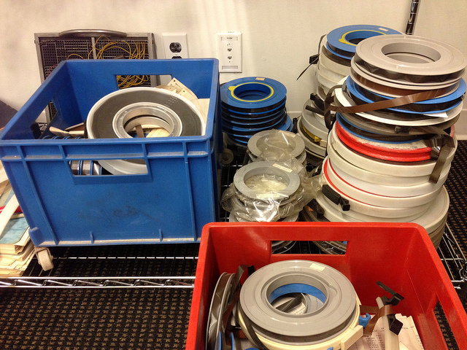
Origin & Model
Human Language Technology landscape pre-1992
  emergence of machine learning as a dominant approach in HLT
  recognition of critical importance of data
  lack of effective infrastructure for sharing

Slide 4
Origin & Model
Human Language Technology landscape pre-1992
  emergence of machine learning as a dominant approach in HLT
  recognition of critical importance of data
  lack of effective infrastructure for sharing
Linguistic Data Consortium established 1992
  via open, competitive DARPA solicitation, won by U. Penn.
  originally just for centralized distribution, archiving of language data
LDC Model
  developed by overseers from government, industry and academia
  5 year seed funding to cover operations, commissioning corpus creation
  required to be self-sufficient via annual membership fees, data licenses
Consortium
  members provide annual support generally fees, sometimes data, services
  receive ongoing rights to data published in years when they support LDC
  reduced fees on older corpora, extra copies
  new grants fund LR creation, not maintenance; NSF, NIST early supporters
  data from donations, funded projects, community initiatives, LDC initiatives

Slide 5
Benefits
Uniform licensing within & across research communities
  agreements: ~100 provider (1 type), ~3200 membership/license (4 types)
  no significant copyright issues in 21 years, several external issues resolved
Cost Sharing
  sponsors cover development costs, no distribution costs, concerns
    corpus development costs: min=$42,000, max=$2,000,000
  production costs distributed across users
    original annual membership fees: NFP/GOV ($2K), COM ($20K), special
    include 30-36 datasets
    ROI: lowest possible 153% in 2006, but >=1250% in 1996-7 on subset of data
    development cost for 1 corpus ≥ (LDC membership fee * 10 | 100 | 1000)
Stable research infrastructure
  LRs permanently accessible, across multiple platform changes
  terms of use & distribution methods standardized & simple
  members’ access to data is ongoing
  any patches available via same methods
  tools, specifications, papers distributed without fee

Slide 6
Models
Provider
Provider
Provider
Provider
Provider
Provider
Provider
Provider
Provider
Provider
Member
Member
Member
Member
Member
Member
Member
Member
Member
Member

Slide 7
Models
Provider
Provider
Provider
Provider
Provider
Provider
Provider
Provider
Provider
Provider
Member
Member
Member
Member
Member
Member
Member
Member
Member
Member

Slide 8
Models
Provider
Provider
Provider
Provider
Provider
Provider
Provider
Provider
Provider
Provider
Member
Member
Member
Member
Member
Member
Member
Member
Member
Member

Slide 9
Models
Provider
Provider
Provider
Provider
Provider
Provider
Provider
Provider
Provider
Provider
Member
Member
Member
Member
Member
Member
Member
Member
Member
Member

Slide 10
Models
Provider
Provider
Provider
Provider
Provider
Provider
Provider
Provider
Provider
Provider
Member
Member
Member
Member
Member
Member
Member
Member
Member
Member

Slide 11
Models
Provider
Provider
Provider
Provider
Provider
Provider
Provider
Provider
Provider
Provider
Member
Member
Member
Member
Member
Member
Member
Member
Member
Member

Slide 12
Models
Provider
Provider
Provider
Provider
Provider
Provider
Provider
Provider
Provider
Provider
Member
Member
Member
Member
Member
Member
Member
Member
Member
Member

Slide 13
Models
Provider
Provider
Provider
Provider
Provider
Provider
Provider
Provider
Provider
Provider
Member
Member
Member
Member
Member
Member
Member
Member
Member
Member

Slide 14
Models
Provider
Provider
Provider
Provider
Provider
Provider
Provider
Provider
Provider
Provider
Member
Member
Member
Member
Member
Member
Member
Member
Member
Member

Slide 15
Models
Provider
Provider
Provider
Provider
Provider
Provider
Provider
Provider
Provider
Provider
Member
Member
Member
Member
Member
Member
Member
Member
Member
Member

Slide 16
Models
Provider
Provider
Provider
Provider
Provider
Provider
Provider
Provider
Provider
Provider
Member
Member
Member
Member
Member
Member
Member
Member
Member
Member

Slide 17
Models
Provider
Provider
Provider
Provider
Provider
Provider
Provider
Provider
Provider
Provider
Member
Member
Member
Member
Member
Member
Member
Member
Member
Member

Slide 18
Models
Provider
Provider
Provider
Provider
Provider
Provider
Provider
Provider
Provider
Provider
Member
Member
Member
Member
Member
Member
Member
Member
Member
Member

Slide 19
Models
Provider
Provider
Provider
Provider
Provider
Provider
Provider
Provider
Provider
Provider
Member
Member
Member
Member
Member
Member
Member
Member
Member
Member

Slide 20
Models
Provider
Provider
Provider
Provider
Provider
Provider
Provider
Provider
Provider
Provider
Member
Member
Member
Member
Member
Member
Member
Member
Member
Member

Slide 21
Models
Provider
Provider
Provider
Provider
Provider
Provider
Provider
Provider
Provider
Provider
Member
Member
Member
Member
Member
Member
Member
Member
Member
Member

Slide 22
Models
Provider
Provider
Provider
Provider
Provider
Provider
Provider
Provider
Provider
Provider
Member
Member
Member
Member
Member
Member
Member
Member
Member
Member

Slide 23
Models
Provider
Provider
Provider
Provider
Provider
Provider
Provider
Provider
Provider
Provider
Member
Member
Member
Member
Member
Member
Member
Member
Member
Member
Notes:
Not an exaggeration. The English and Chinese Gigaword corpora have more than 10 data providers between them and more than 10 LDC members wanted those corpora. 100 providers, 3168 recipients

Slide 24
Models
Provider
Provider
Provider
Provider
Provider
Provider
Provider
Provider
Provider
Provider
Member
Member
Member
Member
Member
Member
Member
Member
Member
Member
Data Center

Slide 25
IPR Intermediary
IPR intermediary improves combinatorics
  agreements = providers + members
  agreements != providers * members
  important considering
    100 provider agreements, 3200 member agreements/licenses
    Negotiating time: ~20 hours/member agreement, ~30 hours/provider agreement
    IP lawyers @ $300/hour
But much more
  standard agreements
    consistent, attractive terms to providers and users, rarely renegotiated
    represents 3200 organizations: peace-of-mind for providers, clarity for members
  greater experience negotiating IPR than any single member
    dedicated staff, trained and experienced, negotiation paths already worked out
    linguists, computer scientists can focus on what they do best
    work with researchers who have high value contacts

Slide 26
Data Center Timeline
1992 Data Center (LDC), IPR Management, Commissioned Data Production
1993 Publication including QC
1994 Corpus Development (Parallel Text)
1995 Collection, Lexicon Building, Human Subject Protocol Management, ELRA
1996 Corpus development for a technology evaluation campaign
1997 New Data Types (Broadcast News)
1998 Annotation, Conference Organization
1999 Tools, Best Practices
2000 Transatlantic Cooperation, Gov’t Published Data > LDC, Program Coordination
2001 Lx-Re-Use Publication, EC Networking project
2002 LR Coordination for multisite program
2003 ”Seven Dimensions” paper published in Language
2004 LDC-IL Planning WS, OOM Scale change in Conversational corpora, Video
2005 International Subcontractors
2006 Google contributes OOM more data, Other DC collections shifted to LDC
2007 Formal Corpus Specification (Mixer 5)
2008 NYT contributes, BioIE corpora
2009 Integration of Diverse Annotations (NXT-SB)
2010 Service Grid, Impact Assessment (Bibliography), Data Grants
2011 SemEval data
2012 Service Grid, RMA in South Africa
2013 Aging corpus Published, ISLRN

Slide 27
Benchmarking
Since inception in 1992, LDC has distributed
  >105,000 copies
  >1810 titles
  >3400 organizations
  >70 countries
~1200 of the titles are e-corpora
  developed for technology evaluation programs
  released generally after use in the relevant communities
    frequently after merging several e-corpora into 1 published corpus
>4 years of publications “in queue”!!!
11,000 academic papers relying on LDC Corpora
  search for such papers is ~85% complete

Slide 28
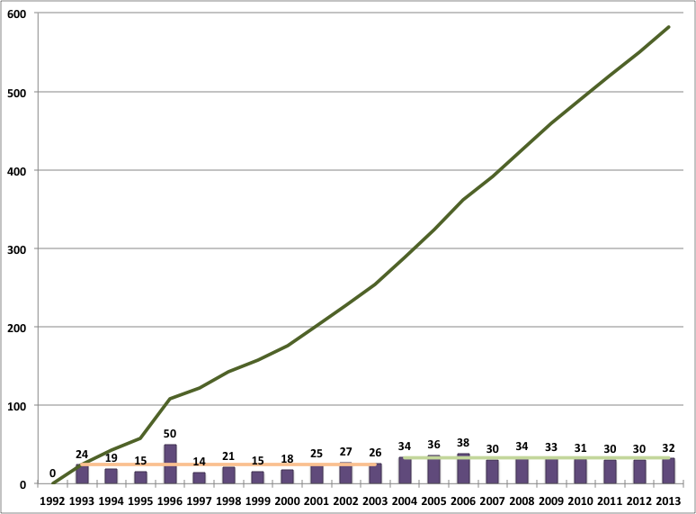
Benchmarking: LDC Corpus Growth
Notes:
>= 1800 published LRs among LDC and other DCs

Slide 29
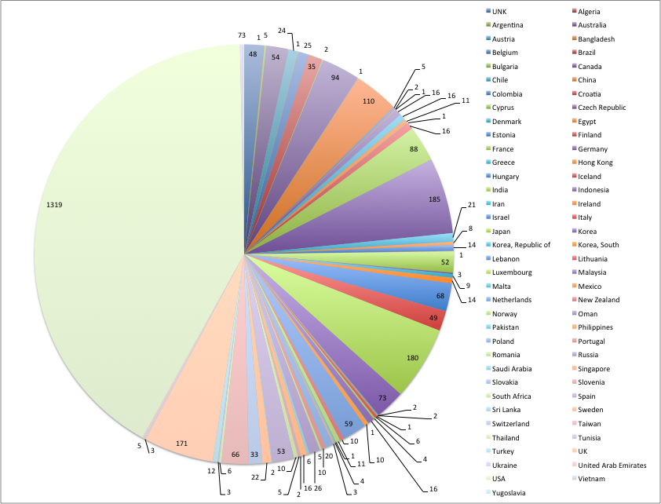
Benchmarking

Slide 30
LDC Data in NIST Evaluations
 | 96 | 97 | 98 | 99 | 00 | 01 | 02 | 03 | 04 | 05 | 06 | 07 | 08 | 09 | 10 | 11
LRE | ✓ |  |  |  |  |  |  | ✓ |  | ✓ |  | ✓ |  | ✓ |  | ✓
SRE | ✓ | ✓ | ✓ | ✓ | ✓ | ✓ | ✓ | ✓ | ✓ | ✓ | ✓ |  | ✓ |  | ✓
BN Re | ✓ | ✓ | ✓ | ✓
CTS Re |  | ✓ | ✓ |  | ✓ | ✓
SDR |  |  | ✓ | ✓ | ✓
TDT |  |  | ✓ | ✓ | ✓ | ✓ | ✓ | ✓ | ✓
ACE |  |  |  |  | ✓ | ✓ | ✓ | ✓ | ✓ | ✓ |  | ✓ | ✓
OpenMT |  |  |  |  |  | ✓ | ✓ | ✓ | ✓ | ✓ | ✓ |  | ✓ | ✓
DUC |  |  |  |  |  | ✓ | ✓ | ✓ | ✓ | ✓ | ✓ | ✓
RT |  |  |  |  |  |  | ✓ | ✓ | ✓ | ✓ | ✓ | ✓ |  | ✓
STD |  |  |  |  |  |  |  |  |  |  | ✓
GALE Trans |  |  |  |  |  |  |  |  |  |  | ✓ | ✓ | ✓ | ✓ | ✓ | ✓
MetricsMaTr |  |  |  |  |  |  |  |  |  |  |  |  | ✓ |  | ✓
MADCAT |  |  |  |  |  |  |  |  |  |  |  |  | ✓ | ✓ | ✓ | ✓
TAC KBP |  |  |  |  |  |  |  |  |  |  |  |  |  | ✓ | ✓ | ✓
TRECVid SED |  |  |  |  |  |  |  |  |  |  |  |  | ✓ | ✓ | ✓ | ✓
TRECVid MED |  |  |  |  |  |  |  |  |  |  |  |  |  |  | ✓ | ✓

Slide 31
LDC Structure
Notes:
55 positions, >10% increase since last LREC, 120 PT positions, contract employees, collaborations with ELRA, Appen, NICT, large partnerships in HK, N Africa, India, Australia, numerous small partnerships and sub-contractors, contributors and friends , Middle East Technical Universit, Murat Saraclar
25% increase in physical space, highlighting their support
restructuring to support further growth

Slide 32
LREC Growth
Also hundreds of participating organizations from up to 57 countries

Slide 33
Different Models
 | Development | Internal Distribution | External Distribution | Maintenance
Consortial
Early CTS
DARPA
NSF
OSTP
 |  | User Pays |  | Sponsor Pays
open market versus protectionism
  acquisition of data, contracts, distribution of data
exclusive distribution agreements or not
support provided by NFP/FP participants

Slide 34
1000 Reasons Good Science requires Data Centers
Good Science Requires Data
  empiricism, measurable, systematic observation, objective (thus replicable), reliable
  full disclosure = archive and share all data and methodology
  scientific method gradually improves its own ability to generate new (integrate) knowledge
Modern Good Science Requires Big Data
  🔑 advances in sensors ➙ classic big data issues of volume, velocity, variety, veracity
  🔑 less invasive procedures ➙ more remote thus noisy acquisition
  🔑 need to establish population norms requires big data
  statistical measures of reliability require large data sets for rare phenomena
Data Centers support Good Science based on Big Data
  specialize in data acquisition, preparation, annotation
    specialized equipment, skills, methods, ongoing attention
  support integration of knowledge and re-use for new purposes
    requires building upon previous work including data collection
    requires access, requires discoverability
  external (peer) review of data
  competition for explanatory models (accuracy, coverage, precision, utility)
  🔑 collaboration between content and process specialists
  🔑 balance between better acquisition and processing
  🔑 published accounts based on flawed acquisition devices (still must be archived)

