Slide 1
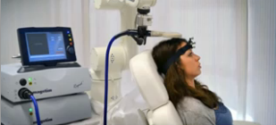
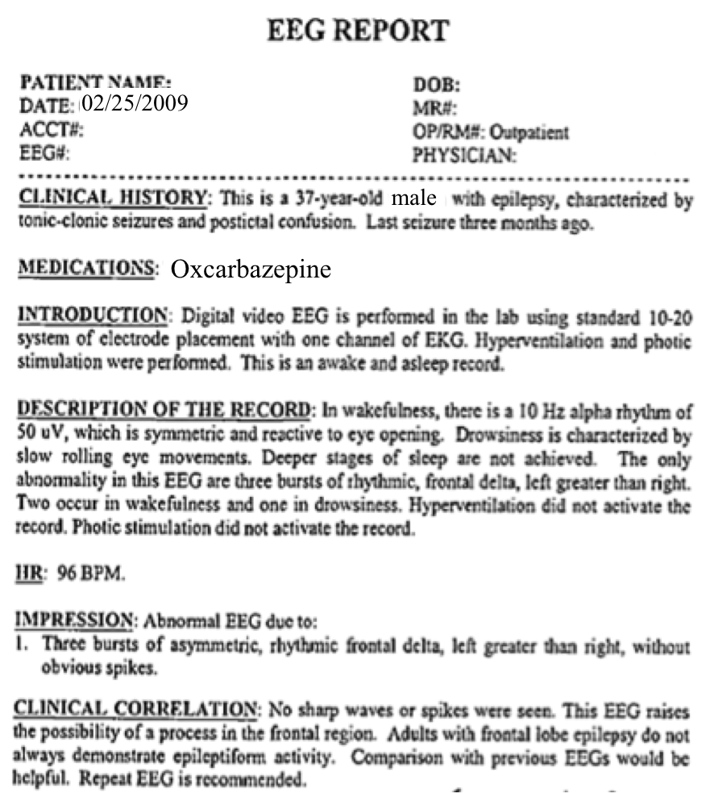
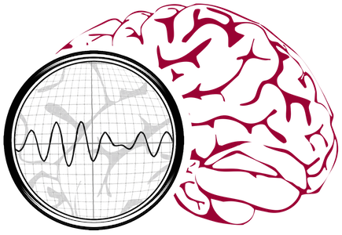
The TUH EEG COrpus:
The Largest Open Source
Clinical EEG Corpus
Iyad Obeid and Joseph Picone
Neural Engineering Data Consortium
Temple University
Philadelphia, Pennsylvania, USA

Slide 2
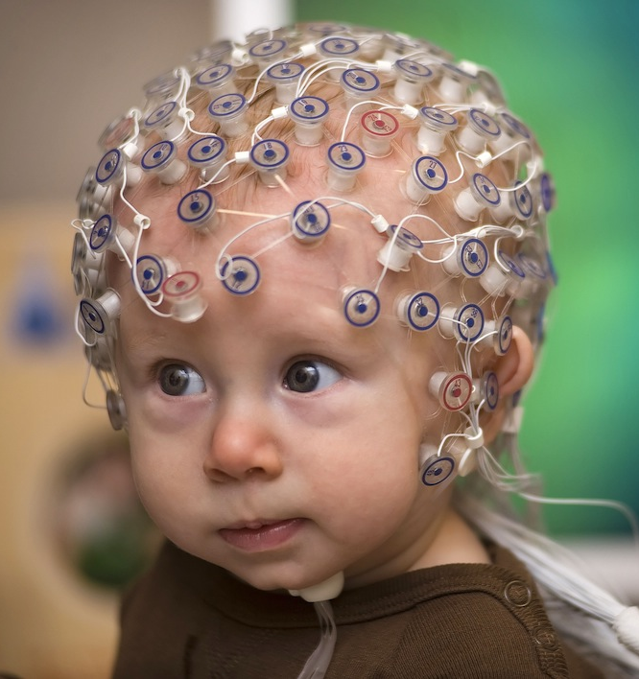
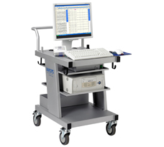
The Clinical Process
  A technician administers a 30−minute recording session.
  An EEG specialist (neurologist) interprets the EEG.
  An EEG report is generated with the diagnosis.
  Patient is billed once the report is coded and signed off.

Slide 3
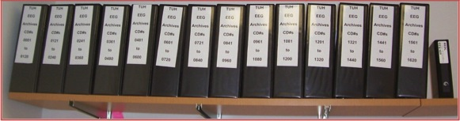
TUH EEG: Bring Big Data to EEG Science
Release 20,000+ clinical EEG recordings from Temple University Hospital (2002-2014+).
Includes physician reports and patient medical histories.
Data resides on over 1,500 CDs.
Data must be deidentified.
Jointly funded by DARPA, Temple University Office of Research and College of Engineering.
The largest corpus of
its type ever released;
will answer many basic
science questions
about EEGs.

Slide 4
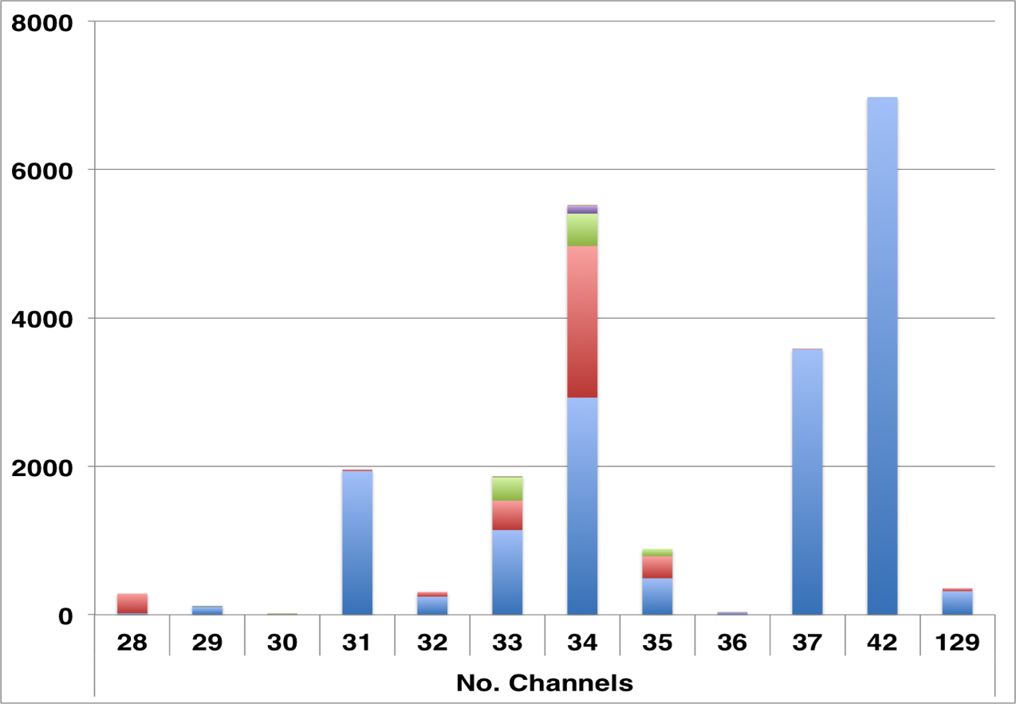
TUH EEG at a Glance
Number of Channels: ranges from [28, 129] (one annotation channel per EDF file)
Number of Sessions: 22,000+
Number of Patients: ~15,000 (one patient has 42 EEG sessions)
Age: 16 years to 90+
Sampling: 16-bit data sampled at 250 Hz, 256 Hz or 512 Hz
Number of Channels:
variable
Over 90% of the alternate channel assignments can be mapped to the 10-20 configuration.
Notes:
Format as appropriate.

Slide 5
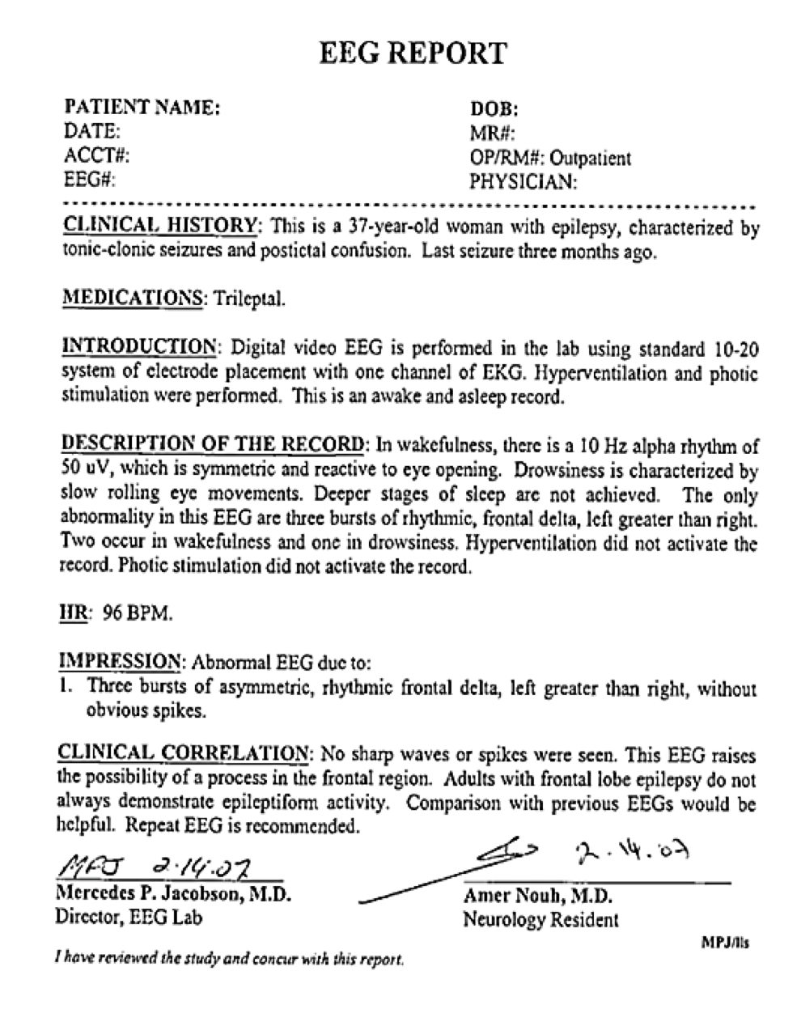
Physician Reports: The Resolving Process
Two Types of Reports:
Preliminary Report: contains a summary diagnosis (usually in a spreadsheet format).
EEG Report: the final “signed off” report that triggers billing.
Inconsistent Report Formats:
The format of reporting has changed several times over the past 12 years.
Report Databases:
MedQuist (MS Word .rtf)
Alpha (OCR’ed .pdf)
EPIC (text)
Physician’s Email (MS Word .doc)
Hardcopies (OCR’ed pdf)
Notes:
Provide a description of the proposed technical risk associated with the previous task.
Describe the challenges encountered and the steps taken to mitigate these challenges.
Describe any new or unexpected challenges encountered.
Describe any challenges encountered, strategies taken to mitigate, needs from PM to overcome this challenge.

Slide 6
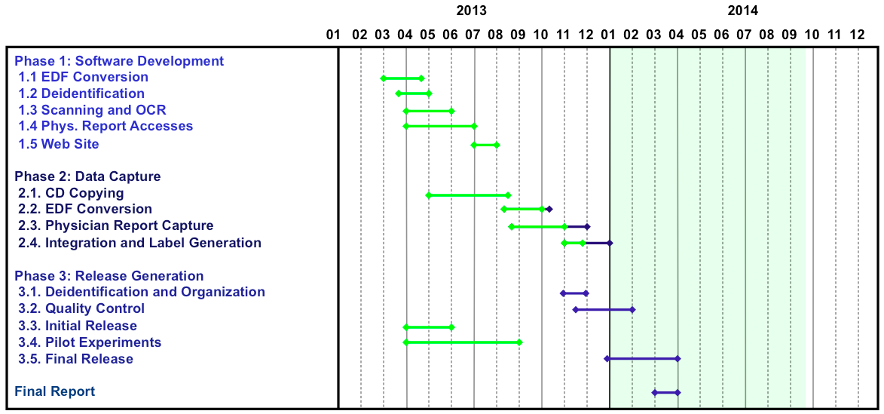
Status and Schedule
Released 250+ sessions in January 2014.
Released 3,000+ sessions in March 2014 for internal testing.
Over 6,000 sessions are ready for release.
New data keeps pouring in (24,750+ sessions online now).

Slide 7
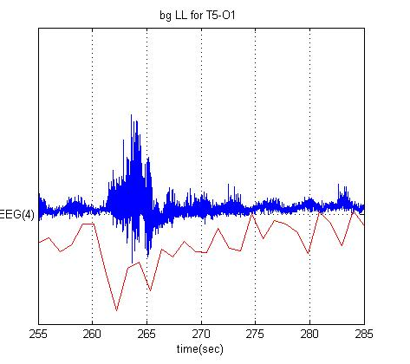
Preliminary Findings
First Attempt (5 Classes):
  Focal epileptiform, generalized epileptiform, focal abnormal, generalized abnormal, artifacts and background.
  Achieved over 80% sensitivity (but results were not useful to physicians).
Second Attempt (5 Classes):
Spike and sharp wave, generalized periodic epileptiform discharge (GPED), periodic lateralized epileptiform discharge (PLED), seizure and background (includes eye blink)
Also: focal/generalized and continuous/intermittent
Automatic Labeling:
Deep learning is used to identify critical EEG events that correlate with EEG reports (using unsupervised training).
These events are then used to train classifiers that will automatically label the data.

Slide 8
Observations
General:
This project would not have been possible without leveraging three funding sources.
Community interest is high, but willingness to fund is low.
Project Specific:
Recovering the EEG signal data was challenging due to software incompatibilities and media problems.
Recovering the EEG reports is proving to be challenging due to the primitive state of the hospital record system.
Making the data truly useful to machine learning researchers will require additional data clean up, particularly with linking reports to specific EEG activity.

Slide 9
Publications
Publications
Harati, A., Choi, S. I., Tabrizi, M., Obeid, I., Jacobson, M., & Picone, J. (2013). The Temple University Hospital EEG Corpus. Proceedings of the IEEE Global Conference on Signal and Information Processing. Austin, Texas, USA.
Ward, C., Obeid, I., Picone, J., & Jacobson, M. (2013). Leveraging Big Data Resources for Automatic Interpretation of EEGs. Proceedings of the IEEE Signal Processing in Medicine and Biology Symposium. New York City, New York, USA.
Planned Publications
Journal paper in collaboration with neurologists on a statistical analysis of the data (should be a seminal paper cited by others using the data)
IEEE Signal Processing in Medicine and Biology, Temple University, Philadelphia, Pennsylvania, December 6, 2014 (NSF-Funded).

Slide 10
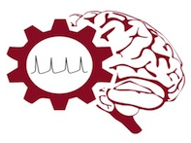
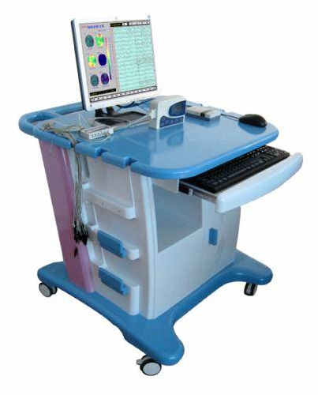
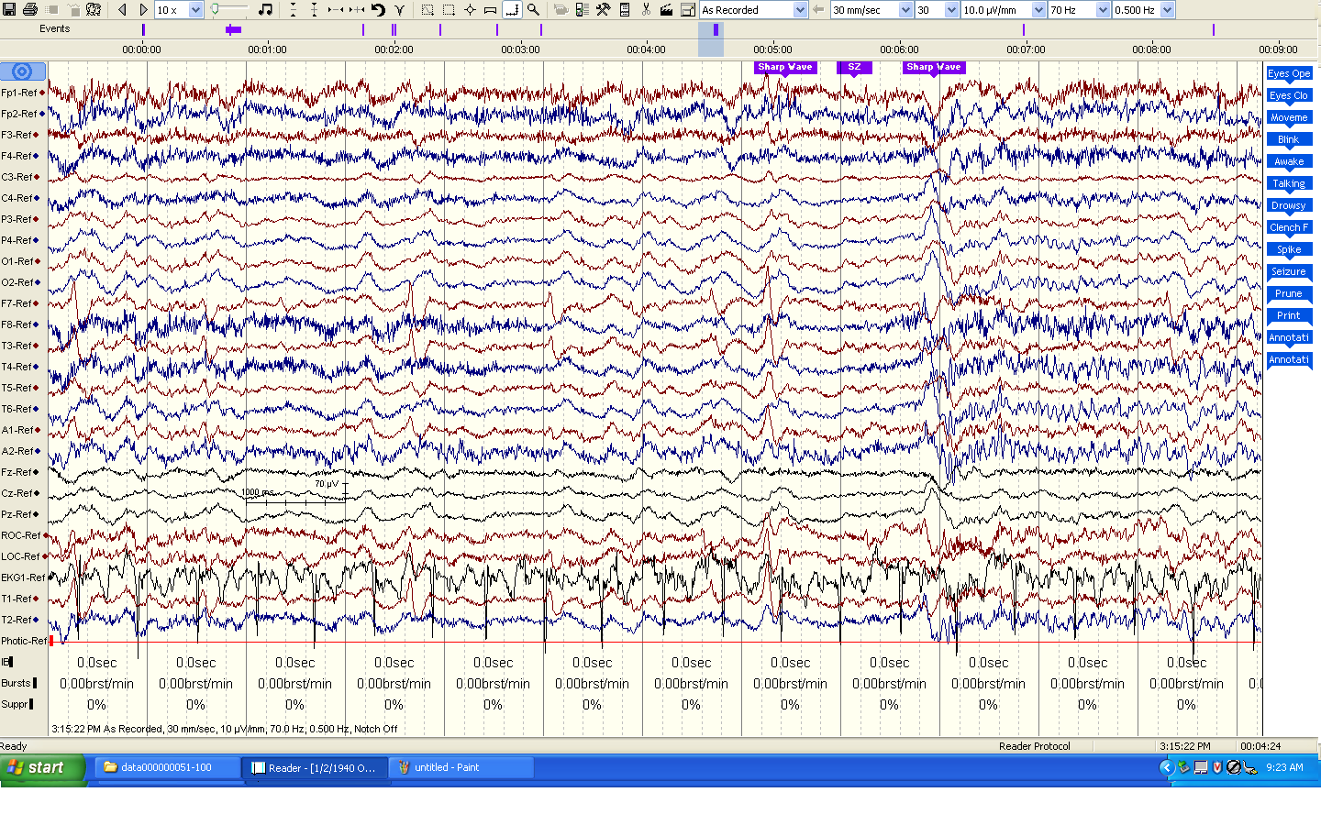
The Temple University Hospital EEG Corpus
Synopsis: The world’s largest publicly available EEG corpus consisting of 20,000+ EEGs collected
from 15,000 patients, collected over 12 years. Includes physician’s diagnoses and patient medical
histories. Number of channels varies from 24 to 36. Signal data distributed in an EDF format.
Impact:
  Sufficient data to support application of state of the art machine learning algorithms
  Patient medical histories, particularly drug treatments, supports statistical analysis of correlations between signals and treatments
  Historical archive also supports investigation of EEG changes over time for a given patient
  Enables the development of real-time monitoring
Database Overview:
  21,000+ EEGs collected at Temple University Hospital from 2002 to 2013 (an ongoing process)
  Recordings vary from 24 to 36 channels of signal data sampled at 250 Hz
  Patients range in age from 18 to 90 with an average of 1.4 EEGs per patient
  Data includes a test report generated by a technician, an impedance report and a physician’s report; data from 2009 forward inlcudes ICD-9 codes
  A total of 1.8 TBytes of data
  Personal information
  has been redacted
  Clinical history and medication history are included
  Physician notes are captured in three fields: description, impression and correlation fields.

Slide 11
Automated Interpretation of EEGs
Goals: (1) To assist healthcare professionals in interpreting electroencephalography (EEG) tests,
thereby improving the quality and efficiency of a physician’s diagnostic capabilities; (2) Provide
a real-time alerting capability that addresses a critical gap in long-term monitoring technology.
Impact:
  Patients and technicians will receive immediate feedback rather than waiting days or weeks for results
  Physicians receive decision-making support that reduces their time spent interpreting EEGs
  Medical students can be trained with the system and use search tools make it easy to view patient histories and comparable conditions in other patients
  Uniform diagnostic techniques can be developed
Milestones:
  Develop an enhanced set of features based on temporal and spectral measures (1Q’2014)
  Statistical modeling of time-varying data sources in bioengineering using deep learning (2Q’2014)
  Label events at an accuracy of 95% measured on the held-out data from the TUH EEG Corpus (3Q’2014)
  Predict diagnoses with an F-score (a weighted average of precision and recall) of 0.95 (4Q’2014)
  Demonstrate a clinically-relevant system and assess the impact on physician workflow (4Q’2014)

