Slide 1
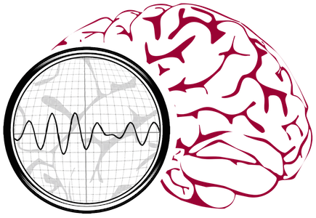
Welcome to the INAUGURAL NEDC
Board of Directors
MEeting
Iyad Obeid and Joseph Picone
Neural Engineering Data Consortium
Temple University
Philadelphia, Pennsylvania, USA

Slide 2
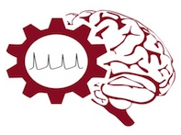
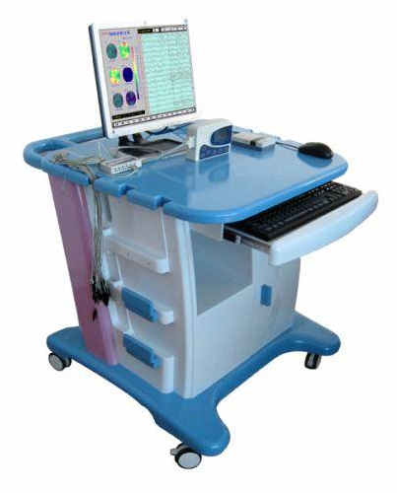
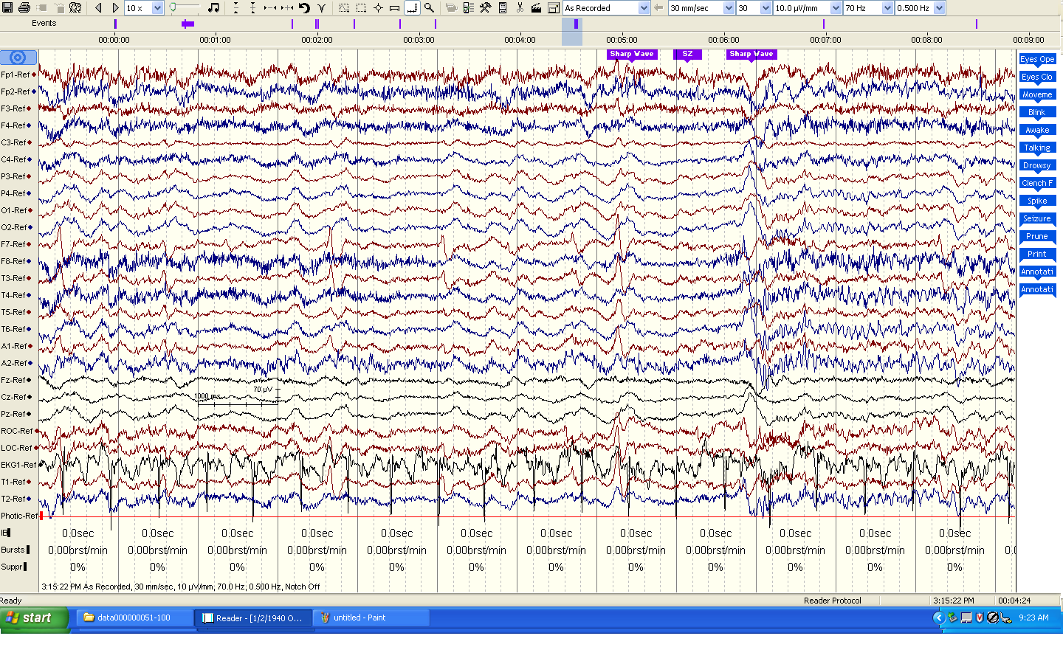
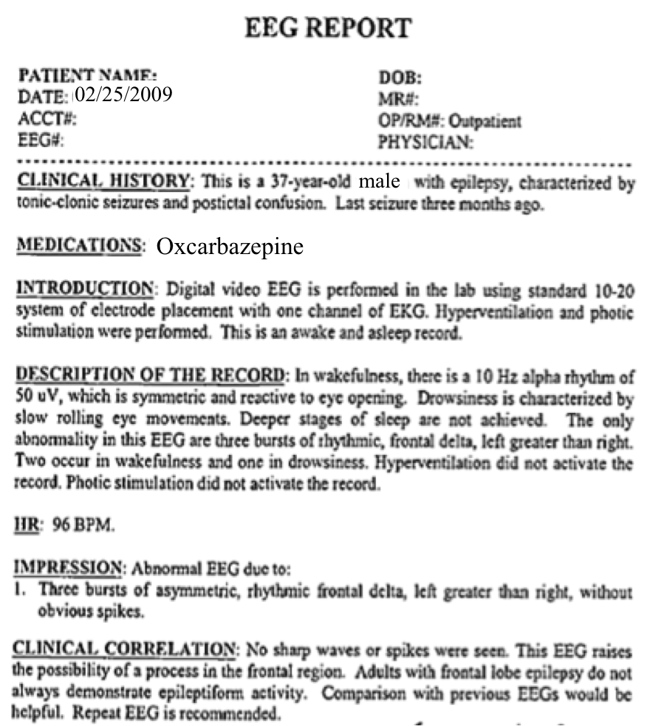
The Temple University Hospital EEG Corpus
Synopsis: The world’s largest publicly available EEG corpus consisting of 20,000+ EEGs collected
from 15,000 patients, collected over 12 years. Includes physician’s diagnoses and patient medical
histories. Number of channels varies from 24 to 36. Signal data distributed in an EDF format.
Impact:
  Sufficient data to support application of state of the art machine learning algorithms
  Patient medical histories, particularly drug treatments, supports statistical analysis of correlations between signals and treatments
  Historical archive also supports investigation of EEG changes over time for a given patient
  Enables the development of real-time monitoring
Database Overview:
  21,000+ EEGs collected at Temple University Hospital from 2002 to 2013 (an ongoing process)
  Recordings vary from 24 to 36 channels of signal data sampled at 250 Hz
  Patients range in age from 18 to 90 with an average of 1.4 EEGs per patient
  Data includes a test report generated by a technician, an impedance report and a physician’s report; data from 2009 forward inlcudes ICD-9 codes
  A total of 1.8 TBytes of data
  Personal information
  has been redacted
  Clinical history and medication history are included
  Physician notes are captured in three fields: description, impression and correlation fields.

Slide 3
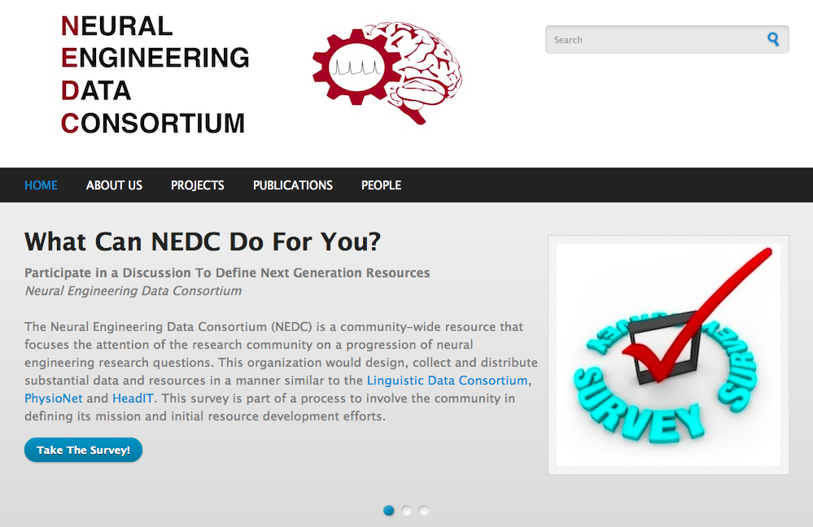

Slide 4
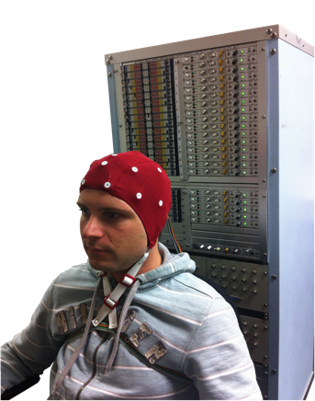
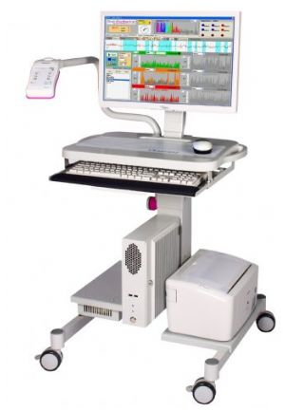
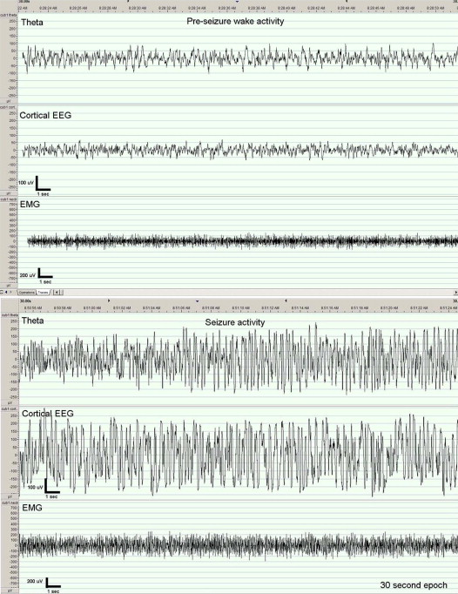
The Neural Engineering Data Consortium
Mission: To focus the research community on a progression of research questions and to
generate massive data sets used to address those questions. To broaden participation by making
data available to research groups who have significant expertise but lack capacity for data generation.
Impact:
  Big data resources enables application of state of the art machine-learning algorithms
  A common evaluation paradigm ensures consistent progress towards long-term research goals
  Publicly available data and performance baselines eliminate specious claims
  Technology can leverage advances in data collection to produce more robust solutions
Expertise:
  Experimental design and instrumentation of bioengineering-related data collection
  Signal processing and noise reduction
  Preprocessing and preparation of data for distribution and research experimentation
  Automatic labeling, alignment and sorting of data
  Metadata extraction for enhancing machine learning applications for the data
  Statistical modeling, mining and automated interpretation of big data
  To learn more, visit www.nedcdata.org

Slide 5
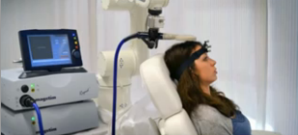
Automated Interpretation of EEGs
Goals: (1) To assist healthcare professionals in interpreting electroencephalography (EEG) tests,
thereby improving the quality and efficiency of a physician’s diagnostic capabilities; (2) Provide
a real-time alerting capability that addresses a critical gap in long-term monitoring technology.
Impact:
  Patients and technicians will receive immediate feedback rather than waiting days or weeks for results
  Physicians receive decision-making support that reduces their time spent interpreting EEGs
  Medical students can be trained with the system and use search tools make it easy to view patient histories and comparable conditions in other patients
  Uniform diagnostic techniques can be developed
Milestones:
  Develop an enhanced set of features based on temporal and spectral measures (1Q’2014)
  Statistical modeling of time-varying data sources in bioengineering using deep learning (2Q’2014)
  Label events at an accuracy of 95% measured on the held-out data from the TUH EEG Corpus (3Q’2014)
  Predict diagnoses with an F-score (a weighted average of precision and recall) of 0.95 (4Q’2014)
  Demonstrate a clinically-relevant system and assess the impact on physician workflow (4Q’2014)

Slide 6
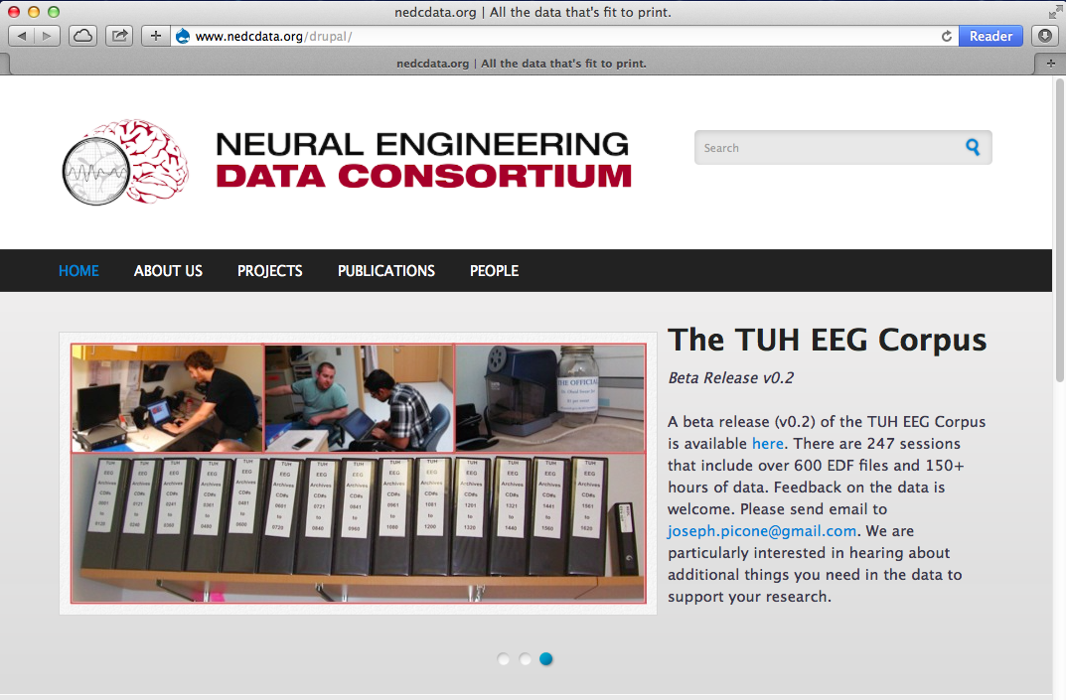

Slide 7


Slide 8
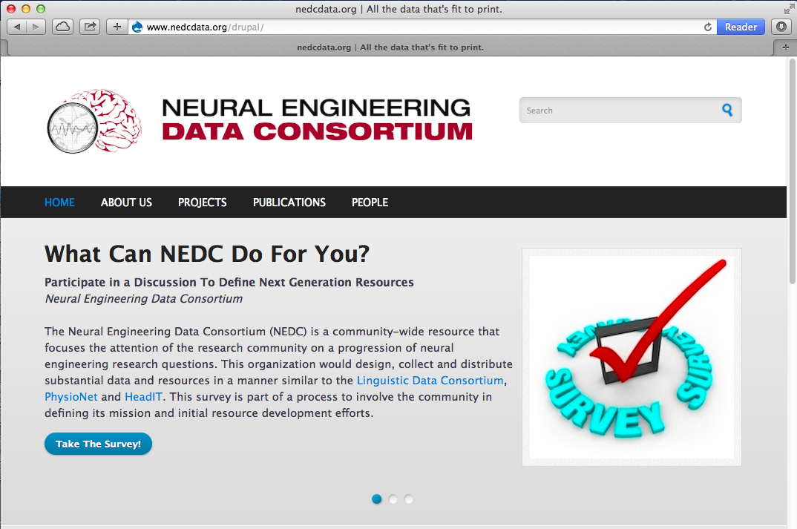

Slide 9
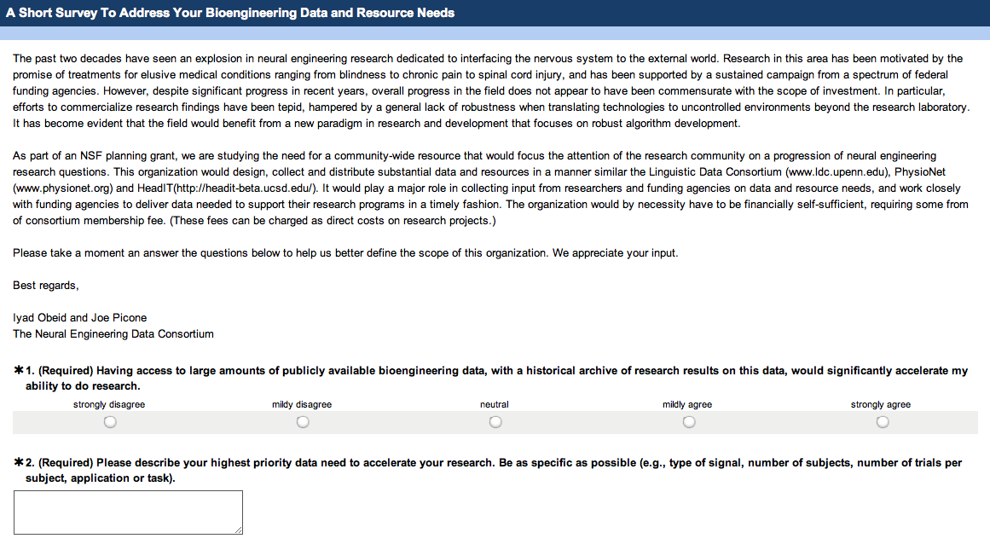
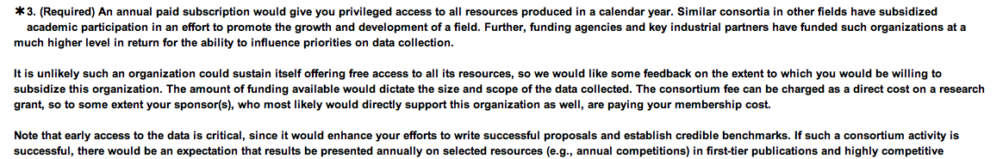

Slide 10


Slide 11
The Temple University Hospital EEG Corpus
Synopsis: The world’s largest publicly available EEG corpus consisting of 20,000+ EEGs collected
from 15,000 patients, collected over 12 years. Includes physician’s diagnoses and patient medical
histories. Number of channels varies from 24 to 36. Signal data distributed in an EDF format.
Impact:
  Sufficient data to support application of state of the art machine learning algorithms
  Patient medical histories, particularly drug treatments, supports statistical analysis of correlations between signals and treatments
  Historical archive also supports investigation of EEG changes over time for a given patient
  Enables the development of real-time monitoring
Database Overview:
  21,000+ EEGs collected at Temple University Hospital from 2002 to 2013 (an ongoing process)
  Recordings vary from 24 to 36 channels of signal data sampled at 250 Hz
  Patients range in age from 18 to 90 with an average of 1.4 EEGs per patient
  Data includes a test report generated by a technician, an impedance report and a physician’s report; data from 2009 forward inlcudes ICD-9 codes
  A total of 1.8 TBytes of data
  Personal information
  has been redacted
  Clinical history and medication history are included
  Physician notes are captured in three fields: description, impression and correlation fields.

Slide 13
The Neural Engineering Data Consortium
Mission: To focus the research community on a progression of research questions and to
generate massive data sets used to address those questions. To broaden participation by making
data available to research groups who have significant expertise but lack capacity for data generation.
Impact:
  Big data resources enables application of state of the art machine-learning algorithms
  A common evaluation paradigm ensures consistent progress towards long-term research goals
  Publicly available data and performance baselines eliminate specious claims
  Technology can leverage advances in data collection to produce more robust solutions
Expertise:
  Experimental design and instrumentation of bioengineering-related data collection
  Signal processing and noise reduction
  Preprocessing and preparation of data for distribution and research experimentation
  Automatic labeling, alignment and sorting of data
  Metadata extraction for enhancing machine learning applications for the data
  Statistical modeling, mining and automated interpretation of big data
  To learn more, visit www.nedcdata.org

Slide 14
Automated Interpretation of EEGs
Goals: (1) To assist healthcare professionals in interpreting electroencephalography (EEG) tests,
thereby improving the quality and efficiency of a physician’s diagnostic capabilities; (2) Provide
a real-time alerting capability that addresses a critical gap in long-term monitoring technology.
Impact:
  Patients and technicians will receive immediate feedback rather than waiting days or weeks for results
  Physicians receive decision-making support that reduces their time spent interpreting EEGs
  Medical students can be trained with the system and use search tools make it easy to view patient histories and comparable conditions in other patients
  Uniform diagnostic techniques can be developed
Milestones:
  Develop an enhanced set of features based on temporal and spectral measures (1Q’2014)
  Statistical modeling of time-varying data sources in bioengineering using deep learning (2Q’2014)
  Label events at an accuracy of 95% measured on the held-out data from the TUH EEG Corpus (3Q’2014)
  Predict diagnoses with an F-score (a weighted average of precision and recall) of 0.95 (4Q’2014)
  Demonstrate a clinically-relevant system and assess the impact on physician workflow (4Q’2014)

Slide 19


