Slide 1
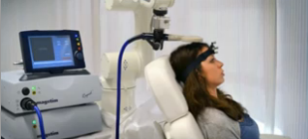
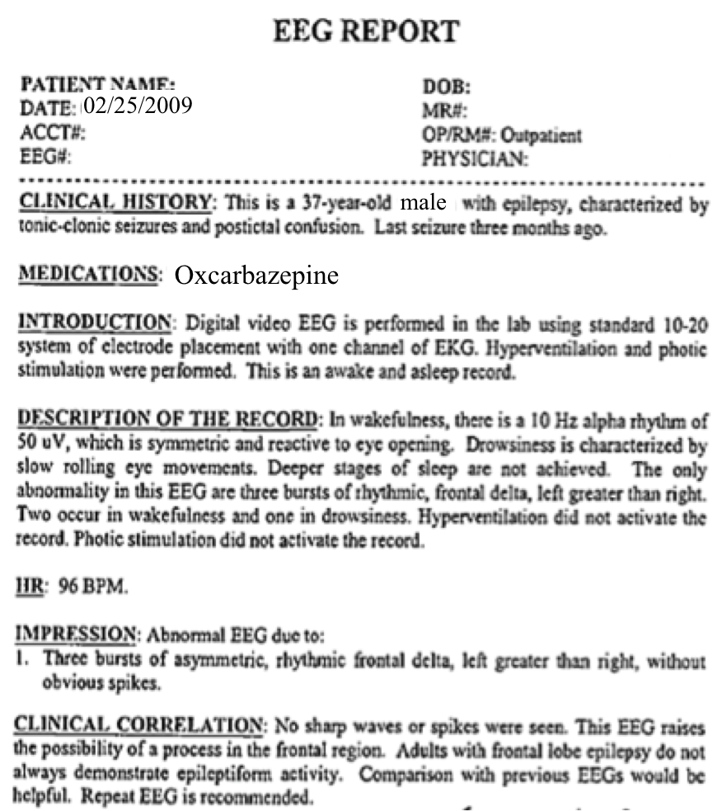
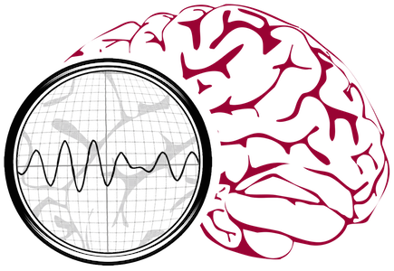
Engaging The Community:
Outreach Activities
Iyad Obeid and Joseph Picone
Neural Engineering Data Consortium
Temple University
Philadelphia, Pennsylvania, USA

Slide 2
Upcoming Planned Activities
Web dissemination
Market Survey (on going)
Summer workshop for constituents.
WE2 and high school outreach.
Conference presentation at Asilomar Conference on Signals, Systems and Computers.
Conference submission at Neuroinformatics 2014.
Hosting the IEEE Signal Processing in Medicine and Biology Symposium in December 2014.
University City Science Center commercialization grant continues to give us significant external exposure.

