Slide 1
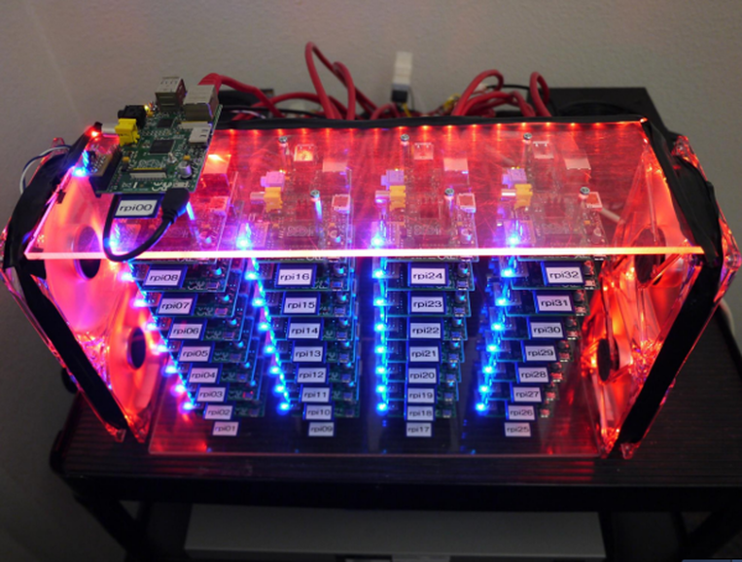
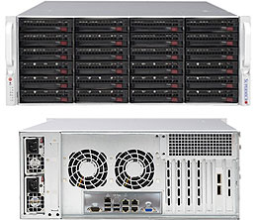
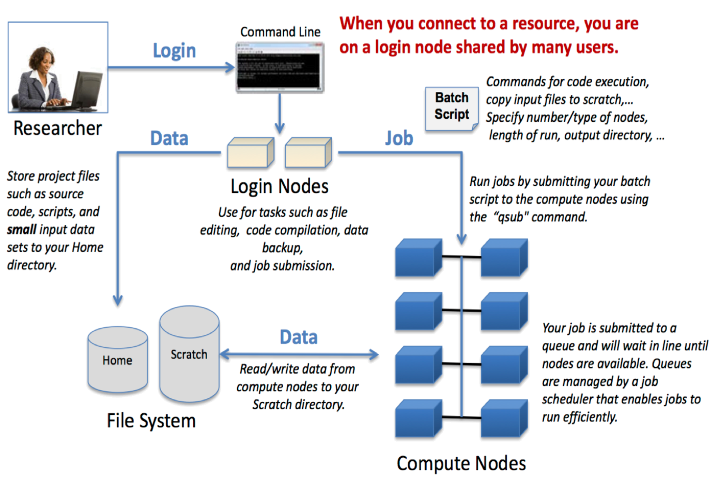
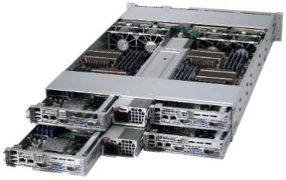
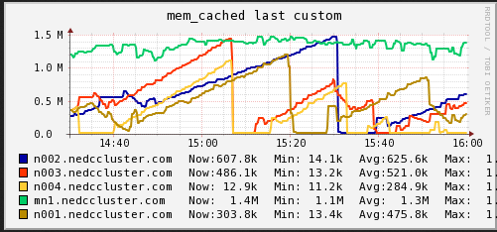
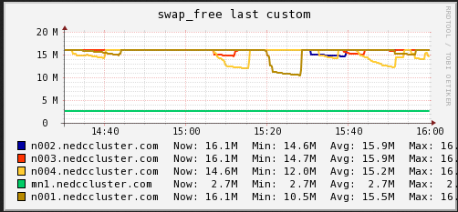
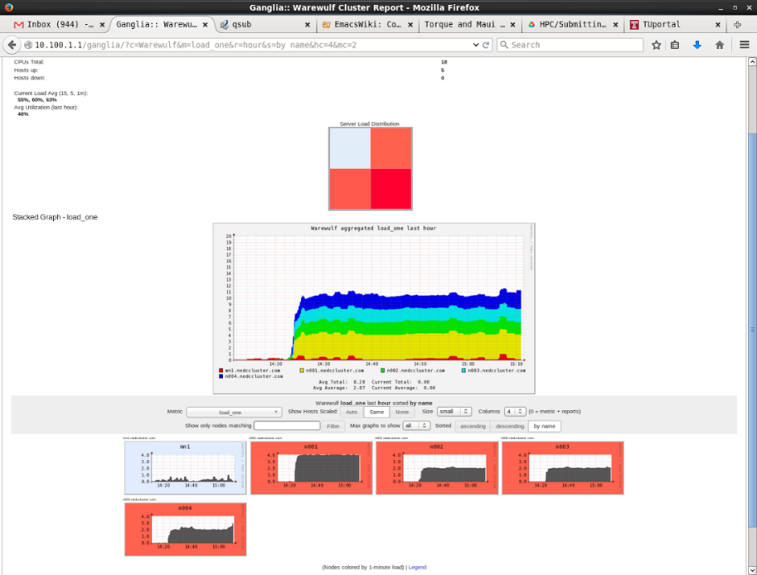
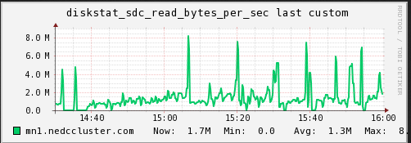
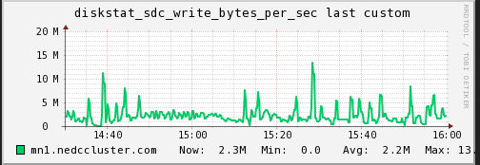
AFFORDABLE SUPERCOMPUTING USING OPEN SOURCE SOFTWARE
Devin Trejo, Dr. Iyad Obeid and Dr. Joseph Picone
The Neural Engineering Data Consortium, Temple University
College of Engineering
Temple University
www.isip.piconepress.com
Abstract
Big data and machine learning require powerful centralized computing systems.
Small research groups cannot afford to support large, expensive computing infrastructure.
Open source projects are enabling the development of low cost scalable clusters.
The main components of these systems include: Warewulf, Torque, Maui, Ganglia, Nagios, and NFS.
In this project, we created a power small cluster with 4 compute nodes that includes: 128 cores, 21TB NFS, 1TB RAM, and a central NFS server. The total system costs was $28K.
Each core can be addressed as an independent computing node, providing a large number of available slots for user processes.
The system is being used to develop AutoEEGTM on a large corpus of over 28,000 EEGs as part of a commercialization effort supported by Temple’s Office of Research.
Open Source Software
Warewulf for provisioning (TFTP)
Distribute your OS install to all compute nodes simultaneously on demand.
Consider also: Kickstart, Cobbler, OpenStack
Warewulf for configuration management.
Warewulf updates machines and maintains a ‘golden’ VNFS image.
Consider also: Puppet ($), Ansible ($)
Torque & Maui for job scheduling.
Consider also: SLURM
Overview of the Job Control Environment
OpenMPI – Message passing library for parallelization
Adapt your scripts to run across multiple cores/nodes using MPI.
Ganglia & Nagios for cluster host monitoring.
Administrators can see real-time usage across the entire cluster.
Alerts for when a node goes down.
NFS - Network File system for sharing data across compute nodes
Consider also: Lustre (PBs of fast storage), GlusterFS (Red Hat Gluster Storage)
A Makeshift HPC (Test) Cluster
Hardware Selection
Our goal was low-cost cycles in a configuration that can be easily expanded using heterogeneous processors and hardware platforms.
Accommodating heterogeneous hardware is crucial to our long-term strategy of supporting low-cost upgrades and minimizing the cost of cycles
Avoiding I/O bottlenecks was crucial to achieving our goal of 100% utilization of each core.
Several test scripts were developed to experiment with tradeoffs between RAM, processing speed, network speed, SSD size and I/O performance.
Hardware Evaluation
Used Ganglia to monitor hardware resource utilization during script testing.
Observed disk swap space being used that slowed down our core usage and thus job speed.
Saw our scripts typically use ~3.5GB of RAM.
Hardware Comparison
Final Hardware Purchase
Budget was constrained to $27.5K
Main Node x1:
2x Intel Xeon E5-2623v3 (4C) @ 3.0 GHz
8x 8GB DDR4 @2133 MHz (64GB)
2x 480GB Kingston SSD (RAID1) (Boot)
14x WDRE 3TB (RAID10) (21TB Usable)
LSI 9361I-8i 8 Port RAID Card
24-Bay 4U Supermicro Chassis w/ 10GbE
Notes: We went with a centralized main node that will server as the login node and NFS server. To ensure there are no bottlenecks now (and in the future) we went with two fast Intel Xeon processors. Also the motherboard supports 10GbE in case we add an extra ordinate number of compute nodes in the future and need to upgrade our network infrastructure. Lastly the disks are setup in RAID10 for redundancy and speed.
Compute Node x4
2x AMD Opteron 6378 (16C) @ 2.4GHz
16x DDR3 1866MHz (256GB/8GB per core)
1x 480GB Kingston SSD
Notes: For compute nodes we went with a high core count since our jobs are batch processing based. Also from our tests we saw we needed at least 3.5GB per core to run jobs successfully. Since our budget allowed we actually went with 8GB per core across the nodes. Lastly we added a SSD to each node so jobs can copy over jobs files to the local drive in case we run into NFS IO bounded issues.
NEDC Test Cluster
Pi Cluster
<Photo Credit: www.zdnet.com>
Background
OwlsNest is a shared supercomputing facility available to Temple researchers.
Wait lines for OwlsNest Compute cluster can range from 20 mins → 4+ hours.
The configuration of the machine is not optimal for the coarse-grain parallel processing needs of machine learning research.
The lifetime of computer hardware for such clusters is less than three years.
Cloud computing options include renting cycles from Amazon AWS.
Architectures that mix conventional CPUs and GPUs were considered.
Other Relevant Cluster Environments
Hadoop: popularized by Google
Data stored in HDFS across compute nodes to reduce IO bottlenecks
MapReduce (YARN)
Best for processing Behavioral Data, Ad Targeting, Search Engines (Example: Storing FitBit data statistics) – Batch processing
Consider using: Cloudera CDH or Hortonworks cluster mangers
Spark: a new project (2009) that promises performance 100x faster than Hadoop’s MapReduce. The speed increase comes from Spark running jobs from memory rather than disk. Spark requires a core Hadoop install and is viable for many HPC clusters.
Data fits in memory
Standalone but best used w/ HDFS
Real-time or batch processing
<Photo Credit: bluewaters.ncsa.illinois.edu>
Summary
Leveraging open source software and architecture designs reduces the budget needed to be allocated towards software, which frees up resources that can be used to purchase better hardware.
Open source software also allows compatibility with most clusters since most are based on the same queue management software (Torque/PBS).
We can quickly add heterogeneous compute nodes to the configuration and easily partition these into groups to balance the needs of our users.
Our main node can handle 50+ compute nodes with a quick upgrade in the network infrastructure.
The overall system will deliver 1.228 TFLOPS for $26.5K, or 46 MFLOPS/$, which competitive with most supercomputers of cloud-based services.
Acknowledgements
Research reported in this publication was supported by the National Human Genome Research Institute of the National Institutes of Health under Award Number U01HG008468.
This research was also supported in part by the National Science Foundation through Major Research Instrumentation Grant No. CNS-09-58854.
Intel Xeon E5506 (4C) @ 2.133 GHz and 6GB RAM (NEDC Test Cluster) | Intel Xeon X5660 (6C) @ 2.8 GHz and 12GB RAM. (OwlsNest)
gen_feats NEDC Test job (777 Files Successful) | gen_feats OwlsNest job (1000 Files Successful)
exec_host: n001.nedccluster.com/0 | exec host: w066/0
Resource_List.neednodes= n001.nedccluster.com:ppn=1 | Resource_List.neednodes= 1:ppn=1
resources_used.cput=07:45:52 | resources_used.cput=05:14:17
resources_used.mem=3459788kb | resources_used.mem=3453572kb
resources_used.vmem= 3498944kb | resources_used.vmem= 3690128kb
resources_used.walltime= 07:53:22 | resources_used.walltime= 05:19:17

