Slide 1
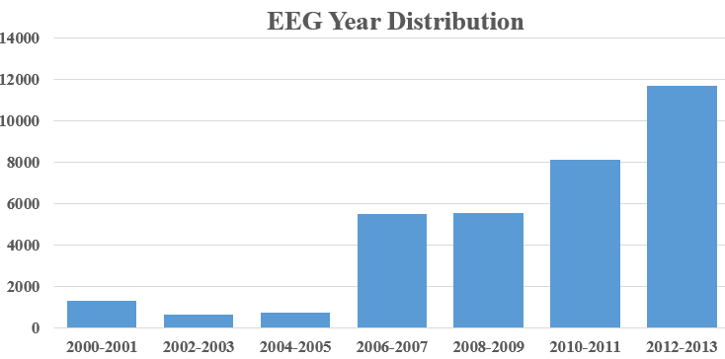
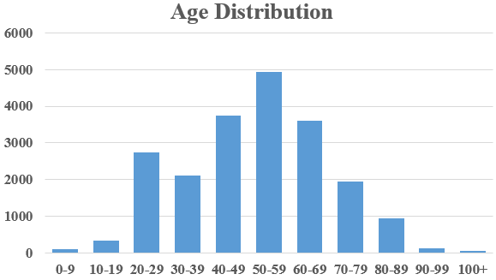
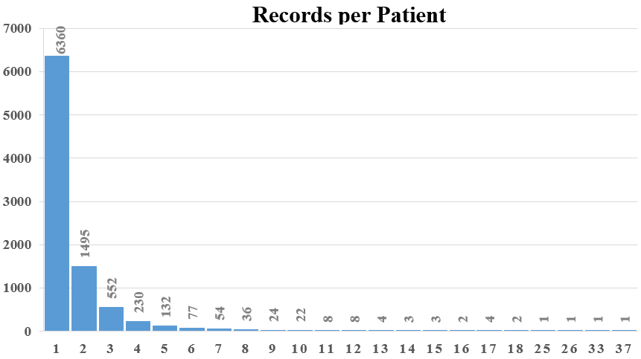
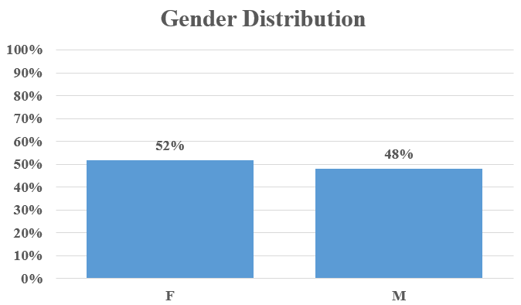
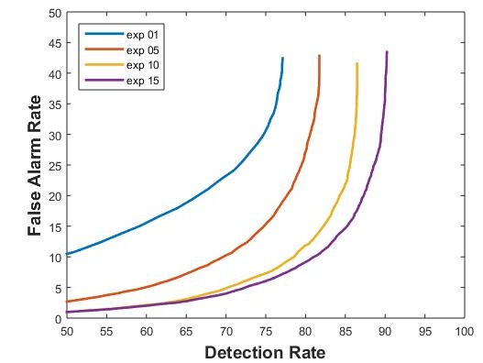
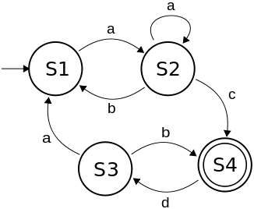
EEG Event detection on the TUH EEG Corpus
Temple University College of Engineering
www.nedcdata.org
www.temple.edu/engineering
Meysam Golmohammadi, Silvia Lopez, Iyad Obeid and Joseph Picone
The Neural Engineering Data Consortium
Temple University
Abstract
Electroencephalography (EEG) is a widely used clinical diagnostic tool and is increasingly important in critical care settings such as the ICU.
Manual interpretation of EEGs is time-consuming, costly and has low interrater agreement.
The emergence of big data and deep learning has played a crucial role in the development of systems that can autonomously learn from data.
The TUH EEG Corpus is the largest and most comprehensive publicly-released corpus representing 14 years of clinical data collected at Temple Hospital. It includes over 15,000 patients, 28,000+ sessions, 50,000+ EEGs and de-identified clinical information.
We have developed a system, AutoEEG, that recognizes key EEG signal events and generates time aligned markers indicating points of interest.
A hybrid system based on hidden Markov models and deep learning delivers a misrecognition rate below 10% with a false alarm rate below 5%.
AutoEEG makes dense data such as EEGs searchable from any portable computing device. Clinical consequences include real-time feedback and decision making support.
The TUH EEG Data Corpus
The corpus development involved the pairing, de-identification and annotation of EEG data:
EEG reports were manually verified and de-identified.
The TUH EEG Data Corpus
Classification Performance
6-way confusion matrix after HMM pass (P1):
Confusion matrix after post-processing (P2+P3):
Detection error tradeoff (DET) curve (P1):
Delta features become more significant when the detection rate is high.
False alarm rate rises rapidly at detection rates above 70%.
Post-processing improves detection rate while maintaining a low false alarm rate:
Summary
The TUH EEG Corpus represents a unique opportunity to advance EEG analysis using state of the art machine learning.
The 2002–2014 data is publicly available. See www.nedcdata.org for more details.
Baseline performance of a multi-pass hybrid HMM/deep learning classification system is promising: 89% DET / 4% FA.
AutoEEG runs hyper real-time on a standard PC processor.
Future Work
The TUH EEG Corpus will continue to grow at a rate of 3,000 EEGs per year, and will expand to multiple collection sites (pending funding).
Improved active learning will enable training of better models.
Enhanced feature extraction, discriminative decoding and adaptation will improve performance.
Real-time detection of seizures for ICU applications is our next focus.
Cohort retrieval will be integrated into our Python-based demonstration.
 | SPSW | PLED | GPED | EYBL | ARTF | BCKG
SPSW | 40% | 5% | 33% | 10% | 8% | 4%
PLED | 20% | 55% | 18% | 4% | 1% | 2%
GPED | 12% | 22% | 51% | 2% | 7% | 6%
EYBL | 3% | 9% | 2% | 84% | 1% | 1%
ARTF | 6% | 3% | 4% | 2% | 39% | 46%
BCKG | 9% | 2% | 8% | 3% | 6% | 72%
Copy EEG files to Disks
Convert EEG files to EDF
Capture Physicians' Reports
Deidentify Reports
Label Generation
Hard Copies
Alpha Database
M*Modal Database
Access Database
Optical Character Recognition
Copy EEG files to Disks
 | SPSW | PLED | GPED | EYBL | ARTF | BCKG
SPSW | 41% | 0% | 33% | 3% | 5% | 18%
PLED | 14% | 39% | 30% | 0% | 3% | 14%
GPED | 1% | 9% | 87% | 1% | 0% | 2%
EYBL | 0% | 0% | 0% | 69% | 2% | 29%
ARTF | 5% | 0% | 2% | 13% | 10% | 70%
BCKG | 3% | 0% | 1% | 7% | 1% | 88%
Introduction
Modern machine learning algorithms require big data to accurately train complex statistical models.
The TUH EEG Data Corpus is the largest publicly available database of clinical EEGs, and is enabling the development of high performance automatic interpretation systems.
AutoEEG is a hybrid system based on hidden Markov models and deep learning:
Events of Interest
Six events of interest based on multiple iterations with board certified neurologists:
Collapse background classes to one class for scoring (4-way).
Collapse to two classes (Epileptiform and Background) for DET curve scoring and analysis.
Feature Extraction
Standard frequency domain analysis is used based on cepstral features and deltas (P1):
No. | System Description | Dims | 6-Way | 4-Way | 2-Way
1 | Cepstral | 7 | 59.3% | 33.6% | 24.6%
2 | Cepstral + E_{f} | 8 | 45.9% | 33.0% | 24.0%
5 | Cepstral + E_{f} +E_{d} | 9 | 39.2% | 30.0% | 20.4%
6 | Cepstral + Δ | 14 | 56.6% | 32.6% | 23.8%
7 | Cepstral + E_{f} + Δ | 16 | 43.7% | 30.1% | 21.2%
8 | Cepstral + E_{t} + Δ | 16 | 42.8% | 31.6% | 22.4%
9 | Cepstral + E_{d} + Δ | 16 | 51.6% | 30.4% | 22.0%
10 | Cepstral + E_{f} +E_{d} + Δ | 18 | 35.4% | 25.8% | 16.8%
11 | Cepstral + Δ + ΔΔ | 21 | 53.1% | 30.4% | 21.8%
12 | Cepstral + E_{f} + Δ + ΔΔ | 24 | 39.6% | 27.4% | 19.2%
13 | Cepstral + E_{t} + Δ + ΔΔ | 24 | 39.8% | 29.6% | 21.1%
14 | Cepstral + E_{d} + Δ + ΔΔ | 24 | 52.5% | 30.1% | 22.6%
15 | Cepstral + E_{f} +E_{d} + Δ + ΔΔ | 27 | 35.5% | 25.9% | 17.2%
16 | (15) but no ΔΔ for E_{d} | 26 | 35.0% | 25.0% | 16.6%
Acknowledgements
Research reported in this poster was supported by National Human Genome Research Institute of the National Institutes of Health under award number 1U01HG008468.
The content is solely the responsibility of the authors and does not necessarily represent the official views of the National Institutes of Health.
The TUH EEG Corpus development was sponsored by the Defense Advanced Research Projects Agency (DARPA), Temple University’s College of Engineering and Office of the Vice Provost for Research.
System | Detection Rate | False Alarm | Error
Heuristics | 99% | 64% | 74%
Random Forest | 85% | 6% | 37%
HMM (P1) | 84% | 4% | 37%
+ Deep Learning (P1+P2) | 82% | 4% | 39%
+ Language Model (P1+P2+P3) | 89% | 4% | 36%
Feature Extraction
Temporal and Spatial Context
TUH EEG CORPUS
Sequential Modeler
Post Processor
Epoch
Label
Demonstration
A Python-based user interface:
Waveform and spectrogram views are supported.
User-configurable montages and filtering.
Scrolling by time or by next event.
Channel-dependent scaling.
Events can be viewed per channel, per epoch, or selectively filtered.
Epoch
Hidden Markov Models
Finite State Machine
Active Learning Approach to Training
EEG reports only contain summaries; a small amount of manually-labeled data available.
Seed models based on manually-annotated data.
Train, classify, and select high-confidence data.
Iterate:
References
Lopez, S., et al. (2015). Automated Identification of Abnormal EEGs. Proceedings of the EEE Signal Processing in Medicine and Biology Symposium (pp. 1–4). Philadelphia, Pennsylvania, USA.
Harati, A., et al. (2015). Improved EEG Event Classification Using Differential Energy. Proceedings of the IEEE Signal Processing in Medicine and Biology Symposium (pp. 1–4). Philadelphia, Pennsylvania, USA.
Harati, A., et al. (2014). THE TUH EEG CORPUS: A Big Data Resource for Automated EEG Interpretation. Proceedings of the IEEE SPMB Symposium (pp. 1-5). Philadelphia, PA, USA.
Epileptiform | Background
SPSW: Spike and sharp wave | ARTF: Artifact
GPED: Generalized periodic epileptiform discharges and triphasic | EYBM: Eye Movement
PLED: Periodic lateralized epileptiform discharges | BCKG: Background
TUH EEG Corpus
Reestimate Parameters
Supervised learning process
Output: Model Parameters
Input: EEG Raw Data
Feature Extraction
Find best alignment between primitives and data
Alignment Found?
Recall Parameters

