Slide 1

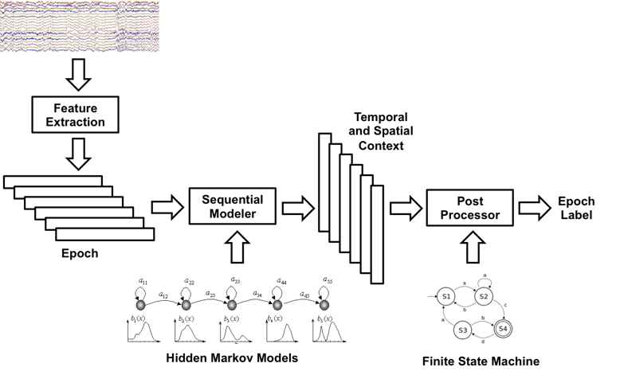
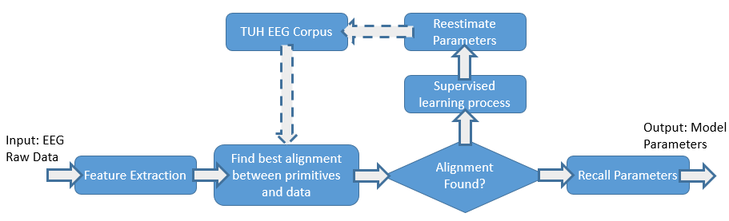
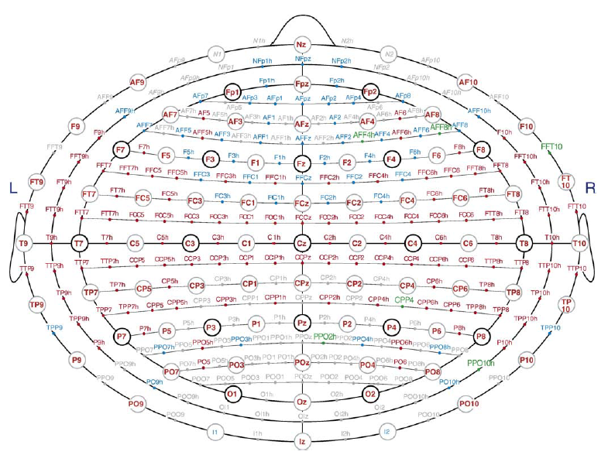
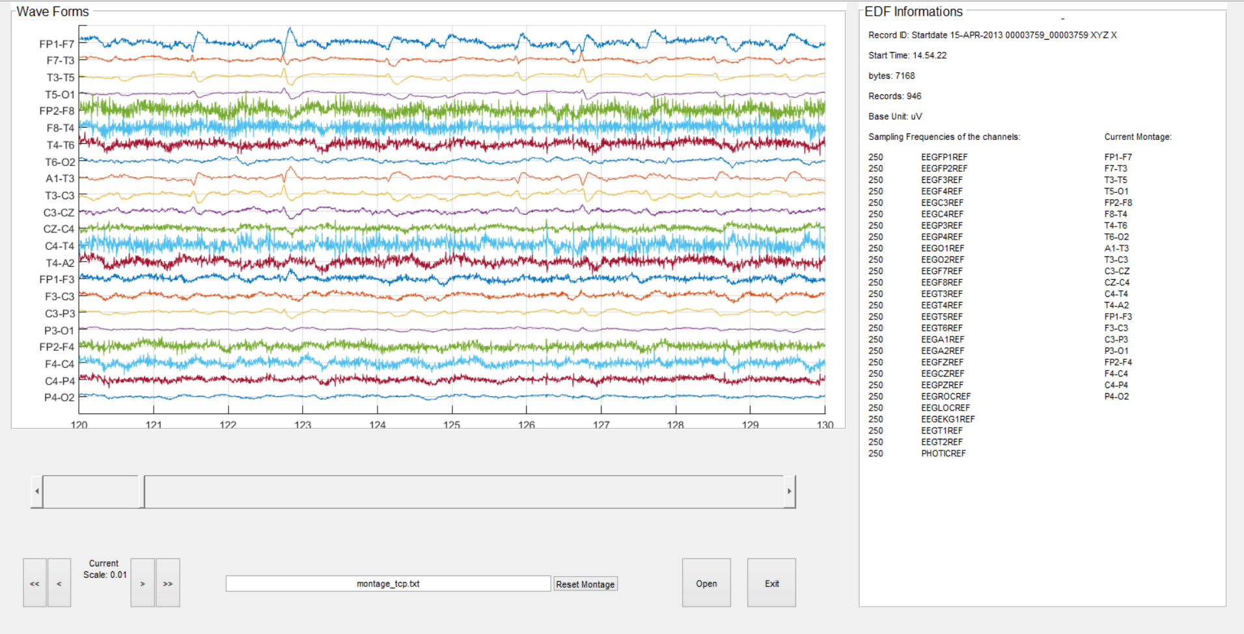
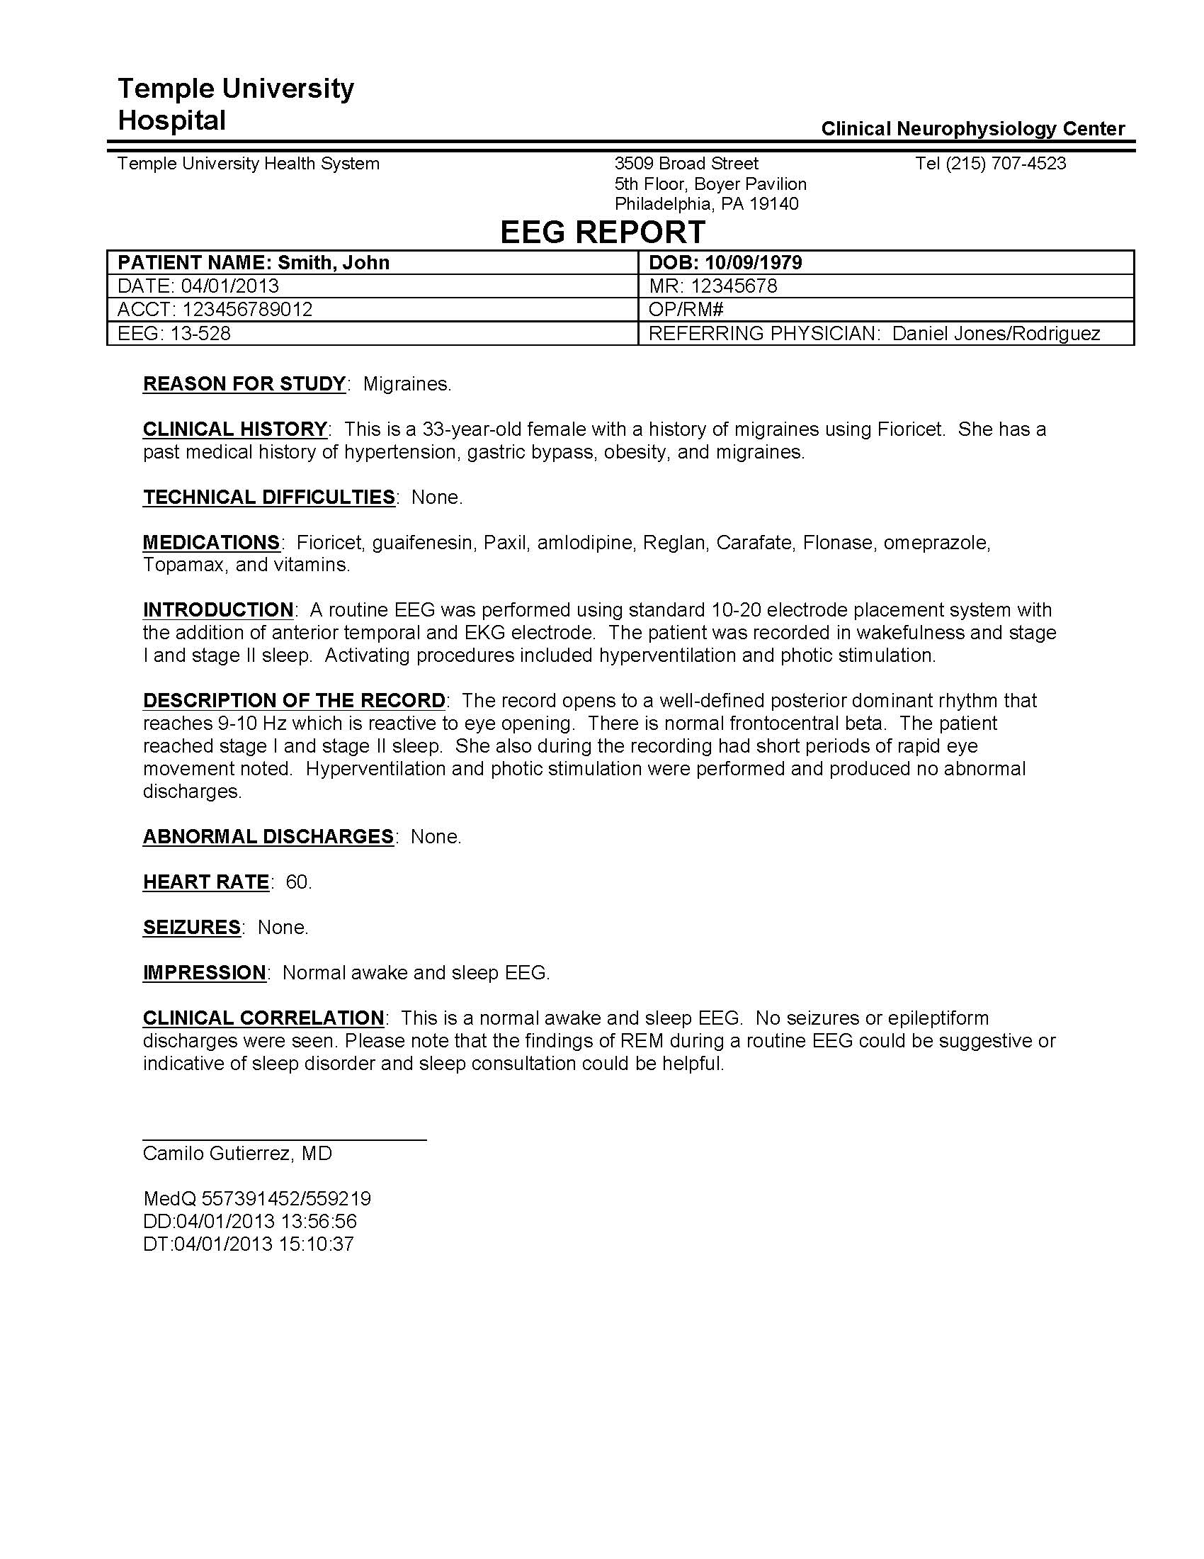
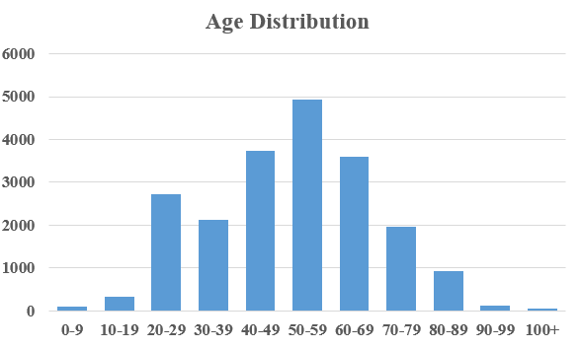
Automatic discovery and processing of EEG cohorts
from clinical records
Human Language Technology
Research Institute
www.nedcdata.org
www.hlt.utdallas.edu
Iyad Obeid and Joseph Picone
The Neural Engineering Data Consortium
Temple University
Sanda Harabagiu
The Human Language Technology Research Institute
University of Texas at Dallas
Abstract
Electronic medical records (EMRs) contain unstructured text, temporally constrained measurements (e.g., vital signs), multichannel signal (e.g., EEGs), and image data (e.g., MRIs).
We are developing a patient cohort retrieval system that allows clinicians to retrieve relevant EEG signals and EEG reports using standard queries (e.g. “Young patients with focal cerebral dysfunction who were treated with Topamax”).
Aim 1: Automatically recognize and time-align EEG events that contribute to a diagnosis.
Aim 2: Automatically recognize critical concepts in the EEG reports.
Aim 3: Automatic patient cohort retrieval.
Aim 4: Evaluation and analysis of the results of the patient cohort retrieval.
Our focus is the automatic interpretation of a clinical BigData resource – the TUH EEG Corpus.
An important outcome will be the existence of an annotated BigData archive of EEGs.
Big Mechanism for Processing EEG Clinical Information on Big Data
Aim 1: Automatically Recognize and Time-Align Events in EEG Signals
Aim 2: Automatically Recognize Critical Clinical Concepts in EEG Reports
Aim 3: Automatic Patient Cohort Retrieval
Aim 4: Evaluation and Analysis
Experts will be recruited to generate query topics. Several sources (e.g., ClinicalTrials.gov, PUBMED) will be used to develop topics.
Judges who are physicians in residence and medical students will be recruited to evaluate relevance judgments.
We will conduct user acceptance testing using three focus groups: expert annotators, clinicians and medical students.
Several formal user acceptance studies will be conducted by measuring user satisfaction using a standard 5‑point Likert scale and also collecting open-ended information on its perceived value.
We will assess quantitatively the impact on productivity by measuring the amount of time required to review an EEG and generate a report.
We will also assess the value of the patient cohort retrieval system for medical student training by working with medical students in training at Temple’s School of Medicine.
Hidden Markov models used for sequential decoding.
Deep learning used to model spatial/temporal context.
Active learning is used to do unsupervised training on the signal data.
The TUH EEG Corpus
An electroencephalogram (EEG) measures electrical activity in the brain.
A typical EEG exam following the 10-20 system consists of 21 electrodes:
The TUH EEG Corpus contains over 28,000 sessions collected from 15,000+ patients over a period of 14 years at Temple University Hospital.
EEG data is stored in EDF files:
Clinical data has many challenges including variations in channel configurations, report formats, and noise due to patient movements.
Anticipated Outcomes
World’s largest publicly available annotated EEG signal corpus and a set of high-performance BigData tools that allow rapid development of new biomedical applications using dense data.
High-performance automatic identification of clinical events as well as medical concepts, spatial and temporal information.
A patient cohort retrieval system operating on a very large corpus of EEG signals and reports.
Clinical evaluation of the patient cohort system through clinical expert judgments.
Acknowledgements
Research reported in this poster was supported by National Human Genome Research Institute of the National Institutes of Health under award number 1U01HG008468.
The content is solely the responsibility of the authors and does not necessarily represent the official views of the National Institutes of Health.
The TUH EEG Corpus development was sponsored by the Defense Advanced Research Projects Agency (DARPA), Temple University’s College of Engineering and Office of Research.
References
Harati, A., et al. (2014). THE TUH EEG CORPUS: A Big Data Resource for Automated EEG Interpretation. Proceedings of IEEE SPMB.
G.K. Roberts, B. Rink and S.M. Harabagiu, “A flexible framework for recognizing events, temporal expressions, and temporal relations in clinical text.” JAMIA 2013 Sep-Oct;20(5):867-75.
Deidentified medical reports are available that include a brief patient history and a neurologist’s findings.
Data is unstructured and the report formats vary.
Field | Description | Example
1 | Version Number | 0
2 | Patient ID | TUH123456789
3 | Gender | M
4 | Date of Birth | 57
8 | Firstname_Lastname | TUH123456789
11 | Startdate | 01-MAY-2010
13 | Study Number/ Tech. ID | TUH123456789/TAS X
14 | Start Date | 01.05.10
15 | Start Time | 11.39.35
16 | Number of Bytes in Header | 6400
17 | Type of Signal | EDF+C
19 | Number of Data Records | 207
20 | Dur. of a Data Record (Secs) | 1
21 | No. of Signals in a Record | 24
27 | Signal[1] Prefiltering | HP:1.000 Hz LP:70.0 Hz N:60.0
28 | Signal[1] No. Samples/Rec. | 250

