Slide 1
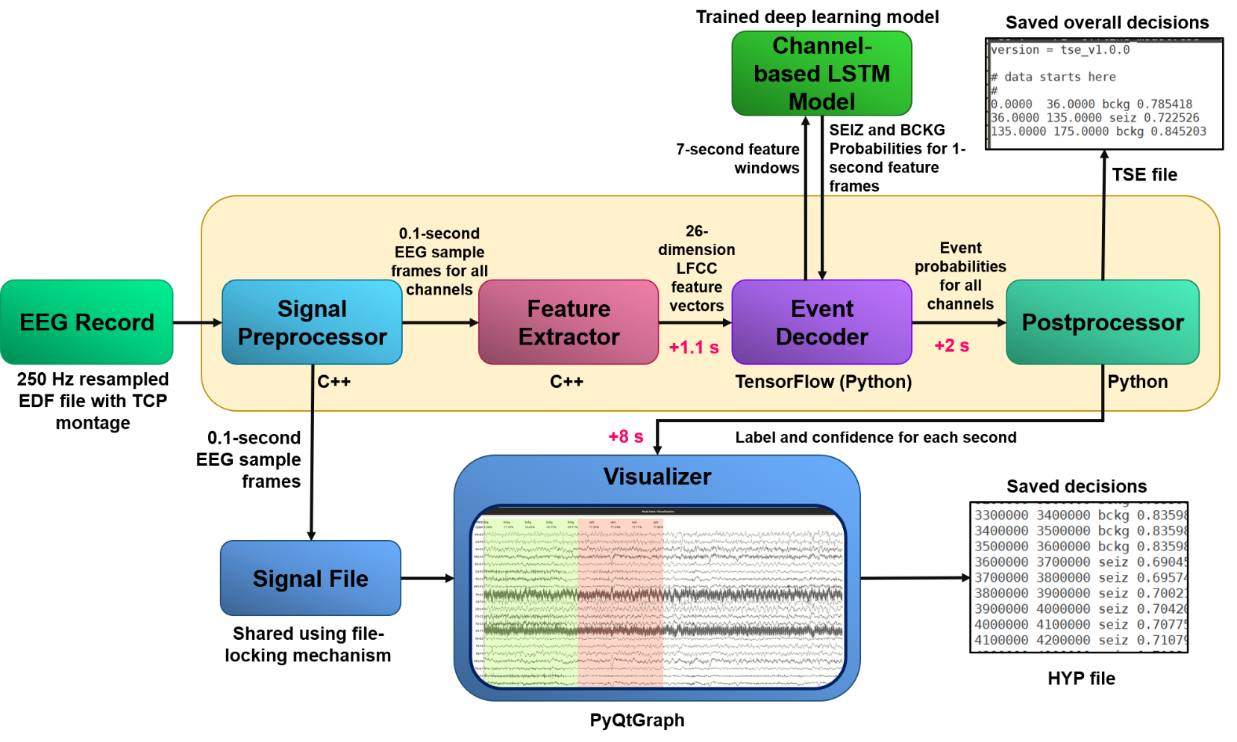
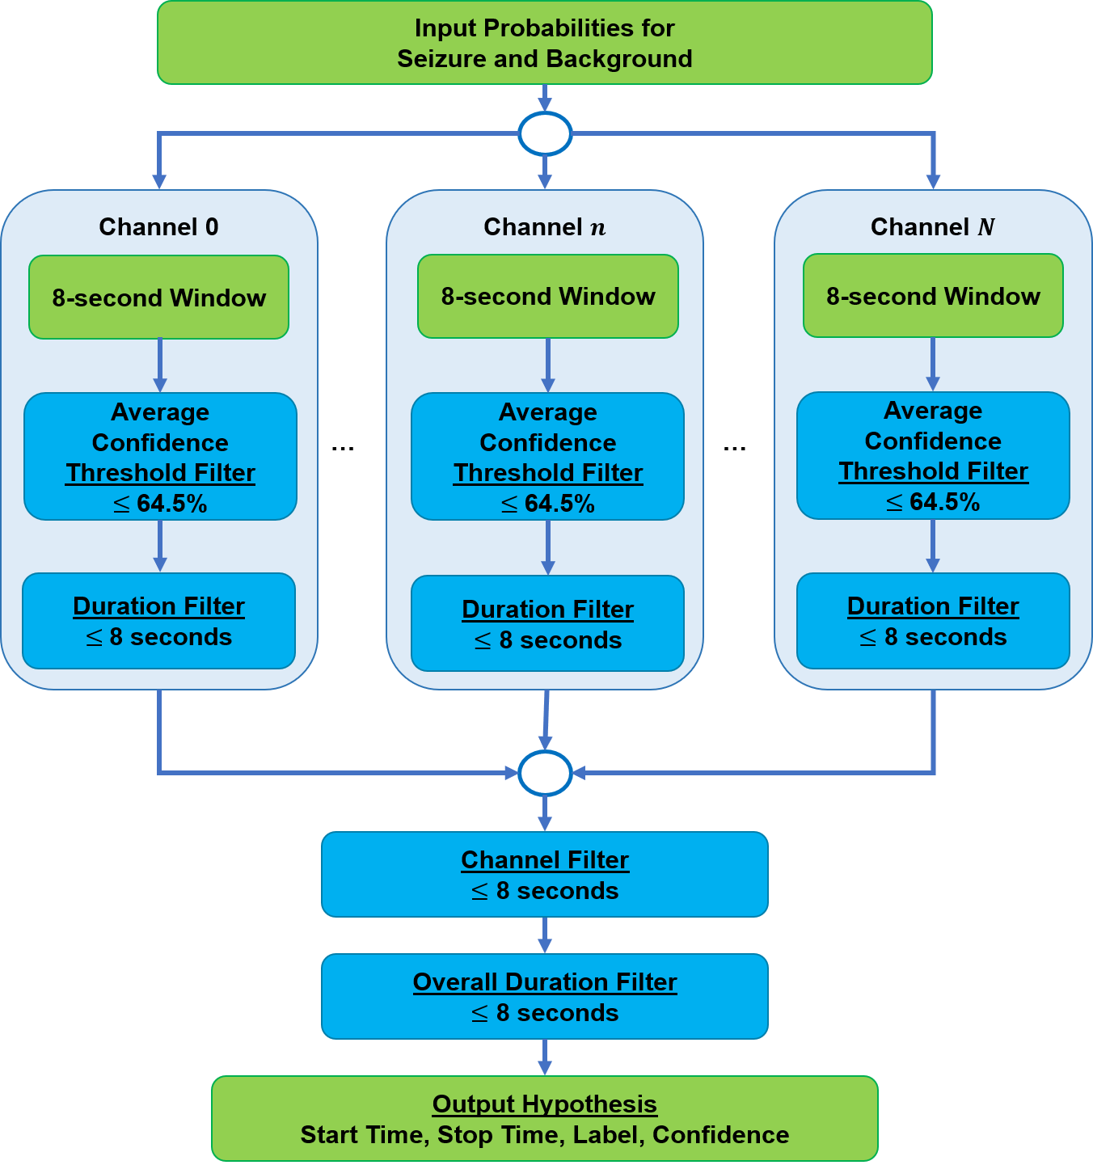
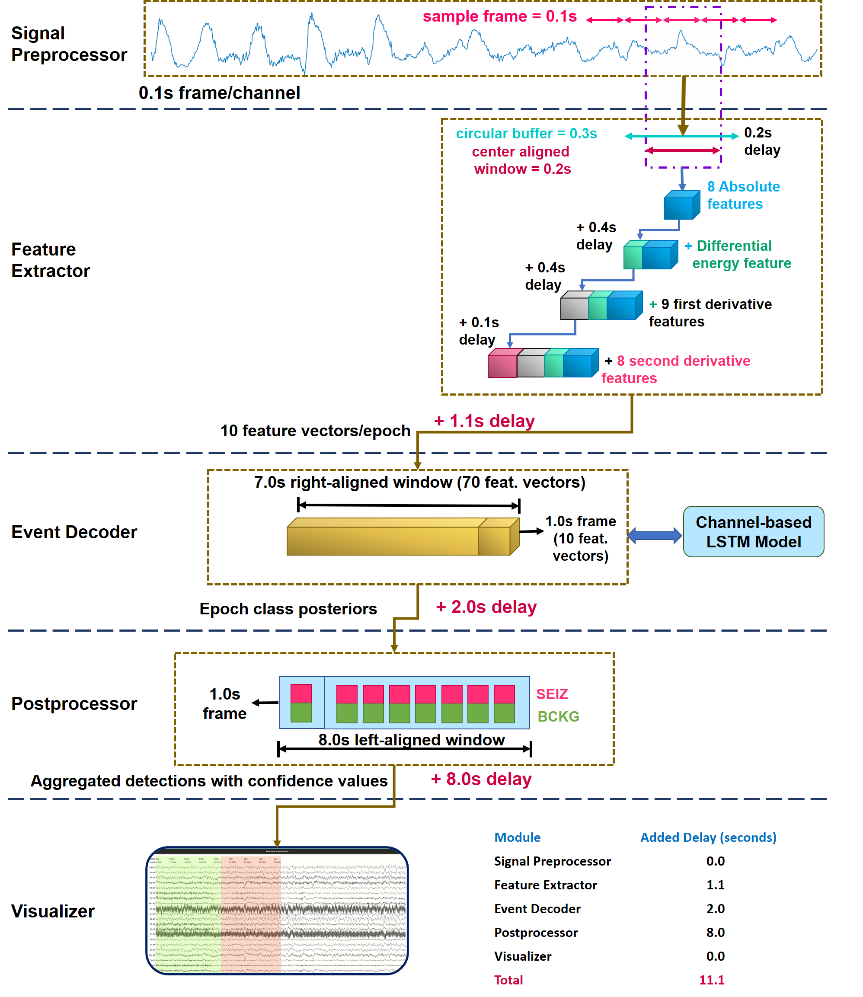
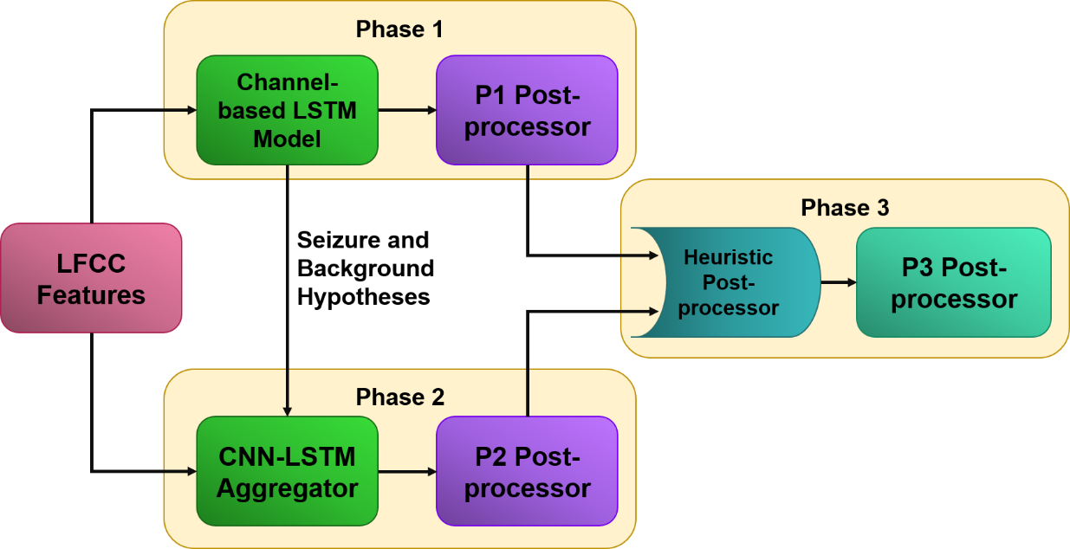
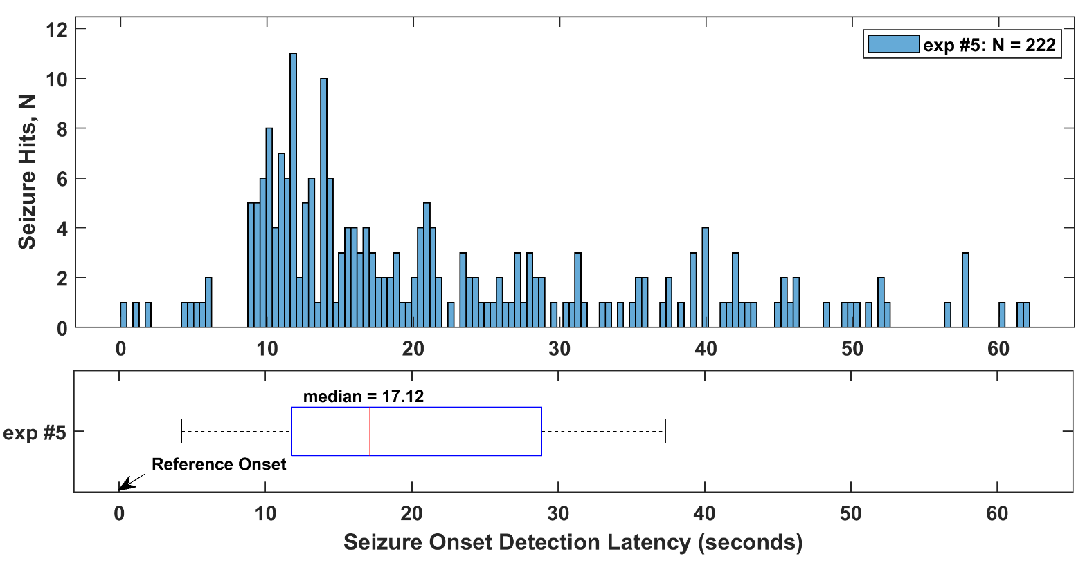
A Deep Learning-Based Real-Time Seizure Detection System
N. Shawki, T. Elseify, T. Cap, V. Shah, I. Obeid and J. Picone
The Neural Engineering Data Consortium, Temple University
College of Engineering
Temple University
www.nedcdata.org
Abstract
Detecting seizures in a critical care setting is an expensive and tedious task.
We describe our effort to establish a pipeline for a real-time seizure detection system.
The real-time system consists of five modules: signal preprocessor, feature extractor, event decoder, postprocessor, and visualizer.
The current performance of the online system is 45.80% sensitivity with 28.14 FAs per 24 hours. The performance of the research prototype is 40.29% sensitivity and 5.77 FAs per 24 hours.
The real-time system, implemented in C++ and Python, takes advantage of the Linux piping mechanism, multithreading techniques and multi-core processors.
Signal Preprocessor
The real-time system accepts streamed EEG data sampled at 250 Hz as input.
The first module applies a TCP montage which also determines the channel count and order. The input signal can have either 20 or 22 channels.
Each channel is processed in 0.1 second (25 sample) duration frames.
Feature extraction and visualization receive a copy of the input signal in parallel so the waveform can be displayed in real time.
Feature Extractor
We produce 26 LFCC features: 8 absolute cepstral coefficients, a differential energy term, 9 first derivatives and 8 second derivatives.
The differential energy term is excluded in the computation of the second derivatives.
This module uses a 0.3 sec buffer (75 samples) from each channel to extract 0.2 sec (50 sample) center-aligned windows every 0.1 secs.
The differential energy feature is calculated in a window of duration 0.9 secs.
Computation of the first and second derivatives use 0.9 sec and 0.3 sec windows respectively.
Total delay: 1.1 secs
Event Decoder
Using the features produced in the previous module, we trained a channel-based LSTM model in TensorFlow for the real-time system.
The research system scales the feature across a channel before applying a sliding window approach. In the real-time system, we normalize each window since it has access to a limited amount of data.
The model processes the feature vectors in a 7-second right-aligned window every 1 sec. The module adds 2 second delay.
Postprocessor
This module receives probabilities for two classes for each epoch and saves 8 epochs (8.0 secs) of data to make a decision.
It applies multiple heuristic filters to make an overall decision by combining events across the channels.
These filters use the average confidence, duration, and knowledge of the channel indices to make a decision.
Visualizer
The EEG signal is displayed as soon as signal data is available. Decisions are overlayed on the signal as soon as they are finalized (see Figure 4).
The system uses the label SEIZ and color red for a seizure. Non-seizure events (background) are displayed using the label BCKG and the color green.
When the streaming finishes, the system saves three files: a signal file in which the sample frames are saved in the order they were streamed, a time segmented event (TSE) file with the overall decisions and confidences, and a hypothesis (HYP) file that saves the label and confidence for each epoch.
Performance
The total system delay is 11.1 sec (see Figure 4). TensorFlow and model initialization requires about 20 secs, but this is not a factor in real-time performance.
The system requires 1.81 secs to process 1 sec of data using a single CPU core, so it can easily run in real-time using multiple cores and/or GPUs.
The decoding process can also be offloaded to GPUs if available and runs hyper real time.
2657
Table 2. The delay in each module
Module | Processing (secs) | Cumulative (secs)
Signal Preprocessor | 0.01 ( 0.55%) | 0.01 ( 0.55%)
Feature Extractor | 0.07 ( 3.87%) | 0.08 ( 4.42%)
Event Decoder | 1.56 ( 86.19%) | 1.64 ( 90.61%)
Postprocessor | 0.15 ( 8.29%) | 1.79 ( 98.90%)
Visualizer | 0.02 ( 1.10%) | 1.81 (100%)
Total | 1.81 (100%) | 1.81 (100%)
3694
Figure 1. A block diagram of a real-time seizure detection system
Figure 3. Postprocessing
Overview
The research prototype uses two phases of deep learning models and a postprocessor.
In Phase 1 (P1), a long short term memory (LSTM) model processes linear frequency cepstral coefficients (LFCC) features derived from each EEG channel separately (per-channel features).
For Phase 2 (P2), we generate additional features using the hypotheses produced in P1. A hybrid convolutional neural network (CNN) and LSTM model is then applied to learn the temporal and spatial aspects of the EEG signal.
Phase 3 (P3) aggregates the results from P1 and P2 before applying a final postprocessing step.
Data processing is parallelized and accelerated via Linux pipes. Efficient data structures such as circular buffers and queues are used.
A network file locking mechanism is used to prevent file and data access collisions.
Only P1 is part of the real-time system because P2 and P3 add excessive amounts of latency.
The Data Flow Pipeline
Results
Table 1. Performance comparison
Exp. No. | Systems | Description | Sens. (%) | FA/24 Hours
1 | Research Prototype | P1 – Channel-based LSTM (infinite latency) | 39.46 | 11.62
2 |  | P2 – CNN-LSTM aggregation | 41.16 | 11.69
3 |  | P3 – Final Postprocessing | 40.29 | 5.77
4 | Real-Time Channel-Based LSTM | Feature extraction + non-real-time P1 | 36.23 | 9.52
5 |  | Feature extraction + real-time P1 | 45.80 | 28.14
Conclusions
Developed a low-latency (11.1 secs) real-time seizure detection system suitable for critical care applications.
Compared to the offline model, the sensitivity increased by 6.34% absolute while the false alarms increased by 16.34 per 24 hours.
Detects seizure onsets with a median latency of 17.1 secs and offsets with a latency of 11.1 secs.
Our future research is focused on reducing the false alarm rate by exploring pretrained models such as ResNets and using more advanced architectures.
For a video demonstration, see:
https://www.isip.piconepress.com/projects/nsf_pfi_tt/resources/ videos/realtime_eeg_analysis/current/video_2.5.1.mp4
Acknowledgements
Research reported in this publication was most recently supported by the National Science Foundation Partnership for Innovation award number IIP-1827565 and the Pennsylvania Commonwealth Universal Research Enhancement Program (PA CURE). Any opinions, findings, and conclusions or recommendations expressed in this material are those of the author(s) and do not necessarily reflect the official views of any of these organizations.
Figure 2. A system level block diagram of the offline seizure detection system
Figure 5: ROC comparison of performance
Figure 4: Data flow in the real-time system
Figure 6: Seizure onset detection latency
Notes:
Notes:
Exps #1-3 describe the performances of the phases in the research model. Exp #1 is the offline model based on which the online system was developed.
Exp #4 uses the delayed LFCC features generated by the online feature extractor for training a model. We used Temple University Seizure Database (TUSZ) v1.2.1 for training and testing both the online and offline systems.
Exp #5 is the online system that is equipped with the real-time feature extractor, decoder and postprocessor.

