Slide 1

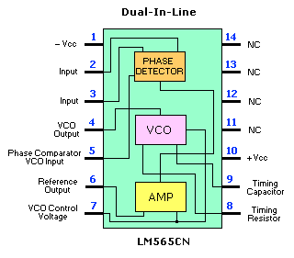
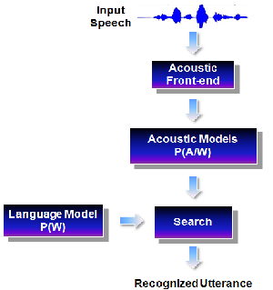
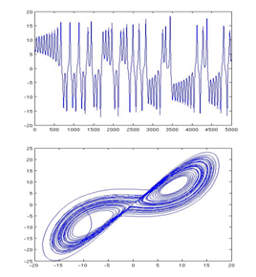

Nonlinear Statistical Modeling of Speech
S. Srinivasan, T. Ma, D. May, G. Lazarou and J. Picone
Department of Electrical and Computer Engineering
Mississippi State University
URL: http://www.isip.piconepress.com/publications/conferences/maxent/2009/nonlinear_models/
This material is based upon work supported by the National Science Foundation under Grant No. IIS-0414450. Any opinions, findings, and conclusions or recommendations expressed in this material are those of the author(s) and do not necessarily reflect the views of the National Science Foundation.

Slide 2
Motivation
Traditional approach to speech and speaker recognition:
  Gaussian Mixture Models (GMMs) to model state output distributions in hidden Markov model-based linear acoustic models.
  However, this popular approach suffers from an inherent assumption of linearity in speech signal dynamics. Such approaches are prone to overfitting and have problems with generalization.
Nonlinear Statistical Modeling of Speech:
  Original inspiration was based on nonlinear devices such as phase locked loop (PLL) and the property of strange attraction of a chaotic system.
  Augment speech features with nonlinear invariants: Lyapunov exponents, correlation fractal dimension, and correlation entropy.
  Introduce two dynamic models: nonlinear mixture of autoregressive models (MixAR) and linear dynamic model (LDM).

Slide 3


Probabilistic interpretation of speech recognition
Speech recognition problem is essentially a probabilistic problem: finding the word sequence, Ŵ, that is most probable given the acoustic observations, A.
p(W|A): posteriori probability of a word sequence after observing the acoustic signal A
After applying Bayes’ rule:
p(A|W): acoustic probability conditioned on a specific word sequence (Acoustic Model)
p(W): priori probability of a word sequence (Language Model)

Slide 4
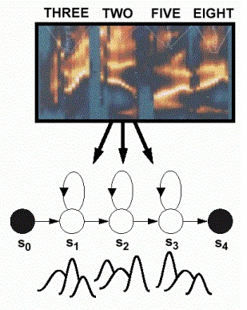
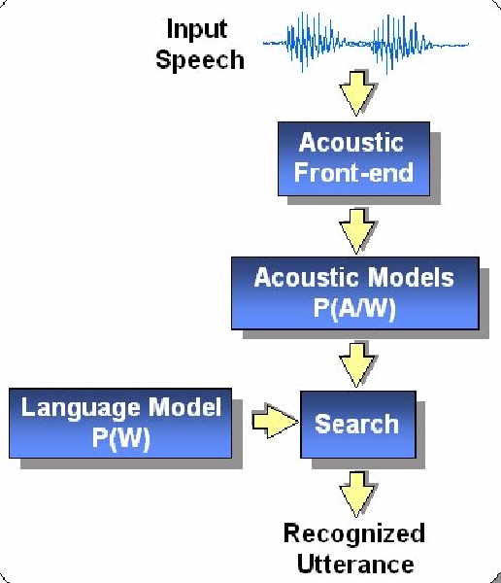
Traditional HMM-based Speech Recognition System
Hidden Markov Models with Gaussian Mixture Models (GMMs) to model state output distributions
Bayesian model based approach for speech recognition system

Slide 5
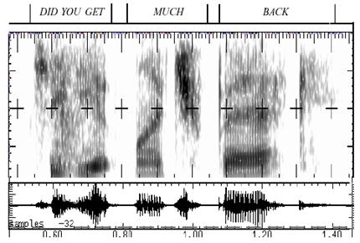
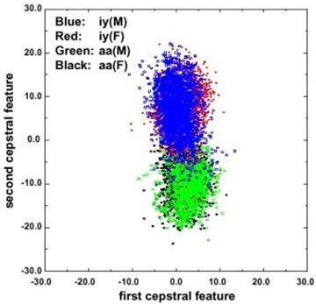
Difficulties of Speech Recognition
Segmentation problem: the begin and end times of units are unknown.
Poor articulation: speakers often delete or poorly articulate sounds when speaking casually.
Ambiguous features: ambiguous speech features lead to high error rates, based solely on feature measurements.
"Did you get" are significantly reduced as “jyuge”
Overlap in the feature space

Slide 6

Nonlinearity: a phased-locked loop and a strange attractor
A phased-locked loop (PPL) is a nonlinear device that is robust to unexplained variations in the input signal.
Over time it synchronizes with the input signal without the need for extensive offline training.
A strange attractor is a set of points or region which bounds the long-term, or steady-state behavior of a chaotic system.
Systems can have multiple strange attractors, and the initial conditions determine which strange attractor is reached

Slide 7
Reconstructed phase space (RPS) to represent a nonlinear system
A nonlinear system can be represented by its phase space which defines every possible state of the system.
Using embedding, we can reconstruct a phase space from the time series. Letting {x_{i}} represent the time series, the reconstructed phase space (RPS) is represented as:

Slide 8
Nonlinear Dynamic Invariants as Speech Features
Three nonlinear dynamic invariants are considered to characterize system's phase space:
Lyapunov Exponent (LE):
Correlation Dimension (CD):
Correlation Entropy (CE):

Slide 9
Phoneme Classification Experiments
Phonetic classification experiments are used to assess the extent to which dynamic invariants are able to represent speech.
Each dynamic invariant is combined with traditional MFCC features to produce three new feature vectors.
Experimental setup:
- Wall Street Journal derived Aurora-4 large vocabulary evaluation corpus with 5,000 word vocabulary.
- The training set consists of 7,138 utterances from 83 speakers totaling 14 hours of speech.
- Using time-alignments of the training data, a 16-mixture GMM is trained for each of the 40 phonemes.
- Signal frames of the training data are then each classified as one of the phonemes.

Slide 10
Phoneme Classification Experiments
Results:
Average relative phoneme classification improvements using MFCC/Invariant combination.
 | Correlation Dimension | Lyapunov Exponent | Correlation Entropy
Affricates | 10.3% | 2.9% | 3.9%
Stops | 3.6% | 4.5% | 4.2%
Fricatives | -2.2% | -0.6% | -1.1%
Nasals | -1.5% | 1.9% | 0.2%
Glides | -0.7% | -0.1% | 0.2%
Vowels | 0.4% | 0.4% | 1.1%
Conclusions:
- Each new feature vector resulted in an overall increase in classification accuracy.
- The results suggest that improvements can be expected for larger scale speech recognition experiments.

Slide 11
Continuous Speech Recognition Experiments
Baseline System
  Adapted from previous Aurora Evaluation Experiments
  Uses 39 dimension MFCC features
  Uses state-tied 4-mixture cross-word triphone acoustic models
  Model parameter estimation achieved using Baum-Welch algorithm
  Viterbi beam search used for evaluations
Four different feature combinations were used for these evaluations and compared to the baseline:
Feature Set 1 (FS1) |  | Feature Set 2 (FS2)
MFCCs (39) |  | MFCCs (39)
Correlation Dimension (1) |  | Lyapunov Exponent (1)
40 Dimensions Total |  | 40 Dimensions Total
Feature Set 3 (FS3) |  | Feature Set 4 (FS4)
MFCCs (39) |  | MFCCs (39)
Correlation Entropy (1) |  | Correlation Dimension (1)
 |  | Lyapunov Exponent (1)
 |  | Correlation Entropy (1)
40 Dimensions Total |  | 42 Dimensions Total
Notes:
This slide seems really boring

Slide 12
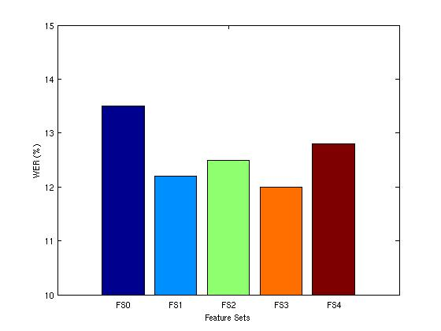
Results for Clean Evaluation Sets
Each of the four feature sets resulted in a recognition accuracy increase for the clean evaluation set.
Dynamic Invariant | WER (%) | Improvement (%) | Significance Level (p)
Baseline (FS0) | 13.5 | -- | --
Feature Set 1 (FS1) | 12.2 | 9.6 | 0.030
Feature Set 2 (FS2) | 12.5 | 7.4 | 0.075
Feature Set 3 (FS3) | 12.0 | 11.1 | 0.001
Feature Set 4 (FS4) | 12.8 | 5.2 | 0.267
The improvement for FS3 was the only one found to be statistically significant with a relative improvement of 11% over the baseline system.

Slide 13
Results for Noisy Evaluation Sets
Most of the noisy evaluation sets resulted in a decrease in recognition accuracy.
 | Relative Improvements for Noisy Dataset (%)
 | Airport | Babble | Car | Restaurant | Street | Train
FS1 | -7.7 | -5.7 | -14.8 | -4.4 | -7.8 | -5.3
FS2 | -7.2 | -8.8 | -5.6 | -8.6 | -8.5 | -4.4
FS3 | 0.4 | -1.6 | -2.6 | 1.3 | -2.6 | 0.6
FS4 | -10.6 | -13.2 | -26.5 | -13.5 | -15.1 | -9.7
FS3 resulted in a slight improvement for a few of the evaluation sets, but these improvements are not statistically significant
The average relative performance decrease was around 7% for FS1 and FS2 and around 14% for FS4.
The performance degradations seem to contradict the theory that dynamic invariants are noise-robust.

Slide 14
Linear Dynamic Model
Linear Dynamic Model (LDM) is derived from a state space model. It incorporates frame to frame correlations in speech signals.
Kalman filter based model, “filter” characteristic of LDM has potential to improve noise robustness of speech recognition

Slide 15

Linear Dynamic Model
Equations for a Linear Dynamic Model
  Current state is only determined by previous state
  H, F are linear transform matrices
y_{t}: p-dimensional observation feature vectors
x_{t}: q-dimensional internal state vectors
H: observation transformation matrix
F: state evolution matrix
ɛ_{t}: white Gaussian noise
ƞ_{t}: white Gaussian noise

Slide 16
LDM for Phoneme Classification
Experimental design:
- Wall Street Journal derived Aurora-4 large vocabulary evaluation corpus with 5,000 word vocabulary.
- The training set consists of 7,138 utterances from 83 speakers totaling 14 hours of speech.
- Signal frames of the training data are then each classified as one of the phonemes.
Classification (% accuracy) results for the Aurora-4 large vocabulary corpus (the relative improvements are shown in parentheses).
Model | Clean Data | Noisy Data
HMM (4-mixt) | 46.9 (-) | 36.8 (-)
LDM | 49.2 (4.9%) | 39.2 (6.5%)
Conclusions:
- For noisy evaluation dataset, LDM generated a 6.5% relative increase in performance over a comparable HMM system.
- Hybrid LDM/HMM speech decoder is expected to increase noise robustness.

Slide 17
Nonlinear Mixture of Autoregressive (MixAR) Models
Directly addresses modeling of nonlinear and data-dependent dynamics. Relieves conventional speech and speaker recognition systems of the linearity assumption.
Can potentially increase performance with fewer parameters since it can incorporate the information in first and higher order linear derivatives, and even more.
An overview of the MixAR approach

Slide 18
Equations for MixAR model
  Each component has a mean and an AR prediction filter.
  The components are mixed with data-dependent weights (similar to a mixture of experts).
where,
ε_{i} : white Gaussian noise with
variace σ_{j}²
w.p.: with probability
a_{i,0} : component means
a_{i,j} : AR prediction filter
coefficients
W_{i} : gating weights, summing to 1
{w_{i}, g_{i}} : gating coefficients
Nonlinear Mixture of Autoregressive (MixAR) Models

Slide 19
Experimental design:
- NIST 2001 dev data.
- 60 enrollment speakers, about 2 min. each.
- 78 test utterances under different noise conditions, about 60 sec. each.
- Equal Error Rate (EER) as measure of performance (lower EER => better perf.)
Speaker recognition EER with MixAR and GMM as a function of #mix. (the numbers of parameters are shown in parentheses)
#mix. | GMM Static+∆+∆∆ | MixAR Static Only
2 | 23.1 (216) | 24.1 (120)
4 | 21.7 (432) | 19.2 (240)
8 | 20.5 (864) | 19.1 (480)
16 | 20.5 (1728) | 19.2 (960)
Conclusions:
- Efficiency: There is a 4x reduction in number of parameters with MixAR to achieve similar performance as a GMM.
- Improved Performance: There is a 10.6% relative reduction in EER with MixAR compared to the best GMM (this also validates our belief that speech has nonlinear dynamic information that conventional models fail to capture.)
MixAR for Speaker Recognition

Slide 20
Summary and Future Work
Conclusions:
Nonlinear dynamical invariants (LE, Kolmogorov entropy, and Correlation Dimension) resulted in relative improvement of 11% for noise-free data.
The Linear dynamic model (LDM) is a promising acoustic modeling technique for noise-robust speech recognition.
Nonlinear mixture of autoregressive (MixAR) models improved speaker recognition performance with 4x fewer parameters.
Future Work:
Investigate Bayesian parameter estimation and discriminative training algorithms for LDM and MixAR.
Further evaluate LDM and MixAR performance base on conversational speech corpus, such as Swithboard.

Slide 21
References
P. Maragos, A.G. Dimakis and I. Kokkinos, “Some Advances in Nonlinear Speech Modeling Using Modulations, Fractals, and Chaos,” in Proc. Int. Conf. on Digital Signal Processing (DSP-2002), Santorini, Greece, July 2002.
A.C. Lindgren, M.T. Johnson, and R.J. Povinelli, “Speech Recognition Using Reconstructed Phase Space Features,” in Proc. of the IEEE Int. Conf. on Acoustics, Speech and Signal Processing, pp. 60-63, April 2003.
A. Kumar, and S.K. Mullick, “Nonlinear Dynamical Analysis of Speech,” Journal of the Acoustical Society of America, vol. 100, no. 1, pp. 615-629, July 1996.
I. Kokkinos and P. Maragos, “Nonlinear Speech Analysis using Models for Chaotic Systems,” IEEE Transactions on Speech and Audio Processing, pp. 1098-1109, November 2005.
J.P. Eckmann and D. Ruelle, “Ergodic Theory of Chaos and Strange Attractors,” Reviews of Modern Physics, vol. 57, pp. 617-656, July 1985.
D. May, Nonlinear Dynamic Invariants For Continuous Speech Recognition, M.S. Thesis, Dept. of Elect. and Comp. Eng., Mississippi State University, May 2008.
J. Frankel and S. King, “Speech Recognition Using Linear Dynamic Models,” IEEE Trans. on Speech and Audio Proc., vol. 15, no. 1, pp. 246-256, January 2007.
Y. Ephraim, and W.J. Roberts, “Revisiting Autoregressive Hidden Markov Modeling of Speech Signals,” IEEE Signal Processing Letters, vol. 12, no. 2, pp. 166-169, February 2005.
C.S. Wong and W.K. Li, “On a Mixture Autoregressive Model,” Journal of the Royal Statistical Society, vol. 62, no. 1, pp. 95-115, February 2000.

Slide 22
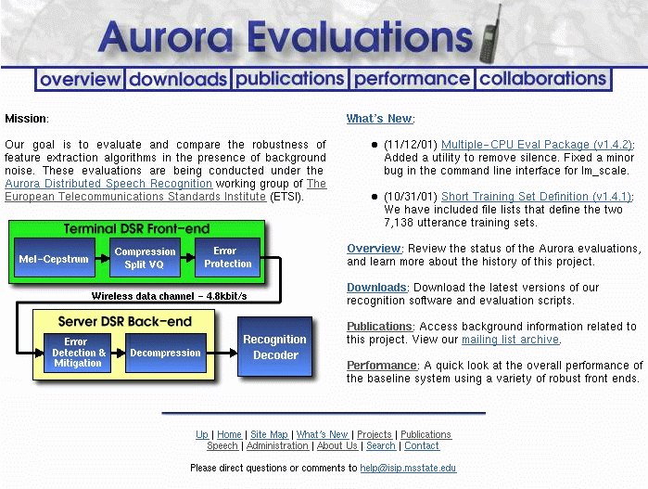
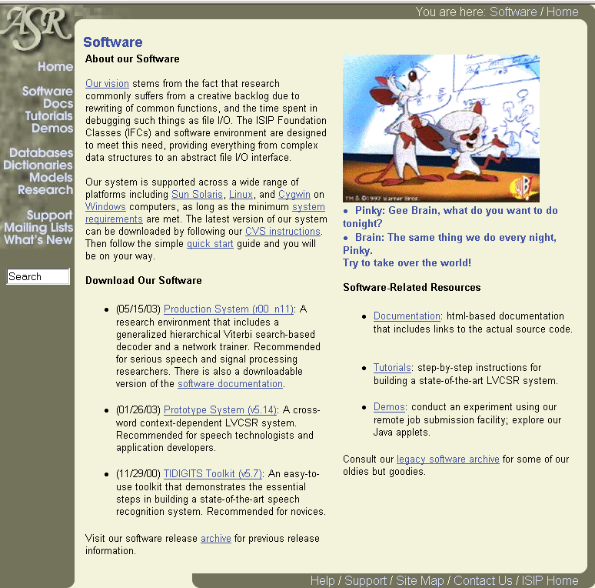
Available Resources
Aurora Project Website: recognition toolkit, multi-CPU scripts, database definitions, publications, and performance summary of the baseline MFCC front end
Speech Recognition Toolkits: compare front ends to standard approaches using a state of the art ASR toolkit

