Slide 1
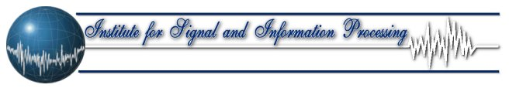
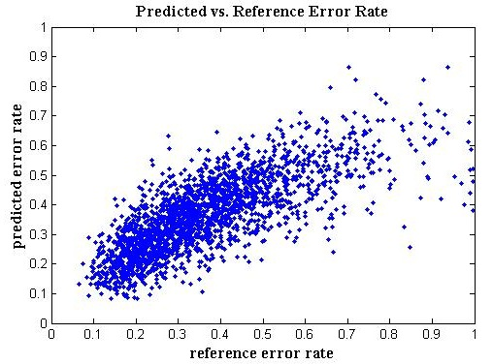
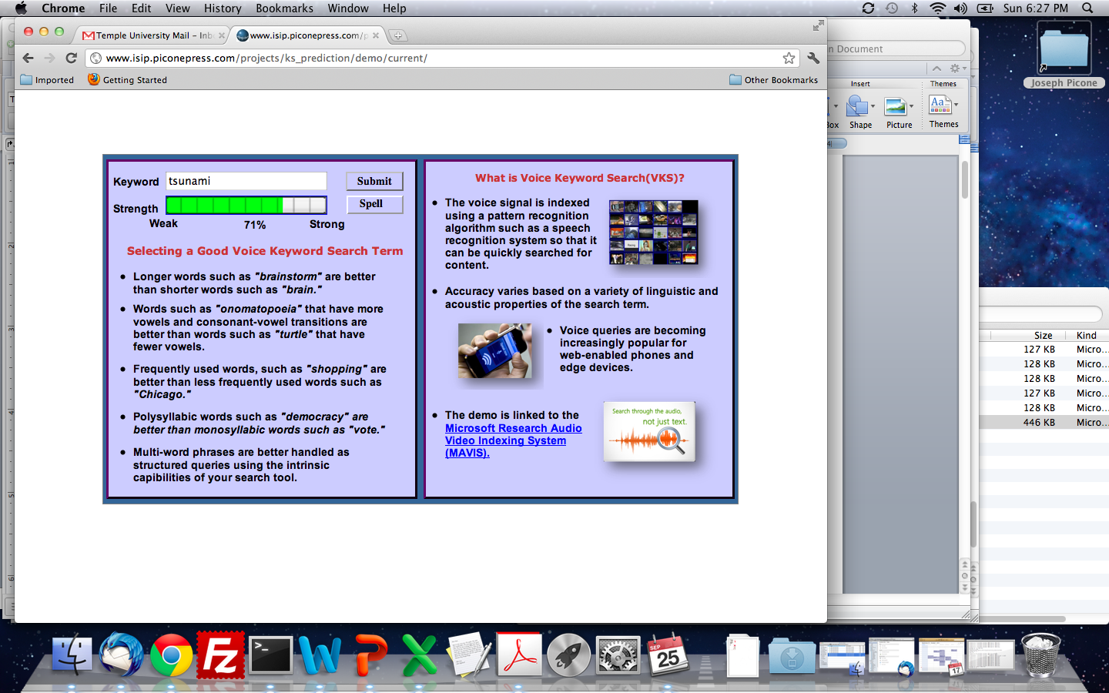
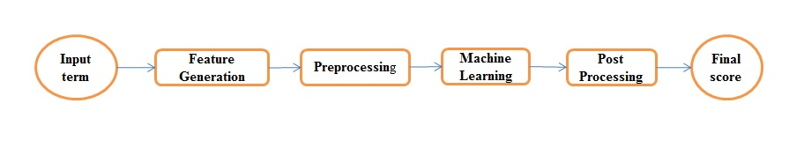
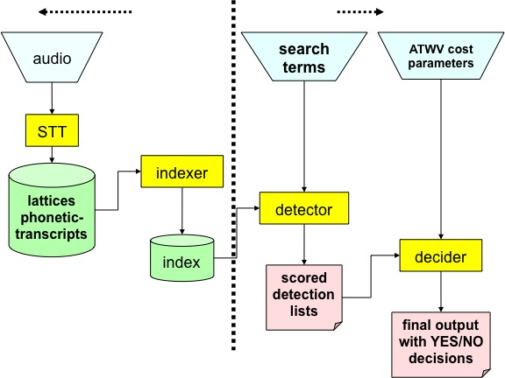
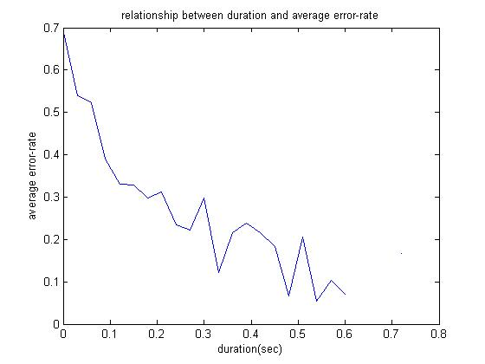
ASSESSING SEARCH TERM STRENGTH IN SPOKEN TERM DETECTION Amir Harati and Joseph Picone
Institute for Signal and Information Processing, Temple University
www.isip.piconepress.com
Introduction
Searching audio, unlike text data, is approximate and is based on likelihoods.
Performance depends on acoustic channel, speech rate, accent, language and confusability.
Unlike text-based searches, the quality of the search term plays a significant role in the overall perception of the usability of the system.
Goal: Develop a tool similar to how password checkers assess the strength of a password.
Core Features
Results
Duration Length No. of Syllables No. of Vowels No. of Consonants Phoneme Frequency BPC and CVC Frequency | Length/Duration No. Syllables/Duration No. Vowels/No. Consonants Start-End Phoneme 2-Grams of Phonemes 2-Grams of BPC 2- and 3-Grams of CVCs
Maximum correlation is
46%, which explains 21%
of the variance.
Many of the core features
are highly correlated.
KNN demonstrates the
most promising prediction
capability.
The data set is not balanced in that the number of data points with low error rate is much higher than the number of points with high error rates. This reduces predictor accuracy.
A significant portion of the
error rate is related to
factors beyond the
spelling of the search term,
such as speech rate.
Features | Train |  |  | Eval
 | Reg | NN | DT | Reg | NN | DT
Duration | 0.46 | 0.43 | 0.48 | 0.44 | 0.40 | 0.45
Duration + No. Syllables | 0.46 | 0.45 | 0.53 | 0.46 | 0.38 | 0.46
Duration + No. Consonants | 0.46 | 0.46 | 0.54 | 0.46 | 0.46 | 0.39
Duration + No. Syllables + No. Consonants | 0.46 | 0.43 | 0.60 | 0.46 | 0.37 | 0.41
Dur. + Length + No. Syllables /Dur. | 0.47 | 0.45 | 0.80 | 0.46 | 0.40 | 0.29
Dur. + # Consonants + CVC2 + Length/Dur. + #Syllables/Dur. | 0.47 | 0.48 | 0.83 | 0.45 | 0.42 | 0.34
Class | Phone
Stops (S) | b p d t g k
Fricative (F) | jh ch s sh z zh f th v dh hh
Nasals (N) | m n ng en
Liquids (L) | l el r w y
Vowels (V) | iy ih eh ey ae aa aw ay ah ao ax oy ow uh uw er
Figure 5. Correlation between the predicted and reference error rates.
K | Train | Eval
1 | 0.97 | 0.32
3 | 0.74 | 0.43
100 | 0.54 | 0.53
400 | 0.53 | 0.51
Word | tsunami
Phonemes | t s uh n aa m iy
Vowels | uh aa iy
Consonants | t s n m
Syllables | Tsoo nah mee
BPC | S F V N V N V
CVC | C C V C V C V
Table 1. The correlation between the hypothesis and the reference WERs for both training and evaluation subsets is shown. Duration is the single most important feature.
Figure 1. A screenshot of our demonstration software:
http://www.isip.piconepress.com/projects/ks_prediction/demo
Table 2. KNN’s predictions correlate well with reference WER.
Spoken Term Detection (STD)
STD Goal: “…detect the presence of a term in large audio corpus of heterogeneous speech…”
STD Phases:
        Indexing the audio file.
        Searching through the indexed data.
Error types:
        False alarms.
        Missed detections.
Machine Learning Algorithms
Machine learning algorithms used to learn the relationship between a phonetic representation of a word and its word error rate (WER).
The score is defined based on average WER predicted for a word:
        Strength Score = 1 − WER
Algorithms: Linear Regression, Feed-Forward Neural Network, Regression Tree and K-nearest neighbors (KNN) in the phonetic space.
Preprocessing includes whitening using singular value decomposition (SVD).
Two-layer, 30-neuron neural network that used back-propagation for training.
Experimentation
  Duration is the most significant feature with around 40% correlation.
Summary
The overall correlation between the predictions and the reference is not high, indicating that there are factors beyond the phonetic content of a search term that influence performance.
A serious limitation for the current work is the size and quality of the data set. Input from more word-based and phone-based systems is needed, as well as a much larger training set.
Despite these problems, the demonstration system provides useful feedback to users and can serve as a valuable training aid.
Future Work
The next NIST STD evaluation should provide significantly more data from a variety of application environments.
With more data, we can examine acoustic scoring-based metrics to move beyond word spelling as a predictor of performance.
Data Set | NIST Spoken Term Detection 2006 Evaluation Results
Sites | BBN | IBM | SRI
Sources | Broadcast News (3hrs) | Conversational Telephone (3 hrs) | Conference Meetings (2 hrs)
Figure 3. An overview of our approach to search term strength prediction that is based on decomposing terms into features.
Figure 2. A common approach in STD is to use a speech to text system to index the speech signal (J. G. Fiscus, et al., 2007).
Figure 4. The relationship between duration and error rate shows that longer words generally result in better performance.

