Slide 1
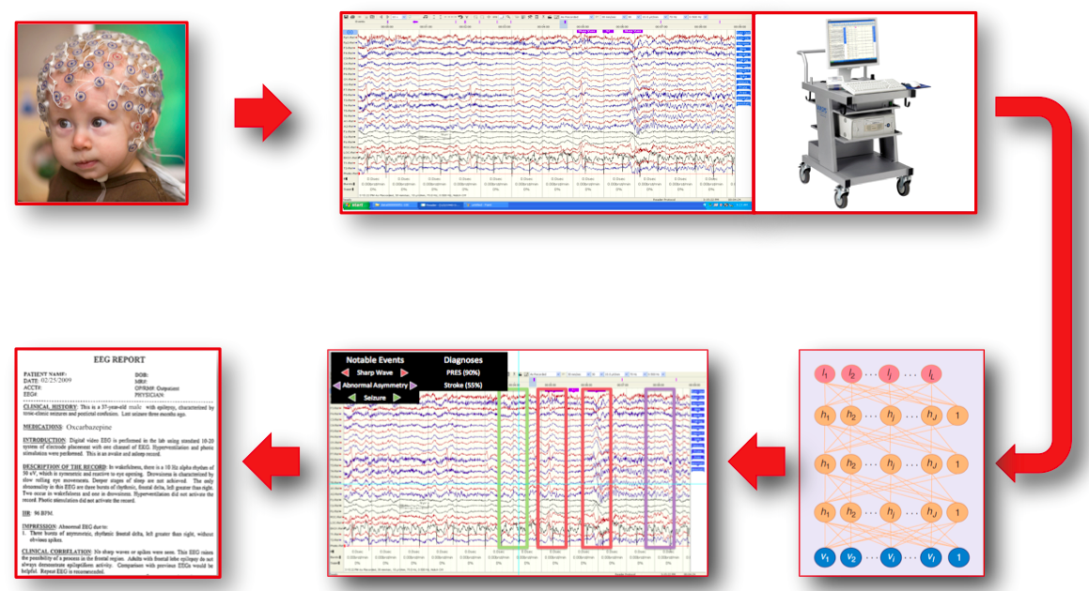
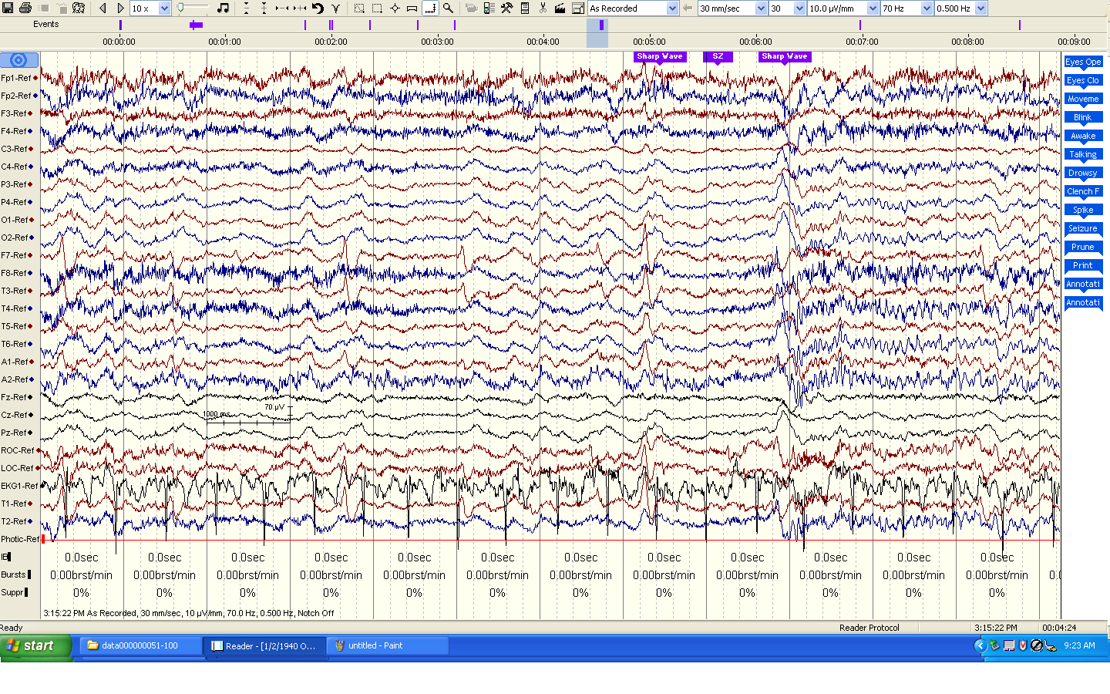
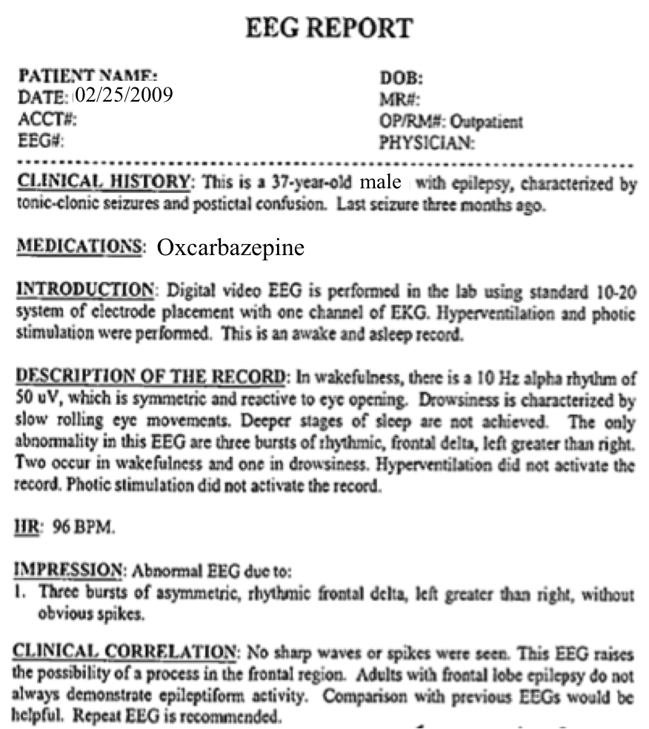
The Temple University Hospital EEG Corpus
A. Harati, S. Choi, M. Tabrizi, I. Obeid and J. Picone M. P. Jacobson, M.D.
The Neural Engineering Data Consortium, Temple University Department of Neurology, Temple University Hospital
www.nedcdata.org
Introduction
Largest and most comprehensive public-released corpus representing 11 years of clinical data collected at Temple University Hospital
Over 15,000 patients, 20,000+ sessions, 50,000+ EEGs
Include patient information (properly redacted), medical histories and physician assessments
Supports application of state of the art machine learning algorithms
Pilot experiments indicate the potential for substantial reductions in error rates as more data is processed
Error rates below 50% on a 12-way classification of events identified in EEG annotations
NEDC’s first publicly available corpus (1Q2014)
Automatic Interpretation of EEGs
Statistics
Preliminary Results
Classification of 12 EEG annotation markers
Field | Description | Example
1 | Version Number | 0
2 | Patient ID | TUH123456789
4 | Gender | M
6 | Date of Birth | 57
8 | Firstname_Lastname | TUH123456789
11 | Startdate | 01-MAY-2010
13 | Study Number/ Tech. ID | TUH123456789/TAS X
14 | Start Date | 01.05.10
15 | Start time | 11.39.35
16 | Number of Bytes in Header | 6400
17 | Type of Signal | EDF+C
19 | Number of Data Records | 207
20 | Dur. of a Data Record (Secs) | 1
21 | No. of Signals in a Record | 24
27 | Signal[1] Prefiltering | HP:1.000 Hz LP:70.0 Hz N:60.0
28 | Signal[1] No. Samples/Rec. | 250
Alg. | Setting | Closed |  | Open
 |  | Raw | Norm | Raw | Norm
kNN | K = 1 | 0.0% | 61.5% | 72.1% | 62.5%
kNN | K = 3 | 27.9% | 61.5% | 63.5% | 49.0%
kNN | K = 5 | 39.4% | 61.5% | 64.4% | 69.2%
NN | N = 5 | 49.0% | 70.2% | 51.9% | 75.0%
NN | N = 10 | 50.0% | 71.2% | 51.9% | 77.9%
NN | N = 15 | 49.0% | 78.9% | 50.0% | 76.0%
NN | N = 20 | 51.9% | 76.9% | 55.8% | 78.9%
RF | T = 1 | 19.2% | 54.8% | 62.5% | 60.6%
RF | T = 20 | 0.0% | 49.0% | 62.5% | 57.7%
RF | T = 50 | 0.0% | 56.7% | 61.5% | 55.8%
RF | T = 100 | 0.0% | 50.0% | 65.4% | 54.8%
Why Big Data is Crucial
Data-driven approaches have made enormous advances in recent years (e.g., hidden Markov models, deep learning).
But overall progress in the field does not appear to have been commensurate with the scope of investment.
A community-wide assessment, funded by a planning grant from the National Science Foundation, is being conducted to better define and prioritize the required resources needed by researchers to fuel innovation.
The existence of massive corpora has proven to substantially accelerate research progress by eliminating unsubstantiated research claims.
Field | Description | Example
3 | Gender | M (46%) F (54%)
4 | Age (Derived from DOB) | Min (20) Max (94) Avg (53) Stdev (19)
13,14 | Duration | 42 hours (17 mins./study)
15 | Number of Channels | 28 (26) 29 (12) 31 (48) 32 (19) 35 (5) 37 (33)
23 | Prefiltering | HP:0.000 Hz LP:0.0 Hz N:0.0
24 | Sample Frequency | 250 Hz (100) 256 Hz (43)
Summary and Future Work
The TUH-EEG Corpus will have a major impact on the development of clinical tools to automatically interpret EEGs.
Preliminary results using a leave-one-out cross-validation approach demonstrate the potential for large error reductions using big data.
Sequential decoding of the EEG using contemporary technology such as hidden Markov models will be crucial to identification and classification of events.
Visit www.nedcdata.org to learn more!
Funding Agencies
Research Question
PI
Data
Marker | Frequency
Eyes Open | 515
Eyes Closed | 355
Movement | 240
Swallow | 98
Awake | 61
Drowsy / Sleeping | 49
Hyperventilation | 40
Talking | 21
Money
Methods
Results
An Example EEG Report
Research Question
PI
Data
Money
Methods
Results
PI
Data
Numeric Label | Name
1 | Hyperventilation
2 | Movement
3 | Sleeping
4 | Cough
5 | Drowsy
6 | Talking
7 | Chew
8 | Seizure
9 | Swallow
10 | Spike
11 | Dizzy
12 | Twitch
Acknowledgements
DARPA/MTO (D13AP00065)
NSF (CNS-1305190)
Temple University College of Engineering
Temple University Office of Research
Research Question
Methods
Money
Results
Take the Survey!
Big data needs?
How could membership benefit you?

