Slide 1
Keynote Talks:
10:00 AM to 10:15 AM: Dr. Iyad Obeid, Bringing Big Data to Bioengineering
10:15 AM to 10:45 AM: Dr. Chris Cieri, Data Center Models and Impact on Scientific Research Communities
10:45 AM to 11:15 AM: Dr. Karen Moxon, Producing Large Sets of Neural Data With An Eye Towards Sharing
11:15 AM to 11:45 PM: Dr. Jack Judy, Government and Academic Needs for Big Data in Neural Engineering
11:45 AM to 12:00 PM: Dr. Iyad Obeid, Summary and Open Discussion
Poster Session:
13:30 PM to 15:30 PM: Poster Area E

Slide 2
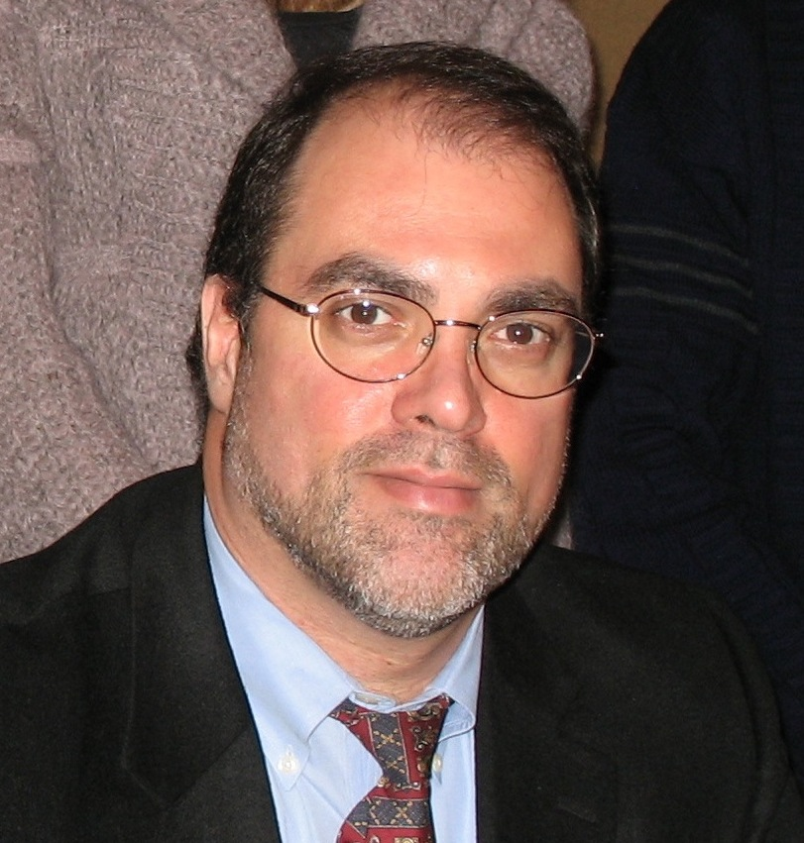
Speaker: Dr. Chris Cieri
Executive Director, The Linguistic Data Consortium
University of Pennsylvania
Title: Data Center Models and Impact on Scientific Research Communities
Biography: Christopher Cieri has been Executive Director of the Linguistic Data Consortium since January 1998, 15 of the organization’s 20 years. He holds BA, MA and PhD in Linguistics from the University of Pennsylvania where he focused on sociolinguistics and language contact in terms of phonetics, phonology and morphology as well as historical and educational linguistics. Cieri’s experience in data collection and research programming began in 1983 with his work for the Language Analysis Center at the University of Pennsylvania. Since joining the LDC, Cieri has developed its annotation activities and a ten-fold increase in accompanying funding. Today he oversees all aspects of LDC work including research and research administration, project planning, data collection, annotation, archiving distribution and outreach as well as the technical infrastructure that enables that work.

Slide 3
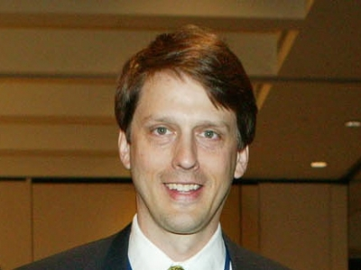
Speaker: Dr. Jack Judy
Professor and Director, NIMET
University of Florida
Title: Government and Academic Needs for Big Data in Neural Engineering
Biography: Dr. Jack Judy joined the Electrical and Computer Engineering Department at University of Florida in 2013, where he serves as the Intel Nanotechnology Endowed Chair and Director of the Nanoscience Institute for Medical and Engineering Technology (NIMET). Dr. Judy was formerly a program manager in the Microsystems Technology Office (MTO) of the Defense Advanced Research Projects Agency (DARPA). While at DARPA he managed the Reliable Neural-Interface Technology Program (RE-NET), which he created to address the fundamental and yet largely overlooked reliability problem of chronic neural-recording interfaces. Dr. Judy served at DARPA while on leave from his faculty position in the Electrical and Biomedical Engineering Departments at UCLA, where he also served as Director of the NeuroEngineering Program and the Nanoelectronics Research Facility.

Slide 4
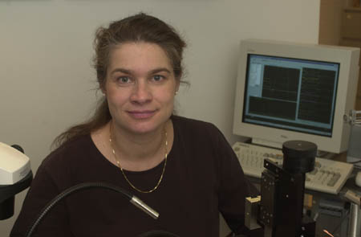
Speaker: Dr. Karen Moxon
Professor and Associate Director for Research
School of Biomedical Engineering, Drexel University
Title: Producing Large Sets of Neural Data With An Eye Towards Sharing
Biography: Dr. Karen A. Moxon is an engineer by training with over 20 years of experience in computational neuroscience developing models to study how the brain represents sensorimotor information. Her experience ranges from using reductionist Hodgkin-Huxley type models of small numbers of neurons to simple integrate and fire models of large networks of neurons. Using an information theoretic approach she developed novel models of how variability in neuronal responses provides information about the type of stimulus. Due in part to the complexity involved in acquiring data from others for model development, she directs the NeuroRobotics Lab that performs basic science experiments, recording from large populations of neurons to gain insight into information representation. She is also involved in developing platform technologies to improve neuronal recording, holding two patents.

