Slide 1
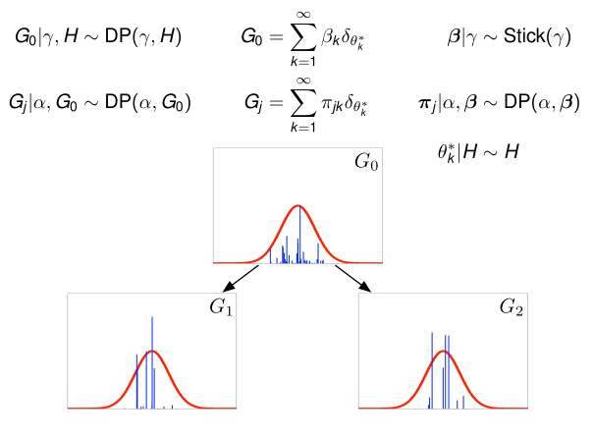
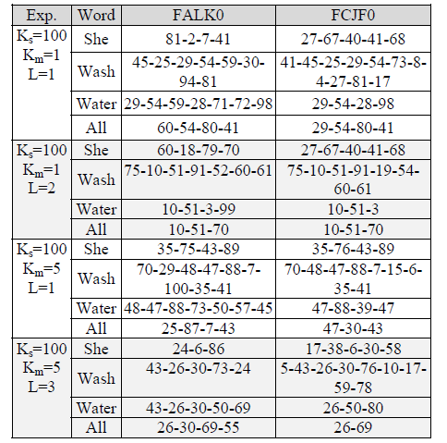
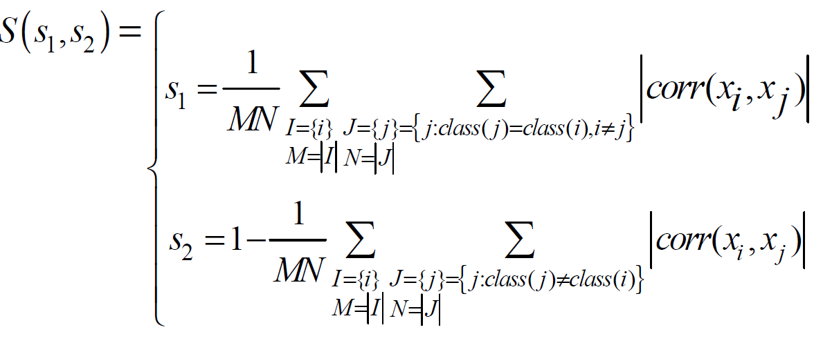
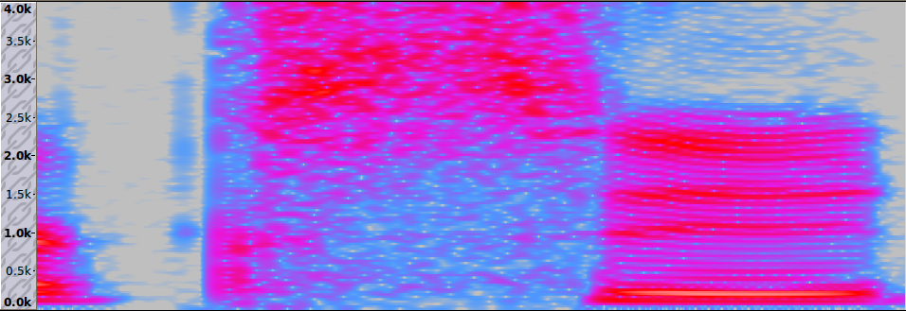
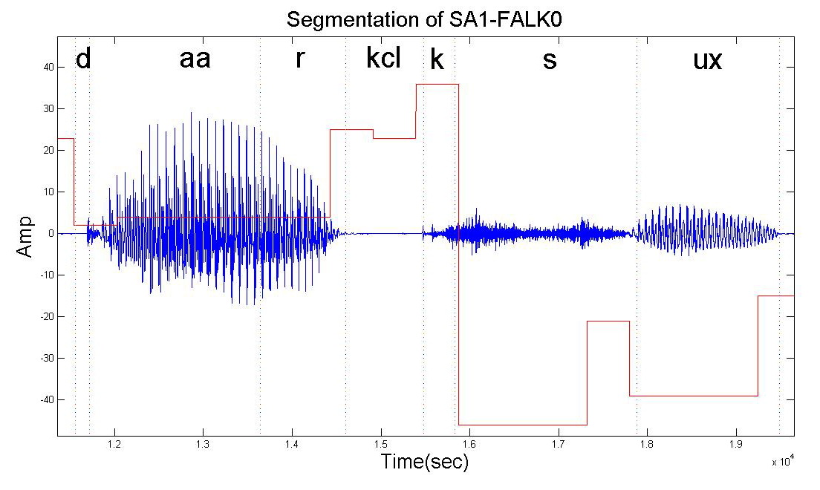
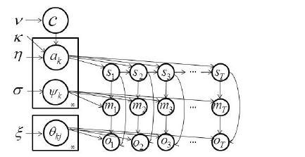
Speech Acoustic Unit Segmentation Using Hierarchical Dirichlet Processes
Amir Harati and Joseph Picone Marc Sobel
Institute for Signal and Information Processing, Temple University Department of Statistics, Temple University
www.isip.piconepress.com
Introduction
Context dependent models are traditionally used in state of the art speech recognition systems.
One alternative is to use automatically discovered acoustic units.
The process of finding new units consists of two steps: segmentation and clustering.
In this work, we present a nonparametric Bayesian approach based on HDP-HMM model to solve the segmentation problem.
The results show 11% improvement relative to other state of the art systems and 85% improvement for self-consistency of the segmentation.
The longer-term goal is to apply nonparametric Bayesian models to speech recognition.
Hierarchical Dirichlet Process (HDP)
A Dirichlet process (DP) is a discrete distribution that is composed of a weighted sum of impulse functions.
Weights for these atoms can be generated using a process referred to as stick breaking.
If we want a collection of DPs to share the same locations of atoms (but with different weights) the result is an Hierarchical DP (HDP).
Results
The TIMIT Corpus has been used for experimentation.
A standard 39-dimensional MFCC feature stream (12 MFCC coefficients plus energy and first and second derivatives) was computed using 10 ms frames.
Evaluation metrics:
Recall: Fraction of correctly declared boundaries relative to ground truth.
Precision: Fraction of declared boundaries that coincide with phoneme boundaries.
F-score: A single numeric score that represent the geometric mean of recall and precision.
The unsupervised HDP-HMM algorithm is 11% better than a supervised algorithm (Qiao et al.).
Define a similarity score:
Results
The similarity score, S, an indicator of consistency, has two main components: (1) s₁, the in-class score, is defined as the average over the correlation between different instances of segments with identical labels; (2) s₂ is a dissimilarity score.
Even when the number of discovered units is slightly smaller (33) than the manually-defined units (42), the in-class similarity score is much better.
A qualitative analysis of the discovered lexicon:
DP~1
Experiments | # units | Manual | HDP-HMM
K_{s}=100, K_{m}=1, L=1 | 70 | (0.44,0.72) | (0.82,073)
K_{s}=100, K_{m}=1, L=2 | 33 | (0.44,0.72) | (0.77,0.73)
K_{s}=100, K_{m}=1, L=3 | 23 | (0.44,0.72) | (0.75,0.72)
K_{s}=100, K_{m}=5, L=1 | 139 | (0.44,0.72) | (0.9,0.72)
K_{s}=100, K_{m}=5, L=2 | 73 | (0.44,0.72) | (0.87,0.72)
K_{s}=100, K_{m}=5, L=3 | 51 | (0.44,0.72) | (0.83,0.72)
θ₂
θ₁
θ₃
Algorithm | Recall | Prec. | F-score
Dusan & Rabiner (2006) | 75.2 | 66.8 | 70.8
Qiao et al. (2008) | 77.5 | 76.3 | 76.9
Lee & Glass (2012) | 76.2 | 76.4 | 76.3
HDP-HMM | 86.5 | 68.5 | 76.6
Speech Segmentation Problem
Goal is to decompose a continuous signal into a series of discrete events (e.g. words or phones).
Event detection traditionally uses a heuristic method based on changes in energy/spectrum.
In this work, events are derived automatically with no prior knowledge (e.g., linguistic constraints).
Hierarchical Dirichlet Process (HDP)
In an ergodic HMM, the number of states is fixed (e.g., an NxN matrix is used to represent the transition probabilities).
In an HDP-HMM, the number of states is unbounded, and we replace the transition vectors from each state with an HDP.
Future Work
We have used a DP mixture to model each unit. A better model is to use an HDP mixture to model each unit. This needs a new extension of HDP-HMM with HDPM emissions, which is under development.
Instead of using Gaussian mixtures for modeling the units, we can use arbitrary models (e.g. neural networks or HMMs).
The next step is to combine the current algorithm with a nonparametric clustering algorithm to complete the automatic discovery process.
The application of a nonparametric Bayesian model to acoustic modeling is not limited to speech segmentation. We have also developed a new type of HDP-HMM with a left-to-right structure that has been used to model individual units and phonemes.
Figure 1. Spectrogram of utterance SA1- FALK0 from TIMIT.
Approach
Each acoustic unit is modeled using a simple distribution (Gaussian mixture). Each utterance can be represented as concatenation of these units.
An HMM can be used to model the temporal relationships between units.
An HMM learns the segmentation automatically, but the number of units is unknown.
An HDP-HMM is used to learn these parameters with fewer constraints than a parametric HMM.
Each state models a unit. However, since the number of states is unbounded, the system learns the number of states in a data-driven fashion.
Figure 2. Segmentation of a speech utterance produced using the proposed algorithm is shown by overlaying the duration and index of each unit on the waveform. The height of each rectangle overlay simply indicates the index of that unit.
Figure 3. A graphical representation of an HDP-HMM is shown in which s_{t}, m_{t} and o_{t} represent state, mixture component and observation respectively.

