Slide 1
A Left-to-Right HDP-HMM
with HDPM Emissions
Amir Harati, Joseph Picone and Marc Sobel
Institute for Signal and Information Processing
Temple University
Philadelphia, Pennsylvania, USA

Slide 2
Abstract
Recently, nonparametric Bayesian (NPB) methods have become a popular alternative to Bayesian approaches. In such approaches, we do not fix the complexity a priori and place a prior over the complexity (or model structure).
The Hierarchical Dirichlet Process hidden Markov model (HDP-HMM) is the nonparametric Bayesian equivalent of an HMM. However, HDP-HMM is restricted to an ergodic topology and uses a Dirichlet Process Model (DPM) to achieve a mixture distribution-like model.
A new type of HDP-HMM is presented that preserves the useful left-to-right properties of a conventional HMM, yet still supports automated learning of the structure and complexity from data.
We also introduce HDP-HMM with HDPM emissions which allows a model to share data-points among different states.
This new model shows better likelihood relative to original HDP-HMM and it has much better scalability properties.

Slide 3
Outline
Nonparametric Bayesian Models
Nonparametric Hidden Markov Models
Acoustic Modeling in Speech Recognition
Left-to-Right HDP-HMM Models
HDP HMM with HDP Emissions
Results
Summary of Contributions

Slide 4
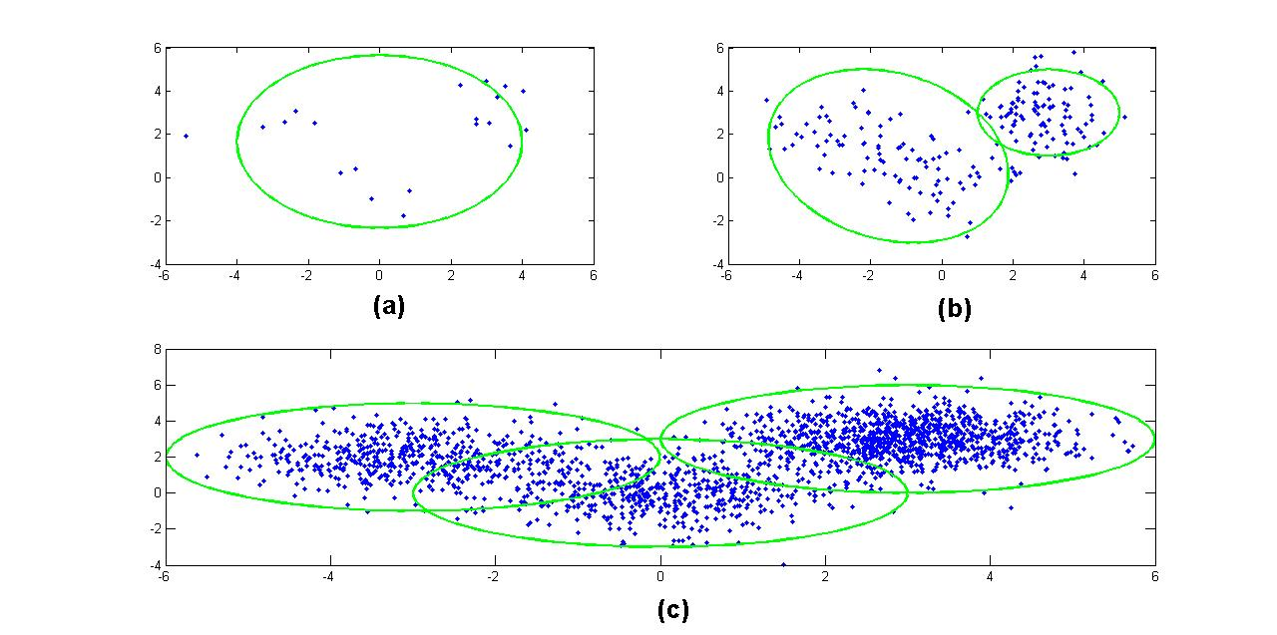
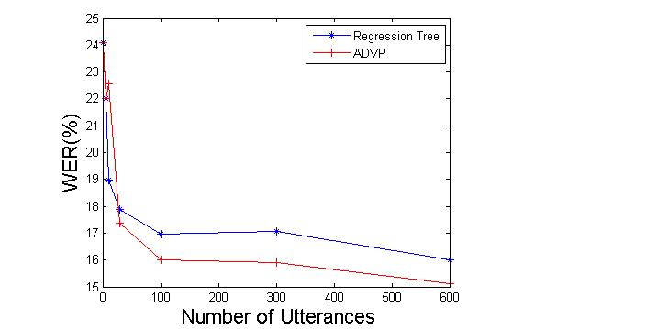
Nonparametric Bayesian
Parametric vs. Nonparametric
Model Selection/Averaging:
Computational Cost
Discrete Optimization
Criteria
Nonparametric Bayesian Promises:
Inferring the model from the data
Immunity to over-fitting
Well defined mathematical framework

Slide 5
Dirichlet Distribution
Functional form:
q ϵ ℝ^{k}: a probability mass function (pmf).
α: a concentration parameter.
α can be interpreted as pseudo-observations.
The total number of pseudo-observations is α₀.
The Dirichlet Distribution is a conjugate prior for a multinomial distribution.

Slide 6
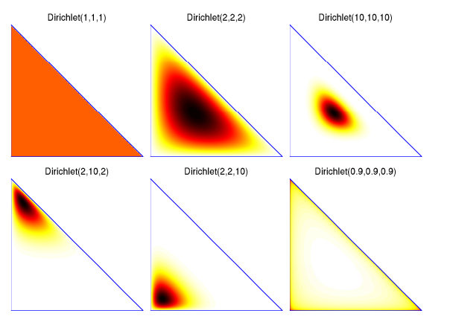
Dirichlet Distribution

Slide 7
Dirichlet Process (DP)
A Dirichlet Process is a Dirichlet distribution split infinitely many times
DP is a discrete distribution with infinite number of atoms.
q₂₂
q₂
q₂₁
q₁₁
q₁
q₁₂

Slide 8
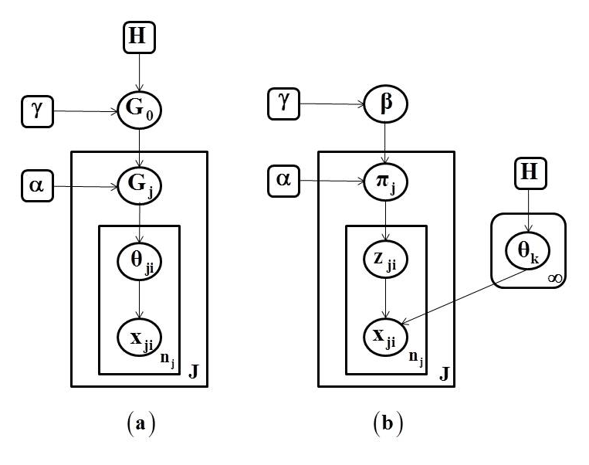
Hierarchical Dirichlet Process (HDP)
Grouped Data Clustering:
Consider data organized into several groups (e.g. documents).
DP can be used to define a mixture over each group.
However, each mixture would be independent of others.
Sometimes we want to share components among mixtures (e.g. to share topics among documents).
HDP:
a)
b)

Slide 9
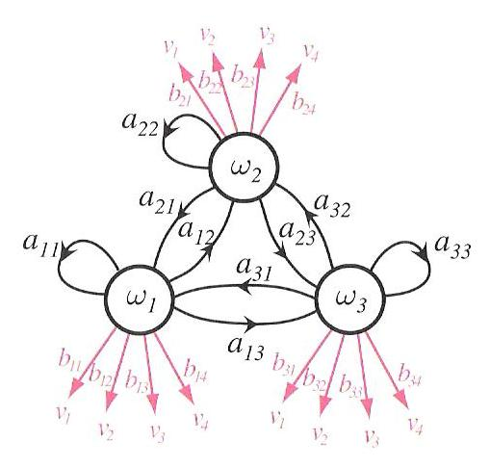
Hidden Markov Models (HMMs)
Markov Chain
A stochastic process with Markov property.
“states” are observed at each time and the probability of being at any state at time t+1 is a function of state at time t.
Hidden Markov Models
A Markov chain where “states” are not observed.
“observed sequence” is the output of probability distribution associated with each state.
A model is characterized by: 1- Number of states. 2-Transition probabilities between these states. 3-Parameters of the of the probability distribution for each state.
Properties
A parametric model.
Expectation-Maximization (EM) is used to “Learn” the model.

Slide 10
Hierarchical Dirichlet Process-Based HMM (HDP-HMM)
Definition:
Graphical Model:
Inference algorithms are used to infer the values of the latent variables (z_{t} and s_{t}).
A variation of the forward-backward procedure is used for training.
K_{z}: Maximum number of states.
K_{s}: Maximum number of components per mixture.
z_{t}, s_{t} and x_{t} represent a state, mixture component and observation respectively.

Slide 11
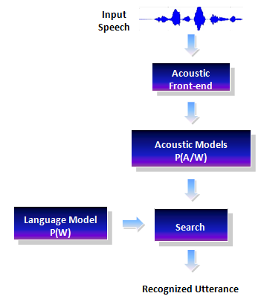
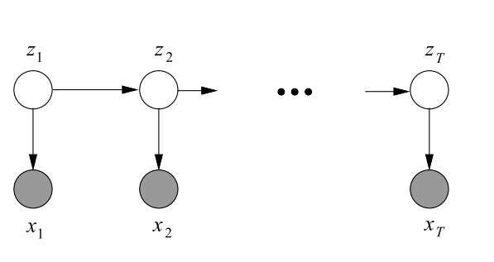
The Acoustic Modeling Problem in Speech Recognition
Goal of speech recognition is to map the acoustic data into word sequences:
In this formulation, P(W|A) is the probability of a particular word sequence given acoustic observations.
P(W) is the language model.
P(A) is the probability of the observed acoustic data and usually can be ignored.
P(A|W) is the acoustic model.

Slide 12
Left-to-Right HDP-HMM with HDP emission
Problem Statement:
In many pattern recognition applications involving temporal structure, such as speech processing, a left-to-right topology is preferred or sometimes required.
In speech recognition, all units usually use the same topology and the same number of mixtures; i.e. the complexity is fixed for all models.
Given more data, model’s structure will remain the same and only the estimation of the parameters (e.g. means and covariances) improves.
Different models have different amount of data but their complexity is the same. This means some models are over-trained and some under-trained.
Because of the lack of hierarchical structure, extending the model is heuristic. For example, there is no consensus about sharing data in gender specific modeling. Some prefer to train completely separate models for each group while others use different heuristic methods to share data.

Slide 13
Left-to-Right HDP-HMM With HDP Emission
Relevant Works:
Bourlard (1993) and others proposed to replace Gaussian mixture models (GMMs) with a neural network based on a multilayer perceptron (MLP).
It was shown that MLPs generate reasonable estimates of a posterior distribution of an output class conditioned on the input patterns.
This hybrid HMM-MLP system works slightly better than traditional HMM-GMMs, but the gain was not significant .
Another example of this approach is reported in (Lefèvre, 2003) and (Shang, 2009) where nonparametric density estimators (e.g. kernel methods) have been used to replace GMMs.
Henter et al. (2012) introduced a new model named a Gaussian process dynamical model (GPDM) to completely replace HMMs in acoustic modeling. This model is used only in speech synthesis and as of now lacks a corresponding recognition algorithm.
The above efforts can be classified as nonparametric non-Bayesian approaches.
Each of these approaches were proposed to model the emission distributions using a nonparametric method but they did not address the model topology problem.

Slide 14
Left-to-Right HDP-HMM With HDP Emission
LR-HDP-HMM with HDP Emission:
The proposed model address both topology and emission distribution modeling problems.
Based on well-defined HDP-HMM Model.
Three new features are introduced:
HDP-HMM is an ergodic model. We extend the definition to a left-to-right topology.
HDP-HMM uses DPM to model emissions for each state. Our model uses HDP to model the emissions. In this manner we allow components of emission distributions to be shared within a HMM. This is particularly important for left-to-right models where the number of discovered states is usually more than an ergodic HMM. As a result we have fewer data points associated with each state.
Non-emitting “initial” and “final” states are included in the final definition.

Slide 15
Left-to-Right HDP-HMM With HDP Emission
LR HDP-HMM (cont.):
A new inference algorithm based on a block sampler has been derived.
The new model is more accurate and does not have some of the intrinsic problems of parametric HMMs (e.g. over-trained and under-trained models).
The hierarchical definition of the model within the Bayesian framework make it relatively easy to solve problems such as sharing data among related models (e.g. models of the same phoneme for different cluster of speakers).
we have shown that the computation time for HDP-HMM with HDP emissions is proportional to K_{s}, while for HDP-HMM with DPM emissions it is proportional to K_{s}*K_{z}.
This means HDP-HMM/HDPM is more scalable when increasing the maximum bound on complexity of a model.

Slide 16
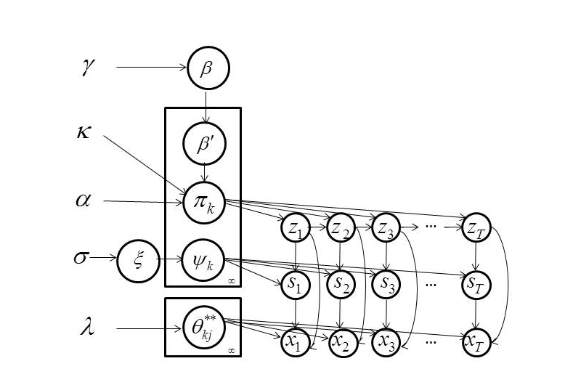
Left-to-Right HDP-HMM With HDP Emission
Definition:
Graphical Model

Slide 17
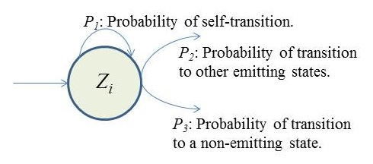
Left-to-Right HDP-HMM With HDP Emission
Adding none-emitting states:
Inference algorithm estimate the probability of self-transitions (P₁) and transition to other emitting states (P₂), but each state can also transit to a none-emitting state (P₃).
Since P₁+P₂+P₃ = 1 we can re-estimate P₁,P₃ by fixing P₂.
The Problem is similar to tossing a coin until obtaining a first head (geometric distribution).
We have shown that a maximum likelihood (ML) estimation cab be obtained using:
Where M is the number examples in which state i is the last state of the model (during the inference) and k_{i} is the number of self-transitions for state i.

Slide 18
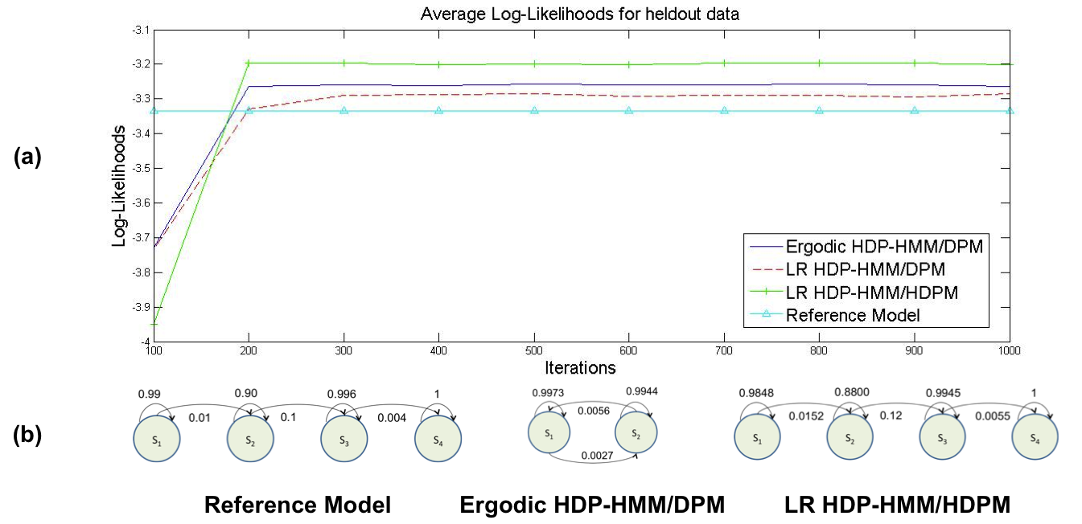
Results
Toy problem:
4-state LR-HMM.
The emission distribution for each state is a GMM with up to three components.

Slide 19
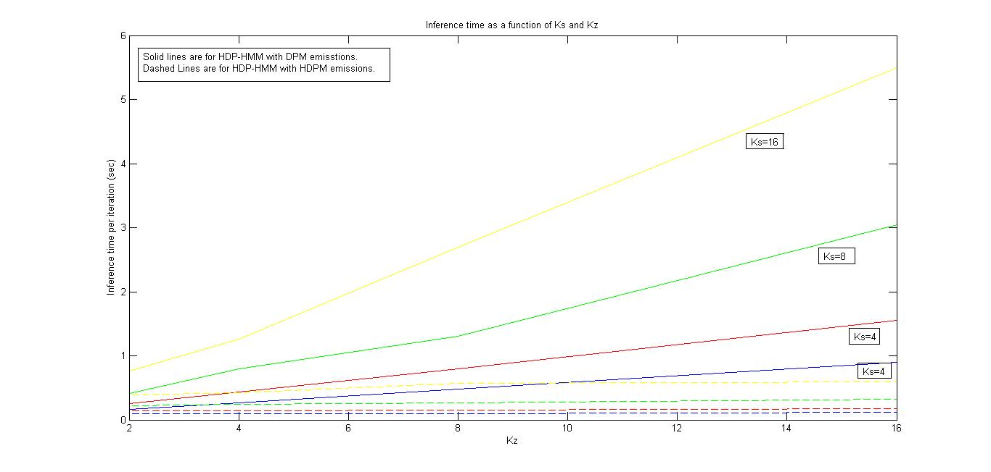
Results
HDP-HMM/DPM computation time is proportional to K_{s} * K_{z}.
HDP-HMM/HDPM inference time is proportional to K_{s}.
Since at each iteration, for HDP-HMM/DPM model, there are K_{s}*K_{z} log-likelihoods to be computed but for HDP-HMM/HDPM model , the mixture components are shared among all states so the actual number of computations is almost proportional to K_{s}.

Slide 20
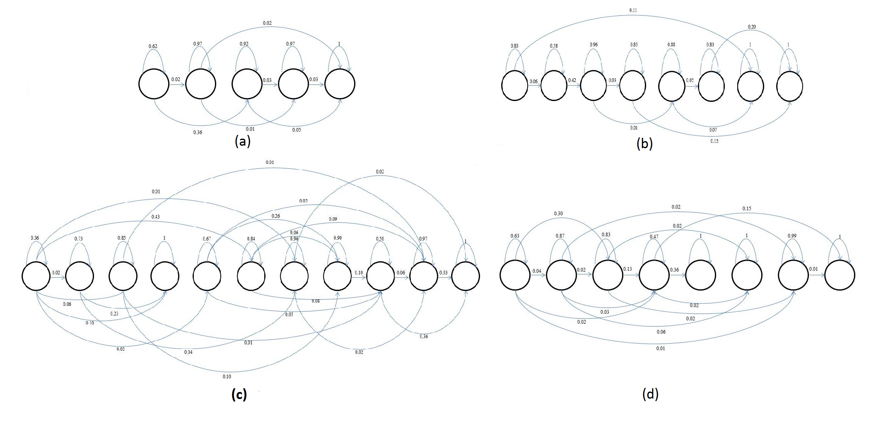
Results
An automatically derived model structure (without the first and last non-emitting states) for:
/aa/ with 175 examples
/sh/ with 100 examples
/aa/ with 2256 examples
/sh/ with 1317 examples using left-to-right HDP-HMM model.
The data used in this illustration was extracted from the training portion of the TIMIT Corpus.
A Comparison of Classification Error Rates
Model | Error Rate
HMM/GMM (10 components) | 27.8%
LR-HDP-HMM/GMM (1 component) | 26.7%
LR-HDP-HMM | 24.1%

Slide 21
Summary of Contributions
contributions:
Introducing left-to-right HDP-HMMs with HDP emissions and a corresponding inference algorithm.
Showing that HDP emissions can replace DPM emissions in most applications (for both LR and ergodic models) without losing performance while the scalability of model improves significantly.
We have also shown that LR HDP-HMM models can learn multi modality in data. For example, for a single phoneme, LR HDP-HMM can learn parallel paths corresponding to different type of speakers while at the same time we can share the data among states if HDPM emissions are used.

Slide 22
Reference
Bacchiani, M., & Ostendorf, M. (1999). Joint lexicon, acoustic unit inventory and model design. Speech Communication, 29(2-4), 99–114.
Bourlard, H., & Morgan, N. (1993). Connectionist Speech Recognition A Hybrid Approach. Springer.
Dusan, S., & Rabiner, L. (2006). On the relation between maximum spectral transition positions and phone boundaries. Proceedings of INTERSPEECH (pp. 1317–1320). Pittsburgh, Pennsylvania, USA.
Fox, E., Sudderth, E., Jordan, M., & Willsky, A. (2011). A Sticky HDP-HMM with Application to Speaker Diarization. The Annalas of Applied Statistics, 5(2A), 1020–1056.
Harati, A., Picone, J., & Sobel, M. (2012). Applications of Dirichlet Process Mixtures to Speaker Adaptation. Proceedings of the IEEE International Conference on Acoustics, Speech and Signal Processing (pp. 4321–4324). Kyoto, Japan.
Harati, A., Picone, J., & Sobel, M. (2013). Speech Segmentation Using Hierarchical Dirichlet Processes. Proceedings of the IEEE International Conference on Acoustics, Speech and Signal Processing (p. TBD). Vancouver, Canada.
Henter, G. E., Frean, M. R., & Kleijn, W. B. (2012). Gaussian process dynamical models for nonparametric speech representation and synthesis. IEEE International Conference on ASSP(pp. 4505– 4508). Kyoto, Japan.
Lee, C., & Glass, J. (2012). A Nonparametric Bayesian Approach to Acoustic Model Discovery. Proceedings of the Association for Computational Linguistics (pp. 40–49). Jeju, Republic of Korea.
Lefèvre, F. (n.d.). Non-parametric probability estimation for HMM-based automatic speech recognition. Computer Speech & Language, 17(2-3), 113–136.
Rabiner, L. (1989). A Tutorial on Hidden Markov Models and Selected Applications in Speech Recognition. Proceedings of the IEEE, 77(2), 879–893.
Sethuraman, J. (1994). A constructive definition of Dirichlet priors. Statistica Sinica, 639–650.
Shang, L. (n.d.). Nonparametric Discriminant HMM and Application to Facial Expression Recognition. IEEE Conference on Computer Vision and Pattern Recognition (pp. 2090– 2096). Miami, FL, USA.
Shin, W., Lee, B.-S., Lee, Y.-K., & Lee, J.-S. (2000). Speech/non-speech classification using multiple features for robust endpoint detection. proceedings of IEEE international Conference on ASSP (pp. 1899–1402). Istanbul, Turkey.
Suchard, M. A., Wang, Q., Chan, C., Frelinger, J., West, M., & Cron, A. (2010). Understanding GPU Programming for Statistical Computation: Studies in Massively Parallel Massive Mixtures. Journal of Computational and Graphical Statistics, 19(2), 419–438.
Teh, Y., Jordan, M., Beal, M., & Blei, D. (2006). Hierarchical Dirichlet Processes. Journal of the American Statistical Association, 101(47), 1566–1581.

