Slide 1
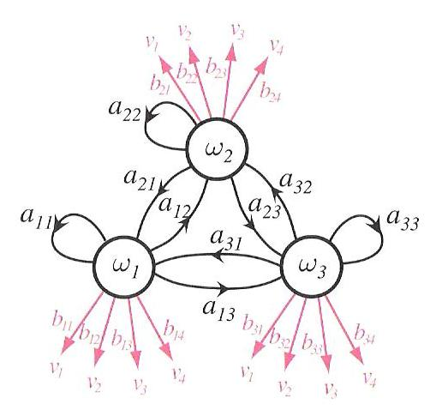
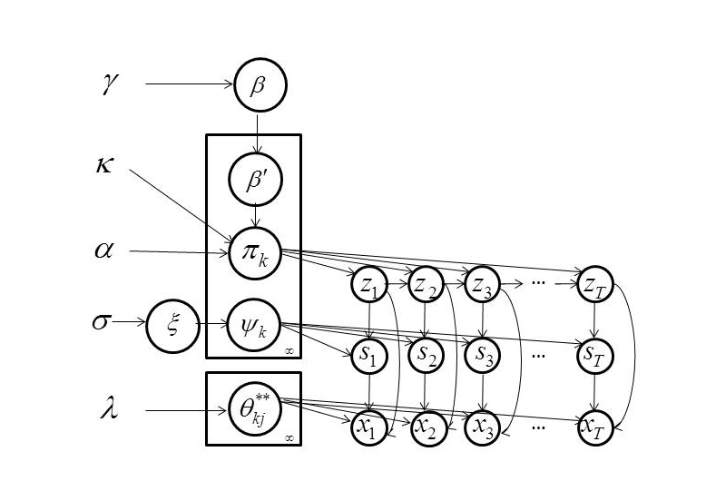
A Left-to-Right HDP-HMM with HDPM Emissions
Amir Harati, Joseph Picone and Marc Sobel
Institute for Signal and Information Processing
Temple University
Philadelphia, Pennsylvania, USA

Slide 2
Abstract
Nonparametric Bayesian (NPB) methods are a popular alternative to Bayesian approaches in which we place a prior over the complexity (or model structure).
The Hierarchical Dirichlet Process hidden Markov model (HDP-HMM) is the nonparametric Bayesian equivalent of an HMM.
HDP-HMM is restricted to an ergodic topology and uses a Dirichlet Process Model (DPM) to achieve a mixture distribution-like model.
A new type of HDP-HMM is introduced that:
preserves the useful left-to-right properties of a conventional HMM, yet still supports automated learning of the structure and complexity from data.
uses HDPM emissions which allows a model to share data-points among different states.
This new model produces better likelihoods relative to original HDP-HMM and has much better scalability properties.

Slide 3
Outline
Nonparametric Bayesian Models
Nonparametric Hidden Markov Models
Acoustic Modeling in Speech Recognition
Left-to-Right HDP-HMM Models
HDP HMM with HDP Emissions
Results
Summary of Contributions
You know my view that short talks should not have an outline, but if you feel comfortable with it, that is okay. I would think you have more important things to talk about.

Slide 4
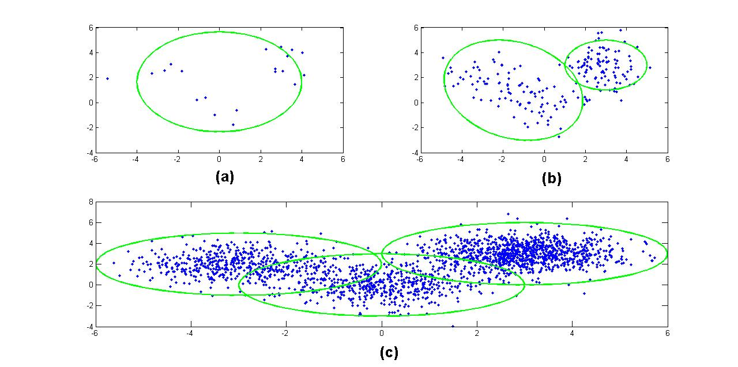
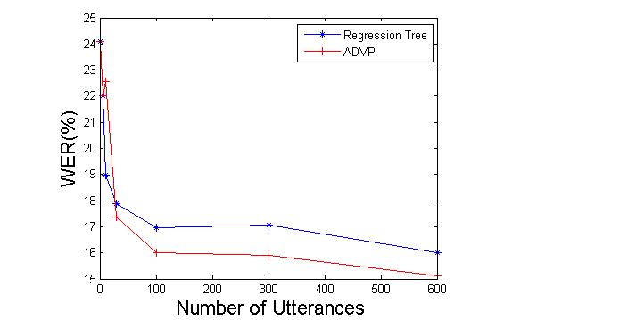
Nonparametric Bayesian Models
Parametric vs. Nonparametric
Model Selection / Averaging:
Computational Cost
Discrete Optimization
Criteria
Nonparametric Bayesian Promises:
Inferring the model from the data
Immunity to over-fitting
Well-defined mathematical framework
This slide covers a lot of important concepts – not sure exactly what you will say for this slide.

Slide 5
Dirichlet Distributions – Popular Prior For Bayesian Models
Functional form:
q ϵ ℝ^{k}: a probability mass function (pmf).
α: a concentration parameter.
α can be interpreted as pseudo-observations.
The total number of pseudo-observations is α₀.
The Dirichlet Distribution is a conjugate prior for a multinomial distribution.
The term pseudo-observations needs a definition.

Slide 6
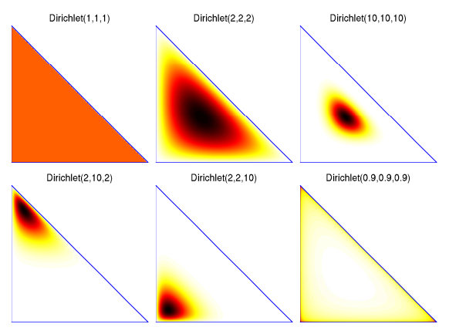
Dirichlet Distributions – What is the point here?
Not sure this slide is essential. What point are you trying to make with this? Might be useful to write out a few of those points.

Slide 7
Dirichlet Processes – Infinite Sequence of Random Variables?
a Dirichlet distribution split infinitely many times:
A discrete distribution with an infinite number of atoms.
q₂₂
q₂
q₂₁
q₁₁
q₁
q₁₂

Slide 8
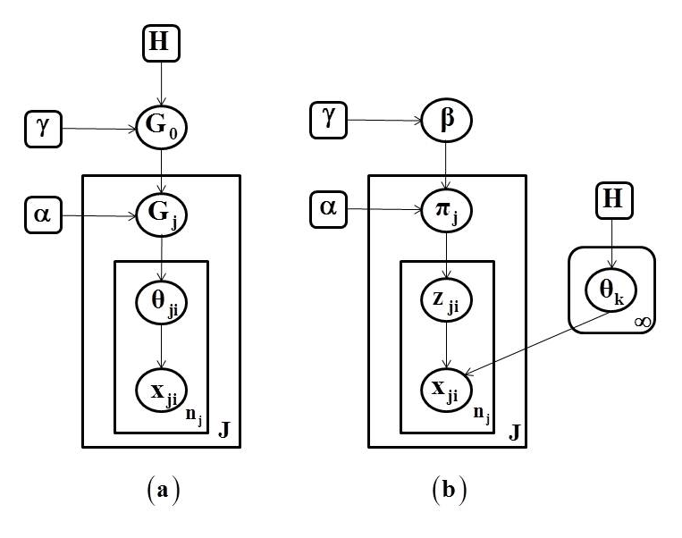
Hierarchical Dirichlet Process – Nonparametric Clustering
Grouped Data Clustering:
Consider data organized into several groups (e.g. documents).
A DP can be used to define a mixture over each group.
Each mixture is independent of the other distributions.
Sometimes we want to share components among mixtures (e.g. to share topics among documents).
Hierarchical Dirichlet Process (HDP):
a)
b)

Slide 9
Hidden Markov Models
Markov Chain
A memoryless stochastic process.
States are observed at each time, t.
The probability of being at any state at time t+1 is a function of the state at time t.
Put a visualization of a Markov chain here.
Hidden Markov Models (HMMs)
A Markov chain where states are not observed.
An observed sequence is the output of a probability distribution associated with each state.
A model is characterized by:
Number of states;
Transition probabilities between these states;
Emission probability distributions for each state.
Expectation-Maximization (EM) is used for training.

Slide 10
Hierarchical Dirichlet Process-Based HMM (HDP-HMM)
Definition:
Graphical Model:
Inference algorithms are used to infer the values of the latent variables (z_{t} and s_{t}).
A variation of the forward-backward procedure is used for training.
K_{z}: Maximum number of states.
K_{s}: Max. no. of components per mixture.
z_{t}, s_{t} and x_{t} represent a state, mixture component and observation respectively.

Slide 11
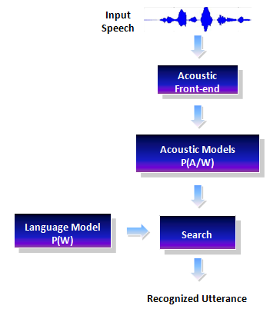
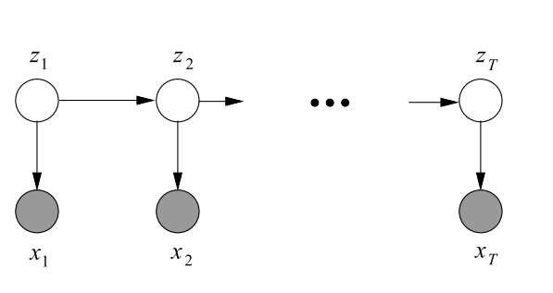
The Acoustic Modeling Problem in Speech Recognition
Goal of speech recognition is to map the acoustic data into word sequences:
P(W|A) is the probability of a particular word sequence given acoustic observations.
P(W) is the language model.
P(A) is the probability of the observed acoustic data and usually can be ignored.
P(A|W) is the acoustic model.

Slide 12
Left-to-Right HDP-HMM with HDP Emissions
In many pattern recognition applications involving temporal structure, such as speech recognition, a left-to-right topology is used to model the temporal order of the signal.
In speech recognition, all acoustic units use the same topology and the same number of mixtures; i.e., the complexity is fixed for all models.
Given more data, a model’s structure (e.g., the topology) will remain the same and only the parameter values change.
The amount of data associated with each model varies, which implies some models are overtrained while others are undertrained.
Because of the lack of hierarchical structure, techniques for extending the model tend to be heuristic.
Example: Gender-specific models are trained as separate models. A counter-example are decision trees.

Slide 13
Relevant Work
Bourlard (1993) and others proposed to replace Gaussian mixture models (GMMs) with a neural network based on a multilayer perceptron (MLP).
It was shown that MLPs generate reasonable estimates of a posterior distribution of an output class conditioned on the input patterns.
This hybrid HMM-MLP system produced small gains over traditional HMMs.
Lefèvre (2003) and Shang (2009) where nonparametric density estimators (e.g. kernel methods) replaced GMMs.
Henter et al. (2012) introduced a Gaussian process dynamical model (GPDM) for speech synthesis.
Each of these approaches were proposed to model the emission distributions using a nonparametric method but they did not address the model topology problem.

Slide 14
New Features
HDP-HMM is an ergodic model. We extend the definition to a left-to-right topology.
HDP-HMM uses DPM to model emissions for each state. Our model uses HDP to model the emissions. In this manner we allow components of emission distributions to be shared within a HMM. This is particularly important for left-to-right models where the number of discovered states is usually more than an ergodic HMM. As a result we have fewer data points associated with each state.
Non-emitting “initial” and “final” states are included in the final definition.
Too much text on this and the next slide…

Slide 15
Left-to-Right HDP-HMM With HDP Emission
LR HDP-HMM (cont.):
A new inference algorithm based on a block sampler has been derived.
The new model is more accurate and does not have some of the intrinsic problems of parametric HMMs (e.g. over-trained and under-trained models).
The hierarchical definition of the model within the Bayesian framework make it relatively easy to solve problems such as sharing data among related models (e.g. models of the same phoneme for different cluster of speakers).
we have shown that the computation time for HDP-HMM with HDP emissions is proportional to K_{s}, while for HDP-HMM with DPM emissions it is proportional to K_{s}*K_{z}.
This means HDP-HMM/HDPM is more scalable when increasing the maximum bound on complexity of a model.
These two slides should be condensed into something more visual.

Slide 16
Mathematical Definition
Definition:
Graphical Model

Slide 17
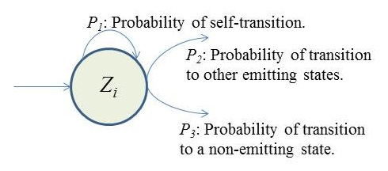
Non-emitting States
Inference algorithm estimates the probability of self-transitions (P₁) and transitions to other emitting states (P₂), but each state can also transit to a none-emitting state (P₃).
Since P₁ + P₂ + P₃ = 1 we can reestimate P₁, P₃ by fixing P₂.
Similar to tossing a coin until a first head is obtained (can be modeled as a geometric distribution).
A maximum likelihood (ML) estimation cab be obtained:
where M is the number examples in which state i is the last state of the model and k_{i} is the number of self-transitions for state i.

Slide 18
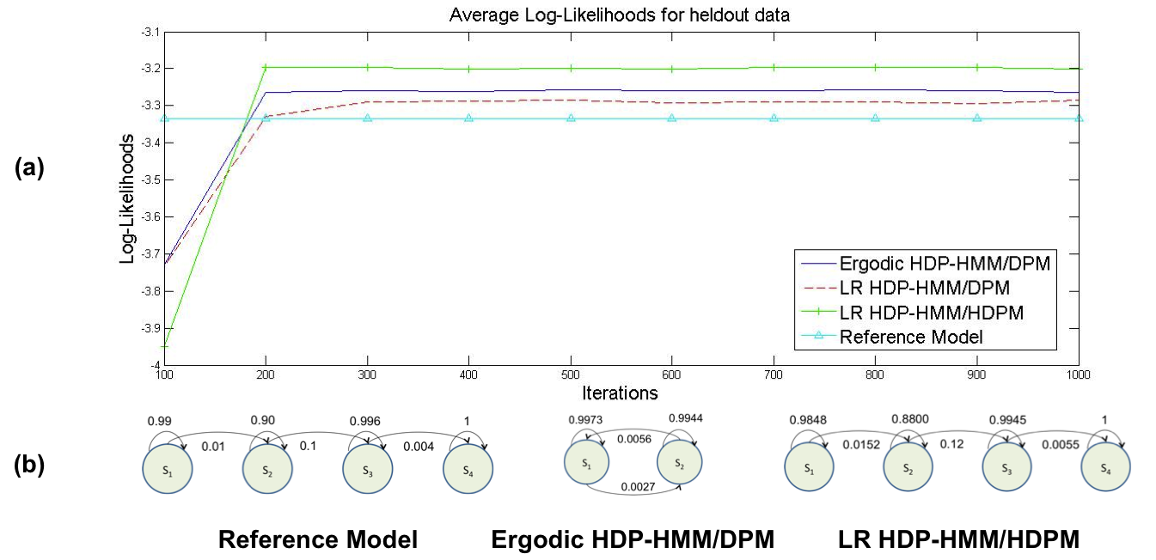
Results – Name this something profound
Describe the data briefly…
Describe the model briefly… (4-state LR-HMM, three-mixture GMMs)

Slide 19
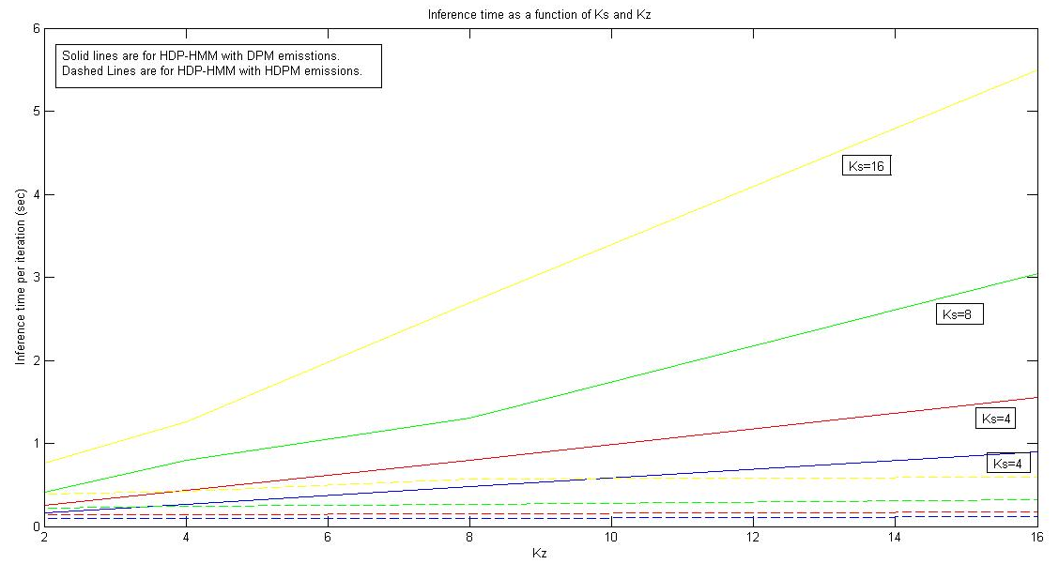
Results – Describe this…
HDP-HMM/DPM computation time is proportional to K_{s} * K_{z}.
HDP-HMM/HDPM inference time is proportional to K_{s}.
The mixture components are shared among all states so the actual number of computations is proportional to K_{s}.

Slide 20
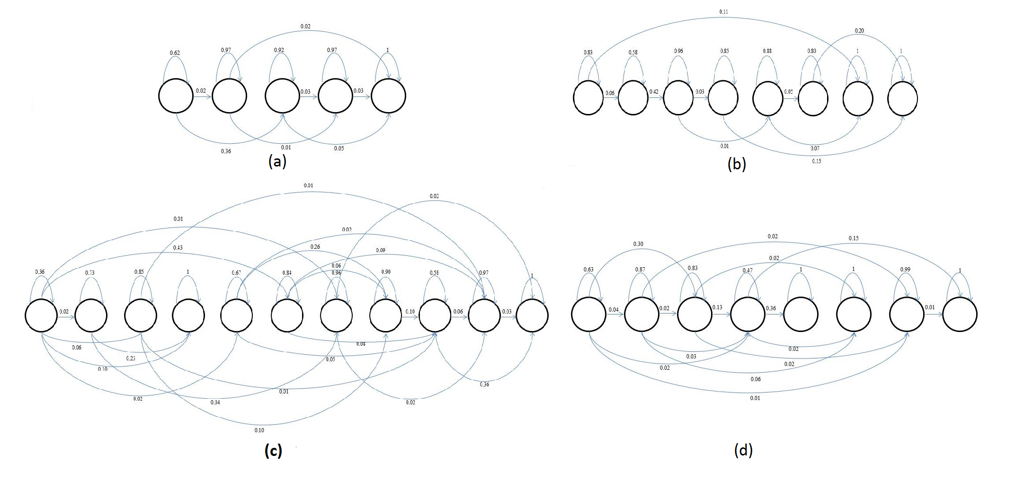
Results – More Description (make this two slides – it is important)
An automatically derived model structure (without the first and last non-emitting states) for:
/aa/ with 175 examples
/sh/ with 100 examples
/aa/ with 2256 examples
/sh/ with 1317 examples using left-to-right HDP-HMM model???.
The data used in this illustration was extracted from the training portion of the TIMIT Corpus.
A Comparison of Classification Error Rates
Model | Error Rate
HMM/GMM (10 components) | 27.8%
LR-HDP-HMM/GMM (1 component) | 26.7%
LR-HDP-HMM | 24.1%

Slide 21
Summary
Summarize your performance results:
Showing that HDP emissions can replace DPM emissions in most applications (for both LR and ergodic models) without losing performance while the scalability of model improves significantly.
We have also shown that LR HDP-HMM models can learn multi modality in data. For example, for a single phoneme, LR HDP-HMM can learn parallel paths corresponding to different type of speakers while at the same time we can share the data among states if HDPM emissions are used.
Xxx
Three theoretical contributions:
A left-to-right HDP-HMM with HDP emissions and a corresponding inference algorithm.
Say something about future work

Slide 22
References
Bacchiani, M., & Ostendorf, M. (1999). Joint lexicon, acoustic unit inventory and model design. Speech Communication, 29(2-4), 99–114.
Bourlard, H., & Morgan, N. (1993). Connectionist Speech Recognition A Hybrid Approach. Springer.
Dusan, S., & Rabiner, L. (2006). On the relation between maximum spectral transition positions and phone boundaries. Proceedings of INTERSPEECH (pp. 1317–1320). Pittsburgh, Pennsylvania, USA.
Fox, E., Sudderth, E., Jordan, M., & Willsky, A. (2011). A Sticky HDP-HMM with Application to Speaker Diarization. The Annalas of Applied Statistics, 5(2A), 1020–1056.
Harati, A., Picone, J., & Sobel, M. (2012). Applications of Dirichlet Process Mixtures to Speaker Adaptation. Proceedings of the IEEE International Conference on Acoustics, Speech and Signal Processing (pp. 4321–4324). Kyoto, Japan.
Harati, A., Picone, J., & Sobel, M. (2013). Speech Segmentation Using Hierarchical Dirichlet Processes. Proceedings of the IEEE International Conference on Acoustics, Speech and Signal Processing (p. TBD). Vancouver, Canada.
Henter, G. E., Frean, M. R., & Kleijn, W. B. (2012). Gaussian process dynamical models for nonparametric speech representation and synthesis. IEEE International Conference on ASSP(pp. 4505– 4508). Kyoto, Japan.
Lee, C., & Glass, J. (2012). A Nonparametric Bayesian Approach to Acoustic Model Discovery. Proceedings of the Association for Computational Linguistics (pp. 40–49). Jeju, Republic of Korea.
Lefèvre, F. (n.d.). Non-parametric probability estimation for HMM-based automatic speech recognition. Computer Speech & Language, 17(2-3), 113–136.
Rabiner, L. (1989). A Tutorial on Hidden Markov Models and Selected Applications in Speech Recognition. Proceedings of the IEEE, 77(2), 879–893.
Sethuraman, J. (1994). A constructive definition of Dirichlet priors. Statistica Sinica, 639–650.
Shang, L. (n.d.). Nonparametric Discriminant HMM and Application to Facial Expression Recognition. IEEE Conference on Computer Vision and Pattern Recognition (pp. 2090– 2096). Miami, FL, USA.
Shin, W., Lee, B.-S., Lee, Y.-K., & Lee, J.-S. (2000). Speech/non-speech classification using multiple features for robust endpoint detection. proceedings of IEEE international Conference on ASSP (pp. 1899–1402). Istanbul, Turkey.
Suchard, M. A., Wang, Q., Chan, C., Frelinger, J., West, M., & Cron, A. (2010). Understanding GPU Programming for Statistical Computation: Studies in Massively Parallel Massive Mixtures. Journal of Computational and Graphical Statistics, 19(2), 419–438.
Teh, Y., Jordan, M., Beal, M., & Blei, D. (2006). Hierarchical Dirichlet Processes. Journal of the American Statistical Association, 101(47), 1566–1581.
Condense this list

Slide 23
Biography
12345
Add a picture and a bio

