Slide 1
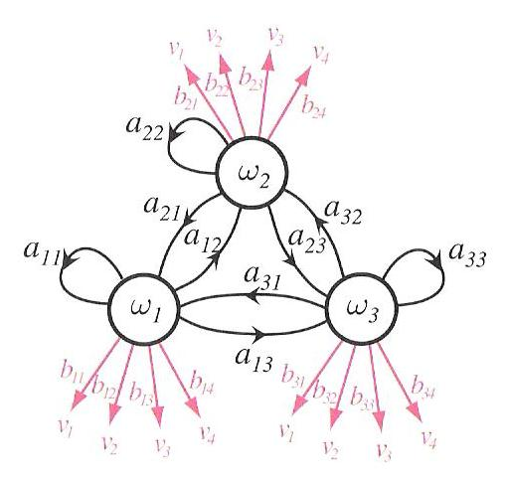
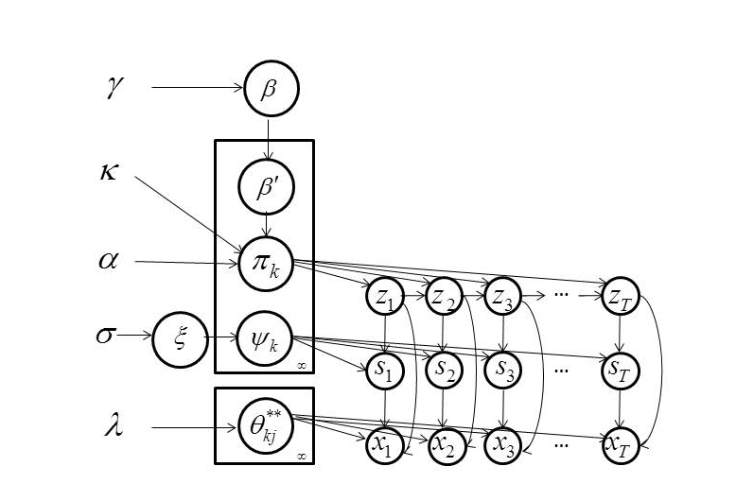
A Left-to-Right HDP-HMM with HDPM Emissions
Amir Harati, Joseph Picone and Marc Sobel
Institute for Signal and Information Processing
Temple University
Philadelphia, Pennsylvania, USA

Slide 2
Abstract
Nonparametric Bayesian (NPB) methods are a popular alternative to Bayesian approaches in which we place a prior over the complexity (or model structure).
The Hierarchical Dirichlet Process hidden Markov model (HDP-HMM) is the nonparametric Bayesian equivalent of an HMM.
HDP-HMM is restricted to an ergodic topology and uses a Dirichlet Process Model (DPM) to achieve a mixture distribution-like model.
A new type of HDP-HMM is introduced that:
preserves the useful left-to-right properties of a conventional HMM, yet still supports automated learning of the structure and complexity from data.
uses HDPM emissions which allows a model to share data-points among different states.
This new model produces better likelihoods relative to original HDP-HMM and has much better scalability properties.

Slide 3
Outline
Nonparametric Bayesian Models
Nonparametric Hidden Markov Models
Acoustic Modeling in Speech Recognition
Left-to-Right HDP-HMM Models
HDP HMM with HDP Emissions
Results
Summary of Contributions
You know my view that short talks should not have an outline, but if you feel comfortable with it, that is okay. I would think you have more important things to talk about.

Slide 4
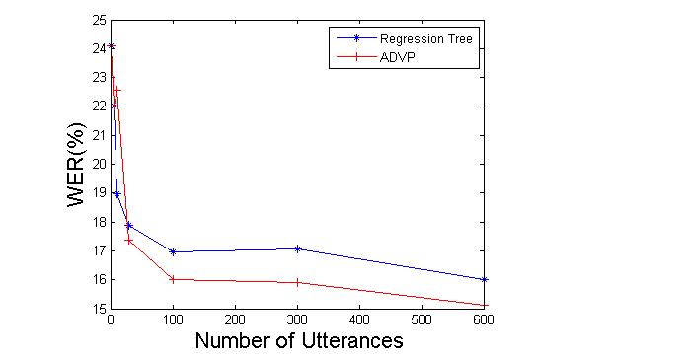
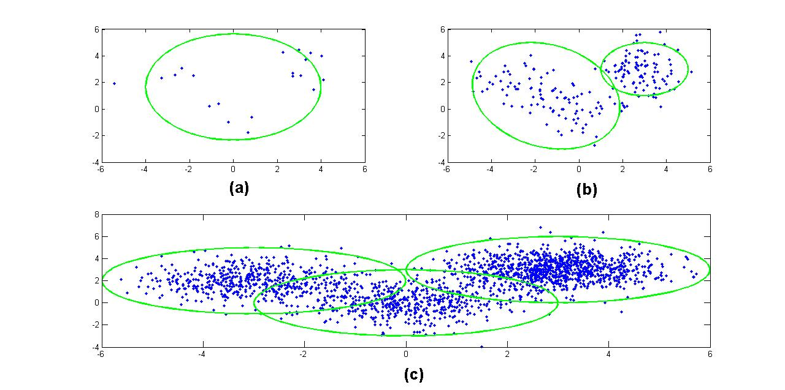
Nonparametric Bayesian Models
Parametric Bayesian:
1
2
3
Nonparametric Bayesian:
1
2
3
This slide covers a lot of important concepts – not sure exactly what you will say for this slide. amir I start by talking about why nonparametric Bayesian methods are desiarbale and what they promise and then give one example. I still think this slide needs work.

Slide 5
Dirichlet Distributions – Prior For Bayesian Models
Functional form:
q ϵ ℝ^{k}: a probability mass function (pmf).
α: a vector of concentration parameters.
{α} are pseudo-observations – counts added to an estimate of (in contrast to real observations pseudo-observations reflects our prior believes about the data) .
The total number of pseudo-observations is α₀.
The Dirichlet Distribution is a conjugate prior for a multinomial distribution.

Slide 6
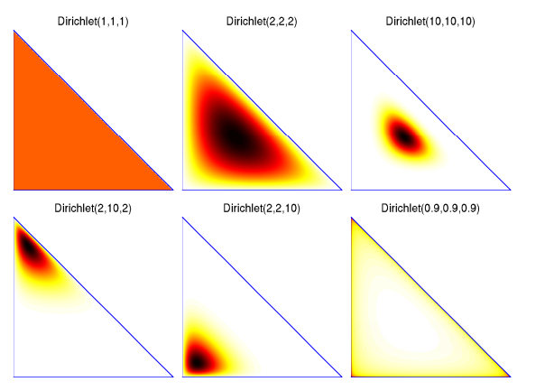
Dirichlet Distributions – What is the point here?
Not sure this slide is essential. What point are you trying to make with this? Might be useful to write out a few of those points. (to describe the pervious slide- What a Dirichlet means) Still needs work.

Slide 7
Dirichlet Processes – Infinite Sequence of Random Variables?
a Dirichlet distribution split infinitely many times:
A discrete distribution with an infinite number of atoms.
q₂₂
q₂
q₂₁
q₁₁
q₁
q₁₂

Slide 8
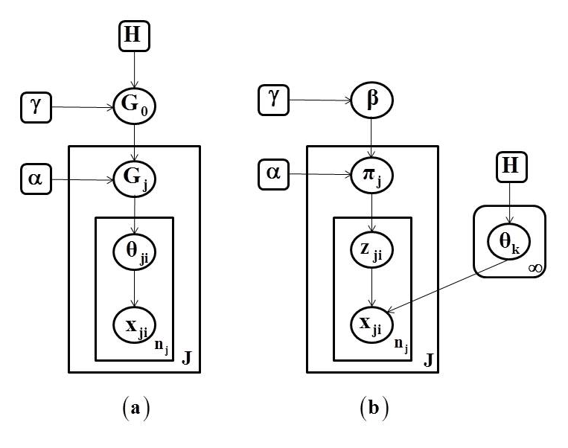
Hierarchical Dirichlet Process – Nonparametric Clustering
Grouped Data Clustering:
Consider data organized into several groups (e.g. documents).
A DP can be used to define a mixture over each group.
Each mixture is independent of the other distributions.
Sometimes we want to share components among mixtures (e.g. to share topics among documents).
Hierarchical Dirichlet Process (HDP):
a)
b)

Slide 9
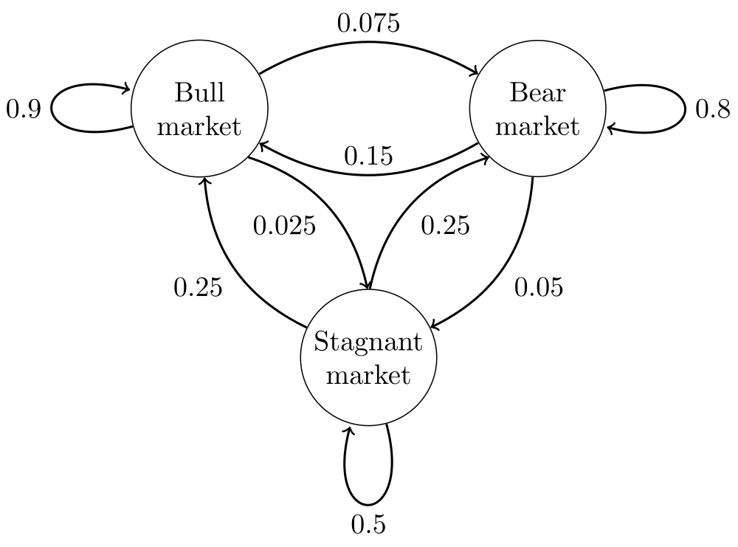
Hidden Markov Models
Markov Chain
A memoryless stochastic process.
States are observed at each time, t.
The probability of being at any state at time t+1 is a function of the state at time t.
Hidden Markov Models (HMMs)
A Markov chain where states are not observed.
An observed sequence is the output of a probability distribution associated with each state.
A model is characterized by:
number of states;
transition probabilities between these states;
emission probability distributions for each state.
Expectation-Maximization (EM) is used for training.

Slide 10
Hierarchical Dirichlet Process-Based HMM (HDP-HMM)
Definition:
Graphical Model:
Inference algorithms are used to infer the values of the latent variables (z_{t} and s_{t}).
A variation of the forward-backward procedure is used for training.
K_{z}: Maximum number of states.
K_{s}: Max. no. of components per mixture.
z_{t}, s_{t} and x_{t} represent a state, mixture component and observation respectively.

Slide 11
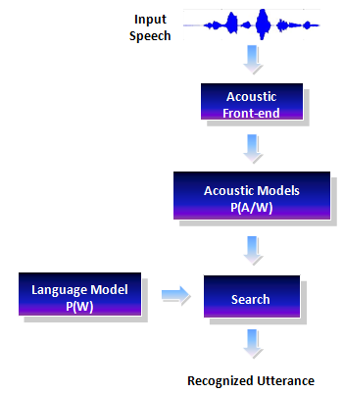
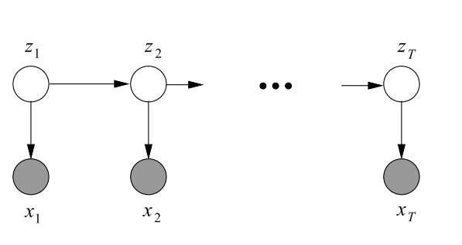
The Acoustic Modeling Problem in Speech Recognition
Goal of speech recognition is to map the acoustic data into word sequences:
P(W|A) is the probability of a particular word sequence given acoustic observations.
P(W) is the language model.
P(A) is the probability of the observed acoustic data and usually can be ignored.
P(A|W) is the acoustic model.

Slide 12
Left-to-Right HDP-HMM with HDP Emissions
In many pattern recognition applications involving temporal structure, such as speech recognition, a left-to-right topology is used to model the temporal order of the signal.
In speech recognition, all acoustic units use the same topology and the same number of mixtures; i.e., the complexity is fixed for all models.
Given more data, a model’s structure (e.g., the topology) will remain the same and only the parameter values change.
The amount of data associated with each model varies, which implies some models are overtrained while others are undertrained.
Because of the lack of hierarchical structure, techniques for extending the model tend to be heuristic.
Example: Gender-specific models are trained as separate models. A counter-example are decision trees.
What Do you mean by the "yellow" part? Decision trees provide a principled hierarchical structure for clustering

Slide 13
Relevant Work
Bourlard (1993) and others proposed to replace Gaussian mixture models (GMMs) with a neural network based on a multilayer perceptron (MLP).
It was shown that MLPs generate reasonable estimates of a posterior distribution of an output class conditioned on the input patterns.
This hybrid HMM-MLP system produced small gains over traditional HMMs.
Lefèvre (2003) and Shang (2009) where nonparametric density estimators (e.g. kernel methods) replaced GMMs.
Henter et al. (2012) introduced a Gaussian process dynamical model (GPDM) for speech synthesis.
Each of these approaches were proposed to model the emission distributions using a nonparametric method but they did not address the model topology problem.

Slide 14
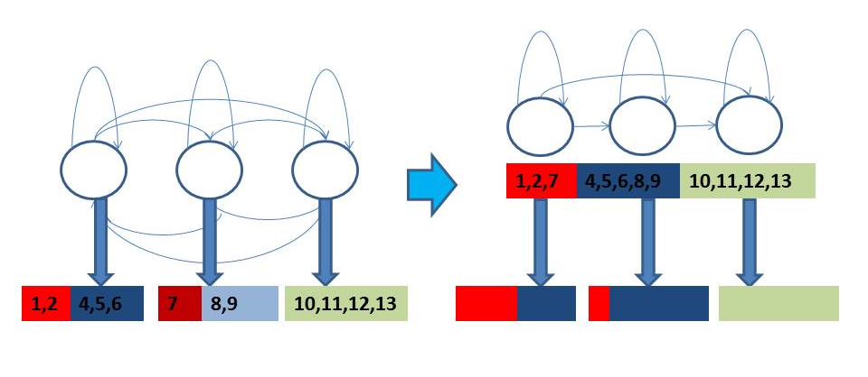
New Features
HDP-HMM is an ergodic model. We extend the definition to a left-to-right topology.
HDP-HMM uses DPM to model emissions for each state. Our model uses HDP to model the emissions. In this manner we allow components of emission distributions to be shared within a HMM. This is particularly important for left-to-right models where the number of discovered states is usually more than an ergodic HMM. As a result we have fewer data points associated with each state.
Non-emitting “initial” and “final” states are included in the final definition.
Too much text on this and the next slide… Done
Each color is a component , numbers represents data point
In the left you see an ergodic HMM with DPM emissions. In the right you see a LR HMM with HDPM emissions.
Note that total length of output boxes is always 1
Still too much text…

Slide 15
Left-to-Right HDP-HMM With HDP Emission
LR HDP-HMM (cont.):
A new inference algorithm based on a block sampler has been derived.
The new model is more accurate and does not have some of the intrinsic problems of parametric HMMs (e.g. over-trained and under-trained models).
The hierarchical definition of the model within the Bayesian framework make it relatively easy to solve problems such as sharing data among related models (e.g. models of the same phoneme for different cluster of speakers).
we have shown that the computation time for HDP-HMM with HDP emissions is proportional to K_{s}, while for HDP-HMM with DPM emissions it is proportional to K_{s}*K_{z}.
This means HDP-HMM/HDPM is more scalable when increasing the maximum bound on complexity of a model.
These two slides should be condensed into something more visual. I think the last image is enough this page can’t change.

Slide 16
Mathematical Definition
Definition:
Graphical Model

Slide 17
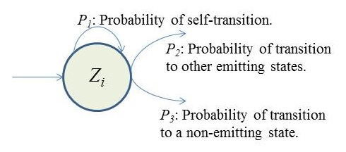
Non-emitting States
Inference algorithm estimates the probability of self-transitions (P₁) and transitions to other emitting states (P₂), but each state can also transit to a none-emitting state (P₃).
Since P₁ + P₂ + P₃ = 1 we can reestimate P₁, P₃ by fixing P₂.
Similar to tossing a coin until a first head is obtained (can be modeled as a geometric distribution).
A maximum likelihood (ML) estimation cab be obtained:
where M is the number examples in which state i is the last state of the model and k_{i} is the number of self-transitions for state i.

Slide 18
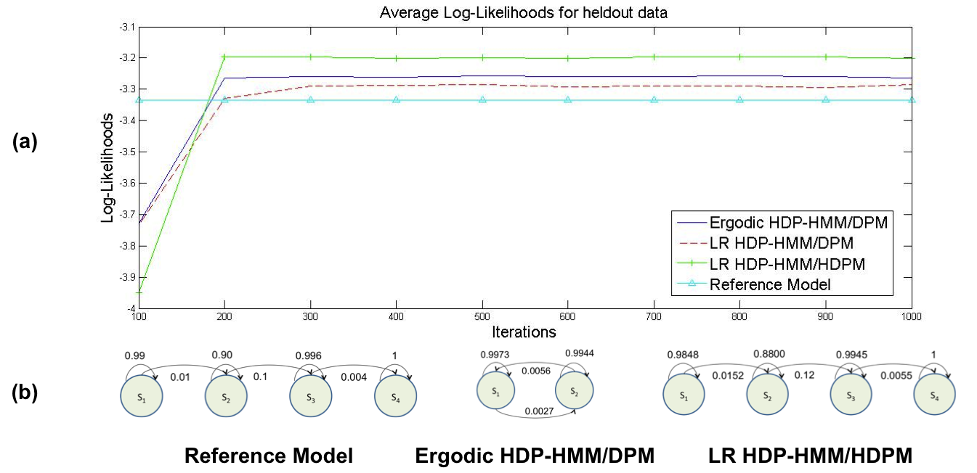
Results – Simulation
data is generated from a LR-HMM with 1 to 3 mixture components per state.
Training data used to train different models and a different set of holdout data used to assess the models.

Slide 19
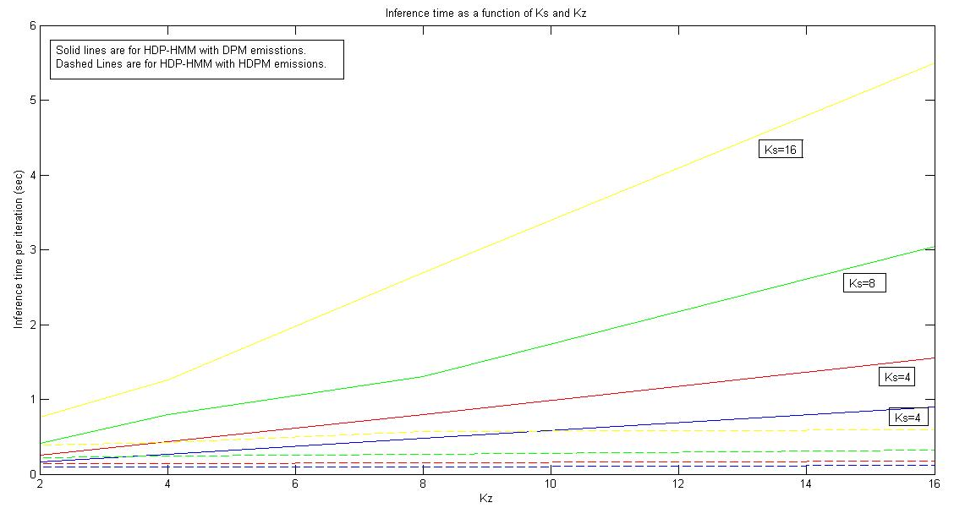
Results – Computation time and scalability
HDP-HMM/DPM computation time is proportional to K_{s} * K_{z}.
HDP-HMM/HDPM inference time is proportional to K_{s}.
The mixture components are shared among all states so the actual number of computations is proportional to K_{s}.

Slide 20
Results – TIMIT classification
The data used in this illustration was extracted from the TIMIT Corpus where a phoneme level transcription is available.
MFCC features plus their first and second derivatives are used (39 dimensions.).
State of the art parametric HMM/GMM used for comparison.
Classification results show around 15% improvement.
A Comparison of Classification Error Rates
Model | Error Rate
HMM/GMM (10 components) | 27.8%
LR-HDP-HMM/GMM (1 component) | 26.7%
LR-HDP-HMM | 24.1%

Slide 21
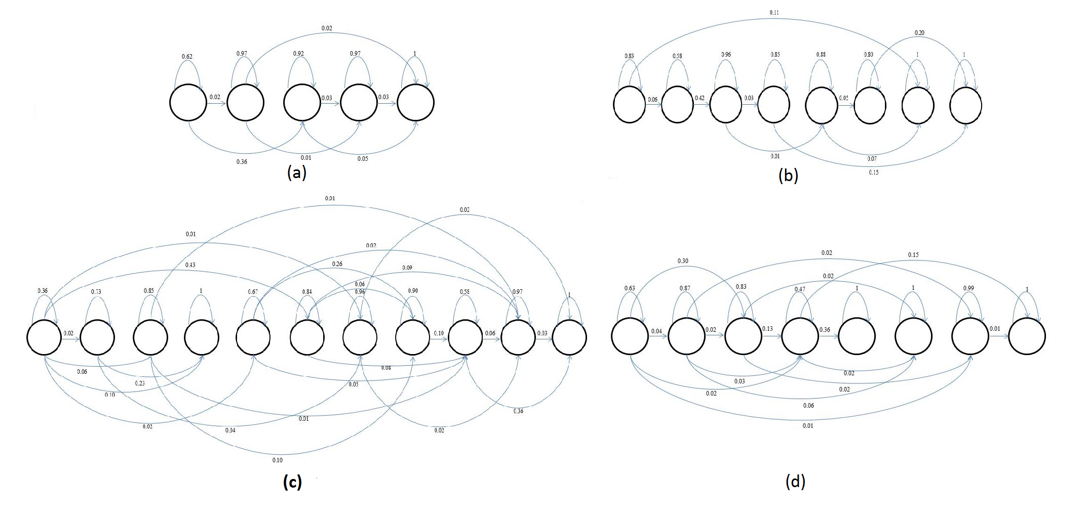
Results – TIMIT classification
An automatically derived model structure (without the first and last non-emitting states) for:
/aa/ with 175 examples
/sh/ with 100 examples
/aa/ with 2256 examples
/sh/ with 1317 examples using LR HDP-HMM model

Slide 22
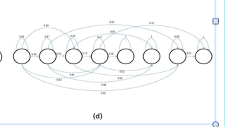
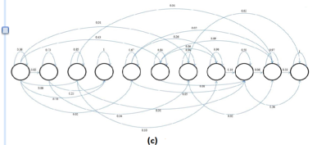
Results – TIMIT classification
An automatically derived model structure (without the first and last non-emitting states) for:
/aa/ with 175 examples
/sh/ with 100 examples
/aa/ with 2256 examples
/sh/ with 1317 examples using LR HDP-HMM model

Slide 23
Summary
Summarize your performance results:
Showing that HDPM emissions can replace DPM emissions in most applications (for both LR and ergodic models) without losing performance while the scalability of model improves significantly.
We have also shown that LR HDP-HMM models can learn multi modality in data. For example, for a single phoneme, LR HDP-HMM can learn parallel paths corresponding to different type of speakers while at the same time we can share the data among states if HDPM emissions are used.
Three theoretical contributions:
A left-to-right HDP-HMM model.
Introducing HDP emissions to HDP-HMM model.
Introducing non-emitting states to the model.
Comparing to EM algorithm the Inference algorithm for HDP-HMM models is computationally too expensive. One of the future directions is to investigate approaches based on Variational Inference for these models.
Another direction is to add level of hierarchy to the model to share data among several HDP-HMM models.

Slide 24
References
Bourlard, H., & Morgan, N. (1993). Connectionist Speech Recognition A Hybrid Approach. Springer.
Fox, E., Sudderth, E., Jordan, M., & Willsky, A. (2011). A Sticky HDP-HMM with Application to Speaker Diarization. The Annalas of Applied Statistics, 5(2A), 1020–1056.
Harati, A., Picone, J., & Sobel, M. (2012). Applications of Dirichlet Process Mixtures to Speaker Adaptation. Proceedings of the IEEE International Conference on Acoustics, Speech and Signal Processing (pp. 4321–4324). Kyoto, Japan.
Harati, A., Picone, J., & Sobel, M. (2013). Speech Segmentation Using Hierarchical Dirichlet Processes. Proceedings of the IEEE International Conference on Acoustics, Speech and Signal Processing (p. TBD). Vancouver, Canada.
Lefèvre, F. (n.d.). Non-parametric probability estimation for HMM-based automatic speech recognition. Computer Speech & Language, 17(2-3), 113–136.
Rabiner, L. (1989). A Tutorial on Hidden Markov Models and Selected Applications in Speech Recognition. Proceedings of the IEEE, 77(2), 879–893.
Sethuraman, J. (1994). A constructive definition of Dirichlet priors. Statistica Sinica, 639–650.
Shang, L. (n.d.). Nonparametric Discriminant HMM and Application to Facial Expression Recognition. IEEE Conference on Computer Vision and Pattern Recognition (pp. 2090– 2096). Miami, FL, USA.
Shin, W., Lee, B.-S., Lee, Y.-K., & Lee, J.-S. (2000). Speech/non-speech classification using multiple features for robust endpoint detection. proceedings of IEEE international Conference on ASSP (pp. 1899–1402). Istanbul, Turkey.
Suchard, M. A., Wang, Q., Chan, C., Frelinger, J., West, M., & Cron, A. (2010). Understanding GPU Programming for Statistical Computation: Studies in Massively Parallel Massive Mixtures. Journal of Computational and Graphical Statistics, 19(2), 419–438.
Teh, Y., Jordan, M., Beal, M., & Blei, D. (2006). Hierarchical Dirichlet Processes. Journal of the American Statistical Association, 101(47), 1566–1581.

Slide 25
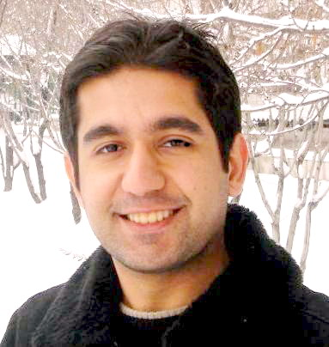
Biography
Amir Harati is a PhD candidate in the Department of Electrical and Computer Engineering at Temple University. He received his Bachelor’s Degree from Tabriz University in 2004 and his Master’s Degree from K.N. Toosi University in 2008, both in Electrical and Computer Engineering. He has also worked as signal processing researcher for Bina-Pardaz LTD in City, Iran, where he […. Explain what you worked on there in two lines…].
He is currently pursuing a PhD in Electrical Engineering at Temple University. The focus of his research is the application of nonparametric Bayesian methods in acoustic modeling for speech recognition. He is also the senior scientist on a commercialization project involving a collaboration between Temple Hospital and the Neural Engineering Data Consortium to automatically interpret EEG signals.
Mr. Harati has published one journal paper and five conference papers on machine learning applications in signal processing. He is a member of the IEEE and … Other interests include …

