Slide 1
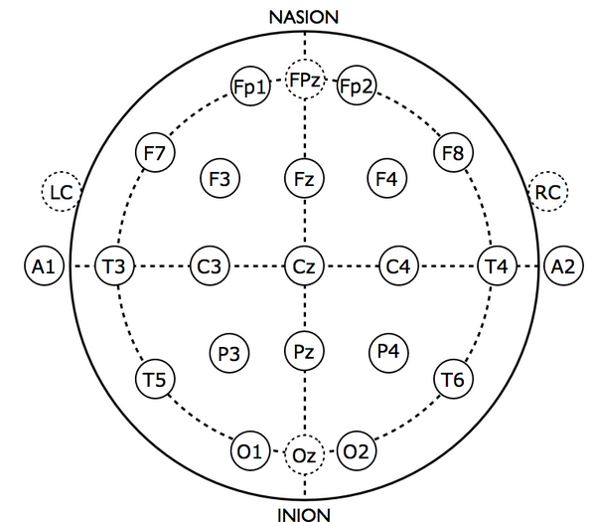
T5
O1
Eyes Open
Eyes Closed

Slide 2
Patient Record
Posterior Dominant Rhythm
(PDR)
Lack
Proceed assuming normal
Abnormal
Determine state at other points on record
Rolling eye movement
Vertex waves, sleep spindles, K-complexes
Otherwise
Drowsy
Asleep
Awake
Pathological
morphology
Otherwise
Pathological
morphology
Pathological
morphology
Standard
Otherwise
Pathology
Benign variant
Pathology
Benign variant
Pathology
Benign variant
Abnormal
Normal
Abnormal
Normal
Abnormal
Normal

