Slide 1

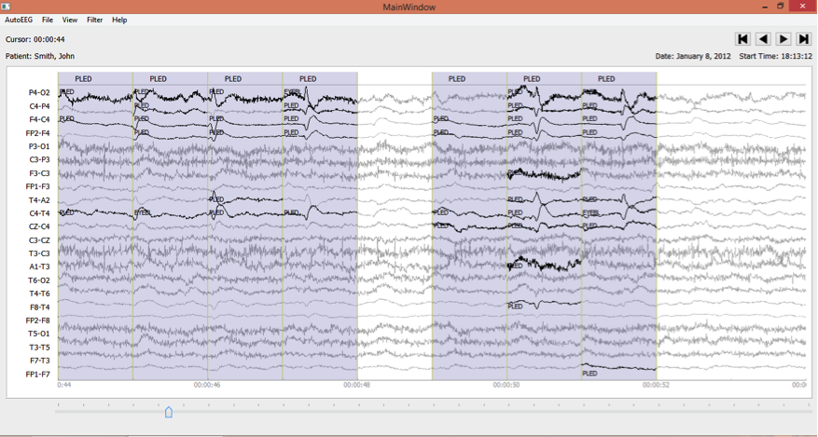
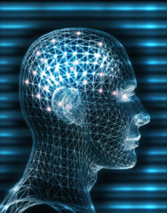

Improved EEG Event Classification Using Differential Energy
Harati, M. Golmohammadi,
S. Lopez, I. Obeid and J. Picone
Neural Engineering Data Consortium
Temple University

Slide 2
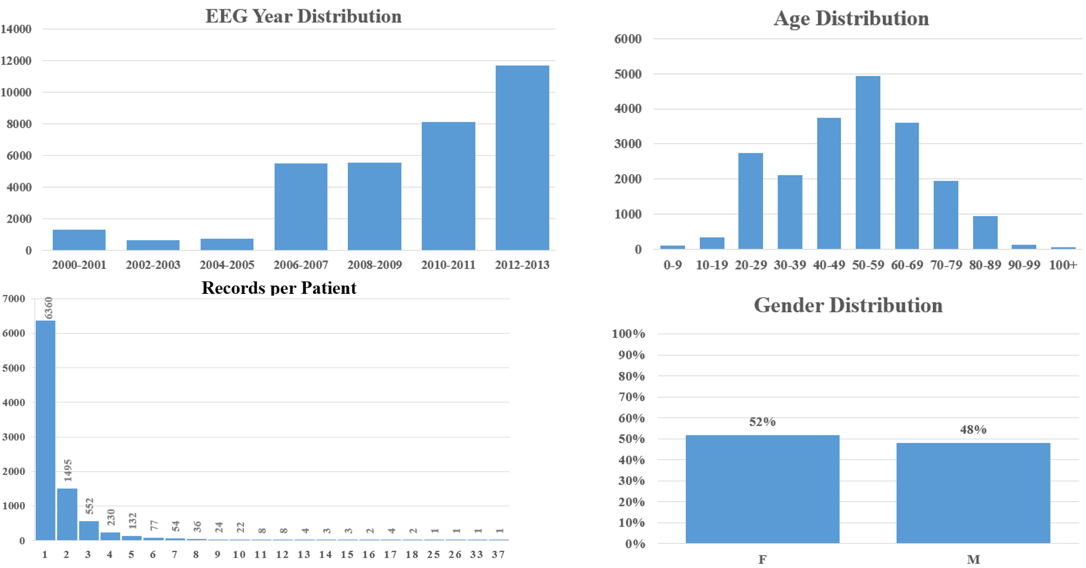
The TUH EEG Data Corpus
The experiments ran on TUH EEG Corpus which contains over 28,000 sessions collected from 15,000+ patients over a period of 14 years at Temple University Hospital.

Slide 3
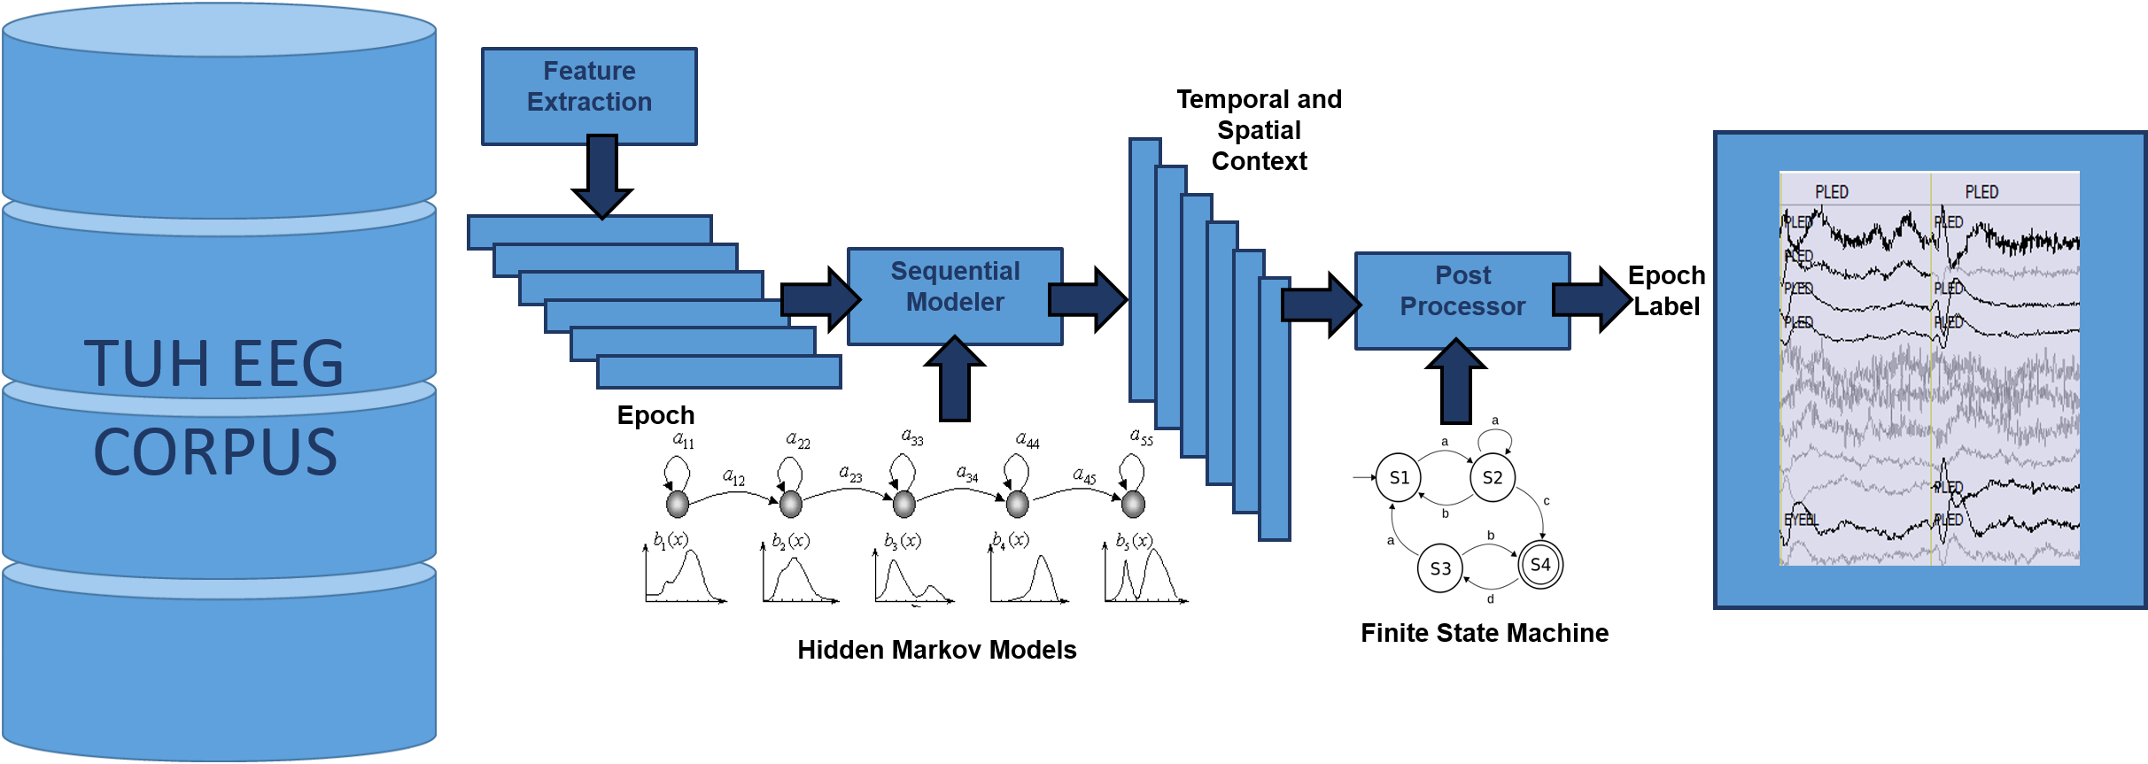
AutoEEG
AutoEEG is a hybrid system that automatically interprets EEGs and delivers high performance on clinical data:
  P1: hidden Markov models
  P2: Deep Learning
  P3: Language Model

Slide 4
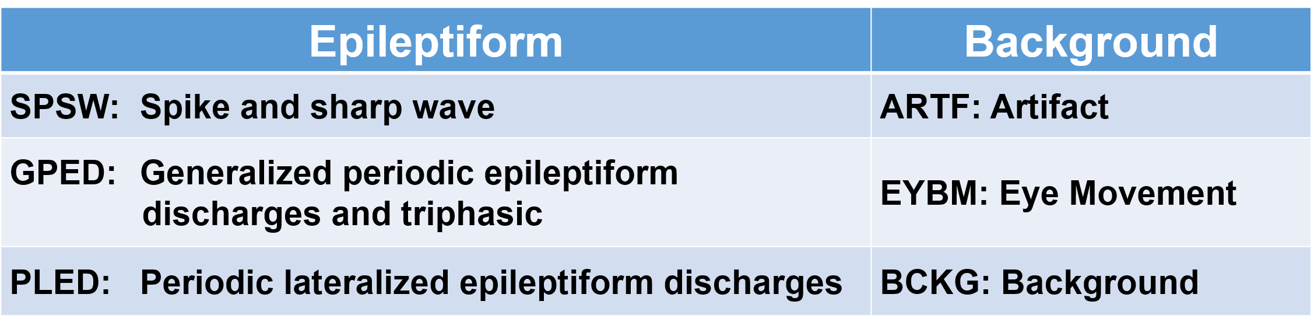
AutoEEG
Six events of interest based on multiple iterations with board certified neurologists:
The recordings contain many artifacts that can easily be interpreted as spikes. Therefore neurologists still rely on manual review of data in clinical applications.
Automatic labeling of these events allows a neurologist to rapidly search long-term EEG recordings for anomalous behavior.
Performance requirements for this application is a detection rate above 95% with a false alarm rate below 5%.

Slide 5
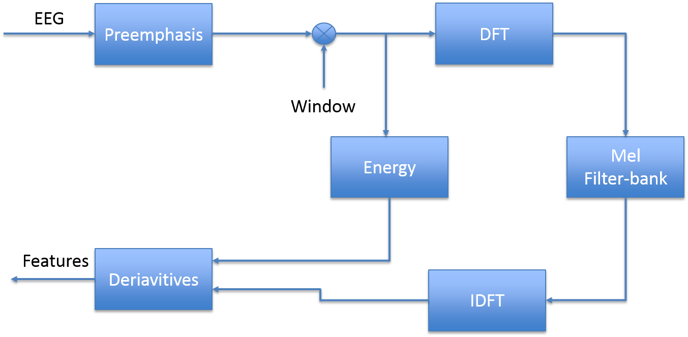
EEG FEATURES
Goal: Calibrating speech recognition feature extraction methods on EEGs including MFCC, energy term and their derivatives.
Additionally, we introduce a new feature named as differential energy.
Mel Frequency Cepstral Coefficient (MFCC):
  Wavelets have very little advantage over MFCCs on the TUH EEG.
  a linear frequency scale for EEGs.

Slide 6



EEG FEATURES
Time Domain energy
an overlapping analysis window (a 50% overlap was used here) to ensure a smooth trajectory
Frequency Domain energy
provides a smoother, more stable estimate of the energy that leverages the cepstral representation of the signal.
Derivatives of features:
A typical value for N is 9 (corresponding to 0.9 secs) for the first derivative in EEG processing, and 3 for the second derivative.

Slide 7

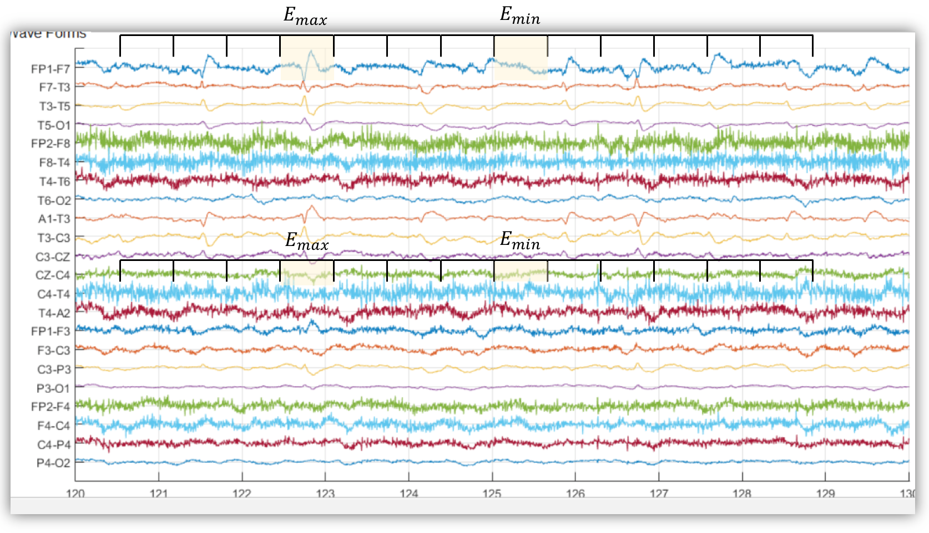
EEG FEATURES
Differential energy:
  To improve differentiation between transient pulse-like events (e.g., SPSW events) and stationary background noise
This simple feature has proven to be surprisingly effective.
We typically use a 0.9 sec window for this calculation.

Slide 8
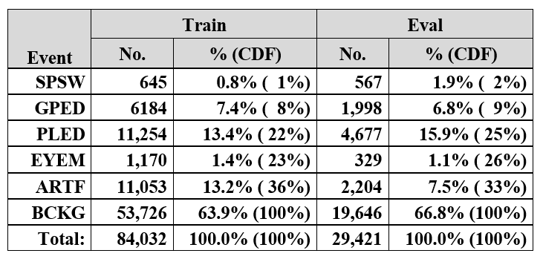
Dimensionality
The use of differential features raises the dimension of a typical feature vector from 9 (e.g., 7 cepstral coefficients, frequency domain energy and differential energy) to 27.
The training set contains segments from 359 sessions while the evaluation set was drawn from 159 sessions.

Slide 9
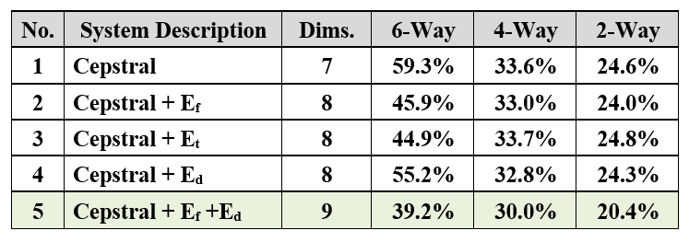
Absolute Features
6-way classification: SPSW, GPED, PLED, EYEM, ARTF, BCKG
4-way classification: It makes more sense to collapse the 3 background classes into one category: SPSW, GPED, PLED and BACKG.
2-way classification: collapse the data into a target class (TARG) and a background class (BCKG).

Slide 10
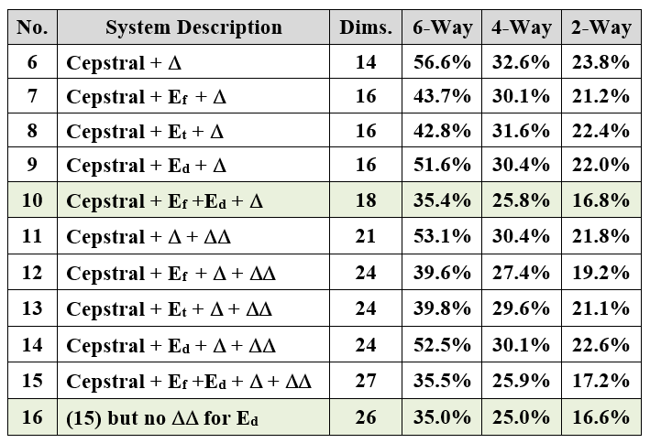
Differential Features
On the base cepstral feature vector, derivatives reduce the error rate on the 6-way task by 4% absolute (systems no. 1, 6 and 11). However, the improvement for a system using differential energy is much less pronounced (systems no. 5, 10 and 15).
Therefore, we evaluated a system that eliminates the second derivative for differential energy. This system is labeled no. 16

Slide 11
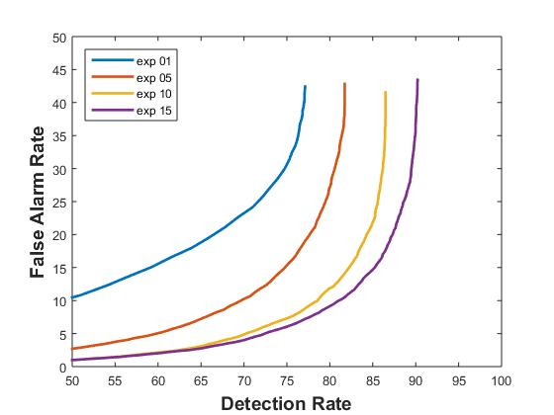
DET Curves
DET curves for systems nos. 1, 5, 10, and 15 are shown at below
The addition of first derivatives provides a measurable improvement in performance while second derivatives are less beneficial.
Differential energy provides a substantial improvement over the base cepstral features.

Slide 12
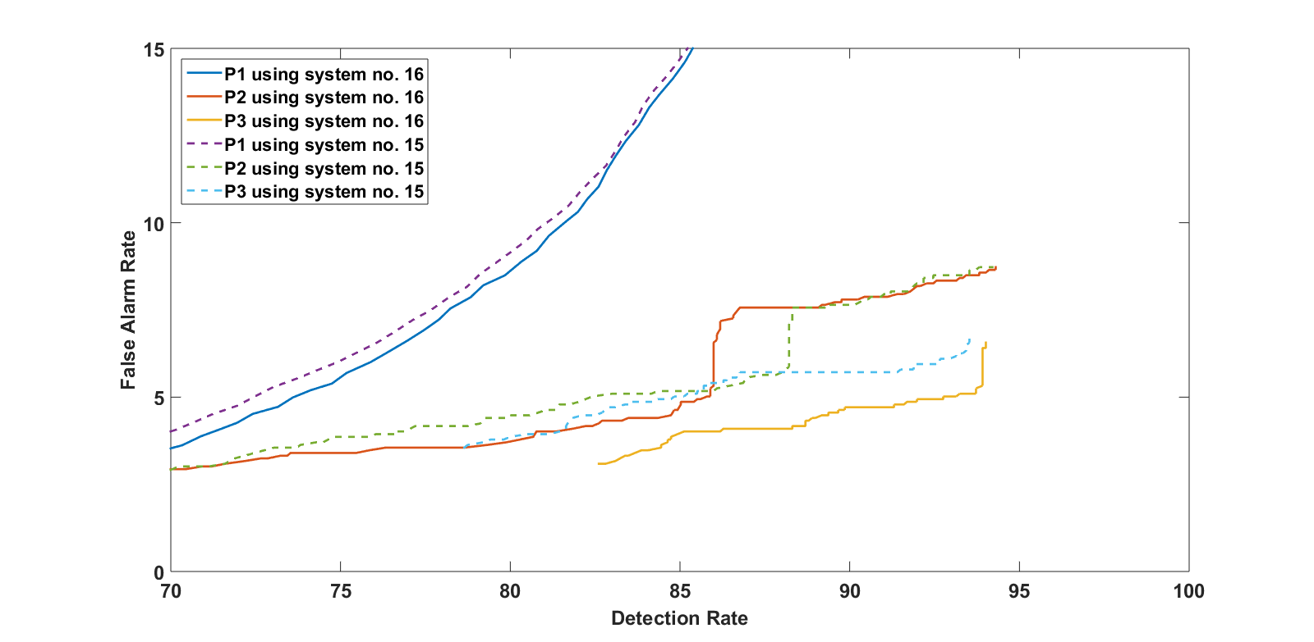
Differential Energy on Deep Learning and Language Model
System no. 15:
  7 cepstral coefficients
  1 f_energy
  1 d_energy
  9 deltas for all
  9 delta-deltas for all
Totally 27 features
System no. 16:
  7 cepstral coefficients
  1 f_energy
  1 d_energy
  9 deltas for all
  8 delta-deltas just for
  cepstral + f_energy
Totally 26 features

Slide 13
Summary
Important algorithms used in feature extraction for EEG processing are calibrated.
Traditional feature extraction methods used in speech recognition are relevant to EEGs.
The use of a novel differential energy feature improved performance for absolute features, but that benefit diminishes as first and second order derivatives are included.
There is benefit to using derivatives and there is a small advantage to using frequency domain energy.
There are no significant benefits to use wavelets and other time-frequency representations.
Future work will focus on new feature extraction methods based on principles of deep learning, discriminative training and nonparametric Bayesian models.

Slide 14
Brief Bibliography
[1] T. Yamada and E. Meng, Practical Guide for Clinical Neurophysiologic Testing: EEG. Philadelphia, Pennsylvania, USA: Lippincott Williams & Wilkins, 2009.
[2] A. Harati, S. Lopez, I. Obeid, M. Jacobson, S. Tobochnik, and J. Picone, “THE TUH EEG CORPUS: A Big Data Resource for Automated EEG Interpretation,” in Proceedings of the IEEE SPMB, 2014, pp. 1–5.
[3] J. Picone, “Continuous Speech Recognition Using Hidden Markov Models,” IEEE ASSP Mag., vol. 7, no. 3, pp. 26–41, Jul. 1990.
[4] S. Sanei and J. A. Chambers, EEG signal processing. Hoboken, New Jersey, USA: Wiley-Interscience, 2008.
[5] J. Lyons, “Mel Frequency Cepstral Coefficient (MFCC) tutorial,” Practical Cryptography, 2015 (available: http://practicalcryptography. com/miscellaneous/machine-learning/guide-mel-frequency-cepstral-coefficients-mfccs/.
[6] S. Davis and P. Mermelstein, “Comparison of Parametric Representations for Monosyllabic Word Recognition in Continuously Spoken Sentences,” IEEE Trans. ASSP, vol. 28, no. 4, pp. 357–366, 1980.
[7] P. Garrit, et al., “Wavelet Analysis for Feature Extraction on EEG Signals,” presented at Temple University CoE Res. Exp. for UG Conf., 2015 (available at http://www.isip.piconepress.com/publications/ unpublished/conferences/2015/summer_of_code/wavelets/).

Slide 15

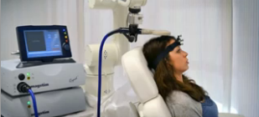
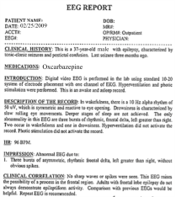
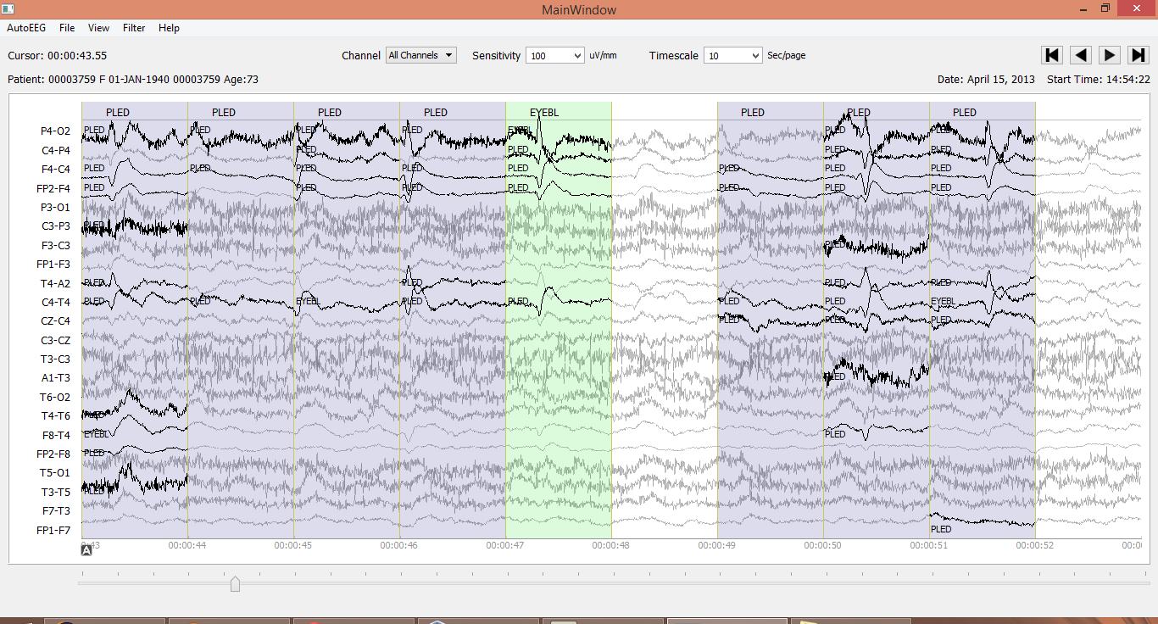
Automated Interpretation of EEGs
Goals: (1) To assist healthcare professionals in interpreting electroencephalography (EEG) tests,
thereby improving the quality and efficiency of a physician’s diagnostic capabilities; (2) Provide
a real-time alerting capability that addresses a critical gap in long-term monitoring technology.
Impact:
  Patients and technicians will receive immediate feedback rather than waiting days or weeks for results
  Physicians receive decision-making support that reduces their time spent interpreting EEGs
  Medical students can be trained with the system and use search tools make it easy to view patient histories and comparable conditions in other patients
  Uniform diagnostic techniques can be developed
Milestones:
  Develop an enhanced set of features based on temporal and spectral measures (1Q’2014)
  Statistical modeling of time-varying data sources in bioengineering using deep learning (2Q’2014)
  Label events at an accuracy of 95% measured on the held-out data from the TUH EEG Corpus (3Q’2014)
  Predict diagnoses with an F-score (a weighted average of precision and recall) of 0.95 (4Q’2014)
  Demonstrate a clinically-relevant system and assess the impact on physician workflow (4Q’2014)

