Slide 1
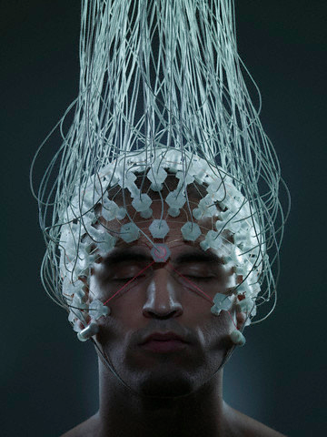
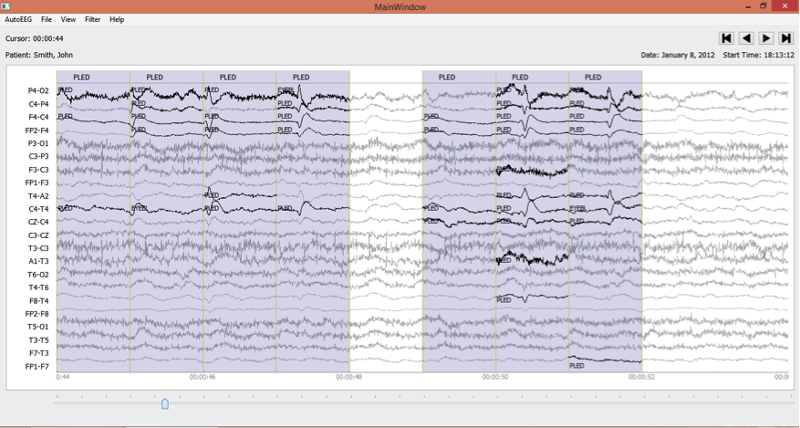
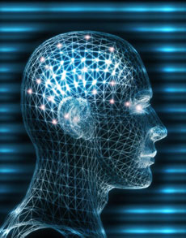
Improved EEG Event Classification Using Differential Energy
Harati, M. Golmohammadi,
S. Lopez, I. Obeid and J. Picone
Neural Engineering Data Consortium
Temple University

Slide 2
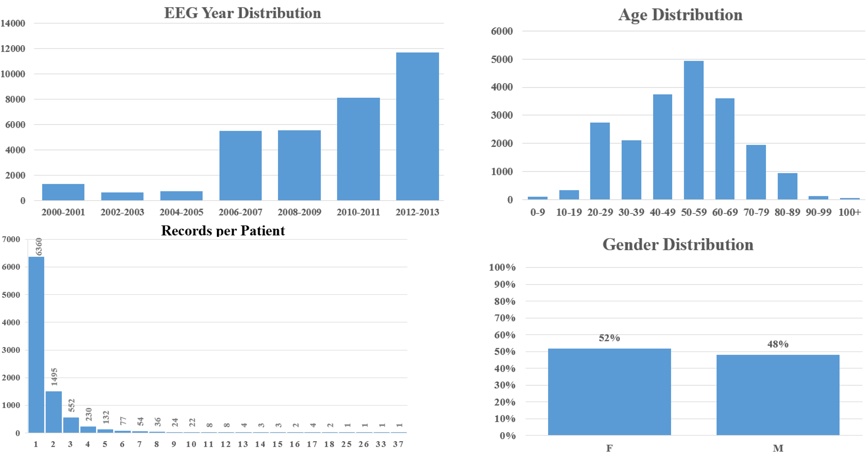
The TUH EEG Corpus
The TUH EEG Corpus contains over 28,000 sessions collected from 15,000+ patients over a period of 14 years at Temple University Hospital.

Slide 3
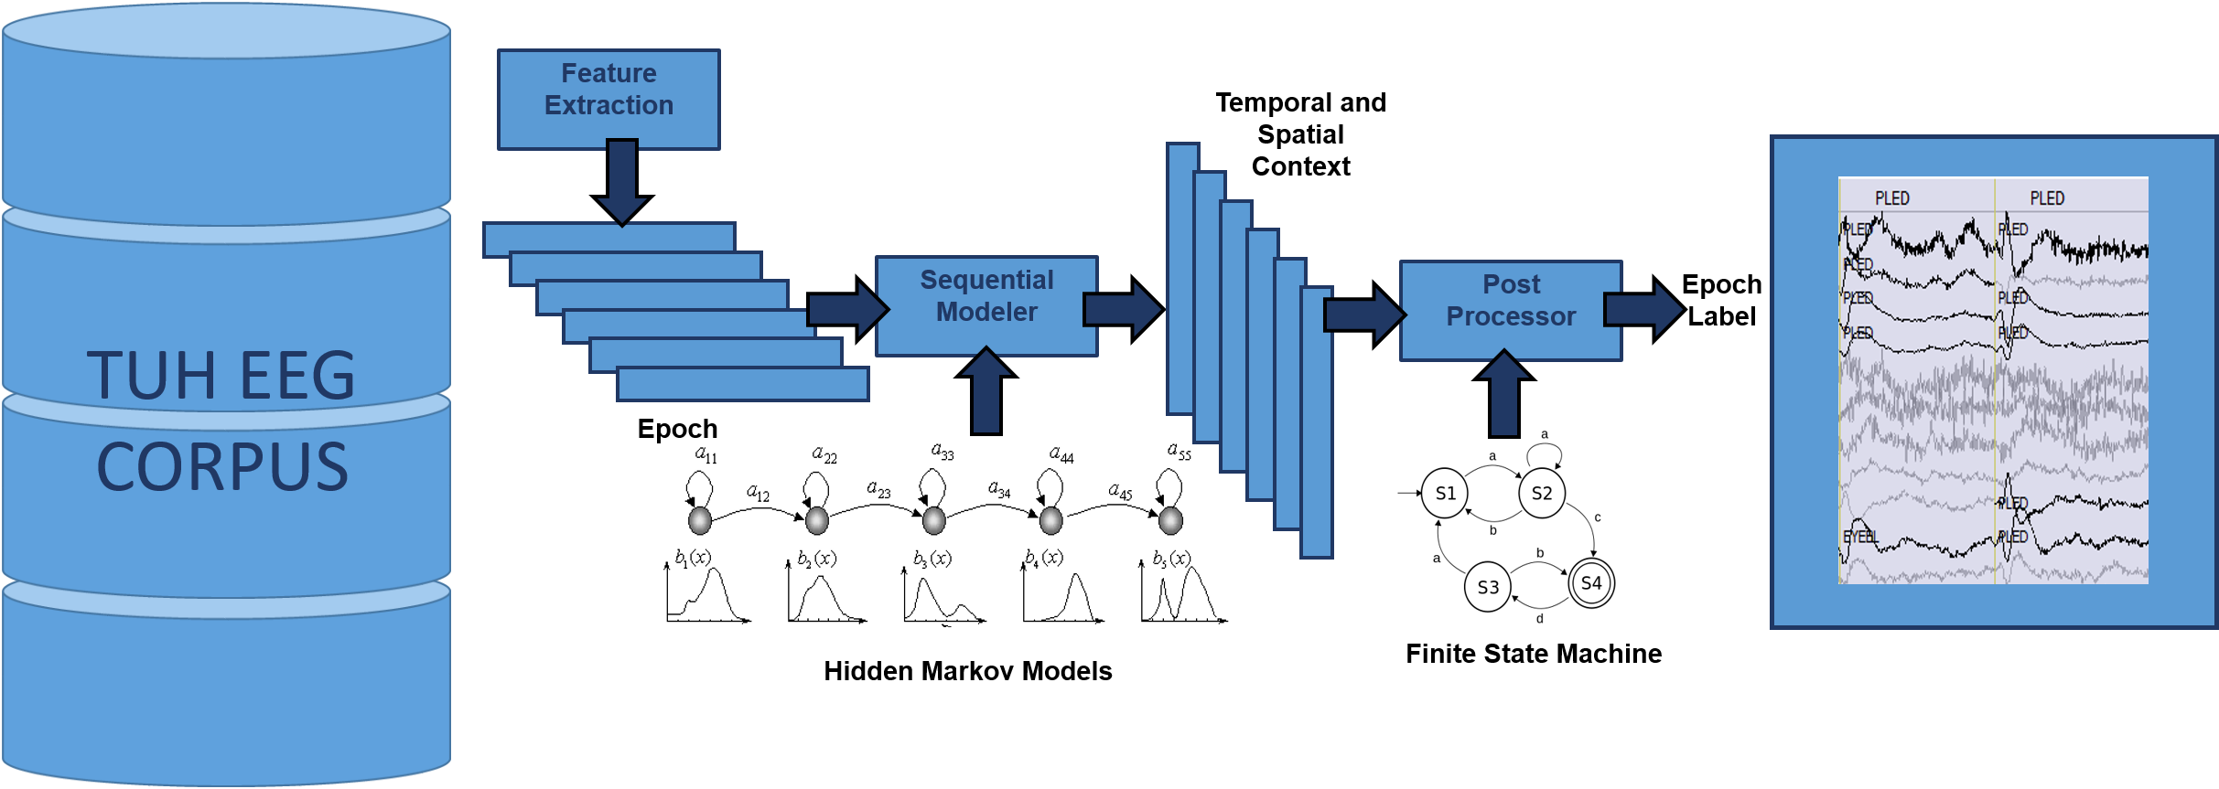
AutoEEG: Automatic Interpretation of EEGs
AutoEEG is a hybrid system that uses three levels of processing to achieve high performance event detection on clinical data:
P1: hidden Markov models
P2: Deep Learning
P3: Language Model

Slide 4
AutoEEG: Clinically-Relevant Signal Events
Six events of interest based on multiple iterations with board certified neurologists:
Clinical data contains many artifacts that can easily be interpreted as spikes, such as patient movement.
Manual review of the data is a time-consuming process, especially for long-term EEG recordings.
In ICU applications, real-time response is critical.
Performance requirements for this application is a detection rate above 95% with a false alarm rate below 5%.
For ICU applications, the false alarm rate must be extremely low (e.g., 1/8 FA/hr.).

Slide 5
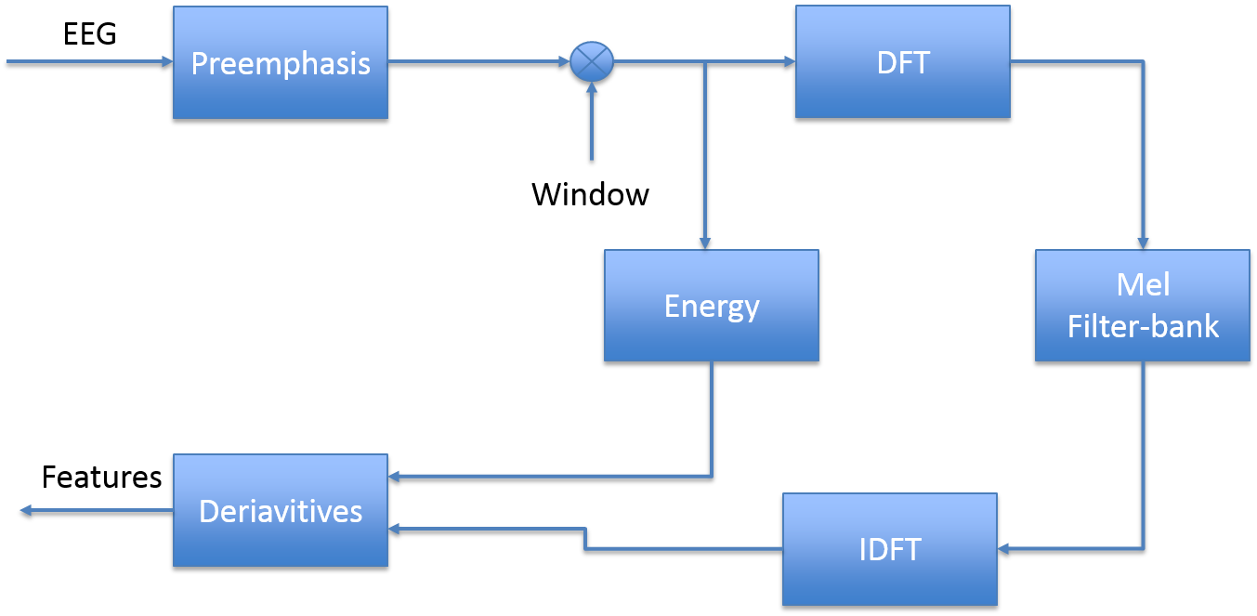
AutoEEG: Feature Extraction
Goal: Calibrate traditional approaches to feature extraction based on cepstral coefficients, energy and derivatives.
Mel Frequency Cepstral Coefficients (MFCCs):
A linear frequency scale is used for EEGs.
We have shown wavelets have very little advantage over MFCCs on the TUH EEG (which contradicts the literature).
Introduced a new differential energy term that accentuates the differences between quasi-periodic signals and spikes.

Slide 6
AutoEEG: Feature Extraction
Time Domain energy
an overlapping analysis window (a 50% overlap was used here) to ensure a smooth trajectory
Frequency Domain energy
provides a smoother, more stable estimate of the energy that leverages the cepstral representation of the signal.
Derivatives of features:
A typical value for N is 9 (corresponding to 0.9 secs) for the first derivative in EEG processing, and 3 for the second derivative.

Slide 7
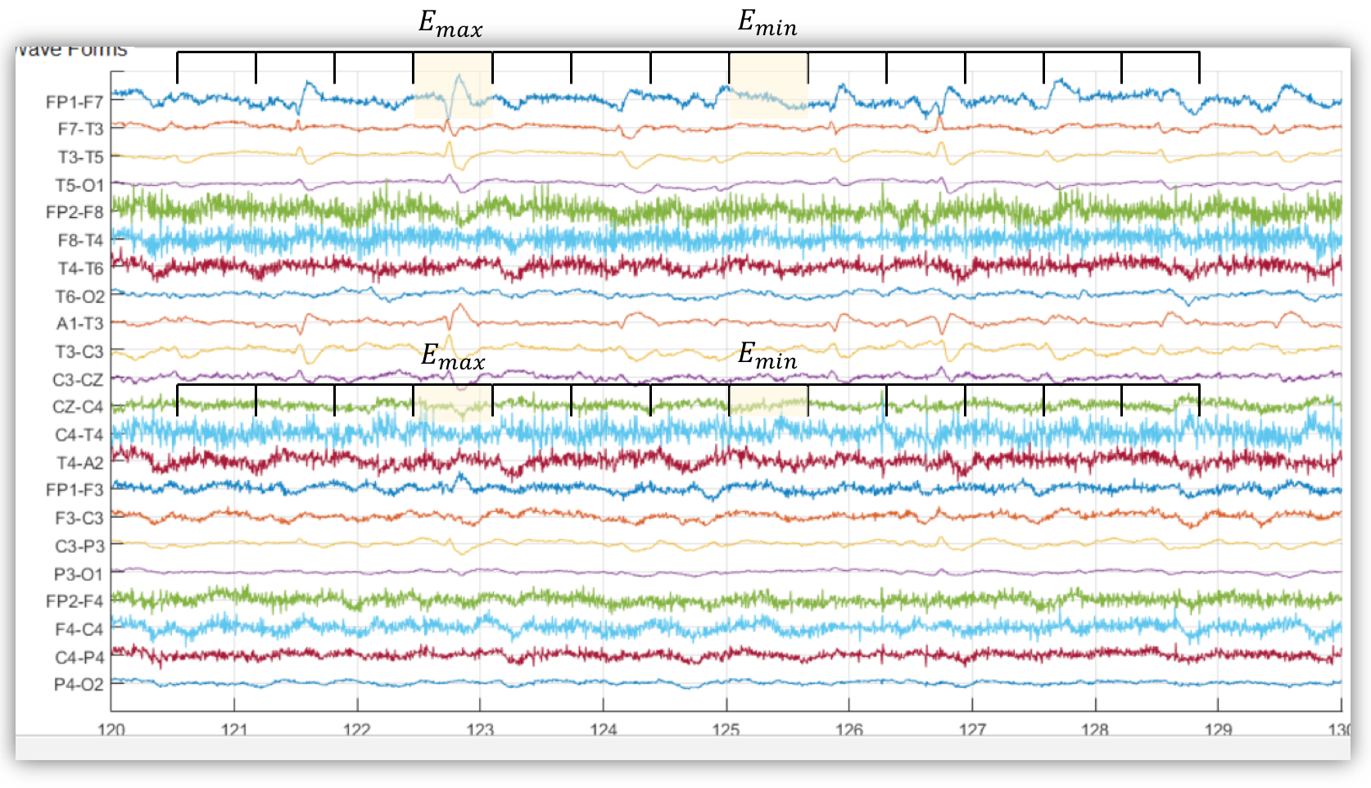
AutoEEG: Feature Extraction
Differential energy:
To improve differentiation between transient pulse-like events (e.g., SPSW events) and stationary background noise
This simple feature has proven to be surprisingly effective.
We typically use a 0.9 sec window for this calculation.

Slide 8
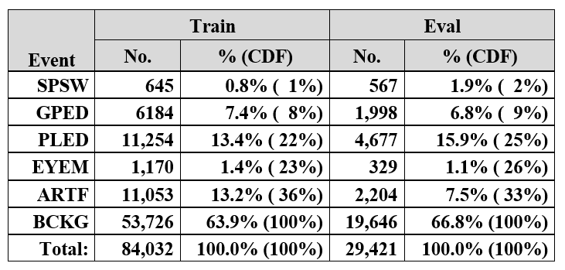
Experiments: The Curse of Dimensionality
The use of differential features raises the dimension of a typical feature vector from 9 (e.g., 7 cepstral coefficients, frequency domain energy and differential energy) to 27.
The training set contains segments from 359 sessions while the evaluation set was drawn from 159 sessions.

Slide 9
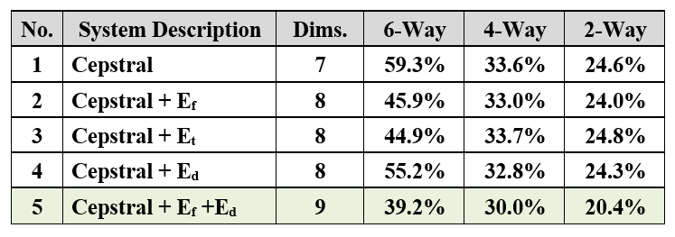
Experiments: Absolute Features
6-way classification: SPSW, GPED, PLED, EYEM, ARTF, BCKG
4-way classification: collapse the 3 background classes into one category, resulting in 4 classes – SPSW, GPED, PLED and BACKG.
2-way classification: collapse SPSW, GPED and PLED into a target class (TARG) and (ARTF, EYEM and BCKG) into a background class (BCKG).

Slide 10
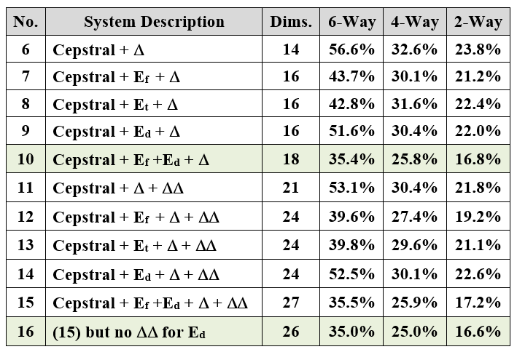
Experiments: Differential Features
Derivatives reduced the error rate on the 6-way task by 4% absolute (systems no. 1, 6 and 11). However, the improvement for a system using differential energy is much less pronounced (systems no. 5, 10 and 15).
Eliminate the second derivative for differential energy (no. 16):

Slide 11
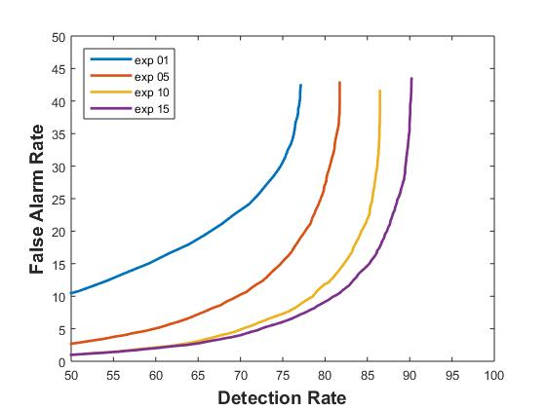
Analysis: DET Curves
DET curves for systems nos. 1, 5, 10, and 15 are shown below.
The addition of first derivatives provides a measurable improvement in performance while second derivatives are less beneficial.
Differential energy provides a substantial improvement over the base cepstral features.

Slide 12
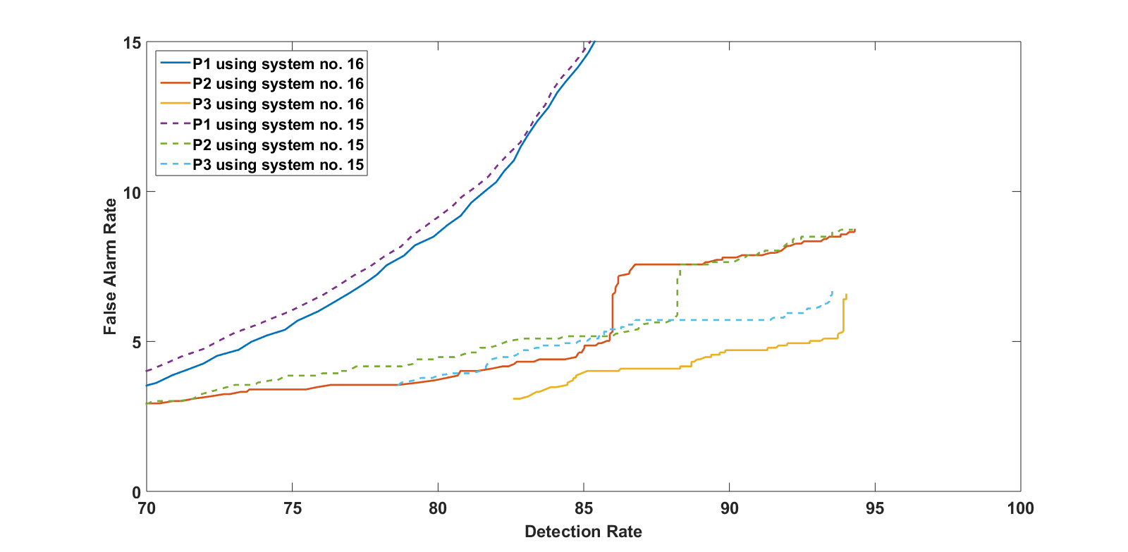
Analysis: Deep Learning and Language Modeling
System no. 15:
7 cepstral coefficients
1 f_energy
1 d_energy
9 deltas for all
9 delta-deltas for all
Total: 27 features
System no. 16:
7 cepstral coefficients
1 f_energy
1 d_energy
9 deltas for all
8 delta-deltas (cepstral + f_energy only)
Total: 26 features

Slide 13
Summary
Established valuable baselines for standard feature extraction approaches for EEG signals.
Traditional feature extraction methods used in speech recognition are relevant to EEGs.
The use of a novel differential energy feature improved performance for absolute features, but that benefit diminishes as first and second order derivatives are included.
There is benefit to using derivatives and there is a small advantage to using frequency domain energy.
There are no significant benefits to using wavelets and other time-frequency representations.
Future work will focus on new feature extraction methods based on principles of deep learning, discriminative training and nonparametric Bayesian models.
The database will be significantly expanded over the next year and evolved into new tasks (e.g., real-time seizure detection).

Slide 14
Brief Bibliography
[1] T. Yamada and E. Meng, Practical Guide for Clinical Neurophysiologic Testing: EEG. Philadelphia, Pennsylvania, USA: Lippincott Williams & Wilkins, 2009.
[2] A. Harati, S. Lopez, I. Obeid, M. Jacobson, S. Tobochnik, and J. Picone, “THE TUH EEG CORPUS: A Big Data Resource for Automated EEG Interpretation,” in Proceedings of the IEEE SPMB, 2014, pp. 1–5.
[3] J. Picone, “Continuous Speech Recognition Using Hidden Markov Models,” IEEE ASSP Mag., vol. 7, no. 3, pp. 26–41, Jul. 1990.
[4] S. Sanei and J. A. Chambers, EEG signal processing. Hoboken, New Jersey, USA: Wiley-Interscience, 2008.
[5] J. Lyons, “Mel Frequency Cepstral Coefficient (MFCC) tutorial,” Practical Cryptography, 2015 (available: http://practicalcryptography. com/miscellaneous/machine-learning/guide-mel-frequency-cepstral-coefficients-mfccs/.
[6] S. Davis and P. Mermelstein, “Comparison of Parametric Representations for Monosyllabic Word Recognition in Continuously Spoken Sentences,” IEEE Trans. ASSP, vol. 28, no. 4, pp. 357–366, 1980.
[7] P. Garrit, et al., “Wavelet Analysis for Feature Extraction on EEG Signals,” presented at Temple University CoE Res. Exp. for UG Conf., 2015 (available at http://www.isip.piconepress.com/publications/ unpublished/conferences/2015/summer_of_code/wavelets/).

