Slide 1
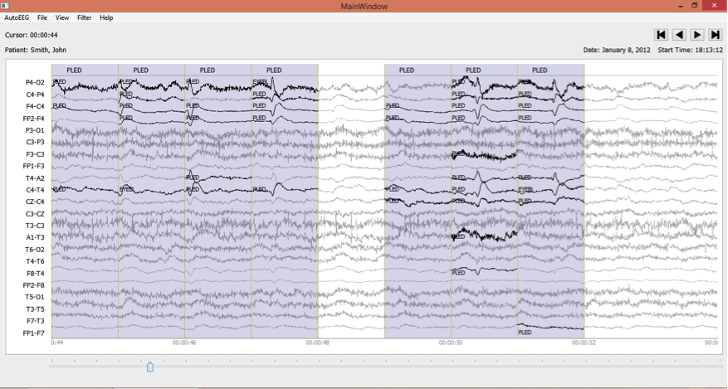
Improved EEG Event Classification Using Differential Energy
Harati, M. Golmohammadi,
S. Lopez, I. Obeid and J. Picone
Neural Engineering Data Consortium
Temple University
Notes:
- My name is MG and on behalf of my colleagues in NEDC I’d like to say one time more welcome to Temple University. Today I am going to talk about improved EEG event classification using differential energy.
- Feature extraction for automatic classification of EEG signals typically relies on time frequency representations of the signal including techniques like wavelets and cepstral-based filter banks.
- In or study we applied feature extraction methods of speech processing on EEG signal. Today I present a comparison of a variety of approaches for feature extraction.
- Additionally, I present a new simple feature named as differential energy and demonstrate that a combination of these approaches with differential energy can decrease the overall error rate more than 24% and improves our ability to discriminate between signal events and background noise.

Slide 2
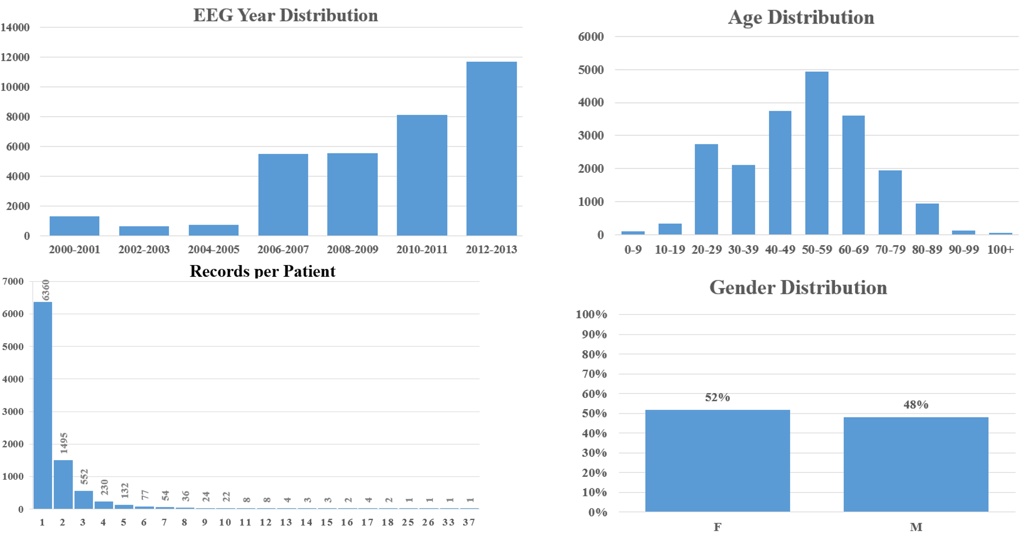
The TUH EEG Corpus
The TUH EEG Corpus contains over 28,000 sessions collected from 15,000+ patients over a period of 14 years at Temple University Hospital.
Notes:
- We have used the TUH EEG Corpus for evaluation. TUH EEG is the world’s largest publicly available database of clinical EEG data, comprising more than 28,000 EEG records and over 15,000 patients.
- It represents the clinical data from Temple University Hospital’s Department of Neurology since 2002 and is an ongoing data collection project.
- The raw signals consist of multichannel recordings that vary between 20 and 128 channels sampled at a minimum of 250 Hz using a 16-bit A/D converter.
The data is stored as EDF files.
In our study, we have resampled all the data to a common sample frequency of 250 Hz.

Slide 3
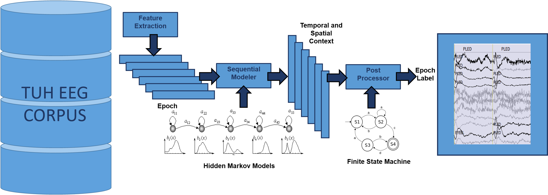
AutoEEG: Automatic Interpretation of EEGs
AutoEEG is a hybrid system that uses three levels of processing to achieve high performance event detection on clinical data:
P1: hidden Markov models
P2: Deep Learning
P3: Language Model
Notes:
In our lab we have been developing a predictive analytic tool named as AutoEEG to analyze EEG signal automatically.
Physicians are spending 4 to 6 hours a day reading and scanning EEGs. AutoEEG can save time and money for them and increase their accuracy.
The first stage is using a conventional HMM.
In the second stage the temporal and spatial context of EEGs are analyzed using a deep learning method and here we are using SdA.
In the third stage, we are using a language mode that is provided in consultation with our board certified neurologists at Temple University Hospital.

Slide 4
AutoEEG: Clinically-Relevant Signal Events
Six events of interest based on multiple iterations with board certified neurologists:
Clinical data contains many artifacts that can easily be interpreted as spikes, such as patient movement.
Manual review of the data is a time-consuming process, especially for long-term EEG recordings.
In ICU applications, real-time response is critical.
Performance requirements for this application is a detection rate above 95% with a false alarm rate below 5%.
For ICU applications, the false alarm rate must be extremely low (e.g., 1/8 FA/hr.).
Notes:
The system detects three events of clinical interest
- SPSW events are epileptiform transients that are typically observed in patients with epilepsy.
- PLED events are indicative of EEG abnormalities and often manifest themselves with repetitive spike or sharp wave discharges that can be focal or lateralized over one hemisphere. These signals display quasi-periodic behavior.
- GPED events are similar to PLEDs, and manifest themselves as periodic short-interval diffuse discharges, periodic long-interval diffuse discharges and suppression-burst patterns according to the interval between the discharges. Triphasic waves, which manifest themselves as diffuse and bilaterally synchronous spikes with bifrontal predominance, typically at a rate of 1-2 Hz, are also included in this class.
artifacts (ARTF) are recorded electrical activity that is not of cerebral origin, such as those due to the equipment, patient behavior or the environment;
eye movement (EYEM) are common events that can often be confused with a spike;
background (BCKG) is used for all other signals.

Slide 5
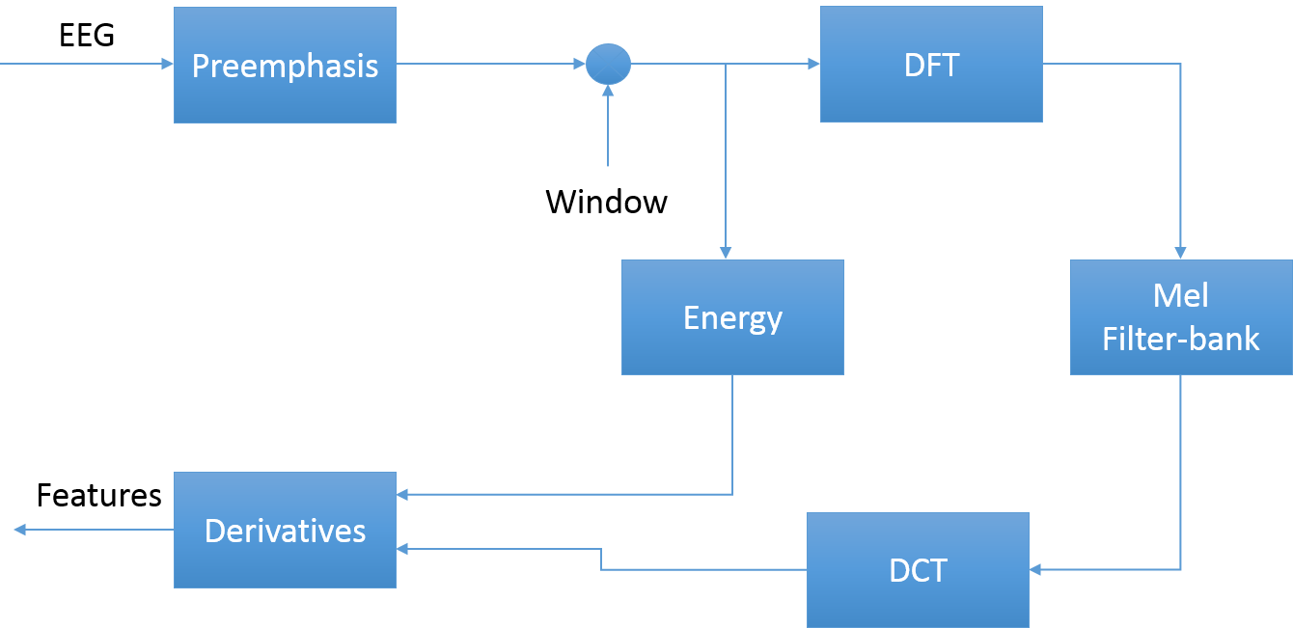
AutoEEG: Feature Extraction
Goal: Calibrate traditional approaches to feature extraction based on cepstral coefficients, energy and derivatives.
Mel Frequency Cepstral Coefficients (MFCCs):
A linear frequency scale is used for EEGs.
We have shown wavelets have very little advantage over MFCCs on the TUH EEG (which contradicts the literature).
Introduced a new differential energy term that accentuates the differences between quasi-periodic signals and spikes.
Notes:
- Here I will review some well-know feature extraction methods in SR that we applied them on EEGs. Our goal is to calibrate traditional approaches and introduce differential energy.
The most important feature extraction method that we used in our system is Mel Frequency Cepstral Coefficient (MFCC). You can see a block diagram of MFCC along with energy feature and their derivatives.
Our window size is 200 ms and frame size 100 ms. It is common in the MFCC approach to compute cepstral coefficients by computing a high resolution fast Fourier Transform, then we apply the mel filterbank to the power spectra and sum the energy in each filter. Take the DCT of the log filterbank energies. Keep DCT coefficients 2-8, discard the rest.
- Our experiments with Wavelets have shown very little advantage over MFCCs on the TUH EEG Corpus.
- Unlike speech recognition which uses a mel scale for reasons related to speech perception, we use a linear frequency scale for EEGs, since there is no physiological evidence that a log scale is meaningful.

Slide 6
AutoEEG: Feature Extraction
Time Domain energy
an overlapping analysis window (a 50% overlap was used here) to ensure a smooth trajectory
Frequency Domain energy
provides a smoother, more stable estimate of the energy that leverages the cepstral representation of the signal.
Derivatives of features:
A typical value for N is 9 (corresponding to 0.9 secs) for the first derivative in EEG processing, and 3 for the second derivative.
Notes:
There are two types of energy terms that are often used: time domain and frequency domain.
Time domain energy is a straightforward computation using the log of the sum of the squares of the windowed signal. We use an overlapping analysis window (a 50% overlap was used here) to ensure a smooth trajectory of this features.
- The energy of the signal can also be computed in the frequency domain by computing the sum of squares of the oversampled filter bank outputs after they are downsampled. This form of energy is commonly used in speech recognition systems because it provides a smoother, more stable estimate of the energy that leverages the cepstral representation of the signal. However, the virtue of this approach has not been extensively studied for EEG processing.

Slide 7
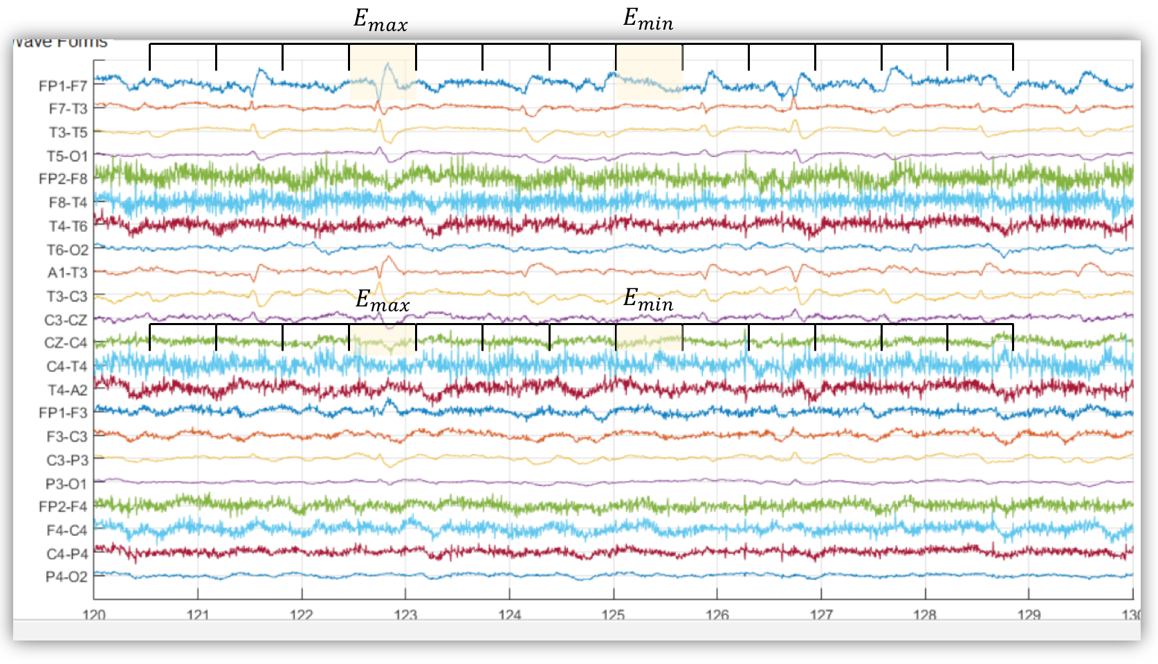
AutoEEG: Feature Extraction
Differential energy:
To improve differentiation between transient pulse-like events (e.g., SPSW events) and stationary background noise
This simple feature has proven to be surprisingly effective.
We typically use a 0.9 sec window for this calculation.
Notes:
- In order to improve differentiation between transient pulse-like events (e.g., SPSW events) and stationary background noise, we have introduced a differential energy term that attempts to model the long-term change in energy.
- This term examines energy over a range of M frames centered about the current frame, and computes the difference between the maximum and minimum over this interval.
- This simple feature has proven to be surprisingly effective.

Slide 8
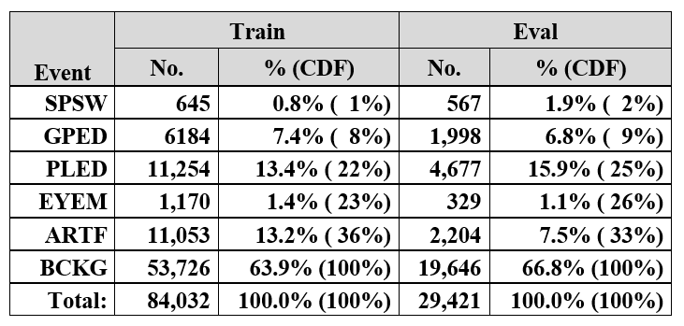
Experiments: The Curse of Dimensionality
The use of differential features raises the dimension of a typical feature vector from 9 (e.g., 7 cepstral coefficients, frequency domain energy and differential energy) to 27.
The training set contains segments from 359 sessions while the evaluation set was drawn from 159 sessions.
Notes:
- Dimensionality is something we must always pay attention to in classification systems and here, the training set was designed to provide a sufficient number of examples to train statistical models such as HMMs.
The use of differential features raises the dimension of a typical feature vector from 9 (e.g., 7 cepstral coefficients, frequency domain energy and differential energy) to 27. There must be sufficient training data to support this increase in dimensionality.
- The training set contains segments from 359 sessions while the evaluation set was drawn from 159 sessions.
A distribution of the frequency of occurrence of the 6 types of events in the training and evaluation set is shown in Table 1.
Note that some classes, such as SPSW, occur much less frequently in the actual corpus than common events such as BCKG. In fact, 99% of the data is assigned to the class BCKG, so special care must be taken to build robust classifiers for the non-background classes.

Slide 9
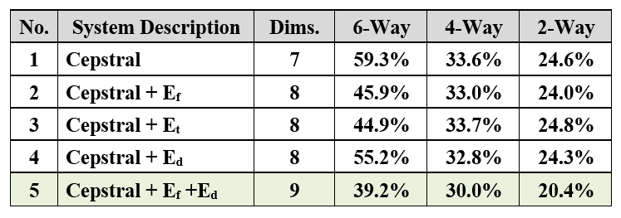
Experiments: Absolute Features
6-way classification: SPSW, GPED, PLED, EYEM, ARTF, BCKG
4-way classification: collapse the 3 background classes into one category, resulting in 4 classes – SPSW, GPED, PLED and BACKG.
2-way classification: collapse SPSW, GPED and PLED into a target class (TARG) and (ARTF, EYEM and BCKG) into a background class (BCKG).
Notes:
The first series of experiments was run on a simple combination of features.
A summary of these experiments is shown in Table.
Cepstral-only features were compared with several energy estimation algorithms. It is clear that the combination of frequency domain energy and differential energy provides a substantial reduction in performance. However, note that differential energy by itself (system no. 4) produces a noticeable degradation in performance.

Slide 10
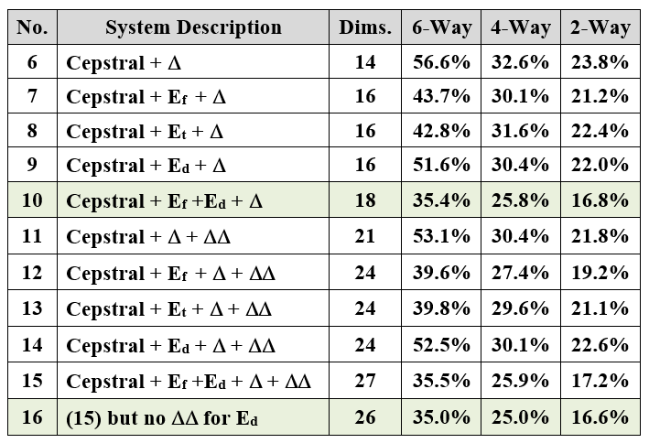
Experiments: Differential Features
Derivatives reduced the error rate on the 6-way task by 4% absolute (systems no. 1, 6 and 11). However, the improvement for a system using differential energy is much less pronounced (systems no. 5, 10 and 15).
Eliminate the second derivative for differential energy (no. 16):
Notes:
- A second set of experiments were run to evaluate the benefit of using differential features. These experiments are summarized in Table.
- The addition of the first derivative adds about 4% absolute in performance. However, when differential energy is introduced, the improvement in performance drops to only 4% absolute.
- The story is somewhat mixed for the use of second derivatives. On the base cepstral feature vector, second derivatives reduce the error rate on the 6-way task by 4% absolute (systems no. 1, 6 and 11). However, the improvement for a system using differential energy is much less pronounced (systems no. 5, 10 and 15).
- In fact, it appears that differential energy and derivatives do something very similar. Therefore, we evaluated a system that eliminates the second derivative for differential energy. This system is labeled no. 16 in Table 3. We obtained a small but significant improvement in performance over system no. 10.

Slide 11
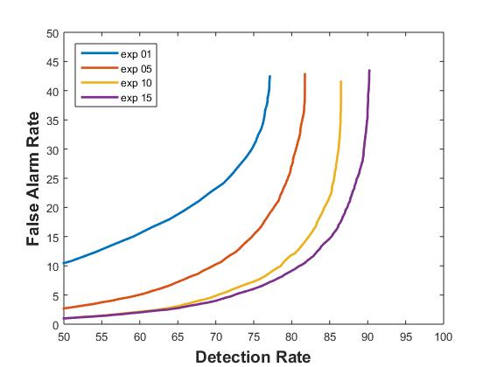
Analysis: DET Curves
DET curves for systems nos. 1, 5, 10, and 15 are shown below.
The addition of first derivatives provides a measurable improvement in performance while second derivatives are less beneficial.
Differential energy provides a substantial improvement over the base cepstral features.
Notes:
A DET curve analysis of feature extraction systems that compares absolute and differential features. The addition of first derivatives provides a measurable improvment in performance while second derivatives are less beneficial.

Slide 12
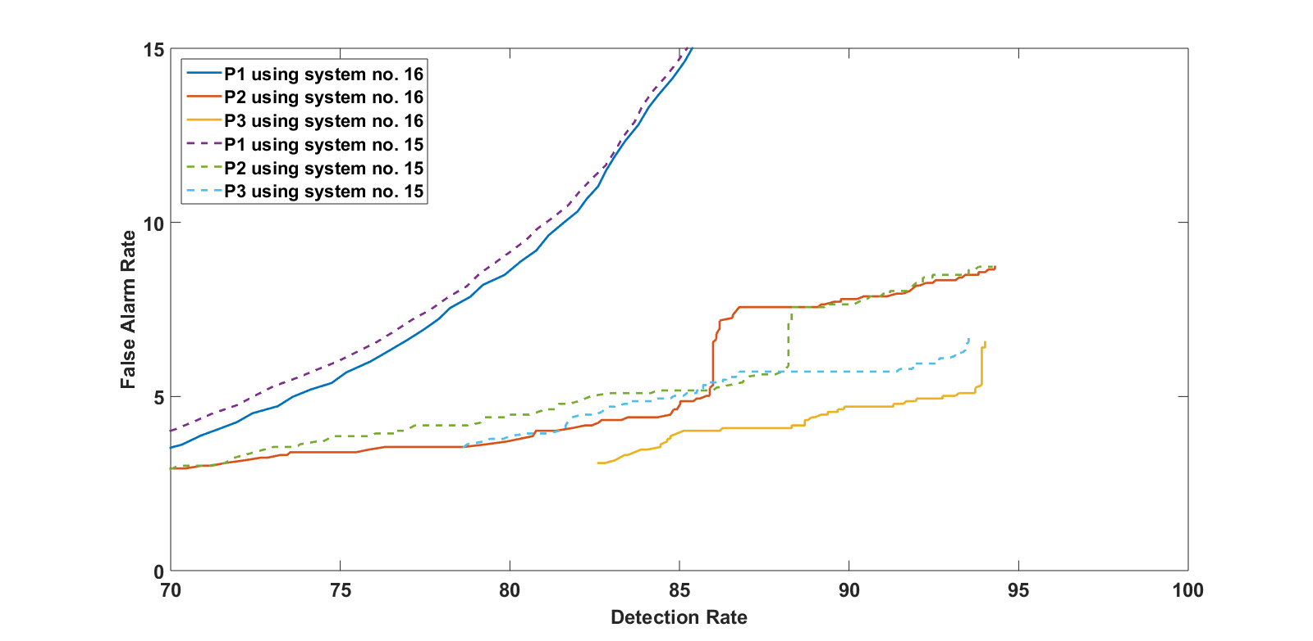
Analysis: Deep Learning and Language Modeling
System no. 15:
7 cepstral coefficients
1 f_energy
1 d_energy
9 deltas for all
9 delta-deltas for all
Total: 27 features
System no. 16:
7 cepstral coefficients
1 f_energy
1 d_energy
9 deltas for all
8 delta-deltas (cepstral + f_energy only)
Total: 26 features

Slide 13
Summary
Established valuable baselines for standard feature extraction approaches for EEG signals.
Traditional feature extraction methods used in speech recognition are relevant to EEGs.
The use of a novel differential energy feature improved performance for absolute features, but that benefit diminishes as first and second order derivatives are included.
There is benefit to using derivatives and there is a small advantage to using frequency domain energy.
There are no significant benefits to using wavelets and other time-frequency representations.
Future work will focus on new feature extraction methods based on principles of deep learning, discriminative training and nonparametric Bayesian models.
The database will be significantly expanded over the next year and evolved into new tasks (e.g., real-time seizure detection).

Slide 14
Brief Bibliography
[1] T. Yamada and E. Meng, Practical Guide for Clinical Neurophysiologic Testing: EEG. Philadelphia, Pennsylvania, USA: Lippincott Williams & Wilkins, 2009.
[2] A. Harati, S. Lopez, I. Obeid, M. Jacobson, S. Tobochnik, and J. Picone, “THE TUH EEG CORPUS: A Big Data Resource for Automated EEG Interpretation,” in Proceedings of the IEEE SPMB, 2014, pp. 1–5.
[3] J. Picone, “Continuous Speech Recognition Using Hidden Markov Models,” IEEE ASSP Mag., vol. 7, no. 3, pp. 26–41, Jul. 1990.
[4] S. Sanei and J. A. Chambers, EEG signal processing. Hoboken, New Jersey, USA: Wiley-Interscience, 2008.
[5] J. Lyons, “Mel Frequency Cepstral Coefficient (MFCC) tutorial,” Practical Cryptography, 2015 (available: http://practicalcryptography. com/miscellaneous/machine-learning/guide-mel-frequency-cepstral-coefficients-mfccs/.
[6] S. Davis and P. Mermelstein, “Comparison of Parametric Representations for Monosyllabic Word Recognition in Continuously Spoken Sentences,” IEEE Trans. ASSP, vol. 28, no. 4, pp. 357–366, 1980.
[7] P. Garrit, et al., “Wavelet Analysis for Feature Extraction on EEG Signals,” presented at Temple University CoE Res. Exp. for UG Conf., 2015 (available at http://www.isip.piconepress.com/publications/ unpublished/conferences/2015/summer_of_code/wavelets/).

