Slide 1
Low Latency Real-Time Seizure Detection Using Transfer Deep Learning
V. Khalkhali, N. Shawki, V. Shah, M. Golmohammadi, I. Obeid, and J. Picone
Neural Engineering Data Consortium
Temple University

Slide 2
Abstract
Scalp electroencephalogram (EEG) signals have a low signal-to-noise ratio.
Temporal and spatial information must be exploited to achieve accurate detection of seizure events.
Most popular approaches to seizure detection using deep learning do not jointly model this information or require multiple passes over the signal, which makes the systems inherently non-causal.
We exploit spatiotemporal information by converting the multichannel signal to a grayscale image and using transfer learning to achieve high performance.
The proposed system is trained end-to-end with only very simple pre- and post-processing operations which are computationally lightweight and have low latency, making them conducive to clinical applications that require real-time processing.
We have achieved a performance of 42.05% sensitivity with 5.78 false alarms per 24 hours on the development dataset of v1.5.2 of the Temple University Hospital Seizure Detection Corpus.
On a single core CPU operating at 1.7 GHz, the system runs faster than real-time (0.58 xRT), uses 16 Gbytes of memory, and has a latency of 300 msec.
Notes:
We propose a system for seizure detection in a real-time manner.
Low SNR EEG signal’s interpretation needs spatiotemporal processing.
We propose a system based on deep learning methods to find the seizure patterns in the EEG signals. It is very lightweight with respect to pre and post processing and can be run in real-time.
We reached good results with very low latency on the famous Temple University Seizure dataset.

Slide 3
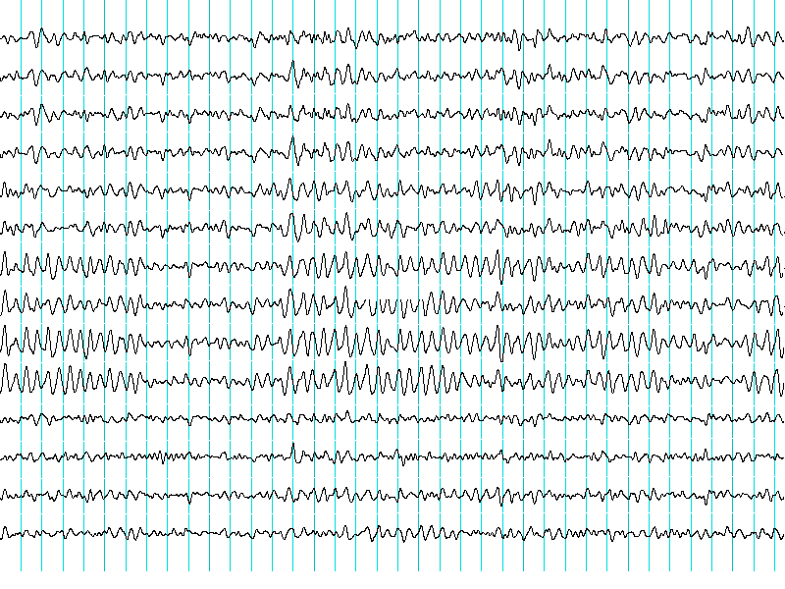
Introduction: Visual Interpretation of an EEG
Manual Interpretation
Human Vision
Train to Visually Interpret EEG
Expert Interpreter of EEG
Normal | Seizure | Normal
Seizure | Seizure | Seizure
Normal | Normal | Normal
? | ➔ | Normal
? | ➔ | Seizure
? | ➔ | Normal
Automatic Interpretation
ImageNet Pretrained Network
EEG Adaptation Training
Machine Interpretation
Notes:
Neurologists are capable of manually interpreting EEGs with accuracies that can exceed machine performance. Image processing approaches, such as those disclosed in ImageNet competitions, attempts to emulate the way humans interpret visual data in an application independent manner.
Manual interpretation of an EEG signal requires detection of very subtle pattens. Accurate classification of these patterns requires a deep learning system with many parameters, which in turn, requires large amounts of manually annotated training data. When the number of model parameters greatly exceeds the number of patterns available for training, overfitting becomes a huge concern. Dropout, batch normalization and other regularization methods attempt to mitigate this, but a better approach is to add relevant data from other sources.
In this way, we can leverage vast amount of training image data available from other applications, such as object recognition and autonomous vehicle navigation.
We attempt to leverage these pretrained models from the ImageNet competition and adapt them to seizure detection.

Slide 4
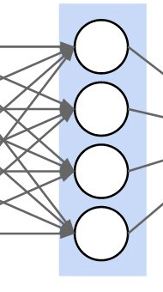
Transfer Learning: Leveraging Pretrained Networks
ResNet18
Input
(D₁, D₂)
Input
(3, 64)
Input
Conv2D@D1xD2
kernel: 7x7
stride: 2x2
padding: 3x3
MaxPool2D@D₁xD₂
kernel: 3x3
stride: 2x2
padding: 1x1
dilation: 1x1
BatchNorm@D₂
Layer 1
ReLU
Basic Block
(64, 64)
Basic Block
(64, 64)
Basic Block
(D₁, D₂)
Layer 2
Basic Block
(64, 128)
Downsample
(64, 128)
Basic Block
(128, 128)
Conv2D@D₁xD₂
k: 3x3
s: 1x1
p: 1x1
Conv2D@D₂xD₂
k: 3x3
s: 1x1
p: 1x1
BatchNorm@D₂
BatchNorm@D₂
ReLU
Basic Block
(128, 256)
Basic Block
(256, 256)
Layer 3
Downsample
(128, 256)
Downsample
(D₁, D₂)
Output
(D₁, D₂)
Basic Block
(256, 512)
Basic Block
(512, 512)
Layer 4
Downsample
(256, 512)
Conv2D@D₁xD₂
k: 1x1
s: 2x2
p: 1x1
Average Pooling
Linear@D₁ to D₂
BatchNorm@D₂
Output
(512, 2)
Output
Notes:
One of the well-known and efficient networks that has achieved good performance is ResNet18. It is a type of deep residual network that overcame the limitations of training very deep networks by introducing identity shortcut connections between the layers.
The ResNet18 model consists of four module blocks as shown in the left figure.
The input block contains a two-dimensional CNN followed by batch normalization and max pooling. The output block consists of an average pooling operation that improves generalization and a linear layer that performs classification.
The numbers in the right figure refers to the dimensions of the input and output planes (channels), respectively.
The four hidden layers are similar in design.
The network is loaded with pretrained parameters from ImageNet. During training, we optimize parameters using a cross-entropy loss function with predefined prior probabilities (weights).

Slide 5
Processing Pipeline: An Overview
Local Normalization
Conversion to Image
Decimation to 50Hz
Postprocessing
ResNet18
Conversion to HDF5
Notes:
Our proposed system passes EEG signals through six major operations to train and find the optimum working points.

Slide 6
Processing Pipeline: Decimation
Local Normalization
Conversion to Image
Decimation to 50Hz
Postprocessing
ResNet18
Conversion to HDF5
Notes:
We found that higher frequencies than 25Hz does not have obvious impact on seizure detection but filtering the input signal can largely reduce the storage, processing needs, and noise power.

Slide 7
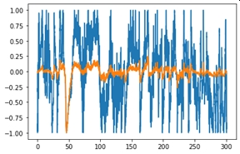
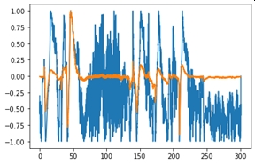
Processing Pipeline: Local Normalization
$$A_{max}\left[n\right]=\max\left(\left|A\left[i\right]\right|\right); n−N/2≤i≤n+N/2$$
Local Normalization
Conversion to Image
Decimation to 50Hz
$$\hat{A}[n]={\left.A[n\right]}/{\left.A_{max}[n\right]}$$
$$A:Amplitude$$
$$n:index of the sample$$
$$N:number of samples in a window centered around current sample$$
$$\hat{A}\left[n\right]:Locally Scaled Image$$
Postprocessing
ResNet18
Conversion to HDF5
Notes:
Scaling or normalization of the resulting signals is a very important step. Channel dependent or global normalization does not work well for this data.
Moving average filters, which are also popular, can significantly diminish spike behavior. Outlier removal is another popular method for artifact removal, but in practice this approach also tends to remove many seizure events.
We chose to implement a local scaling approach, which we refer to as max local scaling, in which all samples in a window are scaled between $\left[−1, +1\right].$
where $A$ is amplitude, $n$ is the current sample and $N$ is the number of samples in a window centered around the current sample. $\hat{A}[n]$ is the locally scaled sample.
In our work, we found that implementing local scaling with a 6‑second center-aligned window gives good results.

Slide 8
Processing Pipeline: Conversion to an Image
Background Windows
Local Normalization
Conversion to Image
Decimation to 50Hz
Seizure Windows
Postprocessing
ResNet18
Conversion to HDF5
Notes:
The next step for data preparation is converting all samples into grayscaled images.
Through experimentation, we found using $256$ samples for every window for every channel is efficient. But, since it is necessary to use a square shaped image as an input to the ResNet system, and the height of the windows is equal to the number of montages, then rescaling these images is necessary. Therefore, the windows are resized from $20×256$ to $256×256$ with cubic interpolation.

Slide 9
Processing Pipeline: Conversion to HDF5
Local Normalization
Conversion to Image
Decimation to 50Hz
The Hierarchical Data Format version 5 (HDF5), is an open-source file format that supports large, complex, heterogeneous data with fast read and write capabilities.
Postprocessing
ResNet18
Conversion to HDF5
Notes:
All necessary operations on neural networks (training, development and evaluation) can be done on images produced on the last step, but it run slow. To improve the speed of processes, especially training, the HDF5 format were used. All 2D images attached vertically and three (train, dev, eval) large HDF5 were made. Every dataset contains two subset which are called bckg and seiz. The total size of HDF5 file for train set is 32GB, dev set is 7GB and eval set is 6.5GB.
Since accessing HDF5 is much faster than images, the training process will be run much faster.
Also, the samples in HDF5 files are arranged sequentially, random sampling (without replacement) removes the need for a windowing process with predefined overlaps.

Slide 10
Processing Pipeline: Retraining ResNet18
$$ω_{b}=\frac{N_{seiz}}{N}, ω_{s}=\frac{N_{bckg}}{N} ,$$
Local Normalization
Conversion to Image
Decimation to 50Hz
$$N:Total number of samples$$
$$N_{seiz}:Number of seizure samples$$
$$N_{seiz}:Number of background samples$$
$$loss_{weighted}=ω_{b}∗loss\left(x_{i}, b\right)+ω_{s}∗loss\left(x_{i},s\right),$$
$$x_{i}:i^{th} input sample$$
$$b:background index$$
$$s:seizure index$$
$$loss\left(x, y\right):cross entropy or mse$$
Postprocessing
ResNet18
Conversion to HDF5
Notes:
Seizures occur about 7% of the time in the TUSZ Corpus. Since the distribution of classes is highly unbalanced, we must adjust the weights of the loss function. Hence, to better balance the number of seizure and background patterns, we randomly selected one-fifth of the background patterns. It was observed that using all the background samples did not improve the results. In practice, we have used about 30,000 samples for seizure events and 100,000 samples for background events.
To further adjust for the unbalanced number of samples in the two classes, we include prior probabilities in the loss function computation.
By observing the confusion matrix, the low false positive and high true positive of the ResNet18 on both train and development set show that the system has done his best to distinguish seizure samples between very complex shapes of backgrounds.
But the false positive ratio is still too high to be accepted in clinical applications.

Slide 11
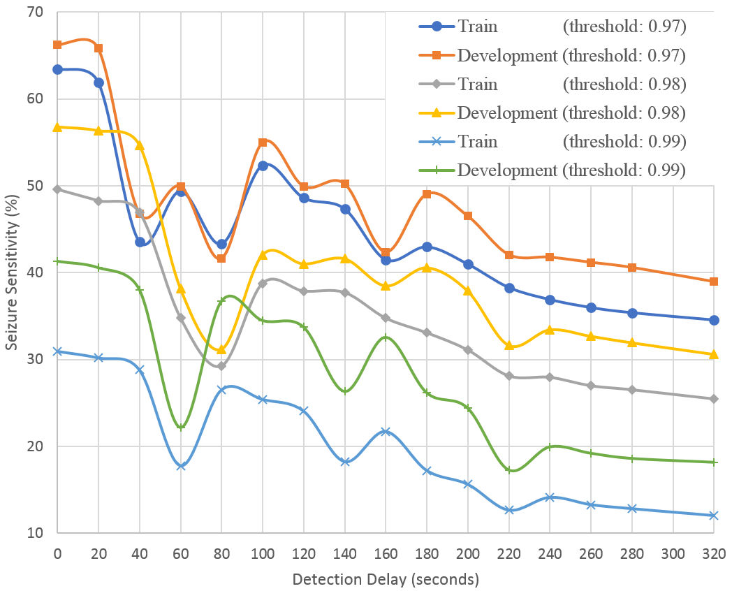
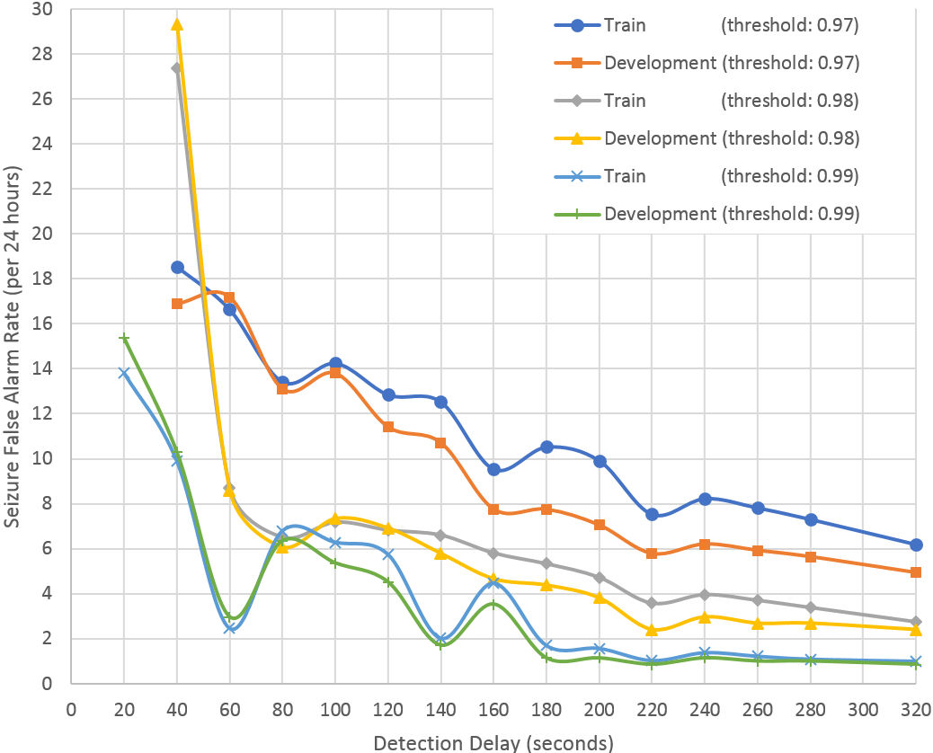
Processing Pipeline: Postprocessing
Seizure confidence threshold, Sth
Minimum acceptable background duration, Bdmin
Minimum acceptable seizure duration, SDmin
Local Normalization
Conversion to Image
Decimation to 50Hz
$$Detection Delay={BD}_{min}+{SD}_{min}$$
Sensitivity
False Alarm
Postprocessing
ResNet18
Conversion to HDF5
Notes:
The raw classification performance of ResNet18 is poor and needs additional postprocessing. Our postprocessor is based on three parameters:
Seizure confidence threshold
Minimum acceptable background duration
Minimum acceptable seizure duration
The first parameter reduces noisy decisions by increasing the seizure confidence threshold. The second and third parameters act similar to dilation and erosion in morphological image processing.
Once the threshold is applied, then all background windows between two seizure events with a duration less than (BDmin) will be classified as seizures. Similarly, all seizure events with a duration less than SDmin will be classified as background.
Detection delay is defined as the summation of minimum acceptable duration of background and seizure events.
Postprocessing has a significant impact on both the misclassification errors and the false alarm rate. Left figure shows the sensitivity as a function of the detection latency. Right shows the false alarm rate as a function of the detection latency.
The false alarm rate is significantly reduced by increasing the detection delay. There is also a moderate reduction in sensitivity.

Slide 12
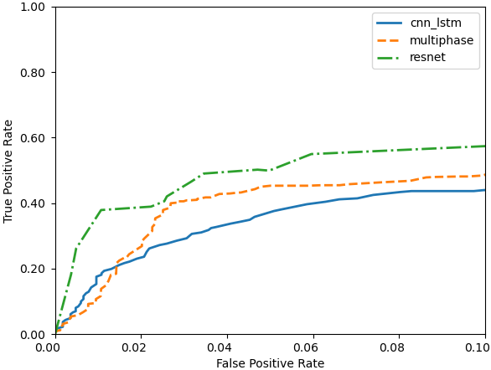
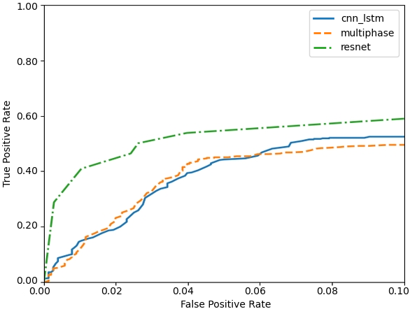
Results: Performance Comparison Using Overlap Scoring
Three systems were evaluated:
cnn_lstm: a hybrid CNN/LSTM system
mphase: a multipass system
resnet: transfer learning
System | Sensitivity | FA Rate (/24H)
cnn_lstm | 43.69% | 20.85
mphase | 40.12% | 6.62
resnet | 42.05% | 5.78
Development Data
Evaluation Data
ResNet outperforms both of these systems when the FA rate is low.
Notes:
In the left figure, we compare the performance of the proposed system to two other previously published systems: a hybrid CNN/LSTM system (cnn_lstm) developed by Golmohammadi and a multiphase system (mphase) developed by Shah.
This comparison was performed on the development data set (dev) using the overlap (OVLP) scoring metric. Note that we focus on performance for the range $[0,0.1]$ where false alarms are very low. This is the operating region of most interest for this application.
In the right figure, a similar analysis is shown for the blind evaluation set (eval). It is important to note that no tuning was performed based on the evaluation set results.
The seizure sensitivity and false alarm rate of the new system, which are 42.05% and 5.78/24h, respectively, are better than our previous best results (40.12% and 6.62/24h for the multiphase system). However, it is important to note that the resnet system is much simpler, has much less latency, and runs faster than real-time on relatively modest computing resources. This makes it ideal for critical care applications.

Slide 13
Results: Analysis of the False Positive Rate
Comparison with two top systems in the NeurekaTM 2020 Epilepsy Challenge.
ResNet still lags the two best performing systems (sia and pnc98).
The ResNet system runs faster than real time with a latency of 300 ms. The competition systems are non-real-time with infinite latency.
Development Data
Evaluation Data
Metric |  | cnn lstm | multi phase | resnet | sia | pnc98
D P A L | Sens | 45.17 | 36.70 | 20.36 | 23.45 | 6.98
 | Spec | 88.63 | 96.25 | 96.72 | 99.47 | 98.33
 | FPs | 23.25 | 6.76 | 5.50 | 0.97 | 2.54
E P C H | Sens | 37.67 | 36.34 | 49.83 | 12.84 | 1.56
 | Spec | 96.56 | 97.16 | 92.64 | 99.97 | 99.99
 | FPs | 2686.97 | 2221.29 | 5753.08 | 25.85 | 8.45
O V L P | Sens | 43.69 | 40.12 | 42.06 | 23.26 | 6.39
 | Spec | 91.71 | 97.19 | 97.40 | 99.74 | 99.65
 | FPs | 20.85 | 6.62 | 5.78 | 0.64 | 0.85
T A E S | Sens | 35.83 | 32.27 | 15.34 | 11.38 | 2.04
 | Spec | 83.91 | 90.18 | 88.81 | 99.46 | 99.42
 | FPs | 32.55 | 18.07 | 19.42 | 0.99 | 0.87
 | WGT | -53.05 | -21.21 | -40.71 | 2.59 | 0.83
Metric |  | cnn lstm | multi phase | resnet | sia | pnc98
D P A L | Sens | 54.79 | 45.01 | 14.29 | 24.07 | 8.61
 | Spec | 90.41 | 94.47 | 98.03 | 99.31 | 99.44
 | FPs | 21.79 | 11.61 | 3.50 | 1.27 | 0.95
E P C H | Sens | 38.15 | 52.04 | 42.82 | 1.27 | 5.09
 | Spec | 98.40 | 98.27 | 95.88 | 99.95 | 100.00
 | FPs | 1282.04 | 1391.52 | 3314.04 | 43.23 | 2.07
O V L P | Sens | 51.47 | 44.62 | 37.18 | 23.88 | 8.41
 | Spec | 92.63 | 95.48 | 98.33 | 99.61 | 99.93
 | FPs | 19.25 | 11.45 | 3.82 | 0.96 | 0.16
T A E S | Sens | 39.46 | 37.80 | 10.97 | 12.37 | 2.04
 | Spec | 87.49 | 91.29 | 93.51 | 99.22 | 99.90
 | FPs | 28.21 | 18.39 | 11.82 | 1.44 | 0.17
 | WGT | -38.57 | -16.58 | -26.08 | 2.46 | 0.82
Notes:
In the above tables, we compare the results of the proposed system to several leading systems including two of the top systems that participated in the NeurekaTM 2020 Epilepsy Challenge. These tables include the raw scores for sensitivity, specificity, and the false alarm rate for four scoring metrics. The last metric, time-aligned event scoring (TAES), also shows the final weighted score (WGT) using the weighting function adopted for the competition.
From these results, we see that the performance of the resnet system still lags the two best performing systems from the competition, sia and pnc98. However, the resnet system was designed to be real-time and low latency, while the best performing systems in the competition were non-real time with infinite latency and focused more on minimizing the weighted error metric.

Slide 14
Conclusions
Real-Time System
Sensitivity
Delay
False Alarm
Transfer deep learning is used to improve spatiotemporal modeling and accelerate convergence during training.
Through the optimization of three critical parameters:
Sensitivity
False Alarm Rate
Detection Latency
real-time performance comparable to offline systems, can be achieved on v1.5.2 of the TUH EEG Seizure Detection Corpus without sacrificing performance:
Sensitivity: 42.05%
False Alarm Rate: 5.78 false alarms per 24 hours
While the number of samples in our database is relatively large, we do observe overfitting tendencies on the training dataset.
Though cross-validation was used, we plan to explore other pretrained ImageNet networks to avoid overfitting and improve generalization.
Notes:
Designing high sensitivity, low false alarm, and low delay seizure detection systems from noninvasive electroencephalogram scalp measurements is challenging. We have shown that with some trade-offs between three critical parameters – sensitivity, false alarm rate, and detection delay – real-time performance can be achieved without sacrificing performance.
Transfer deep learning is the core of the proposed system and helps our approach in two important ways: spatiotemporal interpretation of EEG signals and neural network convergence. The multiresolution convolutional layers in ResNet18 can effectively encode spatial and temporal relationships. Data augmentation in transfer learning makes the training fast and more importantly, it improves the convergence of a large neural network significantly. While the number of samples in our database is relatively large, we do observe overfitting tendencies on the training dataset. Though cross-validation was used, we plan to explore other pretrained ImageNet networks to assess their impact on overfitting and maintain generality.

Slide 15
Acknowledgments
This material is based upon work supported by the National Science Foundation under Grant No. IIP‑1827565. Any opinions, findings, and conclusions or recommendations expressed in this material are those of the author(s) and do not necessarily reflect the views of the National Science Foundation.
The TUH EEG Corpus effort was initially funded by (1) the Defense Advanced Research Projects Agency (DARPA) MTO under the auspices of Dr. Doug Weber through the Contract No. D13AP00065, (2) Temple University’s College of Engineering and (3) Temple University’s Office of the Senior Vice-Provost for Research. A number of funding agencies including the National Science Foundation and the National Institutes of Health have since contributed to its development.
NEDC’s data and resources are freely available at:
https://www.isip.piconepress.com/projects/tuh_eeg/html/downloads.shtml

Slide 16
Brief Bibliography
Y. Roy, R. Iskander, and J. Picone, “The NeurekaTM 2020 Epilepsy Challenge,” NeuroTechX, 2020. [Online]. Available: https://neureka-challenge.com/. [Accessed: 16-Apr-2020].
V. Shah, I. Obeid, J. Picone, G. Ekladious, R. Iskander, and Y. Roy, “Validation of Temporal Scoring Metrics for Automatic Seizure Detection,” in Proceedings of the IEEE Signal Processing in Medicine and Biology Symposium (SPMB), 2020, pp. 1‑5. https://ieeexplore.ieee.org/abstract/document/9353631.
M. Golmohammadi, Deep Architectures for Spatio-Temporal Sequence Recognition With Applications in Automatic Seizure Detection, Temple University, 2021. https://www.isip.piconepress.com/publications/ phd_dissertations/2021/seizure_detection/.
V. Shah et al., “The Temple University Hospital Seizure Detection Corpus,” Front. Neuroinform., vol. 12, pp. 1‑6, 2018. ﻿http://journal.frontiersin.org/researchtopic/1563/pdf.
C. Gómez, P. Arbeláez, M. Navarrete, C. Alvarado-Rojas, M. Le Van Quyen, and M. Valderrama, “Automatic seizure detection based on imaged-EEG signals through fully convolutional networks,” Sci. Rep., vol. 10, no. 1, p. 21833, 2020. ﻿https://doi. org/10.1038/s41598-020-78784-3.

