Slide 1
Development of a fast and efficient algorithm for p300 event related potential detection
A master’s thesis Presentation
by Elliot Franz
Advisor: Iyad Obeid, phd
ECE Department, Temple University

Slide 2
Presentation overview
Project Background
BCI Dataset
Experimental Design
Data Processing
Phase I Results
Phase II Results
Shortcomings/Future work

Slide 3
1.) Background Overview
Timeline
Brain Computer Interfaces
P300 Event Related Potential (ERP)
P300 Speller
Emotiv EPOC
Grass Model 12 Neurodata Acquisition System

Slide 4
TimeLine From Proposal

Slide 5
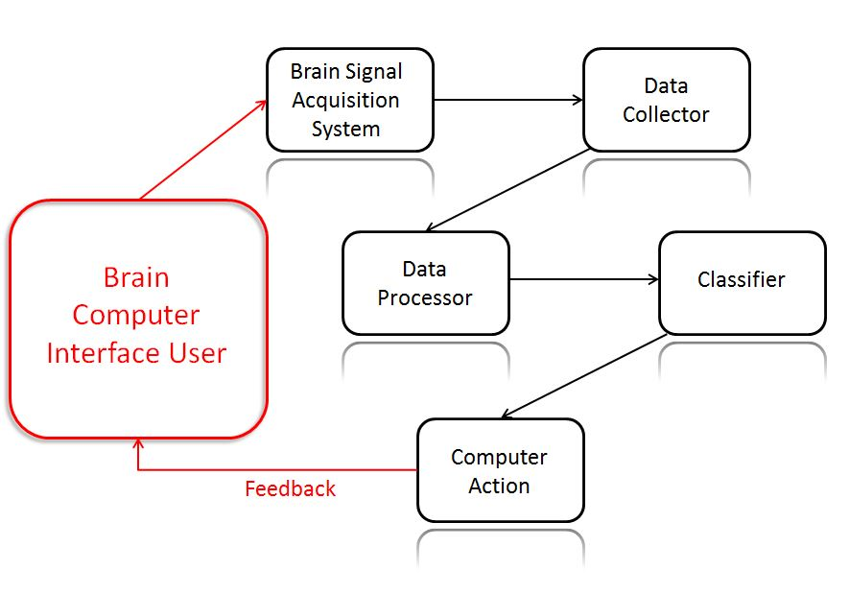
Brain computer Interfaces
What are BCIs?
Why BCIs?
How is brain data acquired?
Surface EEG, Intercranial EEG, Funtional MRI (fMRI)

Slide 6
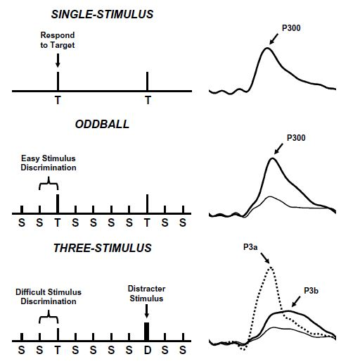
P300 Event Related Potential
What is P300?
Why P300 BCI?
How is
P300 elicited?
Three protocols
Oddball
J. Polich, Clinical Neurphysiology. 2007

Slide 7
Factors which affect p300
A variety of biological factors affect the latency and the amplitude of the P300 ERP
Eating food
Body temperature
Exercise
Rarity of target
Inter-stimulus Interval (ISI)

Slide 8
P300 Speller
H. Cecotti, et al. Pattern Analysis and Machine Intelligence. 2011

Slide 9
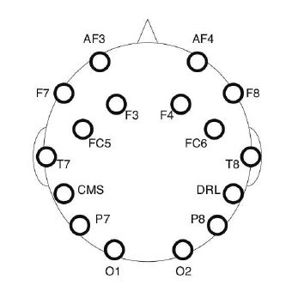
Emotiv EPOC
14 saline electrodes (plus 2 reference) EEG headset
Proprietary 2.4 GHz wireless
Unshielded wires
12 bit A/D converter
0.51 μV resolution
On board pre-filters
0.2 – 45 Hz bandpass
M. Duvinage, et al. Biomedical Engineering. 2012

Slide 10
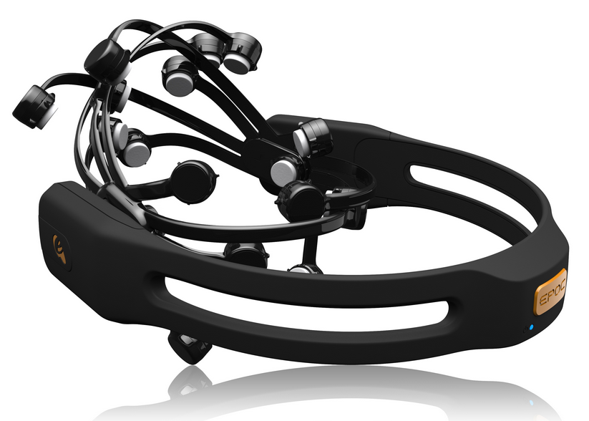
Emotiv EPOC
Image: www.emotiv.com

Slide 11
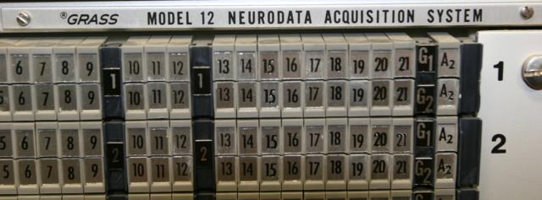
Grass Model 12 Neurodata acquisition system
Capable of recording from 21 Channels
Analog Filters
Capable of bandpass filtering signals (in these experiments, analog signals were filtered between 0.1 and 300 Hz)
Notch filter at 60 Hz

Slide 12
Presentation overview
Project Background
BCI Dataset
Experimental Design
Data Processing
Phase I Results
Phase II Results
Shortcomings/Future work

Slide 13
2.) BCI Dataset Overview
Comparison of Electrode Locations
Algorithm Classification Accuracy (8 parietal electrodes)
Algorithm Classification Accuracy (1 electrode)
Computation Time
2003 BCI Competition Winners

Slide 14
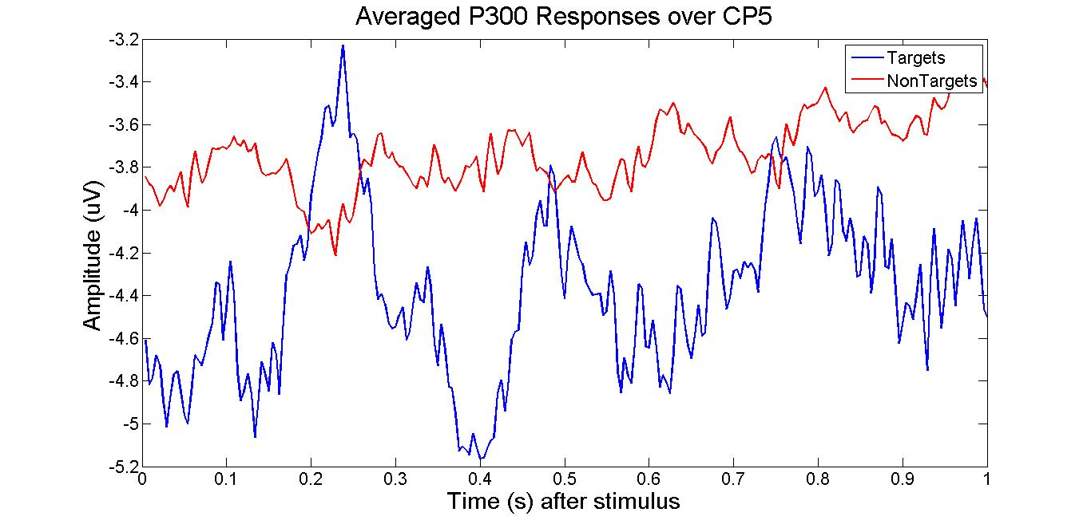
Averaged recordings over c_{z} and CP₅

Slide 15
Classification accuracy (8 parietal electrodes)

Slide 16
Classification Accuracy (1 Electrode)

Slide 17
Bci Winners
A. Rakotomamonjy, et al. IEEE Transactions on Biom. Engr. 2008

Slide 18
Computation Time

Slide 19
Presentation overview
Project Background
BCI Dataset
Experimental Design
Data Processing
Phase I Results
Phase II Results
Shortcomings/Future work

Slide 20
3.) Experimental Design Overview
Block Diagram of Experiment
Hardware Preparation
EPOC
Grass Amplifiers
Software Preparation
OpenViBE
TestBench
LabView SignalExpress
Patient Instruction and Recording Environment
Recording Details

Slide 21
Experimental Setup

Slide 22
Hardware Preparation
EPOC
Moisten Saline electrodes
Place headset backwards on head and power on
Grass Electrodes
Using Tensive gel and medical tape, apply electrodes to scalp as closely as possible to the saline electrodes towards the top and center of the head
Isoground and reference electrode used in addition to 8 channels
Place cap over electrodes to secure

Slide 23
Software preparation
OpenViBE
Close all background programs on simulating computer
Choose appropriate number of characters to spell
Position spelling matrix on display for patient
TestBench
Configure software to receive markers from COM port
LabView Signal Express
Choose 9 channels to record from on the SCB-68 (one channel is the marker channel)
Set collection parameters (NRSE, 240 Hz sampling rate)
Notes:
In an NRSE measurement system, all measurements are still made with respect to a single-node analog input sense (AISENSE), but the potential at this node can vary with respect to the measurement system ground. The previous figure illustrates that a single-channel NRSE measurement system is the same as a single-channel differential measurement system. http://zone.ni.com/reference/en-XX/help/370466V-01/measfunds/refsingleended/

Slide 24
Recording details
Emotiv EPOC
Sampling rate of TestBench is 128 Hz
2.4 GHz wireless dongle transmits signals from EPOC to recording computer
Grass Model 12 Neurodata acquisition system
Amplification set to 20,000 times
Bandpass filtering between 0.1 and 300 Hz
Sampling rate is 240 Hz
SCB-68 serves as the input for 8 channels from amplifiers and 1 channel from the COM port on the simulating computer

Slide 25
Recording Environment
Consistent lighting and size of spelling matrix through all trials
30.5 cm wide by 28 cm height
Patient seated eye-level from matrix one meter away
Stimulus flashed for 210 ms, matrix blank for 265 ms
20 characters spelled followed by a five minute break (room lights on) and 15 more spelled characters

Slide 26
Patient instructions
Make note of the character to spell at the beginning of each epoch
It appears highlighted in green prior to the start of each epoch
Sit as still as possible
Mentally count the number of times the target character flashes

Slide 27
A subject is seated facing the screen with the 6x6 character matrix displayed. The subject is wearing a cloth cap which helps to secure the gold cup electrodes. Holes have been cut in the cap for the EPOC electrodes to contact the scalp. The overhead lighting is turned on in this picture, but is turned off during actual trials.

Slide 28
Presentation overview
Project Background
BCI Dataset
Experimental Design
Data Processing
Phase I Results
Phase II Results
Shortcomings/Future work

Slide 29
4.) Data processing Overview
Preprocessing
Implementation of Spatial Filters and Classification Algorithms
Implementation of Row and Column Eliminating Algorithms

Slide 30
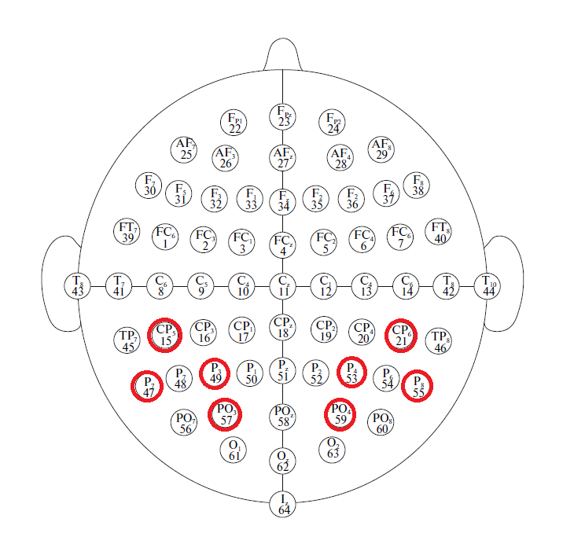
Preprocessing
Data Recorded from the following parietal electrodes:

Slide 31
Preprocessing
Data separated into 1 second epochs
Each channel bandpass filtered between 0.1 and 15 Hz with a fourth order Butterworth filter
Downsampled to 40 Hz (40 samples for a 1 second epoch)
Data scaled to the interval (-1,1)
Data averaged over n intensification cycles (where n = 1, 2, 3, 7, 15)
If used, spatial filter applied here

Slide 32
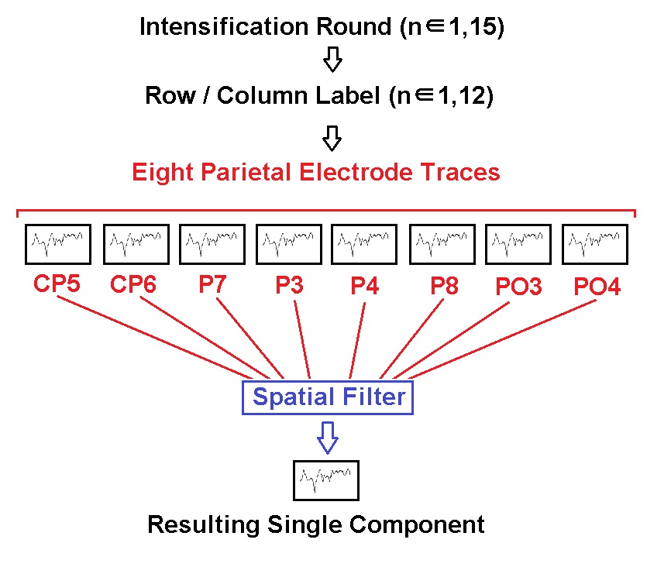
Spatial Filters
Grand Averaging, ICA, and PCA implemented in MATLAB

Slide 33
Classification Algorithms
P300 Detection is a binary classification problem
Identify target or non-target
Algorithms used: FLDA, BLDA, PCM, SVM, Parallel FLDA, and Parallel BLDA
MATLAB packages used to implement all algorithms (except PCM)

Slide 34
Parallel methods

Slide 35
Presentation overview
Project Background
BCI Dataset
Experimental Design
Data Processing
Phase I Results (Three Subjects)
Phase II Results (Five Subjects)
Shortcomings/Future work

Slide 36
EPOC Results

Slide 37
Grass Amplifier Results

Slide 38
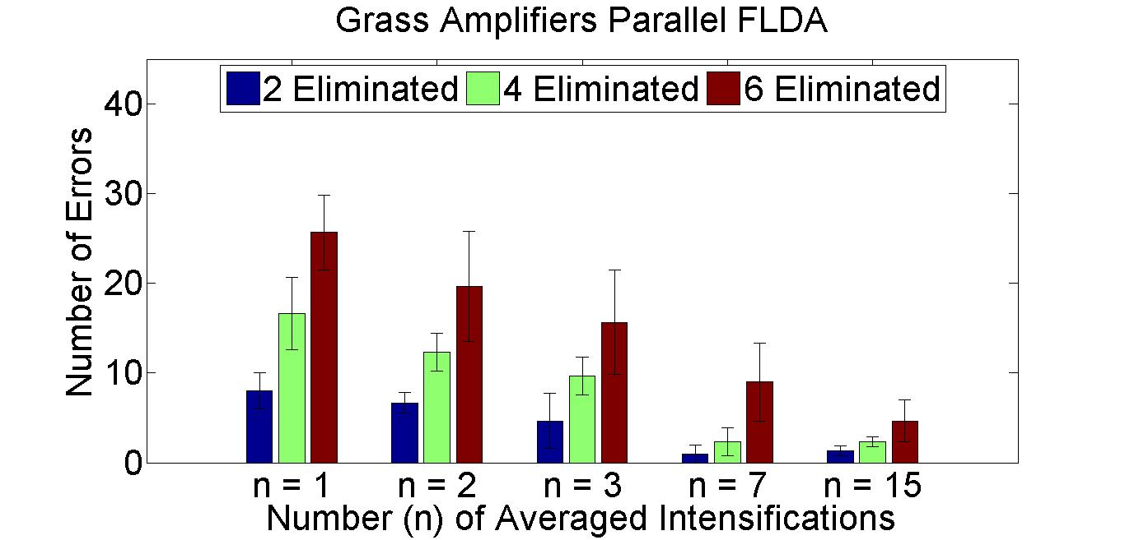
Row and column eliminating algorithms
Number of errors by random chance:
2 Eliminated = 22 errors
4 Eliminated = 40 errors
6 Eliminated = 54 errors

Slide 39
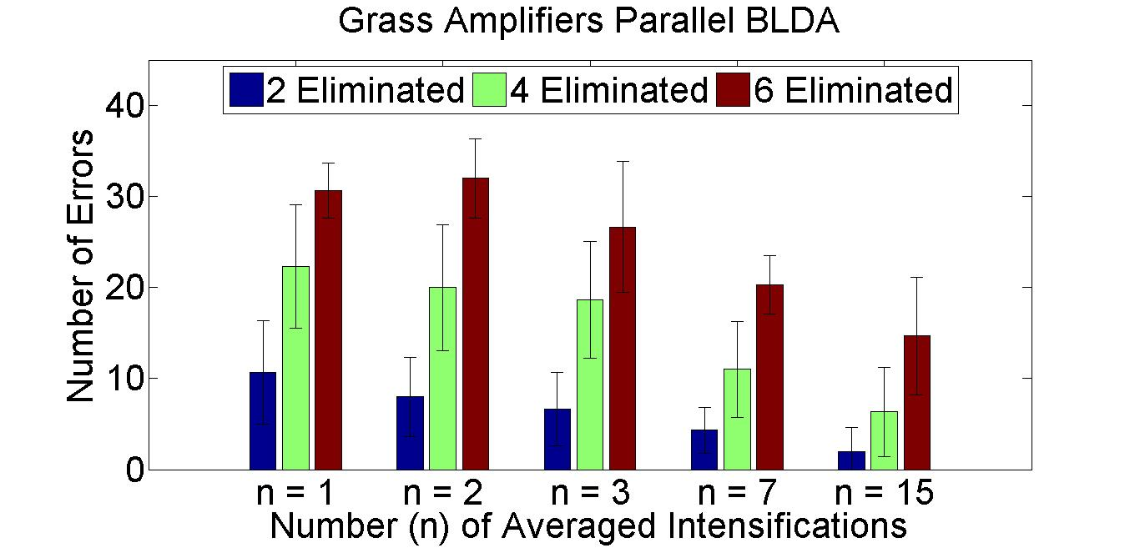
Row and column eliminating algorithms

Slide 40
Presentation overview
Project Background
BCI Dataset
Experimental Design
Data Processing
Phase I Results (Three Subjects)
Phase II Results (Five Subjects)
Shortcomings/Future work

Slide 41
EPOC Results

Slide 42
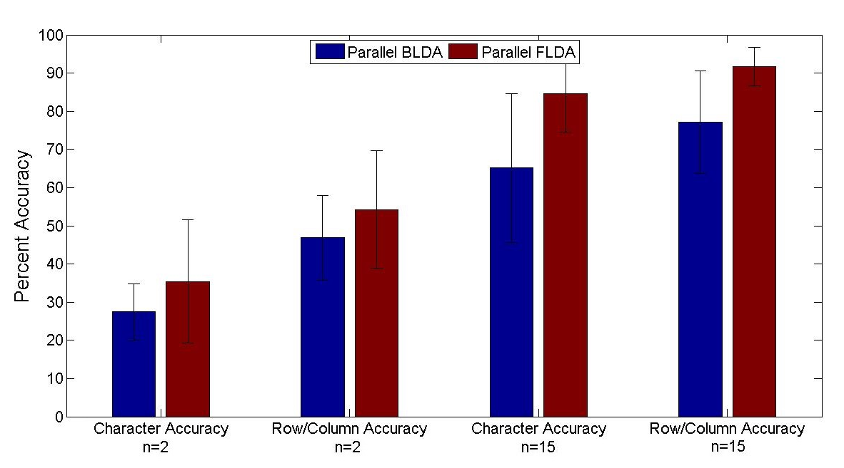
Grass Amplifier Results

Slide 43
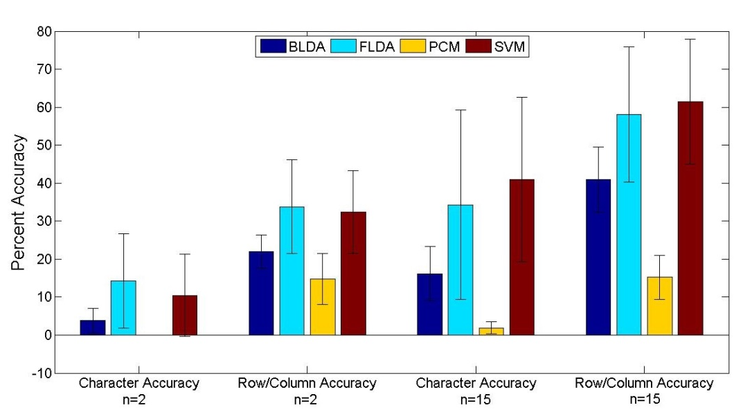
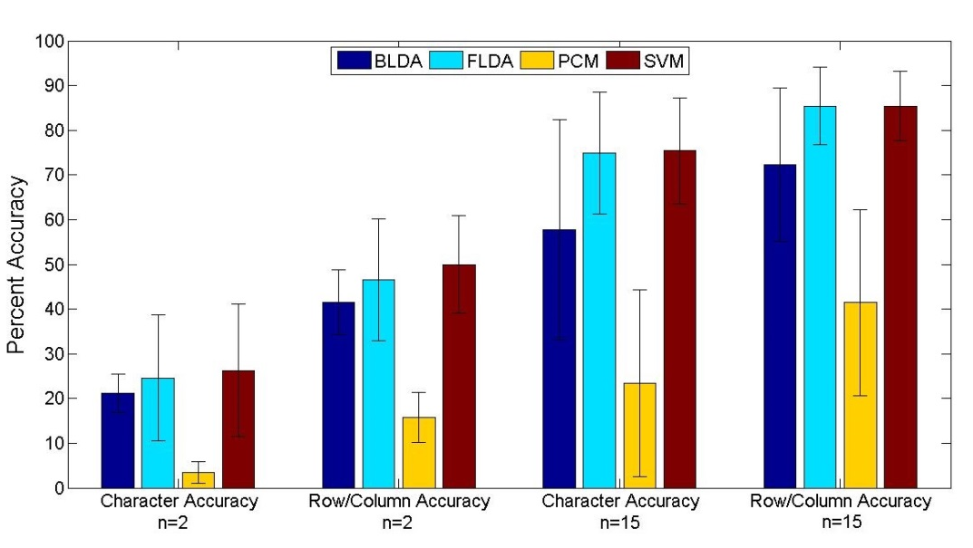
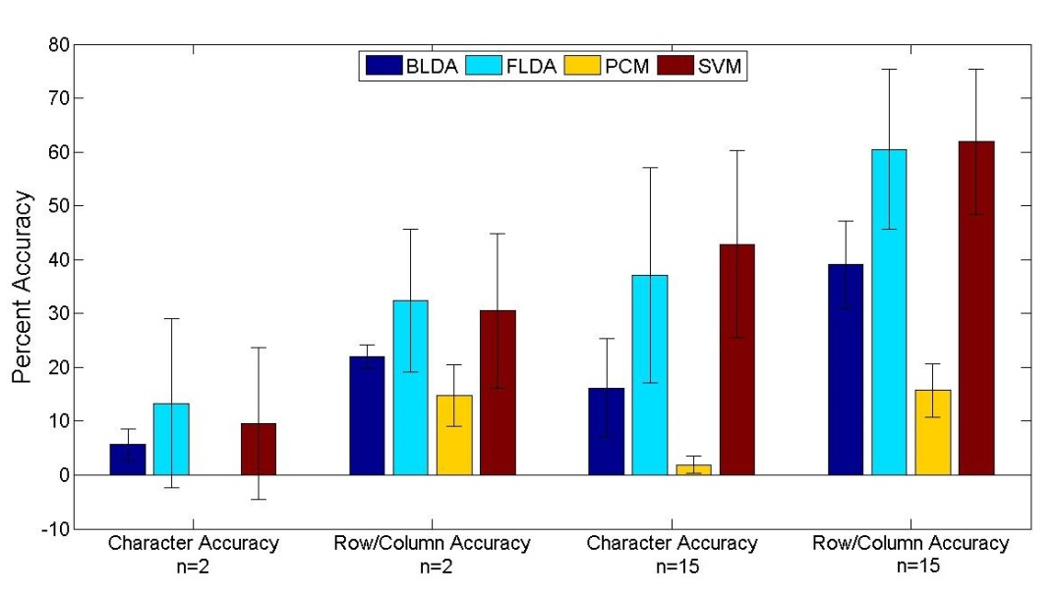
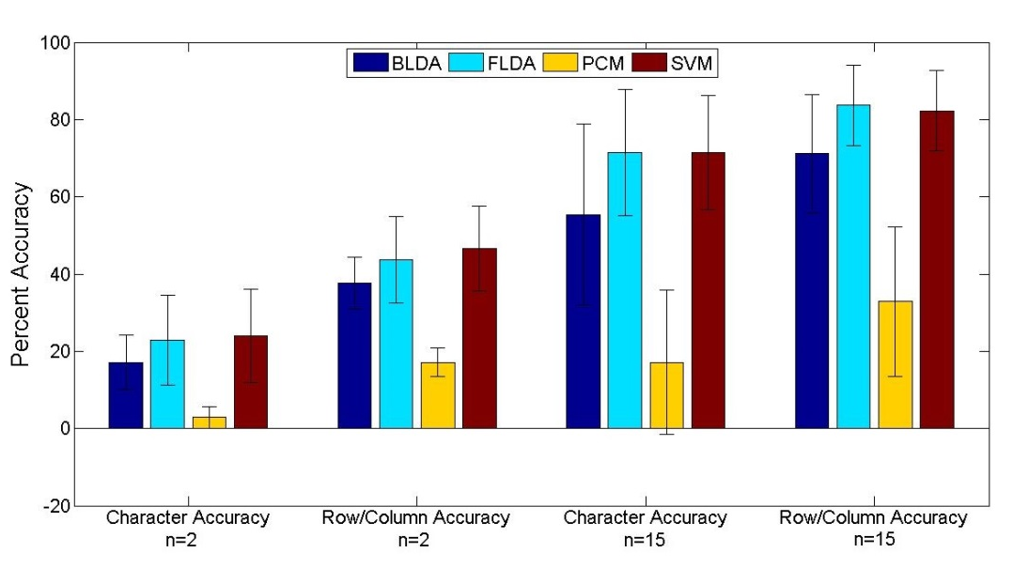
Phase I
Phase II
Grand Averaging
PCA

Slide 44
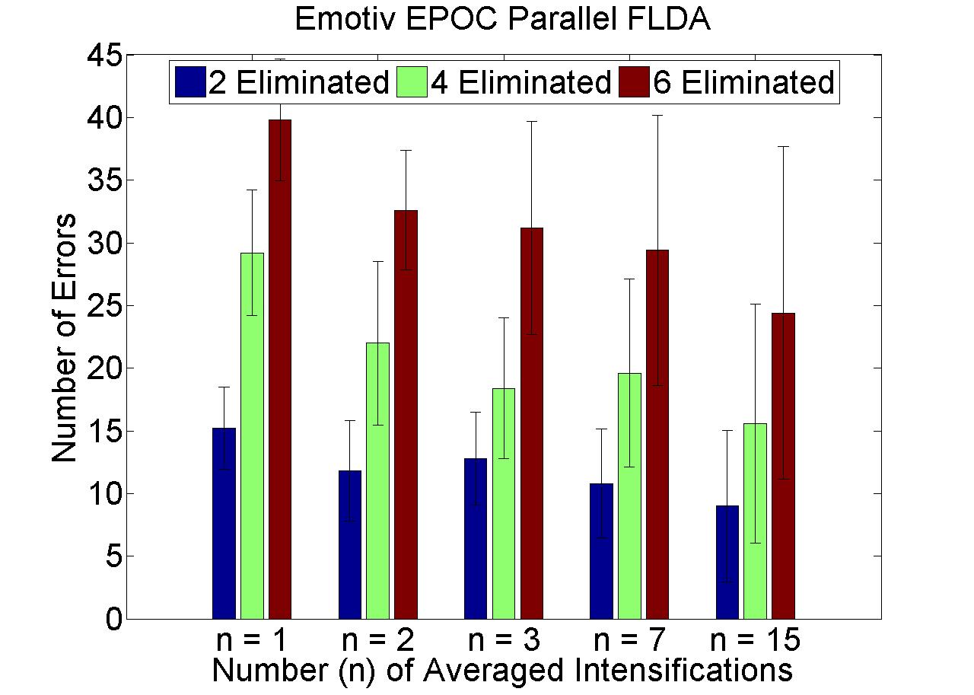
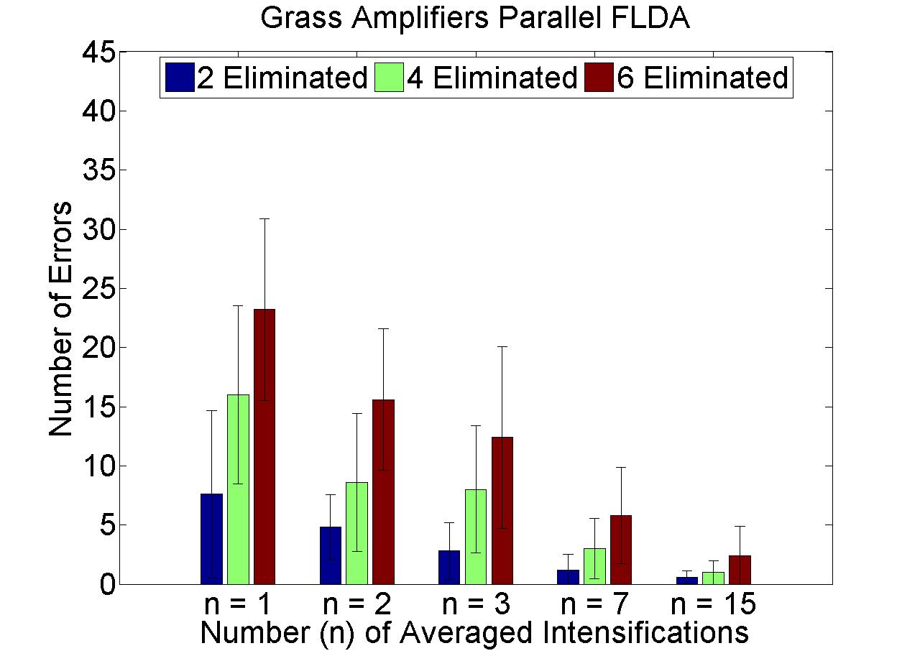
Row and column eliminating algorithms

Slide 45
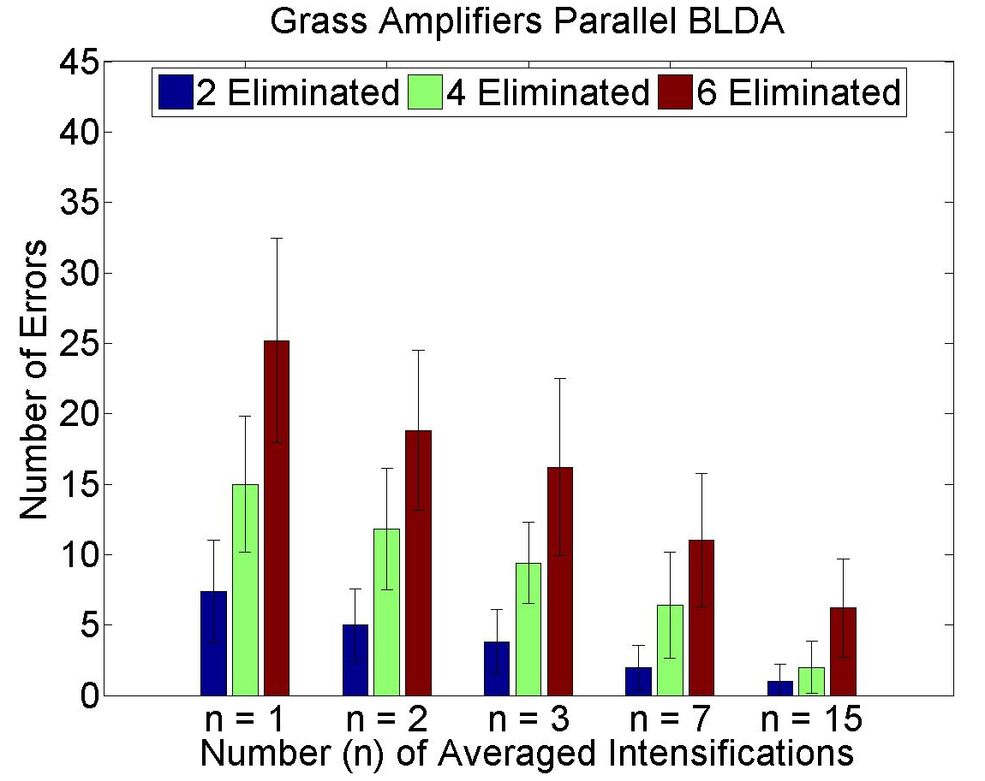
Row and column eliminating algorithms

Slide 46
Presentation overview
Project Background
BCI Dataset
Experimental Design
Data Processing
Phase I Results (Three Subjects)
Phase II Results (Five Subjects)
Shortcomings/Future work

Slide 47
Future work
Test real-time row/column eliminating P300 speller
Evaluate character accuracy
Compare accuracies of this method vs. accuracies with 15 intensifications
Evaluate time savings
More subjects and multiple sessions
Pick appropriate sample size based on population, confidence interval, and confidence level

Slide 48
Shortcomings
Oxidization of saline electrodes over time
Small number of subjects (3 subjects for Phase I and 5 subjects for Phase II)
No tracking of subject improvement over multiple sessions
Electrodes used for analysis were pre-set
Implement recursive electrode elimination

Slide 49
acknowledgements
Thanks to Dr. Iyad Obeid and the committee for useful project advice, Andrew Williams for assistance in collection of data, and the Electrical Engineering Department of Temple University for funding

Slide 50
