Slide 1
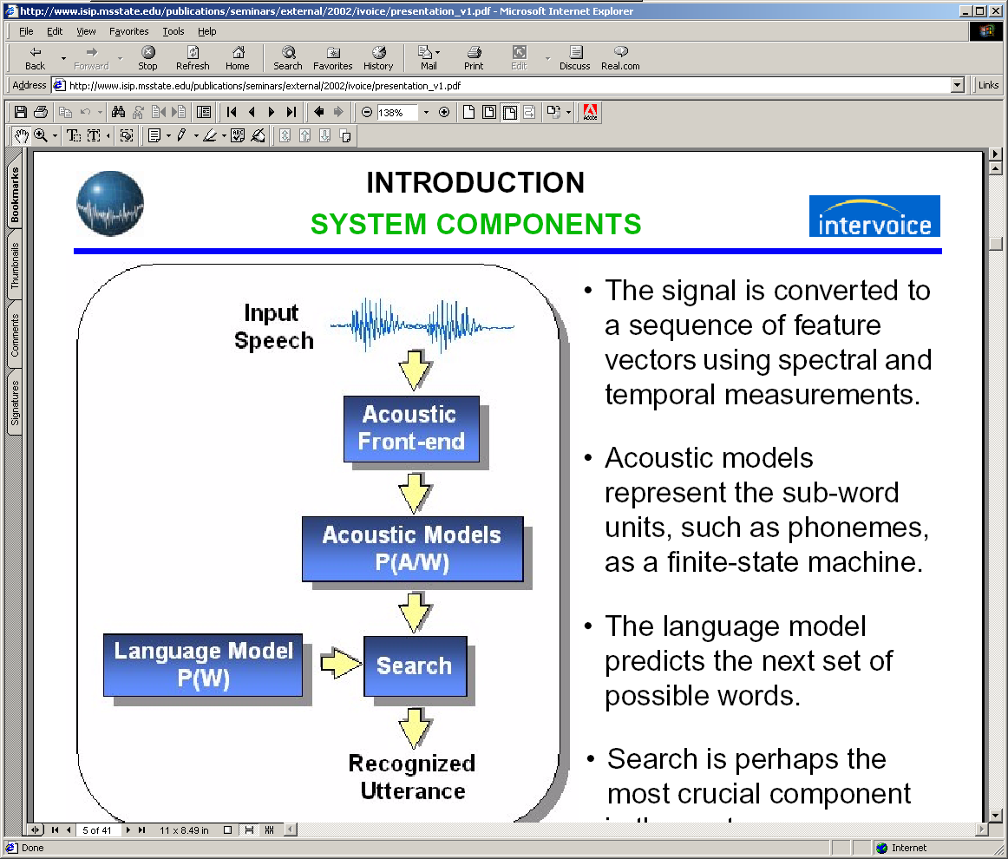
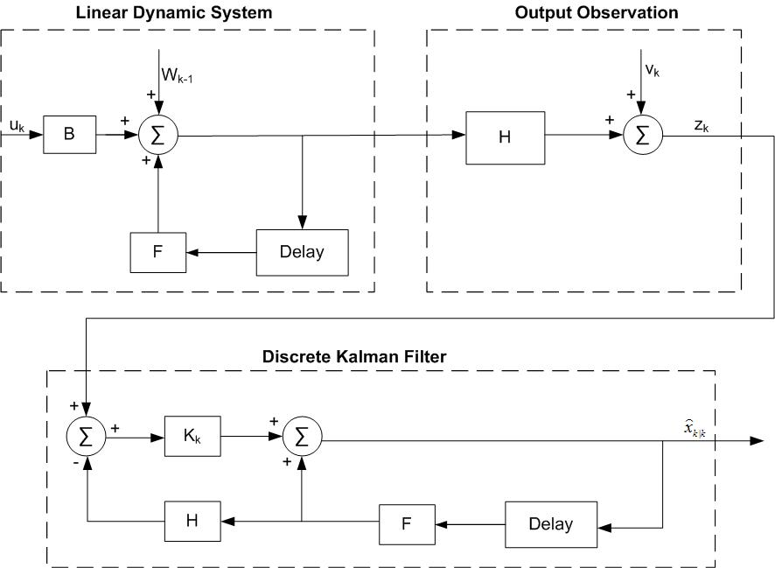
LINEAR DYNAMIC MODEL FOR CONTINUOUS SPEECH RECOGNITION
Ph.D. Candidate: Tao Ma
Department of Electrical and Computer Engineering
Mississippi State University
November 30, 2010

Slide 2
Abstract
In this dissertation work, we address the theoretical weakness of traditional HMM method and develop a hybrid speech recognizer to effectively integrate linear dynamic model into traditional HMM-based framework for continuous speech recognition. Traditional methods simplify speech signal as a piecewise stationary signal and speech features are assumed to be temporally uncorrelated. While these simplifications have enabled tremendous advances in speech processing systems, for the past several years progress on the core statistical models has stagnated. Recent theoretical and experimental studies suggest that exploiting frame-to-frame correlations in a speech signal further improves the performance of ASR systems.
Linear Dynamic Models (LDMs) take advantage of higher order statistics or trajectories using a state space-like formulation. This smoothed trajectory model allows the system to better track the speech dynamics in noisy environments. The proposed hybrid system is capable of handling large recognition tasks such as Aurora-4 large vocabulary corpus, is robust to noise-corrupted speech data and mitigates the effort of mismatched training and evaluation conditions. This two-pass system leverages the temporal modeling and N-best list generation capabilities of the traditional HMM architecture in a first pass analysis. In the second pass, candidate sentence hypotheses are re-ranked using a phone-based LDM model.

Slide 3
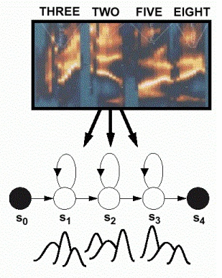
Speech Recognition System
Hidden Markov Models with Gaussian Mixture Models (GMMs) to model state output distributions
Bayesian model based approach for speech recognition system

Slide 4
Is HMM a perfect model for speech recognition?
Progress on improving the accuracy of HMM-based system has slowed in the past decade
Theory drawbacks of HMM
  False assumption that frames are independent and stationary
  Spatial correlation is ignored (diagonal covariance matrix)
  Limited discrete state space
Accuracy
Clean
Noisy
Time

Slide 5
Motivation of Linear Dynamic Model (LDM) Research
Motivation
  The ideal acoustic model should reflect the real characteristics of speech signals
  LDM has good ability to track system dynamics. Incorporating frame-to-frame correlation of speech signals has potential to increase recognition accuracy
  LDM has built-in noise components to estimate real system state from noise corrupted observations, which has potential to increase noise robustness
  Fast growing computation capacity make it realistic to build a two-way HMM/LDM hybrid speech recognizer

Slide 6

State Space Model
Linear Dynamic Model (LDM) is derived from State Space Model
Equations of State Space Model:

Slide 7

Linear Dynamic Model
Equations of Linear Dynamic Model (LDM)
  Current state is only determined by previous state
  H, F are linear transform matrices
  Epsilon and Eta are Gaussian noise components
  y: observation feature vector
  x: corresponding internal state vector
  H: linear transform matrix between y and x
  F: linear transform matrix between current state and previous state
  epsilon: Gaussian noise component
  eta: Gaussian noise component

Slide 8
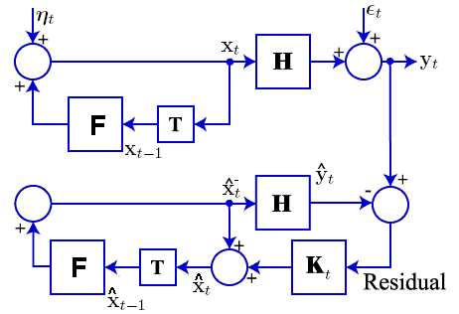
Kalman filtering for state inference
For a speech sound,
Speech Generation System
e
Kalman Filtering Estimation

Slide 9
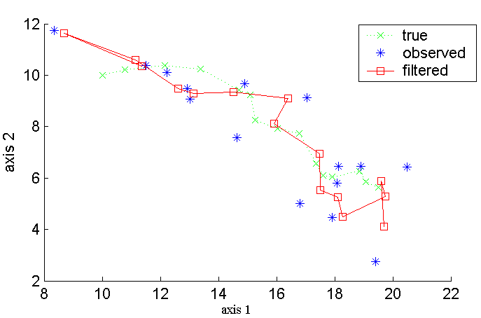
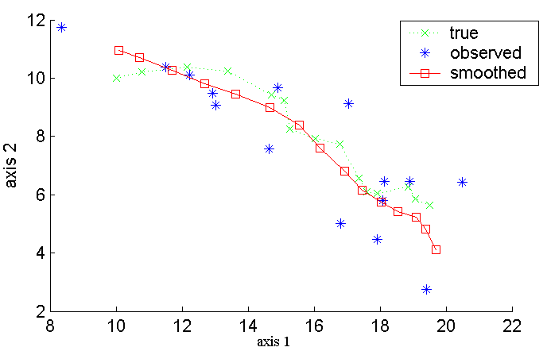
RTS smoother for better inference
Rauch-Tung-Striebel (RTS) smoother
  Additional backward pass to minimize inference error
  During EM training, computes the expectations of state statistics
Standard Kalman Filter
Kalman Filter with RTS smoother

Slide 10
Parameter Estimation (M step of EM)
LDM Parameters:

Slide 11
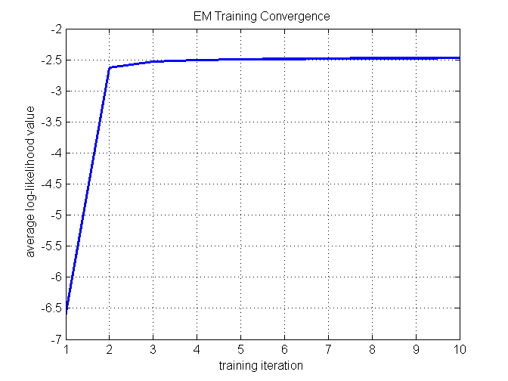
EM Model Training
For a synthetic signal with two-dimensional states and one-dimensional observations, LDM training procedure converges quickly and is stable (here model parameters are initialized with random numbers).

Slide 12
Likelihood Calculation (for classification)
The prediction error at time step t is
The prediction error covariance can be derived:
The log-likelihood of the whole section of observation with a given LDM:
Note: last component is constant, can be neglected in practice

Slide 13
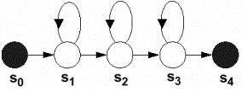
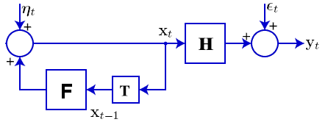
LDM for Speech Classification
one vs. all classifier:
^
aa
x
x
y
^
ch
x
MFCC Feature
Hypothesis
^
eh
x
………
HMM-Based Classifier
x
^
LDM-Based Classifier
aa
x
y
MFCC Feature
^
x
ch
Hypothesis
^
x
eh
………

Slide 14
Challenges of Applying LDM to ASR
Segment-based model
  frame-to-phoneme information is needed before classification
EM training is sensitive to state initialization
  Each phoneme is modeled by a LDM, EM training is to find a set of parameters for a specific LDM
  No good mechanism for state initialization yet
More parameters than HMM (2~3x)
  Currently mono-phone model, to build a tri-phone model for LVCSR would need more training data

Slide 15
Phoneme classification on TIDigits corpus
TIDigits Corpus:
more than 25 thousand digit utterances spoken by 326 men, women, and children.
dialect balanced for 21 dialectical regions of the continental U.S.
Frame-to-phone alignment is generated by ISIP decoder (force align mode)
18 phones, one vs. all classifier

Slide 16
Pronunciation lexicon and broad phonetic classes
Table 1: Pronunciation lexicon
Table 2: Broad phonetic classes
Word | Pronunciation
ZERO | z iy r ow
OH | ow
ONE | w ah n
TWO | t uw
THREE | th r iy
FOUR | f ow r
FIVE | f ay v
SIX | s ih k s
SEVEN | s eh v ih n
EIGHT | ey t
NINE | n ay n
Phoneme | Class | Phoneme | Class
ah | Vowels | s | Fricatives
ay | Vowels | f | Fricatives
eh | Vowels | th | Fricatives
ey | Vowels | v | Fricatives
ih | Vowels | z | Fricatives
iy | Vowels | w | Glides
uw | Vowels | r | Glides
ow | Vowels | k | Stops
n | Nasals | t | Stops

Slide 17
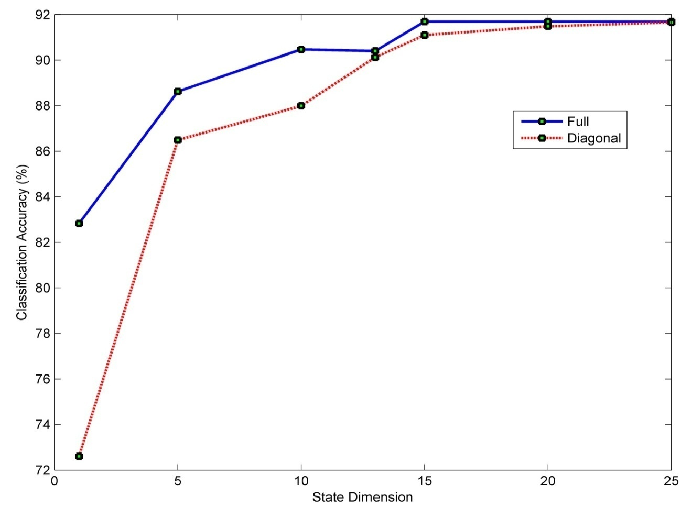
Classification results for TIDigits dataset (13mfcc)
The solid blue line shows classification accuracies for full covariance LDMs with state dimensions from 1 to 25.
The dashed red line shows classification accuracies for diagonal covariance LDMs with state dimensions from 1 to 25.
HMM baseline: 91.3% Acc; Full LDM: 91.69% Acc; Diagonal LDM: 91.66% Acc.

Slide 18
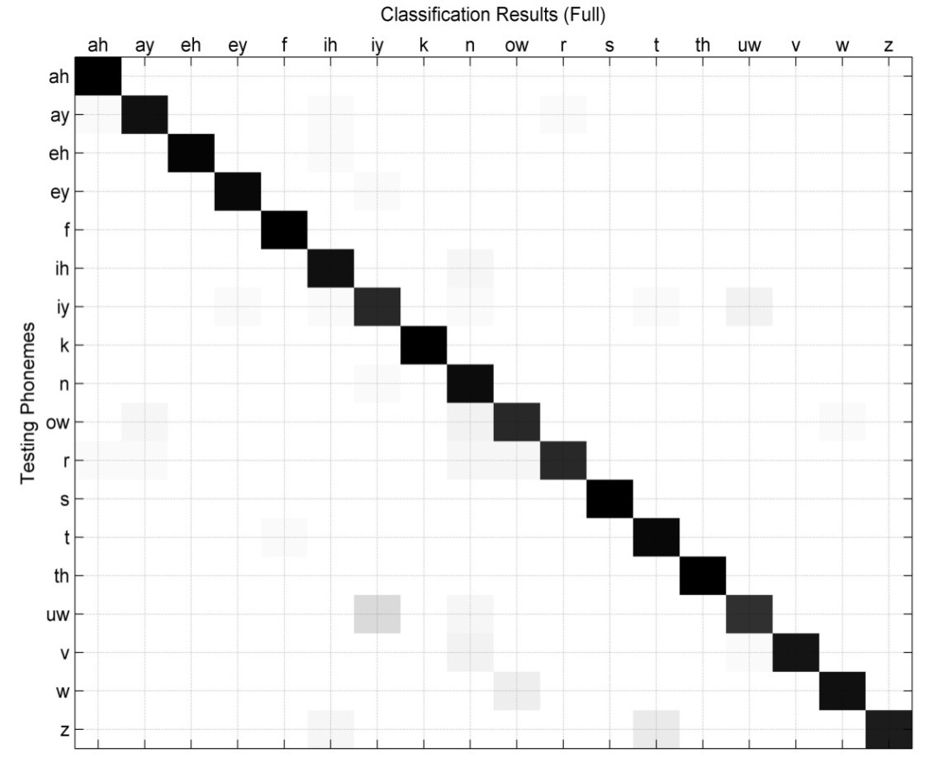
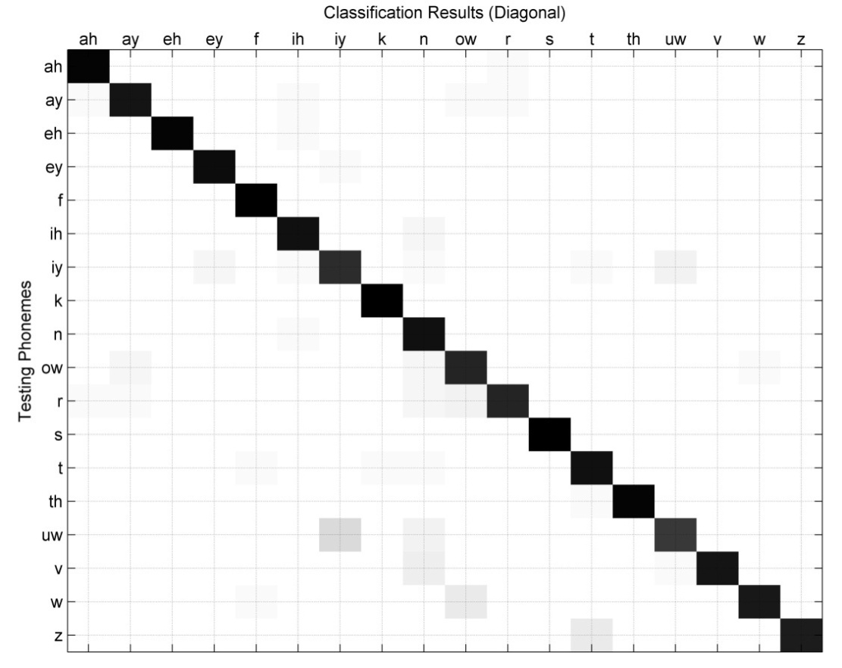
Model choice: full LDM vs. diagonal LDM
Diagonal covariance LDM performs as good as full covariance LDM, with fewer model parameters and computation.
Confusion phoneme pairs for the classification results of using diagonal LDMs
Confusion phoneme pairs for the classification results using full LDMs

Slide 19
Classification accuracies by broad phonetic classes
Classification results for fricatives and stops are high.
Classification results for glides are lower (~85%).
Vowels and nasals result in mediocre accuracy (89% and 93% respectively).
Overall, LDMs provide a reasonably good classification performance for TIDigits.

Slide 20
Hybrid HMM/LDM speech recognizer
Motivations:
LDM phoneme classification experiments provide motivation to apply it for large vocabulary, continuous speech recognition (LVCSR) system.
However, developing pure LDM-based LVCSR system from scratch has been proved to be extremely difficult because LDM is inherently a static classifier.
LDM and HMM is complementary to each other,
incorporating LDM into traditional HMM-based framework could lead to a superior system with better performance.

Slide 21
Two-pass hybrid HMM/LDM speech recognizer
Hybrid recognizer takes advantage of a HMM architecture to model the temporal evolution of speech and LDM advantages to model frame-to-frame correlation and higher order statistics.
First pass: HMM generates multiple recognition hypotheses with frame-to-phoneme alignments.
Second pass: incorporating LDM to re-rank the N-best sentence hypotheses and output the most possible hypothesis as the recognition result.
N-best list rescoring architecture of the hybrid recognizer

Slide 22
Feature Extraction: MFCC Front-end

Slide 23
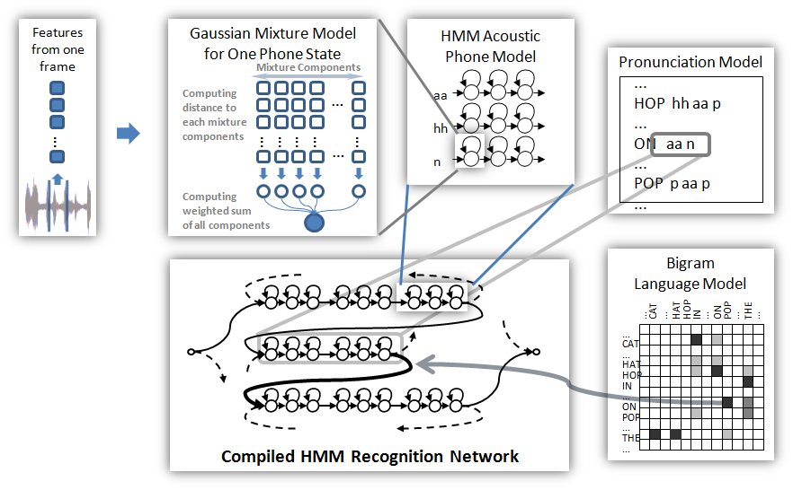
Search Space with Different Knowledge Sources

Slide 24
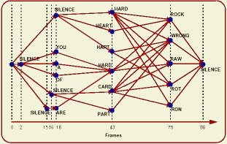
The First-pass Recognition Result
For a speech signal “HARD ROCK”, all promising hypothesis during search can be viewed as a word graph

Slide 25
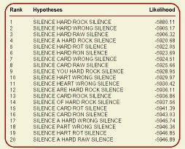
The Second-pass LDM Re-scoring
Corresponding LDM Likelihood Scores
Re-rank to generate final recognition result
N-best list: different number of N from 5, 10, 20, ... up to 100 have been tried using development test dataset.
In the final system, N=10 is applied.

Slide 26

Aurora-4 corpus to evaluate hybrid recognizer
Aurora-4 large vocabulary corpus is a well-established LVCSR benchmark with different noise conditions.
Acoustic Training:
  Derived from 5000 word WSJ0 task
  16 kHz sample rate
  83 speakers
  7138 training utterances totaling in 14 hours of speech
Development Sets:
  Derived from WSJ0 Evaluation and Development sets
  Clean set plus 6 sets with noise conditions
  Randomly chosen SNR between 5 and 15 dB for noisy sets

Slide 27
Experimental Results for Aurora-4 Corpus
Hybrid decoder reduces WER by over 12% for clean and babble noise condition
Marginal improvement for airport, restaurant, street, and train noise conditions
It increases the recognition WER for car noise condition by 4.36%
WER (%) | Clean | Airport | Babble | Car | Restaurant | Street | Train
HMM Baseline | 13.3 | 53.0 | 55.9 | 57.3 | 53.4 | 61.5 | 66.1
Hybrid Recognizer | 11.6 | 50.3 | 48.5 | 59.8 | 50.6 | 59.4 | 63.4
Absolute Reduction | 1.7 | 2.7 | 7.4 | -2.5 | 2.8 | 2.1 | 2.7
Relative Reduction | 12.78% | 5.09% | 13.24% | -4.36% | 5.24% | 3.41% | 4.08%

Slide 28
Dissertation Contributions and Future Work
Dissertation Contributions:
  Efficient implementation of EM training and likelihood calculation algorithms for speech classifications. For TIDigits phoneme classification tasks, LDM classifier produces comparable performance with HMM.
  Propose LDM as complementary model to overcome HMM system drawbacks and limitations. Developed hybrid HMM/LDM speech recognizer to integrate both powerful technologies for large vocabulary continuous speech recognition. From our best knowledge, it is by far the first LDM application for LVCSR. In Aurora-4 speech evaluation, hybrid HMM/LDM system improve recognition accuracy and noise robustness significantly.
Future Work:
  Further investigation about the possible reasons why LDM re-scoring decrease the performance for car noise condition.
  Re-structure the speech recognizer to directly integrate LDM segment score into Viterbi search, instead of N-best list rescoring.

Slide 29
Publication List
Patents:
P29573 Method and Apparatus for Improving Memory Locality for Real-time Speech Recognition by Michael Deisher and Tao Ma (Pending Patent, filed in June 2009).
Journal Papers
T. Ma, S. Srinivasan, G. Lazarou and J. Picone, "Continuous Speech Recognition Using Linear Dynamic Models", IEEE Signal Processing Letters (In Preparation, final proof-reading).
S. Srinivasan, T. Ma, G. Lazarou, J. Picone, "A Nonlinear Mixture Autoregressive Model for Speaker Verification", IEEE Transactions on Audio, Speech and Language Processing (In Preparation, final proof-reading).
Z. Fang, S. Lee, M. Deisher, T. Ma, R. Iyer, S. Makineni, "Optimization and Acceleration to Enable Real-Time Speech Recognition on Handheld Platforms,” IEEE Embedded Systems Letters (Submitted).
Conference Papers:
T. Ma and M. Deisher, "Novel CI-Backoff Scheme for Real-time Embedded Speech Recognition,” ICASSP 2010, Dallas, Texas, USA, March 2010.
S. Srinivasan, T. Ma, D. May, G. Lazarou and J. Picone, "Nonlinear Statistical Modeling of Speech," presentated at the 29th International Workshop on Bayesian Inference and Maximum Entropy Methods in Science and Engineering (MaxEnt 2009), Oxford, Mississippi, USA, July 2009.
S. Srinivasan, T. Ma, D. May, G. Lazarou and J. Picone, "Nonlinear Mixture Autoregressive Hidden Markov Models For Speech Recognition," Proceedings of the International Conference on Spoken Language Processing, pp. 960-963, Brisbane, Australia, September 2008.
Technical Reports and Talks
T. Ma and M. Deisher, "Search Techniques in Speech Recognition," Intel internal technical report, September 2008.
T. Ma, "Linear Dynamic Models (LDM) for Automatic Speech Recognition," Intel Intern Seminar Series, August 2008.

Slide 30
References
[1] Lawrence R. Rabiner, A tutorial on hidden Markov models and selected applications in speech recognition, Readings in speech recognition, Morgan Kaufmann Publishers Inc., San Francisco, CA, 1990
[2] L.R. Rabiner and B.H. Juang, Fundamentals of Speech Recognition, Prentice Hall, Englewood Cliffs, New Jersey, USA, 1993.
[3] J. Picone, “Continuous Speech Recognition Using Hidden Markov Models,” IEEE Acoustics, Speech, and Signal Processing Magazine, vol. 7, no. 3, pp. 26-41, July 1990.
[4] Digalakis, V., Rohlicek, J. and Ostendorf, M., “ML Estimation of a Stochastic Linear System with the EM Algorithm and Its Application to Speech Recognition,” IEEE Transactions on Speech and Audio Processing, vol. 1, no. 4, pp. 431–442, October 1993.
[5] Frankel, J. and King, S., “Speech Recognition Using Linear Dynamic Models,” IEEE Transactions on Speech and Audio Processing, vol. 15, no. 1, pp. 246–256, January 2007.
[6] S. Renals, Speech and Neural Network Dynamics, Ph. D. dissertation, University of Edinburgh, UK, 1990
[7] J. Tebelskis, Speech Recognition using Neural Networks, Ph. D. dissertation, Carnegie Mellon University, Pittsburg, USA, 1995
[8] A. Ganapathiraju, J. Hamaker and J. Picone, "Applications of Support Vector Machines to Speech Recognition," IEEE Transactions on Signal Processing, vol. 52, no. 8, pp. 2348-2355, August 2004.
[9] J. Hamaker and J. Picone, "Advances in Speech Recognition Using Sparse Bayesian Methods," submitted to the IEEE Transactions on Speech and Audio Processing, January 2003.

Slide 31
Thank you!
Questions?

Slide 32
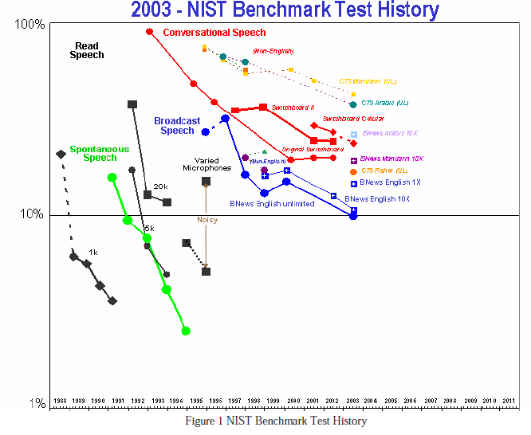
Backup Slides

Slide 33
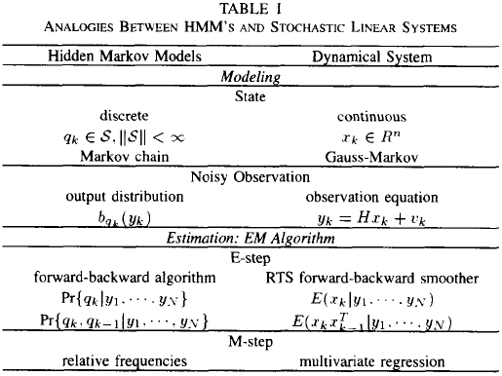
Backup Slides

Slide 34
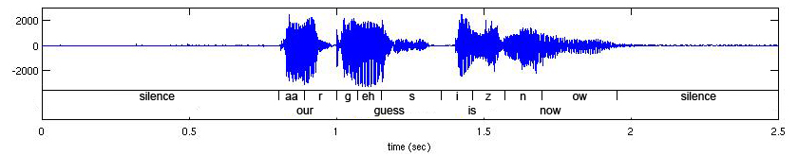
Backup Slides
An example of alignment information for an utterance.

