Slide 1
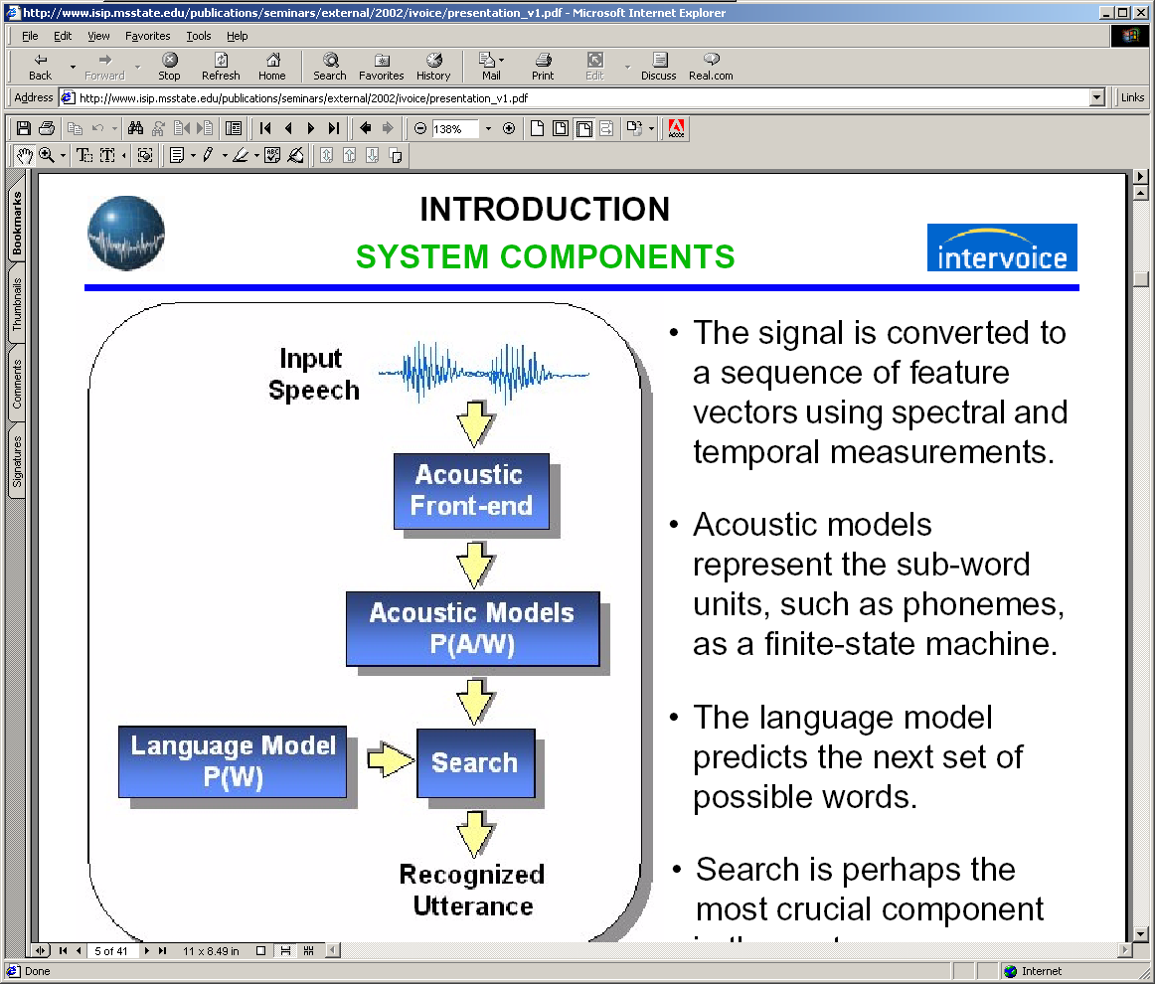
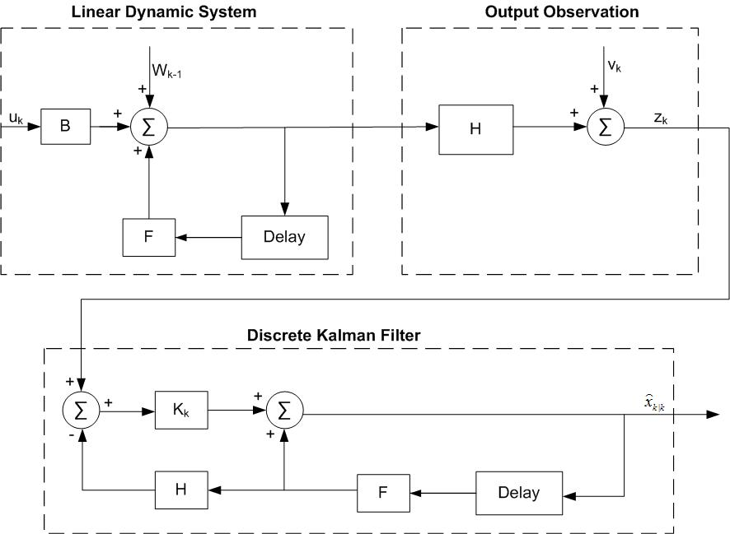
LINEAR DYNAMIC MODEL FOR CONTINUOUS SPEECH RECOGNITION
Ph.D. Proposal: Tao Ma
Advised by: Dr. Joseph Picone
Institute for Signal and Information Processing (ISIP)
Mississippi State University
January 23, 2010
URL: http://www.isip.piconepress.com/publications/books/msstate_theses/2010/linear_dynamics/

Slide 2
Abstract
In this dissertation work, we propose a hybrid speech recognizer to effectively integrates linear dynamic model into traditional HMM-based framework for continuous speech recognition. Traditional methods simplify speech signal as a piecewise stationary signal and speech features are assumed to be temporally uncorrelated. While these simplifications have enabled tremendous advances in speech processing systems, for the past several years progress on the core statistical models has stagnated. Recent theoretical and experimental studies suggest that exploiting frame-to-frame correlations in a speech signal further improves the performance of ASR systems.
Linear Dynamic Models (LDMs) take advantage of higher order statistics or trajectories using a state space-like formulation. This smoothed trajectory model allows the system to better track the speech dynamics in noisy environments. The proposed hybrid system is capable of handling large recognition tasks such as Aurora-4 large vocabulary corpus, is robust to noise-corrupted speech data and mitigates the effort of mismatched training and evaluation conditions. This two-pass system leverages the temporal modeling and N-best list generation capabilities of the traditional HMM architecture in a first pass analysis. In the second pass, candidate sentence hypotheses are re-ranked using a phone-based LDM model.

Slide 3
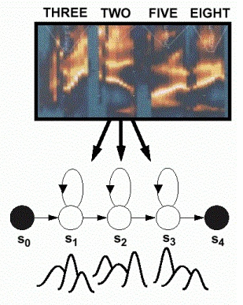
Speech Recognition System
Hidden Markov Models with Gaussian Mixture Models (GMMs) to model state output distributions
Bayesian model based approach for speech recognition system

Slide 4
Is HMM a perfect model for speech recognition?
Progress on improving the accuracy of HMM-based system has slowed in the past decade
Theory drawbacks of HMM
  False assumption that frames are independent and stationary
  Spatial correlation is ignored (diagonal covariance matrix)
  Limited discrete state space
Accuracy
Clean
Noisy
Time

Slide 5
Motivation of Linear Dynamic Model (LDM) Research
Motivation
  A model which reflects the characteristics of speech signals will ultimately lead to great ASR performance improvement
  LDM incorporates frame correlation information of speech signals, which is potential to increase recognition accuracy
  “Filter” characteristic of LDM has potential to improve noise robustness of speech recognition
  Fast growing computation capacity make it realistic to build a two-way HMM/LDM hybrid speech recognizer

Slide 6

State Space Model
Linear Dynamic Model (LDM) is derived from State Space Model
Equations of State Space Model:

Slide 7

Linear Dynamic Model
Equations of Linear Dynamic Model (LDM)
  Current state is only determined by previous state
  H, F are linear transform matrices
  Epsilon and Eta are Gaussian noise components
  y: observation feature vector
  x: corresponding internal state vector
  H: linear transform matrix between y and x
  F: linear transform matrix between current state and previous state
  epsilon: Gaussian noise component
  eta: Gaussian noise component

Slide 8
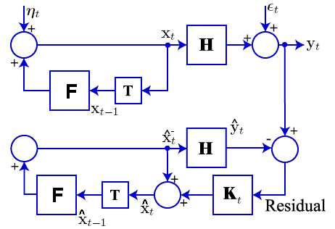
Kalman filtering for state inference
For a speech sound,
Human Being Sound System
e
Kalman Filtering Estimation

Slide 9
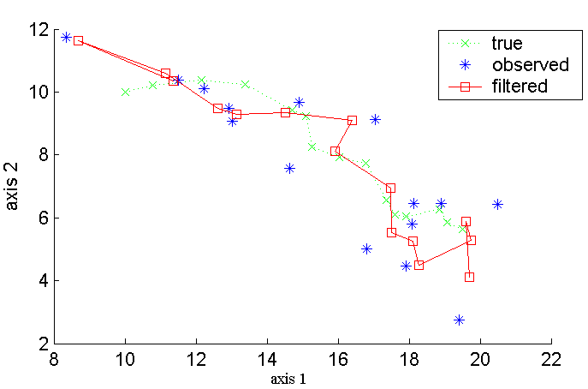
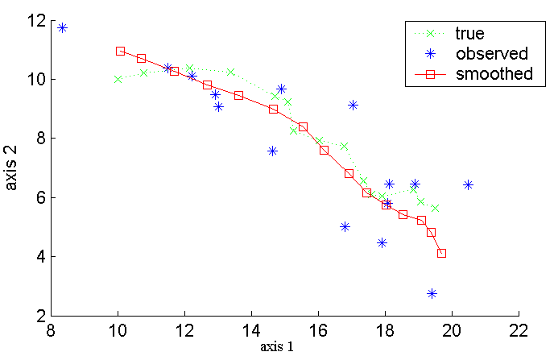
RTS smoother for better inference
Rauch-Tung-Striebel (RTS) smoother
  Additional backward pass to minimize inference error
  During EM training, computes the expectations of state statistics
Standard Kalman Filter
Kalman Filter with RTS smoother

Slide 10
Maximum Likelihood Parameter Estimation
LDM Parameters:

Slide 11
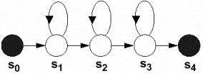
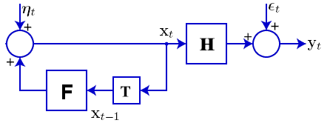
LDM for Speech Classification
one vs. all classifier:
^
aa
x
x
y
^
ch
x
MFCC Feature
Hypothesis
^
eh
x
………
HMM-Based Recognition
x
^
LDM-Based Recognition
aa
x
y
MFCC Feature
^
x
ch
Hypothesis
^
x
eh
………

Slide 12
Challenges of Applying LDM to ASR
Segment-based model
  frame-to-phoneme information is needed before classification
EM training is sensitive to state initialization
  Each phoneme is modeled by a LDM, EM training is to find a set of parameters for a specific LDM
  No good mechanism for state initialization yet
More parameters than HMM (2~3x)
  Currently mono-phone model, to build a tri-phone model for LVCSR would need more training data

Slide 13
Phoneme classification on TIDigits corpus
TIDigits Corpus:
more than 25 thousand digit utterances spoken by over 326 men, women, and children.
dialect balanced for 21 dialectical regions of the continental U.S.
Frame-to-phone alignment is generated by ISIP decoder (force align mode)
18 phones, one vs. all classifier

Slide 14
Pronunciation lexicon and broad phonetic classes
Table 1: Pronunciation lexicon
Table 2: Broad phonetic classes
Word | Pronunciation
ZERO | z iy r ow
OH | ow
ONE | w ah n
TWO | t uw
THREE | th r iy
FOUR | f ow r
FIVE | f ay v
SIX | s ih k s
SEVEN | s eh v ih n
EIGHT | ey t
NINE | n ay n
Phoneme | Class | Phoneme | Class
ah | Vowels | s | Fricatives
ay | Vowels | f | Fricatives
eh | Vowels | th | Fricatives
ey | Vowels | v | Fricatives
ih | Vowels | z | Fricatives
iy | Vowels | w | Glides
uw | Vowels | r | Glides
ow | Vowels | k | Stops
n | Nasals | t | Stops

Slide 15
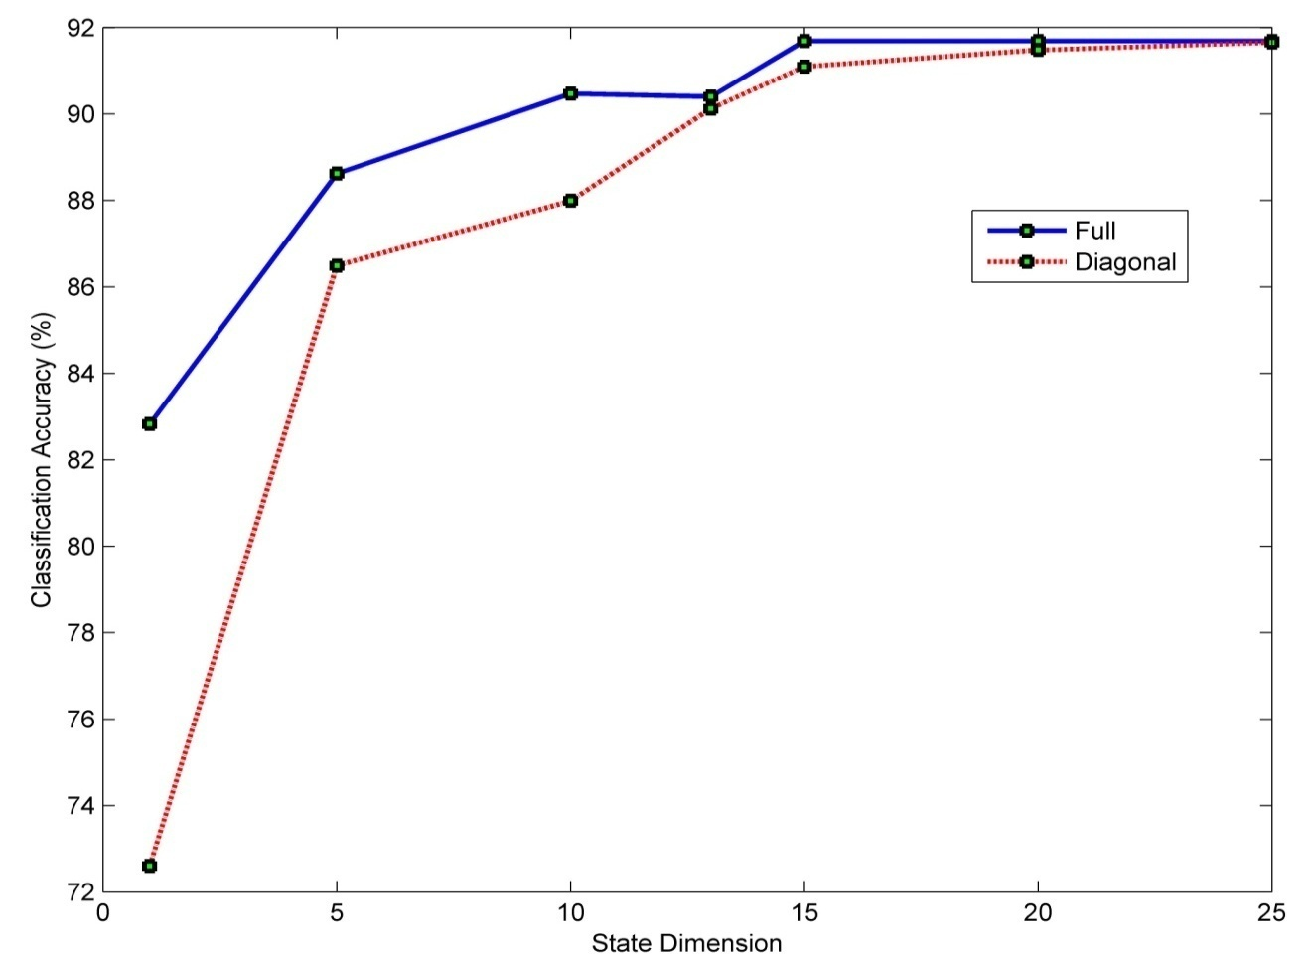
Classification results for TIDigits dataset (13mfcc)
The solid blue line shows classification accuracies for full covariance LDMs with state dimensions from 1 to 25.
The dashed red line shows classification accuracies for diagonal covariance LDMs with state dimensions from 1 to 25.
HMM baseline: 91.3% Acc; Full LDM: 91.69% Acc; Diagonal LDM: 91.66% Acc.

Slide 16
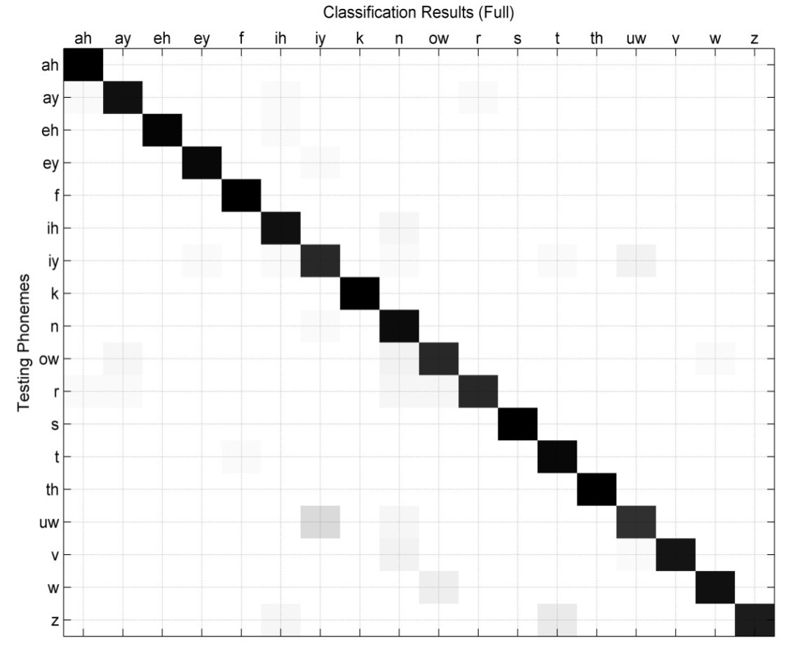
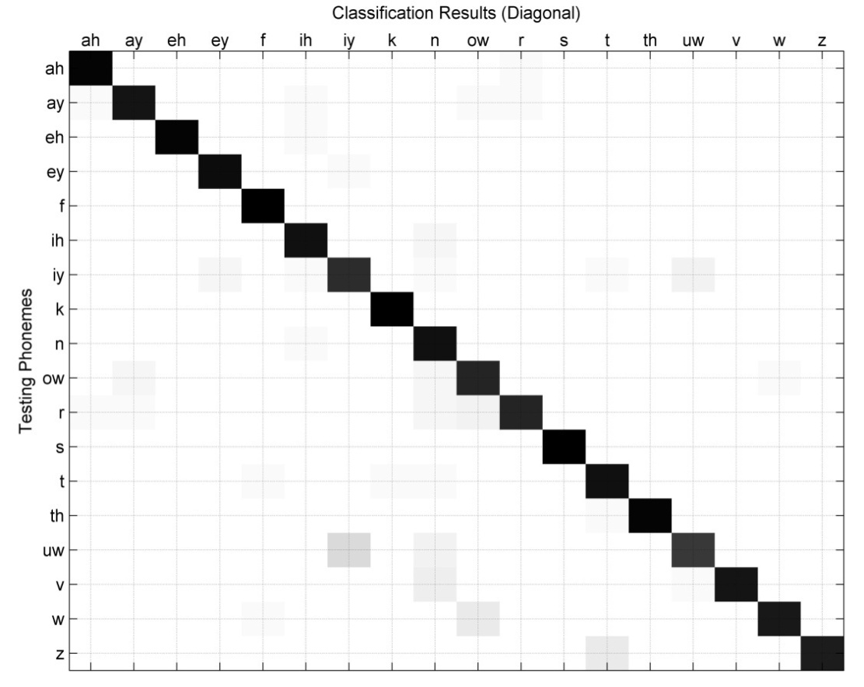
Model choice: full LDM vs. diagonal LDM
Diagonal covariance LDM performs as good as full covariance LDM, with much less model parameters.
Confusion phoneme pairs for the classification results of using diagonal LDMs
Confusion phoneme pairs for the classification results using full LDMs

Slide 17
Classification accuracies by broad phonetic classes
Classification results for fricatives and stops are high.
Classification results for glides are lower (~85%).
Vowels and nasals result in mediocre accuracy (89% and 93% respectively).
Overall, LDMs provide a reasonably good classification performance for TIDigits.

Slide 18
Proposed work: hybrid HMM/LDM speech recognizer
Motivations:
LDM phoneme classification experiments provide motivation to apply it for large vocabulary, continuous speech recognition (LVCSR) system.
However, developing LDM-based LVCSR system from scratch has been proved to be extremely difficult because LDM is inherently a static classifier.
LDM and HMM can be complementary to each other,
incorporating LDM into traditional HMM-based framework could lead to a superior system with better performance.

Slide 19
Two-pass hybrid HMM/LDM speech recognizer
Hybrid recognizer takes advantage of a HMM architecture to model the temporal evolution of speech and LDM advantages to model frame-to-frame correlation and higher order statistics.
First pass: HMM generates multiple recognition hypotheses with frame-to-phoneme alignments.
Second pass: incorporating LDM to re-rank the N-best sentence hypotheses and output the most possible hypothesis as the recognition result.
N-best list rescoring architecture of the hybrid recognizer

Slide 20

Aurora-4 corpus to evaluate hybrid recognizer
Aurora-4 large vocabulary corpus is a well-established LVCSR benchmark with different noisy conditions.
Acoustic Training:
  Derived from 5000 word WSJ0 task
  16 kHz sample rate
  Recorded with Sennheiser microphone
  83 speakers
  7138 training utterances totaling in 14 hours of speech
Development Sets:
  Derived from WSJ0 Evaluation and Development sets
  7 individual test sets recorded with Sennheiser microphone
  Clean set plus 6 sets with noise conditions
  Randomly chosen SNR between 5 and 15 dB for noisy sets

Slide 21
What will be in my dissertation?
Chapter 1: Introduction
Chapter 2: THE STATISTICAL APPROACH FOR SPEECH RECOGNITION
2.1 The Speech Recognition Problem
2.2 Hidden Markov Models
2.3 Segment-based Models
2.4 Hybrid Connectionist Systems
2.5 Summary
Chapter 3: LINEAR DYNAMIC MODELS
3.1 Linear Dynamic System
3.2 Kalman Filter
3.3 Linear Dynamic Model
3.3.1 State Inference
3.3.2 Model Parameter Estimation
3.3.3 Likelihood Calculation
3.4 Summary
Chapter 4: LDM FOR SPEECH CLASSIFICATION
4.1 Acoustic Front-end
4.2 TIDigits Corpus
4.3 Training from Multiple Observation Sequences
4.4 Classification Results
4.5 Summary
Chapter 5: HMM/LDM ARCHITECTURE FOR SPEECH RECOGNITION
5.1 Aurora-4 Corpus
5.2 Hybrid Recognizer Architecture
5.3 Segmental Modeling
5.4 Modifications to an ASR System
5.5 N-best List Rescoring Paradigm
5.6 Experiment Results
5.7 Summary
Chapter 6: CONCLUSIONS AND FUTURE DIRECTIONS
REFERENCES

Slide 22
Tasks to be finished and technical risks
Tasks to be finished:
  Validate the hybrid HMM/LDM recognizer using a small dataset to ensure correct algorithm implantation
  Code optimization for core LDM training and likelihood calculation
  Evaluate hybrid HMM/LDM speech recognizer using Aurora-4 speech corpus for both clean data and noisy data and analyze the experiment results
Technical risks:
  LDM model training for very large dataset might lead to singular matrix problem due to arithmetic precision of matrix operation
  Investigation needed to optimally combine the HMM acoustic score and LDM acoustic score

Slide 23
Patents/Publications/Reports/Talks
Patents
P29573 Method and Apparatus for Improving Memory Locality for Real-time Speech Recognition by Michael Deisher and Tao Ma (pending patent, filed in June 2009).
Publications/Reports/Talks
T. Ma, S. Srinivasan, D. May, G. Lazarou and J. Picone, "Robust Speech Recognition Using Linear Dynamic Models," submitted to the IEEE Signal Processing Letters, Spring 2009.
T. Ma and M. Deisher, "Novel CI-Backoff Scheme for Real-time Embedded Speech Recognition,” to be appeared in ICASSP 2010, Dallas, Texas, USA, March 2010.
S. Srinivasan, T. Ma, D. May, G. Lazarou and J. Picone, "Nonlinear Statistical Modeling of Speech," presentated at the 29th International Workshop on Bayesian Inference and Maximum Entropy Methods in Science and Engineering (MaxEnt 2009), Oxford, Mississippi, USA, July 2009.
S. Srinivasan, T. Ma, D. May, G. Lazarou and J. Picone, "Nonlinear Mixture Autoregressive Hidden Markov Models For Speech Recognition," Proceedings of the International Conference on Spoken Language Processing, pp. 960-963, Brisbane, Australia, September 2008.
T. Ma, S. Srinivasan, D. May, G. Lazarou and J. Picone, "Robust Speech Recognition Using Linear Dynamic Models,” submitted to INTERSPEECH, Brisbane, Australia, September 2008.
D. May, S. Srinivasan, T. Ma and J. Picone, “Continuous Speech Recognition Using Nonlinear Dynamical Invariants,” submitted to International Conference on Acoustics, Speech, and Signal Processing, Las Vegas, Nevada, USA, March 2008.
T. Ma and M. Deisher, "Search Techniques in Speech Recognition," Intel internal technical report, September 2008.
T. Ma, "Linear Dynamic Models (LDM) for Automatic Speech Recognition," Intel Intern Seminar Series, August 2008.

Slide 24
References
[1] Lawrence R. Rabiner, A tutorial on hidden Markov models and selected applications in speech recognition, Readings in speech recognition, Morgan Kaufmann Publishers Inc., San Francisco, CA, 1990
[2] L.R. Rabiner and B.H. Juang, Fundamentals of Speech Recognition, Prentice Hall, Englewood Cliffs, New Jersey, USA, 1993.
[3] J. Picone, “Continuous Speech Recognition Using Hidden Markov Models,” IEEE Acoustics, Speech, and Signal Processing Magazine, vol. 7, no. 3, pp. 26-41, July 1990.
[4] Digalakis, V., Rohlicek, J. and Ostendorf, M., “ML Estimation of a Stochastic Linear System with the EM Algorithm and Its Application to Speech Recognition,” IEEE Transactions on Speech and Audio Processing, vol. 1, no. 4, pp. 431–442, October 1993.
[5] Frankel, J. and King, S., “Speech Recognition Using Linear Dynamic Models,” IEEE Transactions on Speech and Audio Processing, vol. 15, no. 1, pp. 246–256, January 2007.
[6] S. Renals, Speech and Neural Network Dynamics, Ph. D. dissertation, University of Edinburgh, UK, 1990
[7] J. Tebelskis, Speech Recognition using Neural Networks, Ph. D. dissertation, Carnegie Mellon University, Pittsburg, USA, 1995
[8] A. Ganapathiraju, J. Hamaker and J. Picone, "Applications of Support Vector Machines to Speech Recognition," IEEE Transactions on Signal Processing, vol. 52, no. 8, pp. 2348-2355, August 2004.
[9] J. Hamaker and J. Picone, "Advances in Speech Recognition Using Sparse Bayesian Methods," submitted to the IEEE Transactions on Speech and Audio Processing, January 2003.

Slide 25
Thank you!
Questions?

