Slide 1

Parallel FPGA Particle Filtering for Real-Time Neural Signal Processing
John Mountney
Co-advisors: Iyad Obeid and Dennis Silage

Slide 2
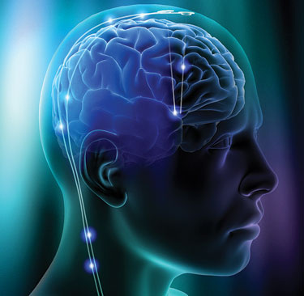
Outline
Introduction to Brain Machine Interfaces
Decoding Algorithms
Evaluation of the Bayesian Auxiliary Particle Filter
Algorithm Implementation in Hardware
Proposed Future Work

Slide 3
Brain Machine Interface (BMI)
A BMI is a device which directly interacts with ensembles of neurons in the central nervous system

Slide 4
Applications of the BMI
Gain knowledge of the operation and functionality of the brain
Decode neural activity to estimate intended biological signals (neuroprosthetics)
Encode signals which can be interpreted by the brain (cochlear, retinal implants)

Slide 5
Interpreting Neural Activity
The neural tuning model is the key component to encoding and decoding biological signals
Given the current state x(t) of a neuron, the model describes its firing behavior in response to a stimulus

Slide 6
Tuning Function Example
Place cells fire when an animal is in a specific location and are responsible for spatial mapping.
Assumed firing model:
Maximum firing rate:
Center of the receptive field:
Width of the receptive field:

Slide 7
Neural Plasticity
Neural plasticity can be the result of environmental changes, learning, acting or brain injury
Based on how active a neuron is during an experience, the synapses grow stronger or weaker
Plasticity results in a dynamic state vector of the neural tuning model

Slide 8
Time-varying Tuning Function
Dynamic firing model:
Dynamic state vector:

Slide 9
Decoding Algorithms

Slide 10
Wiener Filter
Linear transversal filter
Coefficients minimize the error between filter output and a desired response
Applied in recreating center out reaching tasks and 2D cursor movements (Gao, 2002)
Assumes the input signal is stationary and also has an invertible autocorrelation matrix

Slide 11
Least Mean Square (LMS)
Iterative algorithm that converges to the Weiner solution
Avoids inverting the input autocorrelation matrix to provide computational savings
If the autocorrelation matrix is ill conditioned, a large number of iterations may be required for convergence

Slide 12
Kalman Filter
Solves the same problem as the Wiener filter without the constraint of stationarity
Recursively updates the state estimate using current observations
Applied in arm movement reconstruction experiments (Wu, 2002)
Assumes all noise processes have a known Gaussian distribution

Slide 13
Extended Kalman Filter
Attempts to linearize the model around the current state through a first-order Taylor expansion
Successfully implemented in the control and tracking of spatiotemporal cortical activity (Schiff, 2008)
State transition and measurement matrices must be differentiable
Requires evaluation of Jacobians at each iteration

Slide 14
Unscented Kalman Filter
The probability density is approximated by transforming a set of sigma points through the nonlinear prediction and update functions
Easier to approximate a probability distribution than it is to approximate an arbitrary nonlinear transformation
Recently applied in real-time closed loop BMI experiments (Li, 2009)

Slide 15
Unscented Kalman Filter (cont.)
Statistical properties of the transformed sigma points become distorted through the linearization process
If the initial state estimates are incorrect, filter divergence can quickly become an issue
Gaussian environment is still assumed

Slide 16
Particle Filtering
Numerical solution to nonlinear non-Gaussian state-space estimation
Use Monte Carlo integration to approximate analytically intractable integrals
Represent the posterior density by a set of randomly chosen weighted samples or particles
Based on current observations, how likely does a particle represent the posterior

Slide 17
Resampling
Replicate particles with high weights, discard particles with small weights
Higher weighted particles are more likely to approximate the posterior with better accuracy
Known as the sampling importance resampling (SIR) particle filter (Gordon, 1993)

Slide 18
SIR Particle Filtering Algorithm
Sample each particle from a proposal density π that approximates the current posterior:
Assign particle weights based on how probable a sample drawn from the target posterior has been:

Slide 19
SIR Particle Filtering Algorithm
Normalize the particle weights:
Perform Resampling
Re-initialize weights:

Slide 20
SIR Particle Filtering Algorithm
Form an estimate of the state as a weighted sum
Repeat

Slide 21
SIR Particle Filtering
Applied to reconstruct hand movement trajectories (Eden, 2004)
SIR particle filters suffer from degeneracy
  Particles with high weights are duplicated many times
  May collapse to a single point (loss of diversity)
Computationally expensive

Slide 22
Bayesian Auxiliary Particle Filter
(BAPF)
Addresses two limitations of the SIR particle filter
  Poor outlier performance
  Degeneracy
Introduced by Pitt & Shephard (1999), later extended by Liu & West (2002) to include a smoothing factor

Slide 23
BAPF
Favor particles that are likely to survive at the next iteration of the algorithm
Perform resampling at time t_{k-1} using the available measurements at time t_{k}
Use a two-stage weighting process to compensate for the predicted point and the actual sample

Slide 24
BAPF Algorithm
Sample each particle from a proposal density π that approximates the current posterior:
Assign 1st stage weights g(t) based on how probable a sample drawn from the target posterior has been:

Slide 25
BAPF Algorithm
Normalize the importance weights
Resample according to g(t)
Sample each particle from a second proposal density q

Slide 26
BAPF Algorithm
Assign the 2nd stage weights
Compute an estimate as a weighted sum
Repeat

Slide 27
Evaluation of the Bayesian Auxiliary Particle Filter

Slide 28
Gaussian Shaped Tuning Function

Slide 29
Simulation Results
Preliminary Data
Observe an ensemble of hippocampal place cells whose firing times have an inhomogeneous Poisson arrival rate
Estimate the animal’s position on a one dimensional 300 cm track, generated as random walk
Evaluated under noisy conditions
Performance is compared to the Wiener filter and sampling importance resampling particle filter

Slide 30
Mean Square Error vs.
Number of Neurons

Slide 31
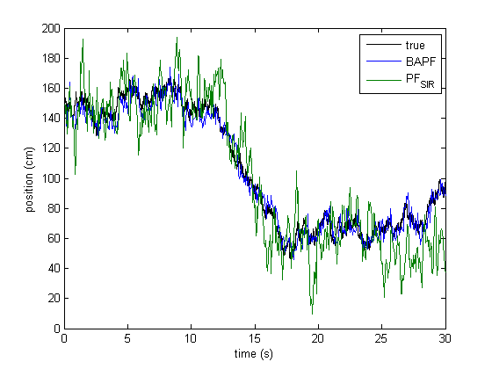
Signal Estimation
100 particles
100 neurons

Slide 32
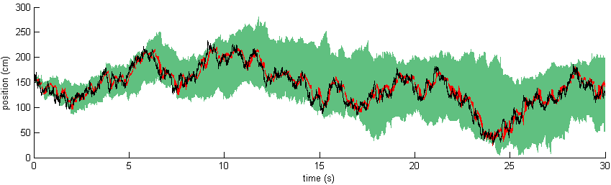
95% Confidence Intervals
100 particles
50 neurons
100 simulations of a single data set
Black: true position
Red: BAPF interval
Green: PF interval

Slide 33
Mean Square Error vs.
Missed Firings
100 particles
50 neurons

Slide 34
Mean Square Error vs.
Rate of False Detections
100 particles
50 neurons

Slide 35
Mean Square Error vs.
Spike Sorting Error
100 particles
50 neurons

Slide 36
Algorithm Implementation in Hardware

Slide 37
Algorithm Implementation
The target hardware is a field programmable gate array (FPGA)
Dedicated hardware avoids fetching and decoding of instructions
FPGAs are capable of executing multiple computations simultaneously

Slide 38
FPGA Resources
Configurable logic blocks (CLB)
  Look-up tables (LUT)
  Multiplexers
  Flip-flops
  Logic gates (AND, OR, NOT)
Programmable interconnects
  Routing matrix controls signal routing
Input-Output cells
  Latch data at the I/O pins

Slide 39
FPGA Resources
Embedded fixed-point multipliers (DSP48E)
  24-bit x 18-bit inputs
On-chip memory
  Up to 32 MB
Digital clock managers
  Multirate signal processing
  Phase locked loops

Slide 40
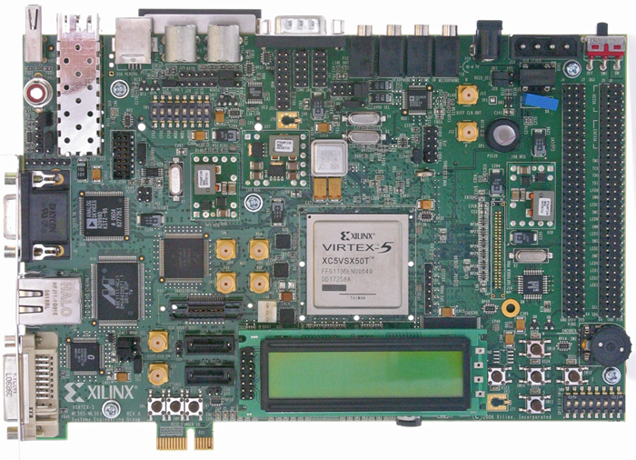
ML506SX50T
Resource | Available
Slices | 8160
Embedded Multipliers | 288
RAM | 5 MB
3.8 Gb/s Transceivers | 12
I/O Pins | 480
Maximum Clock Rate | 550 MHz

Slide 41
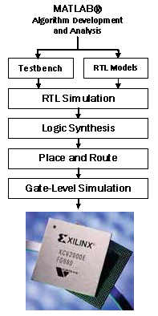
Design Flow
1.
2.
3.
4.

Slide 42
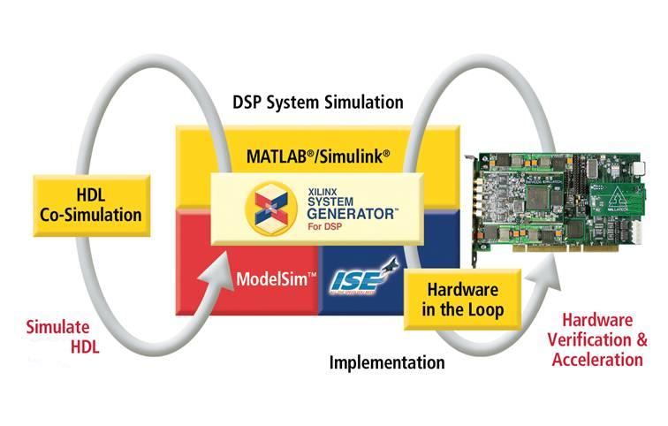
Hardware Co-Simulation

Slide 43
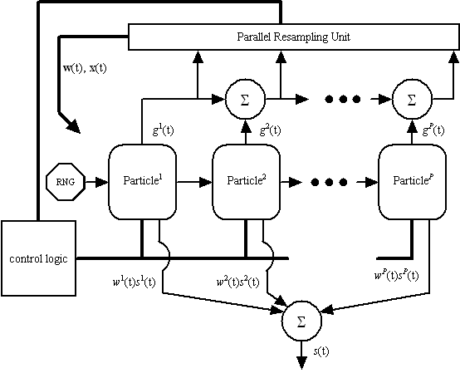
Top-Level Block Diagram

Slide 44
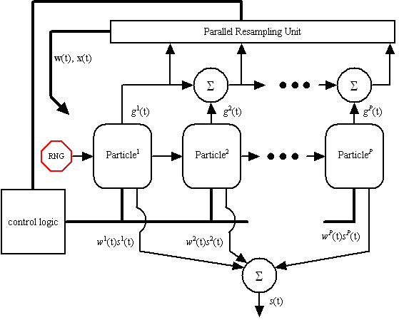
Top-Level Block Diagram

Slide 45
Box-Muller Transformation
Generates two orthogonal standard normal sequences from two uniform distributions

Slide 46
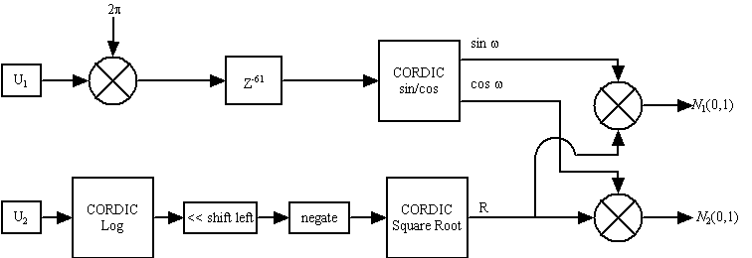
Box-Muller Transformation

Slide 47
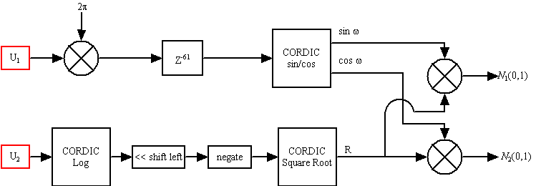
Box-Muller Transformation

Slide 48
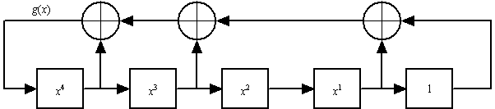
Linear Feedback Shift Register (LFSR)
Shift register made of m flip-flops
Mod-2 adders configured according to a generator polynomial
Represent a value between 0 and 1:

Slide 49
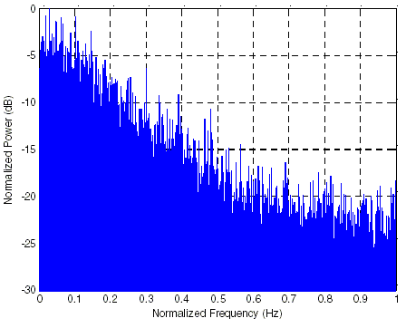
LFSR (cont.)
LFSR output has correlation
Bits are only shifted one position
Has a lowpass effect on the output sequence

Slide 50
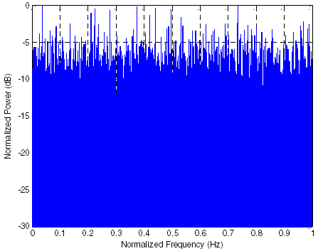
Linear Feedback Shift Register with Skip-ahead Logic
Advances the state of the LFSR multiple states
Bits are shifted multiple positions
Removes correlation in the uniform distribution

Slide 51
Box-Muller Transformation

Slide 52
Top-Level Block Diagram

Slide 53
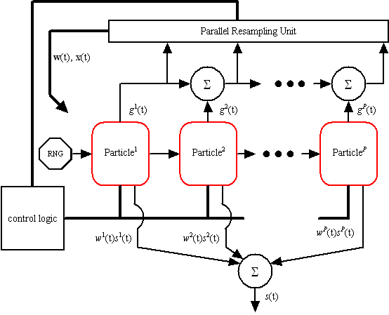
Top-Level Block Diagram

Slide 54
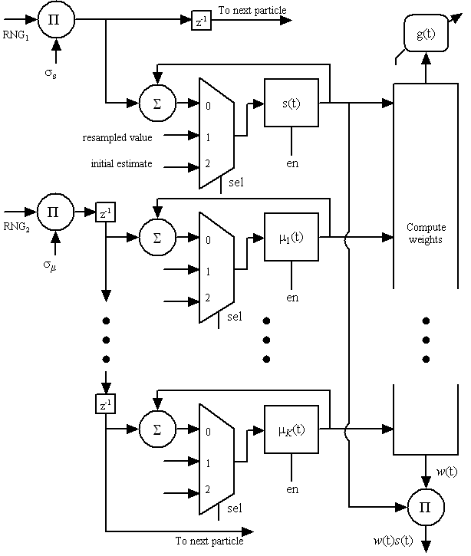
Particle Block Diagram

Slide 55
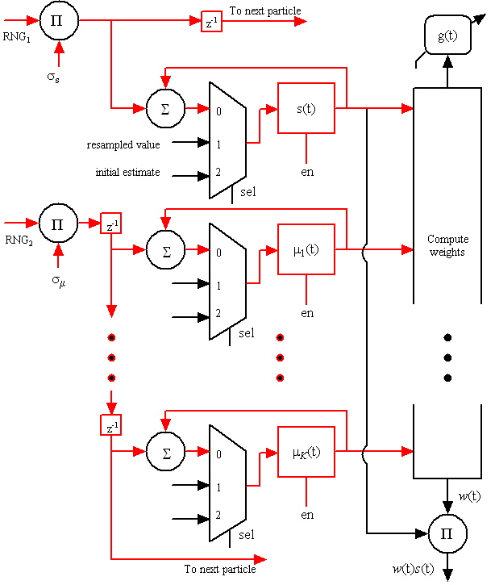
Steps 1 and 2 of the BAPF Algorithm

Slide 56
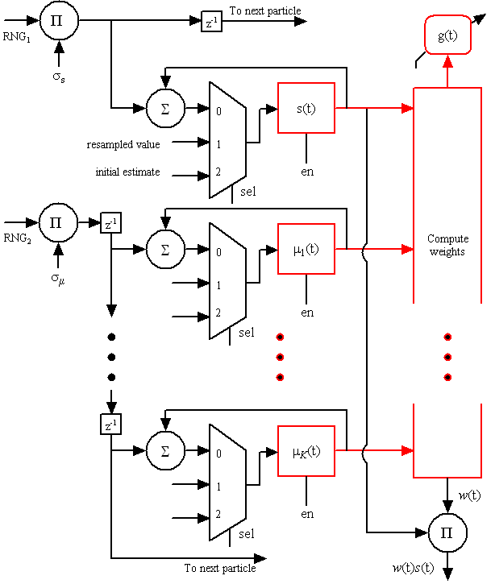
Particle Block Diagram

Slide 57
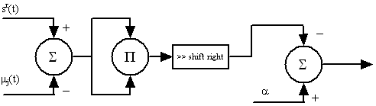
Compute the 1st Stage Weights

Slide 58
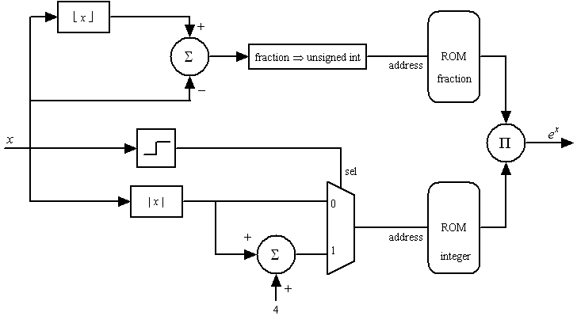
Compute the 1st Stage Weights
integer
fraction
For x<0:

Slide 59
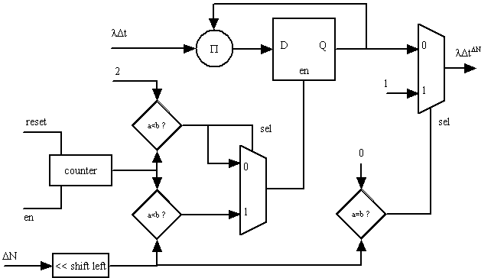
Compute the 1st Stage Weights

Slide 60
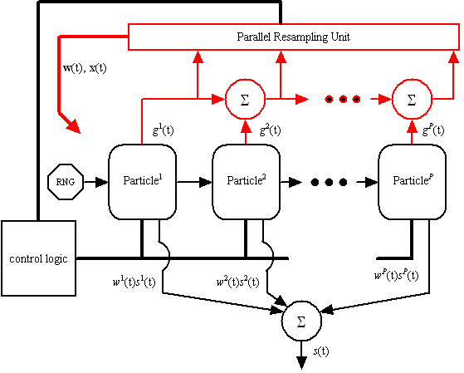
Resample the 1st Stage Weights

Slide 61
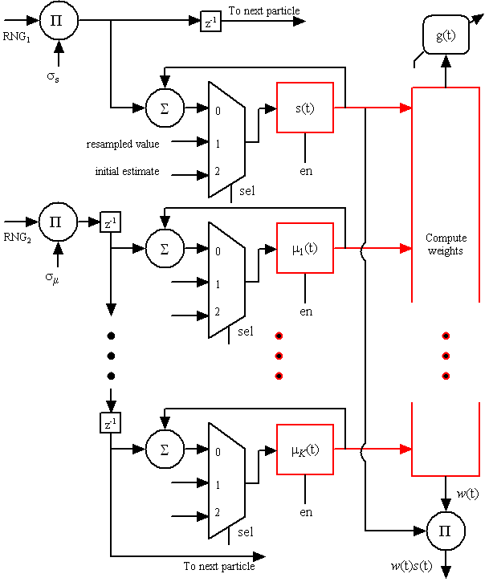
Particle Block Diagram

Slide 62
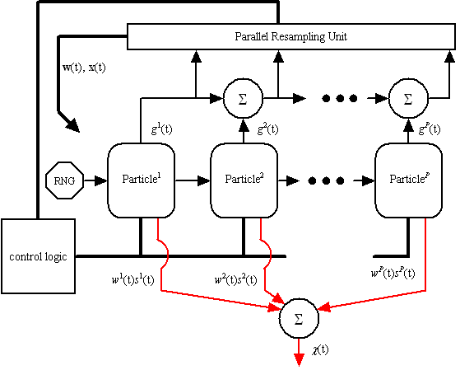
Estimated Output Signal as a Weighted Sum

Slide 63
Synthesis Results
 | Slices | DSP48Es | Clock-cycles | Latency
Random Number Generator | 3506 | 0 | 1 (after pipelining) | 3.7 ns
Exponential | 55 | 1 | 5 | 1.4 ns
Exponential Quantity | 12 | 2 | 3 | 3.0 ns
Raise to Integer Power | 51 | 3 | 4 per sample | 1.6 ns

Slide 64
Proposed Future Work

Slide 65
Parallel Resampling
Particles with high weights are retained
Particles with low weights are discarded
All particles can be resampled in two clock cycles
On the first cycle, all particles are copied to temporary registers
On the second cycle, all particles are compared and assigned new values

Slide 66
Automated Controller
Design as a finite state machine (FSM)
Sampling period, block size, number of neurons and number of particles determine control signals
Signals include: enable lines for data registers, multipliers and counters, select lines for multiplexers and reset signals
Build the FSM from counters, comparators and multiplexers

Slide 67
Verification
Filter output compared to the MATLAB simulations
Quantization error is expected
Determine the number of bits needed for acceptable precision of the estimated signal
Further evaluation of the filter with an increase in particles and neurons

Slide 68
Throughput Comparison
The parallel processing architecture will be compared to a sequential implementation
Current benchmark is MATLAB running on the Java Virtual Machine (not a true comparison)
Comparisons will be made for throughput as a function of particles as well as neurons

Slide 69
Timeline
Throughput Comparison
Verification
Evaluation of the number
of particles/neurons
Synthesize Controller
Simulate Controller
Synthesize Modules
May June July Aug Sept Oct Nov Dec

Slide 70
Acknowledgements
Thank you, advisors and committee members.
    Dr. Iyad Obeid
    Dr. Dennis Silage
    Dr. Joseph Picone
    Dr. Marc Sobel

Slide 71
Questions?

