Slide 1
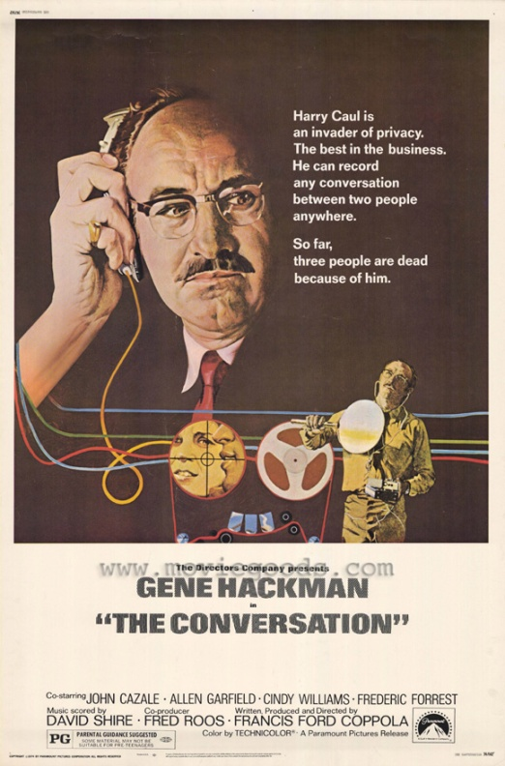
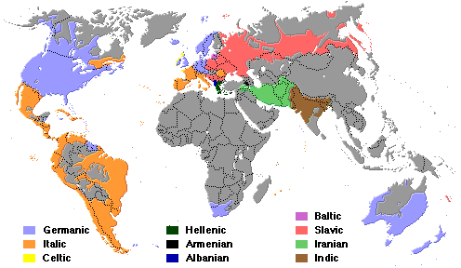
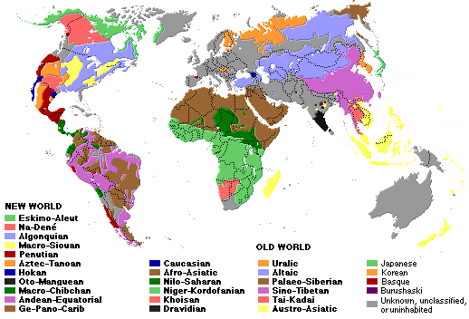
CAN YOU SAY HAMBURGER IN 6,000 LANGUAGES?
Joseph Picone, PhD
Department of Electrical and Computer Engineering
Mississippi State University
URL: http://www.ece.msstate.edu/research/isip/.../2008/msms/ Audio:

Slide 2
Abstract
There are approximately 6,000 spoken languages in the world. Mandarin Chinese is already the world's most widely-used language based on the number of native speakers, with Hindi/Urdu and Arabic expected to surpass English in the next 50 years. Though the number of less common languages in everyday use throughout the world seems to be decreasing as people have a greater need to cross cultural boundaries, the need to understand critical world affairs in real-time in a multilingual multimedia world increasingly requires expertise in the world’s less common languages. So how do you say hamburger in 6,000 languages?
With the advent of modern computing, it is possible to provide some help using a variety of automated information processing services, such as language translation (e.g., Google) and social networking (e.g., Facebook), that use sophisticated computer models whose roots are grounded in the same math you learn in high school. For example, while you surf the Internet, some Internet sites are training a statistical model of your behavior, and attempting to profit from that model (e.g., customizing advertising based on your interests).
In this talk, we will describe how mathematics can be used to automatically understand and monitor human behavior as observed through diverse sources of information such as voice, blogging, and social networking. Television shows, movies, and science fiction literature have done a superb job popularizing the critical role that mathematics plays in understanding human behavior, creating renewed appreciation for those who pursue careers in math and science. Math is, once again, cool... and more importantly, profitable.
BIOGRAPHY Dr. Joseph Picone graduated from Fenwick High School in Chicago, Illinois in 1975. He subsequently received his Ph.D. in Electrical Engineering from Illinois Institute of Technology in 1983. Dr. Picone is currently a Professor in the Department of Electrical and Computer Engineering at Mississippi State University, where he conducts research on new statistical modeling techniques for speech processing.

Slide 3
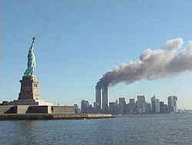
The Challenge
Global politics were dominated by a handful of languages in the post-World War II era (e.g., Russian).
The geopolitical map was split clearly along the lines of democracy, and third-world countries were not seen as pawns in global politics.
Post-1960’s political concerns were dominated by an anti-government sentiment, and the world was more concerned about government/industry collusion.
A 1970’s film, The Conversation, introduced pop culture to the world of industrial espionage.
On September 11, 2001, the world seemed to change overnight. Suddenly expertise in Arabic languages was in great demand.
In recent years, Mandarin Chinese has become the world’s most common language.
Equally important, the need to understand hundreds of less common languages, became critical in both the commercial and military sectors.

Slide 4
The World’s Languages
There are over 6,000 known languages in the world.
A number of these languages are vanishing spurring interest in new ways to use digital media and the Internet to preserve these languages and the cultures that speak them.
The dominance of English is being challenged by growth in Asian and Arabic languages.
In Mississippi, approximately 3.6% of the population speak a language other than English, and 12 languages cover 99.9% of the population.
Common languages are used to facilitate communication; native languages are often used for covert communications.
Starkville Public Schools

Slide 5
Finding the Needle in the Haystack… In Real Time!
There are 6.7 billion people in the world representing over 6,000 languages.
300 million are Americans. Who worries about the other 6.4 billion? Ilocano ( ) Tagalog ( )
Over 170 languages are spoken in the Philippines, most from the Austronesian family. Ilocano is the third most-spoken.
This particular passage can be roughly translated as:
Ilocano¹: Suratannak iti lizardfish3@yahoo.com maipanggep iti amin nga imbagada iti taripnnong. Awagakto isuna tatta.
English: Send everything they said at the meeting to lizardfish@yahoo.com and I'll call him immediately.
Human language technology (HLT) can be used to automatically extract such content from text and voice messages. Other relevant technologies are speech to text and machine translation.
Language identification and social networking are two examples of core technologies that ca be integrated to understand human behavior.
1. The audio clip was provided by Carl Rubino, a world-renowned expert in Filippino languages.

Slide 6
Information Retrieval From Voice Enables Analytics
Speech Activity Detection
“What is the number one complaint of my customers?”
Gender Identification
Language Identification
Speaker Identification
Keyword Search
Speech to Text
Relationship Analysis
Entity Extraction
Relational Database

Slide 7
A Statistical Machine Learning Approach To Language ID
Development:
Operation:
Statistical machine learning approaches to language ID involve training a statistical model to learn the differences between languages.
A statistical model might be something simple, like the mean values of “features.” or something more complicated like a hidden Markov model that uses weighted combinations of Gaussian distributions.
These approaches require a priori knowledge of the languages to be identified, which is not practical for identification of unknown languages.
Start
Decision
Collect Data
Post-Processing
Choose Features
Classification
Choose Model
Feature Extraction
Train Classifier
Segmentation
Evaluate Classifier
Sensing
End
Input

Slide 8
Features: Convert a Signal to a Sequence of Vectors

Slide 9
Model: Capture the Time-Frequency Evolution

Slide 10
Classification: Select the Most Likely Model
A statistical model is built for each language in the test set.
A classifier is designed to maximize the “distance” between each language.
Feature Extraction
Classifier
One of the simplest classification approaches is to choose the language that produces the largest probability:
The first probability measures how well the data fits the model for a specific language. This can use a combination of information measured from the spectral information (acoustics) and from the words spoken (linguistics).
The second model measures the likelihood of the language occurring. We refer to this as the “prior probability.” Accurately estimating this is a problem for less commonly occurring languages.
Other popular classification methods are based on neural networks and Support Vector Machines.

Slide 11
Performance: Accuracy Improves With More Data

Slide 12
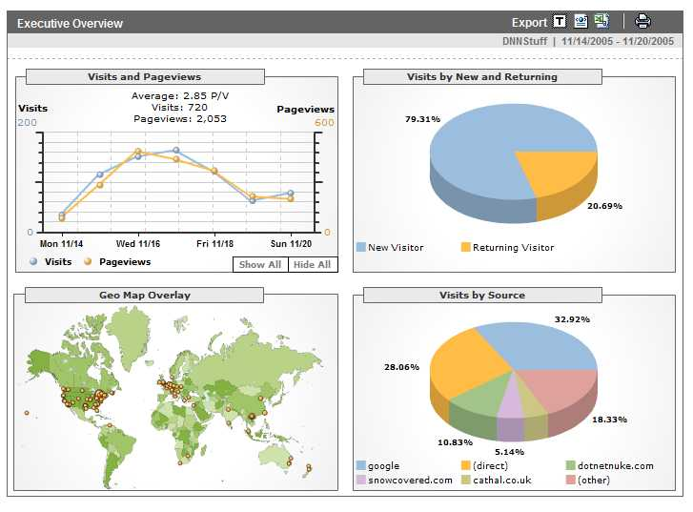
Analytics
Definition: A tool or process that allows an entity (i.e., business) arrive at an optimal or realistic decision based on existing data. (Wiki).
Google is building a highly profitable business around analytics derived from people using its search engine.
Any time you access a web page, you are leaving a footprint of yourself, particularly with respect to what you like to look at.
This has allows advertisers to tailor their ads to your personal interests by adapting web pages to your habits.
Web sites such as amazon.com, netflix.com and pandora.com have taken this concept of personalization to the next level.
As people do more browsing from their telephones, which are now GPS enabled, an entirely new class of applications is emerging that can track your location, your interests and your network of “friends.”

Slide 13
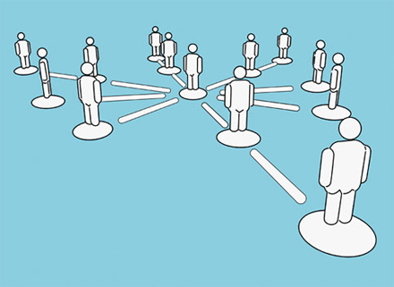
Social Networking
Sites such as Facebook, MySpace, and Linkedin.com are building a business based on your desire to network with other people.
By monitoring what sites/people you visit and how frequently you visit them, a graph can be built describing your social network.
These graphs can be aggregated, or averaged, over groups to better understand group dynamics.
The intersection of these graphs with other people’s graphs can help determine who or what is at the center of an activity.
These graphs can often be clustered into three levels: immediate, near and distant contacts. Graph theory plays a prominent role in the analysis of your “connectedness.”
Other types of information, such as the time of day and the physical location of your edge device, coupled with who/what you are viewing, can be useful in constructing a timeline of an event and understanding your habitual behavior.
Deviation from this behavior can set off alerts (e.g., credit cards).

Slide 14
Linear Discriminants
A simple model of your behavior is:
The inputs, x, can represent names, places, or even features of the sites you visit frequently (e.g., purchases).
The weights, w_{j}, can be set heuristically (e.g., visiting www.aljazeera.com is much more important than visiting www.msms.k12.ms.us).
The parameters of the model can be optimized to minimize the error in predicting your choices, or to maximize the probability of predicting a correct choice.
We can weight these probabilities by the a priori likelihood that the average user would make certain choices (Bayesian models).
Retail
Linear Classifier
Newspapers

Slide 15
Predicting User Preferences
These models can be used to generate alternatives for you that are consistent with your previous choices (or the choices of people like you).
Such models are referred to as generative models because they can generate new data spontaneously that is statistically consistent with previously collected data.
Alternately, you can build graphs in which movies are nodes and links represent connections between movies judged to be similar.
Some sites, such as Pandora, allow you to continuously rate choices, and adapt the mathematical models of your preferences in real time.
This area of science is known as adaptive systems, dealing with algorithms for rapidly adjusting to new data.

Slide 16
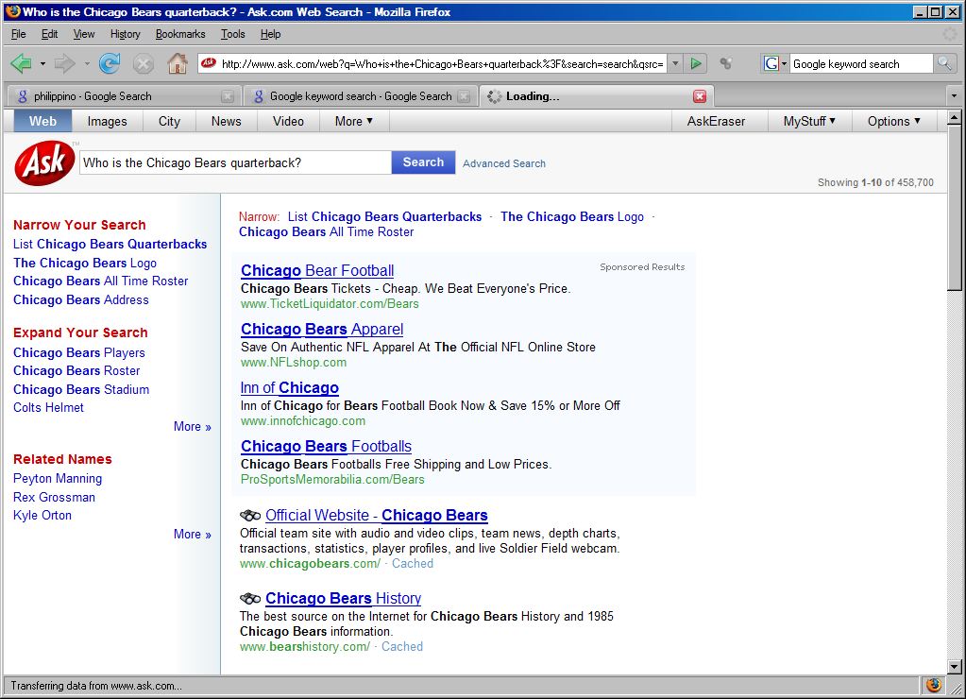
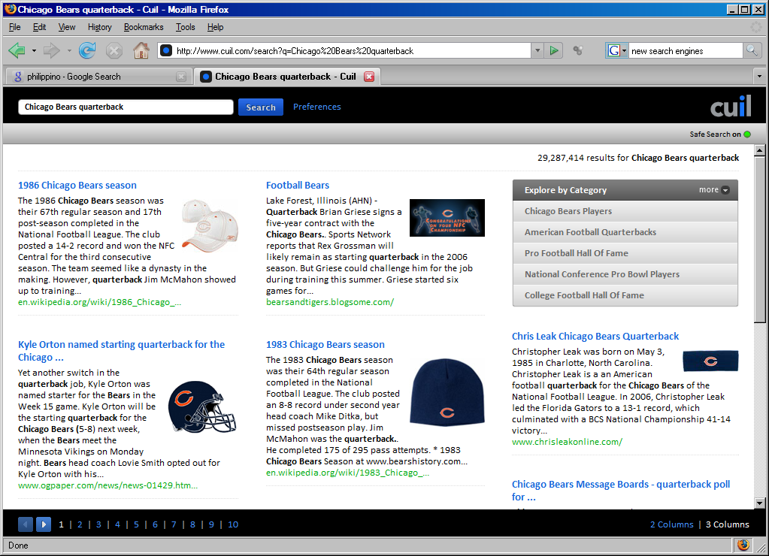
Content-Based Searching
Once the underlying data is analyzed and “marked up” with metadata that reveals content such as language and topic, search engines can match based on meaning.
Such sites make use several human language technologies and allow you to search multiple types of media (e.g., audio tracks of broadcast news).
This is an emerging area for the next generation Internet.

Slide 17
To Learn More
A new generation of Internet technologies are emerging that integrate diverse types of information to better understand and accommodate its users.
Core components of many of these technologies are mathematical and statistical models.
GPS-enabled edge devices such as cell phones are accelerating this transition and allowing applications to enhance the user experience with knowledge of your physical location.
Analytics that attempt to make sense of this information are becoming increasingly powerful and profitable.

Slide 18
Appendix: To Learn More
A. Sterrett, 101 Careers in Mathematics, Mathematical Association of America (MAA), Washington, D.C., USA, ISBN: 0883857286, 2003.
S. Lambert and R. DeCotis, Great Jobs for Math Majors, McGraw-Hill, New York, New York, USA, ISBN: 0844264229, 1998.
She Does Math!: Real-Life Problems from Women on the Job, Mathematical Association of America (MAA), Washington, D.C., USA, ISBN: 0883857022, 1995.
F. Karnes and K. Stephens, Young Women of Achievement: A Resource for Girls in Science, Math and Technology, Prometheus Books, Amherst, New York, USA, ISBN: 1573929654, 2002.

