Slide 1
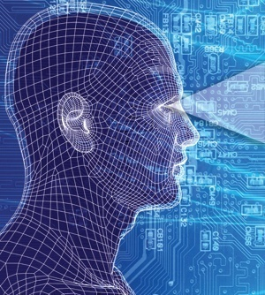
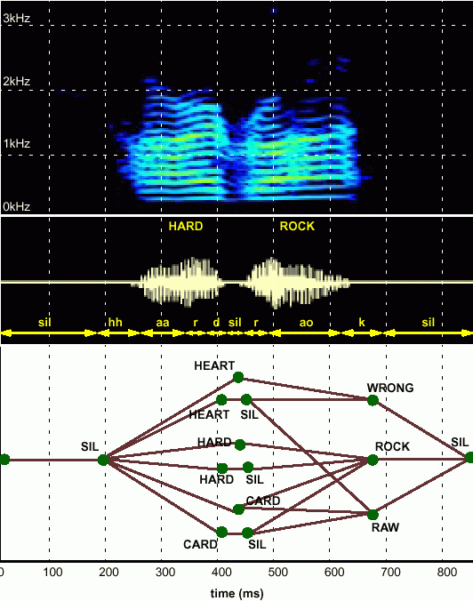
NONLINEAR STATISTICAL MODELING OF SPEECH
Joseph Picone, PhD
Professor, Department of Electrical and Computer Engineering
Mississippi State University
URL:

Slide 2
Abstract
Statistical or machine-learning techniques, such as Hidden Markov models and Gaussian mixture models, have dominated the signal processing and pattern recognition literature for the past 25 years. However, such approaches are prone to overfitting and have problems with generalization. For example, delivering high performance on previously unseen noise conditions remains an elusive goal.
In this presentation, we will review our recent work on applying principles of nonlinear statistical modeling to acoustic modeling in speech recognition. Our goal is to improve recognition performance in noisy environments. We will discuss the use of an extended feature vector containing features based on correlation dimension, correlation entropy and Lyapunov exponents. We will also introduce a new acoustic model based on a probabilistic mixture of autoregressive models.
Experimental results are presented on the Aurora IV large vocabulary speech recognition task in which audio data from a variety of actual noise conditions were digitally added to the standard Wall Street Journal 5K closed-vocabulary task. We will show modest gains in performance can be achieved under matched conditions, but performance degraded under mismatched training conditions.

Slide 3
Fundamental Challenges: Generalization and Risk
Why research human language technology?
“Language is the preeminent trait of the human species.”
“I never met someone who wasn’t interested in language.”
“I decided to work on language because it seemed to be the hardest problem to solve.”
Some fundamental challenges:
Diversity of data, much of which defies simple mathematical descriptions or physical constraints (e.g., Internet data).
Too many unique problems to be solved (e.g., 6,000 language, billions of speakers, thousands of linguistic phenomena).
Generalization and risk are fundamental challenges (e.g., how much can we rely on sparse data sets to build high performance systems).
Underlying technology is applicable to many application domains:
Fatigue/stress detection, acoustic signatures (defense, homeland security);
EEG/EKG and many other biological signals (biomedical engineering);
Open source data mining, real-time event detection (national security).
Significant technology commercialization opportunities!

Slide 4
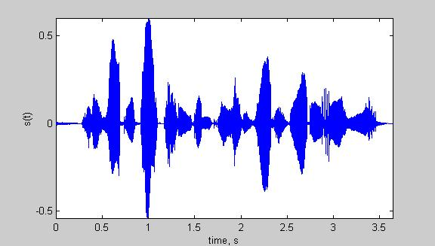
Speech Recognition Overview
Based on a noisy communication channel
model in which the intended message is
corrupted by a sequence of noisy models
Bayesian approach is most common:
Objective: minimize word error rate by
maximizing P(W|A)
P(A|W): Acoustic Model
P(W): Language Model
P(A): Evidence (ignored)
Acoustic models use hidden Markov
models with Gaussian mixtures.
P(W) is estimated using probabilistic
N-gram models.
Parameters can be trained using generative (ML)
or discriminative (e.g., MMIE, MCE, or MPE) approaches.
Input
Speech
Acoustic
Front-end
Research Focus
Acoustic Models
P(A/W)
Language Model
P(W)
Search
Recognized Utterance

Slide 5
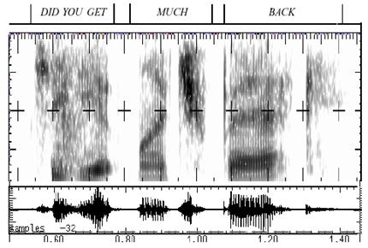
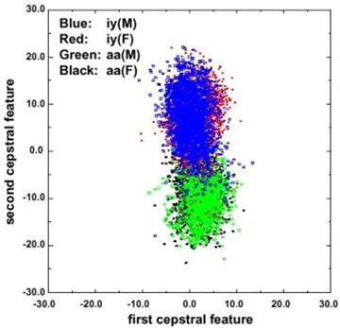
Fundamental Challenges in Spontaneous Speech
Common phrases experience significant reduction (e.g., “Did you get” becomes “jyuge”).
Approximately 12% of phonemes and 1% of syllables are deleted.
Robustness to missing data is a critical element of any system.
Linguistic phenomena such as coarticulation produce significant overlap in the feature space.
Decreasing classification error rate requires increasing the amount of linguistic context.
Modern systems condition acoustic probabilities using units ranging from phones to multiword phrases.

Slide 6
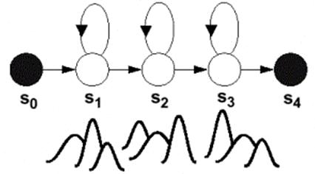

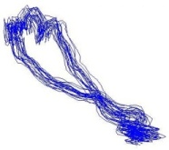

Towards Nonlinear Acoustic Modeling
ARHMM:
autoregressive time series model for feature vectors integrated into an HMM framework
GMMs:
use multiple mixture components to accommodate modalities in the data;
rely on a feature vector to capture dynamics of the signal;
classification tends to perform poorly on unseen data.
Pro: directly models dynamics beyond
1st and 2nd-order derivatives
Con: marginal improvements in performance at a much greater computational cost.
Chaotic Models:
capitalize on self-synchronization and limit cycle behavior.

Slide 7
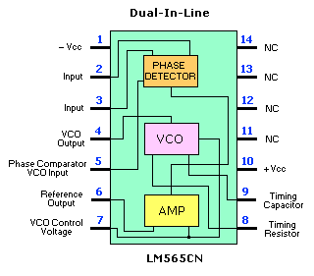

Relevant Attributes of Nonlinear Systems
A PLL is a relatively simple, but very robust, nonlinear
device that uses negative feedback to match the
frequency and phase of an input signal to a reference.
Our original goal was to build “phone detectors”
that demonstrated similar properties to a PLL.
A strange attractor is a set of points or region which bounds the long-term, or steady-state behavior of a chaotic system. Systems can have multiple strange attractors, and the initial conditions determine which strange attractor is reached.
Our original goal was to build “chaotic” phone acoustic models that replaced conventional CDHMM phone models.
However, phonemes in spontaneous speech can be extremely short – 10 to
30 ms durations are not uncommon. Also, some phonemes are transient in nature (e.g., stop consonants). This makes such modeling difficult.
In this talk, we will focus on two promising approaches:
Feature vectors using nonlinear dynamic invariants;
Acoustic models using Nonlinear Mixture Autoregressive HMMs.

Slide 8
Towards Improving Features for Speech Recognition
First attempt involved extended
a standard speech recognition feature
vector with some parameters that
estimate the strength of the nonlinearities
in the signal.
Direct modeling of the speech signal using
nonlinear dynamics has not been promising.
We were interested in a series of
pilot experiments to understand the
value of these features in various
tasks such as speaker-independent
recognition, where short-term
spectral information is important,
and speaker verification, where
long-term spectral information
is important.
Also used this testbed to tune various
parameters required in the calculation of these new features.
Investigated optimal ways to combine the features as well.
Input
Speech
Acoustic
Front-end
Acoustic Models
P(A/W)
Language Model
P(W)
Search
Recognized Utterance

Slide 9
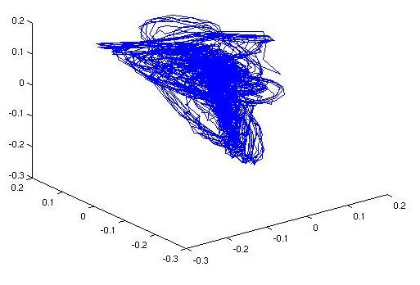

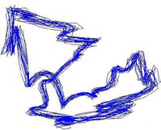

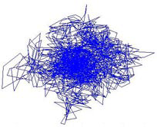
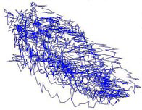
The Reconstructed Phase Space
Nonlinear invariants are computed from the phase space:
  Signal amplitude is an observable of the system
  Phase space is reconstructed from the observable
  Invariants based on properties of the phase space
  Reconstructed phase space (RPS):
  time evolution of the system forms a path, or
  trajectory within the phase space;
  the system’s attractor is the subset of the phase
  space to which the trajectory settles;
  use SVD embedding to estimate the RPS
  (SVD reduction from 11 dimensions to 5).
  Examples of an RPS for speech signals (phonemes):
/ah/
/eh/
/m/
/sh/
/z/

Slide 10
Three Promising Nonlinear Invariants (D. May)
Correlation Dimension (C_{dim}):
quantifies attractor’s geometrical complexity by measuring self-similarity;
tends to be lower for fricatives and higher for vowels (not unlike other spectral measures such as the linear prediction order) .
Correlation Entropy (C_{ent}):
measures the average rate of information production in a dynamic system;
tends to be low for nasals, and is less predictable for other sounds.
Lyapunov Exponent (λ):
measures the level of chaos in the reconstructed attractor;
tends to be low for nasals and vowels; high for unvoiced phones.
/ah/
C_{dim} = 0.88
C_{ent} = 666
λ= -7.7
/m/
C_{dim} = 0.84
C_{ent} = 343
λ= -9.0
/sh/
C_{dim} = 0.33
C_{ent} = 623
λ= 795

Slide 11
Continuous Speech Recognition Experiments
Evaluation: ETSI Aurora IV Distributed Speech Recognition (DSR)
Based on the Wall Street Journal corpus (moderate CPU requirements)
Digitally-added noise conditions at controlled SNRs
Baseline recognition system was the Aurora IV evaluation system (ISIP):
  Features: industry-standard 39-dimension MFCC features
  Acoustic Model: 4-mixture cross-word context-dependent triphones
  Training: standard HMM approach (EM/BW/ML)
  Decoding: one-best Viterbi beam search with a bigram 5K closed-set LM
Four feature combinations:
FS1 | Dim
MFCCs | 39
C_{dim} | 1
Total: | 40
FS2 | Dim
MFCCs | 39
C_{ent} | 1
Total: | 40
FS3 | Dim
MFCCs | 39
λ | 1
Total: | 40
FS4 | Dim
MFCCs | 39
C_{dim} | 1
C_{ent} | 1
λ | 1
Total: | 42

Slide 12
Experimental Results on Aurora IV
The contributions of each feature was analyzed as a function of the broad phonetic class.
A closed-set test was conducted on the training data.
The overall results were mixed and showed no consistent trend.
Two more extensive evaluations were conducted on Aurora IV:
 | C_{dim} | C_{ent} | λ
Affricates | 10.3% | 3.9% | 2.9%
Stops | 3.6% | 4.2% | 4.5%
Fricatives | -2.2% | -1.1% | -0.6%
Nasals | -1.5% | 0.2% | 1.9%
Glides | -0.7% | 0.2% | -0.1%
Vowels | 0.4% | 1.1% | 0.4%
Overall | 1.7% | 1.4% | 1.5%
Clean data (studio quality):
Mismatched training:
Feature Set | WER (%) | Rel. (%) | Sign. (p)
FS0 (MFCCs) | 13.5 | -- | --
FS1 (C_{dim}) | 12.2 | 9.6 | 0.030
FS2 (C_{ent}) * | 12.0 | 11.1 | 0.001
FS3 (λ ) | 12.5 | 7.4 | 0.075
FS4 (All) | 12.8 | 5.2 | 0.267
 | Air. | Babble | Car | Rest. | Street | Train
FS0 | 53.0 | 55.9 | 57.3 | 53.4 | 61.5 | 66.1
FS1 | 57.1 | 59.1 | 65.8 | 55.7 | 66.3 | 69.6
FS2 | 52.8 | 56.8 | 58.8 | 52.7 | 63.1 | 65.7
FS3 | 56.8 | 60.8 | 60.5 | 58.0 | 66.7 | 69.0
FS4 | 58.6 | 63.3 | 72.5 | 60.6 | 70.8 | 72.5
p < 0.001 are statistically significant.

Slide 13
Towards Improved Acoustic Modeling
Investigated a wide variety of nonlinear
modeling techniques including Kalman
filters and particle filters with mixed results.
Focused on a technique that preserves
the benefits of autoregressive modeling,
but adds a probabilistic component to
allow modeling of nonlinearities.
Initially investigated this technique on
data involving artificially elongated
pronunciations of vowels to remove
event duration as a variable.
Techniques to extend these
techniques to large-scale
experiments on large vocabulary
speech recognition tasks are under
development.
The goal remains to achieve high performance
recognition on speech contaminated by noise not represented in the training database.
Input
Speech
Acoustic
Front-end
Acoustic Models
P(A/W)
Language Model
P(W)
Search
Recognized Utterance

Slide 14
Mixture Autoregressive (MAR) Models (S. Srinivasan)
Define a weighted sum of autoregressive models (Wong and Li, 2000):
where,
ε_{i} : zero mean Gaussian with variance σ_{j}²
“w.p. w_{i}” : with probability w_{i}
a_{i,j} (j>0) : AR predictor coefficients
a_{i,0} : mean for the i^{th} component
  An AR filter of order 0 is equivalent to a Gaussian mixture model (GMM).
  MFCCs routinely use 1st and 2nd order derivatives of the features to introduce some dynamic information into the HMM.
  MAR can capture more information about dynamics using an AR model.

Slide 15
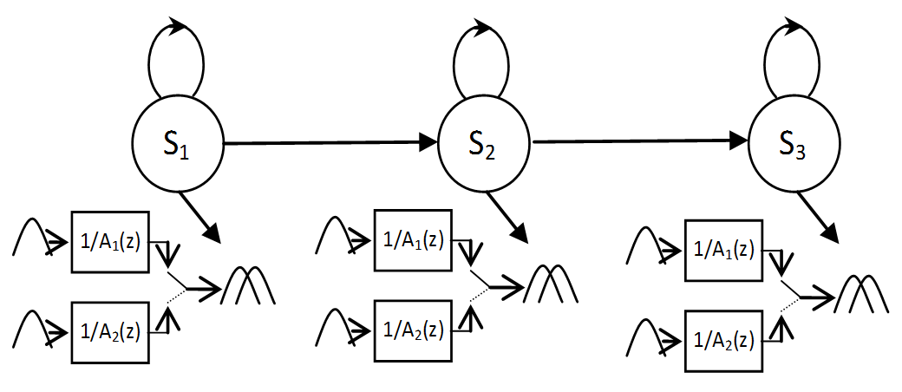
Integrating MAR into HMMs
Phonetic models in an HMM approach typically use a 3-state left-to-right model topology with a large number of mixture components (e.g., 128 mixtures for speech recognition and 1024 mixtures for speaker verification).
Dynamics are captured in the feature vector and through the state transition probabilities.
Observation probabilities tend to dominate.
MAR-HMM uses a probabilistic MAR model in which the weights are estimated using the EM algorithm.
In our work we have extended the scalar MAR model to handle feature vectors by using a single weight estimated by summing the likelihoods across all scalar components.

Slide 16
Experimental Results on Sustained Phones
# Mixts. | # Feats | GMM | MAR
2 | 13 | 77.8 (54) | 83.3 (80)
2 | 39 | 92.2 (158) | 94.4 (236)
4 | 13 | 86.7 (108) | 90.0 (160)
4 | 39 | 94.4 (316) | 97.8 (472)
8 | 13 | 91.1 (216) | 94.4 (320)
8 | 39 | 96.7 (632) | 97.8 (944)
16 | 13 | 93.3 (432) | 95.6 (640)
16 | 39 | 100.0 (1264) | 98.9 (1888)
MAR-HMM was initially evaluated on a pilot corpus of sustained vowels that was developed to prototype nonlinear algorithms.
Results are shown in terms of % accuracy and the number of parameters (in parentheses).
For the same number of parameters, MAR-HMM has a slight advantage.
MAR performance saturates as the number of parameters increases.
Assumption that features are uncorrelated during MAR training is invalid., particularly for delta features. This typically causes problems for both GMMs and MAR, but it seems to impact MAR-HMM more significantly.
Results on continuous speech recognition have not been promising and are the subject of further research.

Slide 17
Summary
Introduced two attempts to add nonlinear statistical models to conventional hidden Markov model (HMM) speech recognition systems.
Demonstrated slight improvements in performance on clean data, but did not achieve our overall goal of improving performance on unseen noisy data.
We are continuing to examine alternate acoustic modeling techniques and are pursuing an alternative known as a linear dynamic model. However, preliminary results are similarly mixed.
We have seen similar modest improvements in speaker identification and verification performance. Here, we overcome the problem of a lack of samples since features are extracted across an entire utterance. However, deconvolving short-term spectral variations and long-term speaker characteristics remains a challenge.
Future directions will include non-Bayesian statistical models.

Slide 18
Brief Bibliography of Related Research
D. May, Nonlinear Dynamic Invariants For Continuous Speech Recognition, M.S. Thesis, Department of Electrical and Computer Engineering, Mississippi State University, May 2008.
S. Srinivasan, T. Ma, D. May, G. Lazarou and J. Picone, "Nonlinear Mixture Autoregressive Hidden Markov Models For Speech Recognition," Proceedings of the International Conference on Spoken Language Processing, pp. 960-963, Brisbane, Australia, September 2008.
T. Ma, S. Srinivasan, D. May, G. Lazarou and J. Picone, "Robust Speech Recognition Using Linear Dynamic Models," submitted to INTERSPEECH, Brisbane, Australia, September 2008.
S. Prasad, S. Srinivasan, M. Pannuri, G. Lazarou and J. Picone, "Nonlinear Dynamical Invariants for Speech Recognition," Proceedings of the International Conference on Spoken Language Processing, pp. 2518-2521, Pittsburgh, Pennsylvania, USA, September 2006.
Y. Ephraim and W.J.J. Roberts, “Revisiting Autoregressive Hidden Markov Modeling of Speech Signals,” IEEE Signal Processing Letters, vol. 12, no. 2, pp. 166-169, Feb. 2005.
H. Kantz and T. Schreiber, Nonlinear Time Series Analysis, Cambridge University Press, New York, New York, USA, 2003.

Slide 19
Appendix: Correlation Integral
The correlation integral quantifies how completely the
attractor fills the phase space by measuring the density
of the points close to the attractor’s trajectory, and
averaging this density over the entire attractor.
Computed using the following steps:
  consider a window of data (30 ms) centered around a frame (10 ms);
  choose a neighborhood radius, ε, and center a hypersphere with this radius on the initial point of the attractor (ε = 2.3);
  count the number of points within the hypersphere;
  move the center of the hyper-sphere to the next point along the trajectory of the attractor and repeat step 2;
  compute the average of the number of points falling within the hypersphere over the entire attractor.
  Mathematically, this is expressed by:
  n_{min} is a correction factor (Theiler) which reduces the negative effects of temporal correlations by skipping points which are temporally close.
/ah/

Slide 20

Appendix: Correlation Dimension
The correlation dimension captures the power-law relation
between the correlation integral of the attractor and the
neighborhood radius of the hypersphere as the number of
points on the attractor approaches infinity and ε becomes
very small.
The relationship between the correlation integral and
correlation dimension is (for small ε):
The correlation dimension is computed using the
correlation integral:
Our approach is to choose a minimum value for ε via tuning
(ε_{min} = 0.2), choose a range for ε in this neighborhood
(0.2 ≤ ε ≤ 2.3), a resolution for this range (ε_{step} = 0.1),
compute the correlation integral for ε, and finally computing the slope using a smoothing approach (regression).
Theoretically, this should be a close approximation to the fractal dimension.

Slide 21
Appendix: Correlation Entropy
A measure of dynamic systems is the rate at which new
information is being produced as a function of time.
Each new observation of a dynamic system potentially
contributes new information to this system, and the average
quantity of this new information is referred to as the metric,
or Kolmogorov entropy.
For reconstructed phase spaces, it is easier to compute the second-order metric entropy, K₂, because it is related to the correlation integral:
where D is the fractal dimension of the reconstructed attractor, ε is the neighborhood radius, m and τ are the number of embedding dimensions and time delay, respectively, used for phase space reconstruction.
From this relation, an expression for K₂ can be derived:
We compute the (log) correlation integral for an RPS in m=5 and m+1=6 dimensions. ε is minimized via tuning (ε_{min}=2.3). K₂ is the ratio scaled by (1/τ).

Slide 22
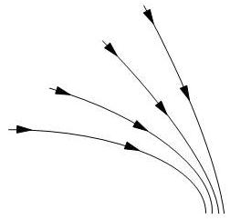
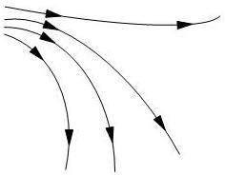
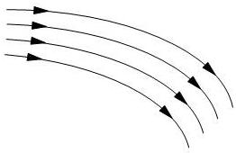
Appendix: Lyapunov Exponents
Describe the relative behavior of neighboring trajectories
within an attractor and quantify the level of chaos.
Determine the level of predictability of the system by
analyzing trajectories that are in close proximity and
measuring the change in this proximity as time evolves.
The separation between two trajectories with close initial
points after N evolution steps can be represented by:
High-level overview of our approach:
  Reconstruct phase space from the original time-series.
  Select a point on the reconstructed attractor.
  Find a set of nearest neighbors to .
  Measure the separation between and its neighbors as time evolves.
  Compute the local Lyapunov exponent from separation measurements.
  Repeat steps 2 though 5 for each of the reconstructed attractor.
  Compute average Lyapunov exponent from the local exponents.

Slide 23
Appendix: Lyapunov Exponents (Cont.)
Mathematically, the Lyapunov exponent is represented by:
The algorithm makes one pass over the attractor, starting
from the first embedded state, advancing by the defined
step size for a maximum of the defined number of steps.
In our experiments, the number of steps was sufficiently
large to include the entire attractor.
At each step, we find the nearest N neighbors and store
these neighbors. We then step the state and its neighbors
according to the step size, and again store the evolved
neighbors.
Next we group the set of original neighbors into subgroups. If any of these neighbors are on the same local trajectory, we group them into the same subgroup. We then group the evolved neighbors into the same groups as their originators and take the average of each subgroup and store these in a matrix.
At this point, we have 2 matrices: the average nearest neighbor subgroup matrix, and the average evolved nearest neighbor subgroup matrix.

Slide 24
Appendix: Lyapunov Exponents (Cont.)
We compute a trajectory matrix based on the singular values
of each of these matrices which defines the direction of all
the neighboring trajectories represented by the neighbor
subgroups.
From the trajectory matrix, we can compute the Lyapunov
spectrum by taking the QR decomposition of the trajectory
matrix, and taking the log of the diagonal values for the
upper-triangular matrix (R).
The Lyapunov exponent is (typically) taken as the maximum
Lyapunov spectrum value.
We repeat the process above across the whole attractor
and average the Lyapunov exponents to arrive at our final
exponent.
The parameters which must be chosen for this algorithm include the size of the neighborhood (ε = 25), the number of time evolution steps (5 samples), and the number of embedding dimensions (m = 5) for SVD embedding. These parameters are typically found experimentally.

Slide 25
Appendix: Major ISIP Milestones
1994: Founded the Institute for Signal and Information Processing (ISIP)
1995: Human listening benchmarks established for the DARPA speech program
1997: DoD funds the initial development of our public domain speech recognition system
1997: Syllable-based speech recognition
1998: NSF CARE award for Internet-Accessible Speech Recognition Technology
1998: First large-vocabulary speech recognition application of Support Vector Machines
1999: First release of high-quality SWB transcriptions and segmentations
2000: First participation in the annual DARPA evaluations (only university site to participate)
2000: NSF funds a multi-university collaboration on integrating speech and natural language
2001: Demonstrated the small impact of transcription errors on HMM training
2002: First viable application of Relevance Vector Machines to speech recognition
2002: Distribution of Aurora toolkit
2002: Evolution of ISIP into the Institute for Intelligent Electronic Systems
2002: the “Crazy Joe” commercial becomes the most widely viewed ISIP document
2003: IIES joins the Center for Advanced Vehicular Systems
2004: NSF funds nonlinear statistical modeling research and supports the development of speaker verification technology
2004: ISIP’s first speaker verification system
2005: ISIP’s first dialog system based on our port to the DARPA Communicator system
2006: Automatic detection of fatigue
2007: Integration of nonlinear features into a speech recognition front end
2008: ISIP’s first keyword search system
2008: Nonlinear mixture autoregressive models for speech recognition
2008: Linear dynamic models for speech recognition
2009: Launch of our first commercial web site and associated business venture…

Slide 26
Biography
Joseph Picone received his Ph.D. in Electrical Engineering in 1983 from the Illinois Institute of Technology. He is currently a Professor in the Department of Electrical and Computer Engineering at Mississippi State University. He recently completed a three-year sabbatical at the Department of Defense where he directed human language technology research and development.
His primary research interests are currently machine learning approaches to acoustic modeling in speech recognition. For over 25 years he has conducted research on many aspects of digital speech and signal processing. He has also been a long-term advocate of open source technology, delivering one of the first state-of-the-art open source speech recognition systems, and maintaining one of the more comprehensive web sites related to signal processing. His research group is known for producing many innovative educational materials that have increased access to the field.
Dr. Picone has previously been employed by Texas Instruments and AT&T Bell Laboratories, including a two-year assignment in Japan establishing Texas Instruments’ first international research center. He is a Senior Member of the IEEE and has been active in several professional societies related to human language technology. He has authored numerous papers on the subject and holds 8 patents.

