Slide 1
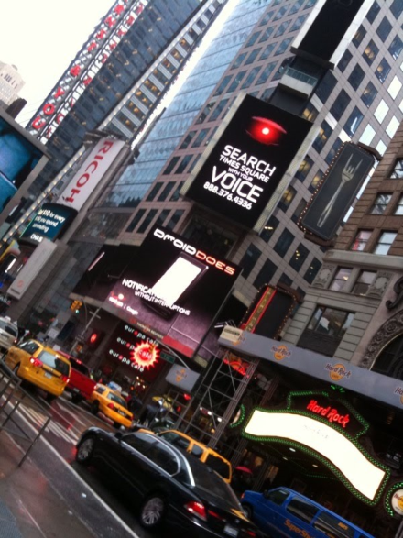
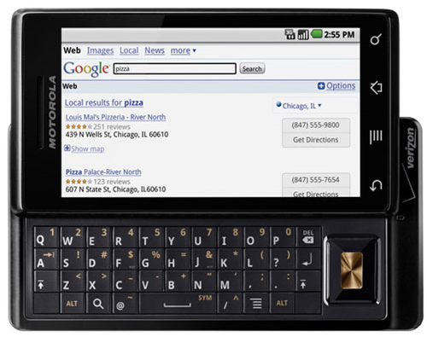
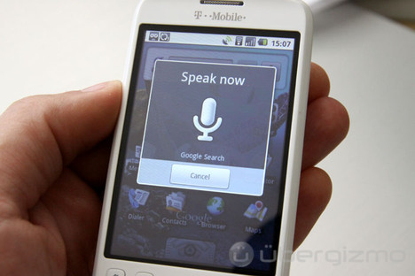
QUALITY ASSESSMENT OF SEARCH TERMS
IN SPOKEN TERM DETECTION
Amir Harati and Joseph Picone, PhD
Department of Electrical and Computer Engineering
Temple University
URL:

Slide 2
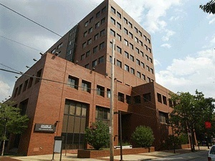

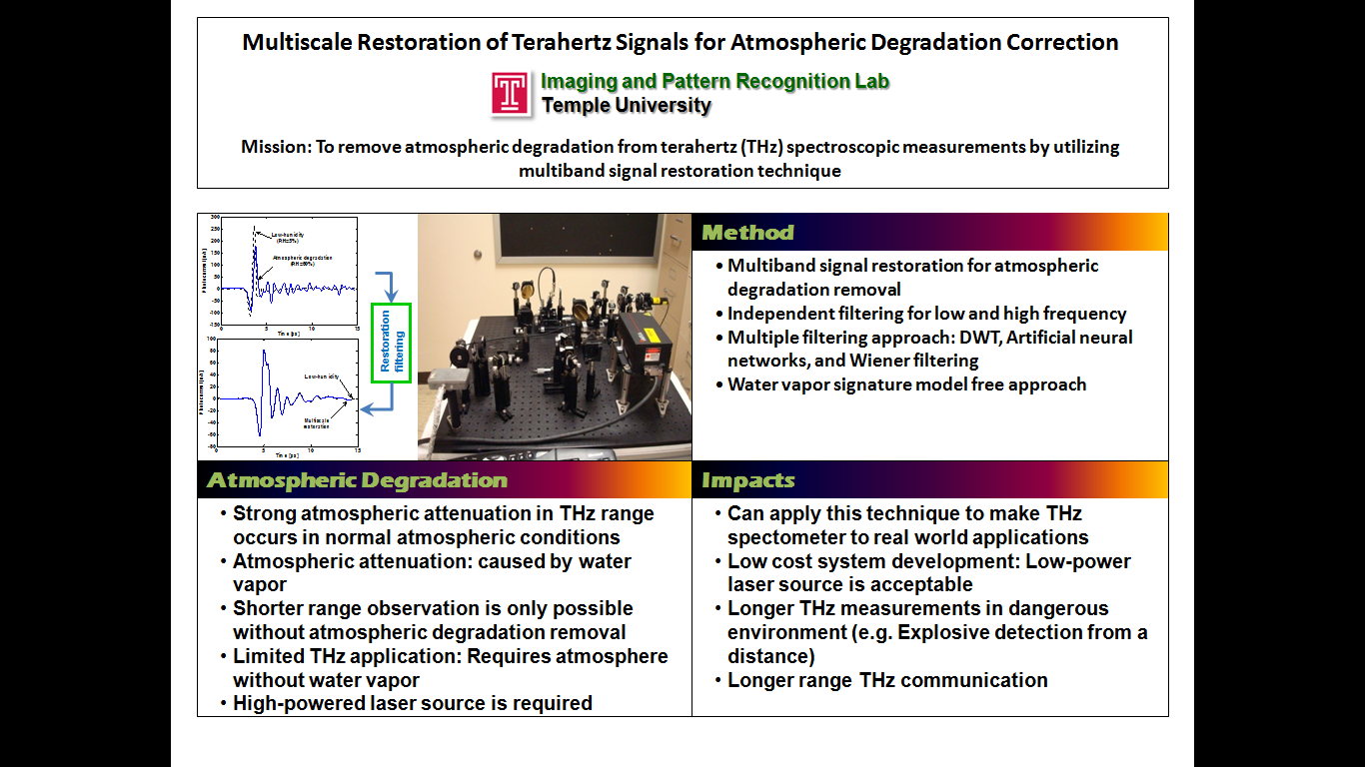
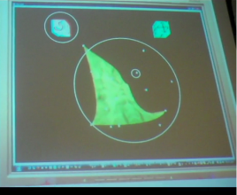
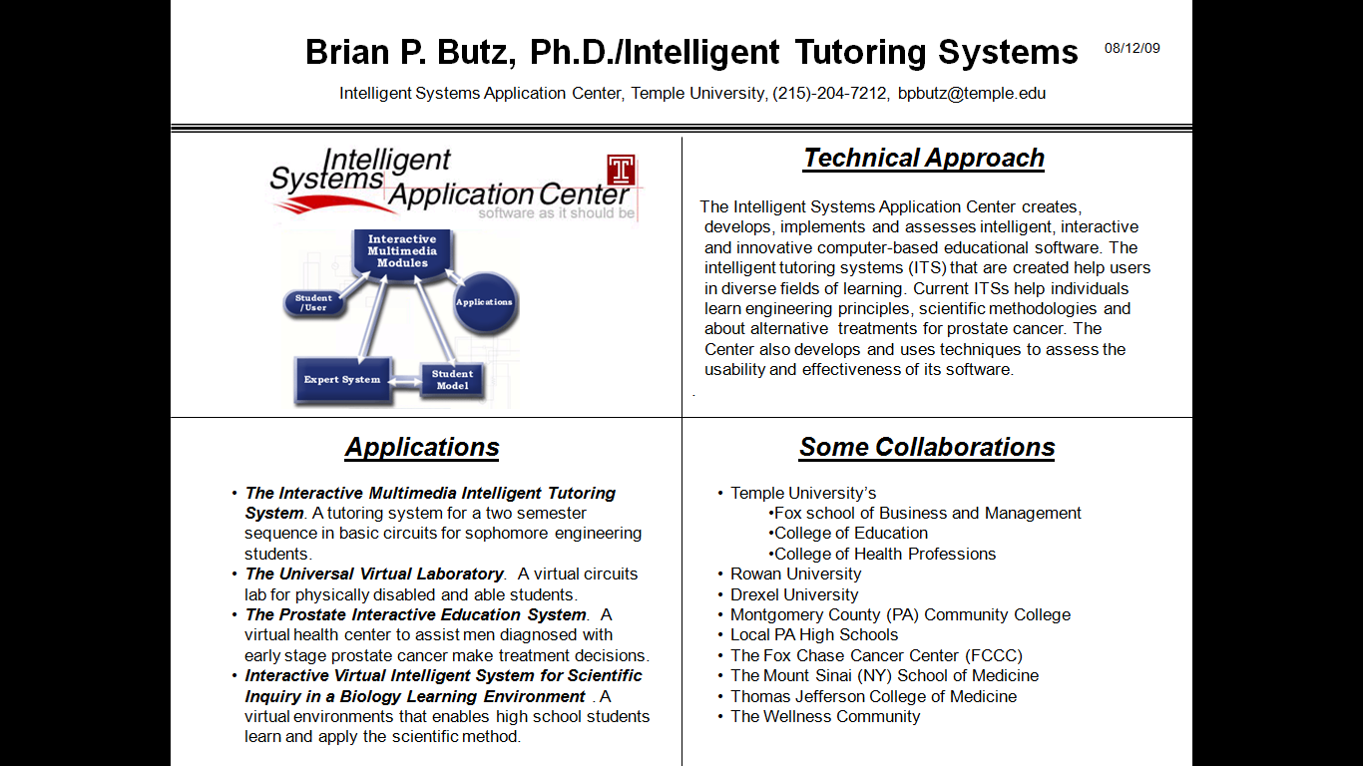
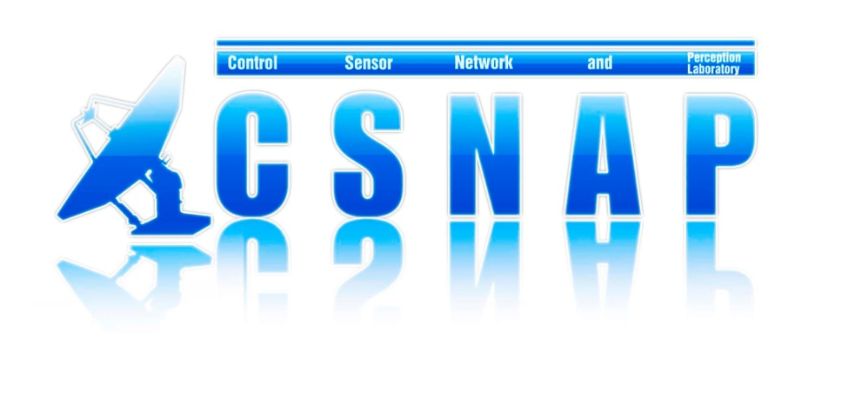
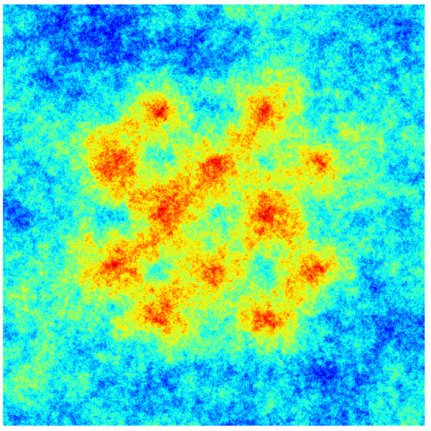
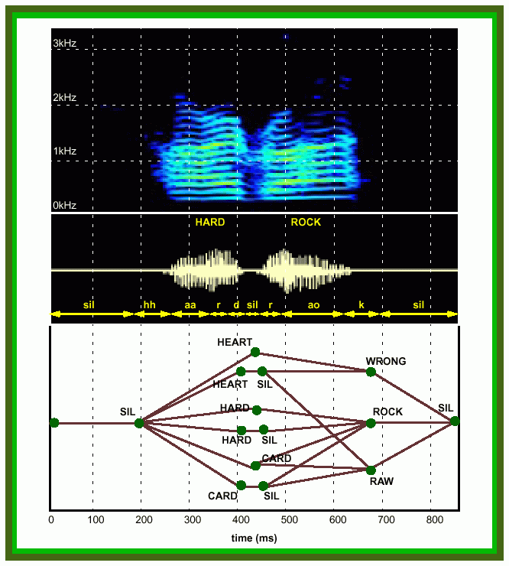
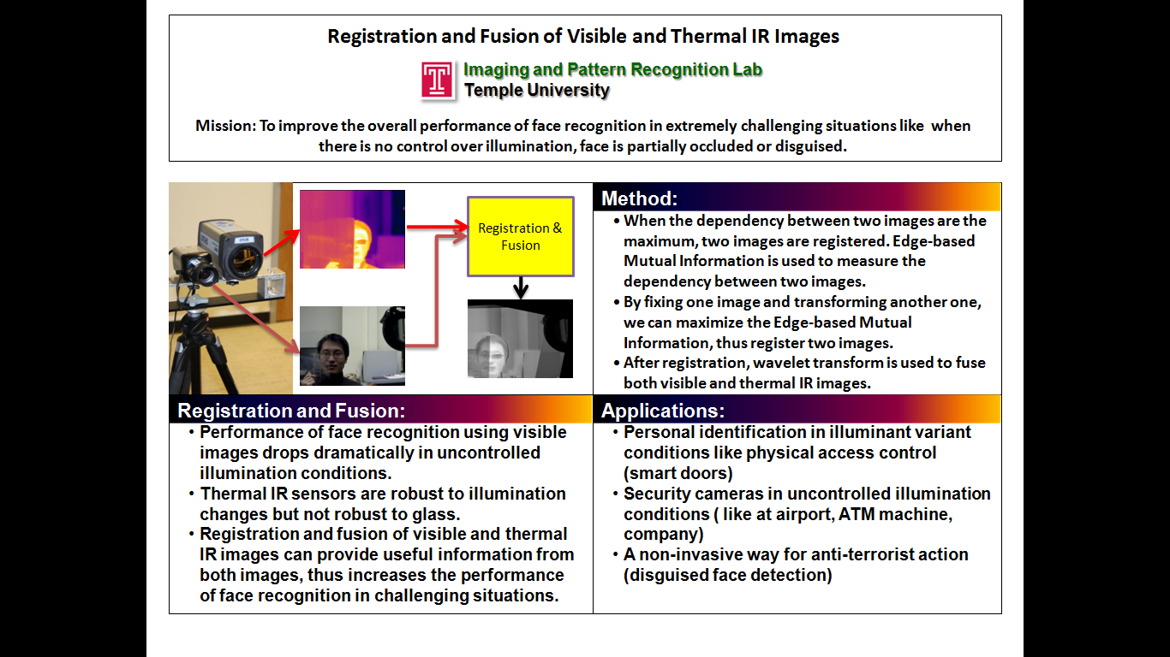
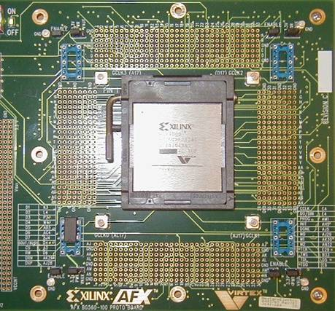
ECE@Temple By The Numbers
Faculty: 12 Tenure-Track (Full: 6; Assoc: 5; Assist: 1)
Adjuncts (10) and NTTs (1) play a crucial role
Three degree options: EE, CpE, BioE
Students: 220 UGs; 70 GRs (12 PhDs)
Space (sqft): 3,000 (offices), 3,500 (research), 5,300 (labs)
Research expenditures: $450K (2009-10)
Intelligent Systems: multi-agent systems, tutoring systems, human language technology
Sensors, Imaging and Control:
game theory, thermal imaging, signal restoration
Devices and Interfaces: system chip design, FPGAs, brain-machine interfaces

Slide 3
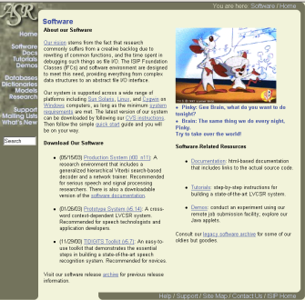
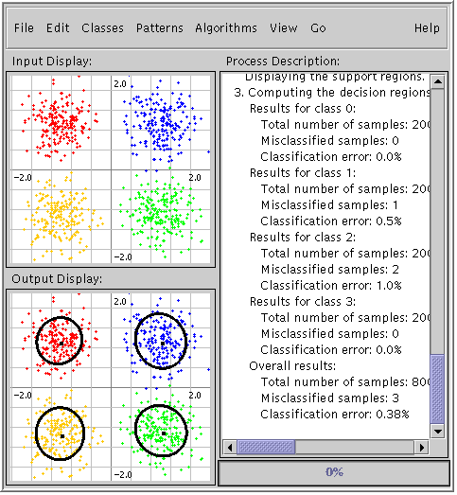
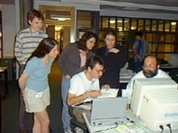
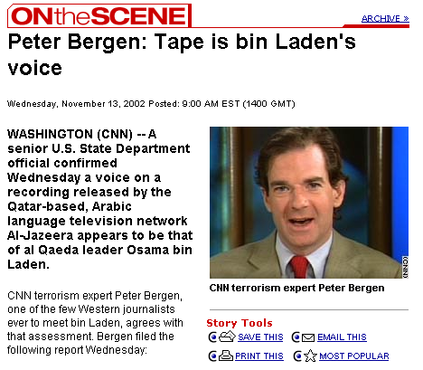
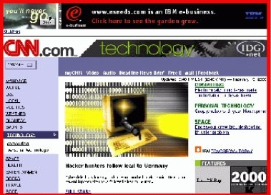
Emerging Directions in HLT @ Temple
Delivering public domain speech and signal processing tools including speech recognition and machine learning.
Also known for producing educational material, workshops, and online tutorials.
Joined Temple in July 2009, where HLT focus will be on national security applications.
Spent three years on an extended sabbatical at DoD where I was involved in HLT R&D.
Pursued the development and deployment of voice keyword search technology.
Educated on the needs of intelligence analysts and the challenges of SIGINT.

Slide 4
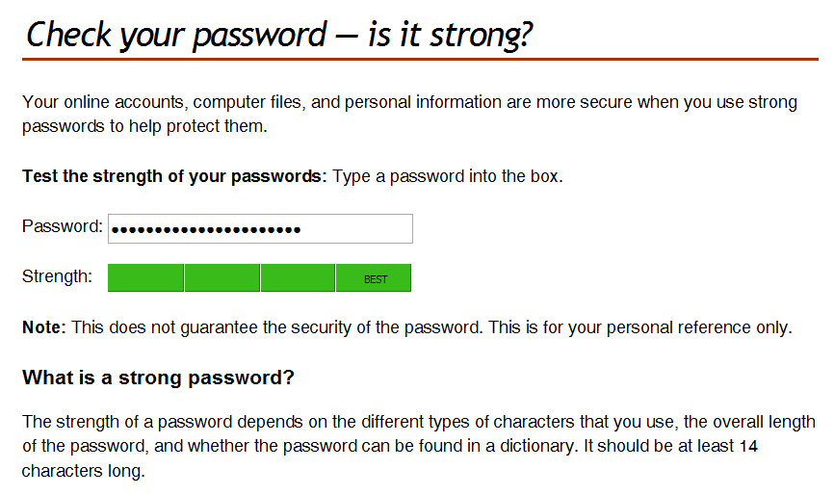
Abstract
Spoken term detection is an extension of text-based searching that allows users to type keywords and search audio files containing spoken language for their existence.
Performance is dependent on many external factors such as the acoustic channel, language and the confusability of the search term.
Unlike text-based searches, the quality of the search term plays a significant role in the overall perception of the usability of the system.
In this presentation we will review conventional approaches to keyword search.
Goal: Develop a tool similar to the way password checking tools currently work.
Approach: develop models that predict the quality of a search term based on its spelling (and underlying phonetic context).

Slide 5
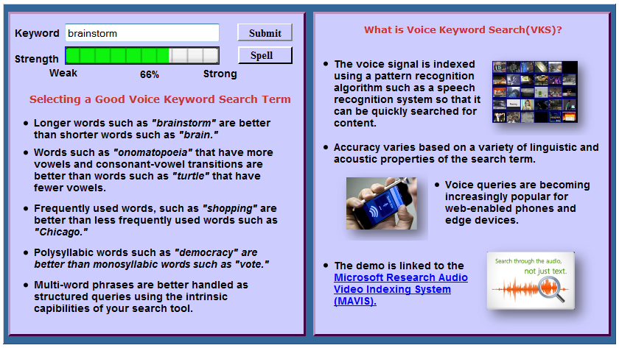
Demo
Available at:
http://www.isip.piconepress.com/projects/ks_prediction/demo/current/

Slide 6
Motivation
What makes machine understanding of human language so difficult?
“In any natural history of the human species, language would stand out as the preeminent trait.”
“For you and I belong to a species with a remarkable trait: we can shape events in each other’s brains with exquisite precision.”
S. Pinker, The Language Instinct: How the Mind Creates Language, 1994
According to the Oxford English Dictionary, the 500 words used most in the English language each have an average of 23 different meanings. The word “round,” for instance, has 70 distinctly different meanings.
(J. Gray, http://www.gray-area.org/Research/Ambig/#SILLY )
Hundreds of linguistic phenomena must be taken into account to understand written language.
  Each cannot always be perfectly identified (e.g., Microsoft Word)
  95% x 95% x … x … x … x … x … = a small number
Keyword search becomes a viable alternative to speech to text transcription, especially if it can be done quickly.

Slide 7
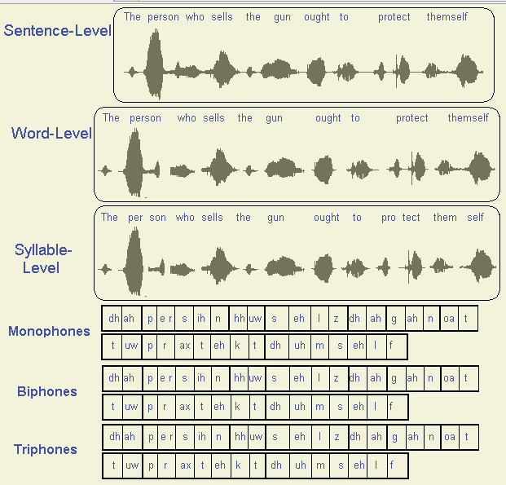
Maybe We Don’t Need to Understand Language?
See ISIP Phonetic Units to run a demo of the influence of phonetic units on different speaking styles.

Slide 8
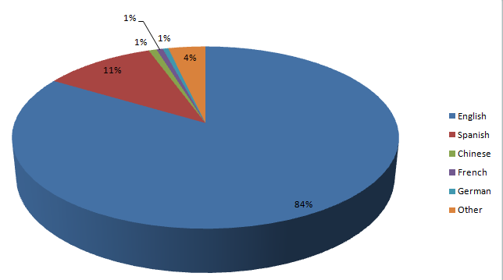
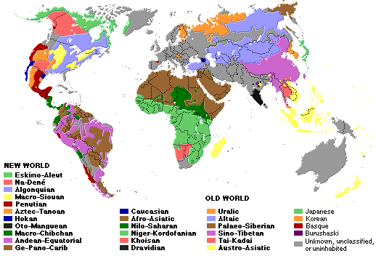
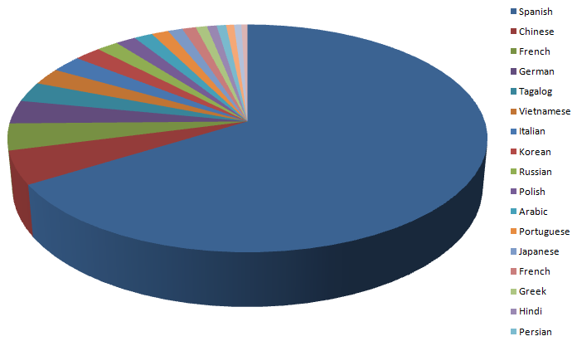
The World’s Languages
There are over 6,000 known languages in the world.
The dominance of English is being challenged by growth in Asian and Arabic languages.
Common languages are used to facilitate communication; native languages are often used for covert communications.
U.S. 2000 Census
Non-English Languages

Slide 9
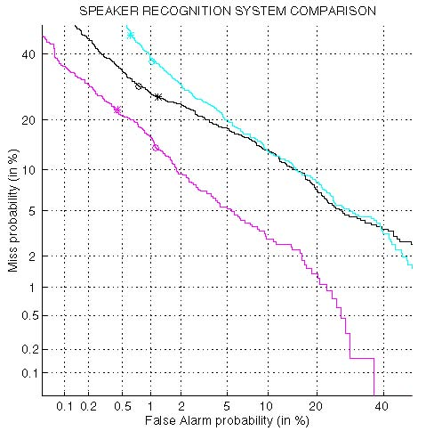
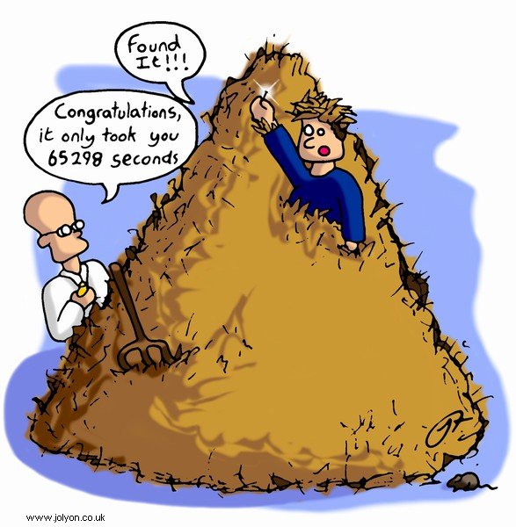
The “Needle in a Haystack” Problem
Detection Error Tradeoff (DET) curves are a common way to characterize system performance (ROC curves).
Intelligence applications often demand very low false alarm rates AND low miss probabilities.
Consider a 0.1% false alarm rate applied to 1M phone calls per day.
This yields 1,000 calls per day that must be reviewed – too many!
The reality is that current HLT does not operate reliably at such extremes.

Slide 10
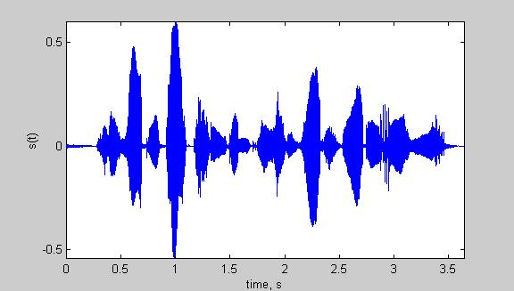
Speech Recognition Architectures
Core components of modern speech recognition systems:
Transduction: conversion of an electrical or acoustic signal to a digital signal;
Feature Extraction: conversion of samples to vectors containing the salient information;
Acoustic Model: statistical representation of basic sound patterns (e.g., hidden Markov models);
Language Model: statistical model of common words or phrases (e.g., N-grams);
Search: finding the best hypothesis for the data using an optimization procedure.
Input
Speech
Acoustic
Front-end
Acoustic Models
P(A/W)
Language Model
P(W)
Search
Recognized Utterance

Slide 11
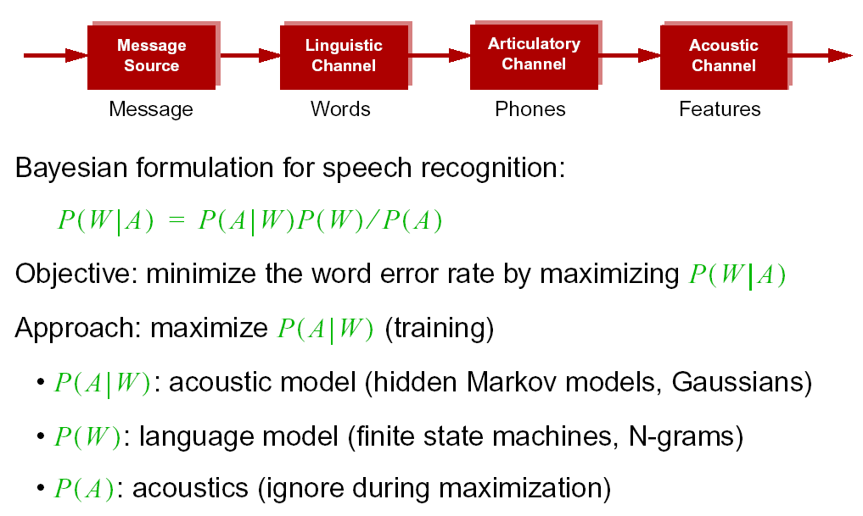
Statistical Approach: Noisy Communication Channel Model

Slide 12
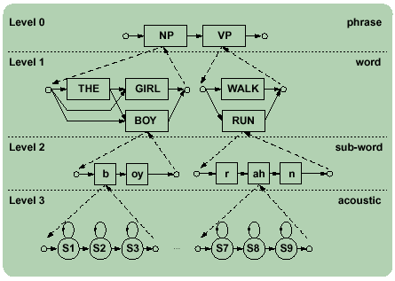
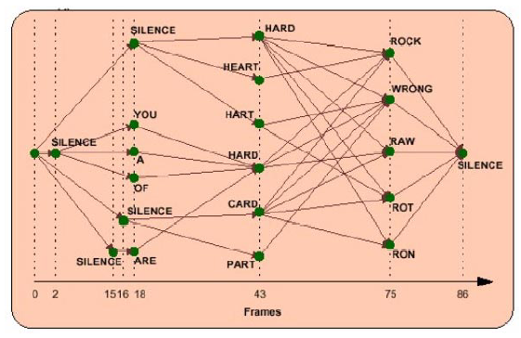
Top Down vs. Bottom Up
Speech recognition systems typically work either in a top-down or bottom-up mode, trading speed for accuracy.
The top-down approach exploits linguistic context through the use of a word-based language model.
The bottom-up approach spots N-grams of phones and favors speed over accuracy.
The general approach is to precompute a permuted database of phone indices (10 to 50 xfRT).
This database can be quickly searched for words or word combinations (~1000 xfRT).

Slide 13
A Typical Word-Based STD System
indexing
searching
audio
search
terms
ATWV cost
parameters
Byblos STT
lattices
phonetic-
transcripts
indexer
detector
index
decider
scored
detection
lists
final output
with YES/NO
decisions
From Miller, et al., “Rapid and Accurate Spoken Term Detection”

Slide 14
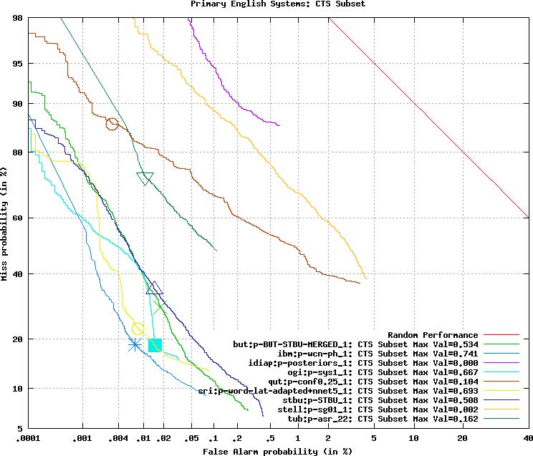
NIST 2006 Spoken Term Detection Evaluation
Phonetic-Based
Approaches
Word-Based
Approaches

Slide 15
Predicting Search Term Performance
Data: 2006 STD data was a mix of Broadcast News (3 hrs), Conversational Telephone Speech (3 hrs) and Conference Meetings (2 hrs).
  1100 unique reference terms; 14,421 occurrences (skewed by frequency)
  475 unique terms after removing multi-word terms and terms that occurred less than three times.
Evaluation Paradigm:
  Closed-Loop: All 475 search terms used in one run.
  Open-Loop: Data randomly partitioned into train (80%) and eval (20%) for 100 iterations. Results are averaged across all runs.
Machine Learning:
  Multiple Linear Regression (regress): preprocessed data using SVD and then fit the data using least squares.
  Neural Network (newff): a simple 2 layer network that used backpropagation for training and SVD for feature decorrelation.
  Decision Tree (treefit): a binary tree with a twoing splitting rule.
Goal: Predict error rate as a function of feature combinations including linguistic content (e.g., phones, phonetic class, syllables) and duration.

Slide 16
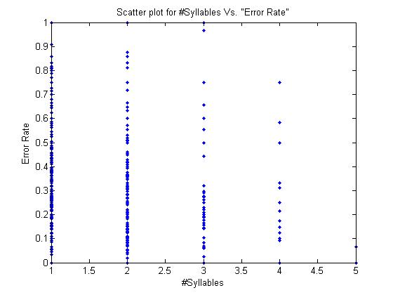
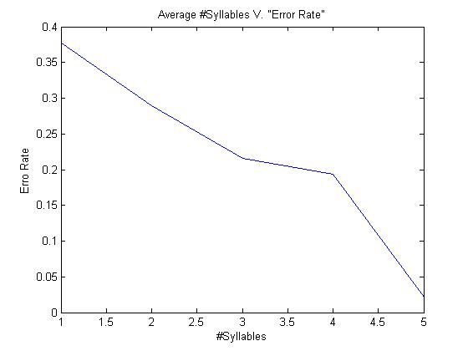
Search Term Error Rates
Search term error rates typically vary with the duration of the word.
Monosyllabic words tend to have a high error rate.
Polysyllabic words occur less frequently and are harder to estimate.
Multi-word sequences are common (e.g., Google search).
Alternate measures, such as TWV, model the localization of the search hit. These have produced unpredictable results in our work.
Average error rate (misses and false alarms) as a function of the number of syllables shows a clear correlation.
Query length is not the whole story.

Slide 17
Baseline Experiments - Duration
Features | Closed-Loop |  |  |  |  |  | Open-Loop
 | Regression |  | NN |  | DT |  | Regression |  | NN |  | DT
 | MSE | R | MSE | R | MSE | R | MSE | R | MSE | R | MSR | R
Duration | 0.045 | 0.46 | 0.057 | 0.43 | 0.044 | 0.48 | 0.045 | 0.46 | 0.060 | 0.40 | 0.046 | 0.45
No. Syllables | 0.053 | 0.28 | 0.067 | 0.23 | 0.052 | 0.28 | 0.053 | 0.28 | 0.067 | 0.22 | 0.053 | 0.27
No. Phones | 0.051 | 0.32 | 0.075 | 0.23 | 0.048 | 0.40 | 0.049 | 0.33 | 0.069 | 0.27 | 0.049 | 0.34
No. Vowels | 0.053 | 0.28 | 0.066 | 0.23 | 0.052 | 0.29 | 0.053 | 0.28 | 0.067 | 0.22 | 0.053 | 0.28
No. Consonants | 0.052 | 0.30 | 0.070 | 0.25 | 0.051 | 0.32 | 0.053 | 0.30 | 0.073 | 0.22 | 0.053 | 0.29
No. Characters | 0.051 | 0.32 | 0.059 | 0.32 | 0.049 | 0.38 | 0.052 | 0.32 | 0.062 | 0.28 | 0.051 | 0.33
Duration is the average word duration based on all word tokens.
Duration has long been known to be an important cue in speech processing.
The “length” of a search term, as measured in duration, number of syllables, or number of phones has been observed to be significant “operationally.”
Number of phones (or number of characters) slightly better than the number of syllables.

Slide 18
Baseline Experiments – Phone Type
Features | Closed-Loop |  |  |  |  |  | Open-Loop
 | Regression |  | NN |  | DT |  | Regression |  | NN |  | DT
 | MSE | R | MSE | R | MSE | R | MSE | R | MSE | R | MSR | R
Duration | 0.045 | 0.46 | 0.057 | 0.43 | 0.044 | 0.48 | 0.045 | 0.46 | 0.060 | 0.40 | 0.046 | 0.45
Init. Phone Typ. | 0.057 | 0.04 | 0.067 | 0.03 | 0.057 | 0.04 | 0.058 | 0.02 | 0.069 | -0.01 | 0.058 | 0.02
Final Phone Typ. | 0.057 | 0.03 | 0.071 | 0.01 | 0.057 | 0.03 | 0.058 | -0.01 | 0.072 | -0.01 | 0.058 | -0.01
No.. Vowels / No. Consonants | 0.056 | 0.10 | 0.062 | 0.17 | 0.053 | 0.25 | 0.057 | 0.10 | 0.065 | 0.11 | 0.056 | 0.19
CVC | 0.051 | 0.32 | 0.070 | 0.27 | 0.048 | 0.40 | 0.052 | 0.32 | 0.074 | 0.19 | 0.053 | 0.30
BPC | 0.053 | 0.26 | 0.069 | 0.23 | 0.052 | 0.30 | 0.054 | 0.25 | 0.074 | 0.17 | 0.056 | 0.21
Class | Phone
Stops | b p d t g k
Fricative | jh ch s sh z zh f th v dh hh
Nasals | m n ng en
Liquids | l el r w y
Vowels | iy ih eh ey ae aa aw ay ah ao ax oy ow uh uw er
Broad Phonetic Class (BPC)
Consonant Vowel Consonant (CVC)
(“Cat” ⇨ C V C)

Slide 19
CVC and BPC N-grams
Features | Closed-Loop |  |  |  |  |  | Open-Loop
 | Regression |  | NN |  | DT |  | Regression |  | NN |  | DT
 | MSE | R | MSE | R | MSE | R | MSE | R | MSE | R | MSR | R
Duration | 0.045 | 0.46 | 0.057 | 0.43 | 0.044 | 0.48 | 0.045 | 0.46 | 0.060 | 0.40 | 0.046 | 0.45
CVC | 0.051 | 0.32 | 0.070 | 0.27 | 0.048 | 0.40 | 0.052 | 0.32 | 0.074 | 0.19 | 0.053 | 0.30
BPC | 0.053 | 0.26 | 0.069 | 0.23 | 0.052 | 0.30 | 0.054 | 0.25 | 0.074 | 0.17 | 0.056 | 0.21
BPC Bigrams | 0.049 | 0.38 | 0.064 | 0.29 | 0.023 | 0.77 | 0.056 | 0.23 | 0.078 | 0.08 | 0.085 | 0.12
CVC Bigrams | 0.054 | 0.22 | 0.068 | 0.19 | 0.053 | 0.26 | 0.056 | 0.17 | 0.074 | 0.10 | 0.059 | 0.12
CVC Trigrams | 0.050 | 0.35 | 0.066 | 0.30 | 0.043 | 0.50 | 0.053 | 0.30 | 0.074 | 0.18 | 0.063 | 0.18
Insufficient amount of training data to support phone N-grams.
Explored many different ways to select the most influential N-grams (e.g. most common N-grams in the most accurate and least accurate words) with no improvement in performance.
Also explored the relationship of the position in the word with little effect.

Slide 20
Feature Combinations
Features | Closed-Loop |  |  |  |  |  | Open-Loop
 | Regression |  | NN |  | DT |  | Regression |  | NN |  | DT
 | MSE | R | MSE | R | MSE | R | MSE | R | MSE | R | MSR | R
Duration | 0.045 | 0.46 | 0.057 | 0.43 | 0.044 | 0.48 | 0.045 | 0.46 | 0.060 | 0.40 | 0.046 | 0.45
Duration + No. Syllables | 0.045 | 0.46 | 0.055 | 0.45 | 0.041 | 0.53 | 0.045 | 0.46 | 0.060 | 0.38 | 0.046 | 0.46
Duration + No. Consonants | 0.045 | 0.46 | 0.055 | 0.46 | 0.040 | 0.54 | 0.046 | 0.46 | 0.058 | 0.41 | 0.051 | 0.39
Duration + No. Syllables + No. Consonants | 0.045 | 0.46 | 0.056 | 0.43 | 0.036 | 0.60 | 0.046 | 0.46 | 0.060 | 0.37 | 0.050 | 0.41
Duration + Length + No. Syllables /Duration | 0.044 | 0.47 | 0.055 | 0.45 | 0.021 | 0.80 | 0.045 | 0.46 | 0.059 | 0.40 | 0.068 | 0.29
Duration + No. Consonants + Length/Duration + No. Syllables / Duration + CVC2 | 0.044 | 0.47 | 0.049 | 0.48 | 0.018 | 0.83 | 0.046 | 0.45 | 0.054 | 0.42 | 0.065 | 0.34

Slide 21
Demo Revisited
Available at:
http://www.isip.piconepress.com/projects/ks_prediction/demo/current/

Slide 22
Future Directions
How do we get better?
We need more data and are in the process of acquiring 10x more data from both word and phonetic search engines.
Need more data from both clean and noisy conditions.
More data will provide better estimates of search term accuracy and also allow us to build more complex prediction functions.
More data will let us explore more sophisticated features, such as phone N-grams.
How can we improve performance with the current data?
  Combining multiple prediction functions is an obvious way to improve performance.
  We are not convinced MSE or R are the proper metrics for performance. We have explored postprocessing the error functions to limit the effects of outliers, but this has not resulted in better overall performance.
  What are the limits of performance?
  Predicting error rates only from spellings ignores a number of important factors that contribute to recognition performance, such as speaking rate.
  Correlating metadata with keyword search results can be powerful.

Slide 23
Brief Bibliography of Related Research
S. Pinker, The Language Instinct: How the Mind Creates Language, William Morrow and Company, New York, New York, USA, 1994.
“The NIST 2006 Spoken Term Detection Evaluation,” available at http://www.itl.nist.gov/iad/mig/tests/std/2006/index.html.
F. Juang and L.R. Rabiner, “Automatic Speech Recognition - A Brief History of the Technology,” Elsevier Encyclopedia of Language and Linguistics, 2nd Edition, 2005.
P. Yu, K. Chen, C. Ma and F. Seide, “Vocabulary-Independent Indexing of Spontaneous Speech,” IEEE Transactions on Speech and Audio Processing, vol.13, no.5, pp. 635-643, Sept. 2005 (doi: 10.1109/TSA.2005.851881).
R. Wallace, R. Vogt and S. Sridharan, “Spoken term Detection Using Fast Phonetic Decoding," in Proceedings of the IEEE International Conference on Acoustics, Speech and Signal Processing, pp. 4881-4884, April 2009 (doi: 10.1109/ICASSP.2009.4960725).

Slide 24
Biography
Joseph Picone received his Ph.D. in Electrical Engineering in 1983 from the Illinois Institute of Technology. He is currently Professor and Chair of the Department of Electrical and Computer Engineering at Temple University. He recently completed a three-year sabbatical at the Department of Defense where he directed human language technology research and development.
His primary research interests are currently machine learning approaches to acoustic modeling in speech recognition. For over 25 years he has conducted research on many aspects of digital speech and signal processing. He has also been a long-term advocate of open source technology, delivering one of the first state-of-the-art open source speech recognition systems, and maintaining one of the more comprehensive web sites related to signal processing. His research group is known for producing many innovative educational materials that have increased access to the field.
Dr. Picone has previously been employed by Texas Instruments and AT&T Bell Laboratories, including a two-year assignment in Japan establishing Texas Instruments’ first international research center. He is a Senior Member of the IEEE, holds several patents in this area, and has been active in several professional societies related to human language technology.

