Slide 1

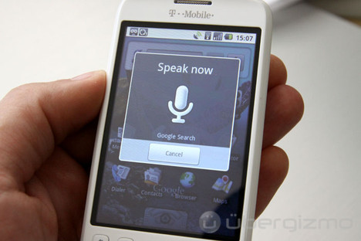
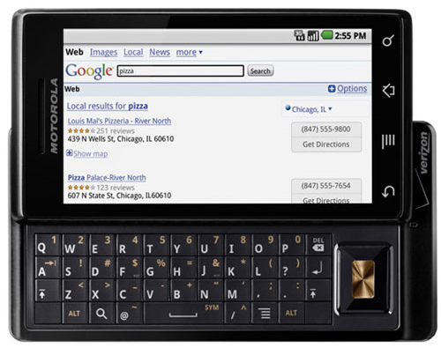

Applications of
Dirichlet Process Models to Speech Processing
and Machine Learning
Amir Harati and Joseph Picone
Institute for Signal and Information Processing
Temple University
Philadelphia, Pennsylvania, USA

Slide 2
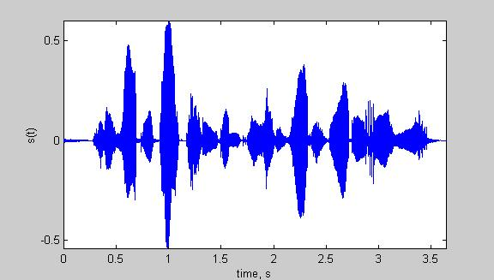
Introduction to Speech Recognition
Speech recognizer architecture.
Performance of the system depends on the quality of acoustic models.
HMMs and mixture models are frequently used for acoustic modeling.
Number of models and parameter sharing is among the most important model selection problems in speech recognizer.
Can nonparametric Bayesian modeling help us?
Input
Speech
Acoustic
Front-end
Acoustic Models
P(A/W)
Language Model
P(W)
Search
Recognized Utterance

