Slide 1
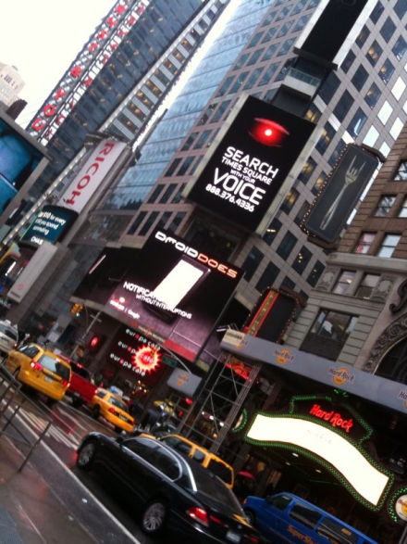
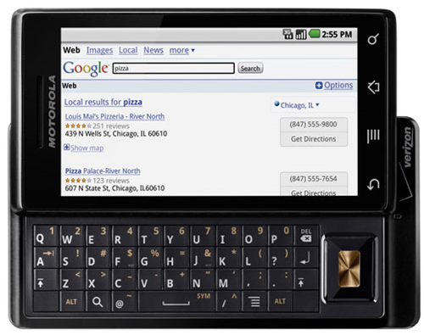
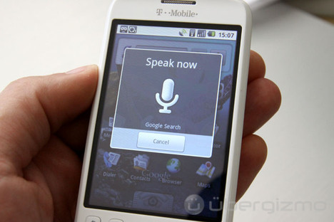
Applications of Dirichlet Process Models
to Speech Processing and Machine Learning
Amir Harati and Joseph Picone, PhD
Institute for Signal and Information Processing
Temple University
URL:

Slide 2
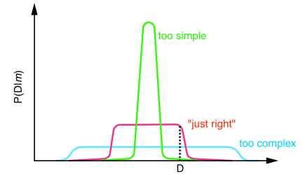
Motivation
Parametric models can capture a bounded amount of information from the data.
Real data is complex and therefore parametric assumptions is wrong.
Nonparametric models can lead to model selection/averaging solutions without paying the cost of these methods.
In addition Bayesian methods often provide a mathematically well defined framework, with better extendibility.
From []

Slide 3
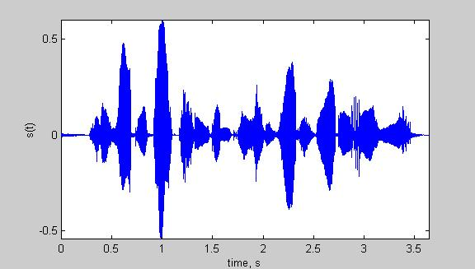
Motivation
Speech recognizer architecture.
Performance of the system depends on the quality of acoustic models.
HMMs and mixture models are frequently used for acoustic modeling.
Number of models and parameter sharing is among the most important model selection problems in speech recognizer.
Can nonparametric Bayesian modeling help us?
Input
Speech
Acoustic
Front-end
Acoustic Models
P(A/W)
Language Model
P(W)
Search
Recognized Utterance

Slide 4
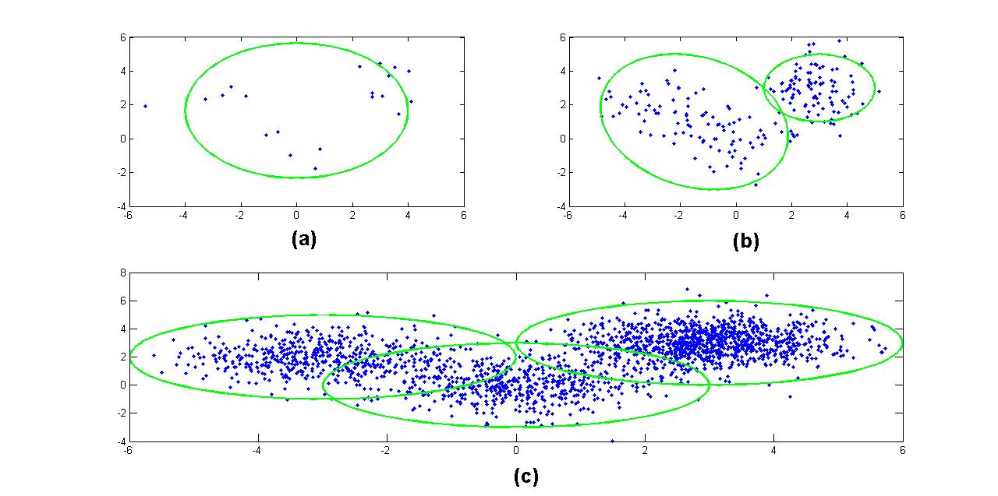
Nonparametric Bayesian
Bayes Rule in Machine learning :
Bayesian methods are sensitive to the prior. Prior should reflect the beliefs about the model.
Inflexible priors ( and models) lead to wrong conclusions.
Nonparametric models are very flexible, meaning the number of parameters can grow proportionally with the amount of data.
Areas: Regression, classification, clustering, time series analysis , …

Slide 5
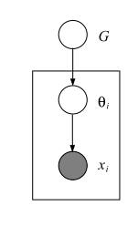
Clustering
A Generative approach to clustering :
1- pick one of K clusters from
2- Generate a data point from cluster specific parametric distribution (e.g. Gaussian).
This yields a finite mixture model :
Finite mixture model can also be expressed using an underlying measure G:

Slide 6
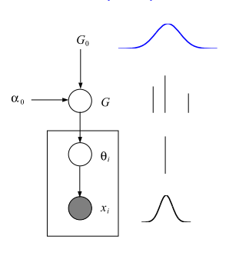
Clustering
In Bayesian model based clustering we should put some prior on the parameters.
θ is model specific; usually we use a conjugate prior which is case of Gaussian distribution is the normal-inverse gamma distribution. We name this prior G₀.
π is multinomial and therefore we use a symmetric Dirichlet distribution as its prior with concentration parameter α₀ .

Slide 7
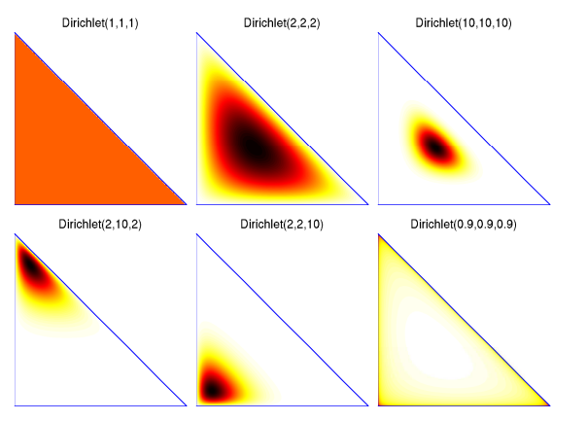


Dirichlet Distribution
(Φ,Σ) is a measurable space where Σ is the sigma algebra.
A measure μ over (Φ,Σ) is a function from Σ->R⁺ such that:
For a probability measure μ(Φ)=1
A Dirichlet distribution is a distribution over the K-dimensional probability simplex.

Slide 8
Finite Mixture Model

Slide 9
Finite Mixture Model
How to determine K?
  Using model comparison methods.
  Going nonparametric.
If we let K-> can we obtain a nonparametric model? What is the definition of G in this case?
The answer is Dirichlet Process.

Slide 10

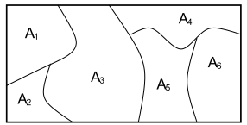

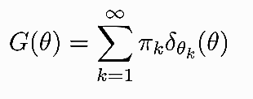
Dirichlet Process
A Dirichlet Process (DP) is a random probability measure over (Φ,Σ) such that for any measurable partition over Φ we have
DP has two parameters: Base distribution (G₀) is like a mean for DP and  is the concentration parameter (inverse of the variance).
We write :
DP is discrete with probability one

Slide 11
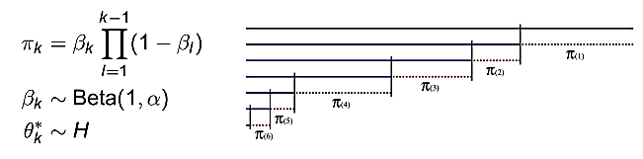
Stick-breaking Representation
Stick-breaking construction represents a DP explicitly:
Consider a stick with length one.
At each step, the stick is broken. The broken part is assigned as the weight of corresponding atom in DP.
If  is distributed as above we write:

Slide 12
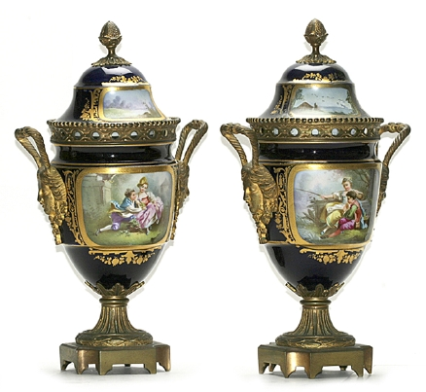
Polya’s Urn Scheme
Consider i.i.d. draws from G :
Now marginalize G and consider the conditional probabilities:
Imagine picking balls of different color from an urn.
Start with an empty urn.
With probability proportional to  add a new ball to the urn. (draw from G₀)
With probability proportional to the number of balls draw a ball from the urn; return the ball into the urn and add another ball with the same color to the urn.

Slide 13
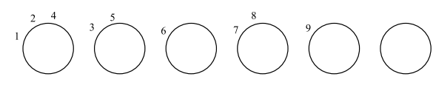
Chinese Restaurant Interpretation
Consider draws ₁, …, _{n} from Polya’s urn scheme, and consider distinct values of these draws ₁*,… _{K}*.
In other words, random draws from Polya’s urn scheme induces a partition over natural numbers . The induced partition over partitions is called Chinese Restaurant Process (CRP).
Generating from the CRP:
  First Customer sits at the first table.
  Other customers sit at table k with probability proportional to the number of customers at table k, or start a new table with probability proportional to .
  Customers Integers Tables  Clusters
Notes:
Customers Integers Tables  Clusters

Slide 14
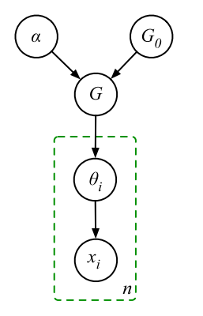
Dirichlet Process Mixture (DPM)
DPs are discrete with probability one so they cannot be used as a prior on continues densities.
However, we can draw parameter of a mixture model from a draw from a DP.

Slide 15
Applications to Speech Recognition
In speech recognition technology, we deal with the complexity problem at many levels.
Examples includes:
  The number of states and the number of mixture components in a hidden Markov model.
  The number of models and parameter-sharing between these models.
  In language modeling, we must estimate the probabilities of unseen events in very large but sparse N‑gram models. Nonparametric Bayesian modeling has been used to smooth such N-gram language models.
  Nonparametric Bayesian HMMs (HDP-HMM) are used in speaker diarization task and word segmentation.
In this project we have investigated the replacement of binary regression tree for speaker adaption with DPM.

Slide 16
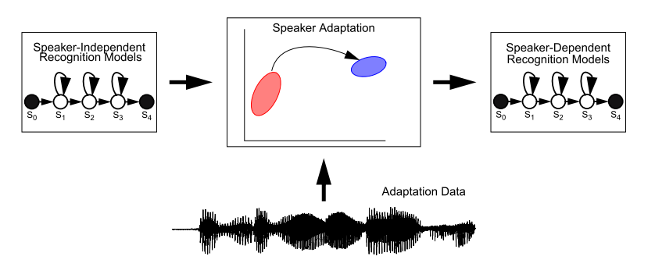
Adaption
Def: To adjust model parameters for new speakers.
Adjusting all parameters requires too much data and is computationally complex.
Solution: Create clusters and adjust all models in a cluster together.
Clusters are organized hierarchically.
The classical solution is to use a binary regression tree. The tree is constructed using a centroid splitting algorithm.
In transform-based adaption a transformation is calculated for each cluster.
In Maximum Likelihood Linear Regression (MLLR), transforms are computed an ML criterion.

Slide 17
Algorithm
Premise: Replace the binary regression tree in MLLR with a DPM.
Procedure:
Train speaker independent (SI) model. Collect all mixture components and their frequencies of occurrence.
Generate samples for each component and cluster them using a DPM model.
Construct a tree structure of the final result using a bottom-up approach. We start from terminal nodes and merge them based on Euclidean distance.
Assign clusters to each component using a majority vote scheme.
With the resulting tree, compute the transformation matrix using maximum likelihood approach.
Inference is accomplished using three different variational algorithms:
  Accelerated variational Dirichlet process mixture (AVDP) .
  Collapsed variational stick-breaking (CSB).
  Collapsed Dirichlet priors (CDP)

Slide 18
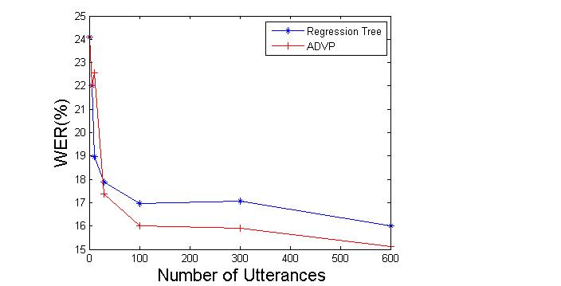
Results for Monophones
Experiments using Resource Management (RM).
Monophone models using a single Gaussian mixture model.
12 different speakers with 600 training utterances.
The result of clustering resembles broad phonetic classes.
DPM finds 6 clusters in the data while the regression tree finds only 2 clusters.
Word error rate (WER) can be reduced by more than 10%.

Slide 19
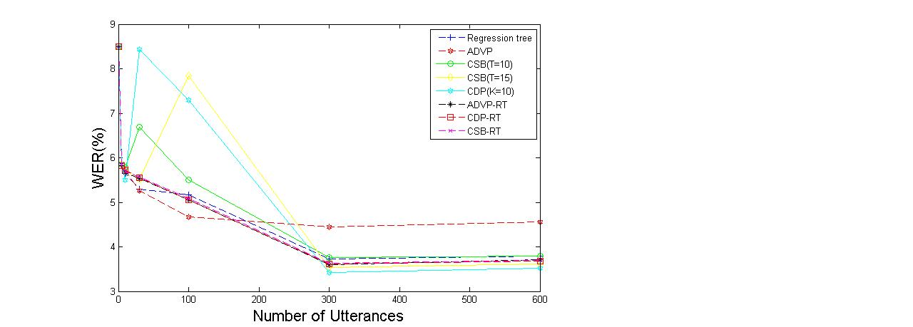
Results for Cross Word Triphones
Cross-word triphone models use a single Gaussian mixture model.
12 different speakers with 600 training utterances.
The clusters generated using DPM have acoustically and phonetically meaningful interpretations.
ADVP works better for moderate amounts of data while CDP and CSB work better for larger amounts of data.

Slide 20
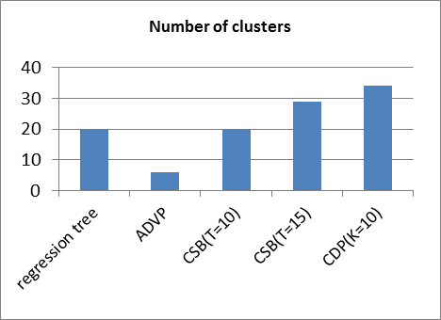
Results for Cross Word Triphones
Cross-word triphone models use a single Gaussian mixture model.
12 different speakers with 600 training utterances.
The clusters generated using DPM have acoustically and phonetically meaningful interpretations.
ADVP works better for moderate amounts of data while CDP and CSB work better for larger amounts of data.

Slide 21
Future Directions
Use hierarchical nonparametric models (e.g. HDP-HMMs) to model acoustical units.
Using nonparametric Bayesian segmentation to find new sets of acoustical units.
Nonparametric Bayesian framework provides two important features that can facilitate speaker dependent systems:
1-Number of clusters of speakers is not known a priori and could possibly grow with obtaining new data.
2-Paramter sharing and model (and state )tying can be accomplished elegantly using proper hierarchies. Depending on the available training data, the system would have different number of models for different acoustic units. All acoustic units are tied. Moreover each model has different number of sates and different number of mixtures for each state.

Slide 22
Brief Bibliography of Related Research

Slide 23
Biography
Joseph Picone received his Ph.D. in Electrical Engineering in 1983 from the Illinois Institute of Technology. He is currently Professor and Chair of the Department of Electrical and Computer Engineering at Temple University. He recently completed a three-year sabbatical at the Department of Defense where he directed human language technology research and development.
His primary research interests are currently machine learning approaches to acoustic modeling in speech recognition. For over 25 years he has conducted research on many aspects of digital speech and signal processing. He has also been a long-term advocate of open source technology, delivering one of the first state-of-the-art open source speech recognition systems, and maintaining one of the more comprehensive web sites related to signal processing. His research group is known for producing many innovative educational materials that have increased access to the field.
Dr. Picone has previously been employed by Texas Instruments and AT&T Bell Laboratories, including a two-year assignment in Japan establishing Texas Instruments’ first international research center. He is a Senior Member of the IEEE, holds several patents in this area, and has been active in several professional societies related to human language technology.

