Slide 1

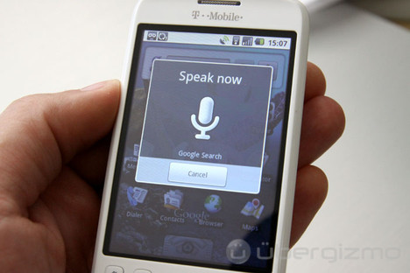
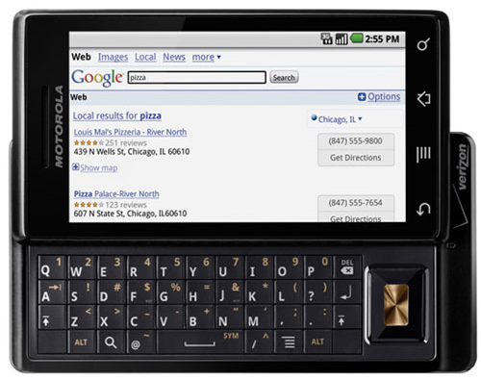
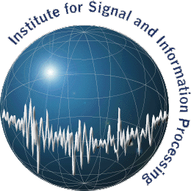
Applications of
Dirichlet Process Models to Speech Processing
and Machine Learning
Amir Harati and Joseph Picone
Institute for Signal and Information Processing
Temple University
Philadelphia, Pennsylvania, USA

Slide 2








Nonparametric Bayesian Approaches
Generalization of any data-driven
statistical model is a challenge.
How many degrees of freedom?
Solution: Infer complexity from
the data (nonparametric model).
Clustering algorithms tend
not to preserve perceptually
meaningful differences.
Prior knowledge can mitigate this (e.g., gender).
Models should utilize all of the available data and incorporate it as prior knowledge (Bayesian).
Our goal is to apply nonparametric Bayesian methods to acoustic processing of speech.

