Slide 1
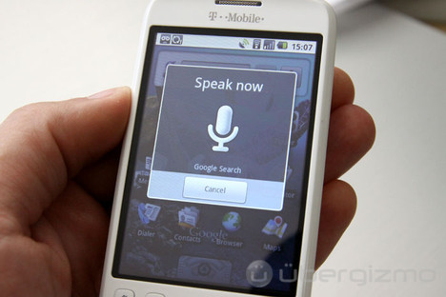


Nonparametric Bayesian Approaches for Acoustic Modeling in Speech Recognition
Joseph Picone
Co-PIs: Amir Harati, John Steinberg and Dr. Marc Sobel
Institute for Signal and Information Processing
Temple University
Philadelphia, Pennsylvania, USA

Slide 2
Abstract
Balancing unique acoustic or linguistic characteristics, such as a speaker's identity and accent, with general behaviors that describe aggregate behavior, is one of the great challenges in applying nonparametric Bayesian approaches to human language technology applications. The goal of Bayesian analysis is to reduce the uncertainty about unobserved variables by combining prior knowledge with observations. A fundamental limitation of any statistical model, including Bayesian approaches, is the inability of the model to learn new structures.
Nonparametric Bayesian methods are a popular alternative because we do not fix the complexity a priori (e.g. the number of mixture components in a mixture model) and instead place a prior over the complexity. This prior usually biases the system towards sparse or low complexity solutions. Models can adapt to new data encountered during the training process without distorting the modalities learned on the previously seen data — a key issue in generalization. In this talk we discuss our recent work in applying these techniques to the speech recognition problem and demonstrate that we can achieve improved performance and reduced complexity. For example, on speaker adaptation and speech segmentation tasks, we have achieved a 10% relative reduction in error rates at comparable levels of complexity.

Slide 3
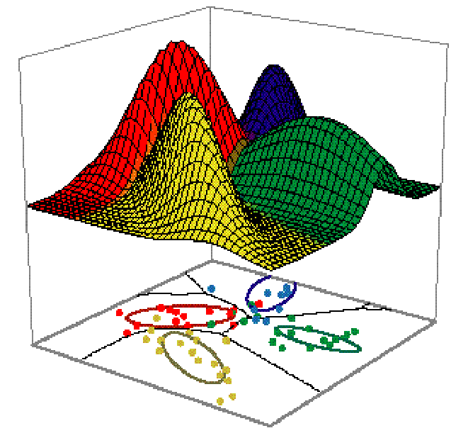
The Motivating Problem – A Speech Processing Perspective
A set of data is generated from multiple distributions but it is unclear how many.
    Parametric methods assume the number of distributions is known a priori
        Nonparametric methods learn the number of distributions from the data, e.g. a model of a distribution of distributions
Notes:
Don’t discuss parametric and non-parametric methods here

Slide 4








Generalization and Complexity
Generalization of any data-driven
statistical model is a challenge.
How many degrees of freedom?
Solution: Infer complexity from
the data (nonparametric model).
Clustering algorithms tend
not to preserve perceptually
meaningful differences.
Prior knowledge can mitigate this (e.g., gender).
Models should utilize all of the available data and incorporate it as prior knowledge (Bayesian).
Our goal is to apply nonparametric Bayesian methods to acoustic processing of speech.

Slide 5
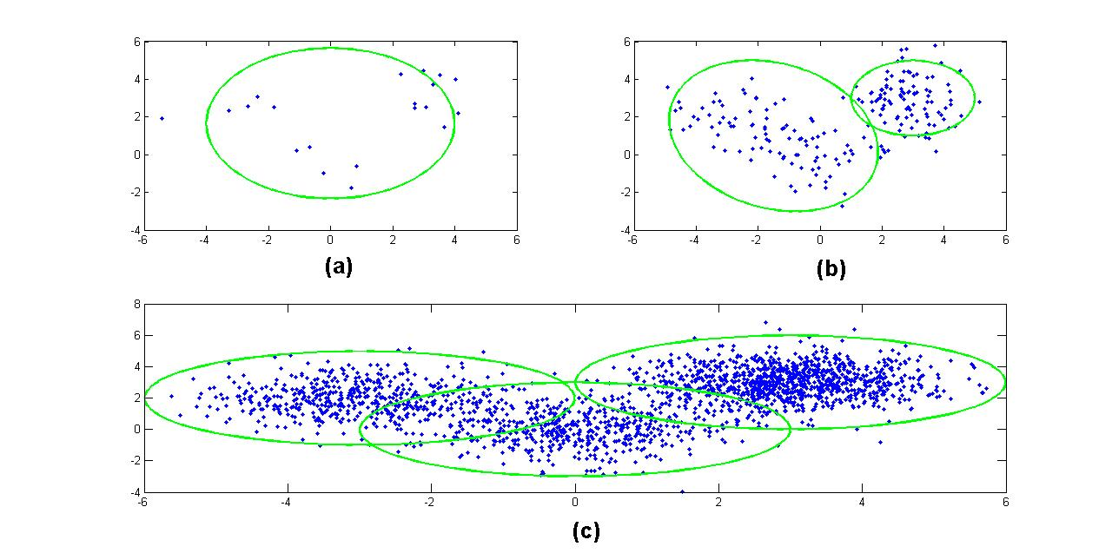
Bayesian Approaches
Bayes Rule:
Bayesian methods are
sensitive to the choice
of a prior.
Prior should reflect the beliefs about the model.
Inflexible priors (and models) lead to wrong conclusions.
Nonparametric models are very flexible — the number of parameters can grow with the amount of data.
Common applications: clustering, regression, language modeling, natural language processing

Slide 6
Parametric vs. Nonparametric Models
Parametric | Nonparametric
Requires a priori assumptions about data structure | Do not require a priori assumptions about data structure
Underlying structure is approximated with a limited number of mixtures | Underlying structure is learned from data
Number of mixtures is rigidly set | Number of mixtures can evolve Distributions of distributions Needs a prior!
Complex models frequently require inference algorithms for approximation!
Notes:
-Averaging across distributions is ok for capturing general acoustic features for phone identification but can’t capture unique acoustic traits.

Slide 7
Taxonomy of Nonparametric Models
Nonparametric Bayesian Models
Regression
Density Estimation
Survival Analysis
Neural Networks
Wavelet-Based Modeling
Dirichlet Processes
Hierarchical Dirichlet Process
Proportional Hazards
Competing Risks
Multivariate Regression
Spline Models
Pitman Process
Dynamic Models
Neutral to the Right Processes
Dependent Increments
Inference algorithms are needed to approximate
these infinitely complex models
Notes:
-survival analysis focuses on modeling time before an event

Slide 8
Dirichlet Distributions
Functional form:
  q ϵ ℝ^{k}: a probability mass function (pmf)
  α: a concentration parameter
The Dirichlet Distribution is a conjugate prior for a multinomial distribution.
Conjugacy: Allows a posterior to remain in the same family of distributions as the prior.
Notes:
-example, 3 hidden dice to model probability of (1,2, …, 6)
-Dirichlet Dist. are distributions over pmfs
-α is similar to inverse variance

Slide 9
Dirichlet Processes (DPs)
A Dirichlet Process is a Dirichlet distribution split infinitely many times
q₂₂
q₂
q₂₁
q₁₁
q₁
q₁₂
These discrete probabilities are used as a prior for our infinite mixture model

Slide 10
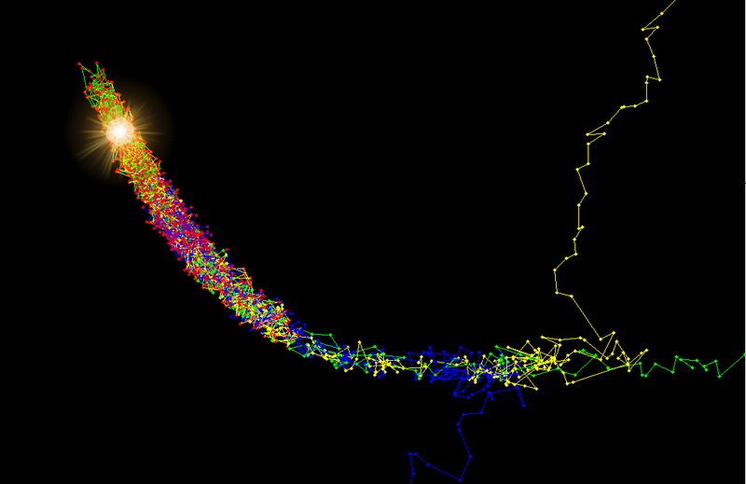
Inference: An Approximation
Inference: estimating probabilities in statistically meaningful ways
Parameter estimation is computationally difficult
  Distributions of distributions ∞ parameters
  Posteriors, p(y|x), can’t be analytically solved
Sampling methods (e.g. MCMC)
  Samples estimate true distribution
  Drawbacks
    Needs large number of samples for accuracy
    Step size must be chosen carefully
    “Burn in” phase must be monitored/controlled

Slide 11
Variational Inference
Converts sampling problem to an optimization problem
  Avoids need for careful monitoring of sampling
  Uses independence assumptions to create simpler variational distributions, q(y), to approximate p(y|x).
  Optimize q from Q = {q1, q2, …, q_{m}} using an objective function, e.g. Kullbach-Liebler divergence
    EM or other gradient descent algorithms can be used
  Constraints can be added to Q to improve computational efficiency

Slide 12
Variational Inference Algorithms
Accelerated Variational Dirichlet Process Mixtures (AVDPMs)
  Limits computation of Q: For i > T, q_{i} is set to its prior
  Incorporates kd-trees to improve efficiency
    number of splits is controlled to balance
    computation and accuracy
A, B, C, D, E, F, G
A, B, D, F
A, D
B
C, E, G
C, G
E
F
Notes:
-kd tree partitions data into similar subclasses prior to training.
-splits in kd-trees can be controlled (can control balance of computation/accuracy)
-each node shares a common distribution, q, which is used to optimize calculations of child nodes’ q’s

Slide 13
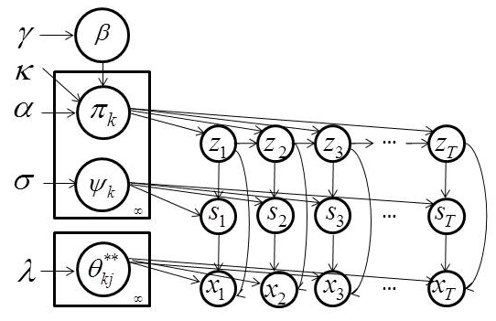
Hierarchical Dirichlet Process-Based HMM (HDP-HMM)
Mathematical Definition:
Markovian Structure:
Inference algorithms are used to infer the values of the latent variables (z_{t} and s_{t}).
A variation of the forward-backward procedure is used for training.
z_{t}, s_{t} and x_{t} represent a state, mixture component and observation respectively.
Notes:
DP essentially clusters data into groups
HDP shares class labels amongst clusters (e.g., words clustered to topics; topics shared to form documents)
Pi_j are the transition matrices
Each state has an infinite number of mixtures per state
Theta is the mean and covariance for each Gaussian component
These are sampled from H(lambda)
Kappa is zero makes no preference for staying or transitioning
Kappa greater than zero biases models to stay in each state for multiple observations
System is biased towards remaining in a state

Slide 14
Applications: Speech Processing
Phoneme Classification
Speaker Adaptation
Speech Segmentation
Coming Soon: Speaker Independent Speech Recognition

Slide 15
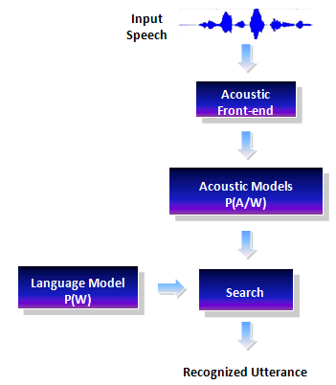
Statistical Methods in Speech Recognition
Notes:
-We don’t run a complete recognition experiment but we do train monophone models in order to generate a phone alignment
-Parametric models are most common

Slide 16
Phone Classification: Experimental Design
Phoneme Classification (TIMIT)
  Manual alignments
Phoneme Recognition (TIMIT, CH-E, CH-M)
  Acoustic models trained for phoneme alignment
  Phoneme alignments generated using HTK
Corpus | Description
TIMIT | Studio recorded, read speech 630 speakers, ~130,000 phones 39 phoneme labels
CALLHOME English (CH-E) | Spontaneous, conversational telephone speech 120 conversations, ~293,000 training samples 42 phoneme labels
CALLHOME Mandarin (CH-M) | Spontaneous, conversational telephone speech 120 conversations, ~250,000 training samples 92 phoneme labels
Notes:
TIMIT is a well calibrated corpus (i.e. many publications on phone classification)
Data was formatted to only include single speakers
CTS is much more difficult to model than read speech

Slide 17
Phone Classification: Error Rate Comparison
CH-E
CH-M
Algorithm | Best Error Rate: CH-E | Avg. k per Phoneme
GMM | 58.41% | 128
AVDPM | 56.65% | 3.45
CVSB | 56.54% | 11.60
CDP | 57.14% | 27.93
Algorithm | Best Error Rate: CH-M | Avg. k per Phoneme
GMM | 62.65% | 64
AVDPM | 62.59% | 2.15
CVSB | 63.08% | 3.86
CDP | 62.89% | 9.45
AVDPM, CVSB, & CDP have comparable results to GMMs
AVDPM, CVSB, & CDP require significantly fewer parameters than GMMs
Notes:
Breiman paper for RF

Slide 18
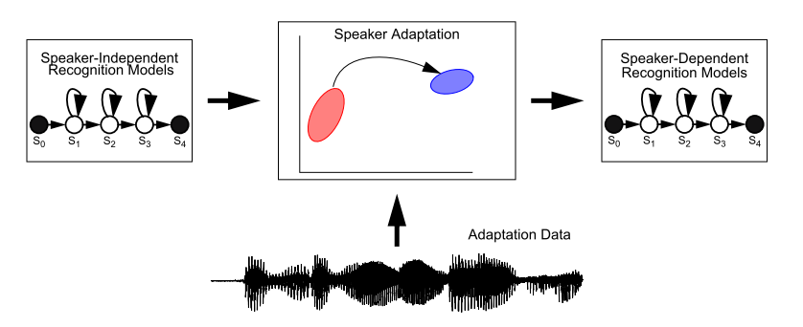
Speaker Adaptation: Transform Clustering
Goal is to approach speaker dependent performance using speaker independent models and a limited number of mapping parameters.
The classical solution is to use a binary regression tree of transforms constructed using a Maximum Likelihood Linear Regression (MLLR) approach.
Transformation matrices are clustered using a centroid splitting approach.

Slide 19
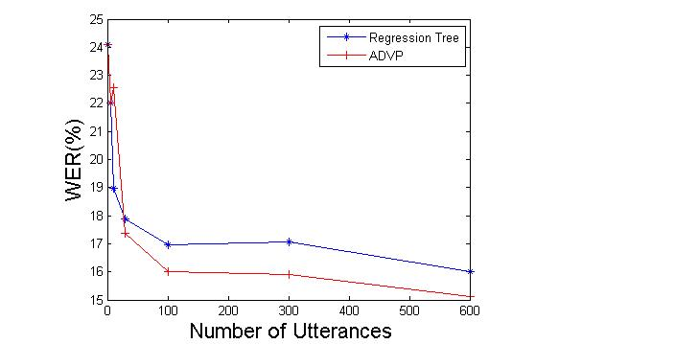
Speaker Adaptation: Monophone Results
Experiments used DARPA’s
Resource Management (RM)
corpus (~1000 word vocabulary).
Monophone models used a
single Gaussian mixture model.
12 different speakers with
600 training utterances
per speaker.
Word error rate (WER) is reduced
by more than 10%.
The individual speaker error rates generally
follow the same trend as the average behavior.
DPM finds an average of 6 clusters
in the data while the regression tree finds only 2 clusters.
The resulting clusters resemble broad phonetic classes (e.g., distributions related to the phonemes “w” and “r”, which are both liquids, are in the same cluster.

Slide 20
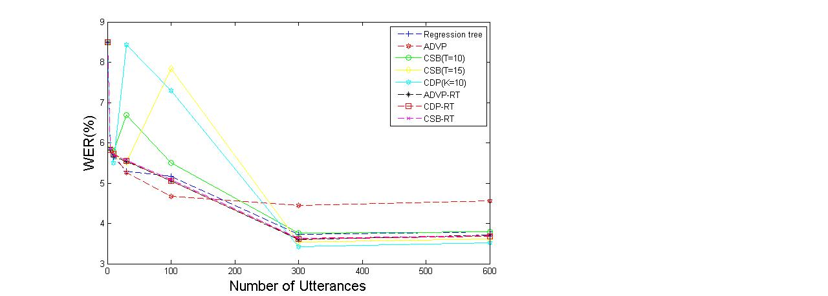
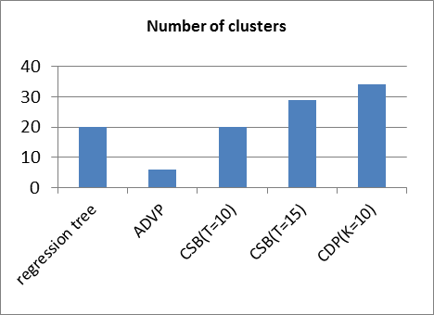
Speaker Adaptation: Crossword Triphone Results
Crossword triphone models use a single Gaussian mixture model.
Individual speaker error rates follow the same trend.
The number of clusters per speaker did not vary significantly.
The clusters generated using DPM have acoustically and phonetically meaningful interpretations.
ADVP works better for moderate amounts of data while CDP and CSB work better for larger amounts of data.

Slide 21
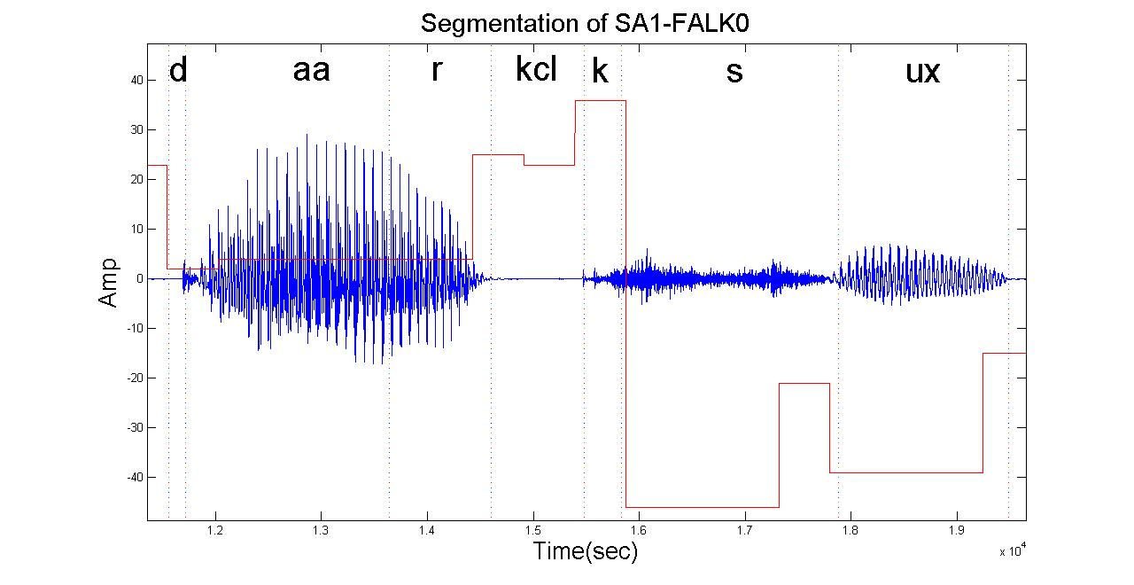
Speech Segmentation: Finding Acoustic Units
Approach: compare automatically derived segmentations to manual TIMIT segmentations
Use measures of within-class and out-of-class similarities.
Automatically derive the units through the intrinsic HDP clustering process.

Slide 22
Speech Segmentation: Results
Algorithm | Recall | Precision | F-score
Dusan & Rabiner (2006) | 75.2 | 66.8 | 70.8
Qiao et al. (2008) | 77.5 | 76.3 | 76.9
Lee & Glass (2012) | 76.2 | 76.4 | 76.3
HDP-HMM | 86.5 | 68.5 | 76.6
Experiment | Params. (N_{s} / N_{c}) | Manual Segmentations | HDP-HMM
K_{z}=100, K_{s}=1, L=1 | 70/70 | (0.44,0.72) | (0.82,0.73)
K_{z}=100, K_{s}=1, L=2 | 33/33 | (0.44,0.72) | (0.77,0.73)
K_{z}=100, K_{s}=1, L=3 | 23/23 | (0.44,0.72) | (0.75,0.72)
K_{z}=100, K_{s}=5, L=1 | 55/139 | (0.44,0.72) | (0.90,0.72)
K_{z}=100, K_{s}=5, L=2 | 53/73 | (0.44,0.72) | (0.87,0.72)
K_{z}=100, K_{s}=5, L=3 | 43/51 | (0.44,0.72) | (0.83,0.72)
HDP-HMM automatically finds acoustic units consistent with the manual segmentations (out-of-class similarities are comparable).

Slide 23
Summary and Future Directions
A nonparametric Bayesian framework provides two important features:
complexity of the model grows with the data;
automatic discovery of acoustic units can be used to find better acoustic models.
Performance on limited tasks is promising.
Our future goal is to use hierarchical nonparametric approaches (e.g., HDP-HMMs) for acoustic models:
acoustic units are derived from a pool of shared distributions with arbitrary topologies;
models have arbitrary numbers of states, which in turn have arbitrary number of mixture components;
nonparametric Bayesian approaches are also used to segment data and discover new acoustic units.

Slide 24
Brief Bibliography of Related Research
Harati, A., Picone, J., & Sobel, M. (2013). Speech Segmentation Using Hierarchical Dirichlet Processes. Submitted to the IEEE International Conference on Acoustics, Speech and Signal Processing. Vancouver, Canada.
Harati, A. (2013). Non-Parametric Bayesian Approaches for Acoustic Modeling. Department of Electrical and Computer Engineering, Temple University, Philadelphia, Pennsylvania, USA.
Harati, A., Picone, J., & Sobel, M. (2012). Applications of Dirichlet Process Mixtures to Speaker Adaptation. Proceedings of the IEEE International Conference on Acoustics, Speech and Signal Processing (pp. 4321–4324). Kyoto, Japan.
Steinberg, J. (2013). A Comparative Analysis of Bayesian Nonparametric Variational Inference Algorithms For Speech Recognition. Department of Electrical and Computer Engineering, Temple University, Philadelphia, Pennsylvania, USA.
Fox, E., Sudderth, E., Jordan, M., & Willsky, A. (2011). A Sticky HDP-HMM with Application to Speaker Diarization. The Annalas of Applied Statistics, 5(2A), 1020–1056.
Sudderth, E. (2006). Graphical Models for Visual Object Recognition and Tracking. Massachusetts Institute of Technology, Boston, MA, USA.

Slide 25

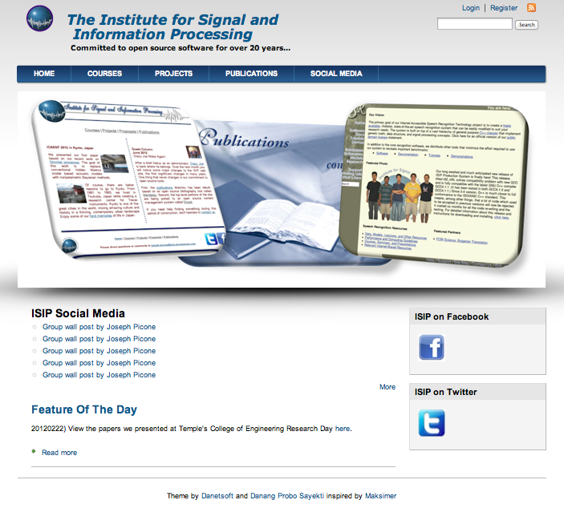
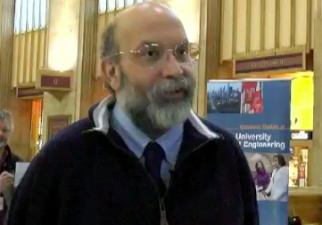
Biography
Joseph Picone received his Ph.D. in Electrical Engineering in 1983
from the Illinois Institute of Technology. He is currently a professor
in the Department of Electrical and Computer Engineering at
Temple University. He has spent significant portions of his career in academia (MS State), research (Texas Instruments, AT&T) and the government (NSA), giving him a very balanced perspective on the challenges of building sustainable R&D programs.
His primary research interests are machine learning approaches to acoustic modeling in speech recognition. For almost 20 years, his research group has been known for producing many innovative open source materials for signal processing including a public domain speech recognition system (see www.isip.piconepress.com).
Dr. Picone’s research funding sources over the years have included NSF, DoD, DARPA as well as the private sector. Dr. Picone is a Senior Member of the IEEE, holds several patents in human language technology, and has been active in several professional societies related to HLT.

Slide 26

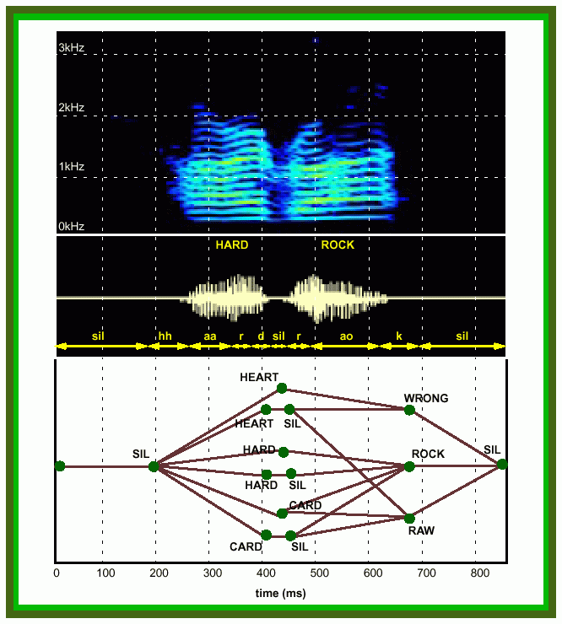

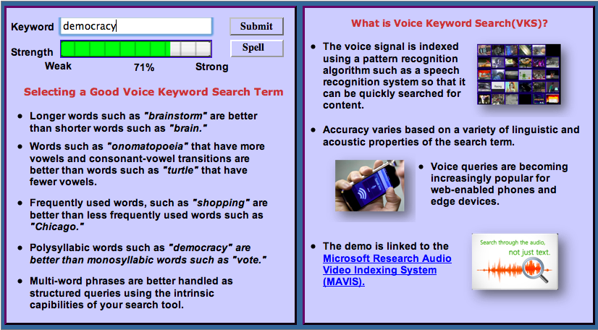
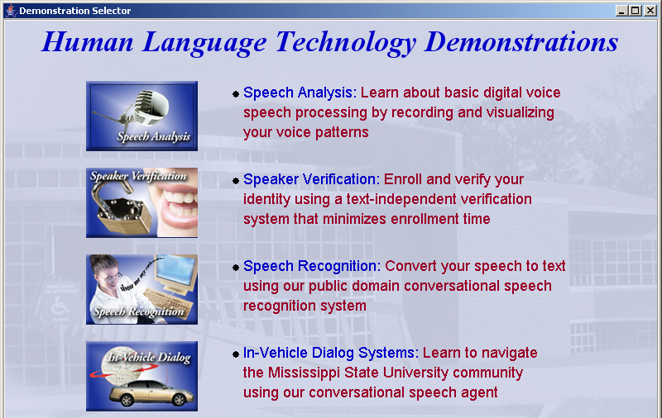
Information and Signal Processing
Mission: Automated extraction and organization of information using advanced statistical
models to fundamentally advance the level of integration, density, intelligence and performance
of electronic systems. Application areas include speech recognition, speech enhancement and biological systems.
Impact:
  Real-time information extraction from large audio resources such as the Internet
  Intelligence gathering and automated processing
  Next generation biometrics based on nonparametric statistical models
  Rapid generation of high performance systems in new domains involving untranscribed big data
Expertise:
  Statistical modeling of time-varying data sources in human language, imaging and bioinformatics
  Speech, speaker and language identification for defense and commercial applications
  Metadata extraction for enhanced understanding
  and improved semantic representations
  Intelligent systems and machine learning
  Data-driven and corpus-based methodologies utilizing big data resources

Slide 27
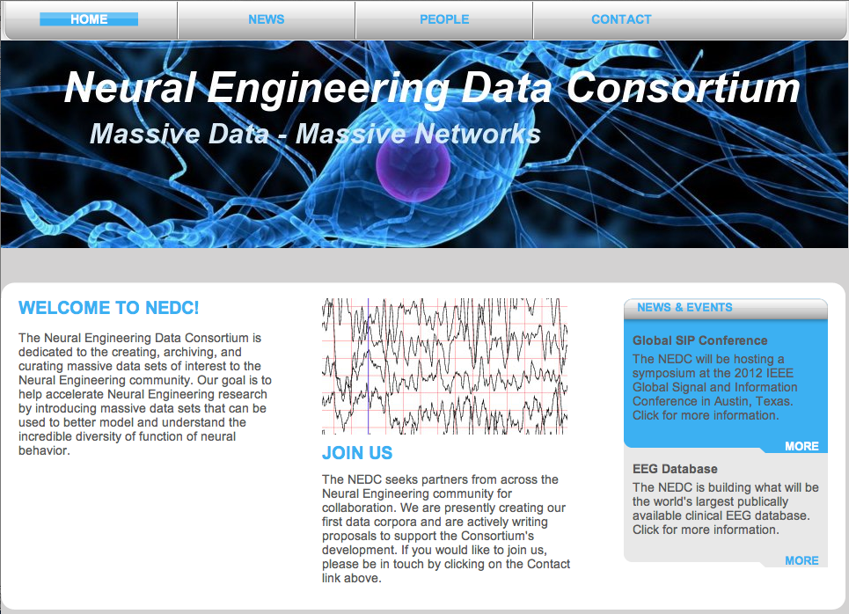

Slide 28
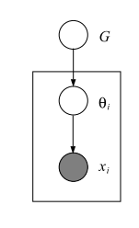
Appendix: Generative Models
A generative approach to clustering:
  Randomly pick one of K clusters
  Generate a data point from a parametric model of this cluster
  Repeat for N >> K data points
Probabilities of each generated data point:
Each data point can be regarded as being generated from a discrete distribution over the model parameters.

Slide 29
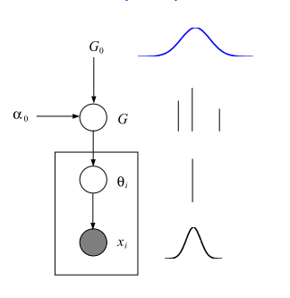
Appendix: Bayesian Clustering
In Bayesian model-based
clustering, a prior is placed
on the model parameters.
Θ is model specific; usually
we use a conjugate prior.
For Gaussian distributions,
this is a normal-inverse
gamma distribution. We name
this prior G₀ (for Θ).
The prior on π is multinomial
and therefore we use a symmetric
Dirichlet distribution as its prior with concentration parameter α₀ .

Slide 30
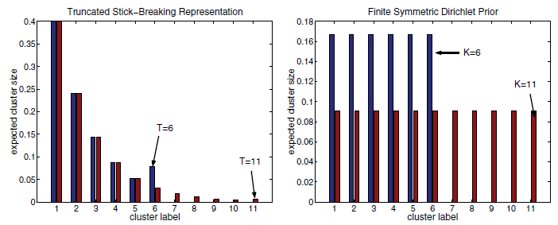
Appendix: Variational Inference Algorithms
Collapsed Variational Stick Breaking (CVSB)
  Truncates the DPM to a maximum
  of K clusters and marginalizes
  out mixture weights
  Creates a finite DP
Collapsed Dirichlet Priors (CDP)
  Truncates the DPM to a maximum
  of K clusters and marginalizes
  out mixture weights
  Assigns cluster size with a
  symmetric prior
  Creates many small clusters
  that can later be collapsed
[ 4 ]
Notes:
Both truncate clusters (everything beyond T =0)
CDP assigns cluster size, uses large number of small clusters, and can be later collapsed into bigger clusters

Slide 31
Appendix: Finite Mixture Distributions
A generative Bayesian finite mixture model is somewhat similar to a graphical model.
Parameters and mixing proportions are sampled from G₀ and the Dirichlet distribution respectively.
Θ_{i} is sampled from G, and each data point x_{i} is sampled from a corresponding probability distribution (e.g. Gaussian).

Slide 32

Appendix: Finite Mixture Distributions
How to determine K?
  Using model comparison methods.
  Going nonparametric.
If we let K➔∞, can we obtain a nonparametric model? What is the definition of G in this case?
The answer is a Dirichlet Process.

Slide 33
Appendix: Stick Breaking
Why use Dirichlet process mixtures (DPMs)?
  Goal: Automatically determine an optimal # of mixture components for each phoneme model
  DPMs generate priors needed to solve this problem!
What is “Stick Breaking”?
DP~1
Step 1: Let p₁ = θ₁. Thus the stick, now has a length of 1- θ₁.
Step 2: Break off a fraction of the remaining stick, θ₂. Now, p₂ = θ₂(1-θ₁) and the length of the remaining stick is (1-θ₁)(1-θ₂). If this is repeated k times, then the remaining stick's length and corresponding weight is:
θ₁
θ₂
θ₃
Notes:
-theta is a fraction of current stick length (not of original stick length)
-stick-breaking continues until cost function is optimized

Slide 34
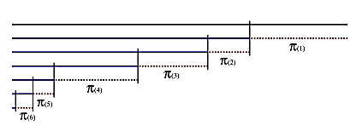
Appendix: Stick-Breaking Prior
Stick-breaking construction
represents a DP explicitly:
  Consider a stick with
  length one.
  At each step, the stick is broken. The broken part is assigned as the weight of corresponding atom in DP.
If π is distributed as above we write:

Slide 35
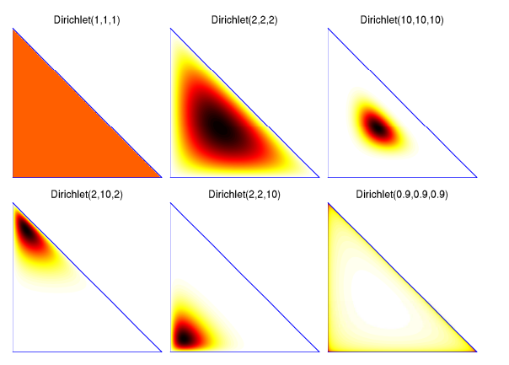
Appendix: Dirichlet Distributions
Dirichlet Distribution
Properties of Dirichlet Distributions
  Agglomerative Property (Joining)
  Decimative Property (Splitting)
Notes:
Each corner represents a die, alpha represents how often each dice is rolled

Slide 36

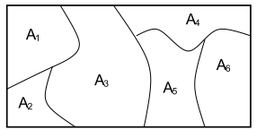

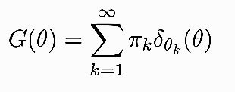
Appendix: Dirichlet Processes
A Dirichlet Process (DP) is a random probability measure over (Φ,Σ) such that for any measurable partition over Φ we have
DP has two parameters: the base distribution (G₀) functions similar to a mean, and α is the concentration parameter (inverse of the variance).
We write :
DP is discrete with probability one:

Slide 37
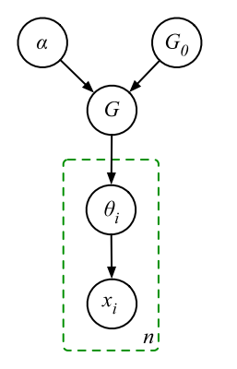
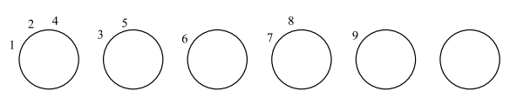
Appendix: Dirichlet Process Mixture (DPM)
DPs are discrete with probability one
so they cannot be used as a prior on continues densities.
However, we can draw a parameter of a mixture model from a draw from a DP.
This model is similar to the finite model, with the difference that G is sampled from a DP and therefore has infinite atoms.
One way of understanding this model is by imagining a Chinese restaurant with infinite number of tables. The first customer (x₁) sits at table one. Other customers, either sit in one of the tables already occupied or initiate their own table.
In this metaphor, each table corresponds to a cluster. This “sitting process” is governed by a Dirichlet process. Customers sit at tables with a probability proportional to the people around them and initiates a new table with probability proportional to α.
The result is a model that number of
clusters grow logarithmically with
the amount of data.

Slide 38
Appendix: Inference Algorithms
  In a Bayesian framework, parameters and variables are treated as random variables; and the goal of analysis is to find the posterior distribution for these variables.
  Posterior distributions cannot be computed analytically; instead we use a variety of Markov Chain Monte Carlo (MCMC) sampling or variational methods.
  Computational concerns currently favor variational methods. For example, Accelerated Variational Dirichlet Process Mixtures (AVDP) incorporates a
  kd-tree to accelerate convergence. This algorithm also use a particular form of truncation in which we assume the variational distributions are fixed to their prior after a certain level of truncation.
  In Collapsed Variational Stick Breaking (CVSB), we integrate out the mixture weights. Results are comparable to Gibbs sampling.
  In Collapsed Dirichlet Priors (CDP), we use a finite symmetric Dirichlet distribution approximation of a Dirichlet process. For this algorithm, we have to specify the size of Dirichlet distribution. Its performance is also comparable to Gibbs sampler.
  All three approaches are freely available in MATLAB. This is still an active area of research.

Slide 39
Appendix: Integrating DPM into a Speaker Adaptation System
Train speaker independent (SI) model.
Collect all mixture components and their frequencies of occurrence (to regenerate samples based on frequencies).
Generate samples from each Gaussian mixture component and cluster them using a DPM model.
Cluster generated samples based on DPM model and using an inference algorithm.
Construct a bottom-up merging of clusters into a tree structure using DPM and a Euclidean distance measure.
Assign distributions to clusters using a majority vote scheme.
Compute a transformation matrix using ML for each cluster of Gaussian mixture components (only means).

Slide 40
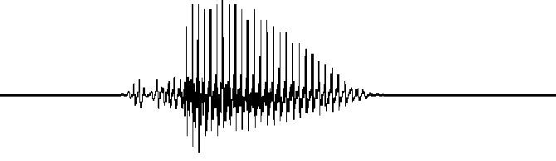
Appendix: Experimental Setup — Feature Extraction
Raw Audio
Data
Frames/
MFCCs
F_{1AVG}
_{Round}
_{Down}
F_{2AVG}
_{Round}
_{Up}
F_{3AVG}
_{Remainder}
3-4-3 Averaging
3x40 Feature Matrix
Window | 39 MFCC Features + Duration
F_{1AVG} | 40 Features
F_{2AVG} | 40 Features
F_{3AVG} | 40 Features

