Slide 1


Big Data in Biomedical Engineering
Iyad Obeid, PhD
November 7, 2014
Temple University
Neural Engineering Data Consortium
iobeid@temple.edu

Slide 2
Brain Machine Interfaces
Systems that bridge biological tissue with electronic circuits
Characterized by the flow of information
Direction of information flow
  In towards the brain - cochlear implant
  Out from the brain - neuroprosthesis
  Bi-directional - closed loop neuroprosthesis

Slide 3
Signal Sources
Acquire neural signals
  Electroencephalogram (EEG)
  Electrocorticogram (ECoG)
  Cortical electrodes (single / multi unit and LFPs)
  Peripheral nerves
  Electromyogram (EMG)
Derive / Estimate neural intent signal
  Kinematic variable
  Static variable

Slide 4
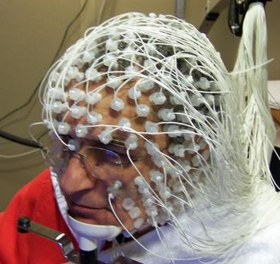
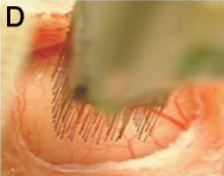
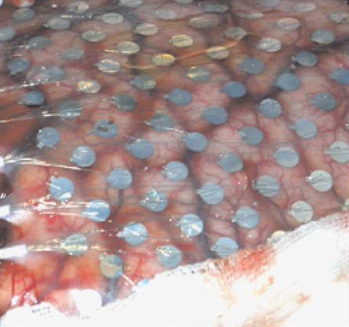
Signal Sources
Invasiveness
Ability to understand the neural code
Long-term stability of the recordings

Slide 5
Key Challenges
Biocompatibility of electrodes with neural tissue
Acquiring and processing multichannel signals
Understanding the neural code
Packaging
  Heat dissipation
  Power supply
  Form factor

Slide 6
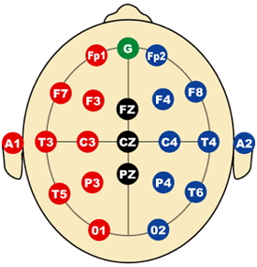
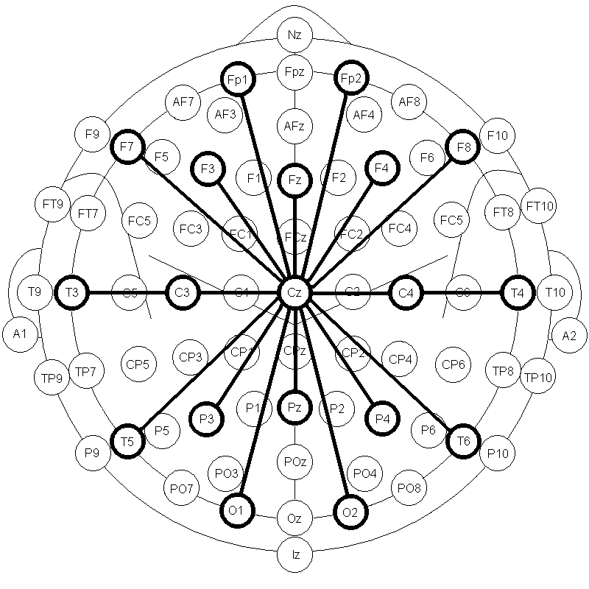
10-20 EEG System

Slide 7
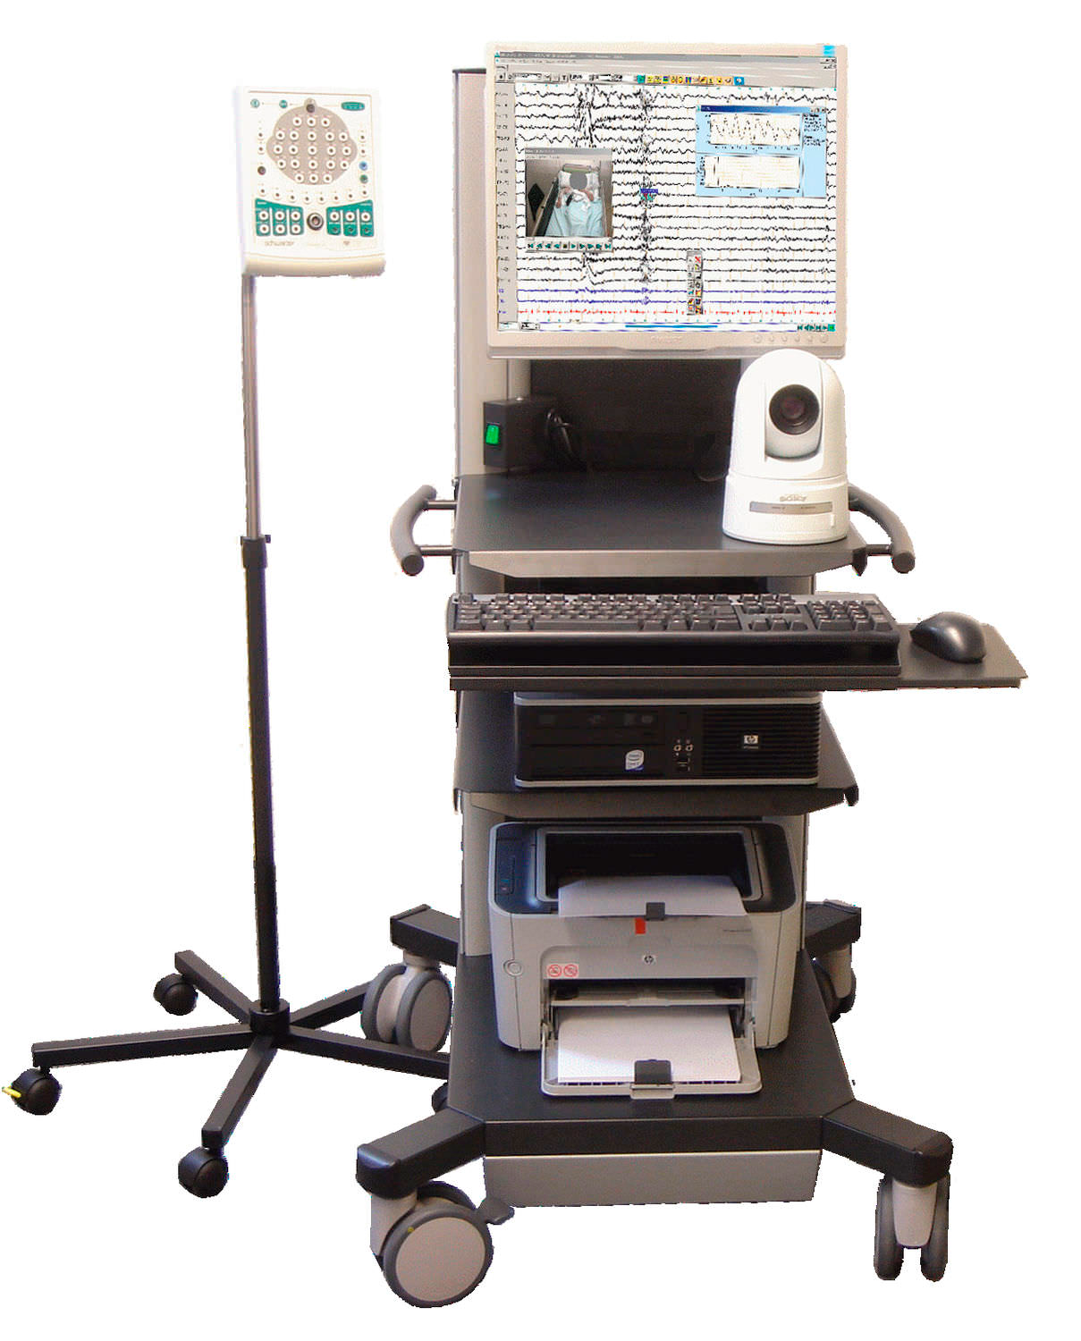
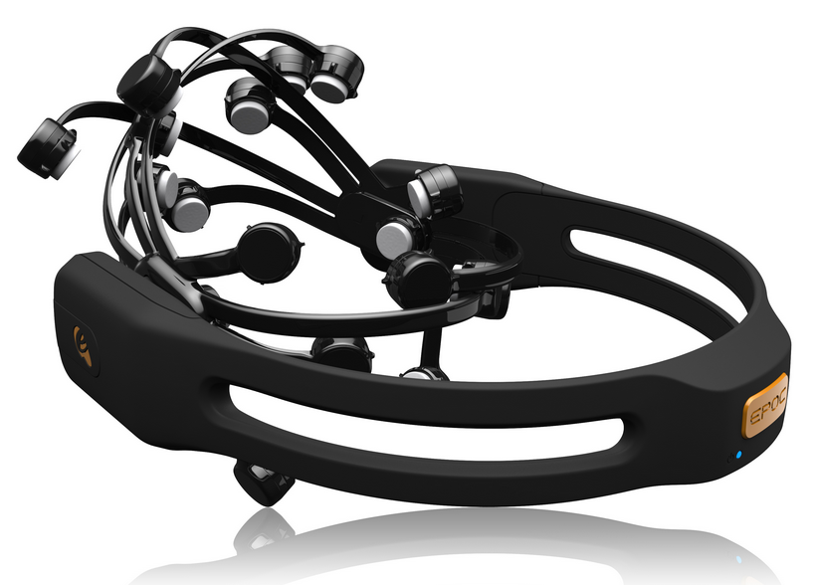
EEG
Commercial EEG
Emotiv Wireless Headset

Slide 8
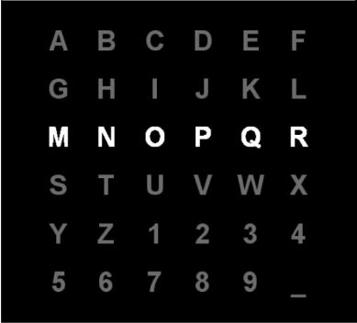
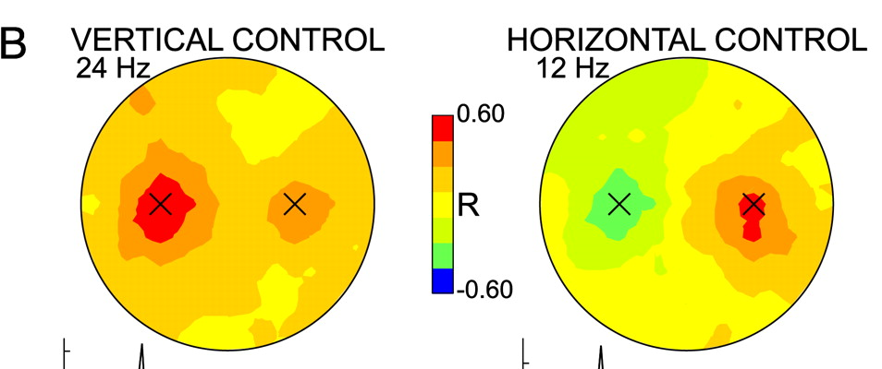
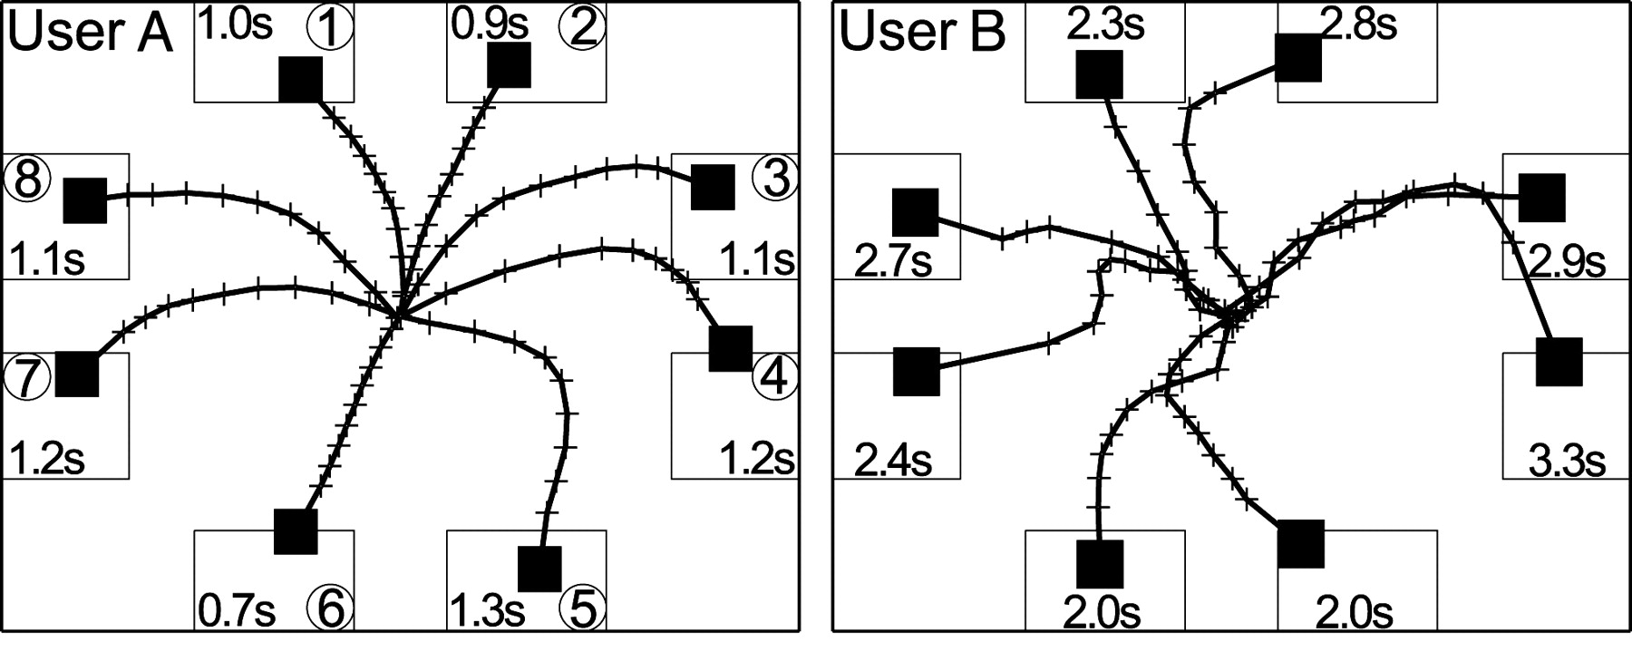
Brain Computer Interfaces
P300 Speller
Cursor Control
Wolpaw J R , and McFarland D J PNAS 2004;101:17849-17854

Slide 9
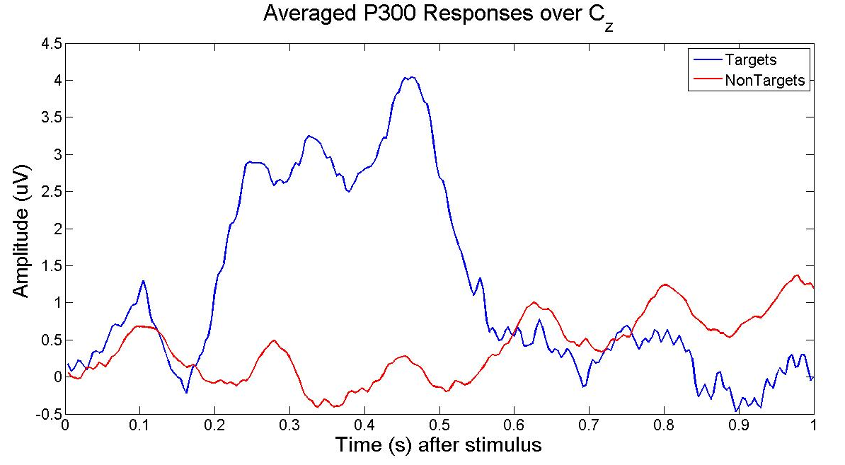
P300 Signals

Slide 10
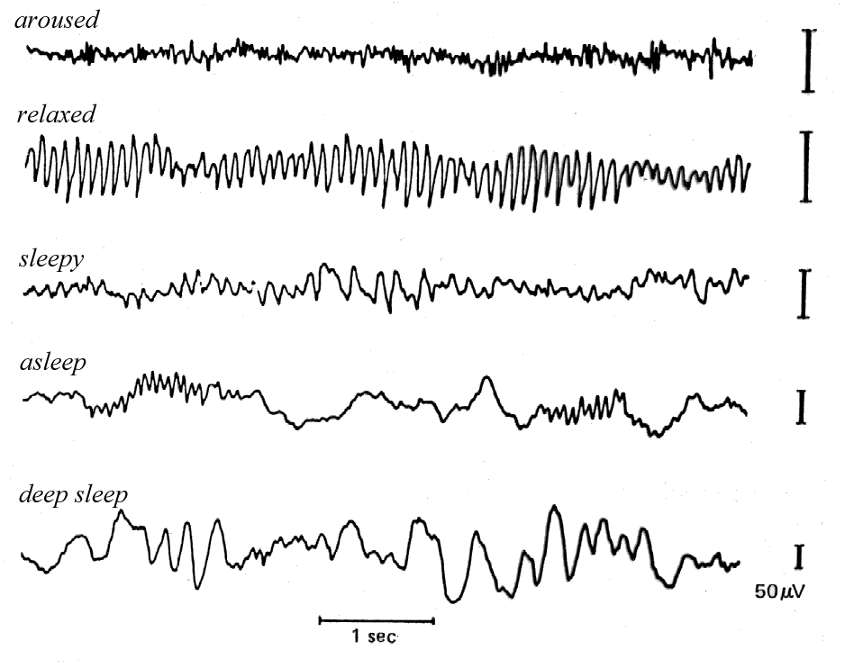
EEG

Slide 11
A Decade of Progress
Over $200M spent by NIH & NSF alone on “neural engineering” and “brain computer interfaces”
Significant additional investment from DARPA, military, state, international agencies
Over 1,700 peer review journal papers
Conferences, book chapters, etc
Excellent academic output

Slide 12
Translation to Marketplace
Relatively little commercial technology development
Relatively little translation from well-controlled lab environments into general use
Signal processing isn’t sufficiently robust
  Insufficient training data
Lack of common benchmarks
  Need for community standards
Is there a better way of investing resources?

Slide 13
Existing Funding Model
Funding Agencies
PI
Data
Research Question
Methods
Money
Results
PI
Data
Research Question
Methods
Money
Results
PI
Data
Research Question
Methods
Money
Results

Slide 14
Limitations of Existing Model
Each PI creates own data using own protocol to answer own question
Practically impossible to generate sufficient data to adequately capture signal variability under a variety of experimental conditions
Lack of common benchmarks
Hard/impossible to cross-validate results or compare results between groups
All of these factors impede progress!

Slide 15
Neural Signal Databases
NIH and NSF Data Sharing Policy
Physionet
CRCNS
These are good, but they do not address the lack of massive datasets collected on common protocols

Slide 16
Big Data Resources
More than just “warehousing” archival data
Can the data drive the research?
Can basic scientific discovery be accelerated by intelligently designing big data resources?
Can scientific discovery be made more cost effective?

Slide 17
Alternative Model
Industry
PI
Research Questions
Funding Agencies
Neural Engineering Data
Consortium
Fees
Funded
PI
Unfunded
PI
Data
Data Design
Results
Funded
PI
Unfunded
PI
Data Generation
Results Scoring
Funded
PI
Unfunded
PI

Slide 18
Neural Engineering Data Consortium www.nedcdata.org
Serves the community (not vice versa)
Focuses community on common problems
Drives algorithm development
Improves amount and quality of data
Validates performance claims
Tiered membership fees
Promotes “technology that works”
Does not preclude PI’s individual work!

Slide 19
Neural Engineering Data Consortium
Board of Directors
Operations
Data Design
Funding Groups
Director
Scientists & Engineers
Academia
External Grants
Statisticians
Industry
Business Mgr
Study Designers
Data Collection
Data Annotation & Archives
Data Delivery and Support
Technicians
Software Developers
IT Personnel
Graduate Students
Scientists & Engineers
Technical Support
Medical Staff
Archivists

Slide 20
TUH-EEG Database
Goal: Release 20,000+ clinical EEG recordings from Temple University Hospital (2002-2013)
Includes physician EEG reports and patient medical histories
Released as free public resource

Slide 21
TUH-EEG Database
Task 1: Software Infrastructure and Development
  convert data from proprietary formats to an open standard (EDF)
Task 2: Data Capture
  copy files from 1500+ CDs and DVDs
Task 3: Release Generation
  Deidentify data
  Resolve physician reports and EEGs
  Clean up data

Slide 22
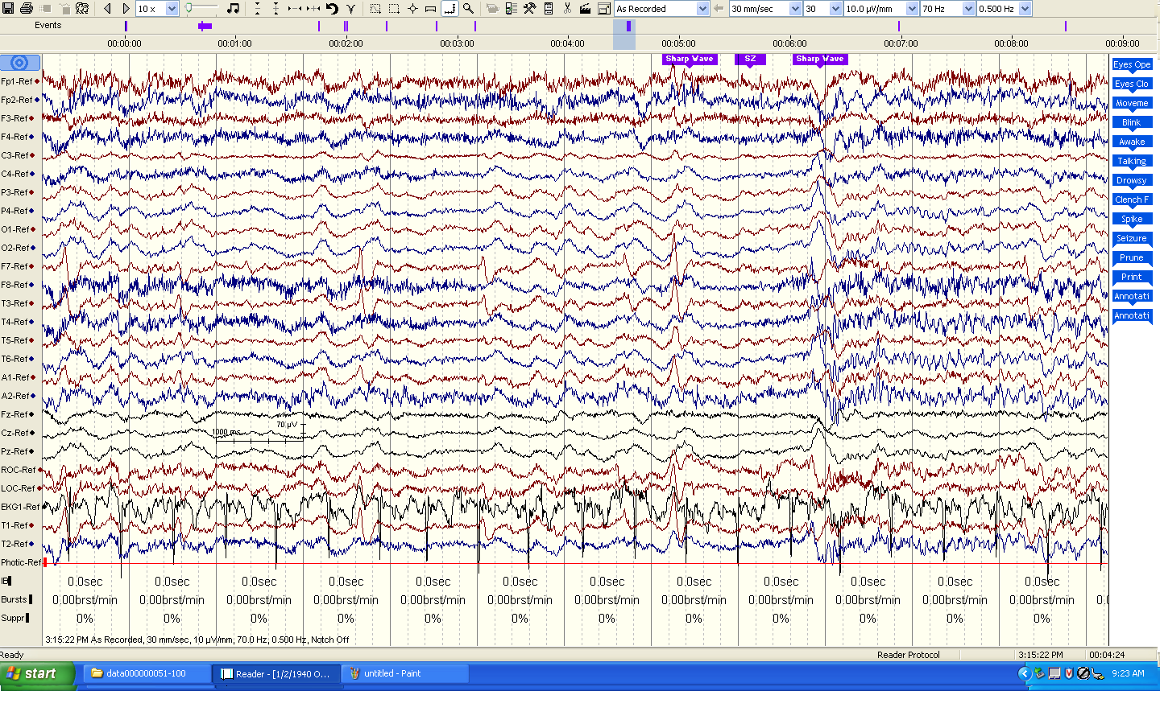
Task 1: Software and Infrastructure Development
Major Tasks:
Inventory the data (EEGs and physician reports)
Develop a process to convert data to an open format
Develop a process to deidentify the data
Gain necessary system accesses to the source forms of the reports
Status and Issues:
Efforts to automate .e to .edf conversion failed due to incompatibilities between Nicolet’s NicVue program and ‘hotkeys’ technology.
Accessing physician reports required access to 5 different hospital databases and cutting through lots of red tape (e.g., it took months to get access to the primary reporting system).
No automated methods for pulling reports from the back-end database.
EDF files were not “to spec” according to open source “EDFlib” so additional EDF conversion software had to be written.
Patient information appears in EDF annotations.

Slide 23
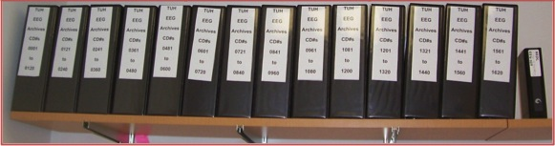
Task 2: Data Capture
Major Tasks:
Copy data from media to disk
Convert EEG files to EDF
Capture Physician Reports
Label Generation
Status and Issues:
22,000+ EEG sessions have been captured from 1570+ CDs/DVDs.
Approximately 15% of the media were defective and needed multiple reads or some form of repair.
Raw data occupies about 2 TBytes of space including video files.
Conversions to EDF averaged 1 file per minute with most of the time spent writing data to disk. The process generates three files: an EEG file in EDF format, an impedance report, and a test report that contains preliminary findings.
Multiple EDF files per session due to the way physicians annotate EEGs.

Slide 24
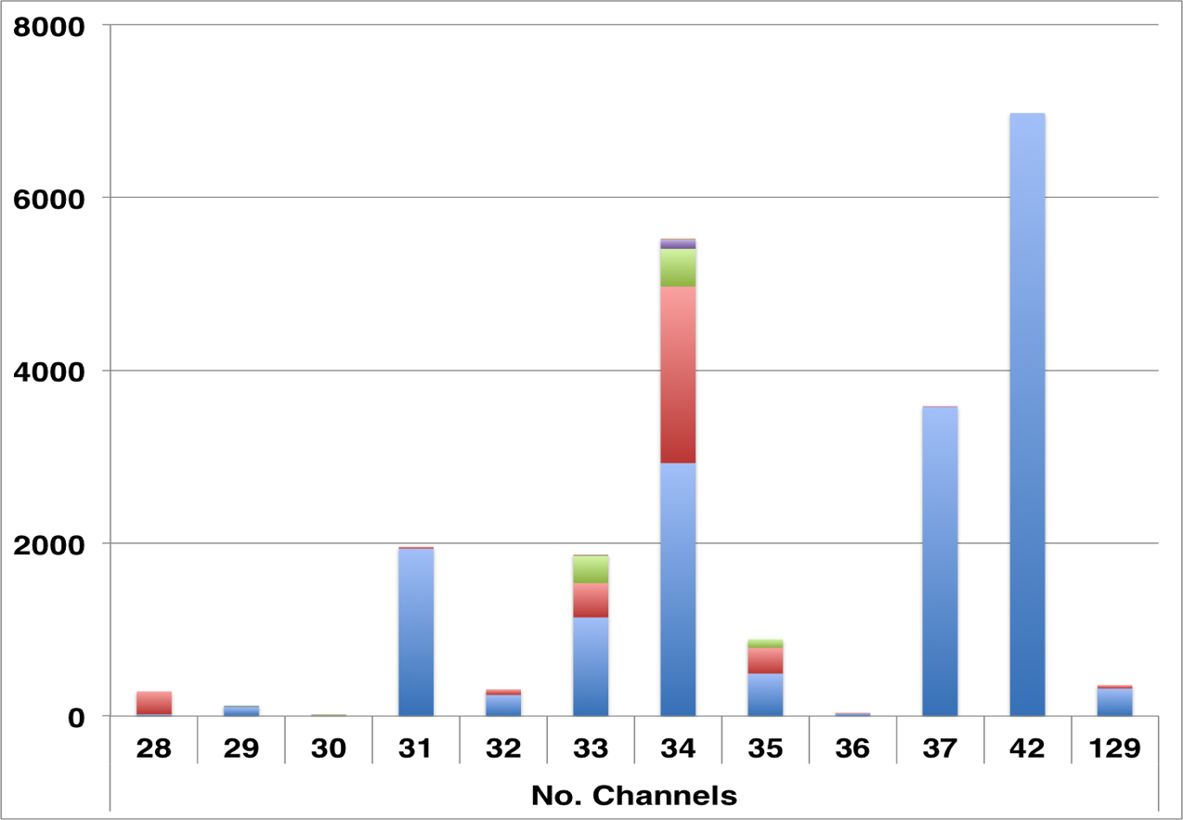
Task 2: TUH-EEG at a Glance
Number of Sessions: 22,000+
Number of Patients: ~15,000 (one patient has 42 EEG sessions)
Age: 16 years to 90+
Sampling: 16-bit data sampled at 250 Hz, 256 Hz or 512 Hz
Number of Channels:
variable
Number of Channels: ranges from [28, 129] (one annotation channel per EDF file)
Over 90% of the alternate channel assignments can be mapped to the 10-20 configuration.

Slide 25
Task 2: Physician Reports
Two Types of Reports:
Preliminary Report: contains a summary diagnosis (usually in a spreadsheet format).
EEG Report: the final “signed off” report that triggers billing.
Inconsistent Report Formats: The format of reporting has changed several times over the past 12 years.
Report Databases:
MedQuist (MS Word .rtf)
Alpha (OCR’ed .pdf)
EPIC (text)
Physician’s Email (MS Word .doc)
Hardcopies (OCR’ed pdf)

Slide 26
Task 2: Challenges and Technical Risks
Missing Physician Reports:
It is unclear how many EEG reports in the standard format will be recovered from the hospital databases.
Coverage for 2013 was good – less than 5% of the EEG Reports were missing (and we are still trying to locate these working with hospital staff).
Coverage pre-2009 could be problematic.
Our backup strategy is to use data available from preliminary reports, which contain basic classifications of normal/abnormal and when abnormal, a preliminary diagnosis.
OCR of Physician Reports:
The scanned images are noisy, resulting in OCR errors.
Takes 2 to 3 minutes per image to manually correct.

Slide 27
Task 3: Release Generation
Major Tasks:
Deidentify and randomly sequence files so patient information can’t be traced.
Quality control to verify the integrity of the data.
Release data incrementally to the community for feedback.
Status and Issues:
Patient’s name can appear in the annotations and must be redacted; format is unpredictable.
Initially, we will only release standard 20-minute EEGs. Long-term monitoring or ambulatory EEGs will be released separately once we understand the data.
Regularization of the physician reports.

Slide 28
Accomplishments and Results
22,000+ EEG signals online and growing
(about 3,000 per year).
Approximately 2,000 EEGs from 2012 and 2013 have been resolved and prepared for deidentification/release.
Anticipated pilot release in January 2014.
Need community feedback on the value of the data and the preferred formats for the reports.
Expect additional incremental releases through 2Q’2014.
Acquired 1,400 more EEGs from the last half of 2013 (newer data is can be processed much faster).

Slide 29
Observations
General:
This project would not have been possible without leveraging three funding sources.
Community interest is high, but willingness to fund is low.
Project Specific:
Recovering the EEG signal data was challenging due to software incompatibilities and media problems.
Recovering the EEG reports is proving to be challenging due to the primitive state of the hospital record system.
Making the data truly useful to machine learning researchers will require additional data clean up, particularly with linking reports to specific EEG activity.

Slide 30
Automatic Interpretation of EEGs
Use TUH-EEG big data resource to train machine learning systems for EEG interpretation
Assist neurologists (esp. w/ long rec’s)
Potentially missed diagnoses
Smaller regional hospitals lacking adequate neurology staff

Slide 31




Funding

Slide 32
How to Help
Take the survey!
Use the data!
www.nedcdata.org

