Slide 1
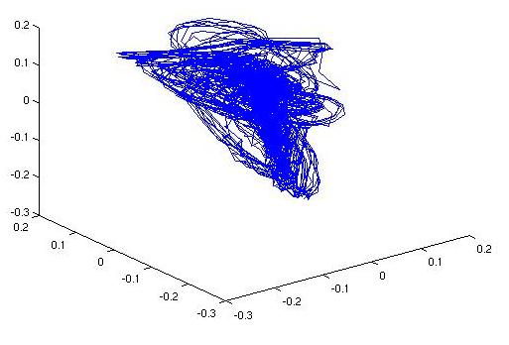
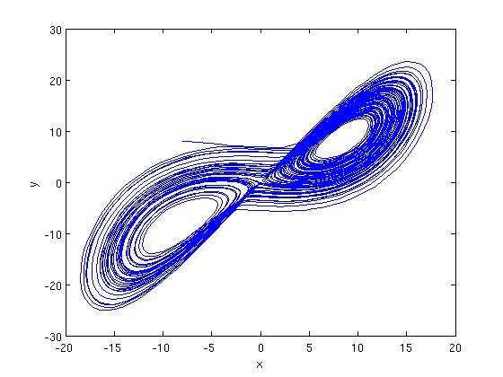
NONLINEAR DYNAMIC INVARIANTS FOR CONTINUOUS SPEECH RECOGNITION
• Author:
Daniel May
Mississippi State University
• Contact Information:
1255 Louisville St. Apt 7
Starkville, MS 39759
Tel: 601-467-6573
Email: MSUdom5@gmail.com
• URL: http://www.isip.msstate.edu/publications/books/msstate_theses/2008/dynamic_invariants

Slide 2
Abstract
In this work, nonlinear acoustic information is combined with traditional linear acoustic information in order to produce a noise-robust set of features for speech recognition. Classical acoustic modeling techniques for speech recognition have relied on a standard assumption of linear acoustics where signal processing is primarily performed in the signal's frequency domain. While these conventional techniques have demonstrated good performance under controlled conditions, the performance of these systems suffers significant degradations when the acoustic data is contaminated with previously unseen noise. The objective of this thesis was to determine whether nonlinear dynamic invariants are able to boost speech recognition performance when combined with traditional acoustic features. Several sets of experiments are used to evaluate both clean and noisy speech data. The invariants resulted in a maximum relative increase of 11.1% for the clean evaluation set. However, an average relative decrease of 7.6% was observed for the noise-contaminated evaluation sets. The fact that recognition performance decreased with the use of dynamic invariants suggests that additional research is required for robust filtering of phase spaces constructed from noisy time-series.
Notes:
JP: You might think about creating more visual impact with bullets for your main conclusions and shortening some of the text.

Slide 3
Motivation
Traditional MFCCs features capture the lower-order characteristics of the speech production process.
Experimental evidence [Teager and Teager] has suggested the existence of nonlinear mechanisms in the production of speech.
Nonlinear dynamic invariants can describe these mechanisms and are able to discriminate between different types of speech.
Dynamic invariants capture the higher-order information missed by traditional linear features.
Research [Pitsikalis and Maragos] has suggested that dynamic invariants are robust to previously unseen recording conditions.
Combining dynamic invariants with MFCCs should produce a more robust feature vector for continuous speech recognition.
Notes:
Motivation for using nonlinear features. I wish I had a witty cartoon for this slide.
Comment: MIT-LL likes you to use the APA style of references, saying things like “Smith and Johnson showed…”
(maybe you need to state specifically what lowe-order and higher-order characteristics are???)

Slide 4
Traditional Features for Speech
Traditional Linear Features
Based on the source-filter model
Model the vocal tract as a linear filter
Features are extracted from the frequency domain of the signal
Mel-Frequency Cepstral Coefficients
10 ms frame duration
25 ms Hamming window
Absolute energy
12 cepstral coefficients
First and second derivatives
Input Speech
Zero-mean and
Pre-emphasis
Energy
Fourier Transf.
Analysis
Cepstral
Analysis
Δ / ΔΔ
Notes:
Maybe for this presentation you need to go to a more professional look with shaded boxes? Of course, this new version of ppt makes it really hard to do basic black fuzzy shading…

Slide 5
Nonlinear Invariant Features for Speech
Dynamic Systems
Defined by a set of first-order ordinary differential equations.
Phase space describes the behavior of the system's dynamic variables as time evolves
Time evolution of the system forms a path, or trajectory within the phase space
The system’s attractor is the subset of the phase space to which the trajectory settles after a long period of time
Nonlinear Invariant Features
Computed from the time domain signal
Signal is an observable of a dynamic systems
Phase space is reconstructed from observable
Invariants estimated based on properties of the phase space
Input Speech
Zero-mean
Phase Space
Reconstruction
Dynamic Invariant
Estimation
Notes:
-Simple intro to nonlinear features. Another block diagram? Is the figure in the block diagram too much?
JP: I think this looks good.

Slide 6
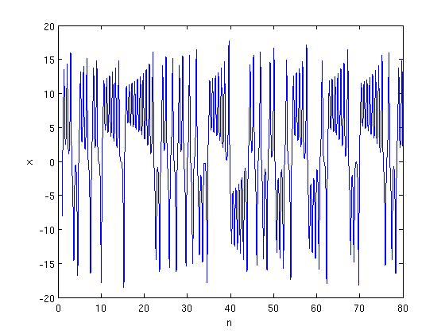
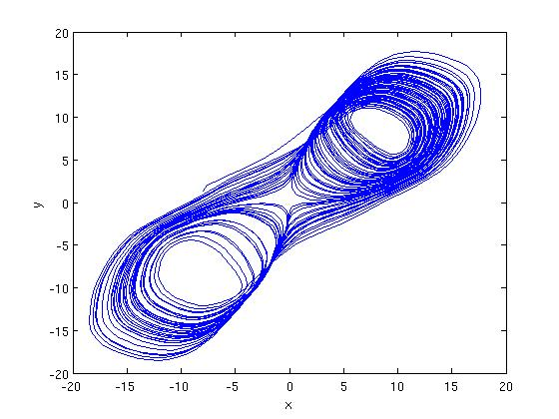
Phase Space Reconstruction (RPS)
Time Delay Embedding
Simplest reconstruction method
Reconstructs phase space using time-delayed copies of the original time series.
Correct choices for time delay τ and embedding dimensions m are important
SVD Embedding
More robust to noise than time-delay embedding
SVD is applied to a time-delay RPS to smooth trajectories
Example: Lorenz System
Original Lorenz System
Observed x Variable
Reconstructed Phase Space (RPS)
Notes:
I don’t like the position of the equations

Slide 7
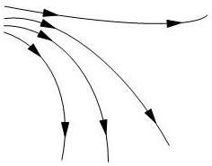
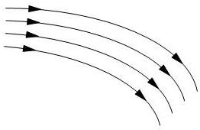
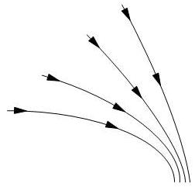
Lyapunov Exponents
Measures the level of chaos in the reconstructed attractor
Computed by analyzing the relative behavior of neighboring trajectories within the attractor
Example:
Final Lyapunov exponent is the average trajectory behavior over the entire attractor
Diverging Trajectories (>0)
Stable Trajectories (~0)
Converging Trajectories (<0)
Notes:
JP: This is a nice slide!

Slide 8
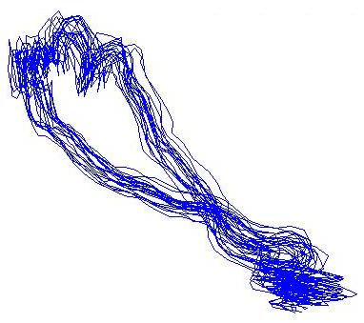
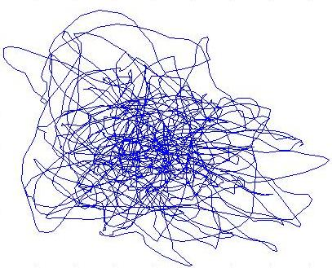
Lyapunov Exponents Examples
Reconstructed attractor for phoneme /m/
On average, neighboring trajectories remain close together as time evolves
This behavior results in a relatively low exponent (λ=-8.96)
Reconstructed attractor for phoneme /f/
Neighboring trajectories diverge quickly as time evolves
This behavior results in a relatively high exponent (λ=566.11)

Slide 9
Fractal Dimension
Quantifies the geometrical complexity of the attractor by measuring self-similarity
Self-similarity example: Sierpinski Triangle
Computed by estimating the attractor’s correlation integral which measures the extent to which the attractor fills the phase space
The method for finding fractal dimension from a time-series is called correlation dimension, and is found from the correlation integral using:

Slide 10
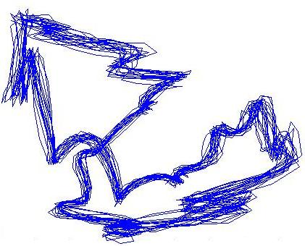
Fractal Dimension Examples
Reconstructed attractor for phoneme /aa/.
Self similarity clearly visible in the symmetric shape of the attractor.
This attractor results in a correlation dimension of 0.88.
Reconstructed attractor for phoneme /eh/.
Self-similarity not as obvious, but can be seen in the ‘jagged’ structures of the attractor.
This attractor results in a correlation dimension of 0.61.

Slide 11
Kolmogorov Entropy
Measures the average rate of information production of a dynamic system
Like Fractal Dimension, Kolmogorov entropy (K₂) is related to the correlation integral of the attractor:
The method used to estimate entropy is called correlation entropy and is defined by:
Examples:
Phoneme /m/ = 343.4
Phoneme /f/ = 964.6
Phoneme /aa/ = 666.0

Slide 12
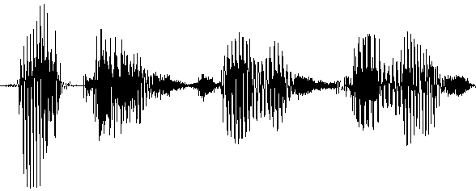
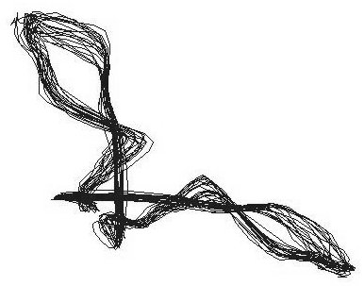
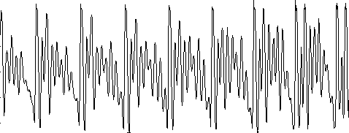
Measuring Dynamic Invariants of Speech Signals
Dynamic invariants are estimated from segments of the speech signal
These segments are aligned with the signal frames from which MFCCs are computed
The length of the signal segment varies depending on which invariant is being estimated

Slide 13
Experimentation Strategy
Use the WSJ-derived Aurora corpus for evaluations
Perform a set of low-level phonetic classification experiments to better understand the effects of adding dynamic invariants to MFCC features
Establish standard MFCC baseline performance
Evaluate noise-free Aurora test set using MFCC/dynamic invariant combinations
Evaluate mismatched Aurora test conditions using MFCC/dynamic invariant combinations

Slide 14
Aurora Corpus Description
Acoustic Training:
Derived from 5000 word WSJ0 task
16 kHz sample rate
Recorded with Sennheiser microphone
83 speakers
7138 training utterances totaling in 14 hours of speech
Development Sets:
Derived from WSJ0 Evaluation and Development sets
7 individual test sets recorded with Sennheiser microphone
Clean set plus 6 sets with noise conditions
Randomly chosen SNR between 5 and 15 dB for noisy sets

Slide 15
Pilot Experiments
Phonetic classification experiments are used to assess the extent to which dynamic invariants are able to represent speech
Each dynamic invariant is combined with the MFCC features to produce three new feature vectors.
Using time-alignments of the training data, a 16-mixture GMM is trained for each of the 40 phonemes present in the data
Signal frames of the training data are then each classified as one of the phonemes.
 | Correlation Dimension | Lyapunov Exponent | Correlation Entropy
Affricates | 10.3% | 2.9% | 3.9%
Stops | 3.6% | 4.5% | 4.2%
Fricatives | -2.2% | -0.6% | -1.1%
Nasals | -1.5% | 1.9% | 0.2%
Glides | -0.7% | -0.1% | 0.2%
Vowels | 0.4% | 0.4% | 1.1%
Overall | 1.7% | 1.5% | 1.4%
Each new feature vector resulted in an overall classification increase.
The results suggest that improvements can be expected for larger scale speech recognition experiments

Slide 16
Continuous Speech Recognition Experiments
Baseline System
Adapted from previous Aurora Evaluation Experiments
Uses 39 dimension MFCC features
Uses state-tied 4-mixture cross-word triphone acoustic models
Model parameters estimated using Baum-Welch algorithm
Viterbi beam search used for evaluations
Four different feature combinations were used for these evaluations and compared to the baseline:
The statistical significance of the results for each experiment are also computed
Feature Set 1 (FS1) |  | Feature Set 2 (FS2)
MFCCs (39) |  | MFCCs (39)
Correlation Dimension (1) |  | Lyapunov Exponent (1)
40 Dimensions Total |  | 40 Dimensions Total
Feature Set 3 (FS3) |  | Feature Set 4 (FS4)
MFCCs (39) |  | MFCCs (39)
Correlation Entropy (1) |  | Correlation Dimension (1)
 |  | Lyapunov Exponent (1)
 |  | Correlation Entropy (1)
40 Dimensions Total |  | 42 Dimensions Total
Notes:
This slide seems really boring

Slide 17
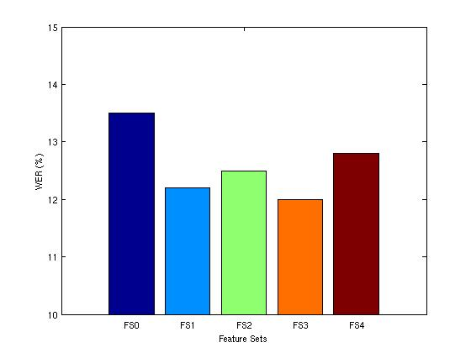
Results for Clean Evaluation Sets
Each of the four feature sets resulted in a recognition accuracy increase for the clean evaluation set.
Dynamic Invariant | WER (%) | Improvement (%) | Significance Level (p)
Baseline (FS0) | 13.5 | -- | --
Feature Set 1 (FS1) | 12.2 | 9.6 | 0.030
Feature Set 2 (FS2) | 12.5 | 7.4 | 0.075
Feature Set 3 (FS3) | 12.0 | 11.1 | 0.001
Feature Set 4 (FS4) | 12.8 | 5.2 | 0.267
Results with a significance level of 0.001 (0.1%) are considered to be statistically significant.
Although each feature set saw a WER decrease, the improvement for FS3 was the only one found to be statistically significant with a relative improvement of 11% over the baseline system.

Slide 18
Results for Noisy Evaluation Sets
Most of the noisy evaluation sets resulted in a recognition accuracy decrease.
FS3 resulted in a slight improvement for a few of the evaluation sets, but these improvements are not statistically significant
 | WER (%)
 | Airport | Babble | Car | Restaurant | Street | Train
Baseline | 53.0 | 55.9 | 57.3 | 53.4 | 61.5 | 66.1
FS1 | 57.1 | 59.1 | 65.8 | 55.7 | 66.3 | 69.6
FS2 | 56.8 | 60.8 | 60.5 | 58.0 | 66.7 | 69.0
FS3 | 52.8 | 56.8 | 58.8 | 52.7 | 63.1 | 65.7
FS4 | 58.6 | 63.3 | 72.5 | 60.6 | 70.8 | 72.5
 | Relative Improvements (%)
 | Airport | Babble | Car | Restaurant | Street | Train
FS1 | -7.7 | -5.7 | -14.8 | -4.4 | -7.8 | -5.3
FS2 | -7.2 | -8.8 | -5.6 | -8.6 | -8.5 | -4.4
FS3 | 0.4 | -1.6 | -2.6 | 1.3 | -2.6 | 0.6
FS4 | -10.6 | -13.2 | -26.5 | -13.5 | -15.1 | -9.7
The average relative performance decrease was around 7% for FS1 and FS2 and around 14% for FS4.
The performance degradations seem to contradict the theory that dynamic invariants are noise-robust.

Slide 19
Computational Issues
Extracting features from a phase space is computationally expensive.
Computation methods require traversing the phase space many times and making computations for each state.
Advanced phase space filtering methods increase computational costs significantly.
Parallelizing the algorithm could cut computational costs.
Further research should investigate and develop optimized algorithms for phase-space related computations.

Slide 20
Conclusions
The recognition performance improvements for the noise-free data suggest that nonlinear dynamic invariants can be combined with MFCCs to better model speech.
The use of correlation entropy resulted in the most significant performance increase with a relative improvement of 11% over the baseline.
Dynamic invariants did not improve the recognition results for the noisy evaluation sets, and in most cases, resulted in a performance decrease.
The use of correlation entropy resulted in a slight WER decrease for some of the noisy sets, but these were not significant.
It is likely that frame-based feature extraction method does not provide the algorithms with enough data to accurately estimate the invariants.
For noisy time series, more data is needed to accurately capture the dynamics of the reconstructed attractor.

Slide 21
Future Work
While SVD embedding has been shown to reduce the effects of noise, it is not very effective for speech since the time-series used for phase space reconstruction is limited by the short frame length. Therefore, more research is required for the development of advanced phase space filtering techniques which can be used to post-process a reconstructed phase space and reduce the effects of noise on phase space dynamics.
Instead of computing values which describe the global behavior of the attractor, such as dynamic invariants, it may be beneficial to model the attractor itself. This would require a new type of statistical model and would provide a more complete description of the local dynamics within the attractor.

Slide 22
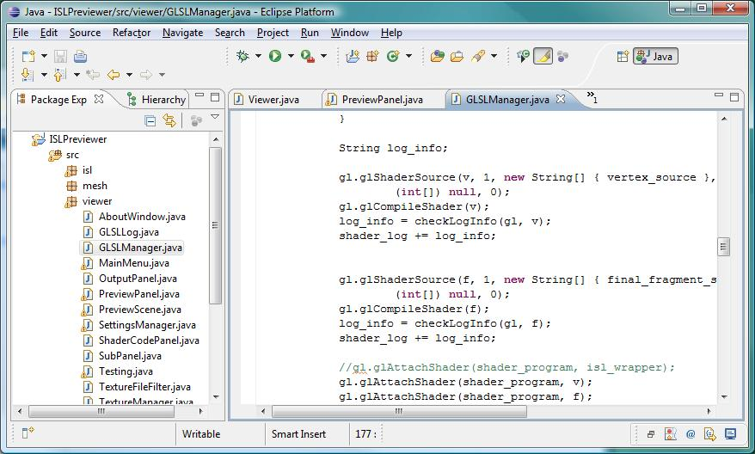
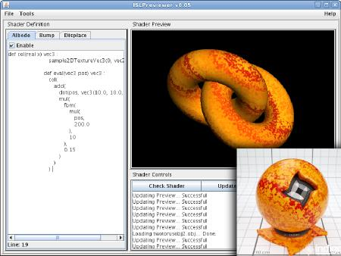
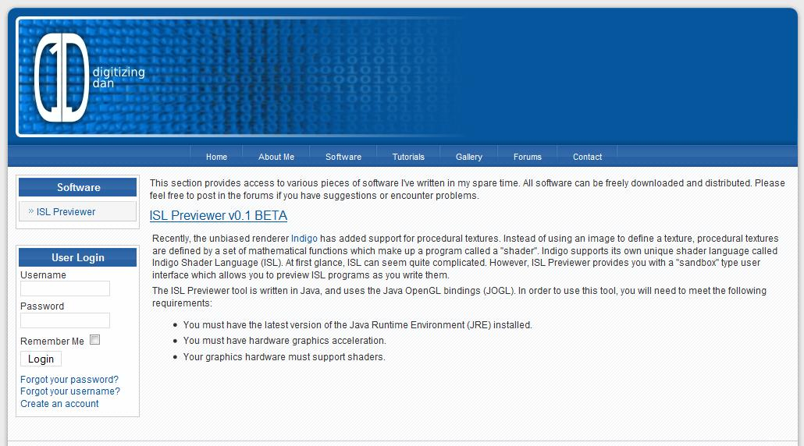
Other Related Interests
Advanced Acoustic Modeling Techniques
Spoken Term Detection
Speaker Recognition
Hardware Acceleration of Speech Recognition Applications (See LLNL Work)
Graphics and GPU Programming

Slide 23
Brief Bibliography
A. Kumar and S. K. Mullick, “Nonlinear Dynamical Analysis of Speech,” Journal of the Acoustical Society of America, vol. 100, no. 1, pp. 615-629, July 1996.
H. M. Teager and S. M. Teager, “Evidence for Nonlinear Production Mechanisms in the Vocal Tract,” NATO Advanced Study Institute on Speech Production and Speech Modeling, Bonas, France, pp. 241-261, July 1989.
V. Pitsikalis and P. Maragos, “Filtered Dynamics and Fractal Dimensions for Noisy Speech Recognition,” IEEE Signal Processing Letters, vol. 13, no. 11, pp. 711-714, November 2006.
M. Banbrook, G. Ushaw, and S. McLaughland, “How to Extract Lyapunov Exponents from Short and Noisy Time Series,” IEEE Transactions on Signal Processing, vol. 45, no. 5, pp. 1378-1382, May 1997.
P. Grassberger and I. Procaccia, “Estimation of the Kolmogorov Entropy from a Chaotic Signal,” Physical Review A, vol. 28, no. 4, pp. 2591-2594, October 1983.
H. F. V. Boshoff and M. Grotepass, “The Fractal Dimension of Fricative Speech Sounds,” Proceedings of the South African Symposium on Communication and Signal Processing, pp. 12-16, Pretoria, South Africa, August 1991.

Slide 24
Available Resources
Aurora Project Website: recognition toolkit, multi-CPU scripts, database definitions, publications, and performance summary of the baseline MFCC front end
Speech Recognition Toolkits: compare front ends to standard approaches using a state of the art ASR toolkit

Slide 25
Related Coursework
Course Number | Title | Semester
ECE 8453 | Intro to Wavelets | Fall 2005
ECE 8443 | Pattern Recognition | Spring 2006
MA 6553 | Prob. Random Processes | Spring 2006
ECE 8413 | Dig. Spectral Analysis | Fall 2006
ECE 8803 | Random Signals and Sys. | Fall 2006
MA 8913 | Intro to Topology | Fall 2006
CSE 8833 | Algorithms | Spring 2007
CSE 6233 | SW Arch & Design | Fall 2007
CSE 6633 | Artificial Intelligence | Fall 2007

