Slide 1
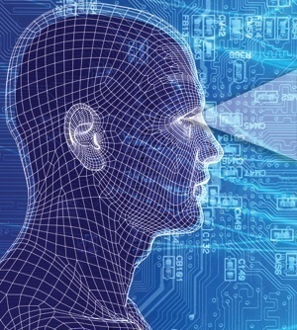
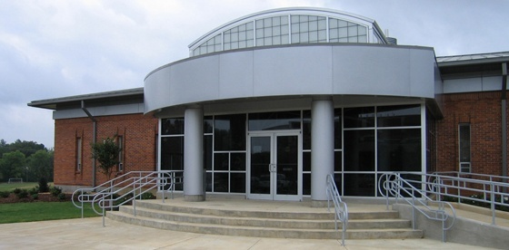

POTENTIAL SYNERGIES BETWEEN
SPEECH RECOGNITION AND PROTEOMICS
Joseph Picone, PhD
Professor, Department of Electrical and Computer Engineering
Mississippi State University
URL:
Audio:

Slide 2
Engineering Terminology
Speech recognition is essentially an application of pattern recognition or machine learning to audio signals:
Pattern Recognition: “The act of taking raw data and taking an action based on the category of the pattern.”
  Machine Learning: The ability of a machine to improve its performance based on previous results.
A popular application of pattern recognition is
the development of a functional mapping
between inputs (observations) and desired
outcomes or actions (classes).
For the past 30 years, statistical methods have
dominated the fields of pattern recognition and
machine learning. Unfortunately, these methods
typically require large amounts of truth-marked
data to be effective.
Generalization and Risk: There are many algorithms that produce very low error rates on small data sets, but many of these algorithms have trouble generalizing these results when constrained to limited amounts of training data., or encountering evaluation conditions different from the training data.

Slide 3
Proteomics (From Wikipedia)
Proteomics is the large-scale study of proteins, particularly their structures and functions.
Proteomics is often considered the next step beyond genomics in the study of biological systems.
It is much more complicated than genomics mostly because while an organism's genome is more or less constant, the proteome differs from cell to cell and from time to time. This is because distinct genes are expressed in distinct cell types. This means that even the basic set of proteins which are produced in a cell needs to be determined.
Several new methods have emerged to probe protein-protein interactions, including protein microarrays and immunoaffinity chromatography followed by mass spectrometry.
Unlike the speech recognition problem, identifying proteins using mass spectrometry is a mature process. But can you generate enough data?
The fundamental challenge is understanding protein interactions and how these relate to diagnostic techniques and disease treatments.
Collaboration Challenge: what role can an ability to learn functional mappings from data play in proteomics?

Slide 4
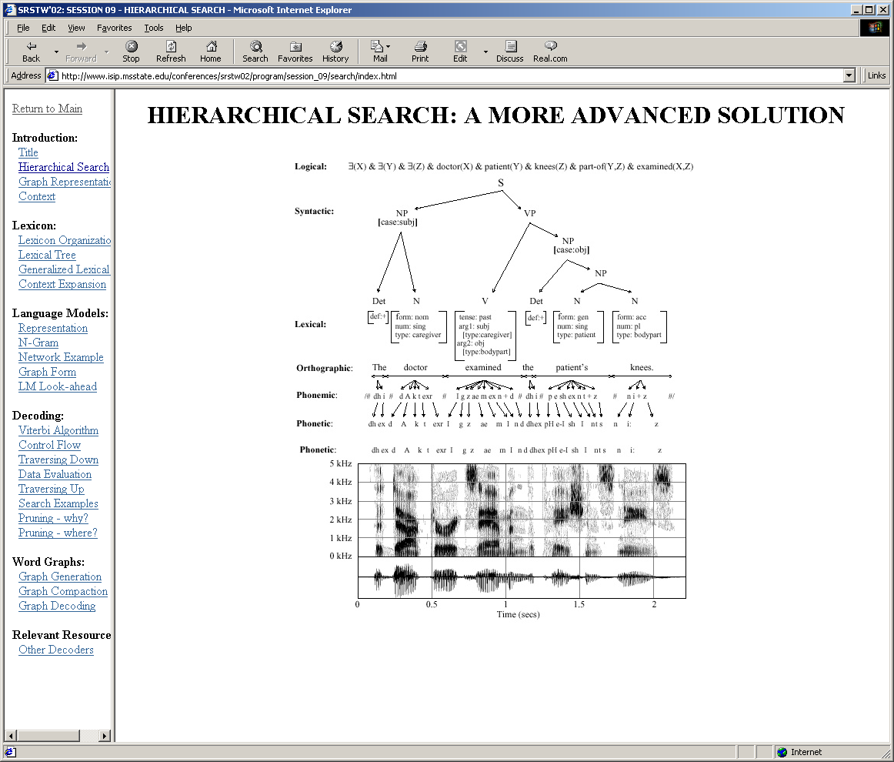
Speech Recognition Overview
Conversion of a 1D time series (sound pressure wave vs. time) to a symbolic description.
Exploits “domain” knowledge at each level of the hierarchy to constrain the search space and improve accuracy.
The exact location of symbols in the signal are unknown.
Segmentation, or location of the symbols, is done in a statistically optimal manner as part of the search process.
Complexity of the search space is exponential.

Slide 5
From a Signal to a Spectrogram
Convert a one-dimensional signal (sound pressure wave vs. time) to a time-frequency representation that better depicts the “signature” of a sound.
Use simple linear transforms such as a Fourier Transform to generate a “spectrogram” of the signal (spectral magnitude vs. time and frequency).
Key challenge: where do sounds begin and end in the signal?

Slide 6
From a Spectrum to Phonemes
The spectral signature of sounds
varies with its context (e.g., there
are 39 variants of “t” in English).
We use context-dependent models
that take into account the left
and right context (e.g., “k-ah+t”).
This unfortunately causes an
exponential growth in the search space.
There are approx. 40 phones in English, and approx. 10,000 possible combinations of three phones, which we refer to as triphones.
Decision-tree clustering is used to reduce the number of parameters required to describe these models.
Since any phone can occur at any time, and any phone can follow any other phone, every frame of processing requires starting 10,000 new hypotheses.
Hence, to control complexity, the search is controlled using a top-down supervision (time-synchronous breadth-first search).
Less probable hypothesis are discarded each frame (beam search).

Slide 7
From Phonemes to Words
Phones are converted to words using a lexicon that typically contains between 100K and 1M words.
About 10% of the expected phonemes are deleted in conversational speech, so pronunciation models must be robust to missing data.
Many words have alternate pronunciations based on context, dialect, accent, speaking rate, etc.
Phoneme recognition accuracies are low (approx. 60%), but by using word-level supervision, recognition accuracy can be high (greater than 90%).
If any of 1M words can occur at almost any time, the size of the search space is enormous. Hence, efficient search strategies are critical, and only suboptimal solutions are feasible.

Slide 8
From Words to Concepts
Words can be converted to concepts or actions using various mapping functions (e.g., finite state machines, neural networks, formal languages).
Statistical models can be used, but these require large amounts of labeled data (word sequence and corresponding action).
Domain knowledge is used to limit the search space.

Slide 9
Next Steps
Speech recognition expertise that is of potential value:
The ability to train sophisticated statistical models on large amounts of data.
The ability to efficiently search enormously large search spaces.
The ability to convert domain knowledge into statistical models (e.g., prior probabilities in a Bayesian framework).
Next steps:
Determine a small pilot project that is demonstrative of the type of data or problems you need solved.
Reality is in the data: transfer some data sets that we can use to create an experimental environment for our algorithms.
Establish baseline performance (e.g., accuracy, complexity, memory, speed) of current state of the art.
Understand through error analysis what are the dominant failure modes, and what types of improvements are desired.

Slide 10
Relevant Publications and Online Resources
Recent relevant peer-reviewed publications:
S. Srinivasan, T. Ma, D. May, G. Lazarou and J. Picone, “Nonlinear Mixture Autoregressive Hidden Markov Models For Speech Recognition,” Proc. Of ICSLP, pp. 960-963, Brisbane, Australia, September 2008.
S. Prasad, S. Srinivasan, M. Pannuri, G. Lazarou and J. Picone, “Nonlinear Dynamical Invariants for Speech Recognition,” Proc. ICSLP, pp. 2518-2521, Pittsburgh, Pennsylvania, USA, September 2006.
J. Baca and J. Picone, “Effects of Navigational Displayless Interfaces on User Prosodics,” Speech Communication, vol. 45, no. 2, pp. 187-202, Feb. 2005.
A. Ganapathiraju, J. Hamaker and J. Picone, “Applications of Support Vector Machines to Speech Recognition,” IEEE Trans. on Signal Proc., vol. 52, no. 8, pp. 2348-2355, August 2004.
R. Sundaram and J. Picone, “Effects of Transcription Errors on Supervised Learning in Speech Recognition,” Proc. ICASSP, pp. 169-172, Montreal, Quebec, Canada, May 2004.
I. Alphonso and J. Picone, “Network Training For Continuous Speech Recognition,” Proc. EURASIP, pp. 565-568, Vienna, Austria, September 2004.
J. Hamaker, J. Picone, and A. Ganapathiraju, “A Sparse Modeling Approach to Speech Recognition Based on Relevance Vector Machines,” Proc. ICSLP, pp. 1001-1004, Denver, Colorado, USA, September 2002.
Relevant online resources:
“Institute for Signal and Information Processing,” http://www.isip.piconepress.com.
“Internet-Accessible Speech Recognition Technology,” http://www.isip.piconepress.com/projects/speech/.
“An Open-Source Speech Recognition System,” http://www.isip.piconepress.com/projects/speech/software/.
“Nonlinear Statistical Modeling of Speech,” http://www.piconepress.com/projects/nsf_nonlinear/.
“An On-line Tutorial on Speech Recognition,” http://www.isip.piconepress.com/projects/speech/software/tutorials/production/fundamentals/current/.
“Speech and Signal Processing Demonstrations,” http://www.isip.piconepress.com/projects/speech/software/demonstrations/.
“Fundamentals of Speech Recognition,” http://www.isip.piconepress.com/publications/courses/ece_8463/.
“Pattern Recognition,” http://www.isip.piconepress.com/publications/courses/ece_8463/.
“Adaptive Signal Processing,” http://www.isip.piconepress.com/publications/courses/ece_8423/.

Slide 11
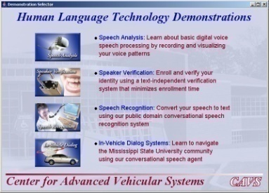
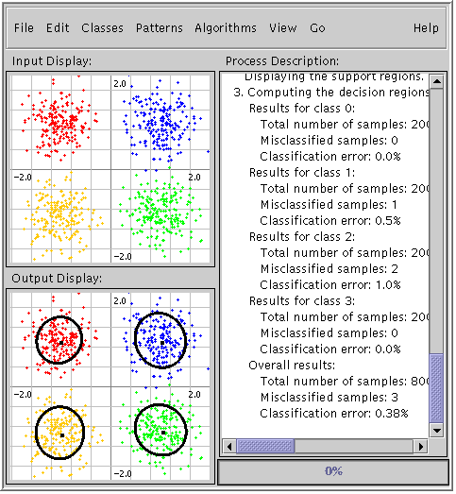
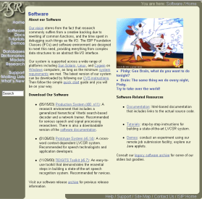
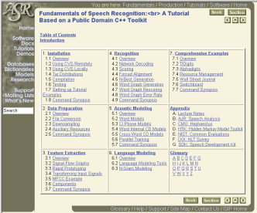
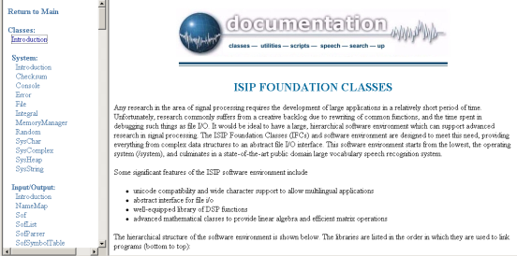


Appendix: Relevant Resources
Interactive Software: Java applets, GUIs, dialog systems, code generators, and more
Speech Recognition Toolkits: compare SVMs and RVMs to standard approaches using a state of the art ASR toolkit
Foundation Classes: generic C++ implementations of many popular statistical modeling approaches
Fun Stuff: have you seen our campus bus tracking system? Or our Home Shopping Channel commercial?

Slide 12
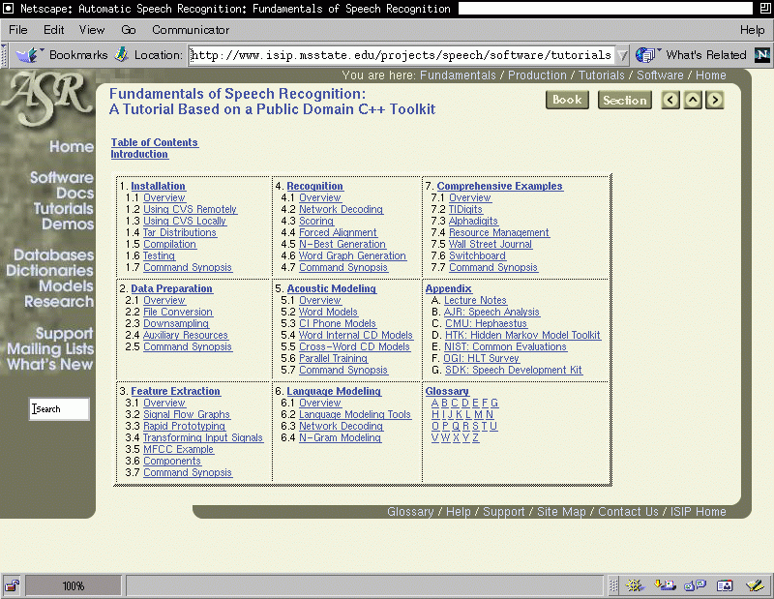
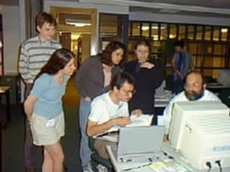
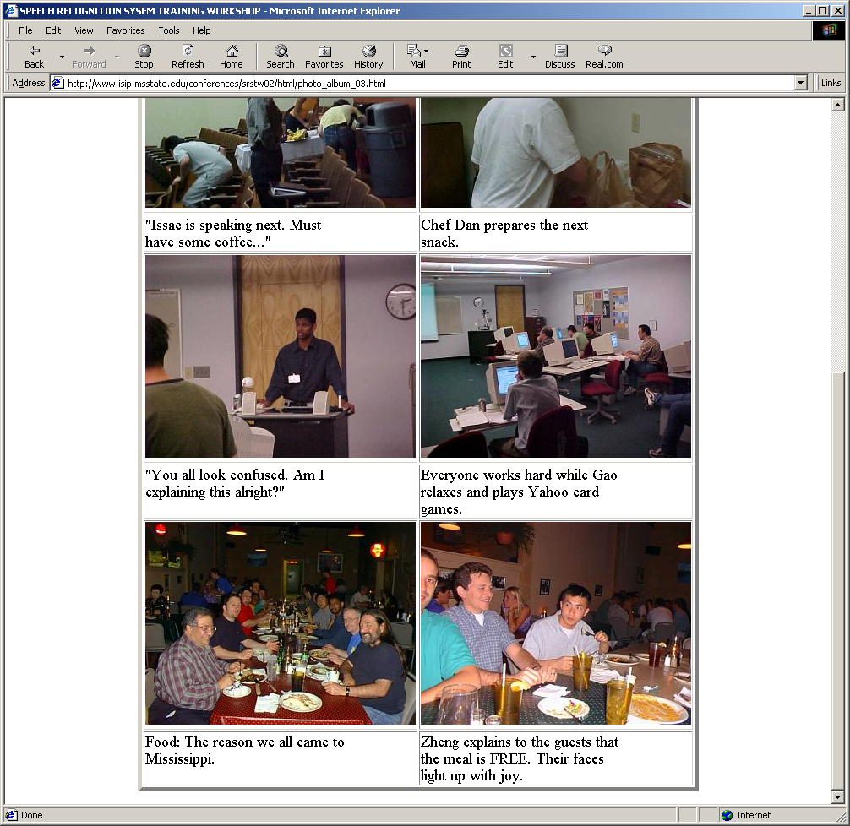
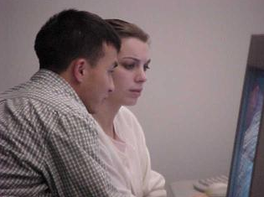
Appendix: ISIP Is More Than Just Software
Extensive online software documentation, tutorials, and training materials.
Extensive archive of graduate and undergraduate coursework.
Web-based instructional materials including demos and applets.
Self-documenting software.
Summer workshops at which students receive intensive hands-on training.
Jointly develop advanced prototypes in partnerships with commercial entities.
Provide consulting services to industry across a broad range of human language technology.
Commitment to open source.

Slide 13
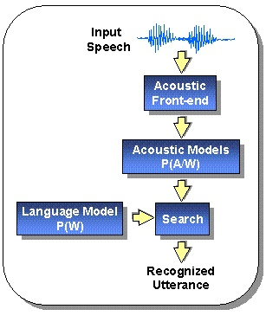
Appendix: Speech Recognition Architectures
Core components:
transduction
feature extraction
acoustic modeling (hidden Markov models)
language modeling (statistical N-grams)
search (Viterbi beam)
knowledge sources
Our focus has traditionally been on the acoustic modeling components of the system.

Slide 14
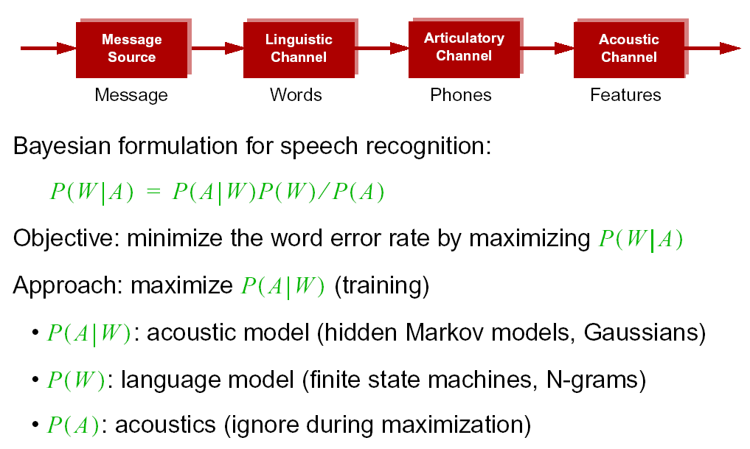
Appendix: Noisy Communication Channel Model

Slide 15
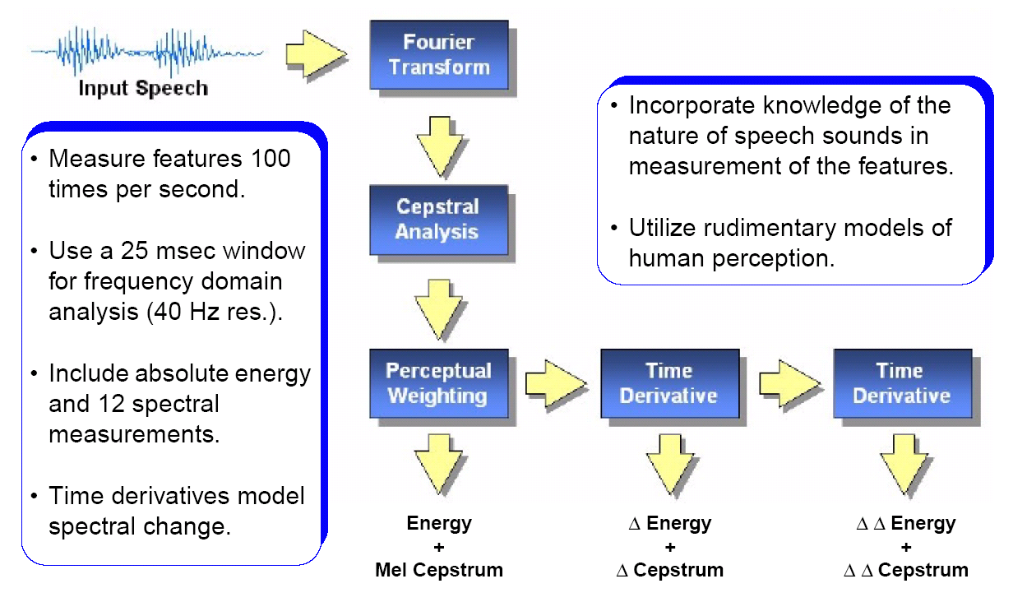
Appendix: Feature Extraction
A popular approach for capturing these dynamics is the Mel-Frequency Cepstral Coefficients (MFCC) “front-end:”
Notes:
]i=k,

Slide 16
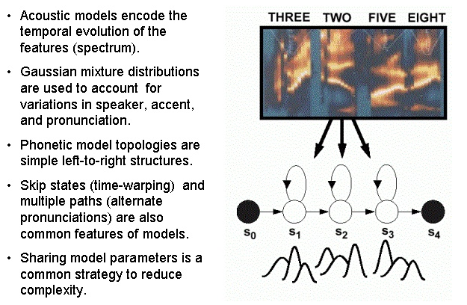
Appendix: Acoustic Modeling

Slide 17
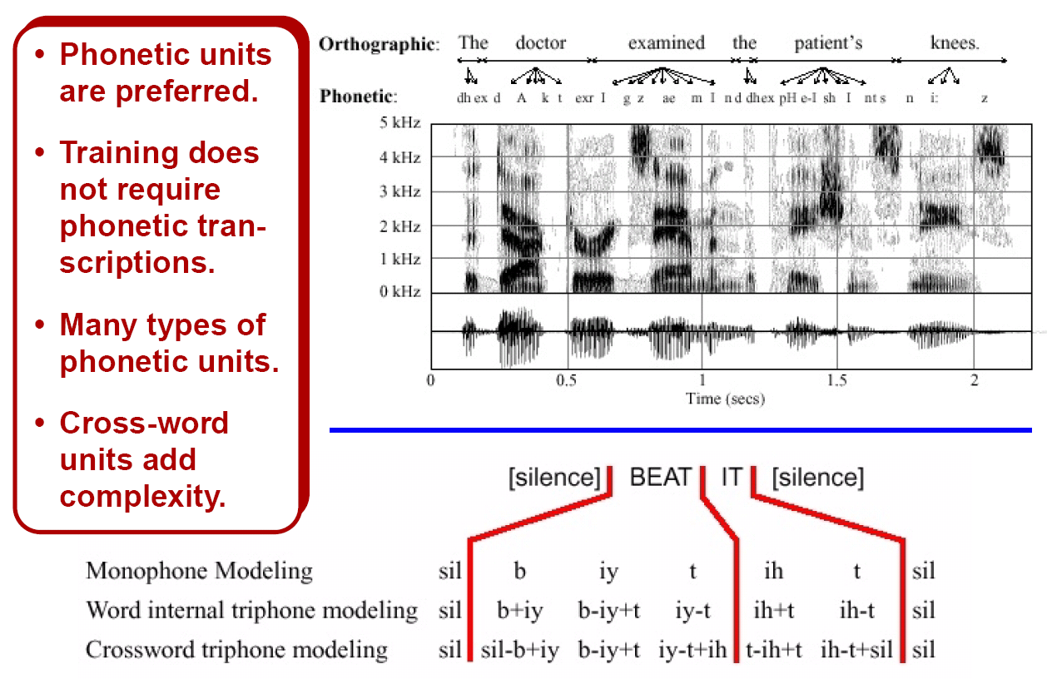
Appendix: Context-Dependent Phones

Slide 18
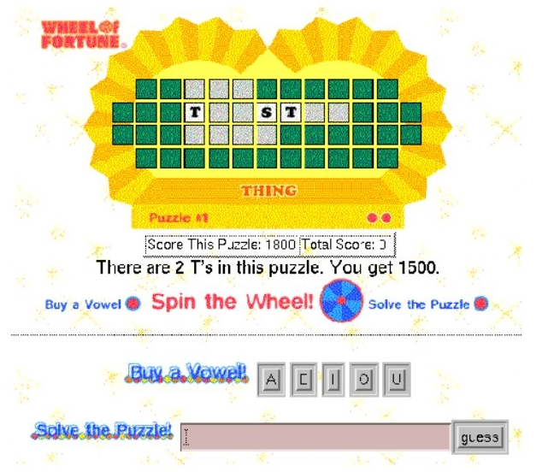
Appendix: Language Modeling

Slide 19
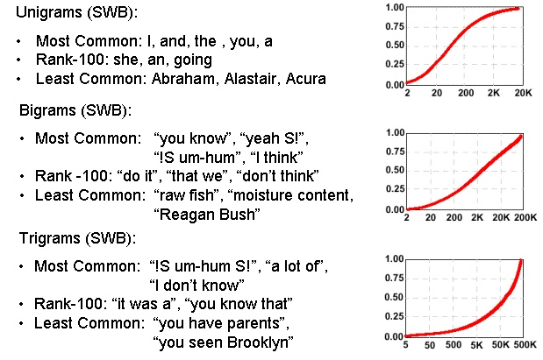
Appendix: Statistical N-gram Models

Slide 20
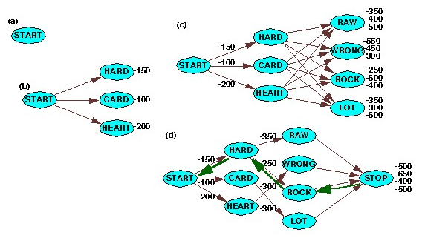
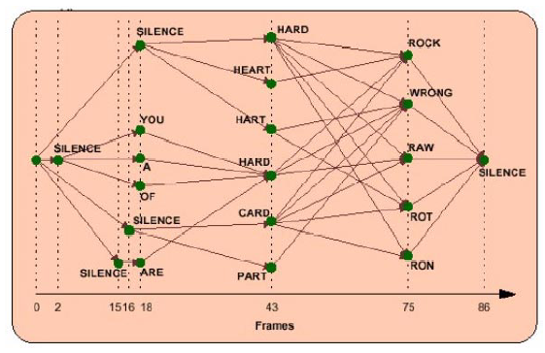
Appendix: Search Strategies
breadth-first
time synchronous
beam pruning
supervision
word prediction
natural language

Slide 21
Appendix: Evolution of Knowledge in HLT Systems
A priori expert knowledge created a generation of highly constrained systems (e.g. isolated word recognition, parsing of written text, fixed-font OCR).
Performance
Statistical methods created a generation of data-driven approaches that supplanted expert systems (e.g., conversational speech to text, speech synthesis, machine translation from parallel text).
… but that isn’t the end of the story …
Source of Knowledge
A number of fundamental problem still remain (e.g., channel and noise robustness, less dense or less common languages).
The solution will require approaches that use expert knowledge from related, more dense domains (e.g., similar languages) and the ability to learn from small amounts of target data (e.g., autonomic).

Slide 22

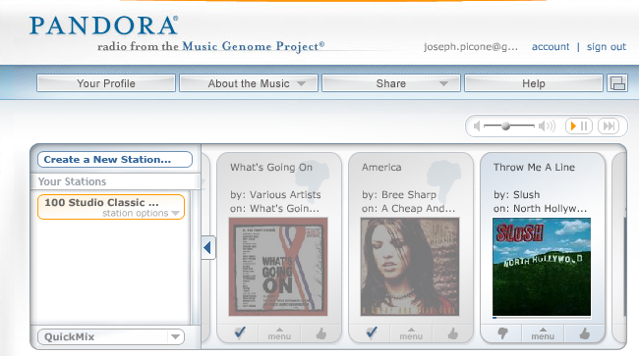
Appendix: Predicting User Preferences
These models can be used to generate alternatives for you that are consistent with your previous choices (or the choices of people like you).
Such models are referred to as generative models because they can generate new data spontaneously that is statistically consistent with previously collected data.
Alternately, you can build graphs in which movies are nodes and links represent connections between movies judged to be similar.
Some sites, such as Pandora, allow you to continuously rate choices, and adapt the mathematical models of your preferences in real time.
This area of science is known as adaptive systems, dealing with algorithms for rapidly adjusting to new data.

Slide 23
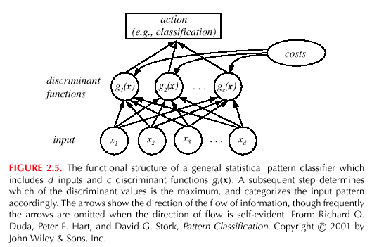
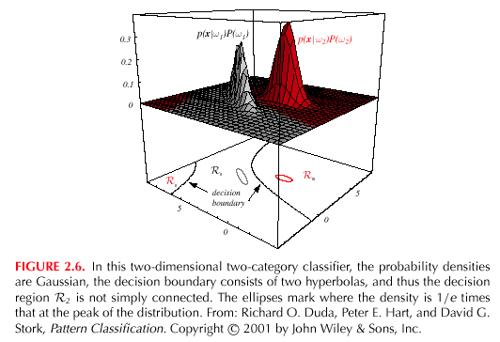
Appendix: Functional Mappings
A simple model of your behavior is:
The inputs, x, can represent names, places, or even features of the sites you visit frequently (e.g., purchases).
The weights, w_{j}, can be set heuristically
(e.g., visiting www.aljazeera.com is much more important than visiting www.msms.k12.ms.us).
The parameters of the model can be optimized to minimize the error in predicting your choices, or to maximize the probability of predicting a correct choice.
We can weight these probabilities by the a priori likelihood that the average user would make certain choices (Bayesian models).
Retail
Linear
Classifier
Newspapers

Slide 24
Appendix: Major ISIP Milestones
1994: Founded the Institute for Signal and Information Processing (ISIP)
1995: Human listening benchmarks established for the DARPA speech program
1997: DoD funds the initial development of our public domain speech recognition system
1997: Syllable-based speech recognition
1998: NSF CARE award for Internet-Accessible Speech Recognition Technology
1998: First large-vocabulary speech recognition application of Support Vector Machines
1999: First release of high-quality SWB transcriptions and segmentations
2000: First participation in the annual DARPA evaluations (only university site to participate)
2000: NSF funds a multi-university collaboration on integrating speech and natural language
2001: Demonstrated the small impact of transcription errors on HMM training
2002: First viable application of Relevance Vector Machines to speech recognition
2002: Distribution of Aurora toolkit
2002: Evolution of ISIP into the Institute for Intelligent Electronic Systems
2002: the “Crazy Joe” commercial becomes the most widely viewed ISIP document
2003: IIES joins the Center for Advanced Vehicular Systems
2004: NSF funds nonlinear statistical modeling research and supports the development of speaker verification technology
2004: ISIP’s first speaker verification system
2005: ISIP’s first dialog system based on our port to the DARPA Communicator system
2006: Automatic detection of fatigue
2007: Integration of nonlinear features into a speech recognition front end
2008: ISIP’s first keyword search system
2008: Nonlinear mixture autoregressive models for speech recognition
2008: Linear dynamic models for speech recognition
2009: Launch of our first commercial web site and associated business venture…

Slide 25
Biography
Joseph Picone received his Ph.D. in Electrical Engineering in 1983 from the Illinois Institute of Technology. He is currently a Professor in the Department of Electrical and Computer Engineering at Mississippi State University. He recently completed a three-year sabbatical at the Department of Defense where he directed human language technology research and development.
His primary research interests are currently machine learning approaches to acoustic modeling in speech recognition. For over 25 years he has conducted research on many aspects of digital speech and signal processing. He has also been a long-term advocate of open source technology, delivering one of the first state-of-the-art open source speech recognition systems, and maintaining one of the more comprehensive web sites related to signal processing. His research group is known for producing many innovative educational materials that have increased access to the field.
Dr. Picone has previously been employed by Texas Instruments and AT&T Bell Laboratories, including a two-year assignment in Japan establishing Texas Instruments’ first international research center. He is a Senior Member of the IEEE and has been active in several professional societies related to human language technology. He has authored numerous papers on the subject and holds 8 patents.

