Slide 1
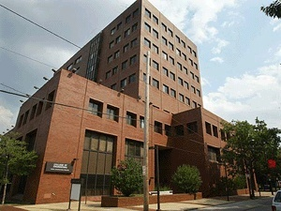



WHY STUDY ENGINEERING AT TEMPLE?
Outline:
• What is an engineer?
• Who is an engineer?
• Why be an engineer?
Why Temple engineering?
Engineering @ Temple
Joseph Picone, PhD
Professor and Chair, Department of Electrical and Computer Engineering
College of Engineering
Temple University
URL:

Slide 2



What is an engineer?
Webster’s Dictionary:
Main Entry: ¹en·gi·neer
Pronunciation: \ˌen-jə-ˈnir\
Function: noun
Etymology: Middle English engineour, from Anglo-French, from enginer to devise, construct, from engin
Date: 14th century
1 : a member of a military group devoted to engineering work
2 obsolete : a crafty schemer : plotter
3 a : a designer or builder of engines …

Slide 3








Who is an engineer?
Leonardo Da Vinci
1452 – 1519
Thomas Edison
1847 – 1931
Hedy Lamarr
1914 - 2000
Scott
Adams
Jimmy
Carter
Cindy
Crawford
Herbie
Hancock
Judith
Resnick

Slide 4
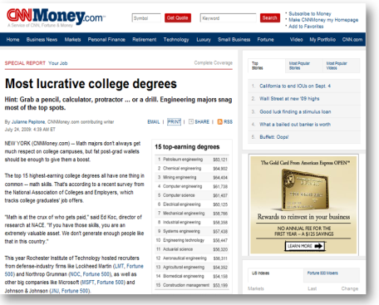


Why be an engineer?
Rankings of the highest-paid jobs, both in terms of salary and fulfillment, are dominated by engineering.
Engineering salaries are holding up well compared to medicine, law and architecture in the current economy.
Engineers work on the world’s biggest and hardest problems.
Engineers make the world a better place.
Engineers make things work.
Engineers change the world.

Slide 5


Why Temple engineering?
Best of both worlds: small college feel within a large, public, urban university.
Value: tuition is comparatively low; quality is high.
Diversity: cultural and academic diversity fosters creativity and innovation.
Multidisciplinary: academic program emphasizes a common core across all engineering disciplines and a shared design experience.
Involvement: students are known for their involvement in professional and social causes.
Jobs: internships, coop, campus employment, job fairs, career services and a strong alumni network are just a few of the tools we use to help students find good jobs.

Slide 6

Engineering @ Temple University
Department of Bioengineering: specialties include biomechanics, biomaterials and bioelectronics (new).
Department of Civil and Environmental Engineering: includes areas such as construction, environmental, geotechnical, structural, and transportation.
Construction Management Technology: prepares a student for a practitioner's role in construction engineering and management.
Department of Electrical and Computer Engineering: including options in electrical, computer and bioelectrical engineering.
Engineering Technology: prepares students for practice in a variety of areas including construction, environment , computer, energy and mechatronics.
Department of Mechanical Engineering: includes options in bioengineering and energy systems. Also manages our general engineering technology curriculum.

