Slide 1
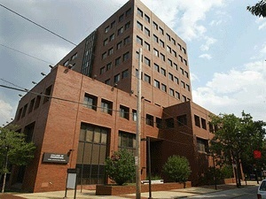

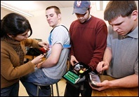
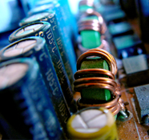
THE DEPARTMENT OF
ELECTRICAL AND COMPUTER ENGINEERING
Outline:
• ECE At a Glance
Graduate Program Overview
Research Clusters
Collaborations
Facilities
Research Labs
Joseph Picone, PhD
Professor and Chair, Department of Electrical and Computer Engineering
College of Engineering
Temple University
URL:

Slide 2
ECE at a Glance
Faculty By Rank:
Three degree options: EE, CpE, BioE
Students By Degree Option (08-09):
Track | Full | Assoc | Assist | Total
TT | 6 | 4 | 2 | 12
NTT | 0 | 1 | 0 | 1
Res. | 1 | 0 | 0 | 1
Adj. |  |  |  | 9
Staff |  |  |  | 2
TOTAL |  |  |  | 25
Degree | Enrolled | Graduated
BS: EE CpE BioE | 210 195 15 0 | 23 18 5 0
MS: EE CpE BioE | 60 58 0 2 | 20 19 0 1
PhD: EE CpE BioE | 10 7 0 3 | 1 1 0 0
Total: | 280 | 44
Faculty By Area of Specialization:
Area | Full | Assoc | Assist
Biomedical |  | 1 | 1
Intelligent Systems | 3 | 1 | 1
Controls | 3 | 1 | 1
Devices and Materials | 1 | 1
Energy | 1

Slide 3
ECE Graduate Program
Clustered into three general areas: Signals, Controls and Hardware.
All students are required to take four core courses: Engineering Analysis (5022), Probability and Random Processes (5033), Digital Signal Processing (5514) and Introduction to Computer Architectures (EE 5622 ).
Computer Engineering
5612: Advanced Microprocessor Systems
5516: Intro. Communication Networks
5622: Intro. Computer Architecture
8516: Performance of Communications Ntwks
8622: Advanced Computer Architectures
9622: Parallel Processing Architectures
Controls
5412: Control System Analysis
8412: Optimal & Robust Control
8414: Adaptive Control
8512: Signal Processing and Control Theory
9412: Nonlinear Control Systems
Intelligent Systems
5712: Intelligent Multimedia Systems
5714: Intro. Intelligent Systems
Microelectronics
5314: Microelectronics
5324: VLSI Systems Design
8324: Mixed Signal VLSI Design
8334: Nano Applications, MEMS and NEMS
9324: VLSI Phys. Design
Signal Processing and Communications
5512: Analog and Digital Communication
5514: Digital Signal Processing
8514: Digital Signal Processing
8524: Speech Signal Processing
8999: Electro-optics
9512: Detection Estimation
9514: Adaptive Signal Processing
9524: Digital Image Processing

Slide 4
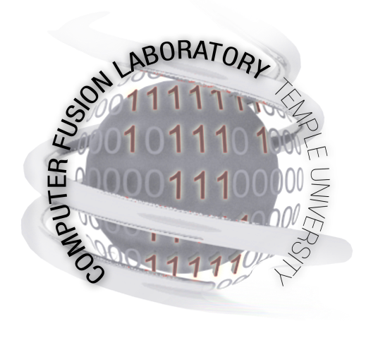
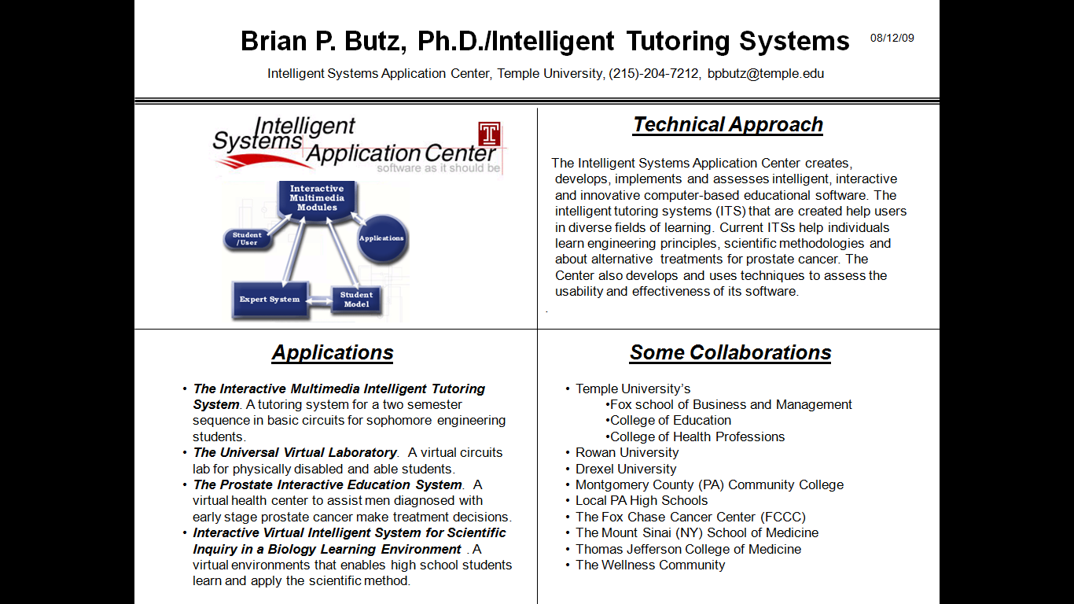
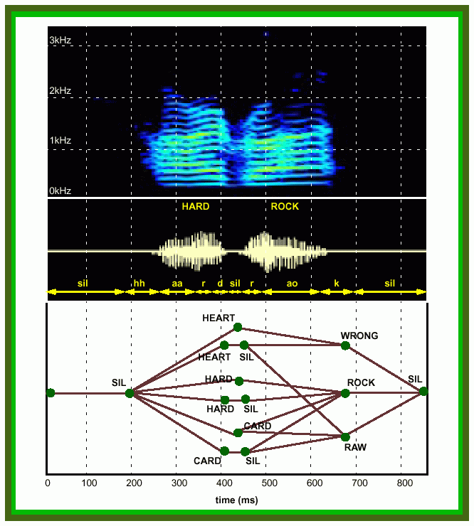
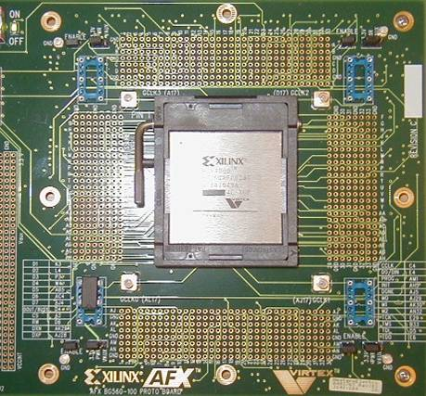
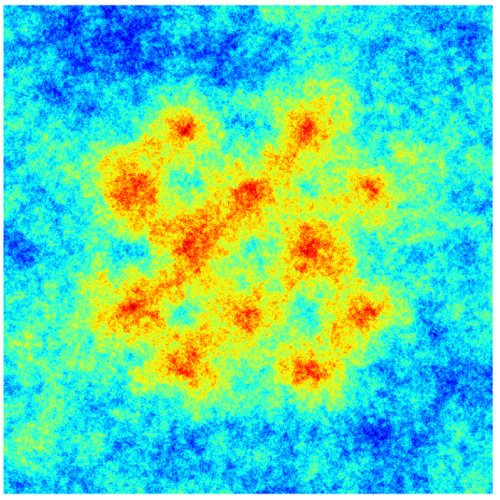
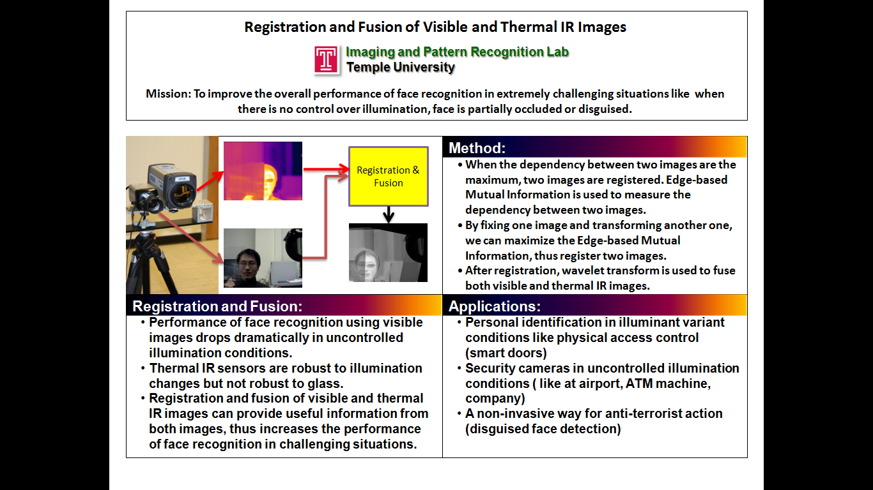
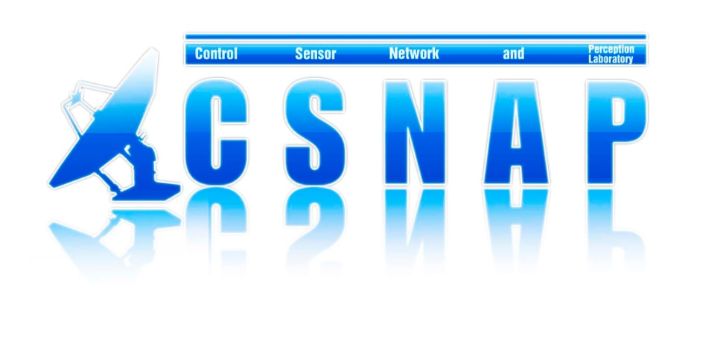
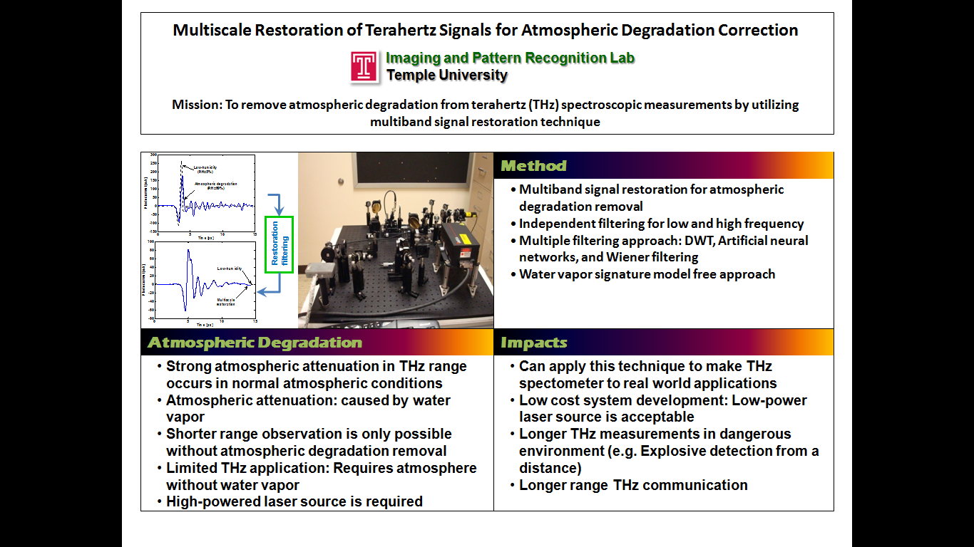
Research Thrusts
Intelligent Systems: multi-agent systems, tutoring systems, human language technology
Devices and Interfaces: system chip design, FPGAs, brain-machine interfaces
Sensors, Imaging and Control: navigation, game theory, thermal imaging, signal restoration

Slide 5
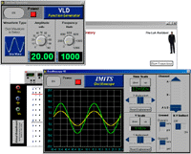
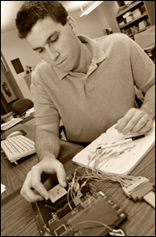

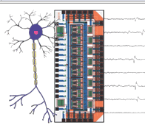
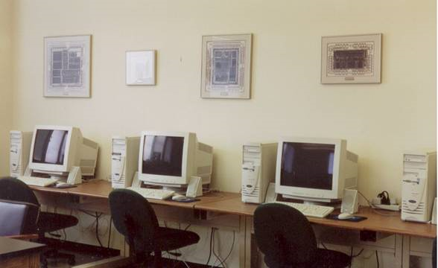
Facilities
Laboratory Space:
Unique Capabilities:
Universal Virtual Lab
Neural Instrumentation Laboratory
Multi-agent Systems Test Lab
System Chip Design
Robotics and Atmospheric Testing
Image Processing System Development
Sensors, Networks and Devices
Speech Processing
Type | Sqft
Offices | 2,966
Instructional Labs | 5,303
Research Labs | 3,565
TOTAL | 11,834

Slide 6
Collaborative Activities
Research Expenditures: $453K (2008-09)
Major Sponsors: Air Force, Boeing, Department of Defense, Exxon Mobil, National Institute of Health, National Science Foundation, NAVAIR, Naval Research Laboratory, Oakridge National Laboratory
Major Internal Collaborators: College of Health Professions, College of Science and Technology, Fox Business School, School of Dentistry
Major External Collaborators: The Mount Sinai School of Medicine, The Fox Chase Cancer Center, The Pennsylvania Department of Health, University of Tennessee, University of Pennsylvania, Drexel University, Villanova University, Rowan University
Outreach: Montgomery County (PA) Community College, High School of Engineering and Science, Council Rock HS North/South, Springfield (Delaware County, PA) HS; Developing NSF REU Site proposal
Major Industrial Partners: The Navy Shipyards, Lockheed Martin, Boeing, Exxon Mobil, Southeastern Pennsylvania Transit Authority (SEPTA)
Professional Development: Hosting the 2010 IEEE Student Activities Conference, ASEE workshops on computer engineering and communications

Slide 7
Future Plans
Five-Year Plan:
Increase research expenditures to $5M/yr. ($300K/faculty x 18 faculty)
Increase faculty size to 18 to accommodate growth in research
Increase total space to 30,000 sqft (including new research space)
Moderate growth in UG enrollment (10% per year)
Significant growth in the PhD program (50 PhD students in 2015)
Approach:
Differentiate the department through focus and collaboration
Pursue major research center and institute initiatives
Improve relationships with local industry
Create regional partnerships with major state universities
Potential areas of focus:
Environment and sustainability
Intelligence and cybersecurity
Renewable energy

Slide 8
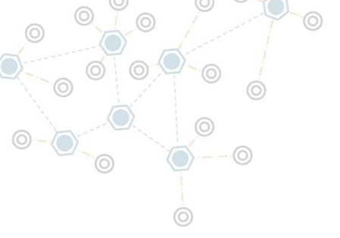
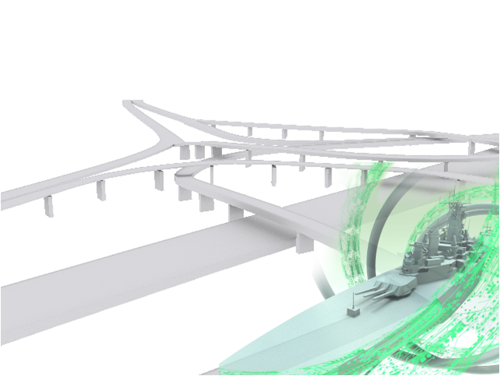
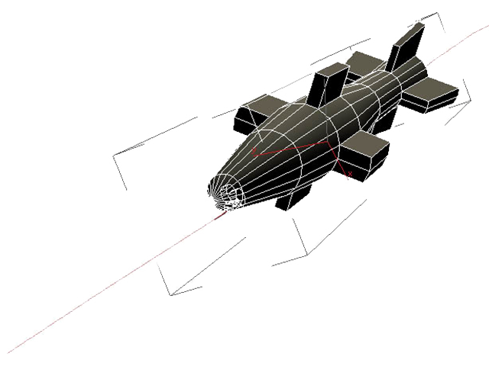
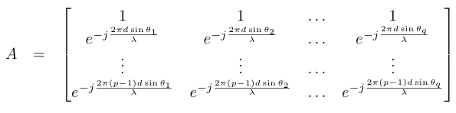



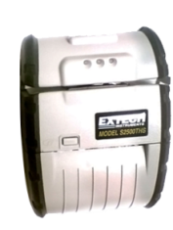
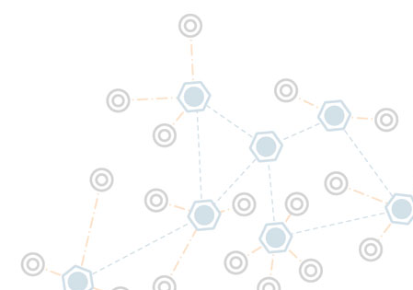
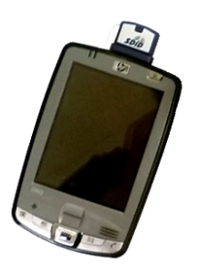
Initiative for
Computer Fusion Laboratory
Mission: CFL is a research group that focuses on cutting edge technology and promotes fundamental theories in computer and data security, communication and information processes. Our work focuses on areas ranging from military applications and sensor systems to transportation and oil refinery applications.
Specialized Infrastructure, Facilities, Systems:
  Interactive 3D simulation environment design
  Widely used image processing and modeling software
  Communication prototyping with HSPA (3G+) and Bluetooth wireless
  Close collaboration with the Office of Naval Research (ONR), South Eastern Pennsylvania Transportation Authority (SEPTA) and ExxonMobil
Expertise:
  Dynamic data and model Analysis of large scale systems
  Intelligent system design using Multi-Agent systems
  Embedded wireless sensor networks
  Information assurance and data security
  Level 2+ information fusion
  Software development for mobile and handheld platforms
  Stochastic process video tracking
  Image steganographic processing
  System reliability, fault detection and prognostics
Impact:
  Flexible electronic mobile ticketing and payment platform
  Large-scale, dynamic autonomous monitoring
  Efficient and Robust target tracking and trajectory estimation processes
  Distributed computation for secure, reliable mobile wireless devices
  Advanced system integration with open source software and COTS products
  Secure information archiving and access control using distributed information hiding

Slide 9
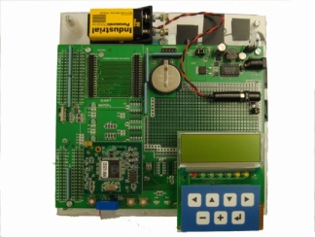
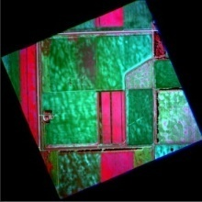

Control, Sensor, Network, and Perception (CSNAP) Laboratory
Director: Chang-Hee Won
Electrical and Computer Engineering, Temple University, Engineering Building 703
Mission: To advance the areas of control and sensor systems and apply to real world applications.
Control System Theory:
  Statistical Optimal Control
  Game Theory
  Minimal Cost Variance Control
  Risk-Sensitive Control
Sensors:
  Navigation Sensors
  Tactile Sensors
  Remote Sensing
  Hyperspectral Sensor
Applications:
  Satellite Control
  Navigation Data Fusion
  Building Control
  Parafoil Control
  Space Robotics

Slide 10
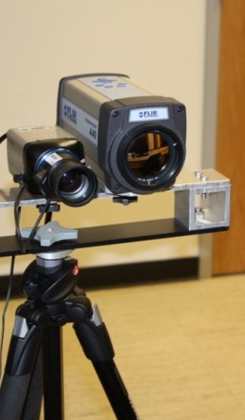
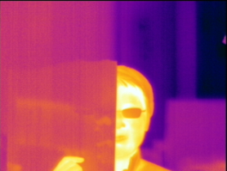

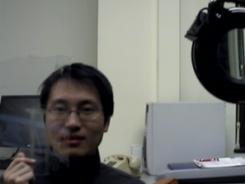
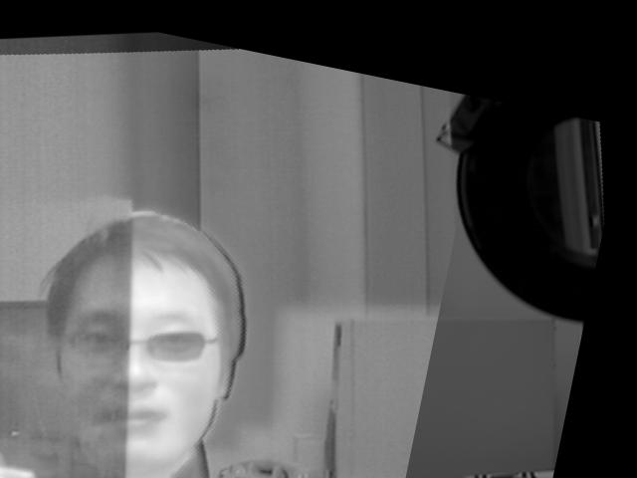
Registration and Fusion of Visible and Thermal IR Images
Mission: To improve the overall performance of face recognition in extremely challenging situations like when there is no control over illumination, face is partially occluded or disguised.
Imaging and Pattern Recognition Lab
Temple University
Method:
  When the dependency between two images are the maximum, two images are registered. Edge-based Mutual Information is used to measure the dependency between two images.
  By fixing one image and transforming another one, we can maximize the Edge-based Mutual Information, thus register two images.
  After registration, wavelet transform is used to fuse both visible and thermal IR images.
Method:
Registration & Fusion
Rgistration and Fusion:
  Performance of face recognition using visible images drops dramatically in uncontrolled illumination conditions.
  Thermal IR sensors are robust to illumination changes but not robust to glass.
  Registration and fusion of visible and thermal IR images can provide useful information from both images, thus increases the performance of face recognition in challenging situations.
Registration and Fusion:
Applications:
  Personal identification in illuminant variant conditions like physical access control (smart doors)
  Security cameras in uncontrolled illumination conditions ( like at airport, ATM machine, company)
  A non-invasive way for anti-terrorist action (disguised face detection)
Applications:

Slide 11
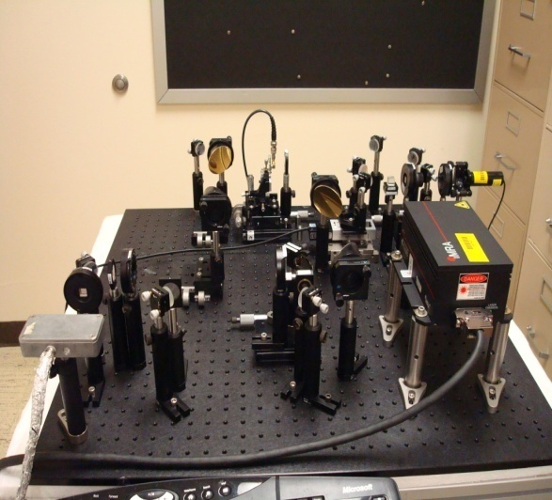
Multiscale Restoration of Terahertz Signals for Atmospheric Degradation Correction
Mission: To remove atmospheric degradation from terahertz (THz) spectroscopic measurements by utilizing multiband signal restoration technique
Imaging and Pattern Recognition Lab
Temple University
  Multiband signal restoration for atmospheric degradation removal
  Independent filtering for low and high frequency
  Multiple filtering approach: DWT, Artificial neural networks, and Wiener filtering
  Water vapor signature model free approach
Method
Restoration
filtering
Atmospheric Degradation
  Strong atmospheric attenuation in THz range occurs in normal atmospheric conditions
  Atmospheric attenuation: caused by water vapor
  Shorter range observation is only possible without atmospheric degradation removal
  Limited THz application: Requires atmosphere without water vapor
  High-powered laser source is required
Impacts
  Can apply this technique to make THz spectometer to real world applications
  Low cost system development: Low-power laser source is acceptable
  Longer THz measurements in dangerous environment (e.g. Explosive detection from a distance)
  Longer range THz communication

Slide 12

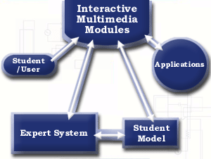
Brian P. Butz, Ph.D./Intelligent Tutoring Systems
Intelligent Systems Application Center, Temple University, (215)-204-7212, bpbutz@temple.edu
08/12/09
Technical Approach
The Intelligent Systems Application Center creates, develops, implements and assesses intelligent, interactive and innovative computer-based educational software. The intelligent tutoring systems (ITS) that are created help users in diverse fields of learning. Current ITSs help individuals learn engineering principles, scientific methodologies and about alternative treatments for prostate cancer. The Center also develops and uses techniques to assess the usability and effectiveness of its software.
.
Applications
Some Collaborations
The Interactive Multimedia Intelligent Tutoring System. A tutoring system for a two semester sequence in basic circuits for sophomore engineering students.
The Universal Virtual Laboratory. A virtual circuits lab for physically disabled and able students.
The Prostate Interactive Education System. A virtual health center to assist men diagnosed with early stage prostate cancer make treatment decisions.
Interactive Virtual Intelligent System for Scientific Inquiry in a Biology Learning Environment . A virtual environments that enables high school students learn and apply the scientific method.
Temple University’s
  Fox school of Business and Management
  College of Education
  College of Health Professions
Rowan University
Drexel University
Montgomery County (PA) Community College
Local PA High Schools
The Fox Chase Cancer Center (FCCC)
The Mount Sinai (NY) School of Medicine
Thomas Jefferson College of Medicine
The Wellness Community

Slide 13
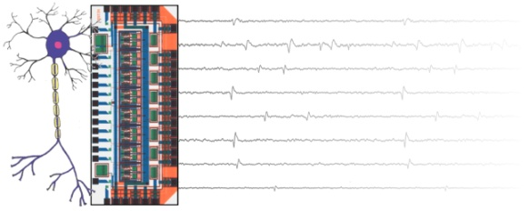
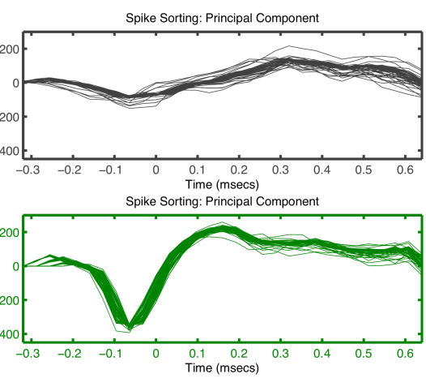
Neural Instrumentation Lab
PI: Dr. Iyad Obeid
Mission: To fundamentally enhance capabilities for recording, manipulating, and decoding neural signals in real-time through signal processing technology.
Specialized Infrastructure, Facilities, Systems:
  System infrastructure for modeling various neural signal processing approaches
  Functional closed-feedback model of adaptive neural circuitry (hybrid robotic/computational)
  Rapid prototyping and development of programmable hardware instrumentation (with Temple’s System Chip Design Center)
Expertise:
  Brain Machine Interfaces
  Biomedical signal processing
  Biomedical instrumentation
  Neural Engineering
  Neural Systems Modeling
  Adaptive neural signal decoding
  Signal processing in customizable programmable hardware
Impact:
  Establish optimal approaches for information extraction and estimation in real-time brain machine interfaces
  Develop real-time processing strategies for multichannel neural signal processing
  Enhance real-world rehabilitative capabilities of brain-machine interfaces
  Develop tools for decoding the language of neural signals

Slide 14

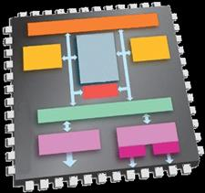
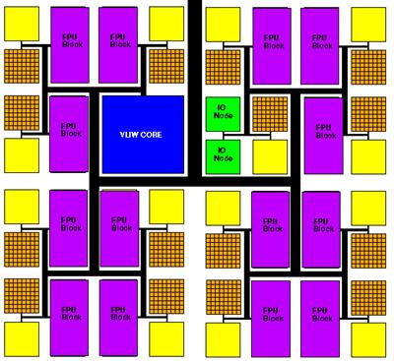
System Chip Design Laboratory
www.temple.edu/scdc
Mission: To facilitate the rapid design of complex digital systems, digital signal and image processing, digital communications, and advanced processor systems in field programmable gate array (FPGA) reconfigurable architectures utilizing behavioral analysis and synthesis.
Specialized Infrastructure, Facilities, Systems:
  Xilinx Integrated Synthesis Environment (ISE)
  Xilinx Spartan and Virtex FPGA target hardware
  MATLAB/Xilinx System Generator for hardware in the loop design
  Xilinx ChipScope latency and functional verification
  Xilinx LogiCORE application and development
  Xilinx soft core processors and peripherals
Expertise:
  Digital communication systems: MIMO, channel equalization, synchronization, Turbo coding
  Algorithm transformation to parallel processing architectures
  High-speed (Xilinx RocketIO) data communication
  Software defined radio and cognitive radio development
  Multiple channel neural signal correlation and processing
Impact:
  Low power, real-time digital signal processing in reconfigurable FPGA architectures
  Cost effective replacement of discrete microprocessor and peripheral systems with FPGA system-on-chip
  Professionals with experience in digital signal processing and communications and FPGA hardware

Slide 15

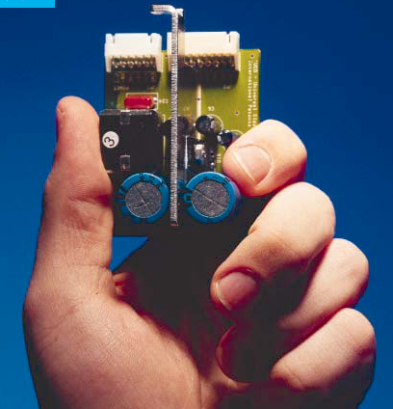
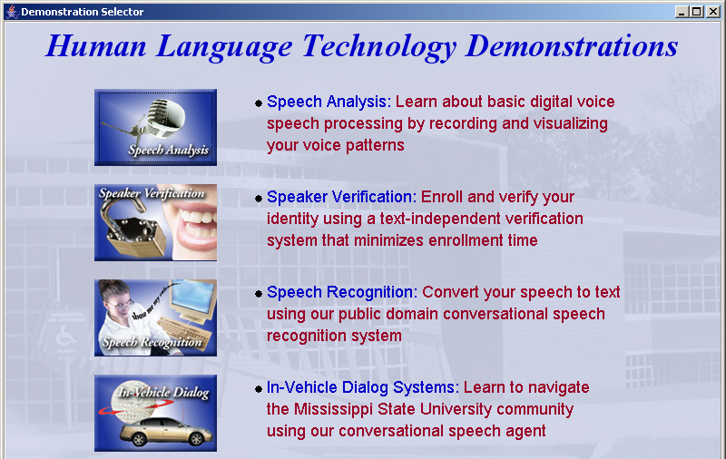
Information and Signal Processing
Mission: Automated extraction and organization of information using advanced statistical
models to fundamentally advance the level of integration, density, intelligence and performance
of electronic systems. Application areas include speech recognition, speech enhancement and biological systems.
Impact:
  Real-time information extraction from large audio resources such as the Internet
  Intelligence gathering and automated processing
  Large-scale autonomous monitoring in a rapid deployment, zero-installation cost framework
  Next generation biometrics based on nonlinear statistical modeling of signals
Expertise:
  Speech recognition and speaker verification for homeland security applications
  Metadata extraction for enhanced understanding and dialog
  Intelligent systems and machine learning
  Wireless communications for intelligent transportation systems
  Computer and communications networking

