Slide 1
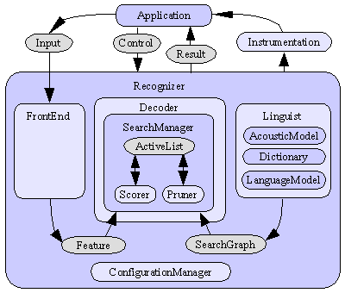
Speech Recognition using Sphinx 4 (Project Ti Digits)
Mubin Amehed, Jaykrishna shukla & cara
Department of Electrical and Computer Engineering
Temple University
URL:

Slide 2
Basic structure of sphinx 4
There are Three main parts to any speech recognizer. Namely:
1. Front end : it performs the digital signal processing task on the input signal
2. Language module: it is the domain for the speech recognizer. It contains a dictionary of all the possible words, that the recognizer is suppose to recognize.
3. Search graph: The graph structure produced by the linguist according to certain criteria (e.g., the grammar), using knowledge from the dictionary, the acoustic model, and the language model.

Slide 3
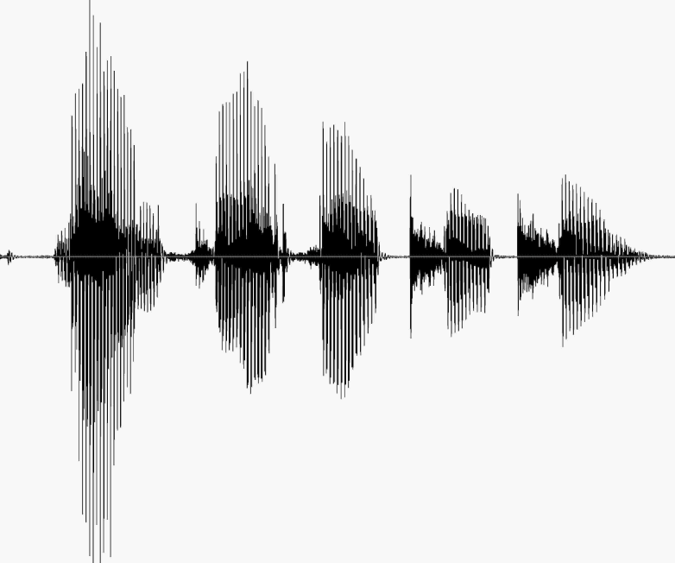
Introduction & Goals
Sphinx 4 is a speech recognizer written completely in java
The two fundamental goals for this week were:
1. To demonstrate the ability of building sphinx in Eclipse.
2. To build an application to recognize Ti digits.

Slide 4
Little background on Ti digits & our Mission
The TI Digits database was one of the first publicly available databases used in speech research. It was collected at Texas Instruments in the early 1980's
In this project we modified the previous mentioned modules, so that the raw audio input file for the ti digits (audio file I created with numbers 0 to 9) is recognized by the sphinx 4 recognizer.
Our goal for this week was to Analyze Sphix 4.1 recognizer to implement ISIP style sound recognizer that was developed in c++

Slide 5
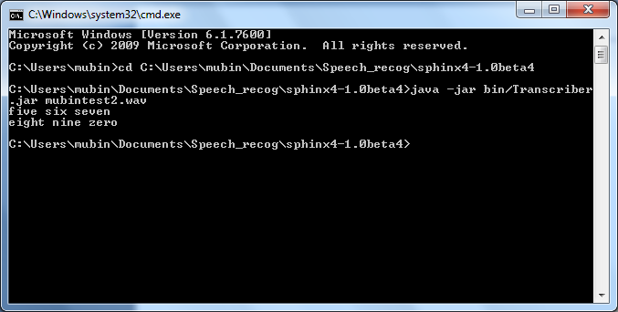
Ti digit 5 6 7 8 9 0 recorded in WAV format
The Sphinx 4.1 recognizer transcribes the TI digits in Audio file

Slide 6
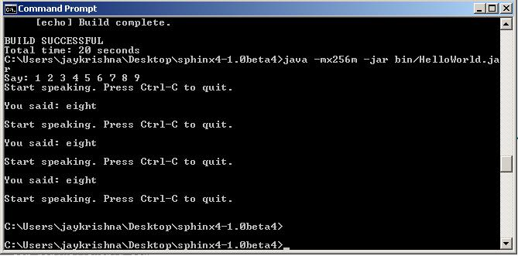
Procedures used to transcribe live audio input
The following Steps were performed in order to run and recognize the spoken TI digit :
1. The first step was to modify the grammar file (language module) of the “Hello world” demo program by adding the list of spelled out numbers from o to 9.
2. Next we ran the program from command line.

Slide 7
Results
Sphinx 4.1 in Java has efficient recognizer, even though rumors were java based sound recognizer are slow.
Application are easy to build on Sphinx

Slide 8
Future Directions
How do we get better?
Since this was the first week and the research material was relatively new, we spend most of the time in getting complete understanding of the theory and the related coding. However, from next week we are going to actually start creating and initiating the grammar files, the configuration files.
This will give us better understanding and confidence to work on different applications on sphinx 4.

