Slide 1
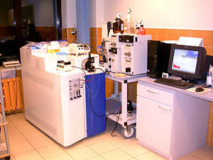
MASS SPECTROMETRY
FURTHER INVESTIGATIONS
Ilyana Mushaeva and Amber Moscato
Department of Electrical and Computer Engineering
Temple University

Slide 2
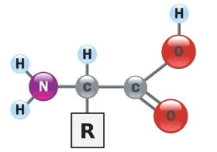
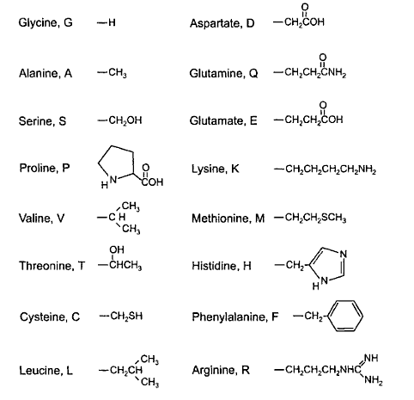
The primary structure of proteins
The general structure of an amino acid has four groups.
A central carbon atom with an attached hydrogen
A primary amine group
A carboxylic acid group
R-group
Differences in the structure of this R-group create the differences in the structure of the various amino acids

Slide 3
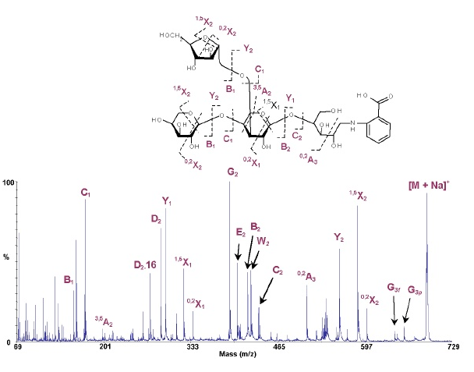
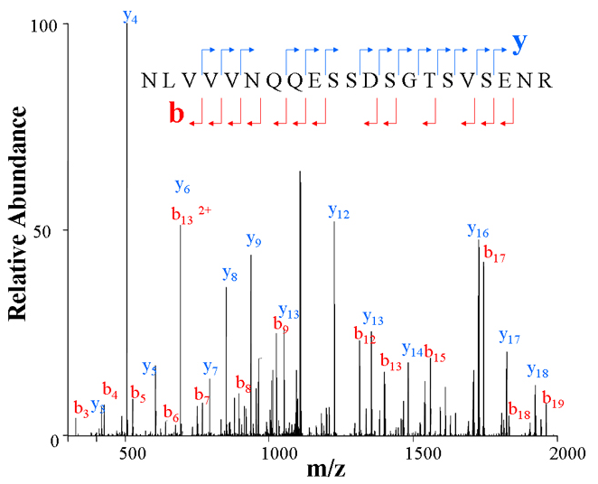
Mass Spectra
A fundamental property of proteins is that they are all composed of the same 20 amino acids.
The critical difference among proteins is the order or sequence in which those 20 amino acids are connected.

Slide 4
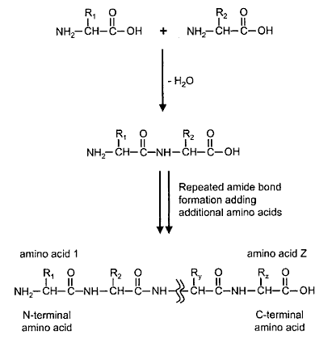
The formation of a protein
The reactions that are incorporating amino acids into a protein by amine bonds.
The formation of each bond is accompanied by loss of a water molecule.
Amino acid sequences are presented so that the first amino acid has contributed only a carboxylic acid group to an amide bond, leaving its amine group free.
This amino acid is referred to as the N-terminus of the protein.
The last amino acid in a protein sequence is C-terminus of the protein.

Slide 5
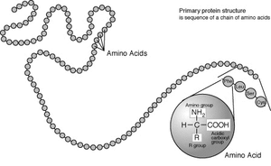
Peptides and Proteins Developed
Ten peptides, consisted of eight Amino Acids with different m/z ratios
Pep1 | Pep2 | Pep3 | Pep4 | Pep5 | Pep6 | Pep7 | Pep8 | Pep9 | Pep 10
1,2,3 | 2,3,4 | 3,4,5 | 4,5,6 | 5,6,7 | 6,7,8 | 7,8,8 | 8,2,3 | 6,6,1 | 4,1,5
Eight proteins, consisted of five peptides above
Protein1 | Protein2 | Protein3 | Protein4 | Protein5 | Protein6 | Protein7 | Protein8
1,2,3,4,5 | 2,3,4,5,6 | 3,4,5,6,7 | 4,5,6,7,8 | 5,6,7,8,9 | 6,7,8,9, 10 | 2,7,8,9, 10 | 5,7,8,9, 10

Slide 6
Protein Models

Slide 7
Brief Bibliography
M. Kinter and N. E. Sherman. Protein Sequencing and Identification using Tandem Mass Spectrometry. Wiley-Interscience. 2000.

