Slide 1
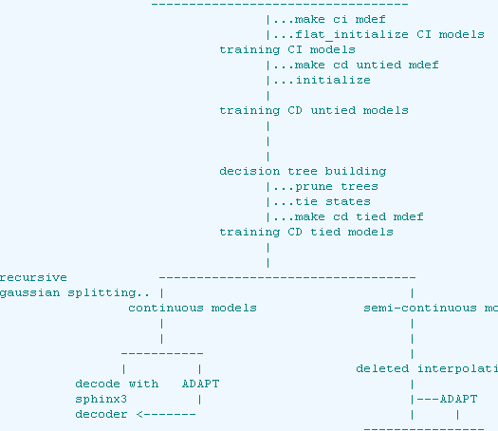
Training Acoustic Models Using SphinxTrain
Jaykrishna Shukla, Mubin Amehed, and Cara Santin
Department of Electrical and Computer Engineering
Temple University
URL:

Slide 2
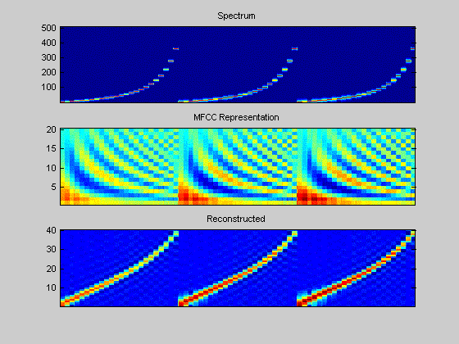
Goals
To complete the training process.
To Train using the ISIP like setup.
Learn the Lexicon file.
Understand the steps in generating ci phone models

Slide 3
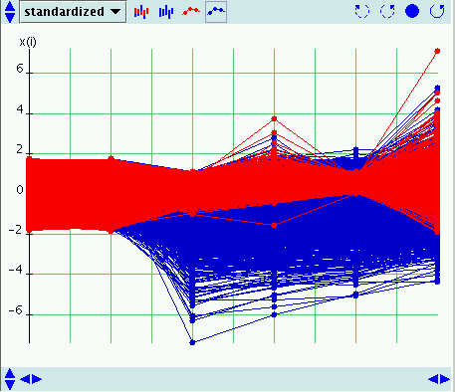
Introduction to Ci Phone models
Last week we generated the feature vectors and now we need the models for ci phones. Again the features are needed to distinguish between words and phones.
What is ci phone models?
Ci phone models are phone models that do not consider the influence of surrounding phonemes on the pronunciation of a given phoneme.

Slide 4
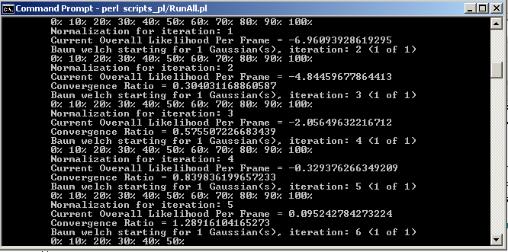
Process of generating the Ci phone models
. Sphinx Train uses a technique of initialization called flat initialization.
. Flat initiation is a simple and effective technique used to initialize an acoustic model. It computes the global mean variance from the training data and sets the model parameters to these values.
After running the ci model script the a model def file for the the ci models are created.
Similar process is repeated for cd models (cd models are more accurate)

Slide 5
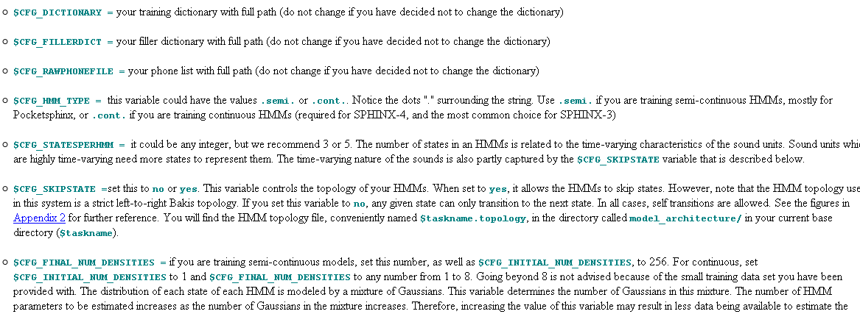
Parameter specifications
Feature vector: 13 dimensional
Gaussian iteration: 10 for ci models 5 for cd models and 8 iteration for the tied models.
Gaussian splitting per state can be a multiple of 2 up till 8
Other parameters

Slide 6
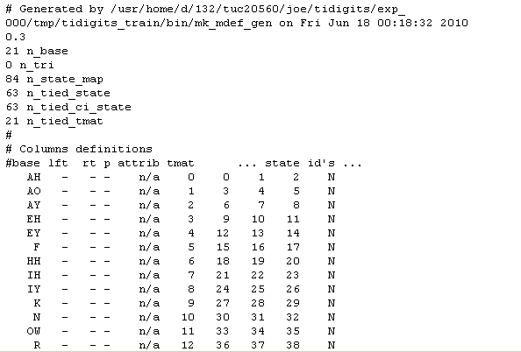
This weeks accomplishment
The following is the model architecture of the ci acoustic models

Slide 7
Future plan (today)
To use the acoustic model generated with Sphinx 4 decoder and get a WER .
To do training using a setup similar to ISIP

