Slide 1
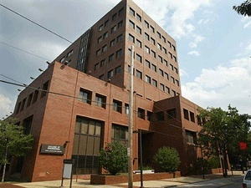
WHY STUDY ENGINEERING AT TEMPLE?
Outline:
Engineering @ Temple
Why Temple engineering?
Engineering by discipline
Things to remember
Joseph Picone, PhD
Professor and Chair, Department of Electrical and Computer Engineering
College of Engineering
Temple University

Slide 2
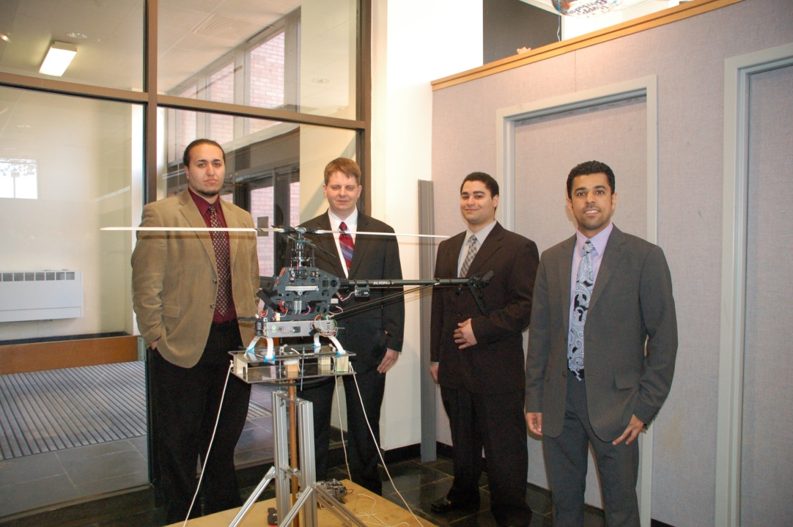
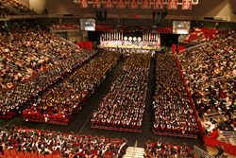
First, a paid commercial advertisement…
It is never too early to start thinking about senior design!
Graduation (and senior design) will arrive much faster than you think.

Slide 3
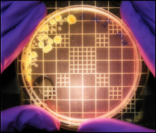
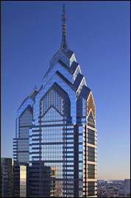
Engineering @ Temple University
Department of Bioengineering: areas such as biomechanics, biomaterials and bioelectronics (a new department).
Department of Civil and Environmental Engineering: areas such as environmental, structural, and transportation.
Department of Electrical and Computer Engineering: areas such as electrical, computer and bioelectrical.
Department of Mechanical Engineering: areas such as mechanical design, renewable energy and materials.
Construction Management Technology: prepares a student for a practitioner's role in construction engineering and management.
Engineering Technology: prepares students for practice in a variety of areas including the environment and energy.

Slide 4
Why Temple engineering?
Best of both worlds: small college feel within a large, public, urban university.
Value: tuition is comparatively low; quality is high.
Diversity: cultural and academic diversity fosters creativity and innovation.
Multidisciplinary: academic program emphasizes a common core across all engineering disciplines and a shared design experience.
Involvement: students are known for their involvement in professional and social causes.
Jobs: internships, co-op, campus employment, job fairs, career services and a strong alumni network are just a few of the tools we use to help students find good jobs.

Slide 5
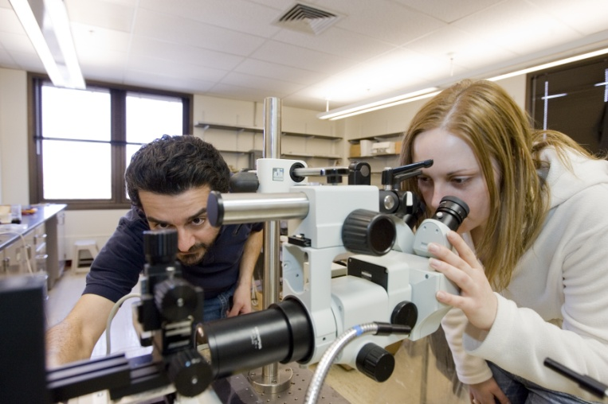
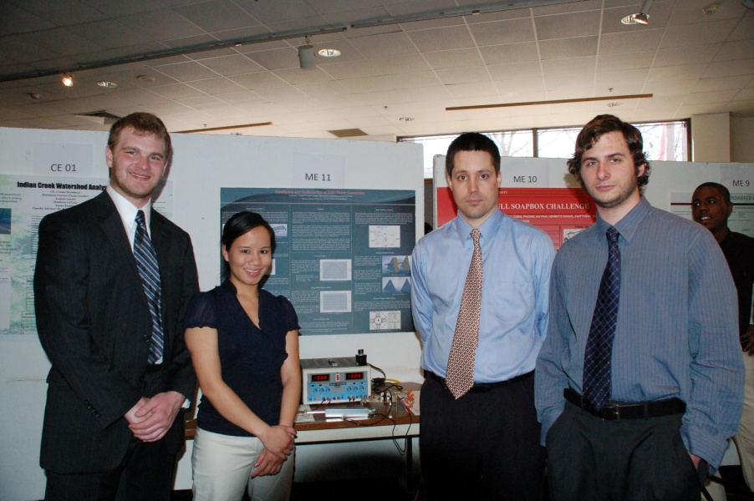
Engineering at Temple is Multidisciplinary
First two years share many courses across disciplines
Calculus, Physics, Chemistry/Biology, General Education
Computer Programming / Graphics
Introduction to Engineering
Third year also shares some courses (statics, circuits)
Common capstone design experience:
Technical Writing for Engineers
Professional Seminar
Senior Design I and II

Slide 6
Engineering By Discipline and Subject Matter
 | CE | EnvE | ElectE | CpE | ME
General Education | 10 | 10 | 8 | 8 | 10
Calculus | 4 | 4 | 4 | 4 | 5
Science | 3 | 4 | 3 | 3 | 3
General Engineering/ Computer Science | 9 | 9 | 2 | 3 | 3
Professional Practice | 4 | 4 | 5 | 5 | 5
Discipline-Specific Engineering | 12 | 11 | 16 | 15 | 15
TOTAL: | 42 | 42 | 38 | 38 | 41
See Temple University Bulletin for detailed comparisons of the programs.

Slide 7
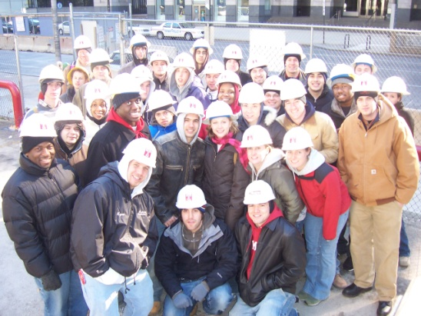
Civil and Environmental Engineering
Two degree options:
Civil Engineering
Environmental Engineering
One professional practice option:
Construction Management Technology
A Sampling of Significant CE Research Activities:
Water and Environmental Technology (WET) Center
Water quality and emerging contaminants
Center for Environmental Science and Technology
Natural resources development and protection

Slide 8
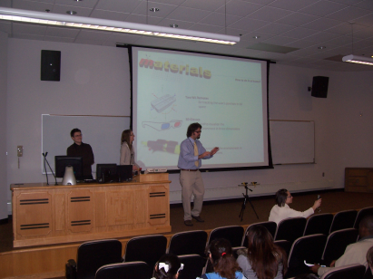
Electrical and Computer Engineering
Three degree options:
Electrical Engineering
Computer Engineering
Bioelectrical Engineering (unofficial)
A Sampling of Significant EE Research Activities:
Computer Fusion Laboratory
Mobile computing, multi-agent networks
Intelligent Systems Application Center
Medical, education and training

Slide 9
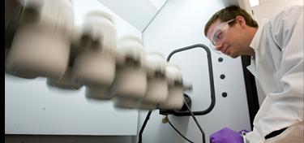
Mechanical Engineering
One degree option:
Mechanical Engineering
Optional concentrations:
Bioengineering
Energy Systems
A Sampling of Significant CE Research Activities:
Center for Bioengineering and Biomaterials
Development of new materials and models
Biofluidics Laboratory
Drug delivery, tissue engineering

Slide 10
Things to Remember…
Get to know your peers …
Get to know your faculty …
Get to know your department chair …
Don’t be afraid to try new things …
Don’t be afraid to ask for help …
Actively seek job experience in your field …
Join professional organizations…
But most importantly:
GET INVOLVED!

