Slide 1
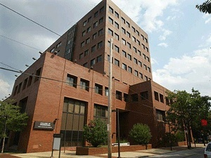
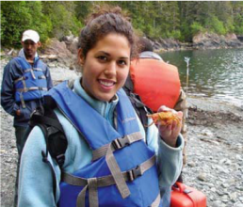


WHY STUDY ENGINEERING AT TEMPLE?
Outline:
Engineering @ Temple
Why Temple engineering?
Engineering by discipline
Things to remember
Joseph Picone, PhD
Professor and Chair, Department of Electrical and Computer Engineering
College of Engineering
Temple University

Slide 2
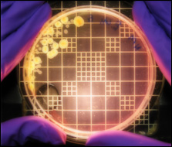
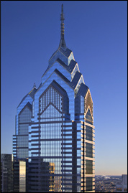
Engineering @ Temple University
Department of Bioengineering: areas such as biomechanics, biomaterials and bioelectronics (a new department).
Department of Civil and Environmental Engineering: areas such as environmental, structural, and transportation.
Department of Electrical and Computer Engineering: areas such as electrical, computer and bioelectrical.
Department of Mechanical Engineering: areas such as mechanical design, renewable energy and materials.
Construction Management Technology: prepares a student for a practitioner's role in construction engineering and management.
Engineering Technology: prepares students for practice in a variety of areas including the environment and energy.

Slide 3


Why Temple engineering?
Best of both worlds: small college feel within a large, public, urban university.
Value: tuition is comparatively low; quality is high.
Diversity: cultural and academic diversity fosters creativity and innovation.
Multidisciplinary: academic program emphasizes a common core across all engineering disciplines and a shared design experience.
Involvement: students are known for their involvement in professional and social causes.
Jobs: internships, co-op, campus employment, job fairs, career services and a strong alumni network are just a few of the tools we use to help students find good jobs.

Slide 4
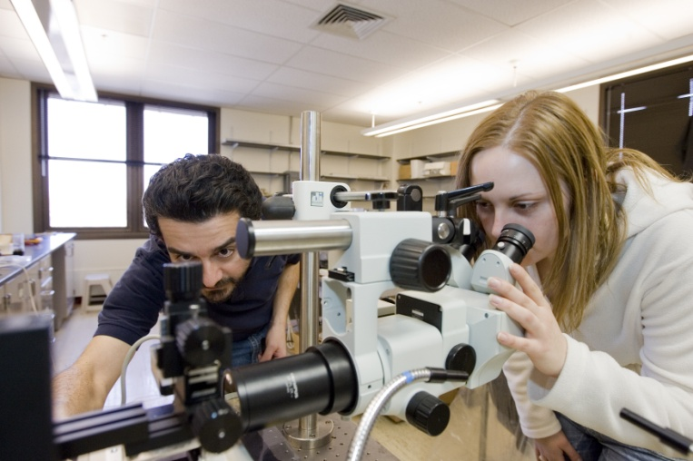
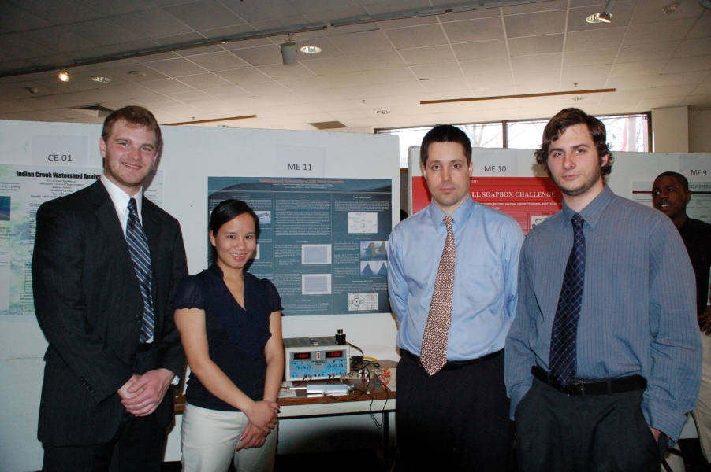
Engineering at Temple is Multidisciplinary
First two years share many courses across disciplines
Calculus, Physics, Chemistry/Biology,
General Education
Computer Programming / Graphics
Introduction to Engineering
Third year also shares some courses (statics, circuits)
Common capstone design experience:
Technical Writing for Engineers
Professional Seminar
Senior Design I and II

Slide 5
Engineering By Discipline and Subject Matter
 | CE | EnvE | ElectE | CpE | ME
General Education | 10 | 10 | 8 | 8 | 10
Calculus | 4 | 4 | 4 | 4 | 5
Science | 3 | 4 | 3 | 3 | 3
General Engineering/ Computer Science | 9 | 9 | 2 | 3 | 3
Professional Practice | 4 | 4 | 5 | 5 | 5
Discipline-Specific Engineering | 12 | 11 | 16 | 15 | 15
TOTAL: | 42 | 42 | 38 | 38 | 41
See Temple University Bulletin for detailed comparisons of the programs.

Slide 6
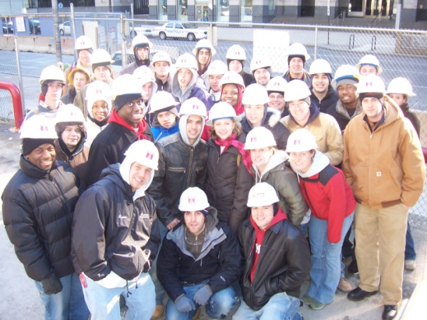

Civil and Environmental Engineering
Two degree options:
Civil Engineering
Environmental Engineering
One professional practice option:
Construction Management Technology
A Sampling of Significant CE Research Activities:
Water and Environmental
Technology (WET) Center
Water quality and emerging contaminants
Center for Natural Resources Development and Protection
Stewardship of public lands and resources

Slide 7







Extracurricular Activities in CEE
Professional Societies:
Student Competitions:
Construction Management Competition (CMT students)
Design-Build Competition
(CE/CMT/Arch students)
Heavy/Highway Competition (CE/CMT)
AWMA's Environmental Challenge

Slide 8

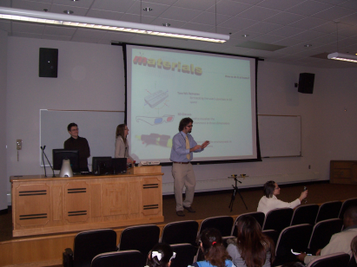
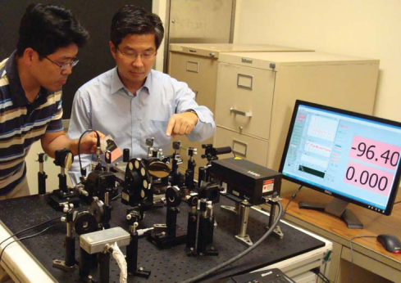
Electrical and Computer Engineering
Three degree options:
Electrical Engineering
Computer Engineering
Bioelectrical Engineering (unofficial)
A Sampling of Significant EE Research Activities:
Computer Fusion Laboratory
Mobile computing, multi-agent networks
Imaging and Pattern Recognition Lab
Thermal facial imaging, terahertz signaling

Slide 9

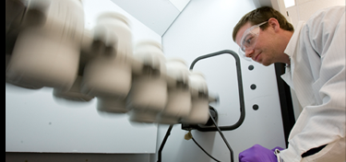

Mechanical Engineering
One degree option:
Mechanical Engineering
Optional concentrations:
Bioengineering
Energy Systems
A Sampling of Significant ME Research Activities:
Center for Bioengineering and Biomaterials
Development of new materials and models
Biofluidics Laboratory
Drug delivery, tissue engineering

Slide 10
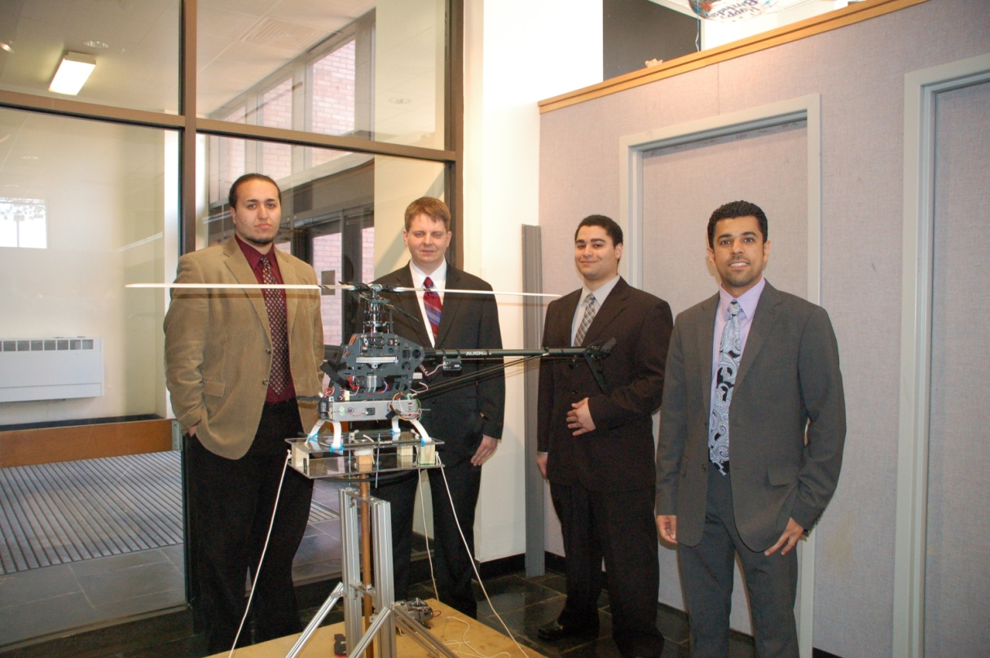
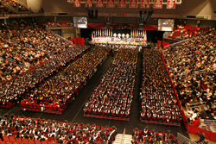
And Now… A Paid Commercial Advertisement…
It is never too early to start thinking about senior design!
Graduation (and senior design) will arrive much faster than you think.

Slide 11
Things to Remember…
Get to know your peers …
Get to know your faculty …
Get to know your department chair …
Don’t be afraid to try new things …
Don’t be afraid to ask for help …
Actively seek job experience in your field …
Join professional organizations…
But most importantly:
  GET INVOLVED!

Slide 12
Extracurricular Activities
Society of Women Engineers
NSBE
Engineer without Borders

