Slide 1
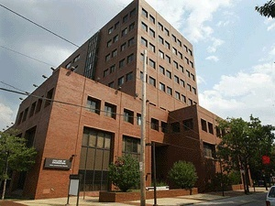

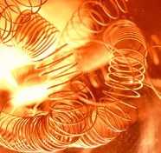

WHY STUDY ENGINEERING AT TEMPLE?
Outline:
Engineering @ Temple
Why Temple engineering?
Engineering by discipline
Things to remember
Joseph Picone, PhD
Professor and Chair, Department of Electrical and Computer Engineering
College of Engineering
Temple University

Slide 2
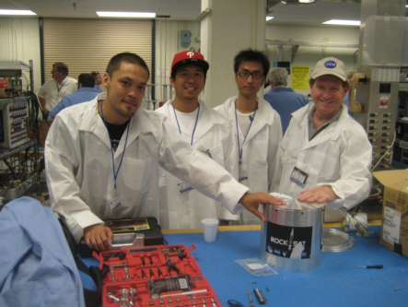
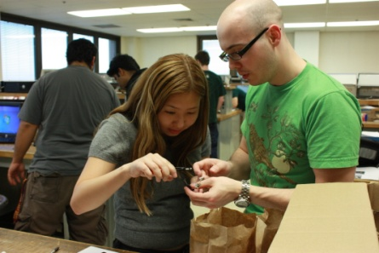
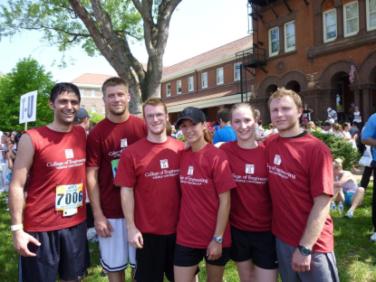
Why Temple Engineering?
You get to build really cool stuff: Dr. Helferty and his students prepare an environmental sensing payload for launch on a NASA rocket in May 2010.
You get help building really cool stuff: Our Iocal IEEE chapter hosted a Brown Bag competition in October 2010 to teach students how to build a simple robot.
You get involved: CoE participates in the Broad Street Run in May 2010; CEE students travel to Alaska in Summer 2009 to study the Exxon-Valdez oil spill.

Slide 3


Why Temple Engineering?
Best of both worlds: small college feel within a large, public, urban university.
Value: tuition is comparatively low; quality is high.
Diversity: cultural and academic diversity fosters creativity and innovation.
Multidisciplinary: academic program emphasizes a common core across all engineering disciplines and a shared design experience.
Involvement: students are known for their involvement in professional and social causes.
Jobs: internships, co-op, campus employment, job fairs, career services and a strong alumni network are just a few of the tools we use to help students find good jobs.

Slide 4
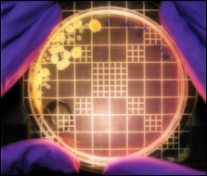
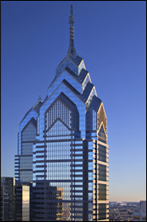
Engineering @ Temple University
Department of Bioengineering: areas such as biomechanics, biomaterials and bioelectronics (a new department).
Department of Civil and Environmental Engineering: areas such as environmental, structural, and transportation.
Department of Electrical and Computer Engineering: areas such as electrical, computer and bioelectrical.
Department of Mechanical Engineering: areas such as mechanical design, renewable energy and materials.
Construction Management Technology: prepares a student for a practitioner's role in construction engineering and management.
Engineering Technology: prepares students for practice in a variety of areas including the environment and energy.

Slide 5
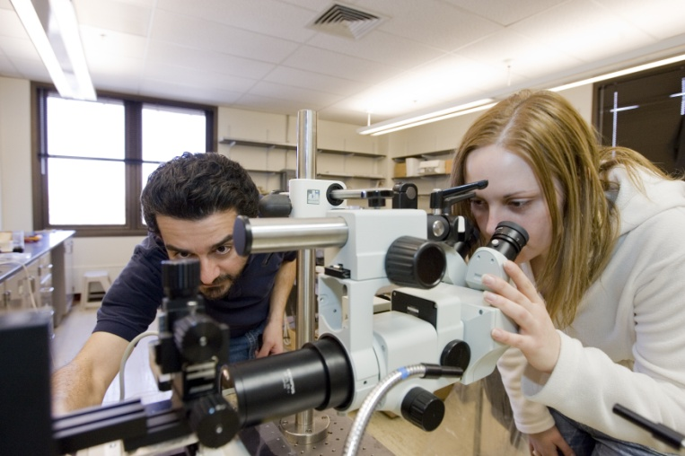
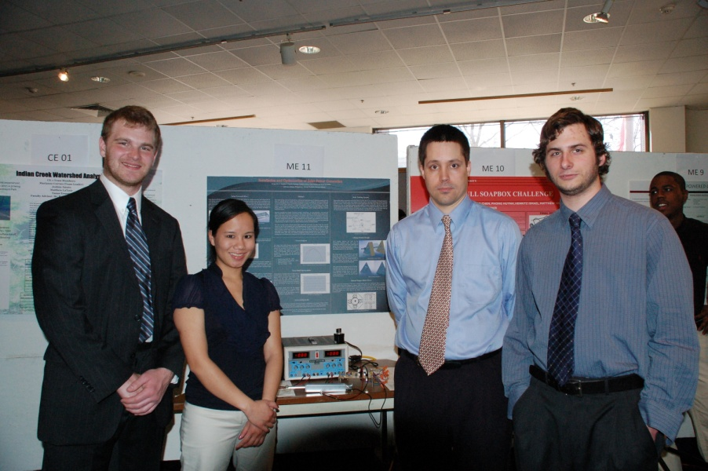
Engineering at Temple is Multidisciplinary
First two years share many courses across disciplines
Calculus, Physics, Chemistry/Biology,
General Education
Computer Programming / Graphics
Introduction to Engineering
Third year also shares some courses (statics, circuits)
Common capstone design experience:
Technical Communication
Professional Seminar
Senior Design I and II

Slide 6
Engineering By Discipline and Subject Matter
 | CE | EnvE | ElectE | CpE | ME
General Education | 10 | 10 | 8 | 8 | 10
Calculus | 4 | 4 | 4 | 4 | 5
Science | 3 | 4 | 3 | 3 | 3
General Engineering/ Computer Science | 9 | 9 | 2 | 3 | 3
Professional Practice | 4 | 4 | 5 | 5 | 5
Discipline-Specific Engineering | 12 | 11 | 16 | 15 | 15
TOTAL: | 42 | 42 | 38 | 38 | 41
See Temple University Bulletin for detailed comparisons of the programs.

Slide 7
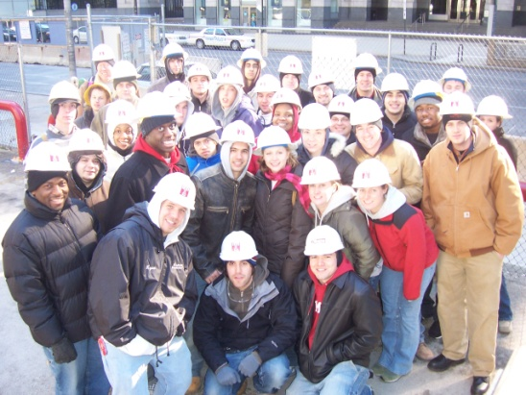

Civil and Environmental Engineering
Two degree options:
Civil Engineering
Environmental Engineering
One professional practice option:
Construction Management Technology
A Sampling of Significant CE Research Activities:
Water and Environmental
Technology (WET) Center
Water quality and emerging contaminants
Center for Natural Resources Development and Protection
Stewardship of public lands and resources

Slide 8



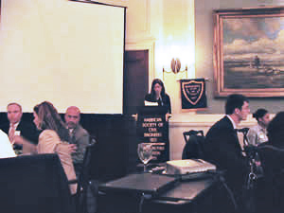


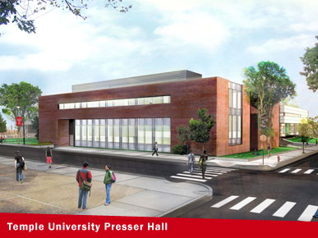
Extracurricular Activities in CEE
Professional Societies:
Student Competitions:
Construction Management Competition (CMT students)
Design-Build Competition
(CE/CMT/Arch students)
Heavy/Highway Competition (CE/CMT)
AWMA's Environmental Challenge

Slide 9

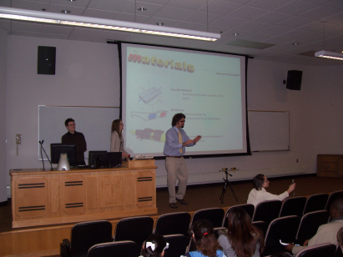
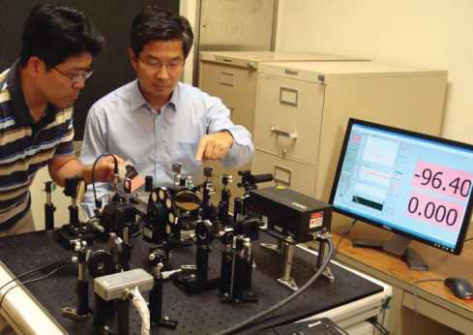
Electrical and Computer Engineering
Three degree options:
Electrical Engineering
Computer Engineering
Bioelectrical Engineering (unofficial)
A Sampling of Significant EE Research Activities:
Computer Fusion Laboratory
Mobile computing, multi-agent networks
Imaging and Pattern Recognition Lab
Thermal facial imaging, terahertz signaling

Slide 10



Extracurricular Activities in ECE
Professional Societies:
Institute of Electrical and Electronics Engineers
(IEEE)
Etta Kappa Nu
(HKN)
Student Competitions:
NASA Robotics and Ballooning
IEEE Xtreme 24-Hour Programming Challenge
Indoor Aerial Robotics Competition
IEEE Philadelphia Section Research Paper Competition

Slide 11

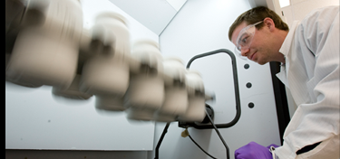

Mechanical Engineering
One degree option:
Mechanical Engineering
Optional concentrations:
Bioengineering
Energy Systems
A Sampling of Significant ME Research Activities:
Center for Bioengineering and Biomaterials
Development of new materials and models
Biofluidics Laboratory
Drug delivery, tissue engineering

Slide 12






Extracurricular Activities
Temple students pride themselves on being involved in a host of issues ranging from politics to social and environmental causes.
Engineers Without Borders: Building a better world one brick at a time
Society for Women Engineers: Professional development
through mentoring
National Society of Black Engineers: increasing cultural consciousness

Slide 13
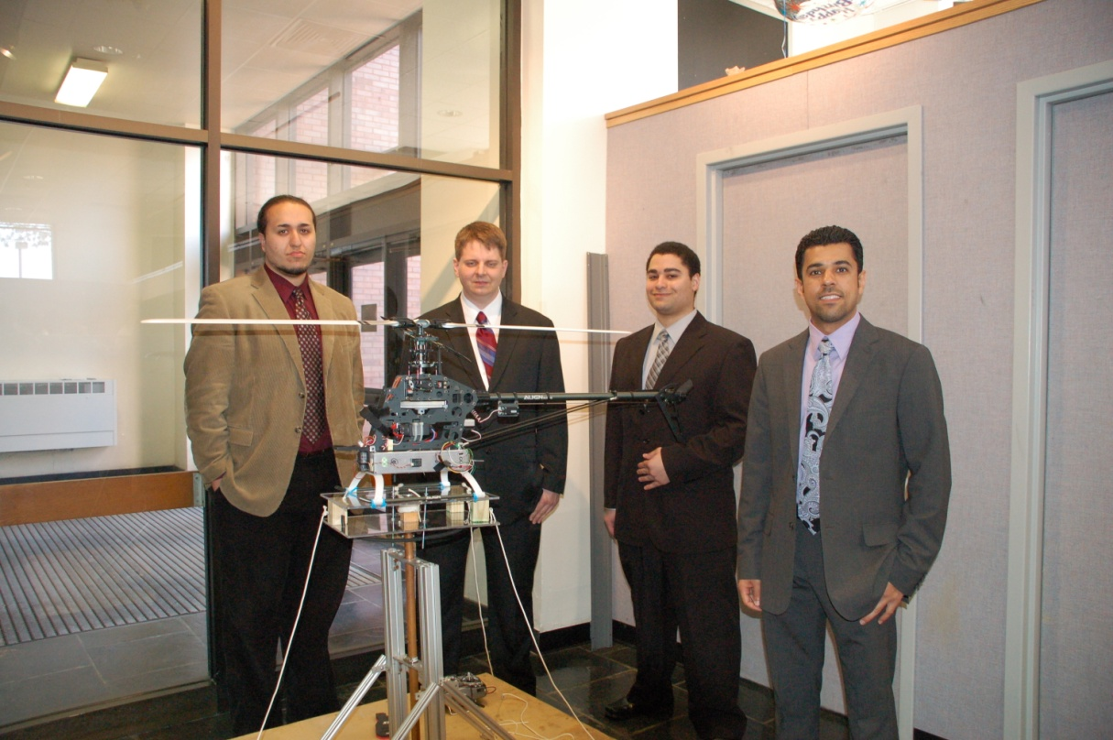
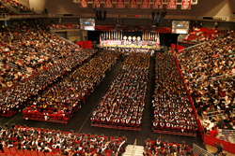
And Now… A Paid Commercial Advertisement…
It is never too early to start thinking about senior design!
Graduation (and senior design) will arrive much faster than you think.

Slide 14
Things to Remember…
Get to know your peers …
Get to know your faculty …
Get to know your department chair …
Don’t be afraid to try new things …
Don’t be afraid to ask for help …
Actively seek job experience in your field …
Join professional organizations…
And most importantly:
  GET INVOLVED!

