Slide 1
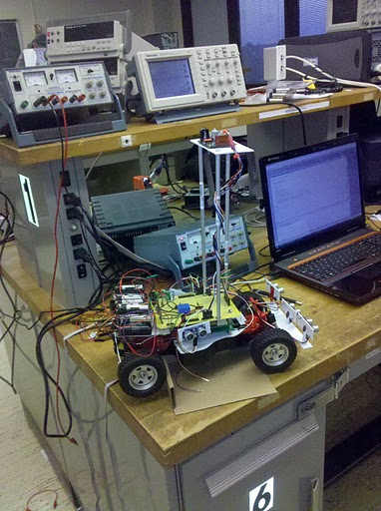
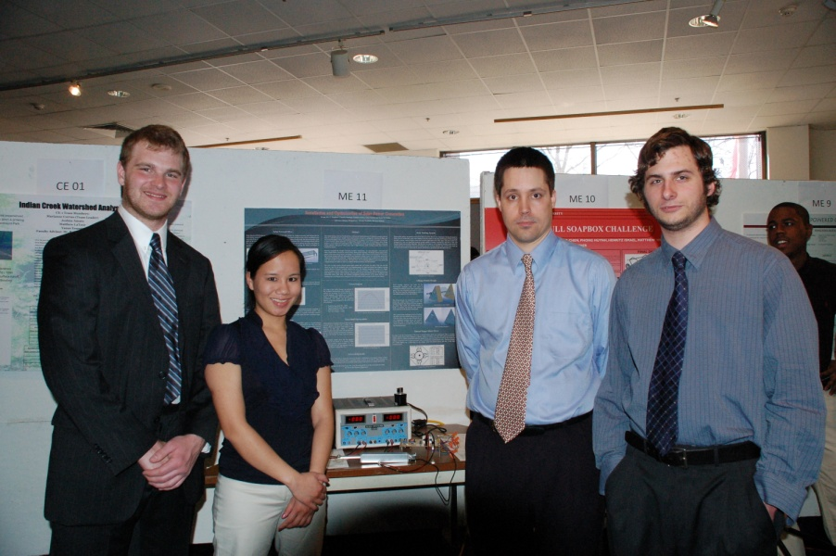
EMERGING DIRECTIONS IN SENIOR DESIGN:
Towards a Multidisciplinary Experience
Richard Cohen, Frank Higgins, Joseph Picone and Sandip Shah
Senior Design Steering Committee
College of Engineering
Temple University
URL:

Slide 2

Top Ten Reasons To Invest In Senior Design
It satisfies a large percentage of our ABET design requirements.
Students learn the difference between design and implementation.
A vibrant senior design program can have a major impact on an undergraduate program.
7) Senior design is a good way to engage industry and motivate industry to care about our program.
6) Students, ironically, learn many practical fabrication skills.
5) Students learn that all that theory they have been struggling with actually does work in practice.
Jobs, jobs, jobs!
… but the real reasons we love senior design are:
Students learn the good, the bad and the ugly about simulations.
2) Students gain a renewed respect for the challenges in running a profitable business (and why many products are manufactured in China).
1) “I love the small of burnt electronics in the morning.”

Slide 3
Program Outcomes From ABET (Criterion 3)
Engineering programs must demonstrate that their students attain the following outcomes:
an ability to apply knowledge of mathematics, science, and engineering
an ability to design and conduct experiments, as well as to analyze and interpret data
an ability to design a system, component, or process to meet desired needs within realistic constraints such as economic, environmental, social, political, ethical, health and safety, manufacturability, and sustainability
an ability to function on multidisciplinary teams
an ability to identify, formulate, and solve engineering problems
an understanding of professional and ethical responsibility
an ability to communicate effectively
the broad education necessary to understand the impact of engineering solutions in a global, economic, environmental, and societal context
a recognition of the need for, and an ability to engage in life-long learning
a knowledge of contemporary issues
an ability to use the techniques, skills, and modern engineering tools necessary for engineering practice.

Slide 4
Just One Course…
Remember that Senior Design is just one of many courses our students take.
Therefore, it does not have to be their only exposure to design, nor does it have to do EVERYTHING.
However, it is important that we give students a comprehensive design experience.
In my opinion, this has to include a “build” phase in which students fabricate something and evaluate performance against their predictions from their design.
But we don’t need to debate this right now…

Slide 5
Definition of Design According to ABET
Engineering design is the process of devising a system, component, or process to meet desired needs. It is a decision-making process (often iterative), in which the basic sciences, mathematics, and the engineering sciences are applied to convert resources optimally to meet these stated needs.
Students must be prepared for engineering practice through a curriculum culminating in a major design experience based on the knowledge and skills acquired in earlier course work and incorporating appropriate engineering standards and multiple realistic constraints.

Slide 6
Additional Program Criteria: Bioengineering
Curriculum: Programs must demonstrate that graduates have proficiency in mathematics through differential equations, a thorough grounding in chemistry and biology and a working knowledge of advanced biological sciences consistent with the program educational objectives. Competence must be demonstrated in the application of engineering to biological systems.
Faculty: The program shall demonstrate that those faculty members teaching courses that are primarily design in content are qualified to teach the subject matter by virtue of education and experience or professional licensure.

Slide 7
Additional Program Criteria: Civil Engineering
Curriculum: The program must demonstrate that graduates can: apply knowledge of mathematics through differential equations, calculus-based physics, chemistry, and at least one additional area of science, consistent with the program educational objectives; apply knowledge of four technical areas appropriate to civil engineering; conduct civil engineering experiments and analyze and interpret the resulting data; design a system, component, or process in more than one civil engineering context; explain basic concepts in management, business, public policy, and leadership; and explain the importance of professional licensure.
Faculty: The program must demonstrate that faculty teaching courses that are primarily design in content are qualified to teach the subject matter by virtue of professional licensure, or by education and design experience. The program must demonstrate that it is not critically dependent on one individual.

Slide 8
Additional Program Criteria: Electrical and Computer Eng.
Curriculum: The structure of the curriculum must provide both breadth and depth across the range of engineering topics implied by the title of the program. The program must demonstrate that graduates have: knowledge of probability and statistics, including applications appropriate to the program name and objectives; and knowledge of mathematics through differential and integral calculus, basic sciences, computer science, and engineering sciences necessary to analyze and design complex electrical and electronic devices, software, and systems containing hardware and software components, as appropriate to program objectives.
Programs containing the modifier “electrical” in the title must also demonstrate that graduates have a knowledge of advanced mathematics, typically including differential equations, linear algebra, complex variables, and discrete mathematics.
Programs containing the modifier “computer” in the title must also demonstrate that graduates have a knowledge of discrete mathematics.

Slide 9
Additional Program Criteria: Environmental Engineering
Curriculum: The program must demonstrate the graduates have: proficiency in mathematics through differential equations, probability and statistics, calculus-based physics, general chemistry, an earth science, e.g., geology, meteorology, soil science, relevant to the program of study, a biological science, e.g., microbiology, aquatic biology, toxicology, relevant to the program of study, and fluid mechanics relevant to the program of study; introductory level knowledge of environmental issues associated with air, land, and water systems and associated environmental health impacts; an ability to conduct laboratory experiments and to critically analyze and interpret data in more than one major environmental engineering focus areas, e.g., air, water, land, environmental health; an ability to perform engineering design by means of design experiences integrated throughout the professional component of the curriculum; proficiency in advanced principles and practice relevant to the program objectives; understanding of concepts of professional practice and the roles and responsibilities of public institutions and private organizations pertaining to environmental engineering.
Faculty: The program must demonstrate that a majority of those faculty teaching courses which are primarily design in content are qualified to teach the subject matter by virtue of professional licensure, or by education and equivalent design experience.

Slide 10
Additional Program Criteria: Mechanical Engineering
Curriculum: The program must demonstrate that graduates have the ability to: apply principles of engineering, basic science, and mathematics (including multivariate calculus and differential equations) to model, analyze, design, and realize physical systems, components or processes; and work professionally in both thermal and mechanical systems areas.
Faculty: The program must demonstrate that faculty members responsible for the upper-level professional program are maintaining currency in their specialty area.

Slide 11
Guiding Principles: The Essence of ABET
“Students must be prepared for engineering practice through a curriculum culminating in a major design experience based on the knowledge and skills acquired in earlier course work and incorporating engineering standards and realistic constraints that include most of the following considerations: economic; environmental; sustainability; manufacturability; ethical; health and safety; social; and political.”
A senior design experience that is truly multidisciplinary is desirable.
The emphasis is placed on designing to realistic constraints, not invention, entrepreneurship or technical communications.
Students should feel some sense of accomplishment.

Slide 12
The Essence of Senior Design
Senior Design is not about:
creating a unique project concept
inventing a new gadget
doing something that has never been done before
Senior Design is about:
Translating customer needs into quantitative design constraints
Optimizing a design to meet these constraints
Verifying that your design meets these constraints
Fabricating a prototype to demonstrate proof of concept.
Key elements include:
Learning how to communicate your ideas to management and the customer
Appreciating the multidisciplinary aspects of engineering design
Understanding how practical constraints such as cost and sustainability influence the design process at every step.

Slide 13
Guiding Principles: The Design Cycle
Problem
Test Verification
Design Constraints
Hardware Implementation
Design
Test Verification
Test Specification
Prototyping
Simulation
Test Verification
There is really only one important question in Senior Design:
What do you claim for the design content in your project?

Slide 14
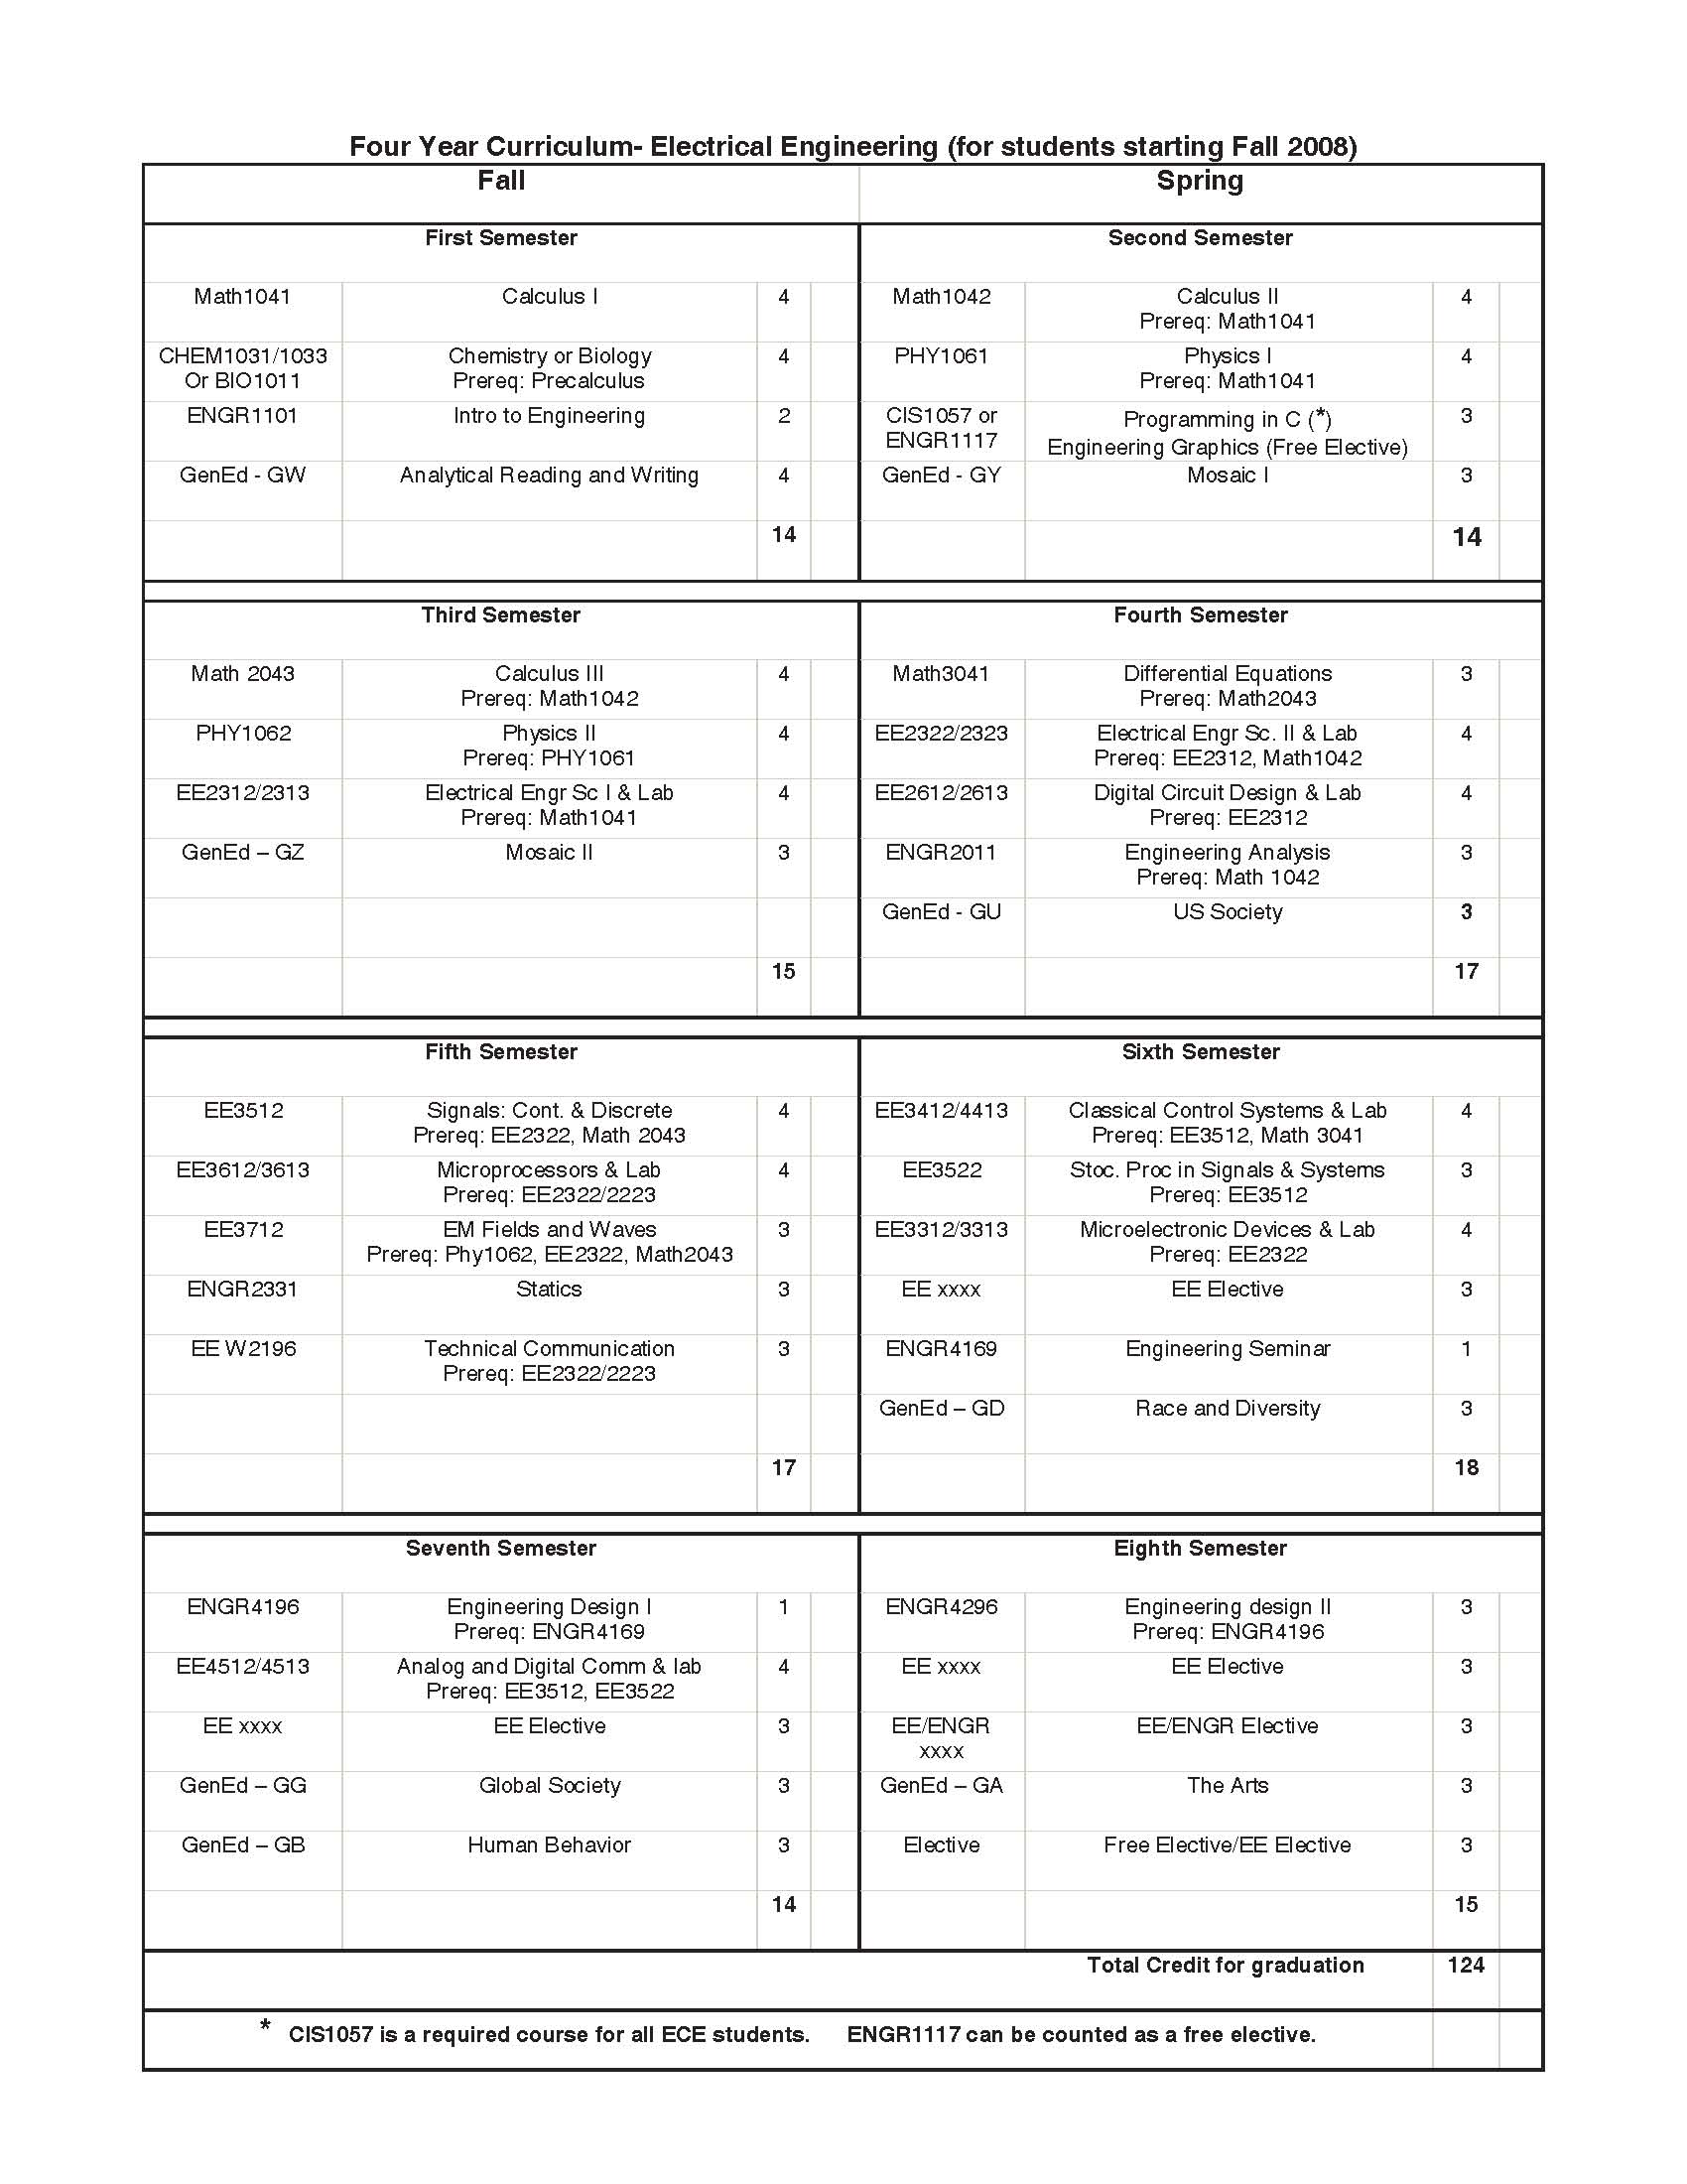
The Senior Design Journey

Slide 15
Senior Design I and II Lecture Schedule
1 | 01/19 | Organization and Introductions
2 | 01/26 | The Design Cycle
3 | 02/02 | Abstract Rev. / Title / Problem State.
4 | 02/09 | Design Constraints
5 | 02/16 | The Design Document
6 | 02/23 | Design Constraints Rev. / Exec Sum.
7 | 03/02 | Technical Presentations (SD I)
8 | 03/09 | Spring Break
9 | 03/16 | Preliminary Design Review
10 | 03/23 | Design Review Post-Mortem
11 | 03/30 | Cost and Schedule
12 | 04/06 | Simulation and Testing
13 | 04/15 | Design Reviews
14 | 04/20 | Design Review Post-Mortem
15 | 04/27 | Guest Speaker
16 | 05/04 | Study Day
17 | 05/06 | Final Deliverable
1 | 09/02 | Organization and Expectations
2 | 09/09 | Test Engineering (SD II)
3 | 09/16 | Technical Presentations (SD II)
4 | 09/23 | Scheduling
5 | 09/30 | Guest Lecture – Design Engineering
6 | 10/07 | Technical Presentations
7 | 10/14 | Design Review Post-Mortem
8 | 10/21 | Designing for Sustainability
9 | 10/28 | Accelerated Life Testing
10 | 11/04 | Business Plans
11 | 11/11 | Guest Lecture - Entrepreneurship
12 | 11/18 | Design Reviews
13 | 11/25 | Thanksgiving
14 | 12/02 | Design Review Post-Mortem
15 | 12/09 | Study Day
16 | 12/16 | Final Deliverable

Slide 16
Senior Design I and II Deliverables
1 | 01/25 | Product Specification Web Site Entry
2 | 02/01 | Project Abstract
3 | 02/08 | Revised Abstract / Project Title Problem Statement (1st Draft)
4 | 02/15 | Report Cover Page / Web Site Main Page / Design Constraints
5 | 02/22 | Revised Problem Statement Integrated Design Document
6 | 03/01 | Design Constraints (Narrative)
7 | 03/15 | Mid-Term Technical Presentation
8 | 03/22 | Executive Summary
9 | 03/29 | System Block Diagram
10 | 04/05 | Cost and Schedule
11 | 04/12 | Test Plans, Final Presentation
12 | 04/19 | Revised Schedule
13 | 04/26 | Approach, Updated Web Site
14 | 05/06 | Design Document and Web Site
1 | 09/02 | Schedule*
2 | 09/09 | Revised Problem Statement
3 | 09/16 | Revised Design Constraints
4 | 09/23 | Revised Test Specifications
5 | 09/30 | Revised Approach
6 | 10/07 | Hardware Prototype (or Equivalent)
7 | 10/14 | Prototype Test Results
8 | 10/21 | Revised Executive Summary
9 | 10/28 | Revised Test Specs (2nd Revision)
10 | 11/04 | Hardware Prototype (2nd Revision)
11 | 11/11 | Prototype Test Results (2nd Revision)
12 | 11/18 | Final Presentation
13 | 12/02 | Web Site
14 | 12/16 | Design Document, Peer Evaluations
* Schedule updates will be graded each week.

Slide 17
Senior Design I and II Grading
Design Document | 25%
Weekly Deliverables | 20%
Proposal Presentation (DR) | 20%
Proposal Presentation (PDR) | 10%
Peer Review | 10%
Advisor Evaluation | 10%
Web Site | 5%
TOTAL | 100%
Design Document | 15%
Weekly Deliverables | 25%
Proposal Presentation (DR) | 15%
Proposal Presentation (PDR) | 15%
Hardware Demonstration | 10%
Peer Review | 5%
Advisor Evaluation | 10%
Web Site | 5%
TOTAL | 100%
Weekly assignments are most effective at achieving incremental progress.
Early hardware deliverables are critical to pushing students to complete their projects by Senior Design Day.

Slide 18
Tools
In addition to discipline-specific design and analysis tools, Senior Design makes extensive use of the following tools:
Microsoft Word: We build on what is taught in Technical Writing and Seminar, and attempt to teach students how to produce professional, structured documents (e.g., paragraph styles, sections, cross-referenced figures).
Microsoft Excel: We encourage use of Excel for obvious things such as cost analysis, design tradeoffs and project management.
Microsoft Project: Available for free use for all CoE students starting Fall 2010. It will be integrated into Professional Seminar, and then ripple through Senior Design I and II in Spring 2011 and Fall 2011.
MATLAB: University site license is in place now. Copies for personal use, including 50 toolboxes, will be available for all faculty, staff, and students by mid-summer. Distribution is in beta test now (and has been successful).
Google Sites: used to develop and maintain web sites. Somewhat cumbersome, but gets the job done.
Wireless Networking: ubiquitous building access should be available very soon.

Slide 19
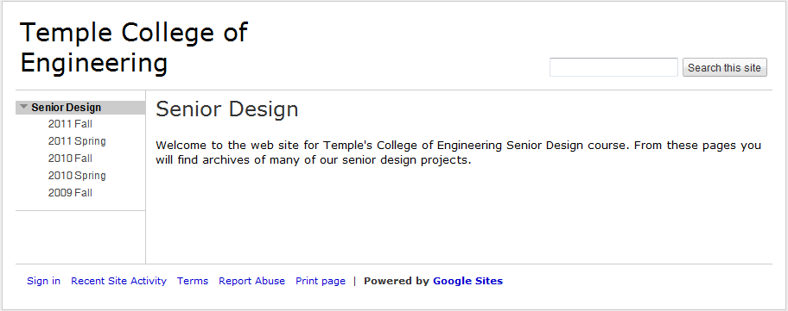
Web Sites
Why force students to do project web sites?
  One thing I consistently hear from students about their job interviews is that they visited their project web site during the interview.
  We use the web site as an archival mechanism. All presentations and grading are done from documents posted to the web site. This is the only way to make sure we get complete copies of everything.
  The emphasis is on content, not graphic design.
  We use Google Sites to develop and manage the SD web sites:

Slide 20
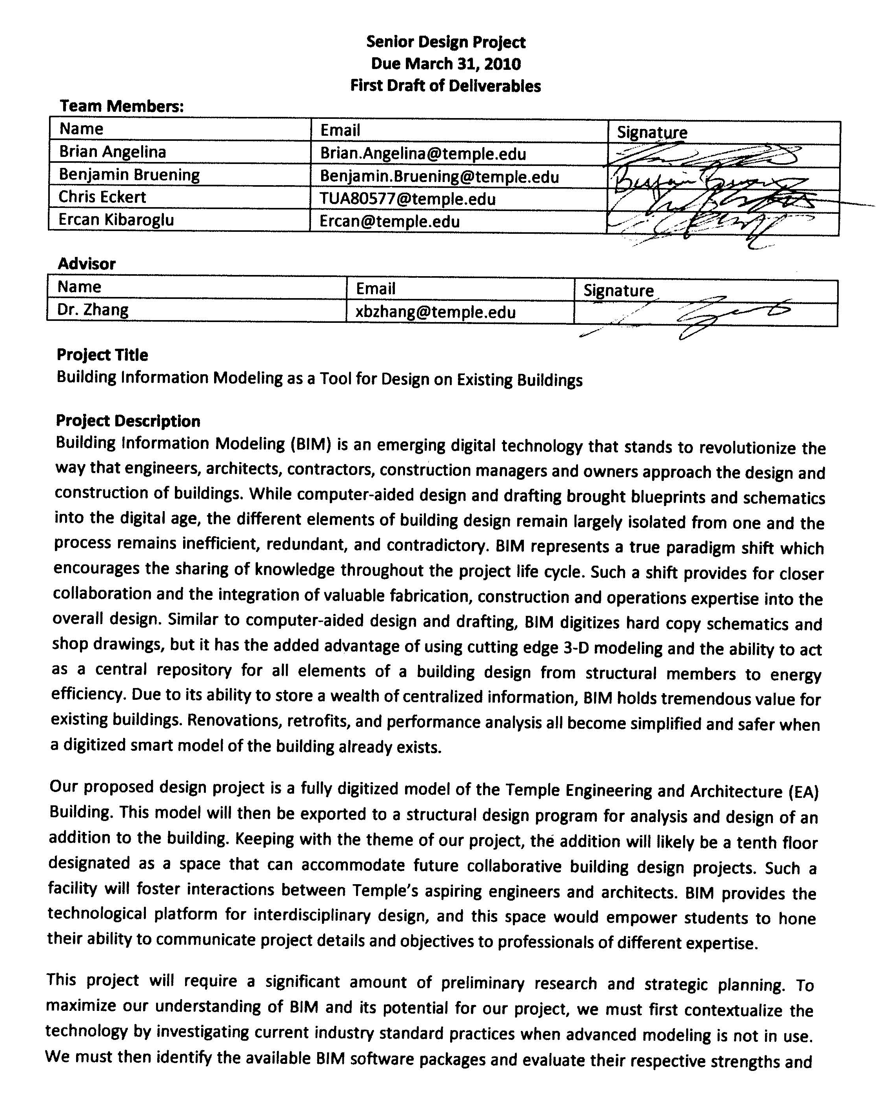
Fall 2010 Project Status
Sandip Shah, building on previous Professional Seminar instruction, made an aggressive attempt to form teams and establish projects.
Students responded enthusiastically, but struggled with the details.
Project status:
Status | No.
Approved: students ready to enter SD I | 20
Tentative: project is sound and ready for SD I, but deliverables need tweaking | 12
In Flux: students still trying to figure out what they need to do, but the advisor is on board. | 1
Redesign: a nice way to say this project is not yet adequately defined | 2
Denied: project is not adequately described so that the deliverables can be assessed for design content. | 4
TOTAL: | 39

Slide 21
Near-Term Suggestions (Low-Hanging Fruit)
Recommended Senior Design Day in Fall 2010: Nov. 18 (alt: Dec. 2).
We need to push it back because we have SD I and II projects, and SD II students need more time to get their hardware working.
Industrial Review Panels: working through our advisory boards, we hope to increase participation from industry. Dick has done a good job getting this started.
More Projects Sponsored by Research Groups: Did you see the hybrid electric vehicle demonstration?
More Industry-Sponsored Projects: love those NASA review panels John Helferty puts his students through.
External Competitions: nothing like the fear of public humiliation to motivate a team.
External competitions usually follow rigorous design methodologies.
Temple CoE had a great year in 2009-10!
Our students compete well when properly motivated.
Important question: must senior design projects build a prototype?

Slide 22
Longer-term Issues
How can we weave design throughout the curriculum?
One approach is to allow students to take independent study hours as technical electives and participate in large design activities (e.g., EcoCar).
Another opportunity is to modify second and third-year labs to include more open-ended design problems.
How can we better prepare students for the senior design experience?
How do we move Senior Design forward and make it something unique to Temple University?
Last, but not least, thanks to Dick, Sandip and Frank for their excellent support:
We have been meeting weekly to discuss SD I projects.
Sandip has made some good changes to Professional Seminar to support Senior Design.
Frank has been teaching ECE students how to solder ☺
Senior Design is a work in progress but we think it is headed in the right direction.

Slide 23
To Learn More
“Criteria for Accrediting Engineering Programs: Effective for Evaluations During the 2010-2011 Accreditation Cycle,” (Engineering Programs Only), www.abet.org.
Temple University College of Engineering Senior Design Web Sites, https://sites.google.com/a/temple.edu/coe/senior-design.
Senior Design I Web Page:
http://www.isip.piconepress.com/publications/courses/temple/engr_4196/
Senior Design II Web Page (under construction):
http://www.isip.piconepress.com/publications/courses/temple/engr_4296/

