Slide 1
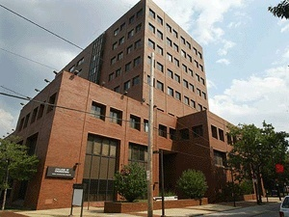

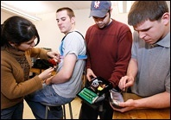
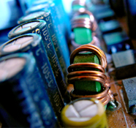
THE DEPARTMENT OF
ELECTRICAL AND COMPUTER ENGINEERING
Outline:
• ECE At a Glance
Research Clusters
Administrative Initiatives
Joseph Picone, PhD
Professor and Chair, Department of Electrical and Computer Engineering
College of Engineering
Temple University

Slide 2
ECE at a Glance
Faculty By Rank:
By the Numbers (2009-10):
Track | Full | Assoc | Assist | Total
TT | 6 | 4 | 2 | 12
NTT | 0 | 1 | 0 | 1
Adj. |  |  |  | 9
Post-Doc |  |  |  | 1
Staff |  |  |  | 2
TOTAL |  |  |  | 25
Degree | Enrolled | Graduated
BS: EE CpE BioE | 220 194 22 4 | 40 34 6 0
MS: EE CpE BioE | 59 57 0 2 | 16 16 0 0
PhD: EE CpE BioE | 13 9 0 4 | 2 2 0 0
Total: | 292 | 58
Faculty By Area of Specialization:
Area | Full | Assoc | Assist
Biomedical |  | 1 | 1
Intelligent Systems | 3 | 2
Controls | 3 | 2
Devices and Materials | 1 | 1
Energy | 1
Research Expenditures:
FY07: $888K
FY08: $421K
FY09: $453K
FY10: growth expected

Slide 3
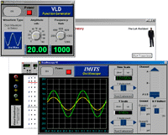
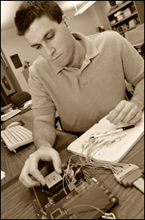

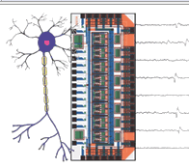
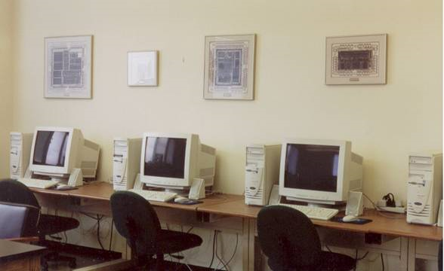
Facilities
Laboratory Space:
Unique Capabilities:
Universal Virtual Lab
Neural Instrumentation Laboratory
Multi-agent Systems Test Lab
System Chip Design
Robotics and Atmospheric Testing
Image Processing System Development
Sensors, Networks and Devices
Speech Processing
Type | Sqft
Offices | 2,966
Instructional Labs | 5,303
Research Labs | 3,565
TOTAL | 11,834

Slide 4

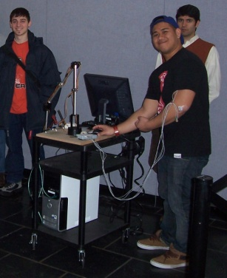
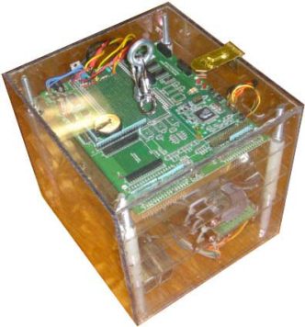
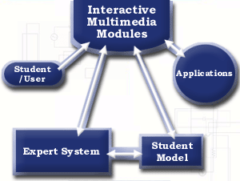
Notable Research Activities in FY10
SEPTA / USDA: multi-agent distributed systems (L. Bai)
NSF CAREER: brain machine
interfaces (I. Obeid)
NASA: high altitude balloons, payloads in space, robotics (J. Helferty)
NSF / NIH: nonlinear statistical control, tactile interfaces (C.H. Won)
NSF / Jefferson Memorial: radiotherapy advisor, intelligent tutoring systems (B. Butz)

Slide 5
Department Initiatives
Academics
  Proposed curriculum restructuring that would reduce our circuits sequence to one course and increase the amount of programming and engineering science
  Integration of Tech Writing, Seminar and Senior Design
Advising
  Advising spreadsheets for undergraduates
  Advising spreadsheets for graduate students (MS and PhD)
Infrastructure
  MATLAB site license
  Anderson 104 and 107 (and 1,000 lbs of concrete...)
  Renovation of EA 702 almost complete
  Re-purposing of EA 702A, 703B and 703D (grad student offices)
  Move towards open laboratories
Efficiency
  Increase our efforts to do everything electronically (including ABET!)

