Slide 1
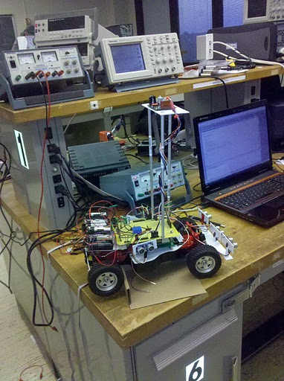
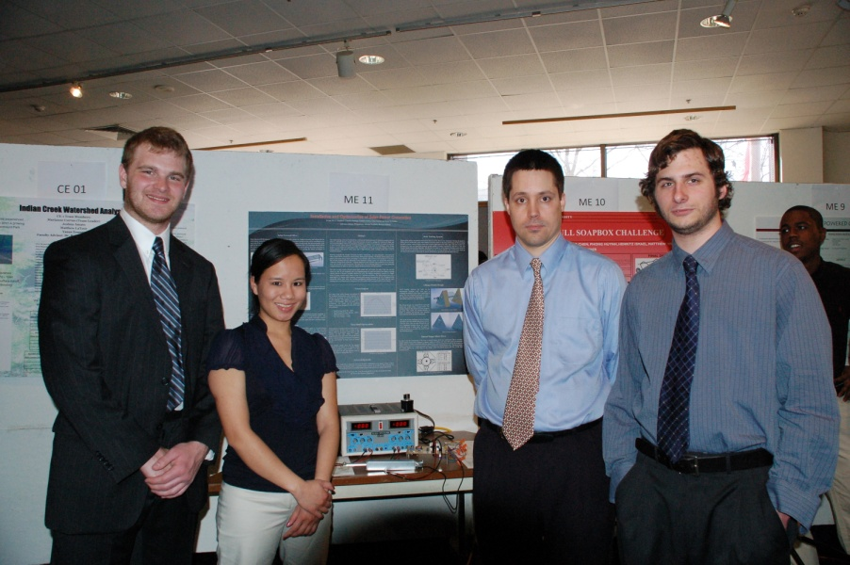
Introduction to
Electrical and Computer Engineering:
Towards Autonomous Robots
Joseph Gro, Amber Moscato and Ilyana Mushaeva
Department of Electrical and Computer Engineering
College of Engineering
Temple University
URL:

Slide 2
Marconi Challenge
Guglielmo Marconi pioneered wireless telegraphy at a wavelength of about 1500 meters and succeeded in sending an RF signal with kilowatts of power across the Atlantic Ocean in 1901
The Marconi Challenge for students is to send an IR signal at a wavelength of about 950 nanometers with milliwatts of power to a detector over the largest distance
The Marconi Challenge offers unique opportunities for experimentation and learning for high school students.
IR digital data communication is
used to provide an educational
experience in electronics, the
use of semaphores to represent
information, and the optical
transmission and reception of
IR light.

Slide 3
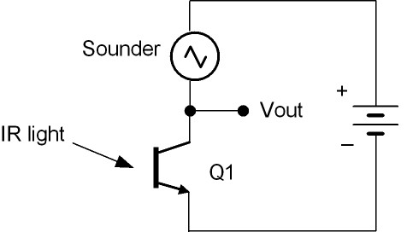
Infrared Semiconductor Emitter and Detector
In the Marconi Challenge the transmission of a signal by infrared (IR) light
using a semiconductor diode emitter and phototransistor detector is introduced.
IR emitter diode transmitter circuit
IR detector phototransistor receiver circuit
These circuits can be easily constructed by twisting the component wires
together on an insulating circuit board even without a permanent
connection by soldering.
The simplicity and excitement of the Marconi Challenge could be the 21st Century equivalent of the crystal radio which provided the impetuous for many high school students to turn-on to engineering and science.

Slide 4
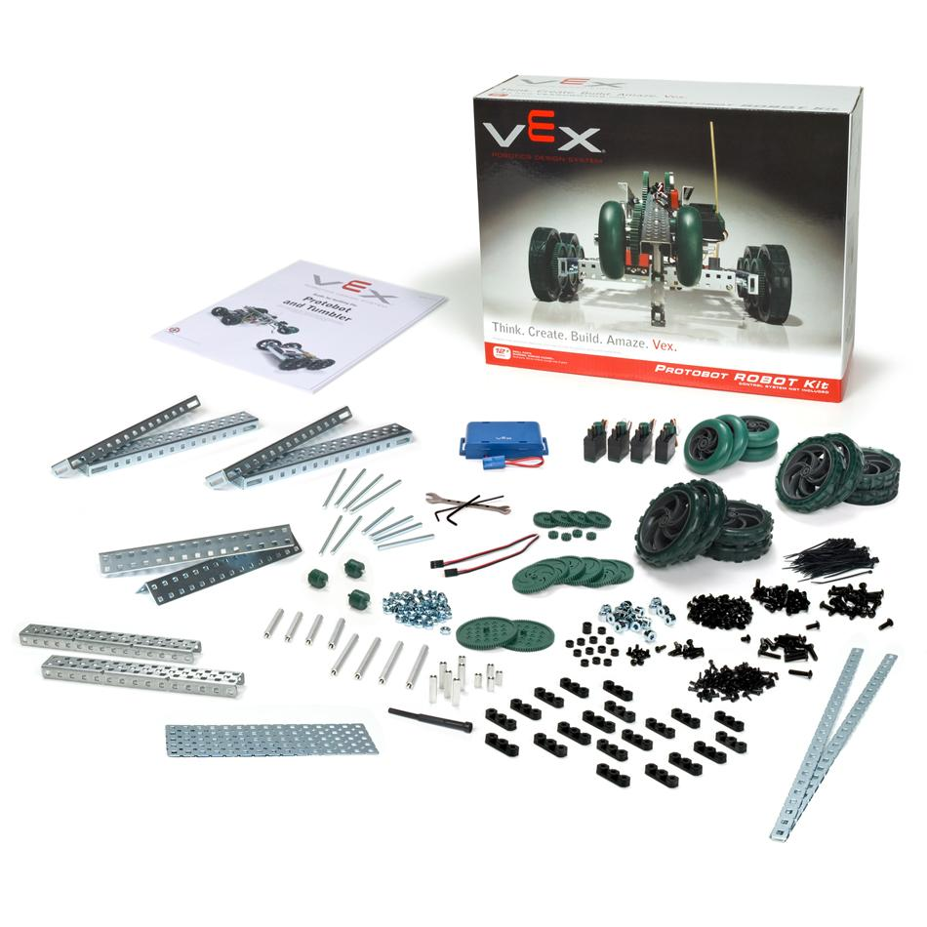
Robotics

Slide 5
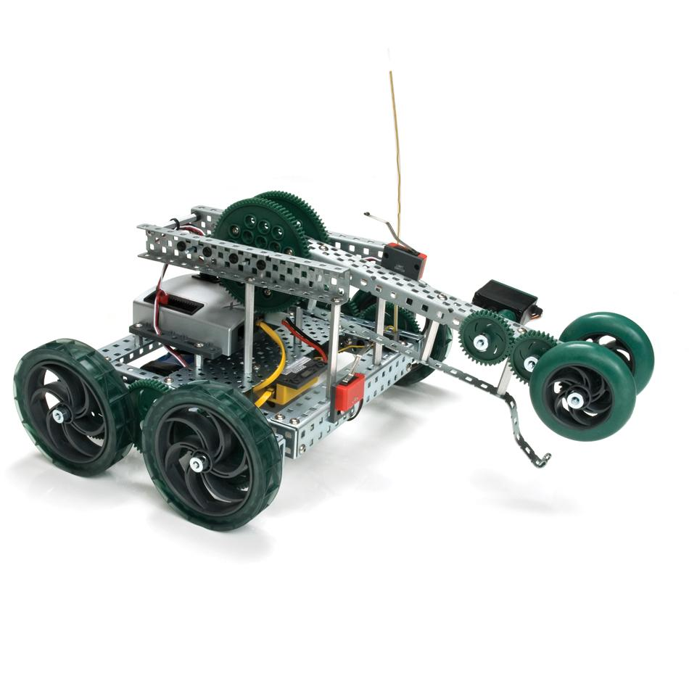
Goals and Applications
Build a fully functional robot
Learn about design, tools, engineering, team building and mechanical concepts
Take away new skills useful in both engineering and life

