Slide 1
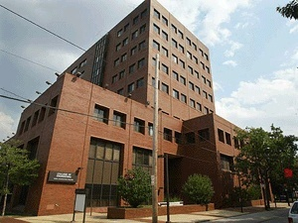

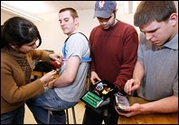
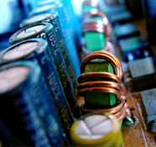
THE DEPARTMENT OF
ELECTRICAL AND COMPUTER ENGINEERING
Outline:
• ECE At a Glance
Undergrad Program
Graduate Program
Research Clusters
Facilities
Joseph Picone, PhD
Professor and Chair, Department of Electrical and Computer Engineering
College of Engineering
Temple University
URL:

Slide 2

Engineering In The News

Slide 3


Why Temple Engineering?
Best of both worlds: small college feel within a large, public, urban university.
Value: tuition is comparatively low; quality is high.
Diversity: cultural and academic diversity fosters creativity and innovation.
Multidisciplinary: academic program emphasizes a common core across all engineering disciplines and a shared design experience.
Involvement: students are known for their involvement in professional and social causes.
Jobs: internships, co-op, campus employment, job fairs, career services and a strong alumni network are just a few of the tools we use to help students find good jobs.

Slide 4
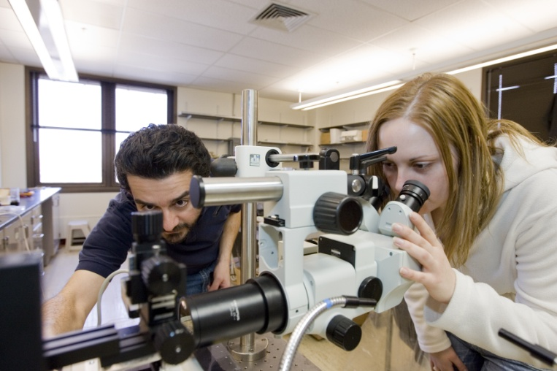
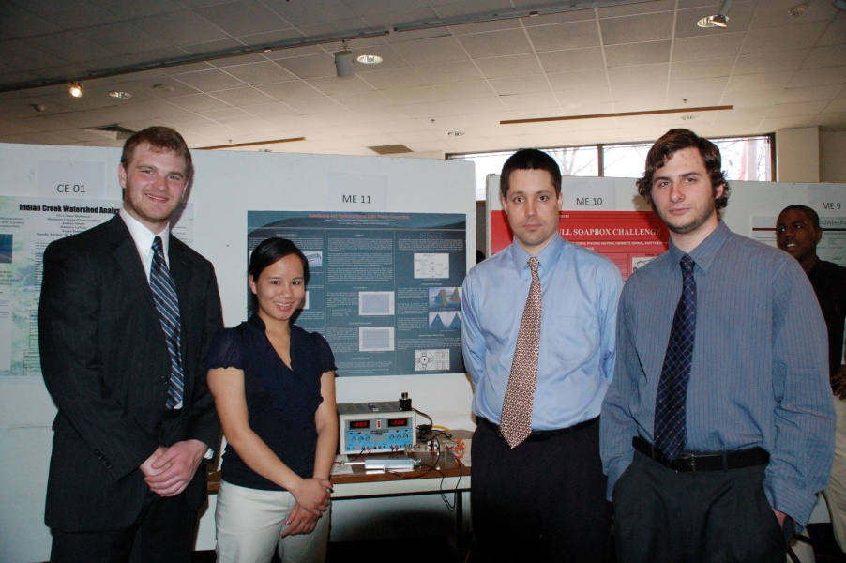
Engineering at Temple is Multidisciplinary
First two years share many courses across disciplines
Calculus, Physics, Chemistry/Biology,
General Education
Computer Programming / Graphics
Introduction to Engineering
Third year also shares some courses (statics, circuits)
Common capstone design experience:
Technical Communication
Professional Seminar
Senior Design I and II

Slide 5

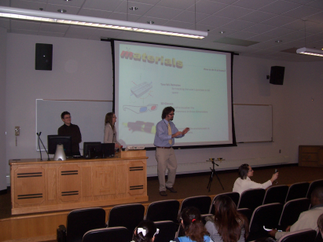
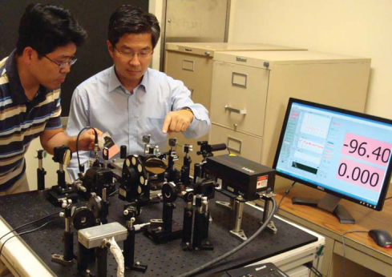
Electrical and Computer Engineering
Three degree options:
Electrical Engineering
Computer Engineering
Bioelectrical Engineering (unofficial)
A Sampling of Significant EE Research Activities:
Computer Fusion Laboratory
Mobile computing, multi-agent networks
Imaging and Pattern Recognition Lab
Thermal facial imaging, terahertz signaling

Slide 6



Extracurricular Activities in ECE
Professional Societies:
Institute of Electrical and Electronics Engineers
(IEEE)
Etta Kappa Nu
(HKN)
Student Competitions:
NASA Robotics and Ballooning
IEEE Xtreme 24-Hour Programming Challenge
Indoor Aerial Robotics Competition
IEEE Philadelphia Section Research Paper Competition

Slide 7
ECE at a Glance
Faculty By Rank:
Three degree options: EE, CpE, BioE
Students By Degree Option (09-10):
Track | Full | Assoc | Assist | Total
TT | 6 | 4 | 2 | 12
NTT | 0 | 1 | 0 | 1
Res. | 0 | 0 | 0 | 0
Adj. |  |  |  | 9
Staff |  |  |  | 2
TOTAL |  |  |  | 24
Degree | Enrolled | Graduated
BS: EE CpE BioE | 228 198 20 10 | 30 18 5 0
MS: EE CpE BioE | 40 32 4 4 | 20 19 0 1
PhD: EE CpE BioE | 14 11 1 2 | 2 2 0 0
Total: | 262 | 52
Faculty By Area of Specialization:
Area | Full | Assoc | Assist
Biomedical |  | 1 | 1
Intelligent Systems | 3 | 1 | 1
Controls | 3 | 1 | 1
Devices and Materials | 1 | 1
Energy | 1

Slide 8
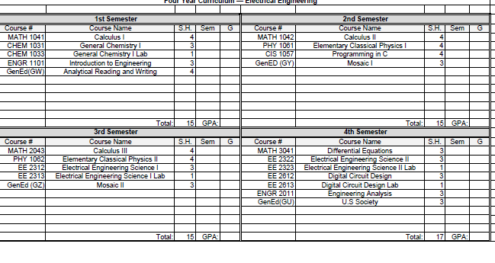
ECE Undergraduate Program – First Two years

Slide 9
ECE Graduate Program
Clustered into three general areas: Signals, Controls and Hardware.
All students are required to take four core courses: Engineering Analysis (5022), Probability and Random Processes (5033), Digital Signal Processing (5514) and Introduction to Computer Architectures (EE 5622 ).
Computer Engineering
5612: Advanced Microprocessor Systems
5516: Intro. Communication Networks
5622: Intro. Computer Architecture
8516: Performance of Communications Ntwks
8622: Advanced Computer Architectures
9622: Parallel Processing Architectures
Controls
5412: Control System Analysis
8412: Optimal & Robust Control
8414: Adaptive Control
8512: Signal Processing and Control Theory
9412: Nonlinear Control Systems
Intelligent Systems
5712: Intelligent Multimedia Systems
5714: Intro. Intelligent Systems
Microelectronics
5314: Microelectronics
5324: VLSI Systems Design
8324: Mixed Signal VLSI Design
8334: Nano Applications, MEMS and NEMS
9324: VLSI Phys. Design
Signal Processing and Communications
5512: Analog and Digital Communication
5514: Digital Signal Processing
8514: Digital Signal Processing
8524: Speech Signal Processing
8999: Electro-optics
9512: Detection Estimation
9514: Adaptive Signal Processing
9524: Digital Image Processing

Slide 10
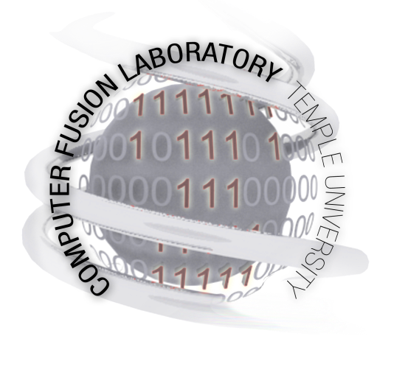
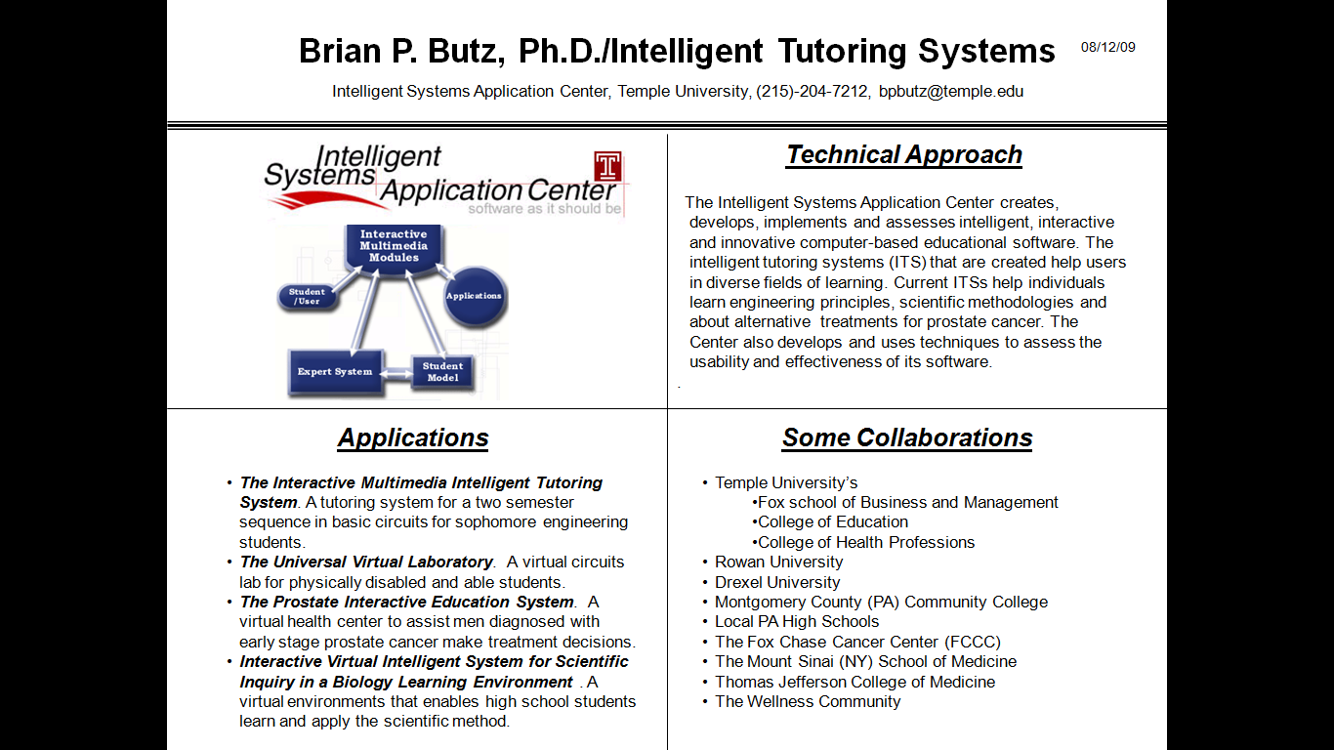
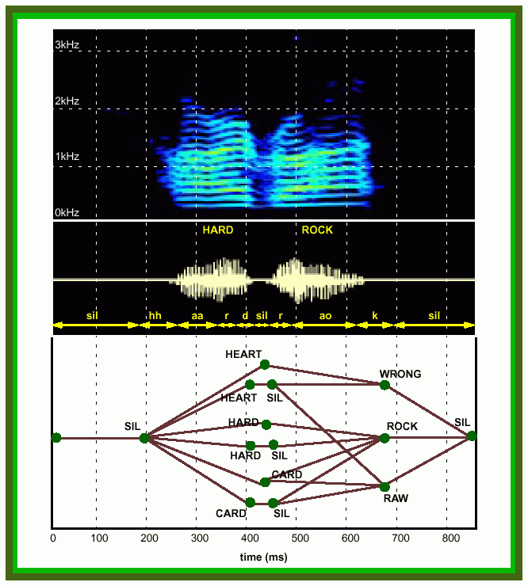
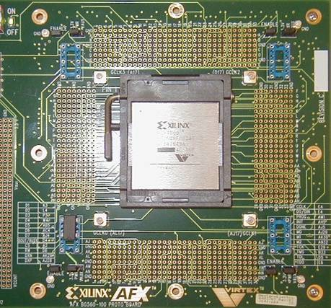
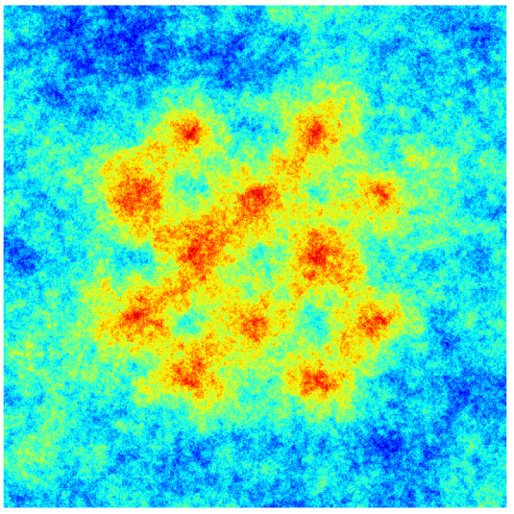
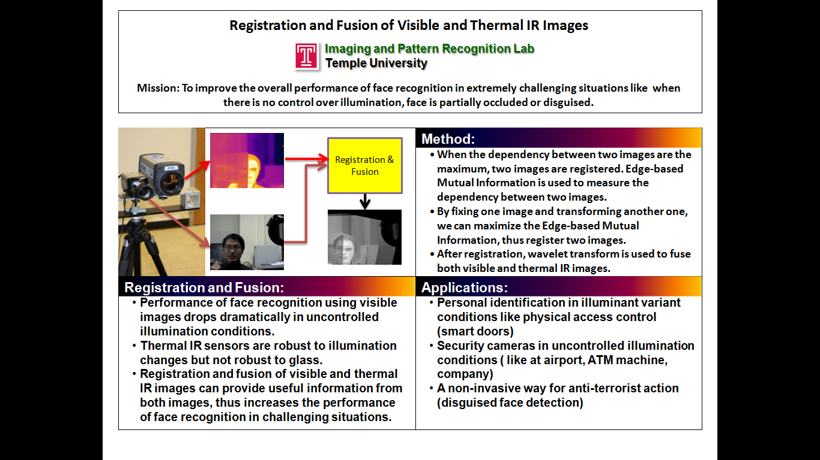
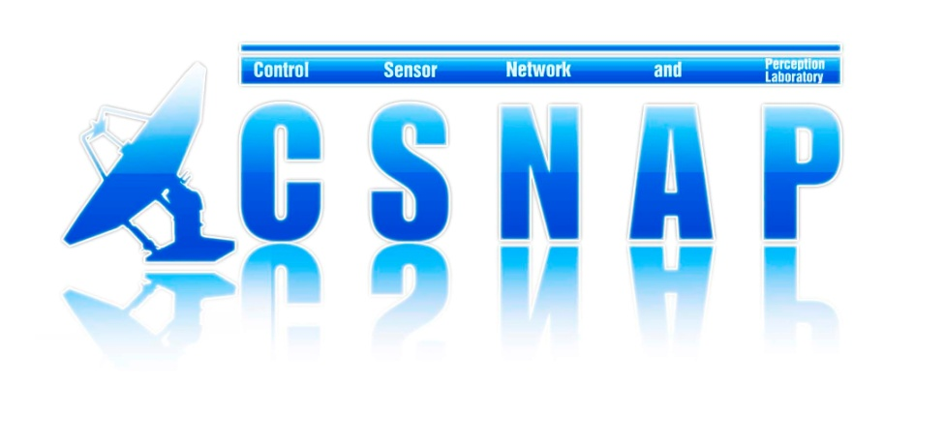
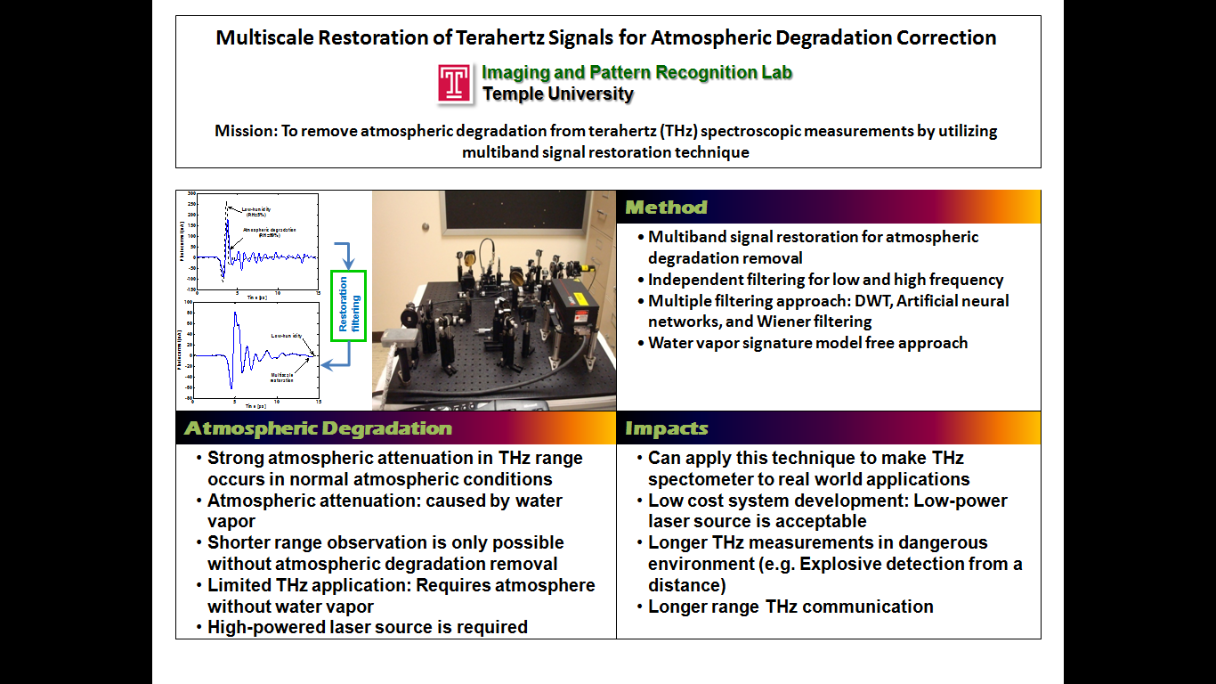
Research Thrusts
Intelligent Systems: multi-agent systems, tutoring systems, human language technology
Devices and Interfaces: system chip design, FPGAs, brain-machine interfaces
Sensors, Imaging and Control: navigation, game theory, thermal imaging, signal restoration

Slide 11
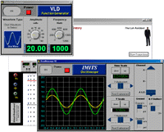
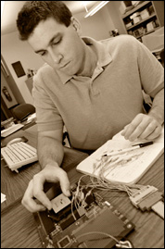

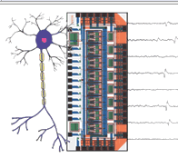
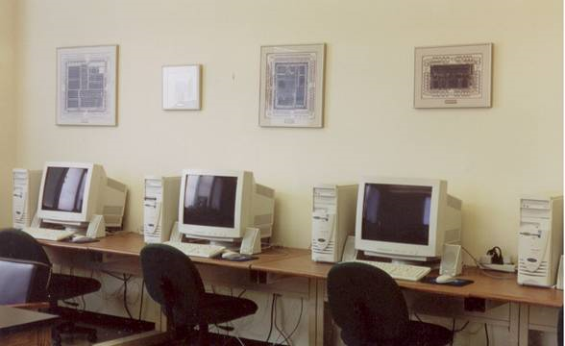
Facilities
Laboratory Space:
Unique Capabilities:
Universal Virtual Lab
Neural Instrumentation Laboratory
Multi-agent Systems Test Lab
System Chip Design
Robotics and Atmospheric Testing
Image Processing System Development
Sensors, Networks and Devices
Speech Processing
Type | Sqft
Offices | 2,966
Instructional Labs | 5,303
Research Labs | 3,565
TOTAL | 11,834

