Slide 1
Hierarchical Dirichlet Process (HDP)
Amir Harati

Slide 2
Latent Dirichlet Allocation (LDA)
Relation to the topic: LDA is the parametric counterpart of HDP
First motivation: Extract efficient features from text data (dimensionality reduction).
LDA is a generative probabilistic model of a corpus. “The basic idea is that documents are presented as random mixtures over latent topics; each topic is characterized by a distribution over words”.

Slide 3
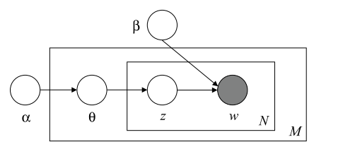
LDA
N: Number of words
M: Number of documents
Graphical model
Θ is the distribution of topic mixture and is a Dirichlet distribution.
As it can be seen, in LDA topic node is sampled for each word so each document can have multiple topics.
We can summarize a document by a vector of weights for each topic.
Limitation: Number of topics should somehow inferred before applying the algorithm and this is a difficult problem by itself.

Slide 4
HDP
Suppose data is divided into J groups (i.e. documents) and within each group we want to find clusters (i.e. topics) that capture the latent structure in the data assigned to that group. The number of clusters within each group is unknown and moreover we want clusters to be shared (tied) across groups.
For example in case of text corpus, each group is a document and each cluster is a topic. We want to infer topics for each document but topics are shared among documents in the corpus or generally a group of corpus.
By comparing this problem with LDA, we can see in order to let number of topics be unspecified we should replace Dirichlet distribution with Dirichlet process (DP). In other words, we associate a DP to each group. But this cause another problem: With this setting clusters could not be shared among groups (Because different DP would have different atoms) . The solution is to somehow, link these DPs together. The first attempt is use common G0 as the base measure. However, this does not solve the problem because for smooth G0 each DP will have a different set of atoms with probability one. To tackle this problem we should have a discrete G0 with broad support. In other words, G0 is itself another DP.
In other words, G0 is an infinite discreet function and its support includes the support of all Gj . This construction cause random measure Gj place its atoms at discrete locations determined by G0.
Therefore, HDP ties Gi by letting them share the base measure and letting this base measure to be random.

Slide 5
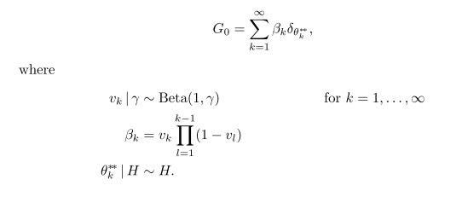
HDP
Stick breaking representation

Slide 6
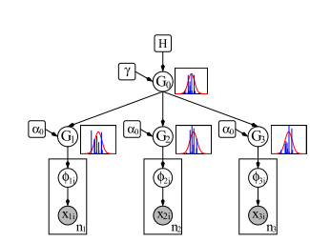
HDP
graphical model of an example HDP mixture model with 3 groups. Corresponding to each DP node we also plot a sample draw from the DP using the stick-breaking construction.

Slide 7
HDP
Chinese Restaurant Franchise (CRP):
In CRP the metaphor of Chinese restaurant is extended to a group of restaurants (J). The coupling among restaurants is achieved via a common menu.
In CRF number of clusters scales doubly logarithmically in the size of each group and logarithmically in the number of groups.
In other words CRF says number of clusters grow slowly with N.

Slide 8
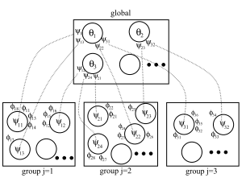
HDP
An instantiation of the CRF representation for the 3 group HDP. Each of the 3 restaurants has customers sitting around tables, and each table is served a dish (which corresponds to customers in the Chinese restaurant for the global DP).

Slide 9
HDP
Applications:
Information Retrieval
Multi-population haplotype phasing
Topic modeling (mixture models): extension of LDA to nonparametric case.

Slide 10
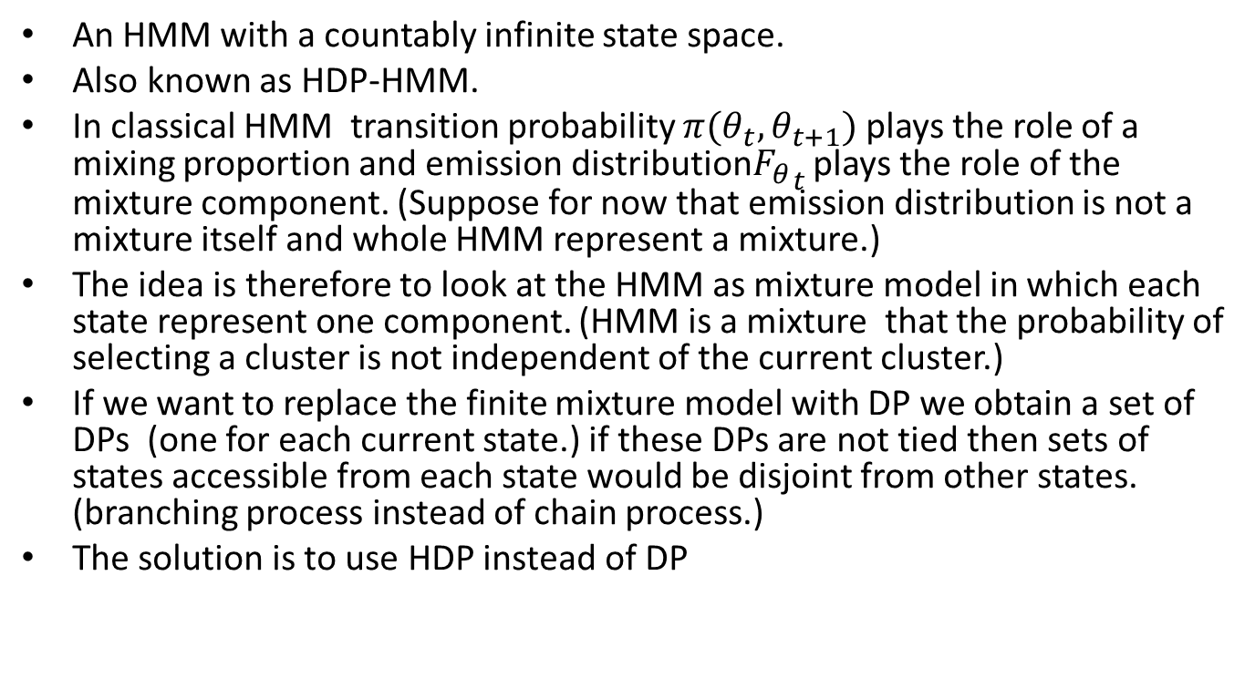
Infinite HMM(IHMM) or HDP-HMM
An HMM with a countably infinite state space.
Also known as HDP-HMM.
In classical HMM transition probability $π(θ_{t},θ_{t+1})$ plays the role of a mixing proportion and emission distribution${F_{θ}}_{t}$ plays the role of the mixture component. (Suppose for now that emission distribution is not a mixture itself and whole HMM represent a mixture.)
The idea is therefore to look at the HMM as mixture model in which each state represent one component. (HMM is a mixture that the probability of selecting a cluster is not independent of the current cluster.)
If we want to replace the finite mixture model with DP we obtain a set of DPs (one for each current state.) if these DPs are not tied then sets of states accessible from each state would be disjoint from other states. (branching process instead of chain process.)
The solution is to use HDP instead of DP

Slide 11
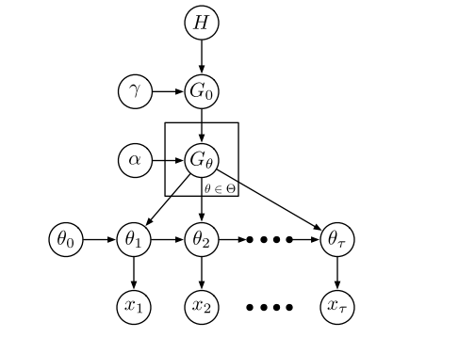
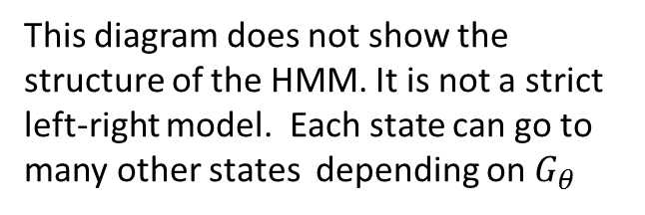
HDP-HMM
Instead of transition matrix we would have a set of transition kernels.
This diagram does not show the structure of the HMM. It is not a strict left-right model. Each state can go to many other states depending on $G_{θ}$

Slide 12
Sticky HDP-HMM
Limitations of HDP-HMM:
It can not model state persistence. It has a tendency to create redundant sates and switch rapidly among them. (In other words, it tends to more complicated models.)
Because of the above problem, in high dimensional problems data is fragmented among many redundant states and prediction performance reduced.
It is limited to uni-modal (Gaussian) emission distribution. (If both rapid switching and multiple Gaussian existed in the same algorithm the uncertainty in the posterior distributions gets very high.)
In cases that underlying process is multimodal it tends to make many redundant states.
Solution: Sticky HDP-HMM

Slide 13
Sticky HDP-HMM
The basic idea is simple: To augment HDP to contain a parameter for self transition bias and place a separate prior on this parameter.
(a) observed Seq. (b) true state Sqe (c) HDP-HMM (d) Sticky HDP-HMM

Slide 14
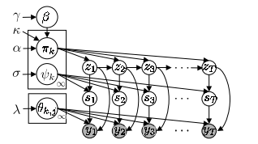
Sticky HDP-HMM
Another extension is to associate a DP to each state of the HMM. The result can model multimodal emission distributions.
Notes:
It seems in its current form, each state has a separate mixture model. I think another improvement could obtained by using a HDP for modeling emission distribution so we can tie distributions among different states.

Slide 15
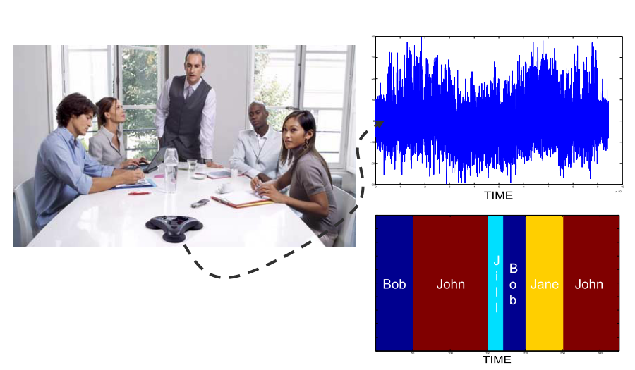
Sticky HDP-HMM -applications
Speaker Diarization: Segmenting an audio file into speaker homogenous regions.

Slide 16
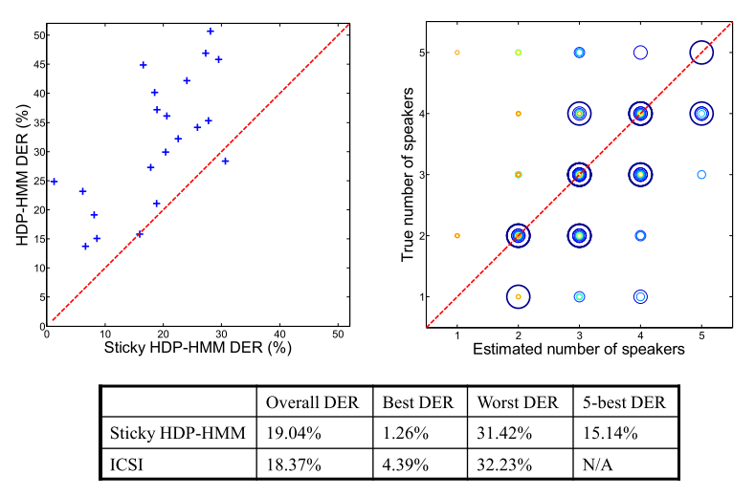
Speaker Diarization
Notes:
It seems the result (with current inference algorithm) is sensitive to starting point

Slide 17
Other applications
Word segmentation: Model an utterance with a HDP-HMM. The latent state is corresponding to a word ( we have unbounded number of words) and observations are phonemes (either in text or speech)
Note: It seems it is essentially a method to encode the n-gram grammar.
Trees and grammars : go beyond chain structure;

