Slide 1
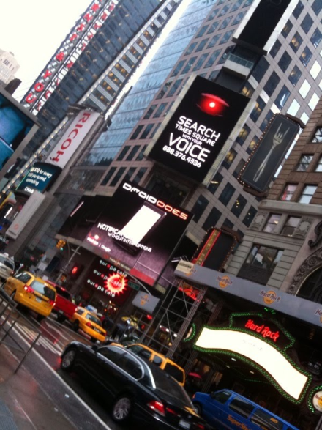
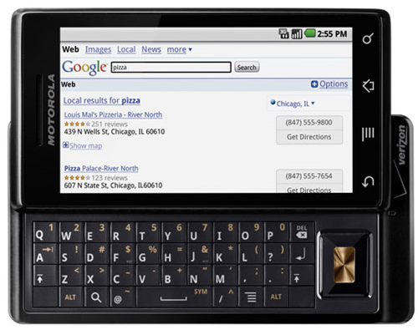
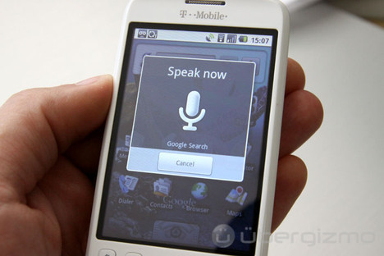
QUALITY ASSESSMENT OF SEARCH TERMS
IN SPOKEN TERM DETECTION
Amir Harati and Joseph Picone, PhD
Department of Electrical and Computer Engineering
Temple University
URL:

Slide 2
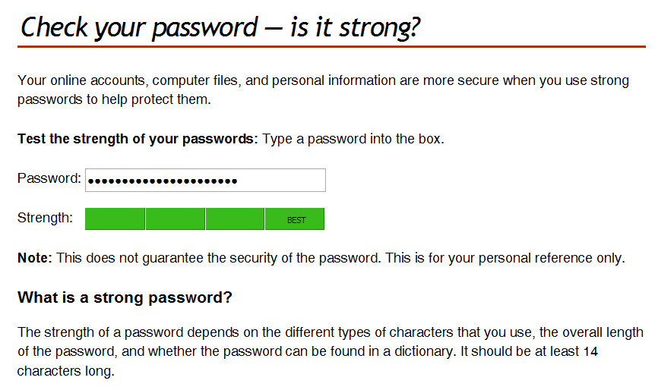
Abstract
Spoken term detection is an extension of text-based searching that allows users to type keywords and search audio files containing spoken language for their existence.
Performance is dependent on many external factors such as the acoustic channel, language and the confusability of the search term.
Unlike text-based searches, the quality of the search term plays a significant role in the overall perception of the usability of the system.
In this presentation we will review conventional approaches to keyword search.
Goal: Develop a tool similar to the way password checking tools currently work.
Approach: develop models that predict the quality of a search term based on its spelling (and underlying phonetic context).

Slide 3
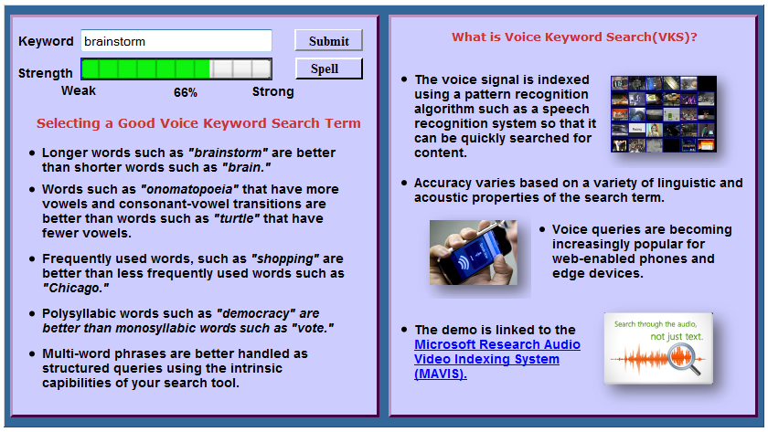
Demo
Available at:
http://www.isip.piconepress.com/projects/ks_prediction/demo/current/

Slide 4
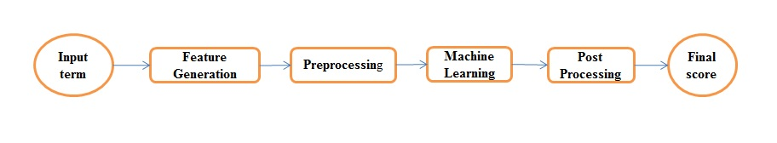
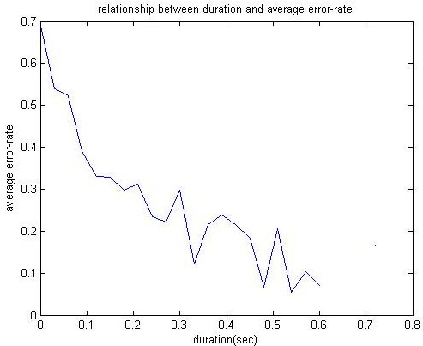
Methods
Acoustic distance algorithm.
Phonetic distance algorithm.
Feature based algorithm.

Slide 5
Feature based methods
Using different pattern recognition methods.
Different features and different feature selection methods.
Example results:
Results for Neural Network

